Slide 1
Army small business boot-camp: a how to guide on competing for army contracts
Kimberly Buehler
Director, Army Office of Small Business Programs
1 November 2022
Controlled by: HQDA, Office of Small Business Programs
CUI Category:
Control: Unrestricted
POC: Kimberly Buehler
Kimberly.d.Buehler.civ@army.mil

Slide 2
AGENDA
Army Small Business Office At a Glance
Small Business Strategic Priorities
Doing Business with the Army
Contact Us!
Key Upcoming Events
2

Slide 3





Army OSBP Organization
Key References
15 USC Ch 14A
DoDI 4205.01
FAR Part 19 (with DoD & Army supplements)
Army General Order 1, Part 1, #23
Secretary of the Army
HON Christine Wormuth
Undersecretary of the Army
HON Gabe Camarillo
Director
Small Business Programs
Kimberly Buehler
Commands with SB Programs
AMC
AFC
USACE
MEDCOM
NGB
Deputy Director
Pamela Callicutt
Policy
Cynthia Lee
SACO*
Edith St. Catherine
Oversight & Reporting
Pamela Monroe
Data Analyst
Angela Hong
Acquisition & Internal Support
Gayna Malcolm-Packnett
Contractor Support (2.5 FTE)
Outreach & Website Developer
Mentor-Protégé Program Analyst
Special Projects**
Gail Foley
Strategic Communication & Outreach
James Lloyd
3

Slide 4
Mission and Vision
Mission
Advise the Secretary of the Army and the Army leadership on small business-related matters.
Maximize opportunities for innovative initiatives that contribute to expanding the small business industrial base relevant to the Army mission priorities.
Leverage Small Businesses to ensure expansion and/or sustainment of the industrial base and provide opportunities to obtain innovative technologies, supplies and services for our soldiers.
Vision
To be the premier advocacy organization committed to maximizing Small Business utilization in support of Army forces.
FY20 & FY21 Annual Report: https://osbp.army.mil/Resources/Annual-Fiscal-Report
4

Slide 5



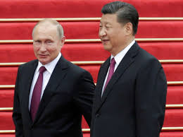

Small Business Goals Support
National Security & Army Priorities
Small businesses are critical infrastructure
Supply chain resilience, diversity
Mitigate and adapt to climate change
  Innovative solutions to sustainability challenges
  Adaptive technologies and installation resilience
Small business enabled the whole of government response to COVID-19
FY20 & FY21 over $9B awarded to SB primes
X-Tech Search COVID-19 Ventilator Challenge
Comprehensive approach to using the purchasing power of the government:
Executive Order 13985 Advancing Racial Equity and Support for Underserved Communities Through the Federal Government
Executive Order 14017 America’s Supply Chains
Executive Order 14002 Economic Relief Related to the COVID-19 Pandemic
Executive Order 14036 Promoting Competition in the American Economy
Small businesses bring the innovation needed to respond in MDO and in any scenario
X-Tech Search
Small Business Innovative Research & Technology Transfer (SBIR/STTR) programs
Mentor-Protégé program
Small Business Programs support diversity, equity and inclusion by affording prime and subcontracting opportunities for businesses owned by
Disadvantaged business owners, including minorities
Service-Disabled Veterans
Women
Businesses located in “historically underutilized business zones” (HUBZones)
5

Slide 6
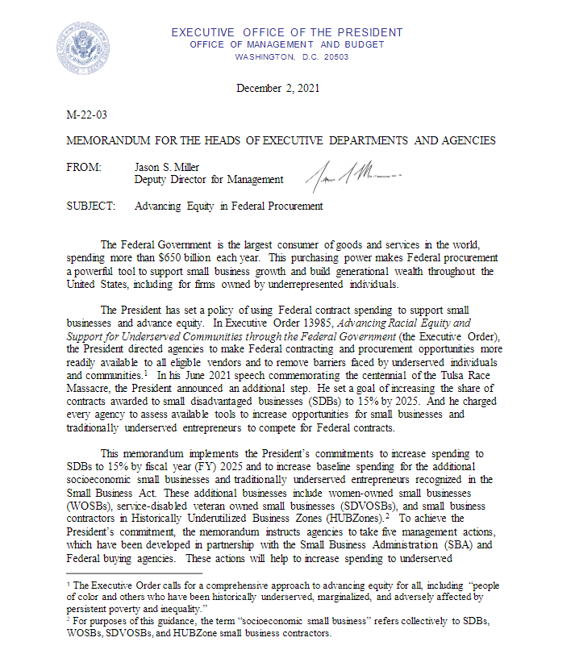
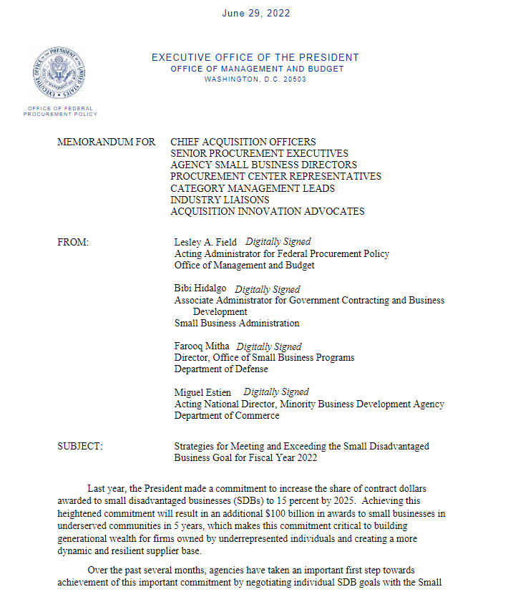
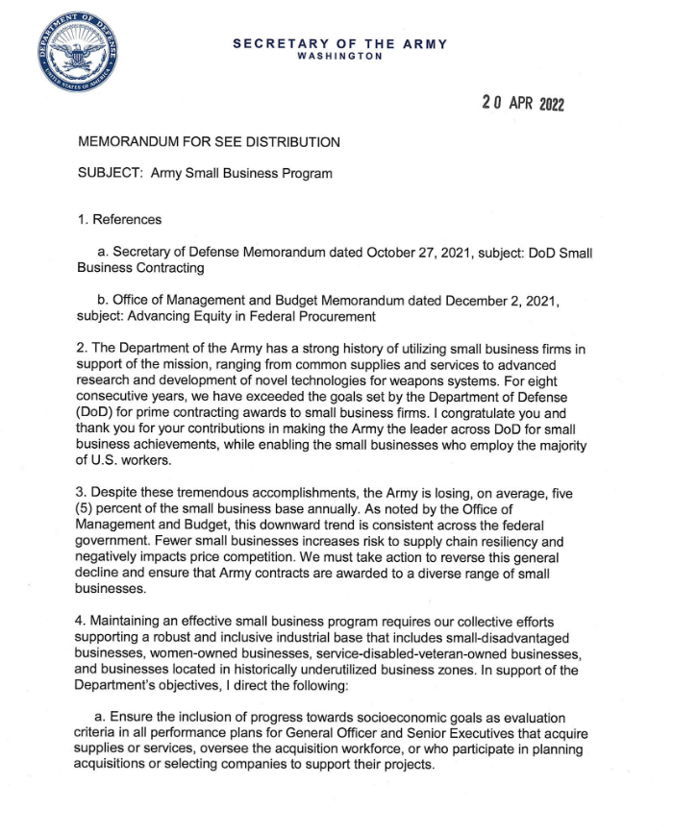
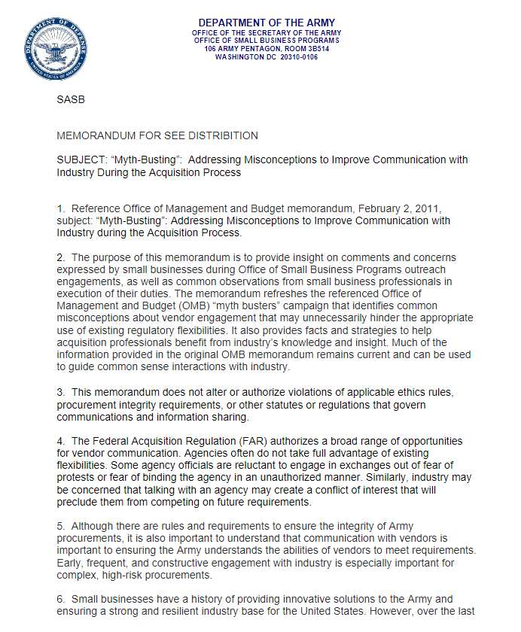
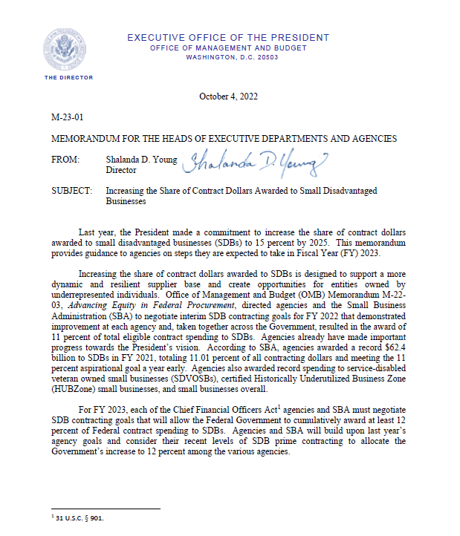
KEY FY22-FY23 MEMORANDUMS
Office of Management and Budget (OMB) M-23-01 “Increasing the Share of Contract Dollars Awarded to Small Disadvantaged Businesses” (4 October 2023)
Office of Management and Budget (OMB) M-22-03 “Advancing Equity in Federal Procurement” implements President’s Management Agenda for SB and includes five management actions including establishing agency-specific goals for FY22 that will allow the federal government to cumulatively award at least 11% of federal contract spend to SDBs (2 Dec 2021)
OMB Strategies for Meeting and Exceeding the Small Disadvantaged Business Goal for Fiscal Year 2022 (29 Jun 2022)
Secretary of the Army “Army Small Business Program” (20 Apr 2022)
Army OSBP “Myth-Busting: Addressing Misconceptions to Improve Communication with Industry During the Acquisition Process (5 Jul 2022)
6

Slide 7
How To Do Business With The Federal Government and the Army
“Small Business 101 for Contractors”
7

Slide 8
HOW TO DO BUSINESS WITH THE FEDERAL GOVERNMENT
STEP 1: Get proper registrations and ID numbers
Register with the System for Award Management (SAM)—a requirement to participate in government contracting. (https://sam.gov/content/home)
  Match your products or services to a North American Industry Classification System (NAICS) code. You may qualify under multiple NAICS if you sell multiple products and services. (https://www.census.gov/naics/)
TIP! Be sure to keep your SAM profile current, accurate and complete—the information in your profile feeds the Dynamic Small Business Search (DSBS) maintained by the SBA. The federal government uses this database to find small businesses for upcoming contracts.
8

Slide 9
HOW TO DO BUSINESS WITH THE FEDERAL GOVERNMENT
STEP 2: Determine if you qualify for small business program status under the Small Business Administration (SBA) socio-economic programs.
    Small Disadvantaged Business
      8(a) Business Development Program
    Service-Disabled Veteran Owned Small Business Program
    Historically-Underutilized Business Zone Program
    Woman-Owned Small Business Program
TIP! Verify your small business size by comparing the size of your company against the “size standards” associated with your NAICS code(s). Use the SBA Size Standards Tool to verify. (https://www.sba.gov/size-standards/)
9

Slide 10
HOW TO DO BUSINESS WITH THE FEDERAL GOVERNMENT
STEP 3: Determine who buys what you sell
  Utilize your “Procurement Technical Assistance Center” (PTAC) for help getting started (https://www.aptac-us.org)
  Utilize other resource partners who provide free and low cost services for current or aspiring small business owners (https://www.sba.gov/local-assistance)
    Small Business Development Center
    Veteran’s Business Outreach Center
    Women’s Business Center
    SCORE
  Search for previously awarded contracts through the Federal Procurement Data System (FPDS-NG) using your NAICS and “Product and Service Codes” (PSC), which are codes that identify the products and services the federal government buys (for information, visit https://www.acquisition.gov/psc-manual)
10

Slide 11
HOW TO DO BUSINESS WITH THE FEDERAL GOVERNMENT
STEP 4: Develop your capture strategy
  What agencies have most opportunity?
  What is the mission of that agency and what problems are they trying to solve?
  How can my company support that mission, solve that problem--what differentiates my company?
  Should I build performance through subcontracting?
  When do I seek prime opportunities?
STEP 5: Search SAM.gov to find federal contract opportunities (https://sam.gov/content/home). Government agencies are required to advertise all contract with an anticipated value over $25,000.
TIP! When responding to “sources sought notices” or “requests for information” answer all questions and be specific about how you can perform the requirement to include subcontracting.
11

Slide 12
HOW TO DO BUSINESS WITH THE FEDERAL GOVERNMENT
STEP 6: Attend matchmaking and outreach events to network with large business primes and government agencies
  Schedule capability briefs
    Use the small business professional as the primary entry point
  Know your audience
    Talk business with the small business professional and contracting officer
    Talk technical with the “customer” (organization with the money)
  TIP! Do not ask what the government can do for you. Lead with your capability and end with your small business status.
12

Slide 13
How to do business with the federal government
OTHER IMPORTANT ACTIONS:
  Become familiar with the Federal Acquisition Regulation (FAR), the Defense Federal Acquisition Regulation Supplement (DFARS), and agency supplements (https://www.acquisition.gov)
  Explore subcontracting opportunities (https://www.sba.gov/contracting/finding-government-customers/subcontracting/small-business-resources)
  Explore Mentor-Protégé Program opportunities (https://business.defense.gov/Programs/Mentor-Protege-Program/)
  Get help with Cybersecurity Maturity Model Certification through the DOD Project Spectrum (https://www.projectspectrum.io)
  Check out Army SBIR/STTR (https://www.armysbir.army.mil)
  Check out xTECH Search (https://www.arl.army.mil/xtechsearch/)
  Get to know the Small Business Professionals!
13

Slide 14

The small business professional in action
Small
Business Professionals
Defense Industrial Base
Industrial Base
Acquisition
14

Slide 15
Contact
Command Points of Contact
Army Office of Small Business Programs
Phone: 703-697-2868
Twitter: @ArmySmallBiz
Army Materiel Command (AMC) - Redstone Arsenal, AL
Buys: Combat systems, Information systems, Intelligence security information systems
  Small Business: 256-955-8560
  Website: www.army.mil/amc
Army Corps of Engineers (USACE) - Washington, DC
Buys: Military/civil works construction projects, Environmental projects
  Small Business: 202-761-8211
  Website: http://www.usace.army.mil
Army Medical Command (MEDCOM) - Ft. Sam Houston, TX
Buys: Medical supplies and health care equipment, Professional services
  Small Business: 210-295-7178
  Website: http://www.armymedicine.army.mil
National Guard Bureau (NGB) - Arlington, VA
Buys: Base operations, Construction/Environmental projects
  Small Business: 703-601-6765
  Websites: http://www.arng.army.mil
Army Futures Command (AFC) - Austin, TX
Buys: Artificial Intelligence, Combat Systems, Medical research
  Small Business: 512-726-4152
  Websites: http://www.armyfuturescommand.com
15

Slide 16
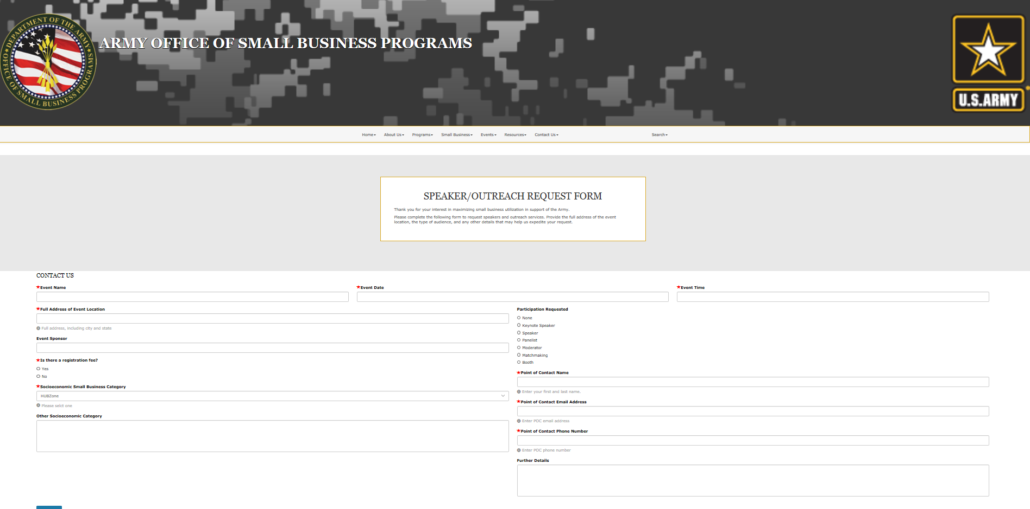
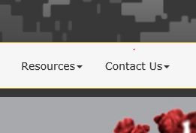
Contact army osbp
16

Slide 17
UPCOMING ENGAGEMENT OPPORTUNITIES
Linked In, Facebook, Twitter: @ArmySmallBiz
Virtual Vendor Training Series (every other month)
  8 Dec Army Climate Strategy
Society for Military Engineers, Small Business Conference, 2 Nov – 4 Nov, Nashville, TN​
National 8(a) Association, 2023 National Small Business Conference, 13-15 Feb, New Orleans, LA​
DoD Mentor-Protégé Conference--FY23
Advanced Planning Briefs to Industry—throughout 2/3QFY23
17

Slide 18
Small business
is
big business
Army!
in the
Department of the
18

Slide 19


Warrior Ethos
People First!
Winning Matters!
Army Strong!
Questions?
https://osbp.army.mil
19

Slide 20
HQDA OSBP Data Slides
20

Slide 21
Army Prime Contracting Achievement
Fiscal Year 2022
21

Slide 22
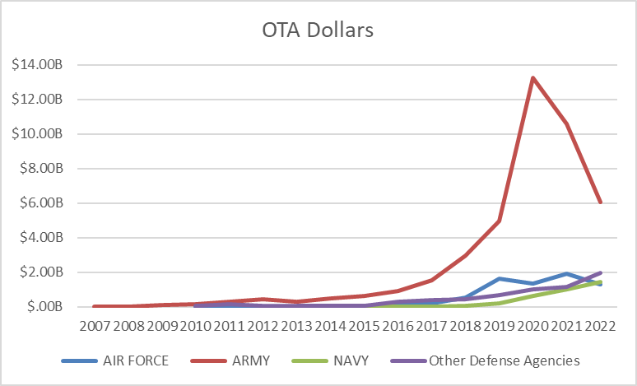
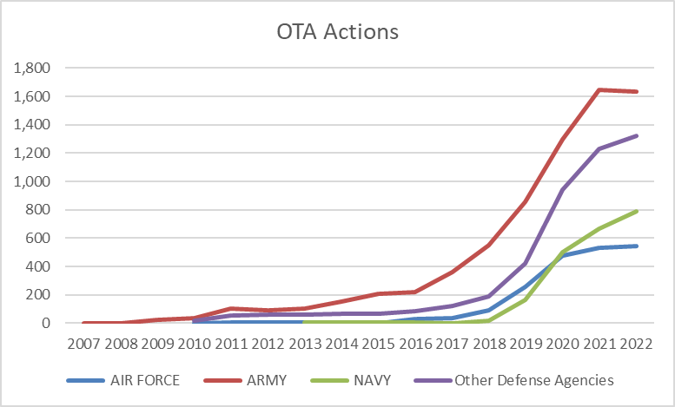
Army other transaction awards surpass other dod agencies
$6.03B in FY22 (down from $10.62 in FY21)
57% of all DoD OTA dollars obligated in FY22 (down from 72% in FY21)
1,634 actions in FY22 (negligible decrease from FY21)
38% of all DoD OTA actions executed in FY22 (down from 41% in FY21)
FY22 Preliminary data as of 03 Oct 2022

Slide 23
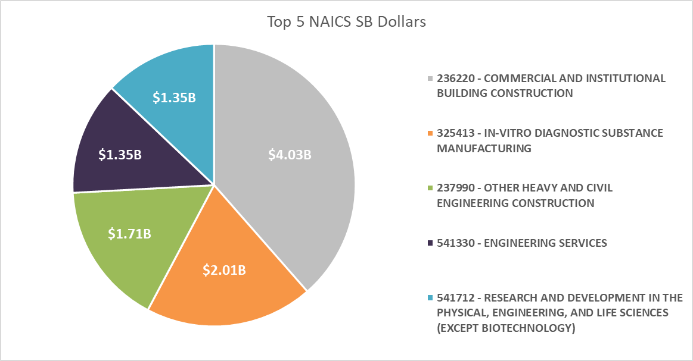
Army Prime Contracting Achievement
Fiscal Year 2022
23

Slide 24
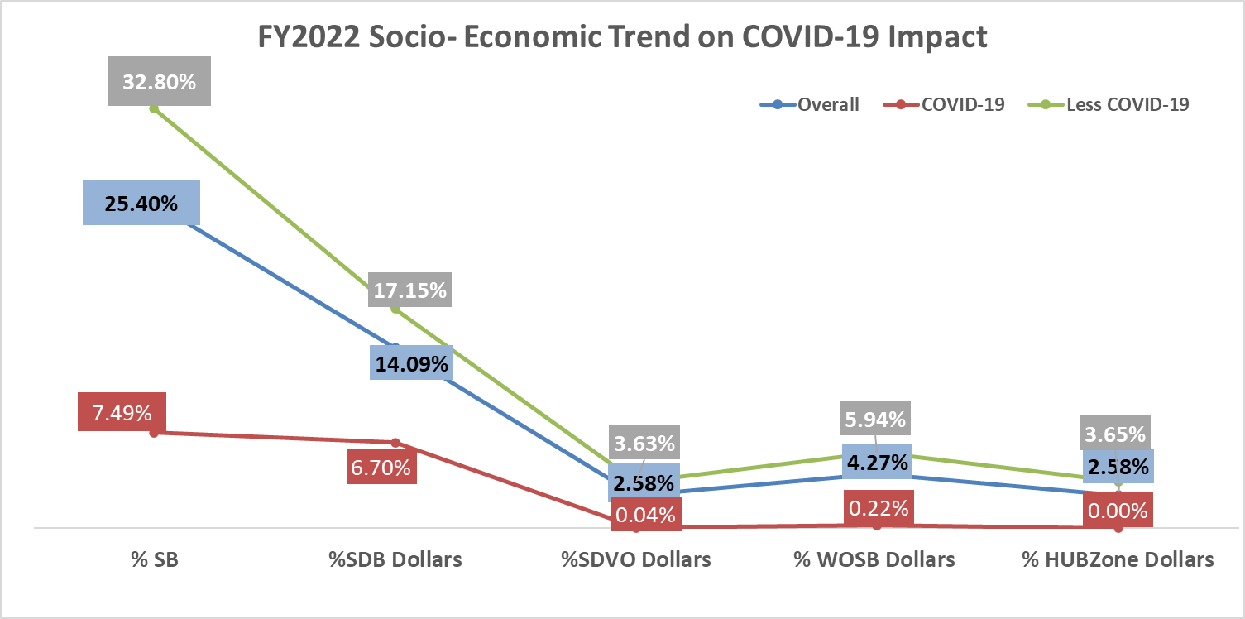
Covid-19 contract impact on army small business achievements—year to date fy22
Goal 26.6%
Goal 12.28%
Goal 3%
Goal 5%
Goal 3%
24

