Slide 1
Black Start Stress Tests- Lessons learned from Ft Knox and Ft Hunter Liggett
Col lance O’Bryan, Garrison Commander, Ft Knox, ky.
lance.a.obryan3.mil@army.mil
Col lisa lamb, garrison commander, ft hunter liggett, ca.
Lisa.m.lamb15.mil@army.mil
Mr. jarrod ross, energy manager, ft hunter liggett, ca.
jarrod.t.ross.ctr@army.mil
Moderator-fred Meurer, ic, booz allen Hamilton
Meurer@meurermuni.com

Slide 2
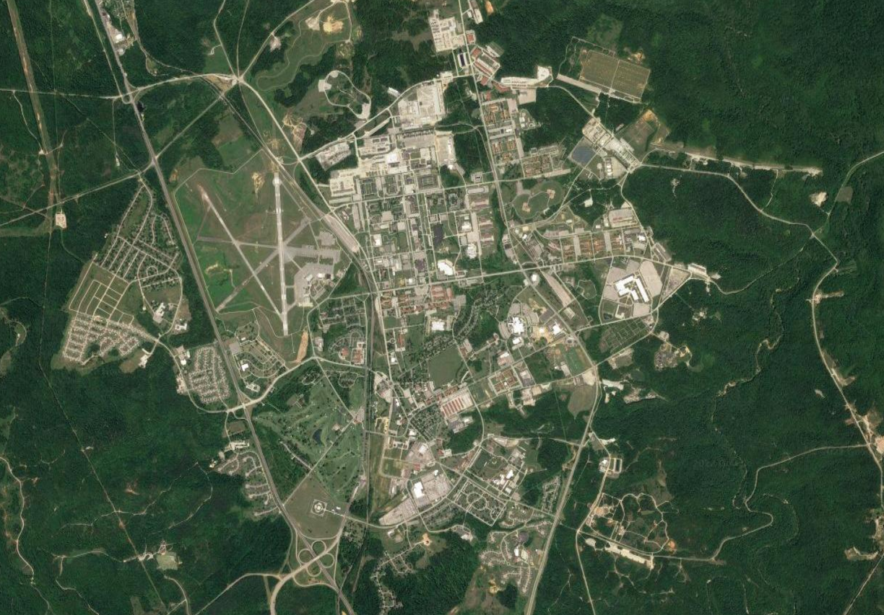
FY22 Installation Full-Scale Exercise (FSE) – Operation Golden Response
​
​
​
​
​
​
Vignette 1:
A cyber phishing email, in coordination with an Installation power outage, damages power grids on Fort Knox.
Cyber Attack: 20 SEP 22
Power Outage: 21 SEP 22
MISSION. USAG, Fort Knox conducts a realistic, challenging, and externally evaluated FSE from 19-23 SEP 22 IOT validate IEMPs and test the operational capability of FKKY’s Infrastructure Resilience.
Vignette 4:
Following LE interviews, impacted personnel are transported to the EFAC & Shelter location at Dever’s for Registration, Mass Care Services, and the provision of temporary shelter.
EFAC Ops: 21 SEP 22
1
4
​
​
​
​
CST Barracks
BLDG 6578
Vignette 5:
A DPW worker attempting to repair a transformer is electrocuted and enters cardiac arrest, prompting an EMS response and CASEVAC.
DPW CASEVAC: 21 SEP 22
Vignette 2:
A threat actor is dropped off at a CST barracks and initiates a MASCAL event. Upon interview, an onlooker describes to LE the vehicle the shooter was transported in, initiating a BOLO search for the vehicle.
MASCAL: 21 SEP 22
5
2
5
2
3
DPW CASEVAC
HRC / Maude Complex
4
​
​
Concurrent Training:
- HRC Barrier Plan & RAM
- Installation Power Outage
- DODEA Lockdown
Mutual Aid:
- Radcliff, Vine Grove, Flaherty, Muldraugh FDs
- Hardin County and Meade County EMS
- Life Flight Air Evac
- Baptist Health Hospital
-FBI (T)
Partners:
- NOLIN and HCWD 1/2
EFAC & Shelter
1
​
​
Vignette 3:
After dropping off the active shooter at the CST Barracks, the driver transits to the HRC parking lot and remains in his/her vehicle until the vehicle is discovered; situation will conclude without incident.
VIC BOLO: 21 SEP 22
3
NEC

