Slide 1
Community Outreach Efforts for Every Student, Everyday, Everywhere!
Kathleen Facon, Chief, Partnership and Resources
Association of Defense Communities Summit October 2022

Slide 2
DoDEA Partnership and Resources
The DoDEA vision is to be among the world’s leaders in education, enriching the lives of military-connected students and the communities in which they live.
To achieve this mission, DoDEA’s work extends to military-connected students in states and countries that are not directly served by a DoDEA school.
Through the Partnership and Resources Division, DoDEA seeks to:
provide resources, technical assistance, and support that facilitates the continuity of education and equitable learning experiences for military-connected transitioning students PreK-grade 12;
implement programs of scale that support DoD dependents around the country and the world;
promote, foster, and engage in partnerships with stakeholders that support military-connected students, families and communities.

Slide 3
DoDEA Partnership and Resources
The following programs support DoDEA’s mission:
DoD Impact Aid: This funding reimburses public school districts that meet specific eligibility criteria and is a supplement to Federal Impact Aid administered by ED.
Non DoD School Program (NDSP): NDSP provides support (educational and financial) to dependents assigned internationally where there is no DoDEA school.
Special Arrangements: This program funds six contracts in locations (MA, DE, NY, PR) providing a PreK-Grade 12 education to DoD dependents who are not served by a DoDEA school.
DoDEA Grant Program: This program funds grants that support military-connected public schools.
Notes:
DoDEA’s Partnership and Resource Division impacts over 350,000 students annually

Slide 4
Our Why
Access to quality K-12 education affects retention, readiness, and morale of our Nation’s all-volunteer military.
The Department is committed to provide resources to ensure military connected students have every opportunity for a quality educational experience.
DoDEA is charged with the responsibility and privilege of educating the children of our nation's military.
Recognizing that most military-connected students attend public schools, leveraging partnerships with school districts is paramount in impacting educational outcomes for military-connected students.
As a result, the National Defense Authorization Act of 2008 provided DoDEA the authority to share resources with public schools that educate military-connected students.

Slide 5
DoDEA Grant Award Process
Who
When
How
US Public School Districts with 10% military-connected enrollment at target schools
Application window January-April 2023 on www.grants.gov
Merit review process and risk assessment determine award, along with funding
Awards no later than September 30, 2023
Notes:
What: Congressionally authorized funding to support military connected student achievement (CFDA 12.556)
Who: U.S. Public School Districts with at least 10% military connected student population at proposed target schools are eligible to apply for funding based on funding formula
Floor: $500K for 500 or fewer students
Ceiling: $2M for 1501 or more students
When: Only available to apply on grants.gov (FY22: Jan-Apr)
How: Applications received are merit reviewed and risk assessed. Ranked and approved by DoDEA Director. Awarded based on approved listing pending availability of funding.

Slide 6
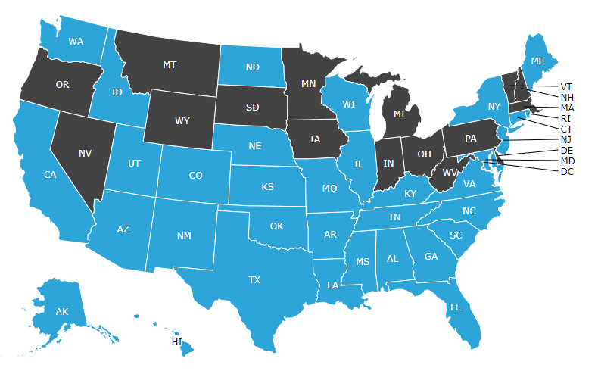
DoDEA Grant Program Portfolio
Since 2009, DoDEA has awarded 588 grants totaling over $653 million to 173 unique school districts serving military-connected students.
Military-connected student enrollment is the basis for eligibility, however every student in the learning community receives the opportunity to benefit from these resources.
The grant program has impacted over 3.2 million students.
*Grantee states are in blue

Slide 7
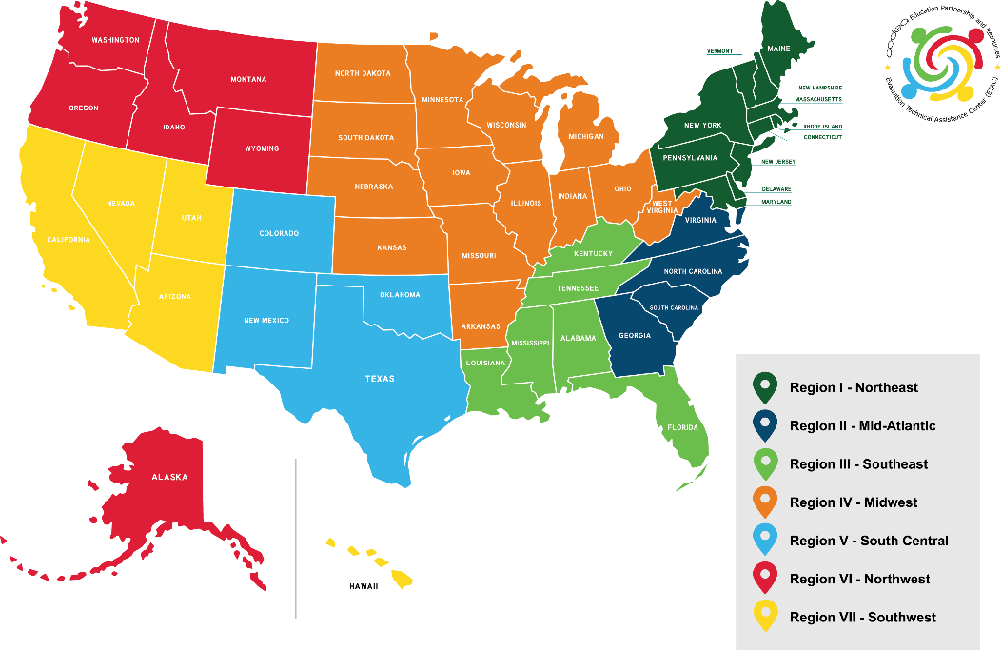
DoDEA Grant Communities of Practice
Our Commitment
We strive to ensure successful implementation of research-based solutions for military-connected students across the United States. Our work empowers educators to provide students with opportunities to engage, enhance, and extend their learning. We see our work as an essential component to provide significant impact for student achievement, professional development for teachers, and enhanced social-emotional support.
https://www.dodea.edu/Partnership/grant-program.cfm
Community of Practice (CoP) Purpose Statement:
The DoDEA Grant Program CoP shares resources, ideas, and experiences to build the capacity of grant professionals.

Slide 8
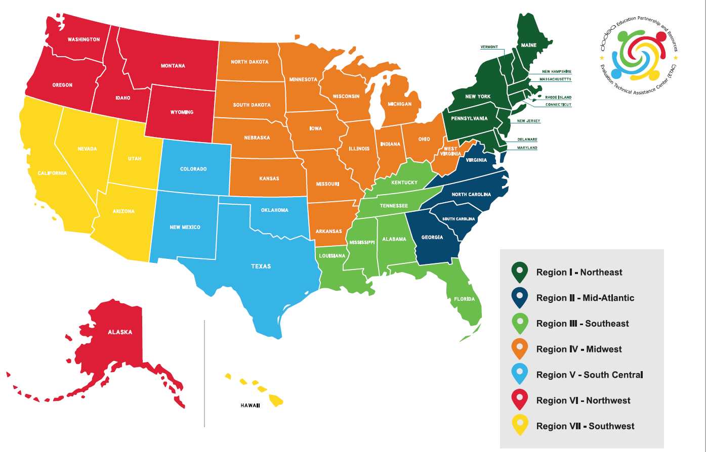

Slide 9
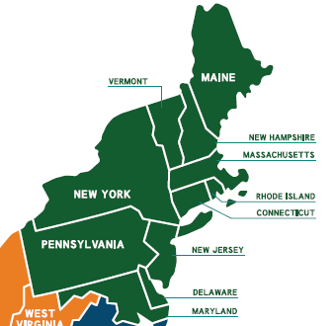
REGION I: NORTHEAST
Fort Drum
Naval Station Newport
U.S. Coast Guard Academy
Naval Submarine Base New London
Joint Base McGuire-Dix-Lakehurst
Fort Meade

Slide 10
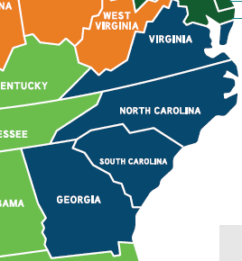
REGION II:
MID-ATLANTIC
U.S. Coast Guard and Naval Weapons Station- Yorktown
Norfolk Naval Base
Oceana Naval Air Station
Joint Expeditionary Base Little Creek/Fort Story
Dam Neck Naval Annex
Langley Air Force Base
Fort Eustis, Joint Forces Command
U.S. Coast Guard Training Center
Fort Lee
Quantico Marine Base
Pentagon
Fort Belvoir
Medical Center Portsmouth
Kings Bay Naval Submarine Base
Fort Stewart-Hunter Army Airfield
Fort Jackson
Cherry Point Air Station
Camp Lejeune
New River Air Station
Simmons Airfield
Pope Airfield
Fort Bragg

Slide 11
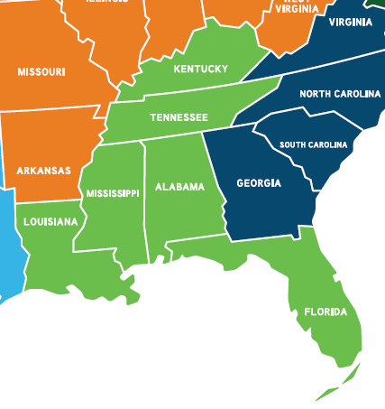
REGION III:
SOUTHEAST
Fort Polk
NAS/JRB Belle Chasse
Fort Rucker
Redstone Arsenal
Fort Knox
Naval Air Station Pensacola
Naval Air Station Saufley Field
Naval Air Station Whiting Field
Hurlburt Field
Elgin Air Force Base
NAS Jacksonville
Camp Blanding FL National Guard Training Base
MacDill Air Force Base
Keesler Air Force Base

Slide 12
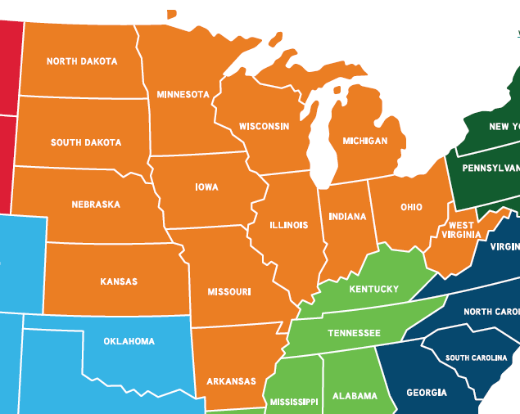
REGION IV:
MIDWEST
Grand Forks Air Force Base
Offutt Air Force Base
Fort McCoy
Volk Field
Naval Station Great Lakes
Fort Leonard Wood
Whiteman Air Force Base
Fort Leavenworth
Fort Riley
McConnell Air Force Base
Camp Perry
Scott Air Force Base

Slide 13
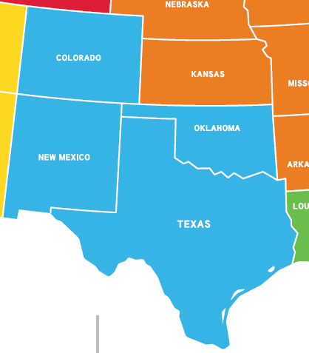
REGION V:
SOUTH CENTRAL
Sheppard Air Force Base
Fort Hood
Fort Sam Houston
Randolph Air Force Base
Fort Bliss
Fort Sill
Denver Federal Center
Buckley Air Force Base
U.S. Air Force Academy
Cheyenne Mountain Air Force Base
Fort Carson
Peterson Air Force Base
NORAD/NORTHCOM
Schriever Air Force Base
Pueblo Army Chemical Depot

Slide 14
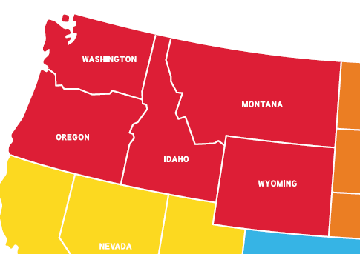
REGION VI:
NORTHWEST
Puget Sound Naval Shipyard & IMF
Naval Hospital-Bremerton
Naval Undersea Warfare Center-Keyport
Naval Base Kitsap
Fairchild Air Force Base
Joint Base Lewis-McChord
Mountain Home Air Force Base
Fort Wainwright
Eielson Air Force Base
Fort Greely

Slide 15
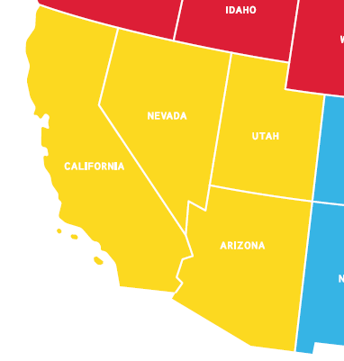
REGION VII: SOUTHWEST
Marine Corps Air Station Yuma
U.S. Army Yuma Proving Ground
Hill Air Force Base
Camp Williams
Davis-Monthan Air Force Base
Travis Air Force Base
The Presidio of Monterey
Naval Post Graduate School
Naval Air Warfare Center Weapons Division, China Lake
Fort Irwin NTC
Marine Corps Logistic Base Barstow
Camp Pendleton
MCAS Miramar
Naval Base Point Loma
Fleet ASW Training Center Pacific
Marine Corps Recruit Depot San Diego
SPAWAR Campus
Naval Medical Center San Diego
Naval Supply Center San Diego
Naval Air Station North Island
Naval Base Coronado
Naval Base San Diego
MCRD San Diego
Naval Support Activity of Monterey - MSAM
Beale Air Force Base

Slide 16
REGION VII: SOUTHWEST (CONTINUED)
Schofield Barracks
Wheeler Army Field
Joint Base Pearl Harbor-Hickam
Barber's Point Naval Air Station and Coast Guard Air Station
U.S. Pacific Fleet and Submarine Force
Coast Guard ISC Honolulu
Marine Corps Base Hawaii
HAWAII

Slide 17
FY22 DoDEA Grant Program Snapshot
$63 Million investment
45 Grants Awarded
Over 200K students impacted
Over 265 public schools served
Notes:
These numbers include the WLARP grantees.

Slide 18
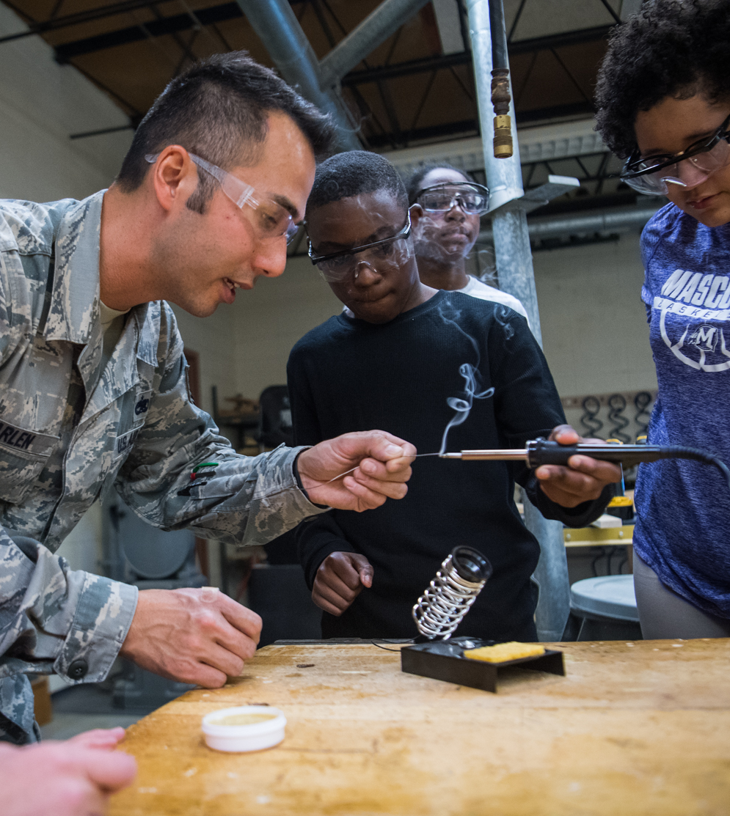
Our Impact…
“Slowing students down is not an effective instructional strategy. This grant would give us another powerful arrow in our quiver as we target our math, and more specifically, Algebra 1 success.”
- Chane Beam
Executive Director of Teaching and Learning
Fairbanks North Star Borough School District
(Supporting the military connected students assigned to Fort Wainwright and Eielson Air Force Base)
Notes:
This quote represents how DoDEA grants are making an impact ---- and we would like to make an even bigger impact

Slide 19
Connecting with you…
Partnerships
What partnerships can be established to support DoDEA grants in your area?
Communication
What types of communications would you like to see regarding DoDEA grants in your area?
Military-Connected Student Opportunities
What opportunities can DoDEA grants provide military-connected students?
So, what… Now what
What questions do you have related to DoDEA grants?

Slide 20
For more information…
DoDEA Grant Program Office
Email: dodea.grants@dodea.edu Phone: 571-372-6026
Evaluation Technical Assistance Center (ETAC)
Website: www.dodeagrants.org Email: info@dodeagrants.org Phone: 1-866-630-DATA (3282)
Follow us:
https://www.facebook.com/dodeaetac
@DoDEAgrants #DoDEAgrants
https://www.instagram.com/dodeagrants
Notes:
https://www.youtube.com/watch?v=aGF24EprH2s

