Slide 1
Altus Partnership
1 Nov 2022

Slide 2
Altus Partners
Altus AFB – Chuck Butchee
Community Partnership Liaison Officer
City of Altus – Gary Jones
City Manager
Altus Chamber of Commerce/EDC– Rodger Kerr
Director
Altus Public Schools – Roe Worbes
Superintendent

Slide 3
Altus AFB Success Factors
Smallest Community supporting an AF Installation
Greatest per capita investment in the DAF
Long-term, trusting and symbiotic relationship with community
Altus AFB is THE leading industry in “our community”
How a part-time POC and a small community can still get to “yes”
The more invested you are in the community, the better
Personal relationships and trust are essential
Be patient, work hard – changing minds and attitudes takes time/effort
Little wins culminate into big wins

Slide 4
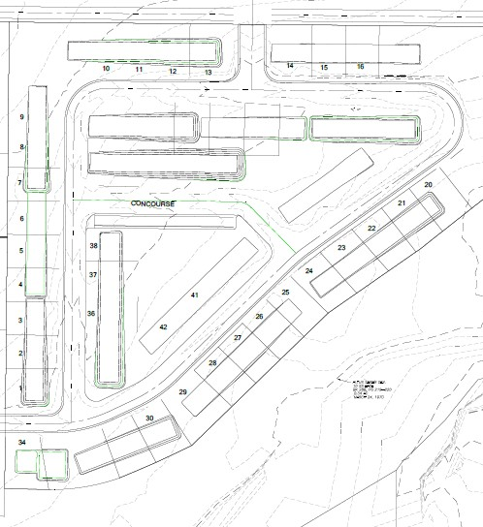
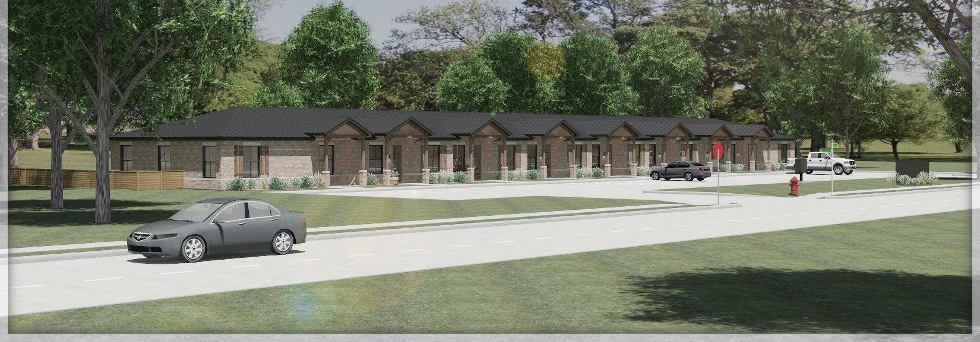
Housing – Current and Future Mission Capability
Partnership Requirement
Housing for inbound military and civilian workforce
Partnership Description
City of Altus incentivized development for a new 156-unit Rental Townhome Complex
How the Partnership Works
City of Altus provides the land and infrastructure for selected contractor to build new rental complex
Partnership Benefits
156 new front doors to support the Altus AFB mission and the local community!!!

Slide 5
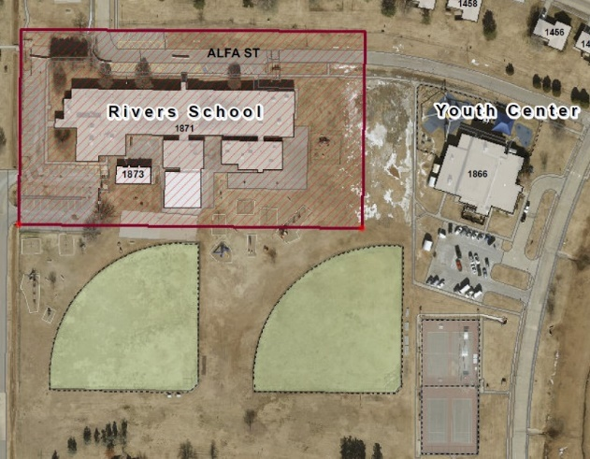
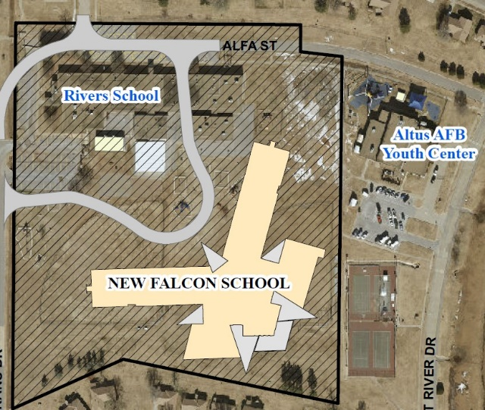
Mendel Rivers Elementary School – Altus Public Schools
Partnership Requirement
Provide Pre-K thru 4th grade facility for 400 students (Altus AFB dependents)
Current 1959 facility does not meet ADA standards, deficient in required space, needs massive infrastructure upgrade – PSMI Report graded F with a quality rating of 4(lowest possible rating)
Partnership Description
Obtain funding to build new facility
Current Status
APS approved for FY23 OLDCC funding -- $45M new facility
80/20 cost share with APS
Partnership Benefits
Rectifies current infrastructure issues (HVAC, electric, plumbing, fixtures, etc…)
Provides ADA compliant facility (entry, restrooms, stage, playground, storm shelter)
Provide Special Needs Classroom (does not meet current needs/requirements)
Provide STEM Lab (currently not available)
Provide Performing Arts Center (currently completed in gym)
Provide Library/Media Center (currently severely undersized/connection issues)
Provide Secure Entry Control and Security System

Slide 6
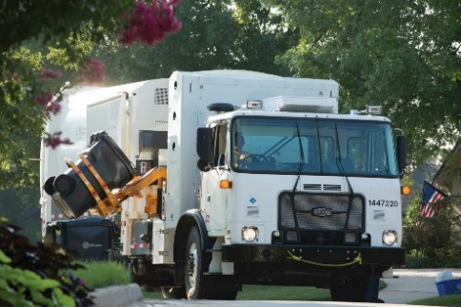
IGSA’s – Refuse/Grounds Maintenance
Partnership Requirement
Altus AFB needed more reliable service/City of Altus enjoys added income
Partnership Description
Refuse/Recycling was 3rd IGSA in DAF; 1st Grounds MX IGSA in DAF
How the Partnership Works
City of Altus provides the manpower and equipment to perform Refuse/Recycling operations and maintain the grounds on base. Altus AFB pays a fee for this service
Partnership Benefits
Altus AFB receives annual cost savings - $60K. Organic operations reduce risk to mission!!!
The City of Altus receives additional revenue of $1.5M/yr by increasing their service area

Slide 7
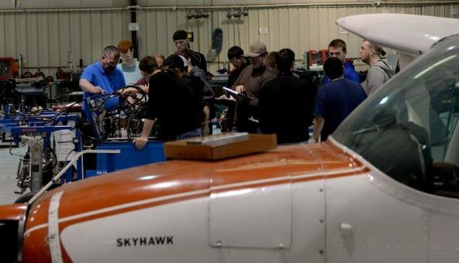
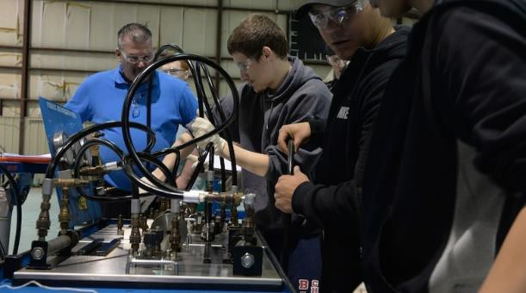
Grow Your Own Mechanic
Partnership Requirement
Altus AFB operates C-17, KC-135 & KC-46 jets, requiring 800 FAA certified mechanics
Partnership Description
The Base partnered with the Southwest Technology Center (SWTC) to create the Mechanic Training Center of Excellence (CoE) - also known as “Grow Your Own Mechanic (GYOM)” – to train FAA certifiable mechanics
How the Partnership Works
Grass roots initiative where individuals from the local labor pool are trained at the CoE to be hired as FAA certified aviation mechanics
To date, 338 students have graduated from the program, still compete with Tinker but make up large portion of the current workforce
In 2020 SWTC started night school to accommodate working schedules.
Partnership Benefits
Altus AFB gets a trained local labor pool to fill aviation mechanic jobs
Altus AFB saves $350K annually in recruiting, relocation, and incentive fees
Economic impact to the City of Altus from locally trained salaried employees is $11.4M

Slide 8
Readiness and Environmental Protection Integration - REPI
Partnership Requirement
Altus AFB identified #1 encroachment issues as
“Reliable Drinking Water”
Partnership Description
Altus AFB utilizing REPI funding to partner with City of Altus
and Mountain Park Conservancy District to procure ground
water rights for Altus AFB
How the Partnership Works
Altus AFB provides funding, City of Altus provides infrastructure, MPCD procures land and manages water production operations
Water rights on purchased property are “deeded” to Altus AFB!!!
Partnership Benefits
Altus AFB is procuring enough water rights to fully support current/future operations
The City of Altus now has access to enough water to ensure full capability to support Altus AFB and the community
Altus AFB has utilized $2.2M of REPI funding to secure water rights

Slide 9
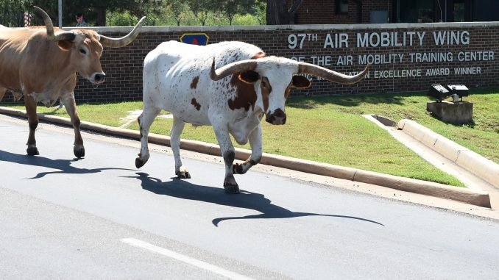
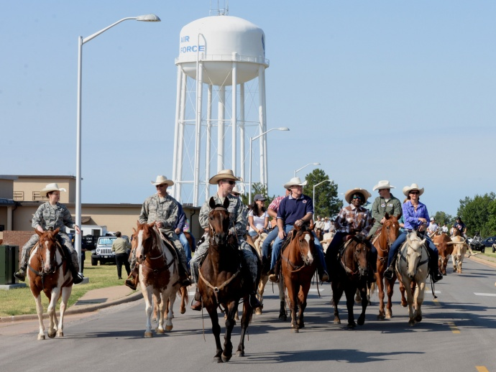
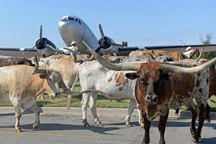
Altus AFB Cattle Drive
Altus Community Sponsored
Provides Altus Airmen the opportunity to experience our local heritage
40 longhorn cattle – 150 cowboys
Altus AFB and Community leaders
Annual Event – 25 years running
Held in conjunction with local PRCA Rodeo
One night is Military Appreciation Night – free to military with free cookout and events

Slide 10
?

