Slide 1
Joint Base Langley-Eustis (JBLE) Dominion Energy
Power of Partnerships
November 1, 2022

Slide 2
Joint Base Langley-Eustis COL Harry Hung 633d Deputy Joint Base Commander

Slide 3
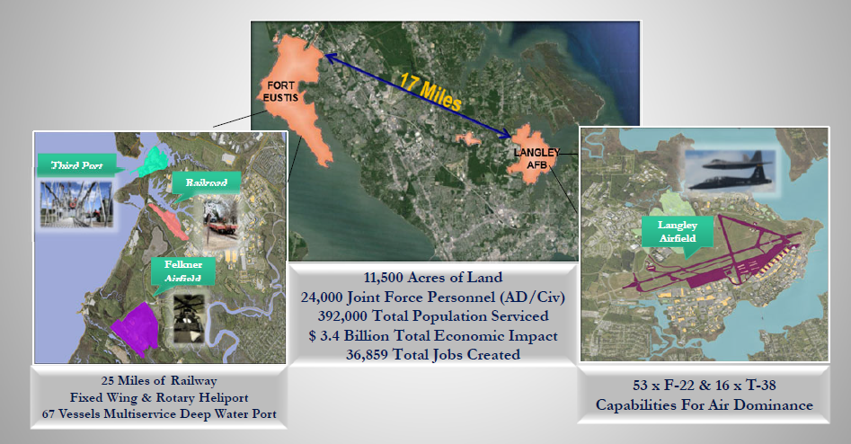
JBLE PORTFOLIO
JBLE-Eustis
Annual Energy Cost: $6.9M
Annual Usage: 115,678,756 kWh
JBLE-Langley
Annual Energy Cost: $7.8M
Annual Usage: 112,610,482 kWh

Slide 4
JBLE ENERGY STRUCTURE
JBLE-Langley:
Operates under an Area-wide Agreement (AWA)
Government owned and operated
Regulated utility – Dominion Energy
Active-duty manpower requirement for dedicated skillset needs to remain
JBLE-Eustis:
Operates under utilities (UP) privatization prior to Joint Basing
Dominion owned and operated and creates cost efficiencies
Regulated utility – Dominion Energy
Dominion Energy has flexibility in preparing a capital improvement plan
2 Joint Base Installations – 2 Different Approaches

Slide 5
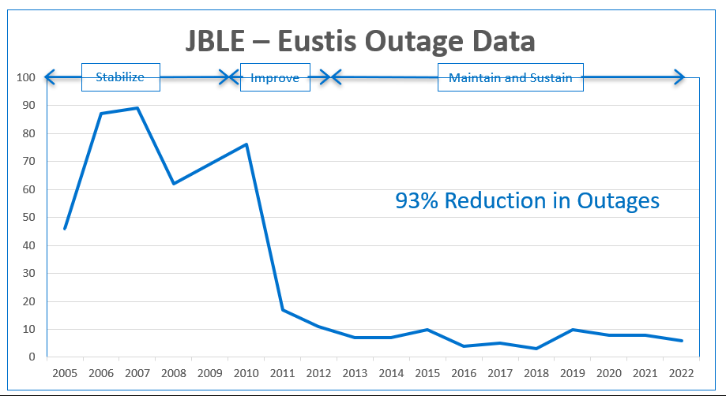
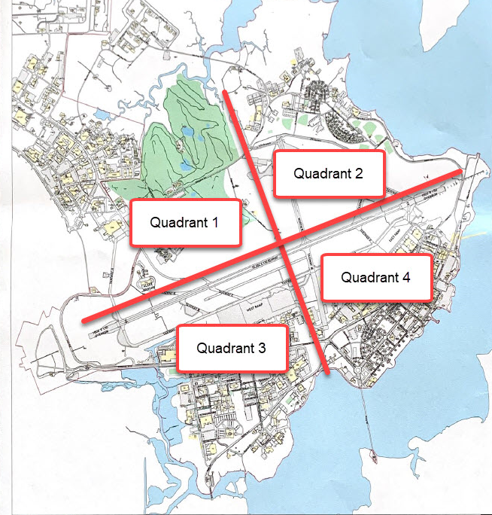
JBLE HURDLES
Exceeding Capacity and Demand
Exceeding Capacity
Exceeding Demand
Capacity
Redundancy
Resiliency

Slide 6
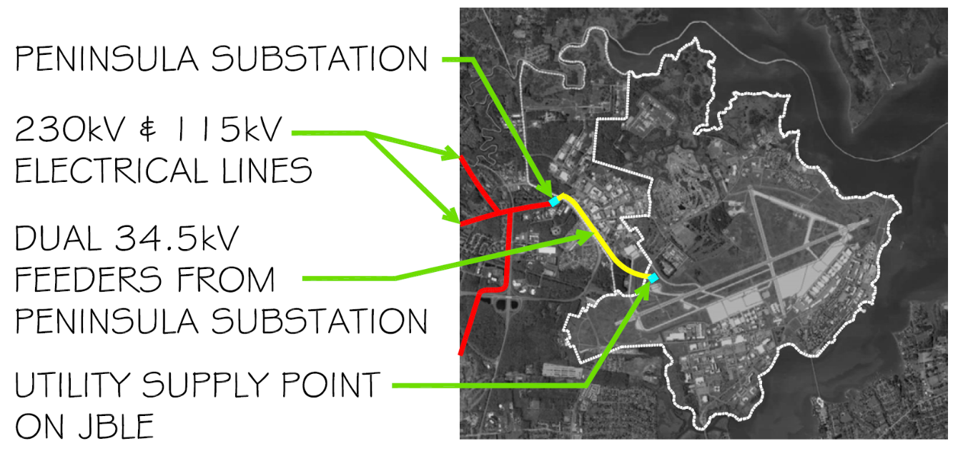
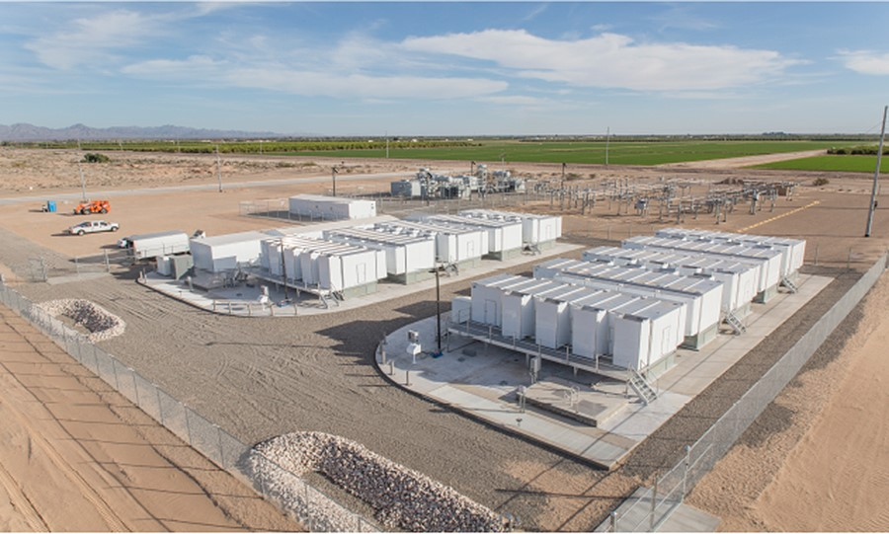
PROJECT EXECUTION
JBLE-Langley:
Third Feed/2nd Substation $14M-Funded by AFCEC
Overhead Transmission lines (Unfunded)
Microgrids
ISRW Campus (Designed, Unfunded)
Remaining Microgrids (Not Designed/Unfunded)
JBLE- Eustis:
Substation ($12.5M)
Transmission Line ($11.7M)
Microgrids
Government owned/operated-DE installed ($XX)
Capital Improvement Projects (Unfunded)
Third Feed from Second Substation – Magruder ($14M)
Future Microgrids – ERCIP $$
Notes:
Current Situation: One feed on North side, base will exceed capacity by 2025
Post Construction: Two feeds, one N side and one S side
Two connect distro systems
Capacity increased
Redundancy
Dominion Funded and designed

Slide 7
Dominion Energy Paul Matthews Director, Federal Energy Solutions

Slide 8
JBLE SUCCESS STORIES
The Base of Tomorrow®
Base of Tomorrow® is an efficient installation that achieves a Reliable, Resilient, and Sustainable energy supply from power generator to end user by incorporating a diverse set of energy solutions in an integrated and optimal way
Reliable
Resilient
Efficient
Sustainable

Slide 9
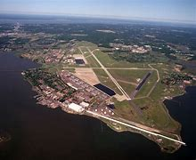
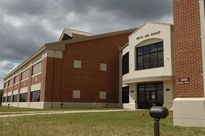
JBLE-LANGLEY
Dominion Energy System Improvements
Expanded Substation
Two New Primary Feeds
Installed Distribution Loop
Integrated into JBLE-Langley Owned System
Regulated Project Under Areawide Contract
System Improvements
Expanded and Integrated System
Work Under Areawide Contract

Slide 10
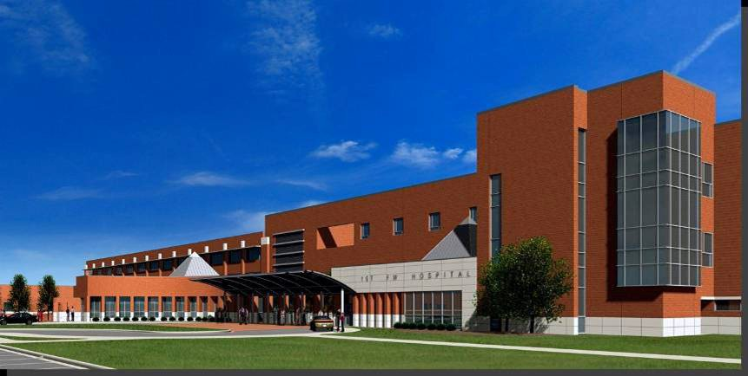
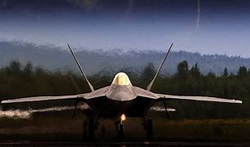
JBLE-LANGLEY
Significant Growth
Hospital Addition
New Fighter Wings
Targeting Center
Hangar 790
Consolidated Operations and Maintenance Hangar (COMH)
Low Observable Component Repair Facility (LOCRF)
Training Support Squadron (TRSS)
Intelligence Camps Expansion
Work Under Areawide Contract

Slide 11
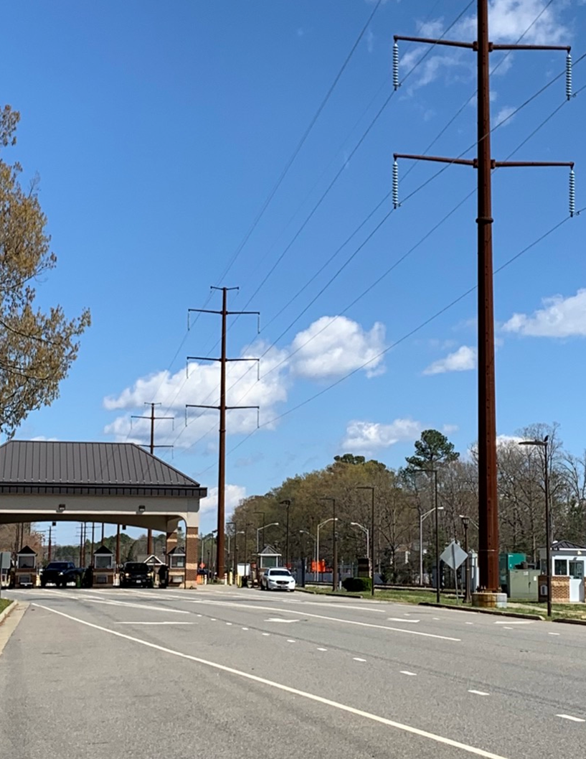
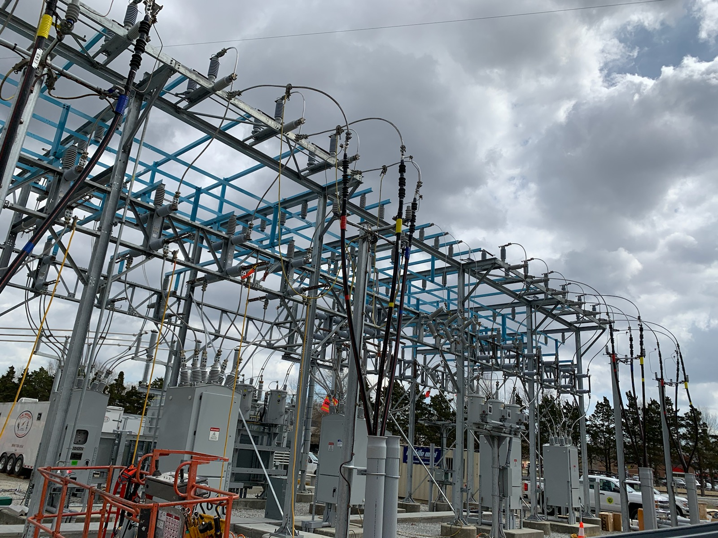
JBLE-EUSTIS
Transmission Project
Rebuilt Radial Tap to Fort Eustis Substation
Double Circuit with Transmission Breaker
Funded by Dominion Energy
Substation Renovation & Expansion
Installed 3rd Transformer to Ensure Capacity
Replaced Antiquated Switchgear with Modern Utility Standard Breakers and Bus
Eliminated Two Field Cubicle Switchgear Location
Funded Through UP Contract

Slide 12
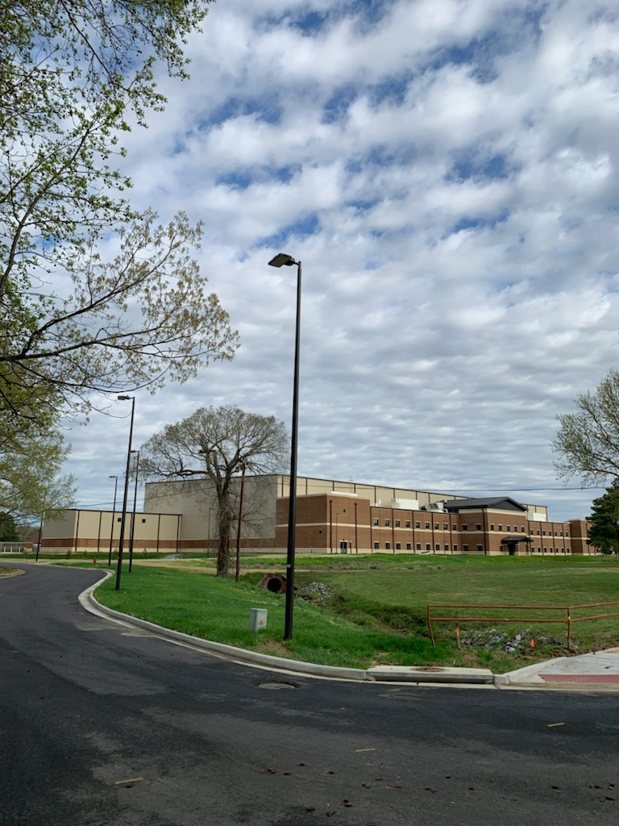
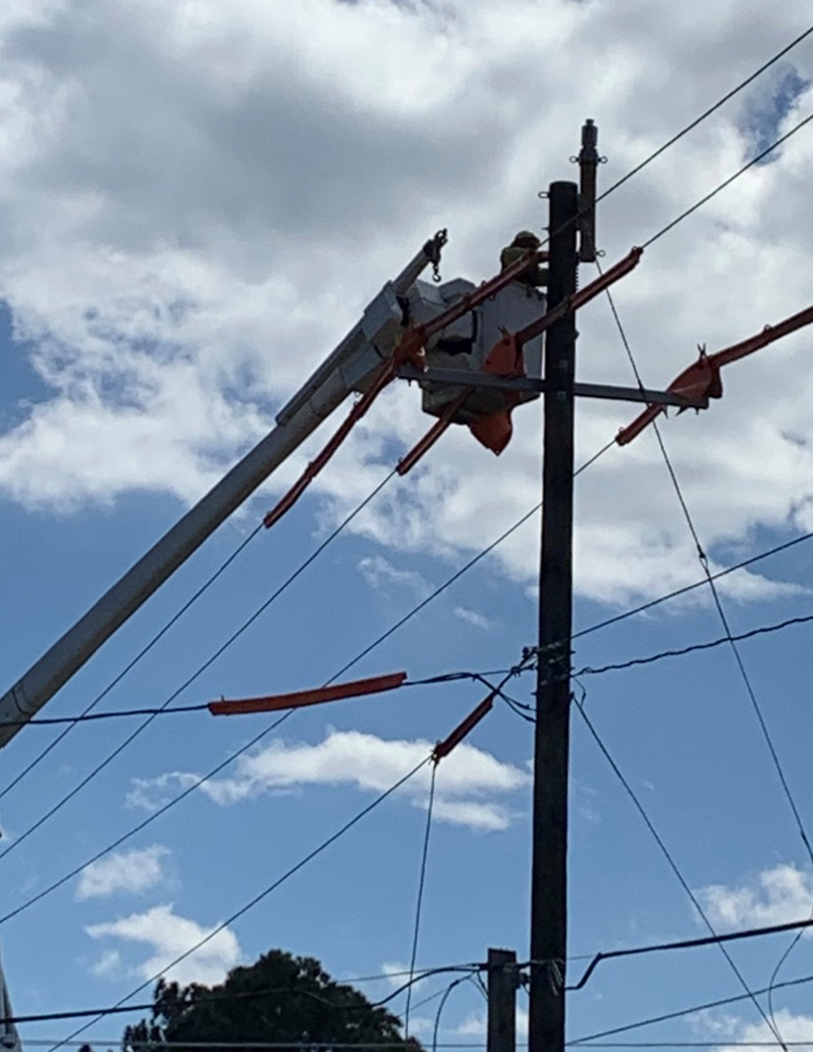
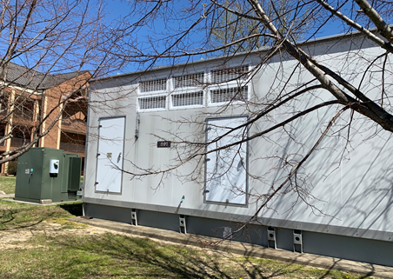
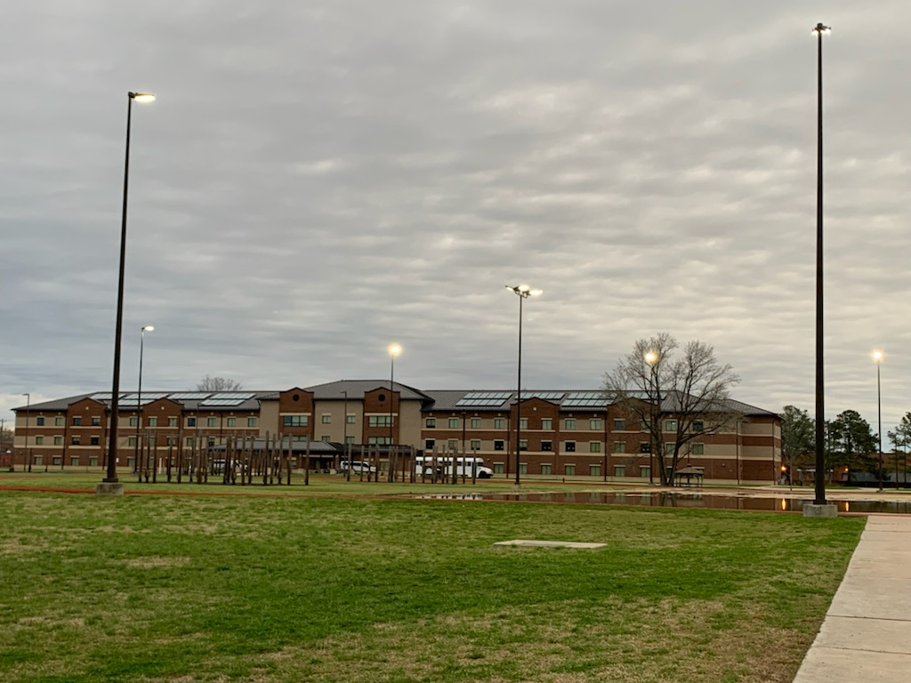
JBLE-EUSTIS
Major System Improvements
Comprehensive O&M Program
Major System Renewals & Replacements
600 Block Micro Grid
Strategic Undergrounding
Distribution Automation
LED Lighting Conversions / Upgrades
Significant Growth
AIT 1, 2, 3, & 4
Battalion Complex
Aviation Maintenance Complex
Gate Rebuild
Funded through UP Contract

Slide 13
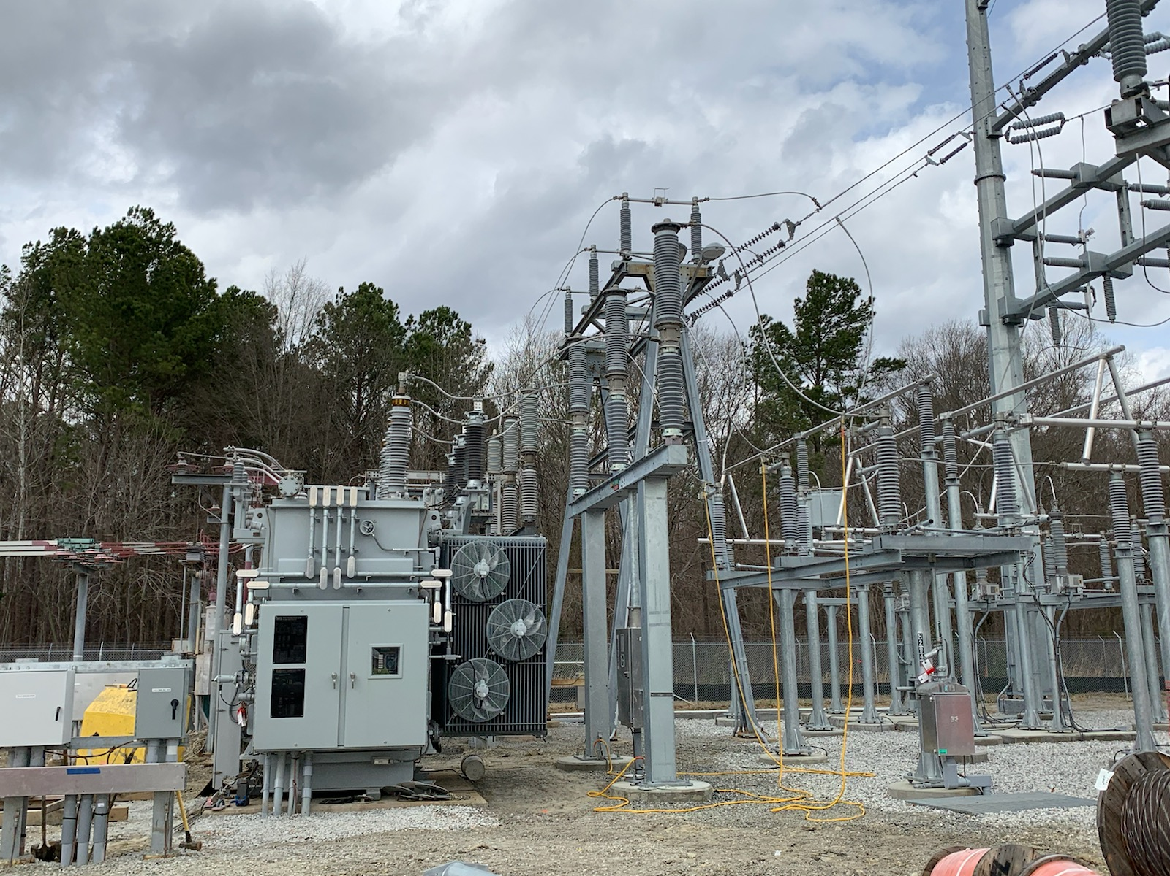
JBLE – Future Projects
Additional Capacity (Langley)
Expand Substation
Install 3rd Primary Feed
Integrate into Distribution Loop
Regulated Project Under Areawide Contract
Mission Critical Resilience (Langley)
Install Micro Grid
Isolate and Sustain Critical Mission
Work Under Areawide Contract (Potential ERCIP)
Mission Critical Resilience (Eustis)
Install Micro Grids
Isolate and Sustain Critical Missions
Work Under Utilities Privatization (Potential ERCIP)

Slide 14
PARTNERSHIPS
Air Force led Joint Base w/an Army Utilities Privatized Contract
Municipalities (City of Hampton, Newport News)
Dominion Energy
Hampton Roads Military Federal Facilities Alliance

Slide 15
Hampton Roads Military Federal Facilities Alliance (HRMFFA) Rick Dwyer Executive Director

Slide 16
PARTNERSHIPS
Regional Advocacy and Support
Work with installation/municipal leadership, state/federal officials, and local support organizations
Address concerns before they become issues
Connect the dots
NDAA Clarification – ERCIP for Area-wide Agreement and Utilities Privatization

Slide 17
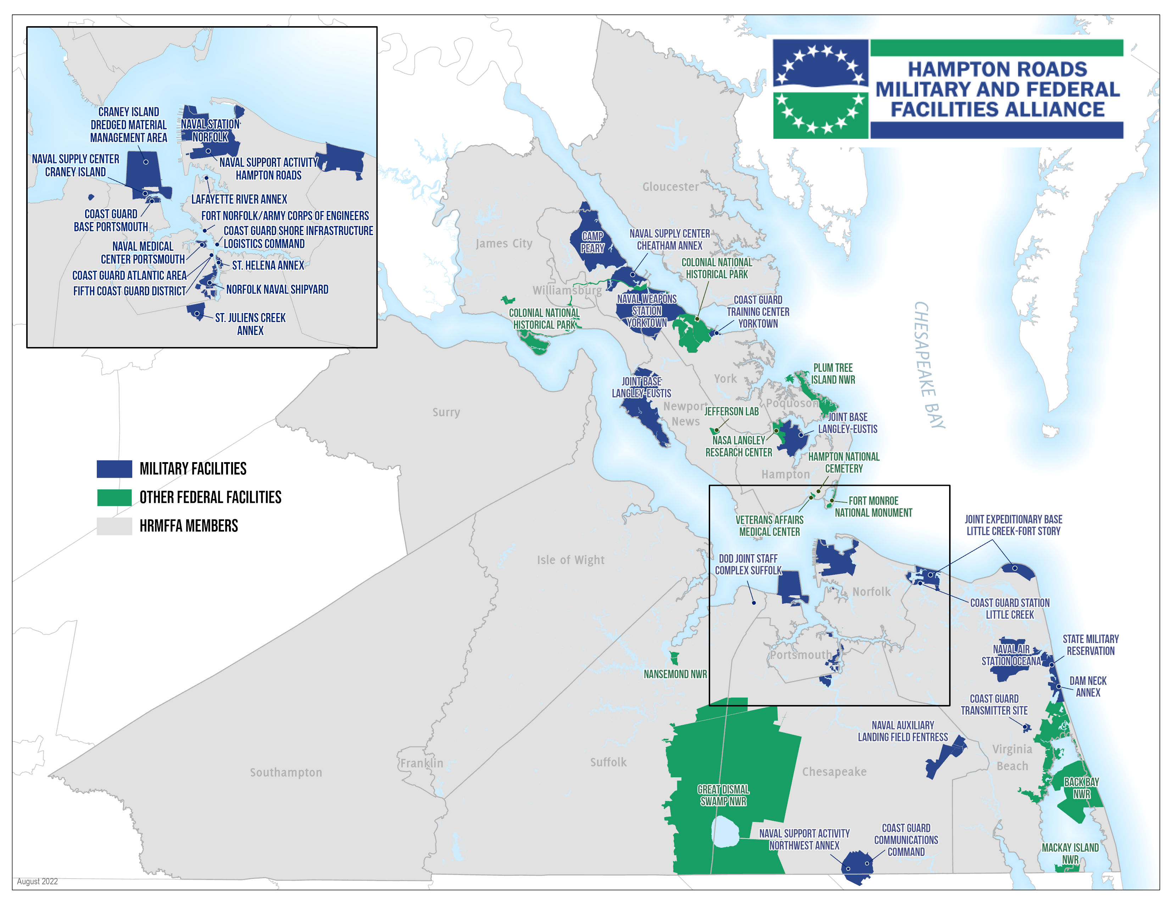

Slide 18
Questions?

