Slide 1
Defense Community Energy and Water Resilience: Combining Forces, Efforts, and Funding Sources

Slide 2
Joe Simonelli Colonel, U.S. Army, Retired DoD Engagement Executive Energy Systems Group

Slide 3
Demand Response
LED Lighting
/ Battery Storage
EVSE
CUP
Energy Efficient
Building Systems
EVSE
Water / Waste
Water Solutions
Resiliency / Microgrids

Slide 4
ADC IIF Panel Discussion
Chris Landgraf
1 Nov 2022

Slide 5
Who we are and how we got here
Who we are
The Northern Virginia Regional Commission (NVRC) is a regional council of thirteen-member local governments in the Northern Virginia suburbs of Washington DC. According to Virginia’s Regional Cooperation Act, NVRC is a political subdivision (a government agency) within the Commonwealth. NVRC has a rich history, spanning 60 years. Our chief roles and functions have focused on providing information, performing professional and technical services for its members, and serving as a mechanism for regional coordination. Current programs and projects to address a wide array of local government interests.
How we got here
NVRC’s Director of Community and Military Partnerships, Ms. Peggy Tadej, applied for and received a Military Installation Resilience Review (MIRR) grant from the Office of Local Defense Community Cooperation (OLDCC). During the MIRR process projects benefitting the communities and the installations were identified. To expand on the projects and start identifying funding options NVRC held an Industry Day and invited the local governments, the private sector, federal government agencies, the installations, and foundations. A summary of the Industry Day follows.
2

Slide 6
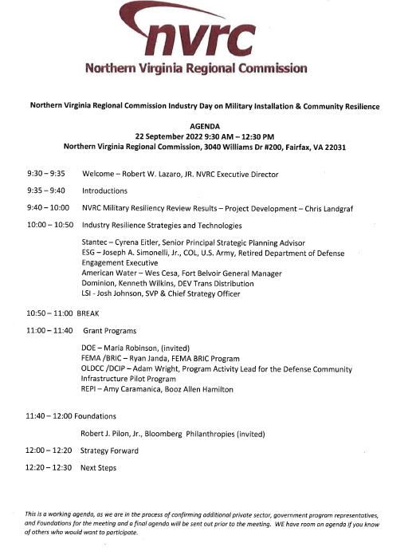
Agenda
2

Slide 7
Framing Questions and Desired Outcomes
Framing Questions
1. How can the Private Sector assist with project planning phase to get projects “shovel ready”?
2. What are the funding sources available for projects? Successful examples?
3. Who are the partners for each project?
Desired Outcome
Develop regional, coordinated project funding applications and an execution strategy plan for:
short-term
mid-term
long-term projects
At the end of the day we want to establish coordinated, regional resilience
2

Slide 8
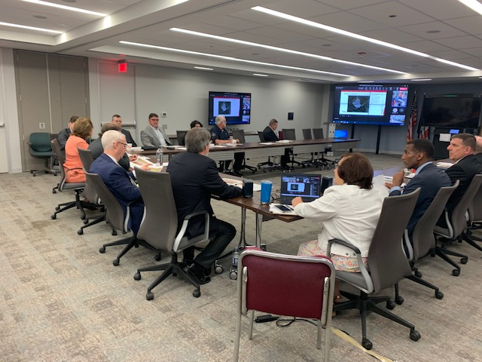
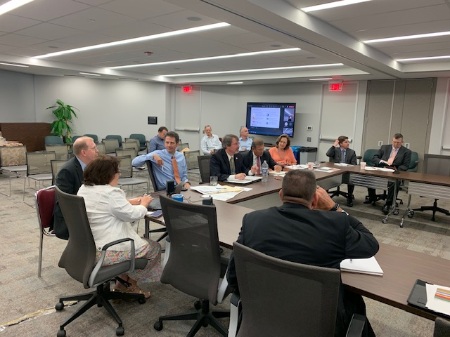
Participants
60 total participants including three elected officials who represent counties the installations are in and staff
25 in-person participants from private sector, DoD, FEMA
Commonwealth of Virginia, Secretary of Veterans and Defense Affairs, Secretary of Energy, and Department of Emergency Management dialed into the meeting
Greater Washington Board of Trade, Fairfax Water Authority, and NVRC
Representatives from Arlington, Fairfax, Stafford, and Prince William Counties
Representatives from Fort Belvoir, Joint Base Myer-Henderson Hall, and Marine Corps Base Quantico
Private sector included American Water, AECOM, Booz Allen Hamilton, Building Momentum, Covanta, Crown Castle, Dominion Energy, ESG, HDR, Spectrum, Stantec
3

Slide 9
Discussion Summary
Presented 20 projects covering Energy, Water, and Wastewater totaling $338.3 M
Top projects are Covanta emergency power generation for water and wastewater operations in Fairfax and Alexandria/Arlington ($15 M) and floating solar with battery back-up in Fairfax, Prince William, and Stafford ($49 M)
Captured private sector interest, capabilities, and experience to support resilience objectives
Proposal writing for grants and cooperative agreements
Project planning studies and implementation
Gathered application timelines and criteria for funding programs
DCIP (30% community match)
REPI (50% community match)
BRIC (25% community match)
4

Slide 10
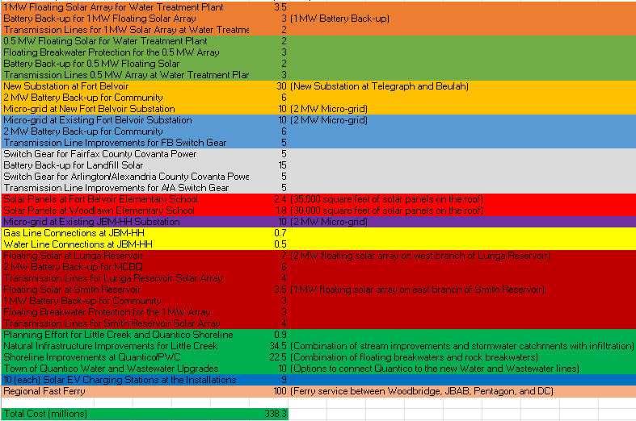
Project List
4

Slide 11
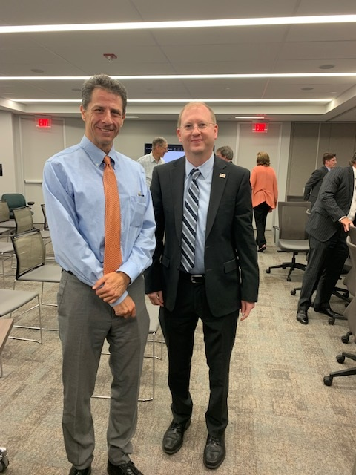
Strategy Plan Elements
Umbrella structure to coordinate the regional effort and coordination (NVRC + Component Jurisdictions + Commonwealth)
Prioritized project list tied to applicable funding sources
Proposal schedule for prioritized projects
Incorporate wireless communications into projects
Proposal team for application submission
Confirmation the IGSA can be used for project award
Andy and Ryan from REPI and BRIC
5

Slide 12
Next Steps
Follow up with DOE and State FEMA coordinator
Refine umbrella strategy and identify key players
Set up working sessions with smaller groups
Develop a business case for each project
Provide an update to the Community, Military, Federal Facilities Partnership meeting 28 Nov 22
Schedule Industry Day #2 in February 2023
6

Slide 13
MIRR POC and Questions
Chris Landgraf
NVRC Program Manager
Military Installation Resilience
(703) 642-4641
clandgraf@novaregion.org
7

Slide 14
COL Chad Foster Garrison Commander Fort Hood, TX

Slide 15
Patrick O’Brien Director Office of Local Defense Community Cooperation

Slide 16
Ashlye Willougbhy Municipal Client Advisor HDR

Slide 17
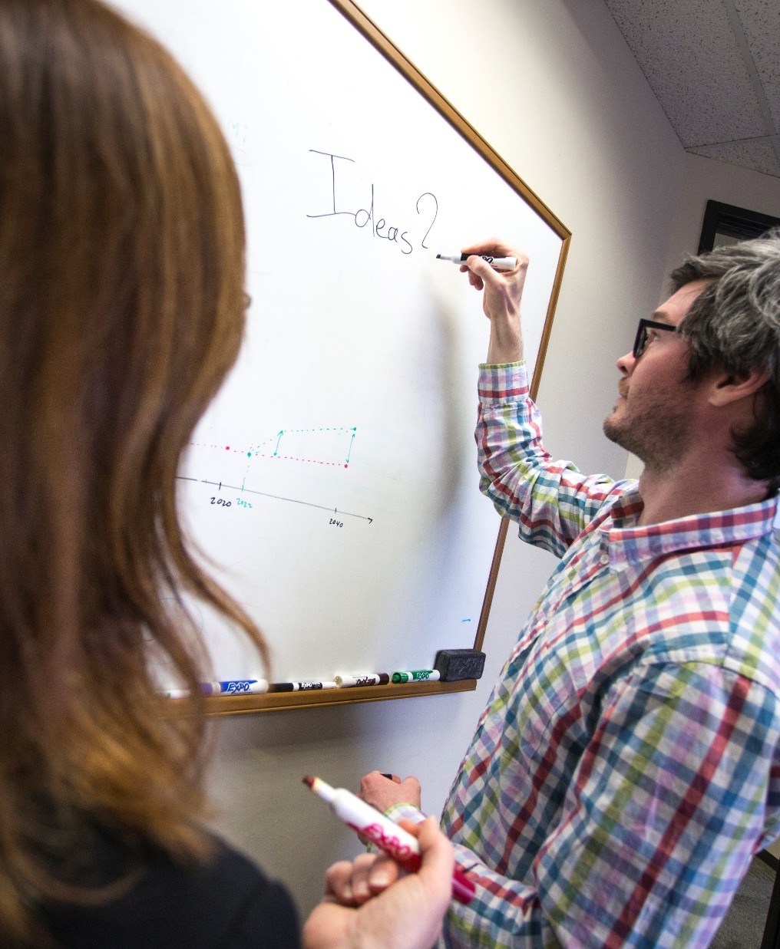
Grants, Funding and Financing We are here to assist
Developing collaborative and strategic funding approach
Identification of priorities and needs
Evaluating grant funding opportunities
Developing financial planning models
Estimating costs and funding gaps
Review funding options to match federal funds
Preparing grant applications
Benefit-Cost Analysis (BCA)
Grants management

Slide 18
Questions?

