Slide 1
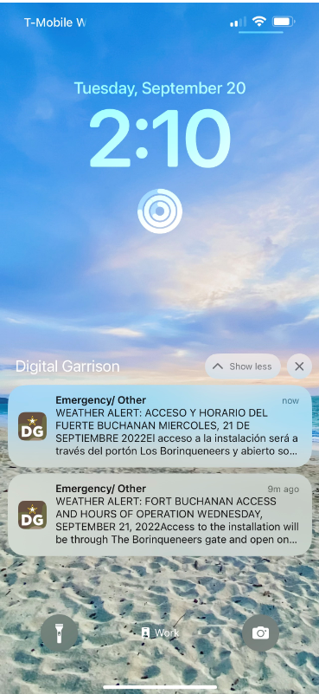

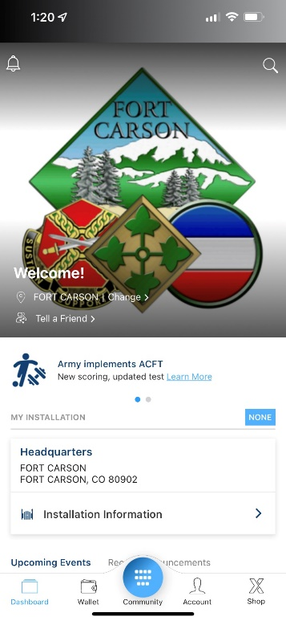
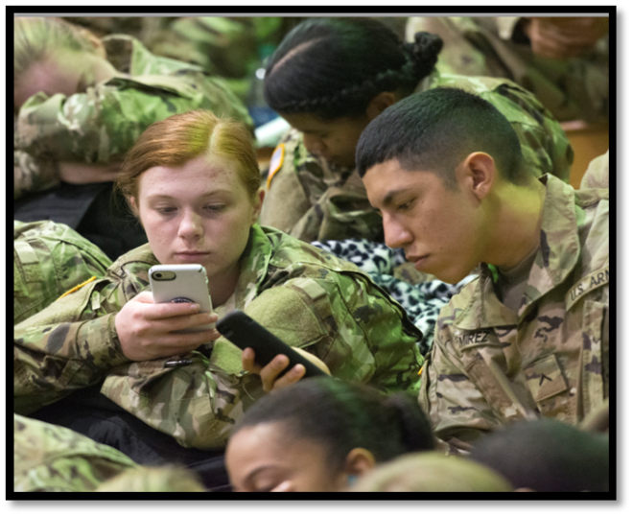

Digital Garrison Mobile App
Scott Malcom, IMCOM HQ Public Affairs

Slide 2
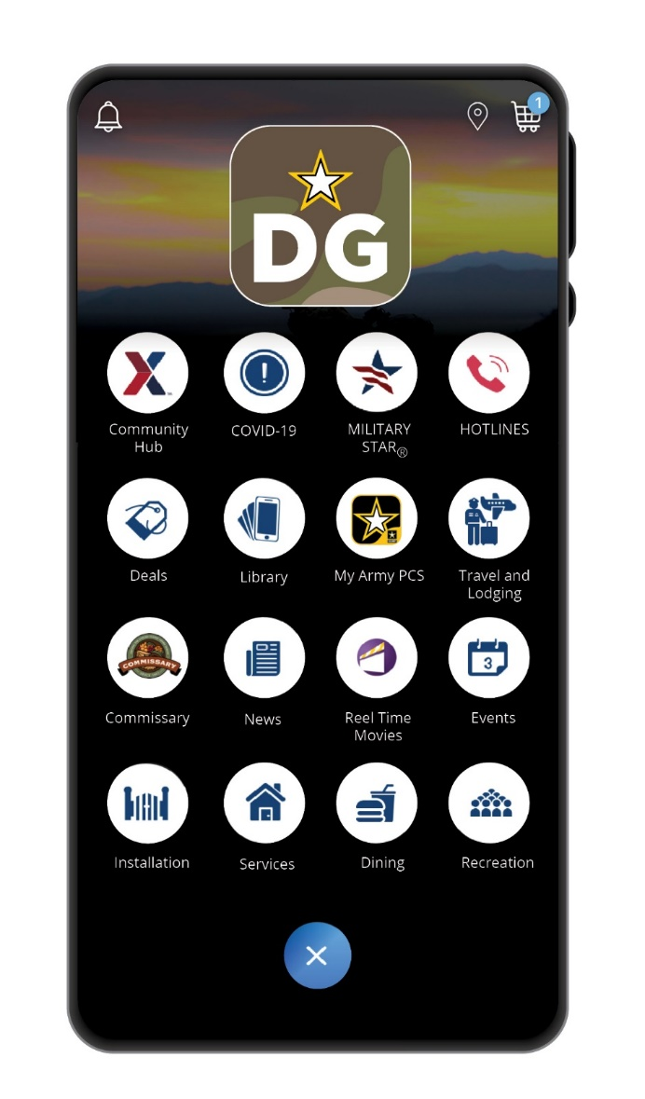


Digital Garrison
Digital Garrison launched in 2020 to provide members of the Army community a single (enterprise solution), FISMA compliant mobile application for accessing installation QOL services including IMCOM public information, Family and MWR services, and AAFES shopping and dining.
Where We Were
14+ non-uniform apps developed at the local level Inconsistent application of security standards, info and user experience Low usage/adoption (est. 5-7% of population)
Where We Are
Enterprise solution that operationalizes commanders’ communication Cyber-secure; FISMA compliant Continually optimized through routine feedback & upgrades

Slide 3
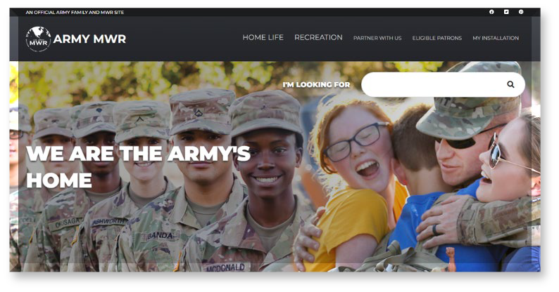
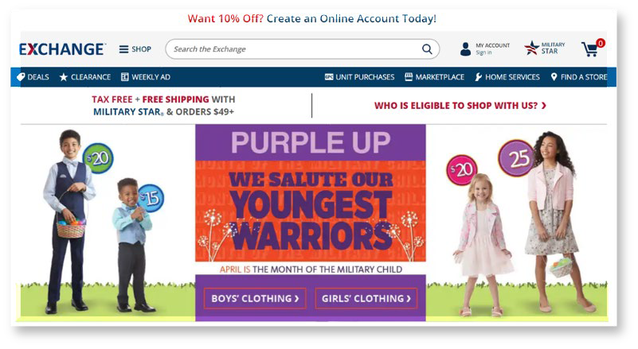
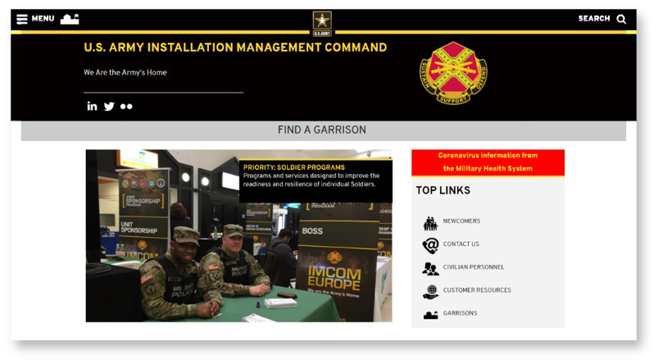



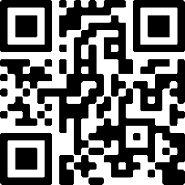
Digital Garrison – How It Works
Garrison.armymwr.com
ShopMyExchange.com
Home.army.mil/garrison
Automatic integration
Facility information
Gate directions
Push notifications
Local events
Soldier and Family resources
Installation news
Enterprise solution
Continually optimizing
285K+ downloads
Available at 67 installations
Cyber-secure; FISMA compliant
At and above industry standards
  4.2 ratings
  37% retention rate
Coming in 2023:
A Community Groups feature to connect select audiences with information tailored for them!

Slide 4
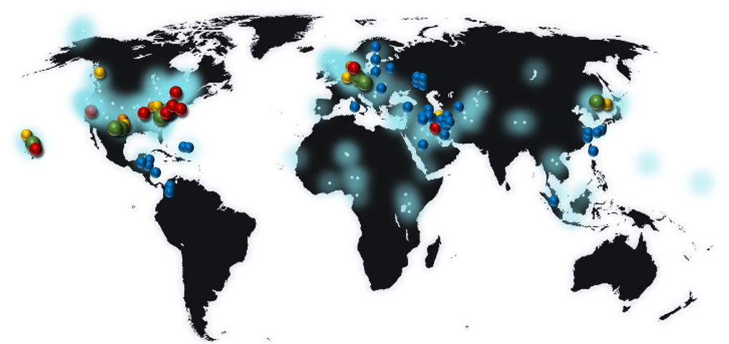
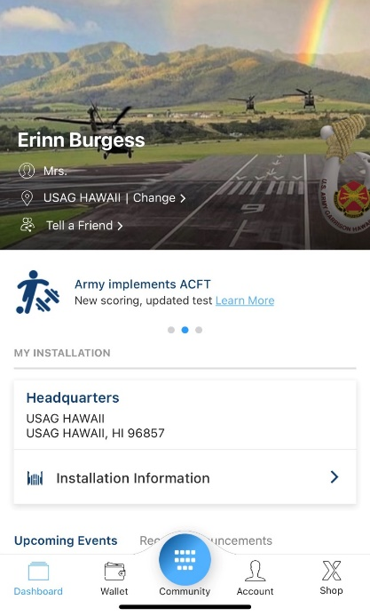
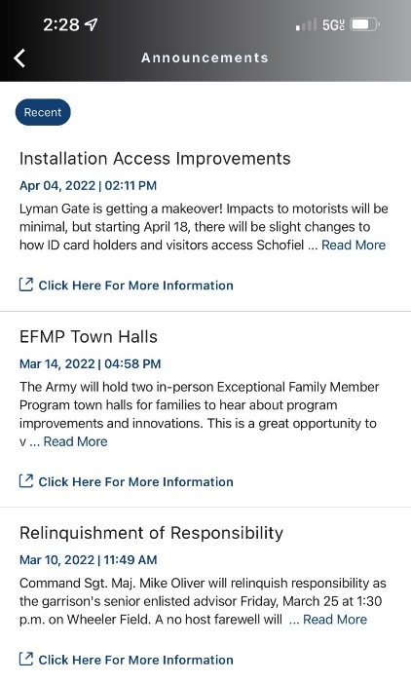
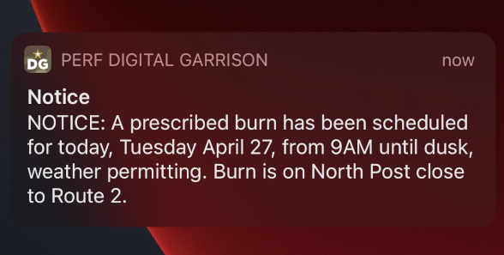
Digital Garrison: Commander’s Communication Tools
Use Digital Garrison to communicate with your community!
Push Notification
Sends message to a user’s mobile device lock screen and the Notification Center in the app
App users must be opted-in for ‘Installation’ Push Notifications to receive the messages
Input by PAOs and POCs in AAFES Message Center website
Widget Carousel
Rotating messages on app dashboard
Two slots for IMCOM-wide messages; three slots for local
Input by PAOs via IMCOM website
Announcement
Users access Announcements on the dashboard after opening the app, or under ‘Installation Information’
Input by PAOs via IMCOM website

Slide 5
Digital Garrison in Action
Conduct live demonstration of Digital Garrison
(Seven minutes)

Slide 6
Digital Garrison: Overview
Current status:
~285K downloads
Aiming for 300K by end of 2022
Great retention in August (36.7%)
Valuable tool for Fort Buchanan during Hurricane Fiona and Fort Stewart in Ian.
*data pulled from subset of users

Slide 7
Digital Garrison
Where We Are Headed
Continued optimization: Newly signed IMCOM-AAFES Memorandum of Agreement allows streamlined improvements and optimization Expanded reach: Increase Digital Garrison presence at all Army installations (currently at 67 installations)
How You Can Help!
Download, use, promote! Word-of-mouth is the most effective marketing tool we have Be our advocate

Slide 8
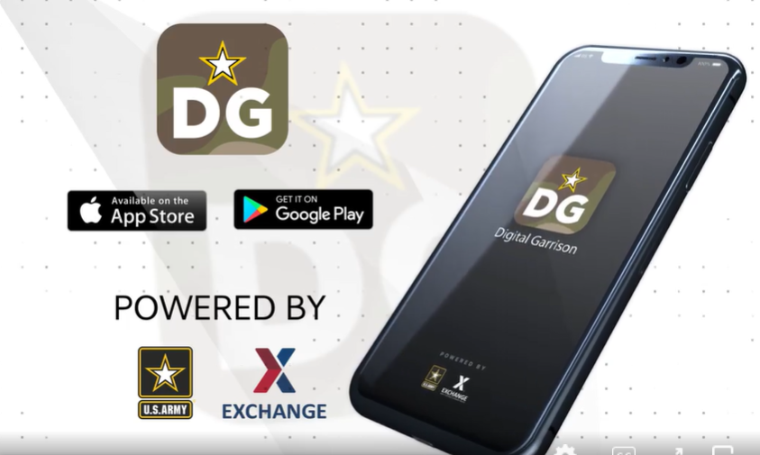
Digital Garrison
Q & A
Discussion

