Slide 1
G-4
Non-Tactical Vehicle Electrification
ADC Installation Innovation Forum
James Gough
Director, Transportation Services
MCICOM G-4

Slide 2
Agenda
Discussion Topic | Slide
Policy Background | 3
Inter-Agency Coordination/Reporting | 4
USMC NTV Electrification Strategy | 5
Issues & Challenges | 6
FY22 Accomplishments | 7
Spotlight: Beam EV ARC | 8
ZEV Adoption | 9
EVSE Deployment | 10
FY22-23 EVSE Site Planning | 11
Way Forward | 12-13
Funding Outlook | 14
Backup Slides | 15-19

Slide 3
Policy Background
EO 14008 Overview
Directs the development of a national plan to convert all Federal Fleets to zero-emission vehicles (ZEVs)
Establishes a derivative requirement for each agency to deploy charging infrastructure, or electric vehicle supply equipment (EVSE)
EO 14057 Mandates
100% ZEV light-duty acquisitions by FY27
100% ZEV medium- and heavy-duty acquisitions by FY35
Applies to non-tactical vehicles (NTVs) only
Applies to domestic vehicles only
FY22 USMC Policy Letter
HQMC Policy Memorandum 1-22: USMC NTV Fleet Electrification
Provides general guidance on USMC approach to NTV electrification
Directs all USMC installations to begin preparing to transition to electric NTVs
Notes:
Memo 1-22 issued as Total Force directive and developed with GF for public works/facilities interests.

Slide 4
Inter-Agency Coordination/Reporting
Inter-Agency Coordination
USMC participates in a variety of efforts across DoN, DoD, and the Federal Government to coordinate the achievement of mandates and reporting requirements:
Monthly DoN Electrification Working Group
DoD Climate Working Group ZEV Sub-Working Group (including Strategic Guidance, Policies, and Training Issue Teams)
Inter-Agency Reporting
FY22 Zero-Emission Vehicle Planning and Capacity Tool (ZPAC) Data Call:
Assessed ZEV conversion suitability of replacement-eligible light-duty vehicles
Annual ZEV Fleet Strategic Plan:
Projected year-over-year targets for both ZEV procurement and EVSE deployment
Summary of NTV electrification challenges, lessons learned, and success stories
Quarterly EVSE Deployment Status Report: Service-wide snapshot progress update for past, current, and future efforts regarding EVSE deployment planning and execution

Slide 5
USMC NTV Electrification Strategy
Strategic Prioritization
EVSE-led approach to ensure all ZEVs acquired have access to charging
Early “shovel-readiness” so USMC can compete for DoD-wide infrastructure funding (e.g., Energy Resilience & Conservation Investment Program [ERCIP])
Data-driven ZEV selection, leveraging telematics to prioritize vehicles most readily suitable for conversion to ZEVs
ZEV & EVSE Balancing
Develop enterprise-wide targets:
Create annual ZEV conversion targets based on total replacement-eligible vehicles
Create annual EVSE deployment minimums to support future year incoming ZEVs
Determine and execute installation ZEV conversion sub-targets:
Analyze installation-level vehicle replacement eligibility and propose sub-targets
Align on final conversion sub-targets with installation fleet managers
Prioritize EVSE deployment at installations identified to receive ZEVs:
Conduct EVSE infrastructure planning to account for long-term charging demand
ZEV Fleet Strategic Plan
USMC’s NTV electrification strategy is encompassed in the FY22 ZEV Strategic Plan.

Slide 6
Issues & Challenges
ZEVs
OEM ZEV Offering Uncertainty: ZEV availability for lease/purchase is difficult to predict and projections are frequently changing
Incremental Cost Uncertainty: ZEV cost to lease is uncertain, making budgeting projections difficult for out-years
EVSE
Limited Existing EVSE: Current infrastructure restricts near-term ZEV procurement
Off-Base Vehicles: Approximately 50% of USMC light-duty fleet is garaged in areas not owned by the USMC creating charging accessibility challenges
External to MCICOM
FY23 NDAA: Policy may require Services to electrify an entire installation by CY25
MCRC/MARFORRES: These vehicles are subject to electrification requirements but are not managed directly under MCICOM chain of command
External Funding Sources: MCICOM will require pre-developed EVSE deployment plans in order to leverage external funding opportunities as they arise

Slide 7
FY22 Accomplishments
ZEVs
Ordered 62 light-duty vehicles to ZEVs in FY22
Planned enterprise-wide ZEV conversion goals through FY35
EVSE
Deployed 21 mobile solar charging units (Beam EV ARCs) across 13 installations
Planned enterprise-wide EVSE implementation goals through FY35 (update annually)
Conducted data call to identify all MCICOM vehicle garage sites aboard installations
Education/Coordination
Presented fleet electrification approach at 2022 G-4 Fleet Manager Workshop
Responded to Council for Environmental Quality (CEQ) FY22 ZEV Fleet Strategic Plan tasker and FY22 Q3 EVSE Deployment Status Report tasker
Provided feedback to OSD regarding potential expansions to Quarterly EVSE Deployment Status Report

Slide 8
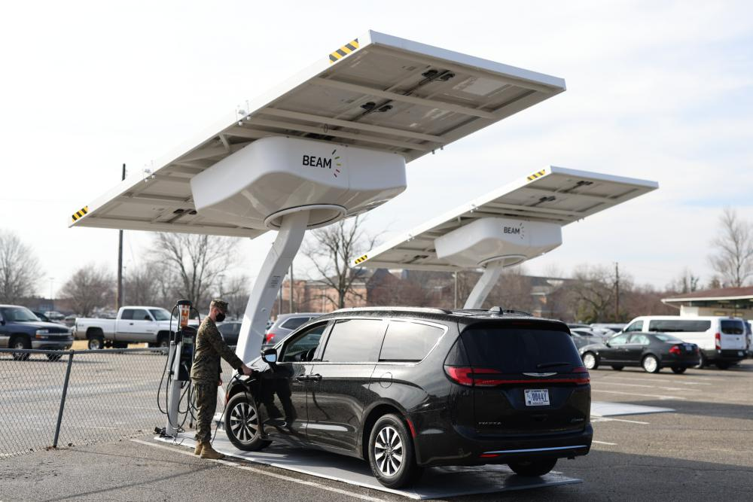
Spotlight: Beam EV ARC
The Beam EV ARC is a portable, rapidly deployable, solar charging station for EVs.
EV ARCs enable MCICOM to bridge the charging gap for early ZEV adopters until permanent charging infrastructure is in place.
USMC has deployed 21 Beam EV ARCs across 13 Marine Corps Installations:
Installation | Qty
MCB Camp Pendleton | 2
MCAGCC Twentynine Palms | 2
MCRD San Diego | 1
MCAS Miramar | 1
MCAS Yuma | 1
MCB Camp Lejeune | 3
MCAS Cherry Point | 1
MCRD Parris Island | 2
MCAS Blount Island | 1
MCLB Albany | 1
MCB Quantico | 3
MCAS Beaufort | 1
MCB Hawaii | 2
Total | 21
Beam EV ARC Aboard MCB Quantico

Slide 9
ZEV Adoption
Current State
USMC currently has 81 ZEVs (22 BEVs, 59 PHEVs), with 56 ZEVs ordered in FY22
Top installations: MCB Camp Pendleton, MCB Quantico, MCAS Yuma, MCAS Miramar
Approach
Data collected from various exercises conducted in FY22 will be used to inform year-over-year ZEV conversion targets and FY23 acquisition planning:
FY22 ZPAC
Data Call
FY22 GSA CAM Replacements
Year-Over-Year Target Planning
FY23 GSA CAM Cycle Prep
USMC’s Data-Fueled Approach
USMC’s approach to ZEV adoption will be repeated on a cyclical basis. USMC will leverage telematics, particularly Geotab’s EV Suitability Assessment, to ensure ZEV conversion planning decisions are informed by the most up-to-date data available.
Improved utilization data will also assist with rightsizing the fleet to avoid excess cost of electrifying underused vehicles.

Slide 10
EVSE Deployment
Current State
USMC currently has (120) Level 2 charging ports, and (21) Beam EV Arc Chargers
Many existing charging stations have suffered damage and/or require upgrades
Approach
Data collected from various FY22 exercises will be used to inform EVSE site assessments and project planning:
FY22 ZPAC
Data Call
FY22 Garage Site Identification
Installation Site Assessments
EVSE Project Planning
USMC’s Data-Fueled Approach
USMC’s approach to EVSE deployment will be repeated on a cyclical basis. USMC will leverage data from the FY22 Garage Site Identification data call, as well as information from previously integrated ZEVs and charging stations to promote informed EVSE planning and decision making.

Slide 11
FY22-23 EVSE Site Planning
FY22-23 EVSE Site Planning
Objective: complete EVSE planning at 10 priority MCICOM installations
Fleets at priority installations composing almost 90% of MCICOM light-duty vehicles
Repeatable process for end-to-end site assessment/project planning
Will provide insight into future energy demand and resilience at priority installations
The FY22-23 EVSE Site Planning effort will be executed using an iterative 3-step process:
1. Site Assessment Prep
Plan order/timeline of assessments
Identify POCs for on-site events
Prepare tools/resources for events
2. Site Assessment Execution
Review current vehicle distribution and missions
Determine appropriate EVSE distribution model
Walk each site to assess infrastructure
3. Project Planning
Determine EVSE needs at each site
Develop project plan, design, and cost estimate
Compile and maintain project list

Slide 12
Way Forward
FY23 Planning
ZEV: Analyze vehicles eligible for replacement in FY23 and determine suitability for electrification. FY23 Enterprise-Level ZEV Target: 154 Vehicles
EVSE: Execute FY23 EVSE project plans and begin new EVSE planning via EVSE site planning initiative. FY23 Enterprise EVSE Target: 105 L2 Ports, 23 DCFC Ports
NTV Electrification Order: Assign roles and responsibilities for specific electrification requirements and activities across MCICOM directorates
Out-Year Planning
Holistic EVSE Planning: Develop EVSE deployment plans to promote installation-wide, long-term planning in preparation for eventual total NTV fleet electrification.
Strategic EVSE Execution: Execute high-priority projects first in support of vehicles garaged at each location that are eligible for ZEV replacement in the following year.
Process Management: Track best practices and lessons learned and collect comprehensive data in order to foster continuous improvement as we iterate various electrification processes.

Slide 13
Way Forward (Continued)
Emerging Topics
POV Charging: Develop plans to incorporate policy for EVSE use by personally-owned vehicles (currently permitted at installation command discretion)
Cybersecurity: Determine cybersecurity considerations associated with EVSE in collaboration with OSD and adjacent Services
Overseas Vehicles: Determine plans for future electrification of vehicles aboard installations located in US territories (Guam) or abroad (Japan)
Off-Base Vehicles: Plan EVSE access for NTVs garaged away from installations (MCRC/MARFORRES)
EVSE Sustainment Plan: EVSE Sustainment funding must be programmed into facilities budgets (grid-connected EVSE recently redesignated as Real Property)
TNTVEI 29 Palms: Conducting a Tactical-Like & Non-Tactical Vehicle Electrification and Infrastructure (TNTVEI) pilot to inform future electrification strategy/operations
Petroleum Vehicle Ban: The California Air and Resources Board (CARB) has approved a policy banning petroleum-powered vehicle sales by 2035

Slide 14
Funding Outlook
PBR-23 Climate (USMC)
Activity | 2023 | 2024 | 2025 | 2026 | 2027
PBR-23 PDM I Table 6 ZEV- BSM1 | $5,000,000 | $5,000,000 | $5,000,000 | $5,000,000 | $5,000,000
PBR-23 PDM I Table 6 ZEV- BSS1 | $1,000,000 | $800,000 | $1,150,000 | $3,100,000 | $3,800,000
Unfunded Deficiencies
Deficiencies | 2023 | 2024 | 2025 | 2026 | 2027
Unfunded - ZEV | $1,565,534 | $4,331,067 | $6,563,261 | $7,178,794 | $9,294,218
Unfunded - EVSE | $(2,300,000) | $(920,000) | $475,000 | $1,855,000 | $775,000
Total Unfunded | Fully Funded | $3,411,067 | $7,038,261 | $9,033,794 | $10,069,218
Challenges
POM: New electrification mandates emerging in FY22 prevented the ability for proper budget requirement programming prior to POM25 planning
External Funds Tracking: Need to identify opportunities for potential electrification funding from DoD-external sources

Slide 15
Electrification Targets vs. Funding
YOY ZEV and EVSE acquisitions from USMC’s FY22 ZEV Fleet Strategic Plan
USMC’s ZEV funding deficit is expected to increase over time
USMC is expected to enter a funding deficit for EVSE starting in FY25

Slide 16
BACKUP

Slide 17
Definitions
Zero-Emission Vehicle (ZEV): Any vehicle that is capable of operational modes that emit zero greenhouse gases. For the purposes of USMC’s NTV electrification effort, this refers to only battery electric vehicles (BEVs) and plug-in hybrid electric vehicles (PHEVs).
Battery Electric Vehicle (BEV): Vehicles that are powered primarily by an electric motor drawing current from a battery, which can be recharged from an external source of electricity. Also referred to as all-electric vehicles.
Plug-In Hybrid Electric Vehicle (PHEV): Dual-fueled vehicles that are propelled by both an internal combustion engine and, to a significant extent, by an electric motor that draws electricity from a battery, which can be recharged from the grid. PHEVs are required to use electricity when available.
Electric Vehicle Supply Equipment (EVSE): Infrastructure that connects ZEVs to a power source. Also referred to as Electric Vehicle Charging Infrastructure (EVCI) or Electric Vehicle Charging Facility (EVCF).

Slide 18
EVSE – Charging Station

Slide 19
ZEV Target Analysis
USMC generated ZEV conversion targets to illustrate a path to achievement of the EO 14057 FY27 and FY35 mandates.
USMC ZEV Targets
 | 2022 | 2023 | 2024 | 2025 | 2026 | 2027 | 2028 | 2029 | 2030 | 2031 | 2032 | 2033 | 2034 | 2035
LD ZEV Added | 15 | 154 | 308 | 463 | 617 | 786 | 818 | 1247 | 1535 | 1432 | 786 | 818 | 1247 | 1535
ZEV % LD Acquisition | 2% | 19% | 25% | 31% | 44% | 100% | 100% | 100% | 100% | 100% | 100% | 100% | 100% | 100%
MD HD ZEV Added | 0 | 0 | 0 | 0 | 0 | 0 | 0 | 0 | 0 | 160 | 277 | 364 | 639 | 799
ZEV % MD/HD Acquisition | 0% | 0% | 0% | 0% | 0% | 0% | 0% | 0% | 0% | 45% | 100% | 100% | 95% | 100%
Total ZEV Added | 15 | 154 | 308 | 463 | 617 | 786 | 818 | 1247 | 1535 | 1592 | 1063 | 1182 | 1886 | 2334
Total ZEV Acquisition % | 1% | 13% | 16% | 20% | 34% | 74% | 69% | 65% | 66% | 89% | 100% | 100% | 98% | 100%
Methodology
Analyzed quantity of NTVs eligible for replacement each year aboard MCIs
Ramped conversion quantities over time to promote piloting/change management
Note: Analysis conducted independent of budget; all targets are funding-dependent

Slide 20
EVSE Target Analysis
USMC generated EVSE deployment targets to illustrate the charging capacity required to support ZEV conversion targets.
USMC EVSE Targets
 | 2022 Targets | 2023 | 2024 | 2025 | 2026 | 2027 | 2028 | 2029 | 2030 | 2031 | 2032 | 2033 | 2034 | 2035
L1 Ports Added | 0 | 0 | 0 | 0 | 0 | 0 | 0 | 0 | 0 | 0 | 0 | 0 | 0 | 0
L2 Ports Added | 52 | 105 | 157 | 210 | 262 | 220 | 311 | 355 | 321 | 92 | 121 | 213 | 266 | 66
DCFC Ports Added | 15 | 23 | 31 | 39 | 33 | 47 | 54 | 49 | 14 | 18 | 32 | 40 | 10 | 15
Methodology
Calculated annual EVSE targets to support the following year’s incoming ZEV targets
Ramped quantity over time to support piloting and process improvement
Note: Analysis conducted independent of budget; all targets are funding-dependent

Slide 21
NEVI Formula Program
Background
The NEVI Formula Program will provide $5B in funding to US states and territories for EVSE deployment. States have published plans to illustrate how they will use this funding.
By 30 September 2022, the FHA will approve State NEVI plans, granting them authorization to begin obligating Federal NEVI Program funding at respective State Government levels.
Common State NEVI Priorities
Deploy EVSE along major highways/routes to develop Alternative Fuel Corridors
Deploy EVSE in rural and disadvantaged communities
Deploy EVSE at tourist attractions/locations of public interest
The Marine Corps will engage in the development of NEVI plans with an eye toward:
Leveraging NEVI-funded charging stations to charge government vehicles off-base
Identifying opportunities to collaborate with state entities to plan mutually beneficial infrastructure upgrades

