Slide 1
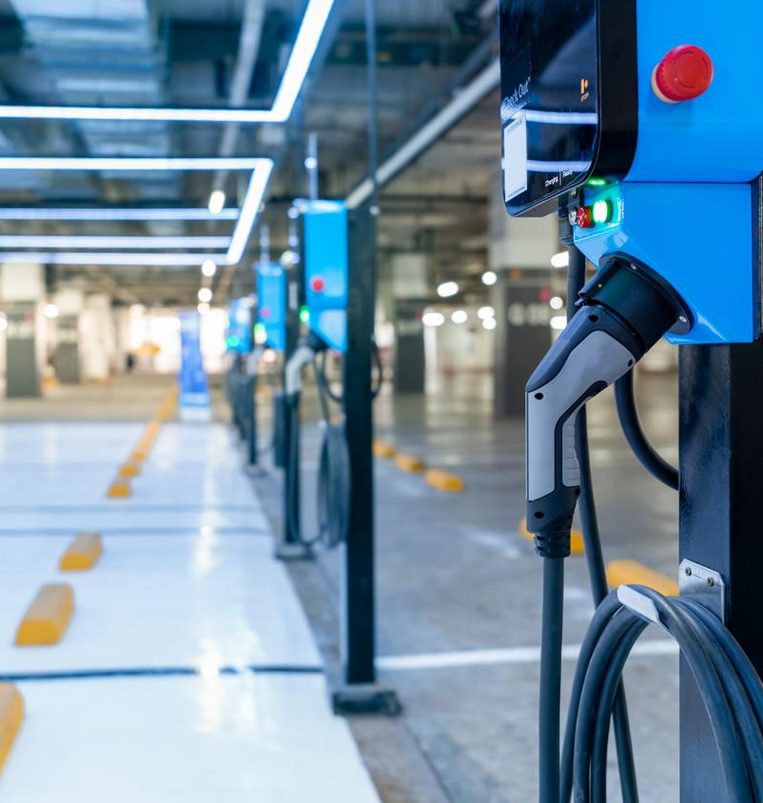
Fleets, Facilities and Fuels
Planning and implementation factors for fielding non-tactical electric vehicles on military installations
Installation Innovation Forum 2022
Association of Defense Communities
November 1, 2022

Slide 2
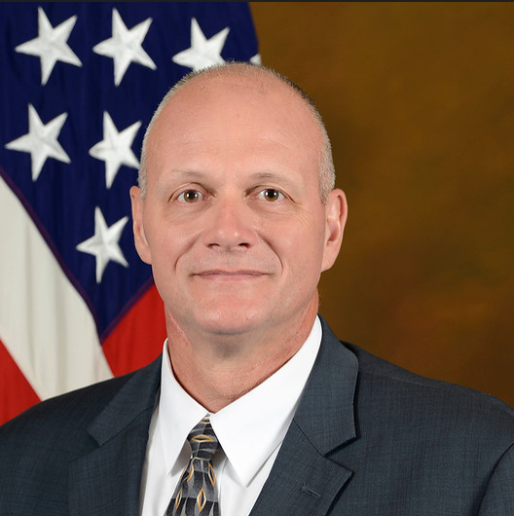

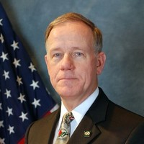







Welcome & Introductions: Ted Adair, Guidehouse
Alan
Parks
Sandy
Kline
Jim
Gough
Richard Houghton
Derek
Jones
Deputy Director, Operations
Office of Deputy Chief of Staff, G9 (Installations)
Director, Installation Resilience
Asst. Secretary of the Navy (Energy, Installations, & Environment)
Transportation Services Director
Installations & Logistics (Facilities) Headquarters
Director
CLP Federal Business Relations
(Colonel ret, USAF)
Director
Mobility Solutions
Guidehouse
Session Moderator

Slide 3

Agenda
Fleet Electrification Planning Status
  Challenges and impacts for Defense Dept. and host communities from fleet transition
  Status of strategy development underway
Strategic Implementation Factors
  Vehicle acquisition
  Infrastructure resilience
  Data interoperability
  Change mgmt.
Open Mic: Audience Q&A
  “No Regrets” Collaboration Priorities
Closing Remarks

Slide 4
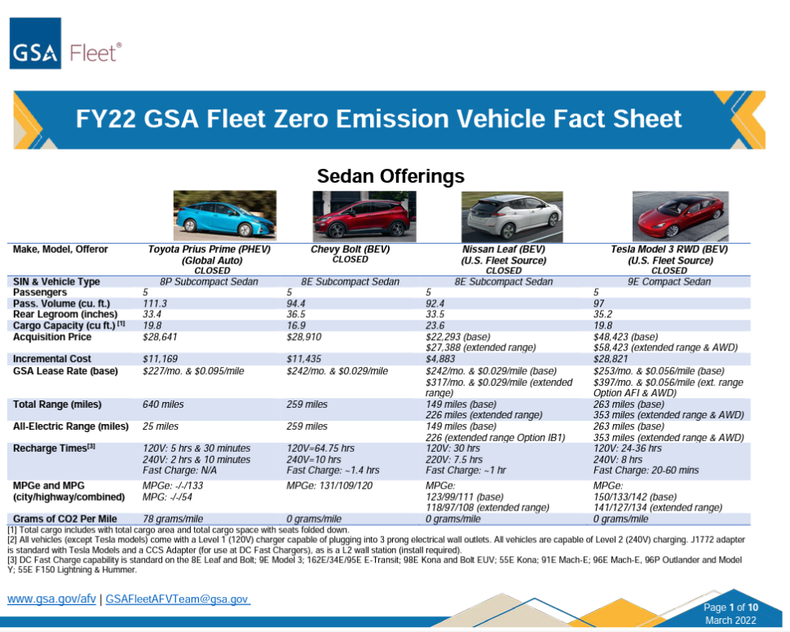
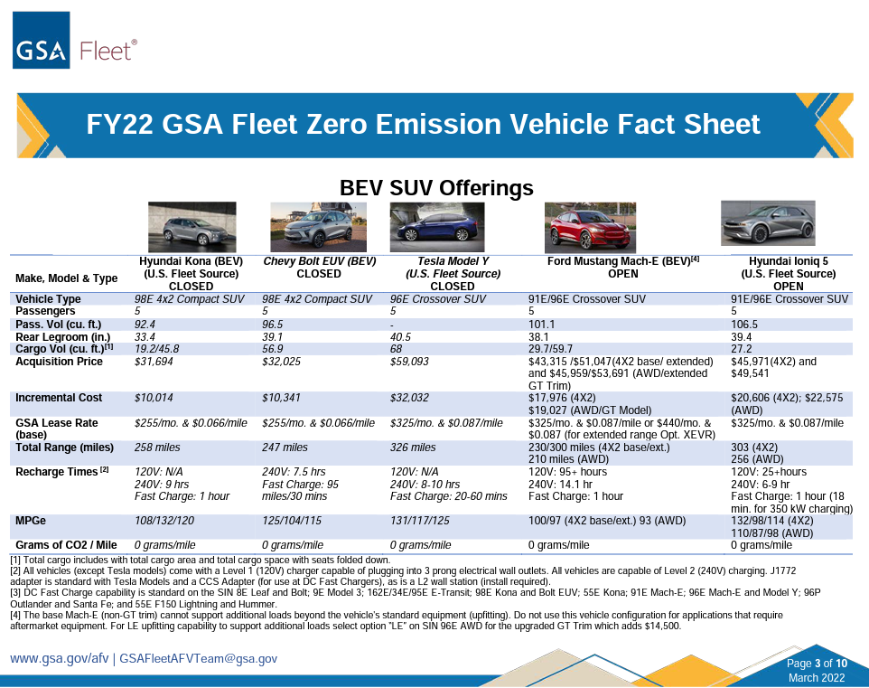
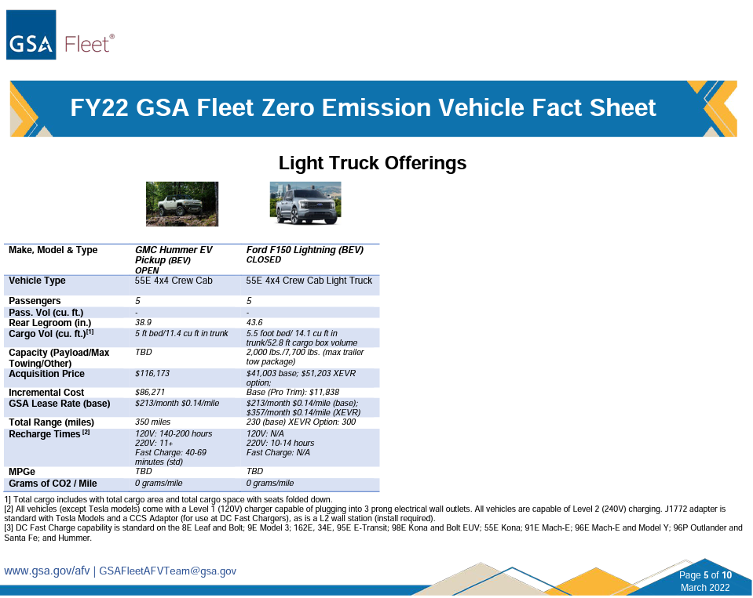
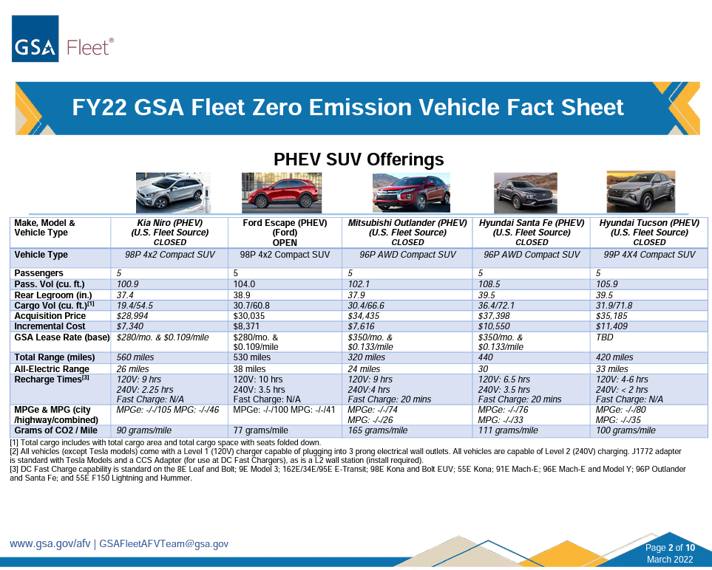

Strategic implementation
factors?
Case Study: Vehicle Acquisition
General Services Administration
Challenge:
FY22 GSA Fleet Zero Emission Vehicle Fact Sheet
GSA is working to enable optimized ZEV deployment across 75 federal agency fleets with ~226,000 non-tactical vehicles
Strategic Implementation Factors:
Procure to own vs. lease from GSA
Analyze users' mobility requirements
Future proof where
possible
Source: GSA Fleet

Slide 5

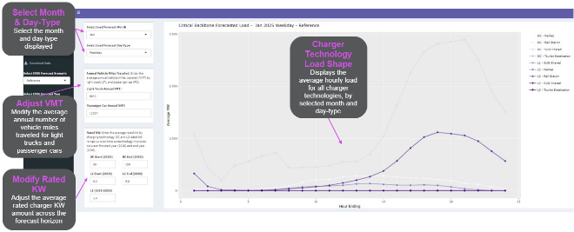
Strategic implementation
factors?
Case Study: Infrastructure Resilience
Hawaiian Electric Companies
Challenge:
HECO EV Critical Backbone Report & Web Tool
Hawaiian Electric Companies (HECO) building a “critical backbone” of charging infrastructure across each island for charging resiliency
Strategic Implementation Factors:
Full charging coverage of populated areas
Equity of access to charging
Align siting and utility upgrades with
grid loading
Source: Guidehouse

Slide 6
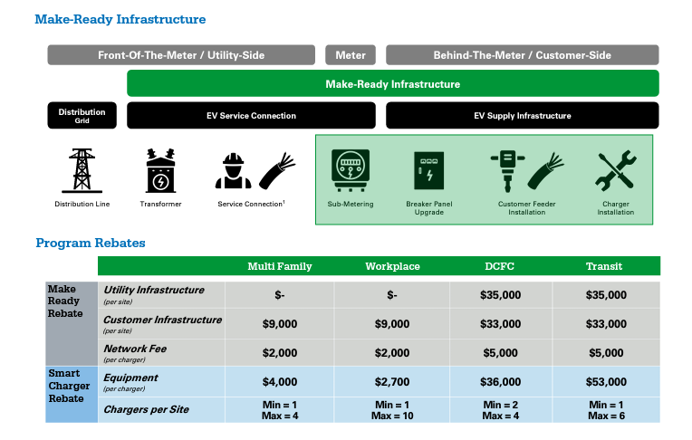

Strategic implementation
factors?
Case Study: Data Interoperability
Dominion Energy SCIP Program
Challenge:
SCIP Program Make-Ready & Network Rebates
Dominion Energy Smart Charging Infrastructure Pilot (SCIP) provides incentives in exchange for access to customer charging data.
Strategic Implementation Factors:
End-to-end data systems integration
Systematic data collection, analysis, and reporting
Site logistics planning
Source: Dominion Energy Virginia

Slide 7
Strategic implementation
factors?
Case Study: Change Management
Commercial Utility Fleet
Challenge:
Change Management Complexity vs. EV Lead Times
Fleet manager required custom solutions based on stakeholder analysis, change impacts and industry knowledge.
Strategic Implementation Factors:
Multiple methods to meet users “where they’re at”
Learn new user fueling patterns
Obtain community
support
Change Management
Class 6-8 Yard Tractors
Class 6-8 Work Trucks
Class 6-8 Bucket Trucks
Class 6-8 Digger Derricks
Class 4-5 Work Trucks
Class 2-3 Work Trucks
Class 6-8 Boom Truck Cranes
Class 2-3 Supervisor Trucks
Class 1-2 Passenger Cars
# of Units
0
6
12
18
24
36
48
60
72
EV Lead Time
(Months)
Source: Guidehouse

Slide 8
Open Mic: Audience Q&A
“No Regrets” Collaboration Priorities
How do local communities APPROACH master planning for electric and other alternative fueling infrastructure?
ZEV isn’t just electric…would your community SUPPORT on-base alternative fuel vehicles (e.g., hydrogen) with complimentary fueling in the field?
What do your communities NEED from the service branches?

Slide 9
Closing Remarks
Fleet Electrification Planning Status
Strategic Implementation Factors
“No Regrets” Collaboration Priorities
Session Description:
As governments, industry, capital providers and other key stakeholders engage in the mobility transition beyond petroleum, it is clear that impacts to infrastructure and operations are imminent. Integrated strategic planning will play a vital role in creating a more resilient infrastructure network in support of military operations. Promoting energy independence and resilience across fleets, facilities and fuels without impeding an agency’s primary mission is paramount. This panel will examine key strategic planning and implementation factors for fielding non-tactical zero emission vehicles (ZEV) on military installations today and the near future as the defense community engages in the transition.

Slide 10
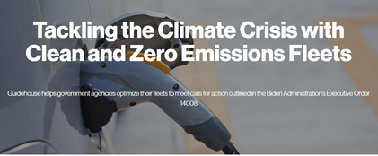
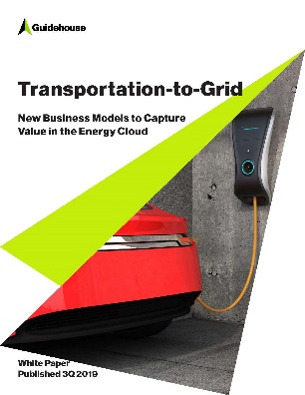

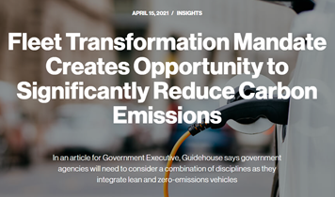
Contact
^{Ted Adair} ^{Director} ^{Growth & Strategy | Defense} ^{tadair@guidehousefederal.com}
^{Derek Jones} ^{Director} ^{Mobility Solutions} ^{derek.jones@guidehouse.com}
Learn more

