Slide 1
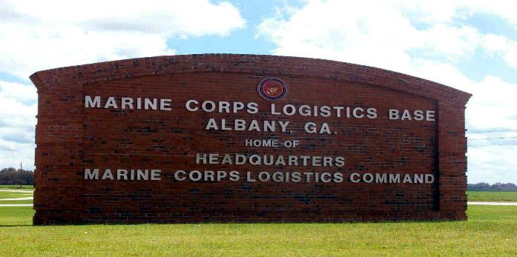
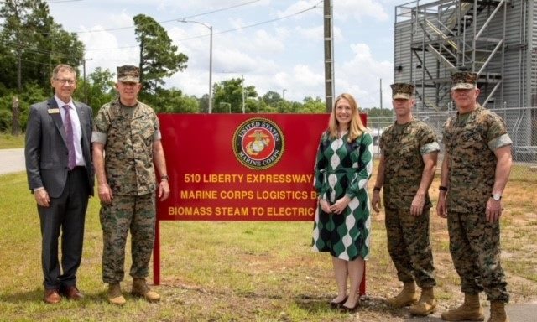
MCLB Albany
Leonard “Len” Housley
Executive Director
Marine Corps Logistics Base Albany
Leonard.Housley@usmc.mil
Office 229-639-6628
Cell 229-376-3069
Notes:
The Marine Corps Logistics Base has successfully supported the United States Marine Corps since the base was commissioned in 1952. The base has been supporting Marine Corps and DoD requirements for over 60 years and plans and preparations are always in place to continue its vital mission.
Since its establishment, the base has forged a strong relationship with the community and is well positioned to meet future Marine Corps requirements and finally….
We are the platform for the logistics hub of the Marine Corps, the Marine Corps Logistics Command.

Slide 2
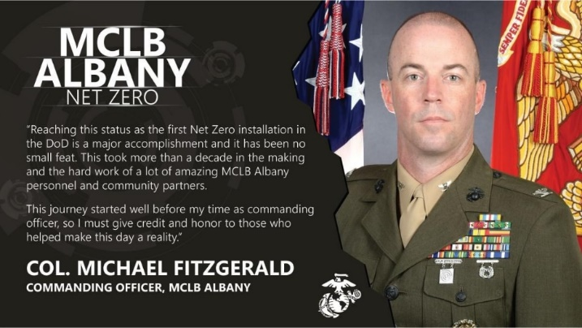
Energy Efficiency, Security, & Resiliency
On 24 May 2022, MCLB Albany became the first Net Zero “Energy” military installation in the Department of Defense; to include SMARTGRID technology.
How did we get there:
Base wide HVAC Repairs: Cost $1.42M, Annual Savings $386K
Geothermal Storage Heat Pumps: Cost $7.2M, Annual Savings $521K
Borehole Thermal Energy Storage: Cost $5.2M, Annual Savings $224K
Energy Savings Performance Contract (ESPC)1: Compressed Air/Light/Infrared Heat, Cost $14.2M, Annual Savings $1.2M
ESPC2: Landfill Gas Generator (methane), Cost $20.6M, Annual Savings $1.67M
ESPC3: 8.5MW Biomass Steam Turbine Generator, 2.1MW Landfill Gas Generator, Lighting Retrofit (100K bulbs/132 facilities), Industrial Air Compressor Upgrades (4x), Transformer Replacements(68x), Boiler Mud-Drum Install (3x), Smart Micro-Grid Controls/SCADA
Notes:
Subj: Marine Corp Logistics Base Albany (MCLBA) Energy Plan for FY23+
1. Purpose. To provide information on MCLB Albany’s plan to further pursue energy reduction, resiliency and security.
2. Key Points
MLCBA Energy Program: Began in 2005 with the goal of becoming the first DoN Net Zero Installation. Net Zero Definition: produce as much electricity from renewable “green” energy sources on or near the installation as it consumes in a year. Through a series of ESPCs and ECIPS, MCLBA is electrically Net Zero as of Feb2022.
Achievements to Date:
Base wide HVAC Repairs: Cost $1.42M, Annual Savings $386K
Geothermal Storage Heat Pumps: Cost $7.2M, Annual Savings $521K
Borehole Thermal Energy Storage: Cost $5.2M, Annual Savings $224K
Energy Savings Performance Contract (ESPC)1: Compressed Air/Light/Infrared Heat, Cost $14.2M, Annual Savings $1.2M
ESPC2: Landfill Gas Generator (methane), Cost $20.6M, Annual Savings $1.67M
ESPC3: 8.5MW Biomass Steam Turbine Generator, 2.1MW Landfill Gas Generator Controls , Lighting Retrofit (100K bulbs/132 facilities), Industrial Air Compressor Upgrades (4x), Transformer Replacements(68x), Boiler Mud-Drum Install (3x), Smart Micro-Grid Controls/SCADA

Slide 3
Energy Efficiency, Security, & Resiliency
On 24 May 2022, MCLB Albany became the first Net Zero “Energy” military installation in the Department of Defense; to include SMARTGRID technology.
Way Ahead-Continuing Efforts:
Electrical Vehicle Support Equipment (EVSE): FY22 award for FY23 execution to install electrical vehicle chargers - 39 chargers at 9 charging points.
Energy Resilience Conservation Investment Program (ERCIP): MCLB Albany will submit the following projects for the FY25 ERCIP call for projects.
1. Smart Grid Enhancement: Enhance electrical utility grid operation that will automate manual switching operations.
2. Advanced Metering Infrastructure (AMI): Install AMI meters to comply with Energy Policy Act 2005 and to improve energy consumption. Est cost $3.3M.
3. Domestic Hot Water Solar Panel Heating: Thermal system at the BEQ. Est cost $1.7M.
4. Water Hardness Treatment: Install a nano-filtration water treatment system to eliminate “hard water”. Est cost $11.5M.
GA Power 31MW Solar Photovoltaic Connection: In discussion with GA Power regarding a dedicated connection to the solar PV system.
Notes:
Way Ahead:
Electrical Vehicle Support Equipment (EVSE): Planned award in FY22 for execution in FY23 to install electrical vehicle chargers to support an all-electric GOV fleet. This consists of 39 chargers at 9 charging points.
Energy Resilience Conservation Investment Program (ERCIP): ERCIP is a subset of the Defense-Wide MILCON Program specifically intended to fund projects that improve energy resilience, contribute to mission assurance, save energy, and reduce DoD’s energy costs. ERCIP accomplishes this through construction of new, high-efficiency energy systems and technologies or through modernizing existing energy systems. MCLB Albany will submit the following projects for the FY25 ERCIP call for projects.
Smart Grid Enhancement: Further enhance the electrical utility grid operation, which will automate manual switching operations, and it will control generation so as to increase energy security, promote better load management, and lower utility costs. Cost TBD.
Advanced Metering Infrastructure (AMI): Install AMI meters to comply with Energy Policy Act 2005 and to improve visibility of energy consumption to facilitate energy conservation analysis. Estimated cost $3.3M.
Domestic Hot Water Solar Panel Heating: Install a new solar thermal system at the Bachelor Enlisted Quarters to provide heat to the new domestic hot water system. The end state is a reliable, resilient and efficient use of the solar collection system to reduce natural gas consumption. Estimated cost $1.7M.
Water Hardness Treatment: Install a nano-filtration water treatment system that will remove the calcium and zinc in the water system, thereby reducing the degradation of system components and increasing the resiliency of the water distribution system. Estimated cost $11.5M.
GA Power 31MW Solar Photovoltaic Connection: MCLB Albany is in discussion with GA Power regarding a dedicated connection to the solar PV system. The system is owned by GA Power under a land use agreement and does not supply the installation with power. This is one of GA Power’s electricity producing systems and is included in their utility rate to all customers, so there are factors/limitations that need to be considered if part of the system is to be dedicated for MCLB Abany’s use.

Slide 4
Transformation and Modernization
MCLB Albany is Marine Corps’ Pilot site for Facility Related Control Systems (FRCS) and 5G for “Smart Warehousing”.
Facility Related Control Systems (FRCS) Pilot Program:
Implement Condition-Based Maintenance Plus (CBM+) to reduce maintenance costs and predict maintenance failures before they happen.
Pilot leverages central data processing at Facility Systems Branch, Kansas City, KS implement CBM+ utilizing FRCS.
FRCS Provides smart-grid architecture to monitor facilities and industrial operations to collect, transmit, analyze and act upon reliable data.
5G Initiative—DoD selected MCLB Albany to implement a network testbed:
5G enabled Smart Warehouse technologies will improve the Efficiency, Accuracy, Security, and Safety of materiel and supply handling, management, storage, and distribution of military assets.
3 phases-System Design, Test prototypes, and Installation.
MCLB Albany Demonstration set for December 2021.
Enterprise Marine Corps Wireless Initiative:
Currently at 90% complete—will eventually transition to 5G.
Greatly enhances operations for the Production Plant and Storage Command.

Slide 5
Community Partnerships
Education
7 agreements with 6 institutions: Albany State University, Albany Technical College, Dougherty Co. Schools, Lee Co. Schools, Worth Co. Schools, and the YMCA.
Base Support
4 IGSAs with Dougherty County and the City of Albany covering canal maintenance, mosquito spraying, waste management, and utilities services.
The Intergovernmental Service Agreements (IGSAs) achieve a 50% savings to the Base from past contracts.
Police/Fire/ Medical / Emergency Response
47 agreements with multiple state, county and municipal agencies including, but not limited to: City and County Fire Departments, Sheriff’s Offices, Police Departments, Health Departments, Departments of Family and Child Services, SWAT Teams, Hazmat Teams, Canine Teams, the GBI and GA State Patrol.
Energy
Partnerships with 2 companies: Georgia Power (electrical high voltage maintenance and repair, solar farm, utility energy savings contract, and electric vehicle project); and Constellation New Energy (energy savings performance contract, bio-mass generator, air compressors, and smart grid).

