Slide 1
USAR Energy & Water Requirements
Address 50% of deficiencies at MFGIs by 2028
Increase use of other peoples’ money
Reduce utility costs
Implement 50% of energy and water evaluation (CEWE) projects using third-party financing
Shall execute cost effective CEWE projects within two years
Army Installation Energy & Water Strategic Plan
Energy Act of 2020
Efficient use of funding
IEWP Project Requirements
Other Existing Requirements
5 Installations at $20M-$50M each
~30 RD/MSC sites at $5M-$15M each
Total: $270M to $400M
Utility Infrastructure modernization
Energy and Water Efficiency
Army Climate Strategy
All-electric, non-tactical, light duty fleet by 2027
Implement installation-wide building control systems by 2028
100% carbon-free electricity for Army installations’ needs by 2030
Microgrid on every installation by 2035
On-site, carbon-free power generation for Army critical missions on all installations by 2040
Net-zero GHG emissions from Army installations by 2045
Notes:
Why are we installing microgrids? How are microgrid requirements and other requirements dictating how we train and prepare the Army Reserve workforce?

Slide 2
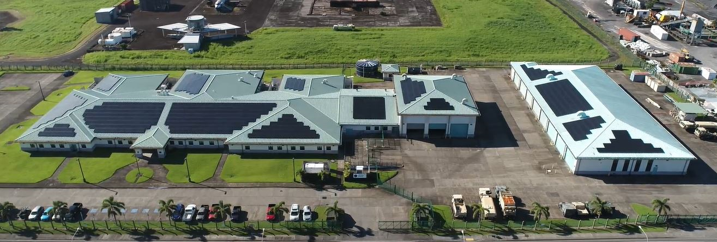
Phases of Microgrids
Pele US Army Reserve Center on American Samoa
Requirements Gathering and definition
Modeling and Simulation
2. Planning
3. Implementation
4 Operations and Maintenance
Operations
Maintenance
Decommissioning
Renewal
Commissioning
Construction
Design and Engineering
Procurement
1. Feasibility
Notes:
What Army Reserve microgrid Initiatives are on the horizon? How are workforce needs linked to the stages/phases of these microgrid initiatives?

