Slide 1
Developing the SMART Military Base of the Future
ADC Phoenix – 2022

Slide 2
SIGNAL POINT
A MOBILITIE-OWNED COMPANY
A BAI Communications Company, backed by the CPP
DEPLOYING BEST-IN-CLASS ENHANCED WIRELESS AND FIBER INFRASTRUCTURE ON U.S. DOD INSTALLATIONS
Active on over 50 DoD installations with 50 macro towers, 250 small cells, and 500 miles of fiber in flight – with plans to deploy to over 100 installations
Access to over $500M of build capital for wireless and fiber infrastructure
Signal Point has partnered with AT&T and FirstNet to deliver the Smart Military Base of the Future with Passive Telecom Infrastructure (PTI) to DoD installations AT NO COST to DoD
Build-to-Suit Macro Towers
Build-to-Suit Small Cells
Fiber Solutions
In-Building Solutions
Private
Networks
Public Safety Solutions
IOT and Smart Cities/ Bases
Venue Connectivity
ENABLING SMART MILITARY BASES
2

Slide 3
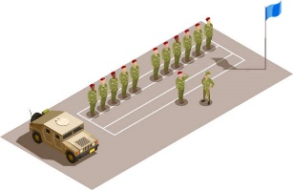
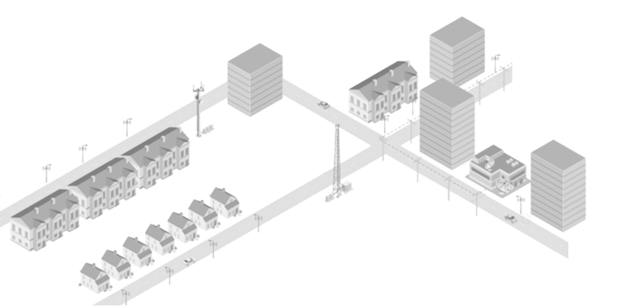
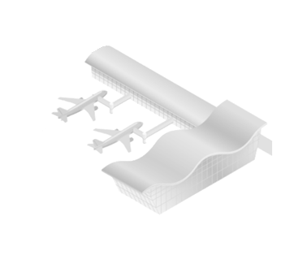
HOLISTIC CONNECTIVY
ENABLING SMART BASES
SMART CITIES
OVER $500M OF BUILD CAPITAL FOR FIBER & WIRELESS INFRASTRUCTURE
SMART BASES
TRAINING (AR/VR)
ALTERNATIVE ENERGY MONITORING
IN BUIDLING
24x7 NOC / CARRIER MEET ME
SMALL CELLS & TOWERS IN HOUSING
FLIGHT LINE OF THE FUTURE
OFFICIAL USE /PUBLIC SAFETY
BROADBAND TO THE HOME
SMART HOMES
SMART
WAREHOUSE
SMART
SHIPYARDS

Slide 4
PANELISTS
CRUCIAL INFLUENCE & GUIDANCE
LtG Michael Ferriter
Retired – Army
ASAF Terry Yonkers
Retired – Air Force
Former Installation Mgt. Command (IMCOM) Commander
Over 35 years of Service
Current CEO of the National Veteran’s Memorial and Museum
Oversite of Energy, Real Estate, Facilities, Weapons, Logistics & Infrastructure Worldwide for the USAF
Over 35 years of Services
Colonel Lou Zeisman Retired – Army
Former Commander 2nd Stryker Brigade, Fort Lewis
Over five combat tours during his 30-years of dedicated service
Colonel Scott Solomon Retired – Air Force
ATT, Chief Strategy Officer, Air Force and Space Force
Former Air Force Global Strike Command CIO
Former Commander of the 81st Training Group
Signal Point is a Board Member at NVMM

Slide 6
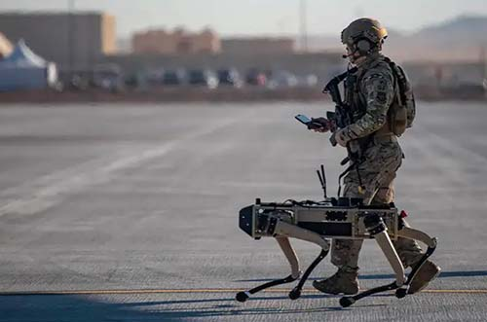
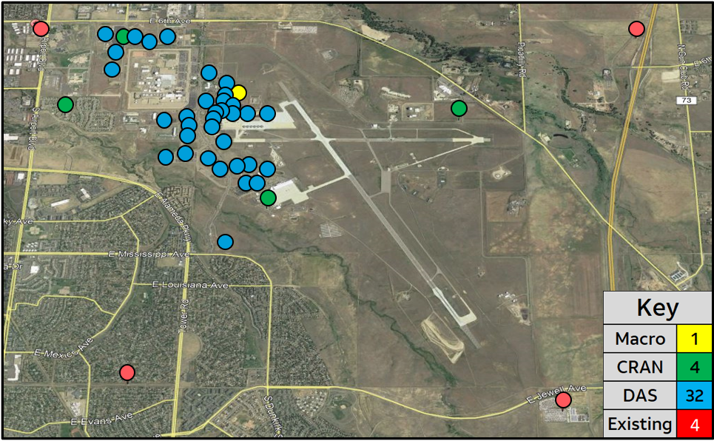
SMART Military Base of the Future
Buckley Space Force Base Update
Tailored to meet space mission needs
Expands Network as a Service (NaaS)
Blueprint for “Base of the future”
Current Status - On Air Dec 2022
Key Take Aways
Seamless end-to-end, connectivity using 5G, WiFi, and MEC to extend the Base Area Network
Wireless options for perimeter security
Smart base IOT
What We Did And Why!
Leveraged low-cost commercial solutions to modernize current base infrastructure as a foundation for expanding mission networks using 5G services
Provided High-Speed, High-Capacity, indoor wireless service in 33 Priority Buildings to meet mission needs
This new network architecture is a foundational piece of the DoD 5G ecosystem for future 5G capabilities
Positioned infrastructure to replace costly Land Mobile Radios with FirstNet services and devices
AT&T Is Pulling And Driving 5G Solutions For The DoD!

Slide 7
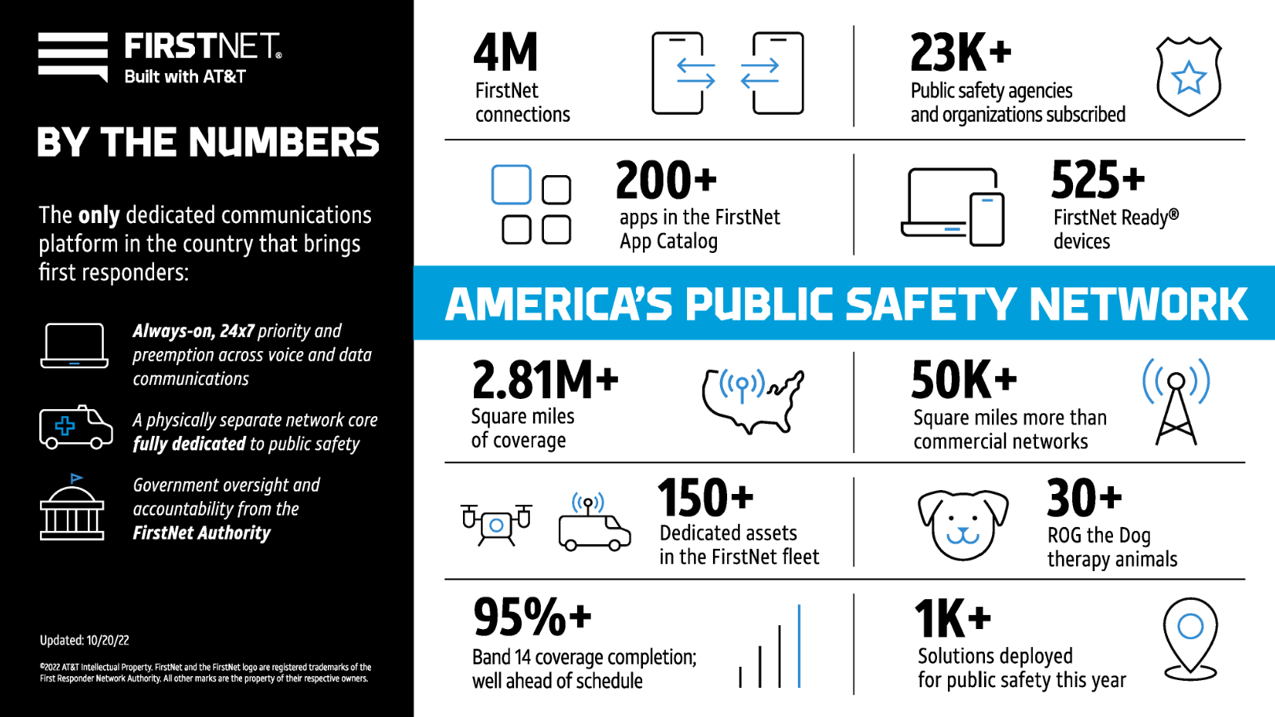

Slide 8
HOLISTIC CONNECTIVY
ENABLING SMART BASES
SMART CITIES
OVER $500M OF BUILD CAPITAL FOR FIBER & WIRELESS INFRASTRUCTURE
SMART BASES
TRAINING (AR/VR)
ALTERNATIVE ENERGY MONITORING
IN BUIDLING
24x7 NOC / CARRIER MEET ME
SMALL CELLS & TOWERS IN HOUSING
FLIGHT LINE OF THE FUTURE
OFFICIAL USE /PUBLIC SAFETY
BROADBAND TO THE HOME
SMART HOMES
SMART
WAREHOUSE
SMART
SHIPYARDS

