Slide 1
One Community
COL Chad Foster
Commander
USAG Fort Hood
The Great Place
ADC 2022

Slide 2
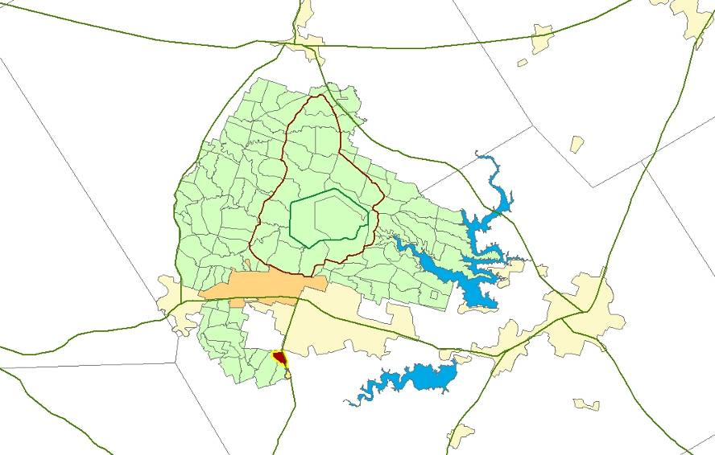
The Great Place in One Great Community
Partnered with 5 counties & 10 cities to support a ready & resilient Army.
Gatesville
Waco
Total Population Served (Actual) | 513,862
Soldiers | 35,814
On-post Family members | 13,674
Off-post Family members | 34,439
Gov Civilian Employees | 4,806
Service/Contract Employees | 6,476
Retirees, Family, Survivors | 418,653
McGregor
Coryell
McLennan
FORT HOOD
Lampasas
Copperas Cove
Killeen/Harker Heights
Belton/Temple
Burnet
Bell
Salado
45kms / 27 miles
Notes:
Q&A Notes:

Slide 3
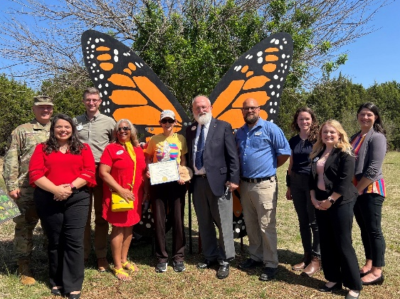
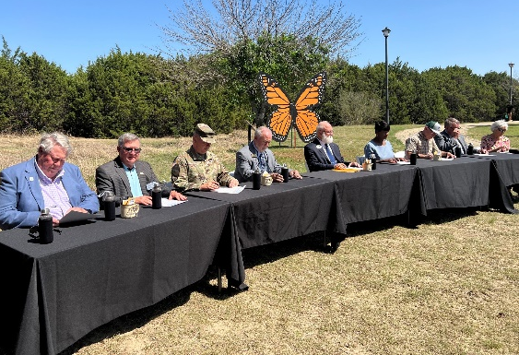
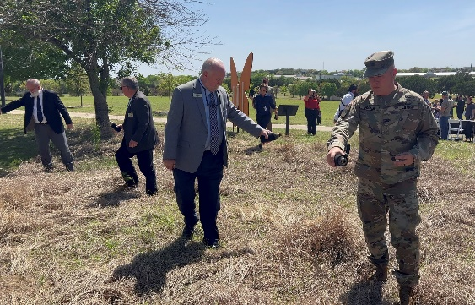
Agenda
One Great Community Achieved Through Partnerships In . . .
Education
Housing
Transportation
Emergency Management
Notes:
Q&A Notes:

Slide 4
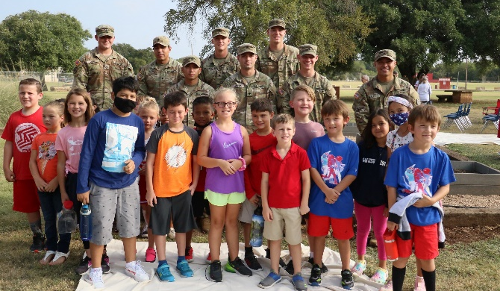
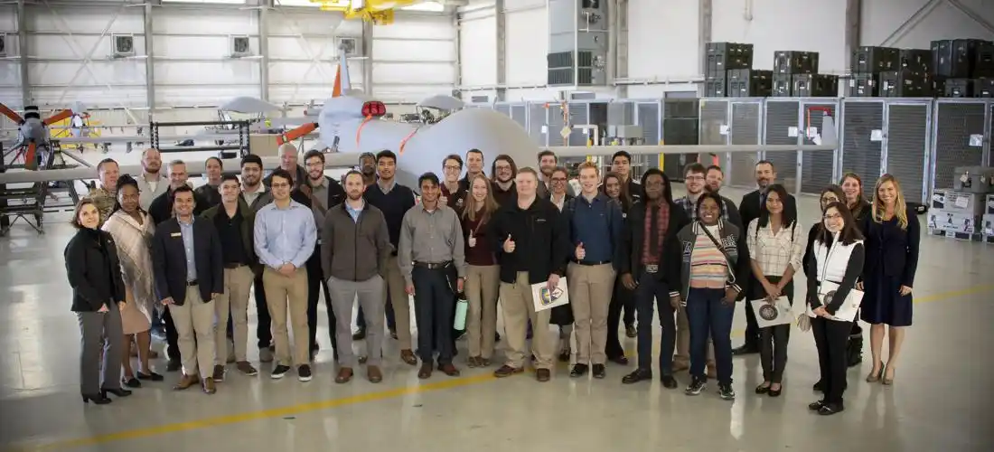
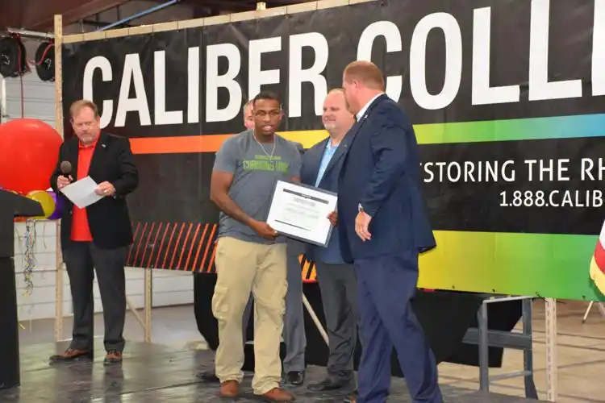
One Great Community through Partnerships
Education
One Goal: Meet the education and training needs of military connected students.
Achieved Through Partnerships:
K-12: Fort Hood partners with 9 x local Independent School Districts to address educational needs of military children.
Garrison School Liaison Officers and ISD Military Liaisons provide interaction backbone.
Adopt a School program aligns military units to 118 schools in 9 districts and operationalizes support to those schools IAW DoD 5500.7, Joint Ethics Regulations and AR 360-1, Community Relations.
College / University: 5 x academic institutions partner with Fort Hood to offer college programs and promote lifelong learning.
Transition Assistance: Fort Hood partners with Workforce Solutions of Central Texas, Career Skills Programs, and Employers to facilitate civilian job placement post military service for approximately 800 Active and 600 Reserve Soldiers per month. 74% of clients are E1-E6 and under the age of 26.
Workforce Solutions of Central Texas provides financial assistance in the pursuit of college or vocational training programs indicated by the area’s high demand occupations list with all services leading to employment for Soldiers and their spouses.
22 x Career Skills Programs provide apprenticeships, on-the-job training, employment skills training,
and internships.
Direct connection with over 4,500 employers.
Notes:
Q&A Notes:
- K-12:
# military students = 17,331 / on-post schools = 4,906, off-post schools = 12,425
# military students completing Early College High School programs in ISDs = 497
- Transition Assistance:
# Soldiers completing CSPs since inception at Fort Hood (FY14 – July 2022) = 8,271 enrolled / 7,541 completed (average of 838 per year)
# Soldiers completing internships since inception at Fort Hood (FY16 – July 2022) = 331 (average of 47 per year)
# Military spouses using Central Texas Workforce program for childcare to job training programs = Per Alan Wedding at Workforce they do not track this specific information. The workforce tracks total only – does not distinguish between military / nonmilitary.

Slide 5
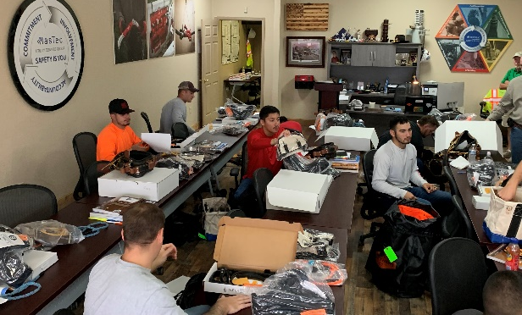
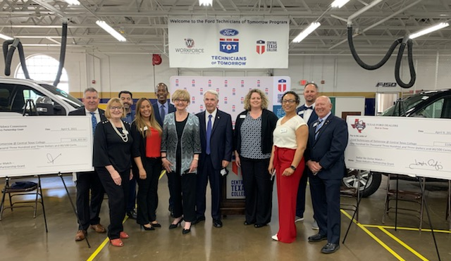
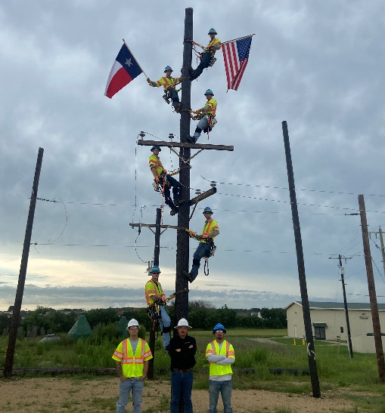
One Great Community Through Partnerships
Education – Training and Employment
Goal: Engage Soldiers and Military Families in Meaningful Employment to Retain
Them in Central Texas
Why
Veterans Inventory (HOTDA) –
In 2021: 18,344 People Transitioned from Fort Hood Annually – Active-Duty (9,780); Reserves (5,419); National Guard (3,145)
Transitioning Military Will Stay in the Area for the “Right” Job
Veterans and Military Spouses Have a Proven Work Ethic and Unique Skills Sets
Local and State Employers Recognize that Veterans and Spouses Have Skills or Can Be Trained to Meet The Employers’ High-Skills Job Demands
Results
$30,938,887 – Department of Labor and Texas Workforce Commission Funds (2003 to 2022)
$23,183,166 – Child Care Funding Assistance – Health and Human Services Funds – Funding Year 2022
8,824 Served – Transitioning Military, Military Spouses, Veterans, Civil Service Employees
91% Entered Employment Rate
Average Placement Salary - $85,000

Slide 6
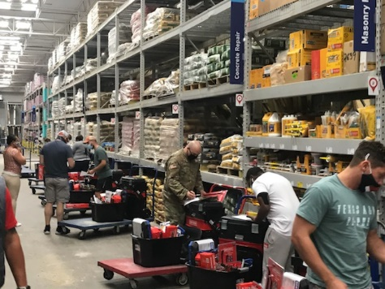
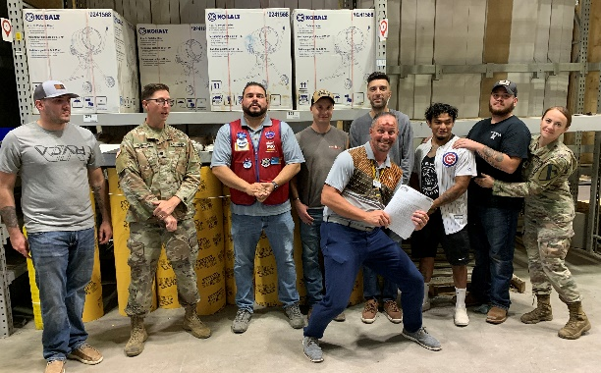
One Great Community Through Partnerships
Education – Training and Employment
What We Do
Services for Transitioning Military, Military Spouses, Veterans, and Civil Service Employees
Information About Local Jobs, Careers, and Wages
Child Care Assistance – Over 2,500 Children in Care This Year
Financial Support for Vocational Training (College Degree)
Financial Assistance for Short-Term Training with Certifications and Related Expenses – Up to $6,750 Per Person – Goal: No One Goes Into Debt Because of Transition
One-on-One Career Counseling and Guidance
Resume Prep and Job Search Assistance – Connection to Employment
How We Do It
Coordination with Transition Assistance Program
Fort Hood Liaison – Daily Onsite Presence Marketing Program - Briefings: Career Skills Programs, Executive Level Retirement, Family Readiness Groups; Community Outreach Events; Command Team Briefings
Annual Red, White, and You Veterans Job Fair – 185 Employers; 142,852 Jobs; Projected Over 3,000 Job Seekers
Streamlined Mass Enrollments
Community Resource Courses
Support for Career Skills Programs Employers and Training Providers
Membership/Support – AUSA, Chambers’ Military Affairs Committees, and Dept. of Labor’s “We Hire Vets”

Slide 7
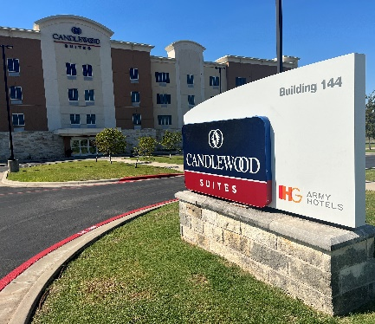
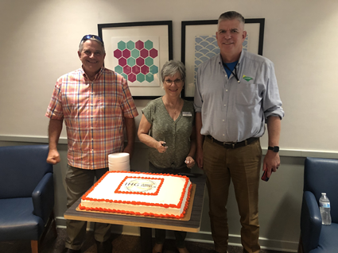
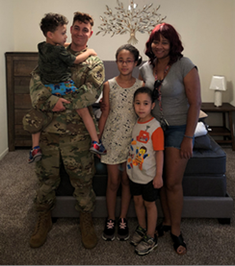
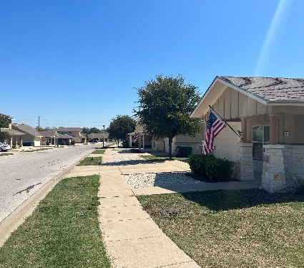
One Great Community Through Partnerships
Housing
One Goal: Affordable, proximate, and reliably available quality housing for military families.
Achieved Through Partnerships:
Privatized Army Lodging: IHG Army Hotels provide temporary lodging at BAH rates until military families find permanent accommodation at their new duty station.
Off-Post Community Housing:
80 years of partnership between the Army and Fort Hood’s surrounding communities.
House approximately 78% of assigned military families.
Military Value Program and Rental Partnership Program provide short- and long-term rental options for families awaiting on-post housing. Agreements in place with 11 owners providing over 100 properties. Average of 62 participating Service Member families per week.
On-Post Privatized Family Housing:
20 years of partnership between the Army and Lendlease. Army has 49% ownership (landowner) and Lendlease has 51% ownership (landlord).
House approximately 22% of assigned military families in 5,613 homes over 11 villages with average daily occupancy of 98%.
Resident Advisory Board and Community Life NCOs facilitate trust, transparency, and collaboration.
Notes:
Q&A Notes:
- How long can a military family stay in IHG hotels at BAH rates? ANSWER: Until permanent housing becomes available; no limit.
- What is the impact of long term stays in IHG hotels doing to availability for other military families moving to Central Texas? ANSWER: No significant impacts; the average stay in our hotels is about a month.

Slide 8
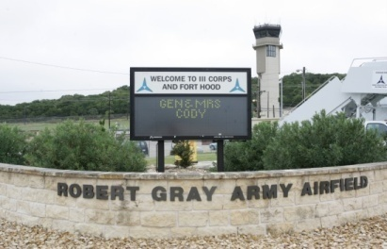
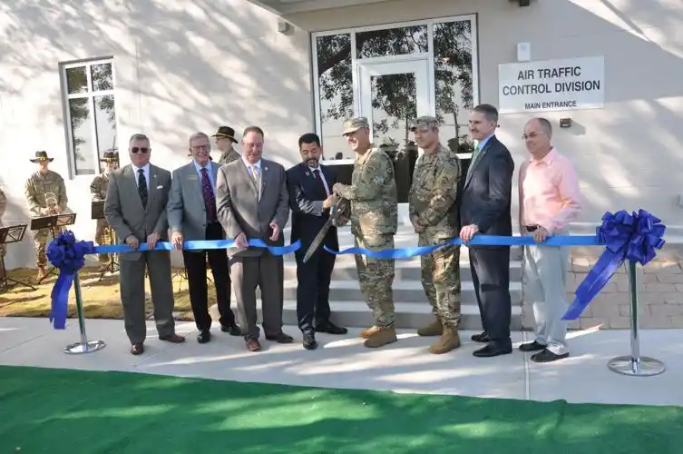
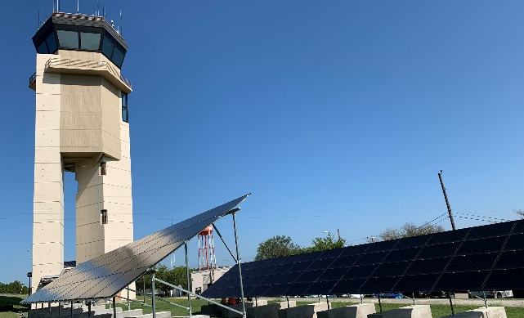
One Great Community Through Partnerships
Transportation
One Goal: Rapid and reliable movement of personnel, equipment, and material via ready and resilient transportation infrastructure and services.
Achieved Through Partnerships:
Readiness: Supporting maneuver and aviation training by controlling airspace and maintaining a regional airport capability.
2001 joint use agreement established partnership between Fort Hood and City of Killeen at Robert Gray Army Airfield. The agreement leased a 75-acre parcel of land on Robert Gray Army Airfield to the City of Killeen for a period of 50 years.
In 2018, Fort Hood entered into an Inter-Governmental Support Agreement with the City of Killeen for maintenance of pavements on Robert Gray Army Airfield.
Fort Hood provides national airspace approach control service to the entire Central Texas aviation community within a 60 nautical mile radius of Robert Gray Army Airfield. This includes Fort Hood and 8 civilian airports – Gatesville, Hamilton, Lampasas, temple, Skylark-Killeen, Salado, Briggs, and Goldthwaite.
Resiliency: Enhancing airfield safety and security by leveraging Defense Economic Adjustment Assistance (DEAAG) Grants.
In March 2016, City of Killeen partnered with Fort Hood on $5.3M project including a $4M DEAAG grant for renovation of Army Radar Approach Control Facility.
In December 2017, Bell County partnered with Fort Hood on $4.7M project including a $3.1M DEAAG grant for construction of a visual surveillance system comprised of 172 cameras.
In January 2022, City of Temple partnered with Fort Hood on $14.5M project including a $5M DEAAG grant to expand the airfield microgrid to include air traffic control, ground operations, and emergency services facilities to provide 14 days of electricity resiliency without resupply or repair.
Notes:
Q&A Notes:

Slide 9
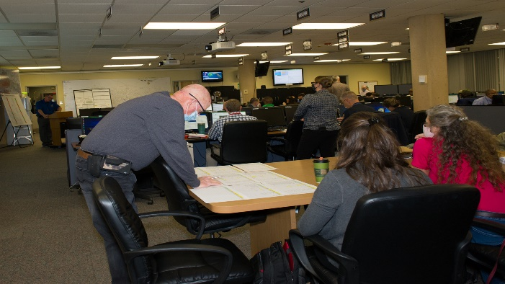
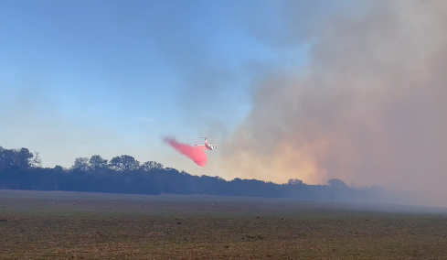
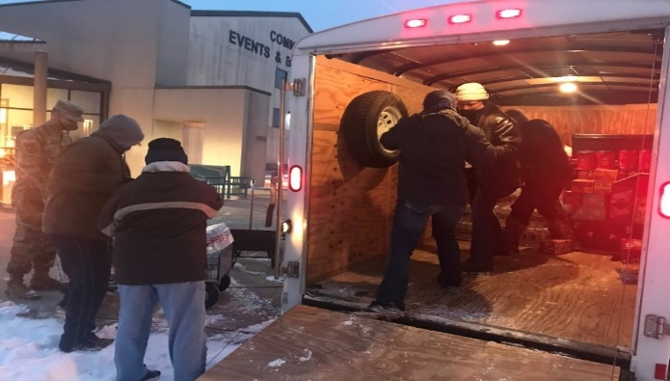
One Great Community Through Partnerships
Emergency Management
One Goal: Prevent, prepare for, respond to, and recover from all hazards impacting our community.
Achieved Through Partnerships:
Integrated Emergency Operations Center: Supporting common and comprehensive operating picture.
Central Texas Council of Governments and Homeland Security Advisory Council.
Defense support to civil authorities.
Memorandum of Agreement for remains recovery.
Mutual Aid Agreements: Protecting the public’s health by sharing information, data, supplies, resources, equipment, or personnel.
Integrated Aid: Crash and rescue support for Killeen / Fort Hood Regional and Robert Gray Army Airfield.
Automatic Aid: Fort Hood Fire automatically responds to select areas of the City of Killeen and Killeen Fire automatically responds to Fort Hood’s non-contiguous housing areas so that both jurisdictions can meet the 7-minute response time.
First Responder Support: United Services Organization and American Red Cross provide first responders with food and water during large scale incidents and wildland fires.
Joint Training: Swift water rescue, aircraft rescue firefighting, and structural firefighting.
Decision Support: Achieving unity of action through coordinated decision making.
Coordinated messaging between Fort Hood and all community entities – Speaking with One Voice.
Establish emergency and/or warming shelters ICW American Red Cross and United Services Organization.
Installation operational status decisions in consultation with Killeen Independent School District and other on/off-post partners.
Road closure decisions ICW Texas Departments of Transportation and Public Safety.
Notes:
Q&A Notes:
# Mutual Aid Agreements = 17 fire / 6 police
# Fort Hood Mutual Aid responses to Community in FY22 = 34
- # Community Mutual Aid responses to Fort Hood in FY 22 = 11

Slide 10
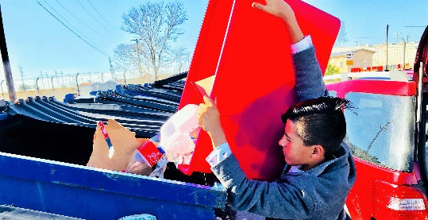
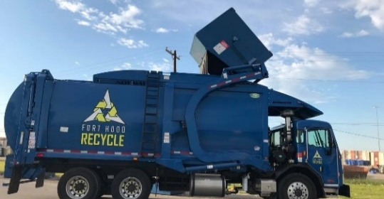
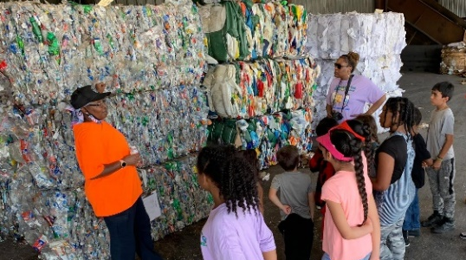
One Great Community Through Partnerships
Our Near Future . . .
Water
Pending Intergovernmental Support Agreement (IGSA) – Partner with City of Gatesville for water delivery and wastewater treatment services.
Pending Defense Economic Adjustment Assistance Grant (DEAAG) application – Back-up power system for WCID#1 District Water Plant.
Recycling
Pending IGSA – Partner with City of Copperas Cove to deliver recycle material to the Fort Hood Recycle Center, where it will be processed and sold. Profits directly benefit Fort Hood and City of Copperas Cove avoids haul costs associated with trucking their material to the Material Recovery Facility in Taylor, TX.
Transportation
Proposal – Partner with City of Copperas Cove to construct and operate a joint use rail intermodal facility located between Fort Hood and Copperas Cove.
Pending IGSA – Expand partnership with City of Killeen to perform Robert Gray Army Airfield inspections and transient aircraft ground services support.
Pending IGSA – Expand partnership with City of Killeen to provide 24/7/365 monitoring of 172 Airfield Closed Circuit TV System cameras and perform on-demand system maintenance.
Recreation
Pending land transaction – Partner with City of Killeen on construction of West Side Regional Park (east of family housing Kouma Village).
Notes:
Q&A Notes:

Slide 11
One Great Community Through Partnerships
Questions & Answers
Notes:
Q&A Notes:

