Slide 1
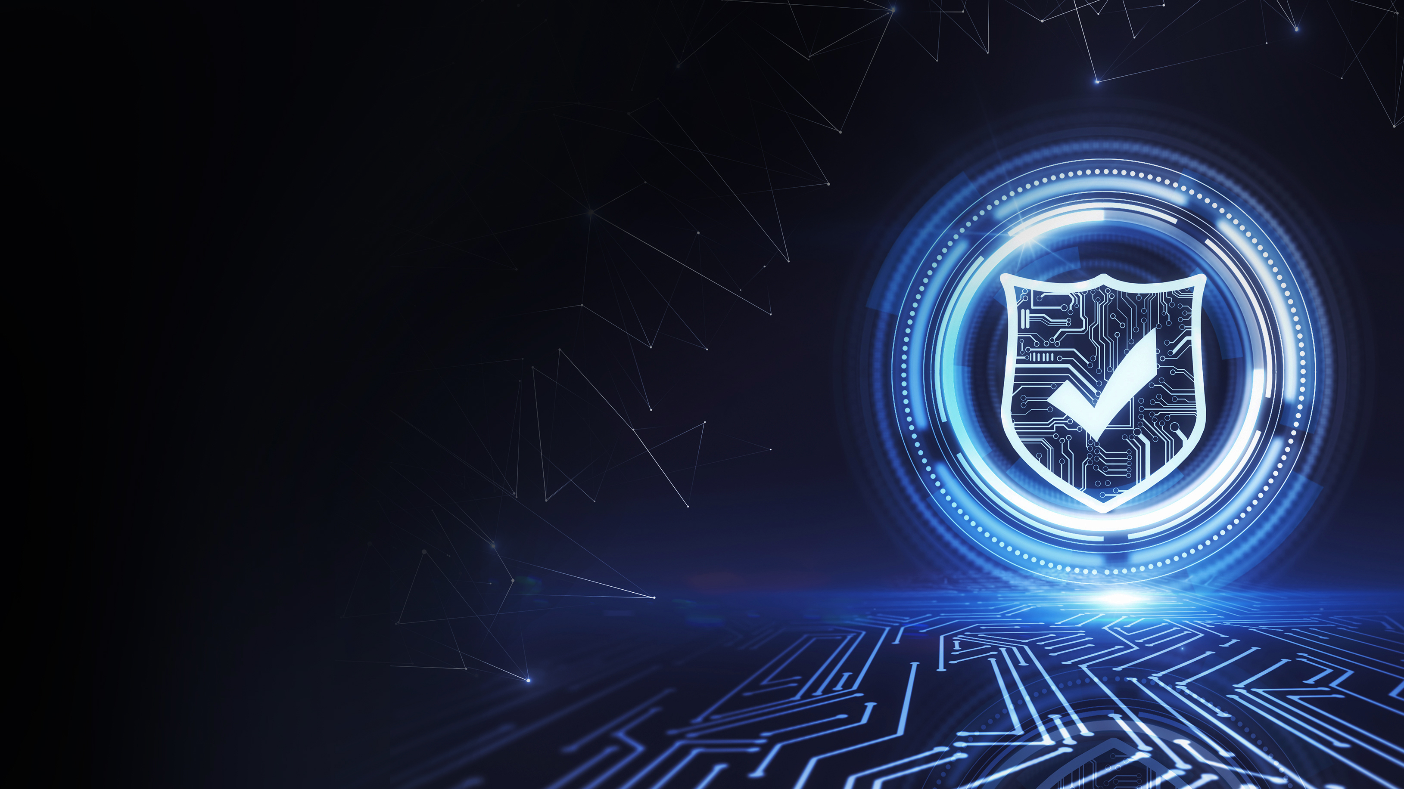
Shields Up!
Hardening Critical Infrastructure in a Connected World
Panelists:
Lucian Niemeyer, CEO Building Cybersecurity
John Kliem, Director, Federal Government Strategic Affairs, Johnson Controls
Mark McCoy, Business Development Manager, Triencon Services
Moderated by:
Fred Meurer, Meurer Municipal Consulting, LLC

