Slide 1
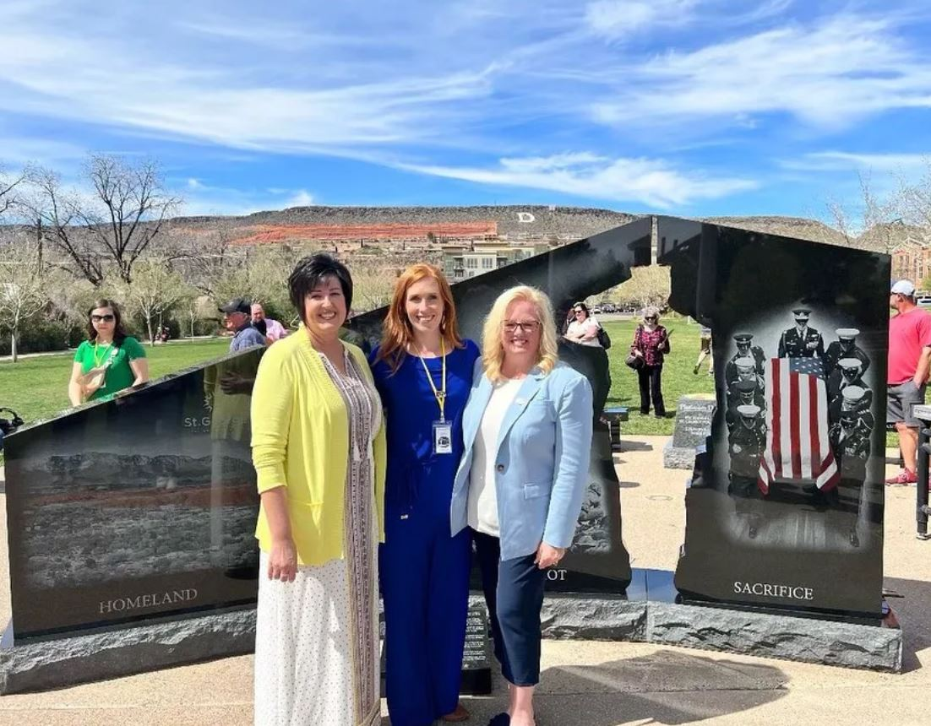
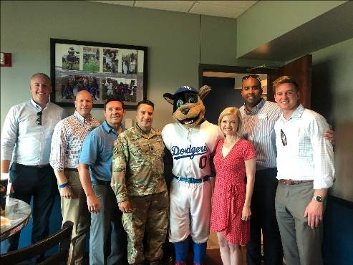
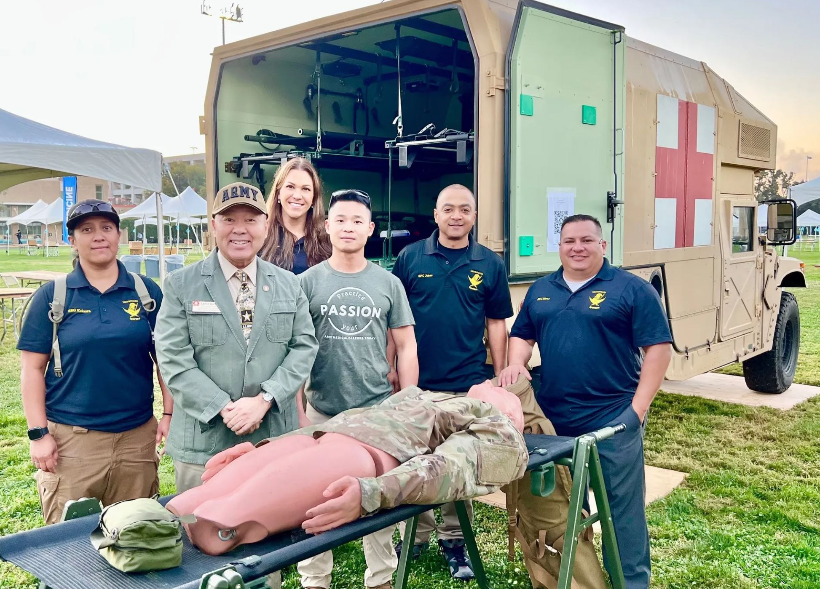
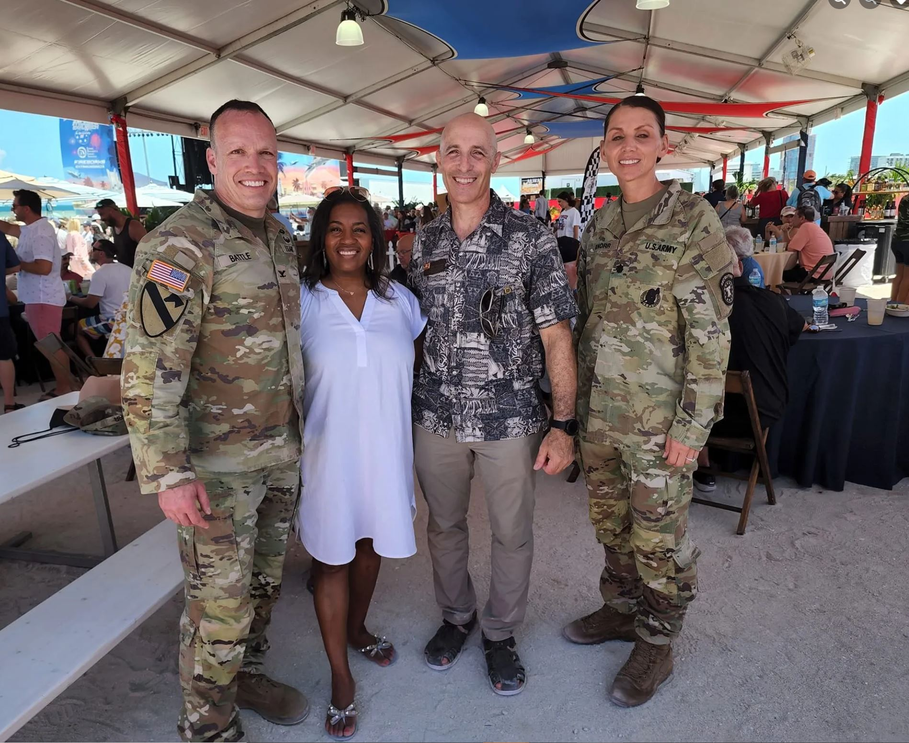
Civilian Aides to the Secretary of the Army
(CASAs): Community Connectors
ADC Innovation Installation Forum
October/November 2022

Slide 2
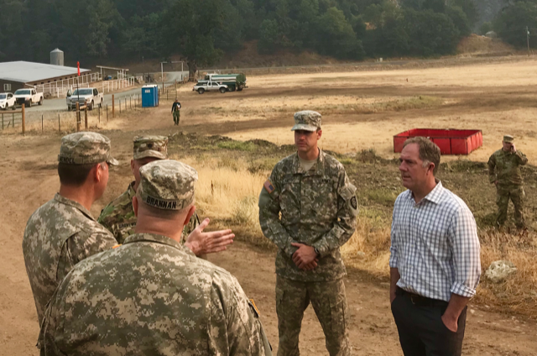
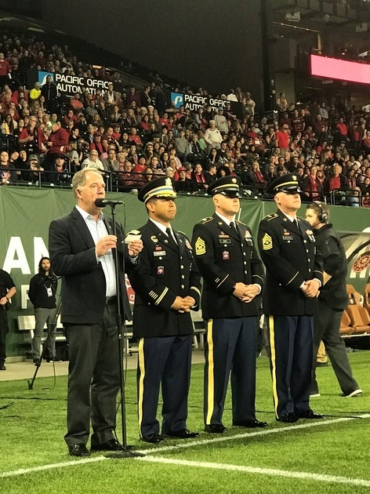
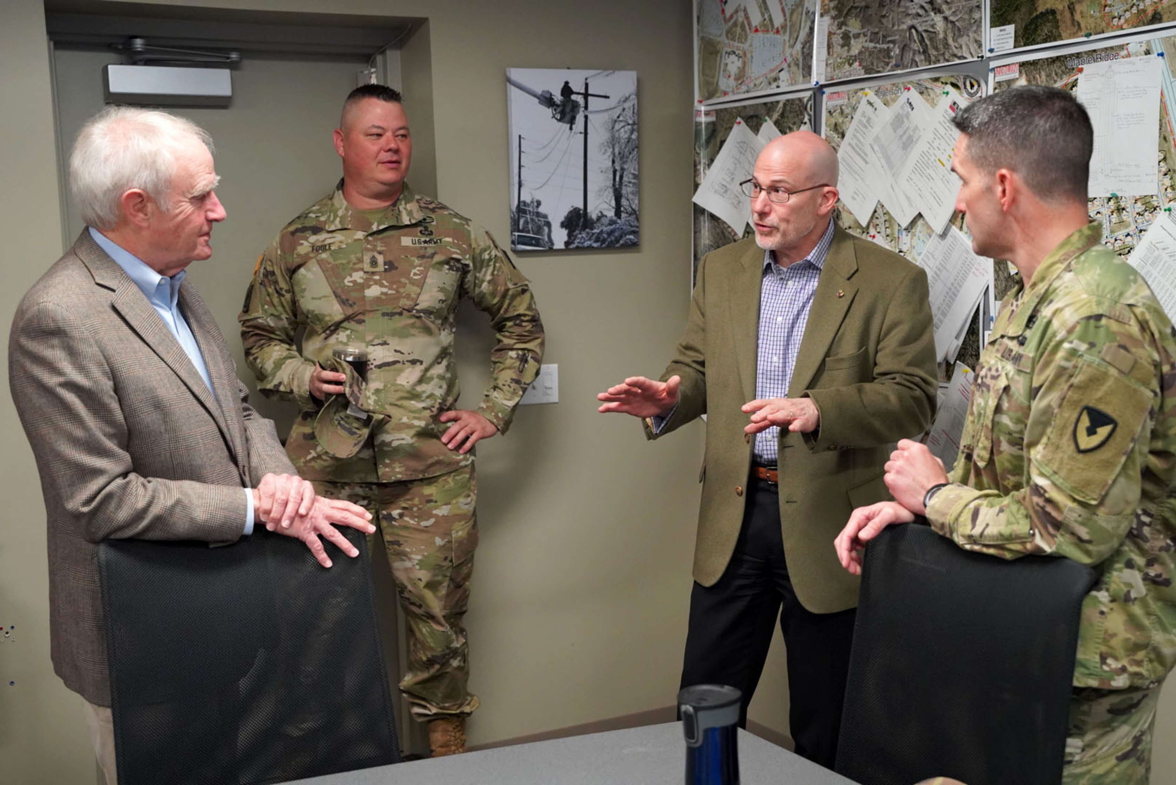
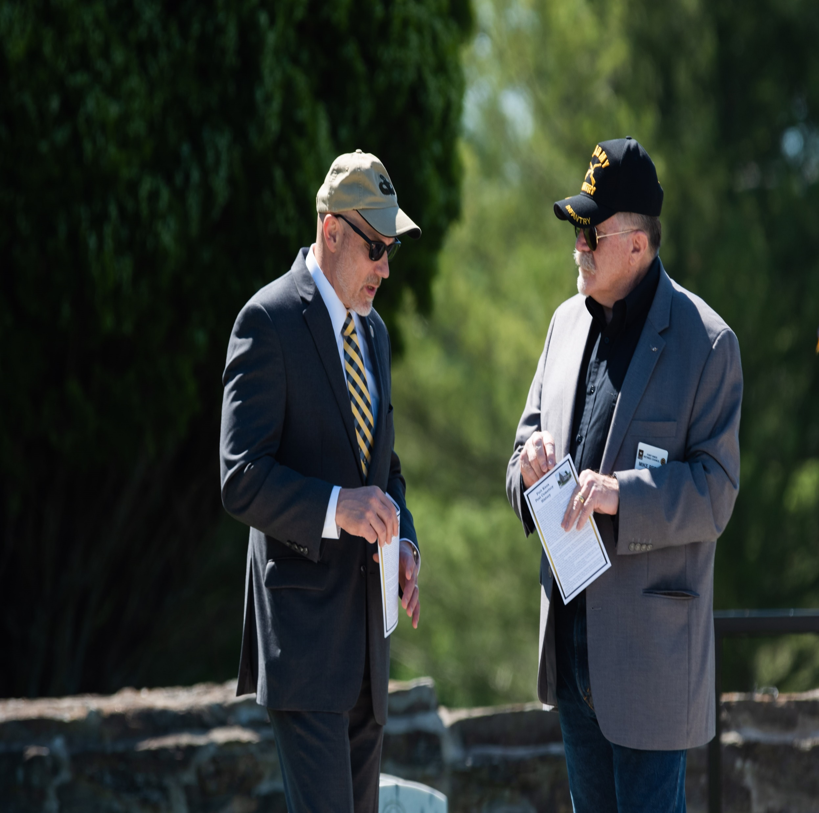
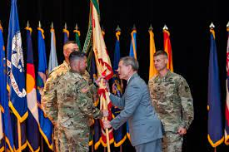
CASAs: Community Connectors Panel Moderator: Angela Ritz, Director of the CASA Program
Craig Wilhelm, CASA for Oregon
Army Veteran of nearly 14 years
SDVOSB Owner /Active in VSOs
CASA since 2017
Jim Iacocca, CASA for Kentucky (North)
Retired Brigadier General, USA
Knox Regional Development Alliance
CASA since 2020
COL Lance O’Bryan
Garrison Commander, Ft Knox, KY
since July 2021
Was Garrison Commander in Okinawa
Previous tour at Knox

Slide 3
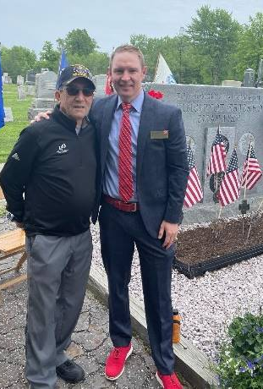
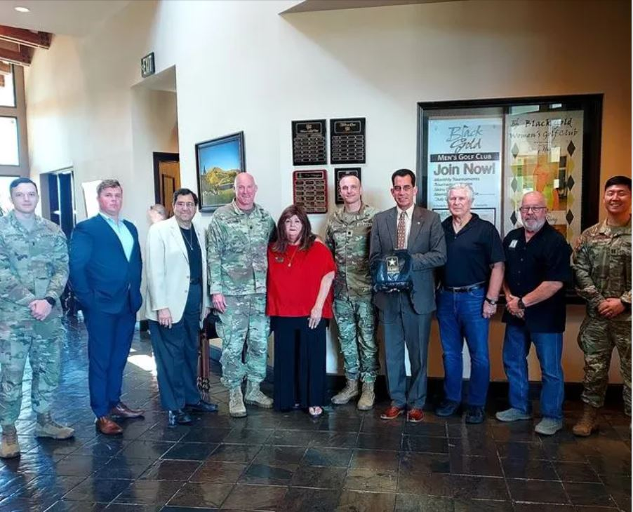
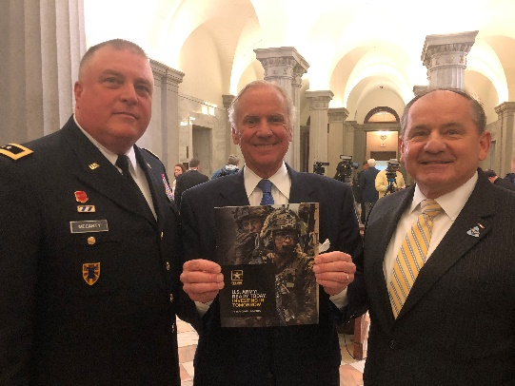
Program Overview
History:
Roots in WWI - Military Training Camps Association
Army formally recognized “Civilian Aide” concept in 1922; 100 years on Nov 28, 2022
Who they are:
Unpaid, part-time Special Government Employees (SGEs); 3-star protocol status
Community/business leaders appointed by the SecArmy for up to 10 years
122 CASAs – every state and 5 territories + 65 Emeritus (honorary title)
65% former military; 21% female; 30% non-white
What they do:
(1) Assist with Recruiting
(2) Support the Total Army
(Active, NG, Reserve, & Civilian)
(3) Help Transitioning Soldiers

Slide 4
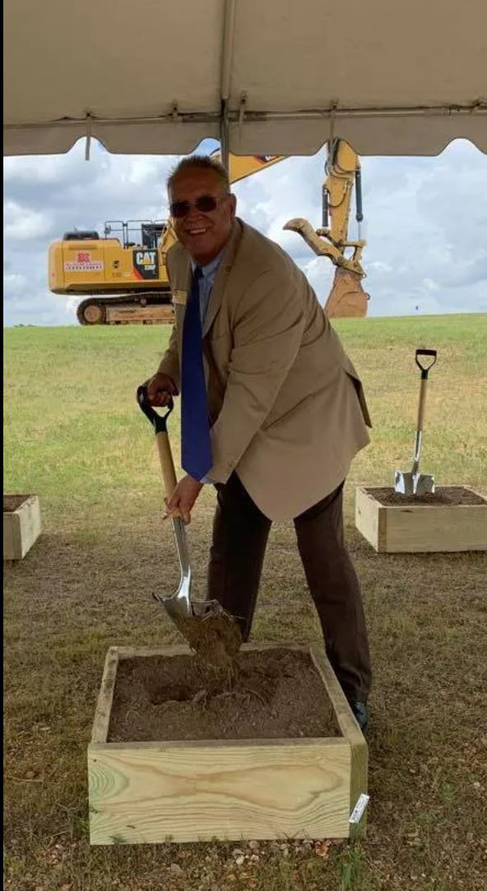
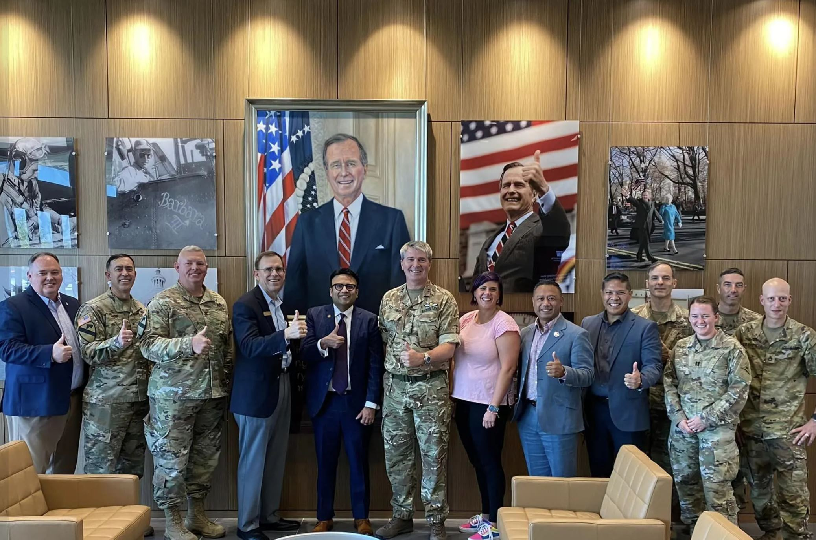
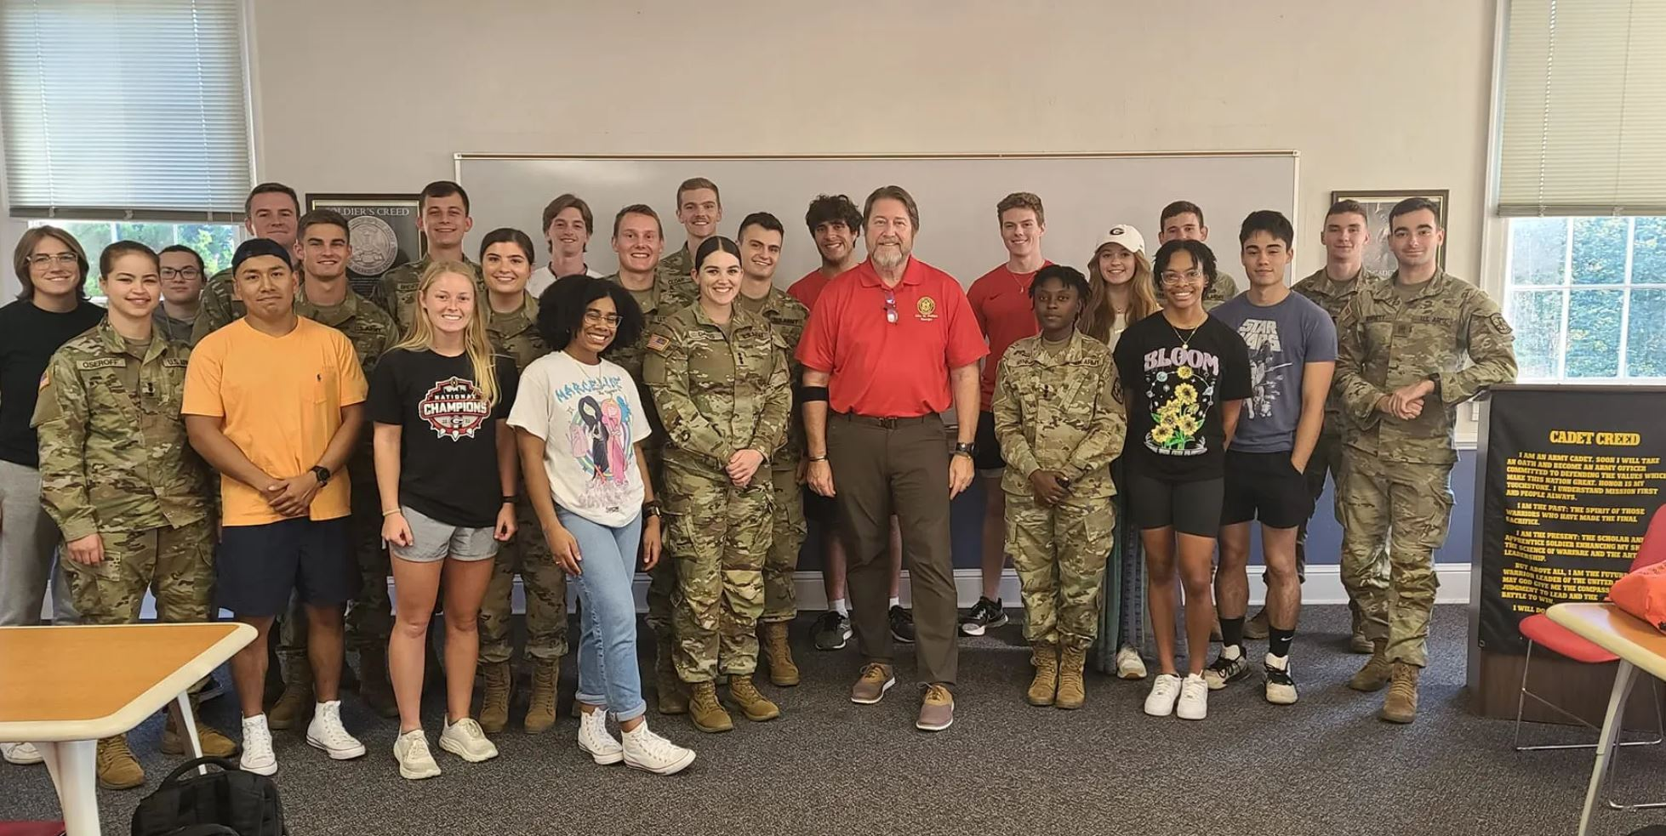
How CASAs Can Help
Connect senior Army leaders to the community
Help recruiters with access to schools
Provide strategic-level assistance to recruiters
Tell the Army Story – media, keynote addresses
Host enlistment/re-enlistment ceremonies
Help plan and execute special events – Meet your Army, Army Birthday, Hometown visits, Special observances
Nominate influencers for National Security Seminar/JCOC
Nominate students for ROTC Minuteman Scholarships
Casualty Assistance
Support ROTC/JROTC
Support senior leader visits
Support Soldier for Life
Coordinate PaYs partners
Each CASA’s strengths, availability, capability, etc. are unique, but we are here to help if you need or want

Slide 5
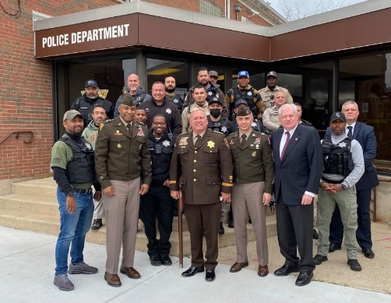
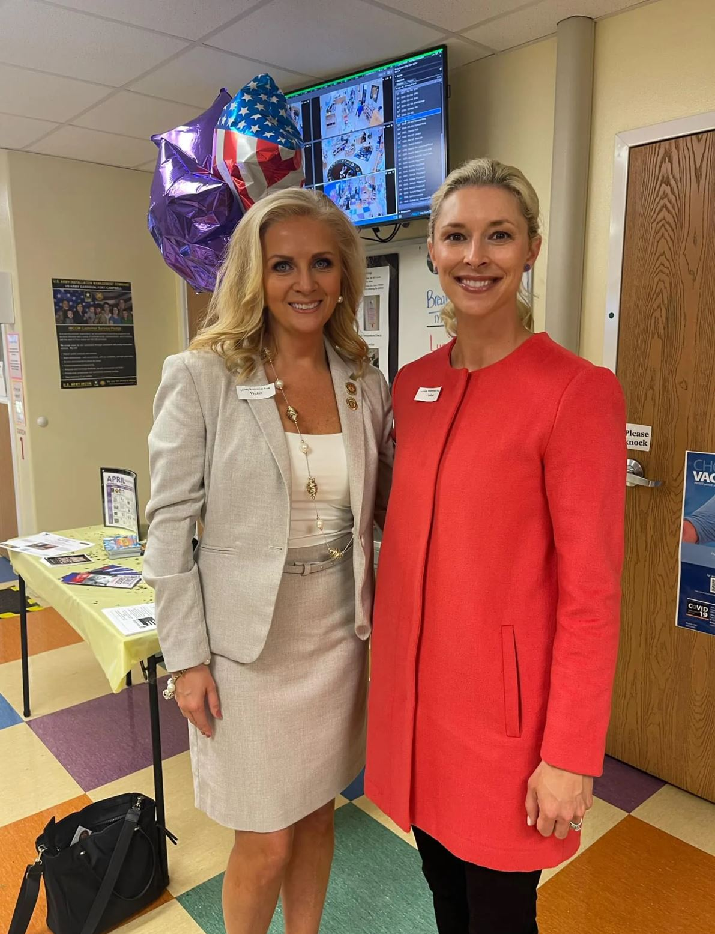
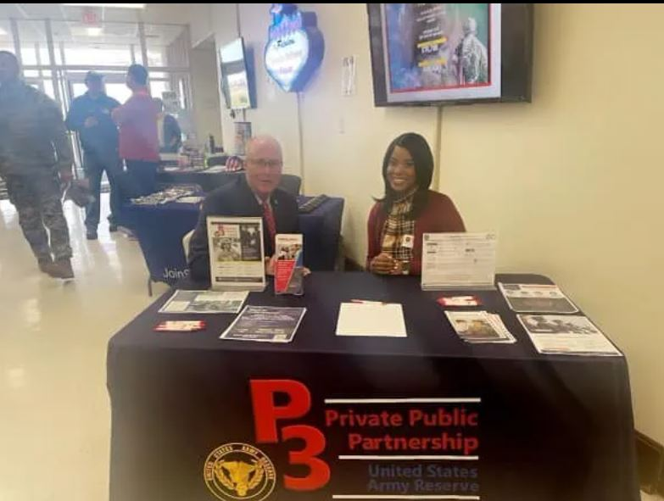
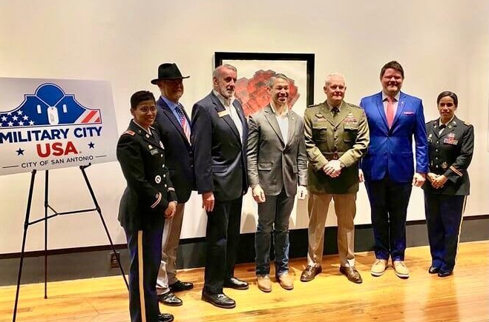
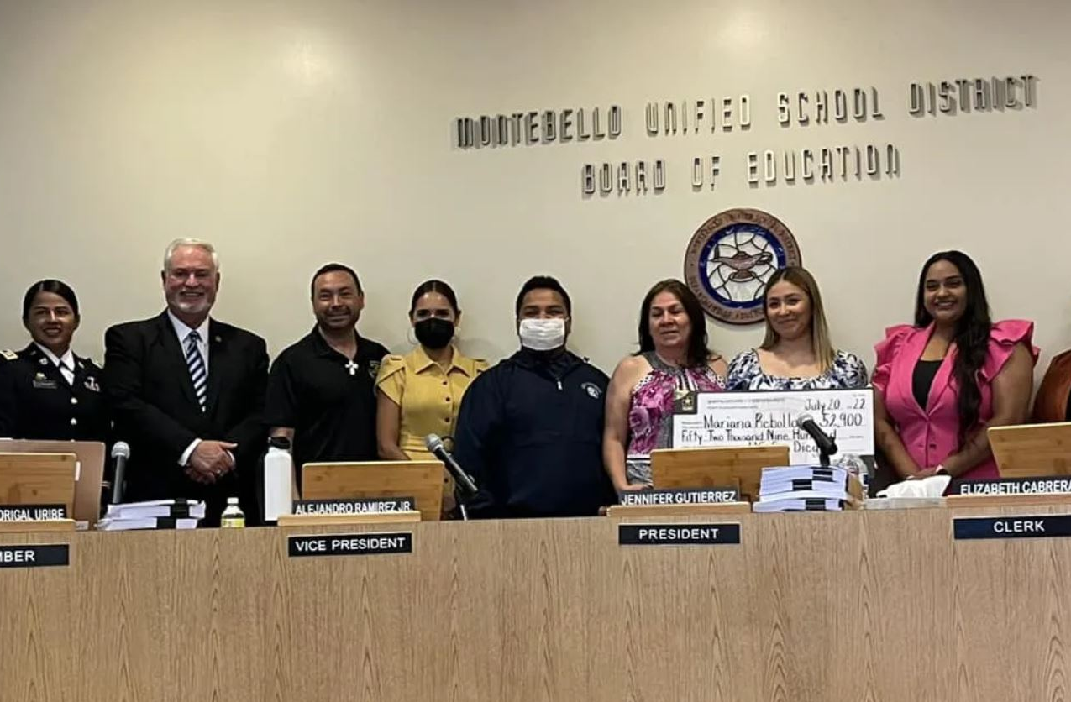
How Communities can help Connect
Connect CASAs to local VSOs and MSOs
Ensure authentic access to schools
Help us tell our Army story
Economic impact
Hometown visits
Media and speaking forums
Connect local businesses
Employ our NG/Reserve Soldiers
Sign up to be PaYS partners
Hire our transitioning Soldiers and families
Do business with the military
Embrace our Gold Star families

Slide 6
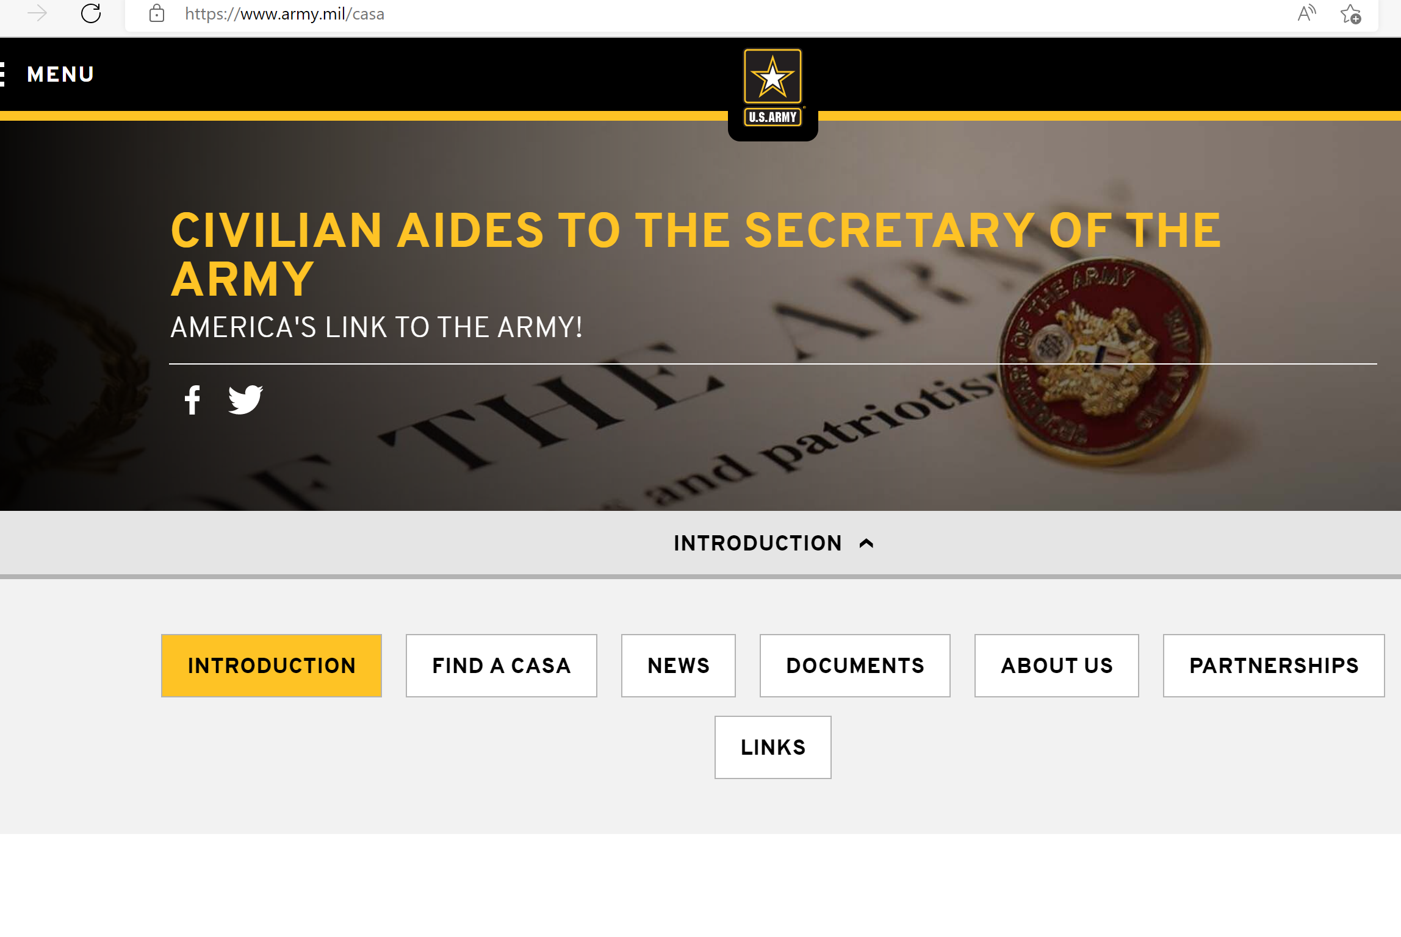
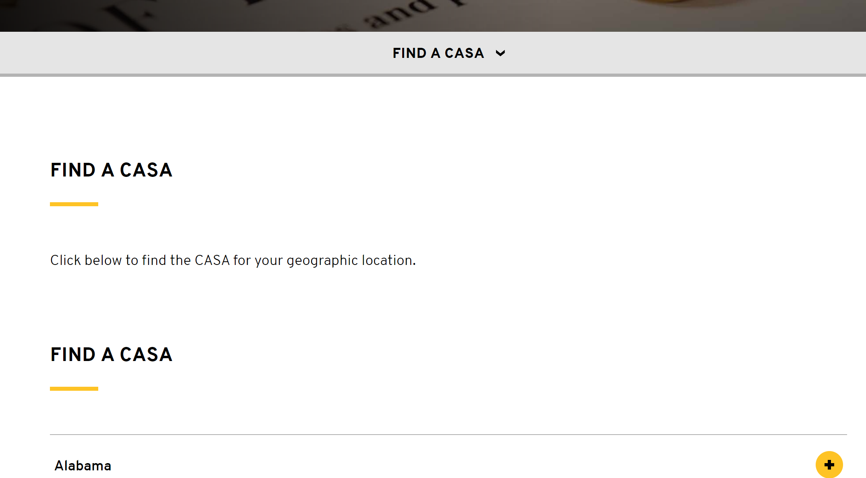
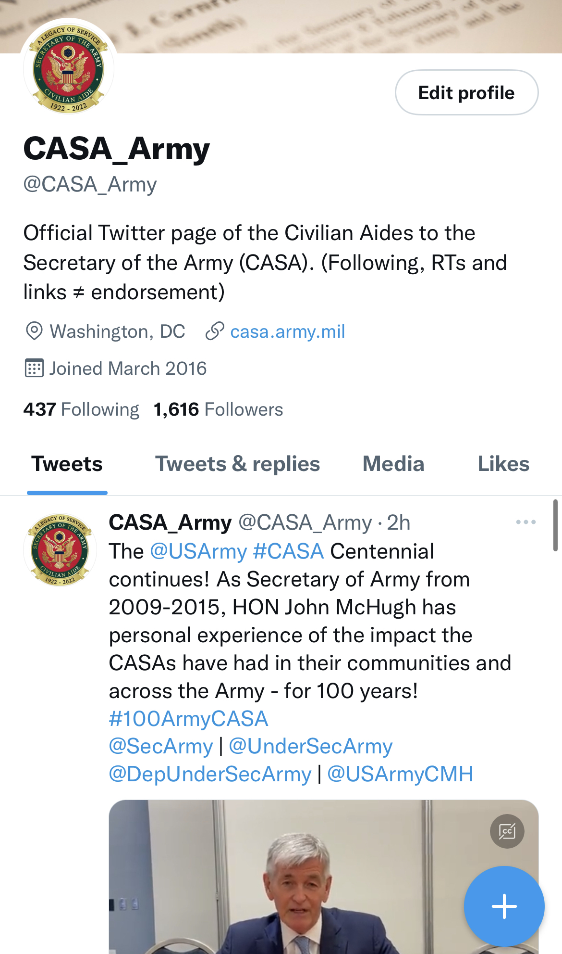
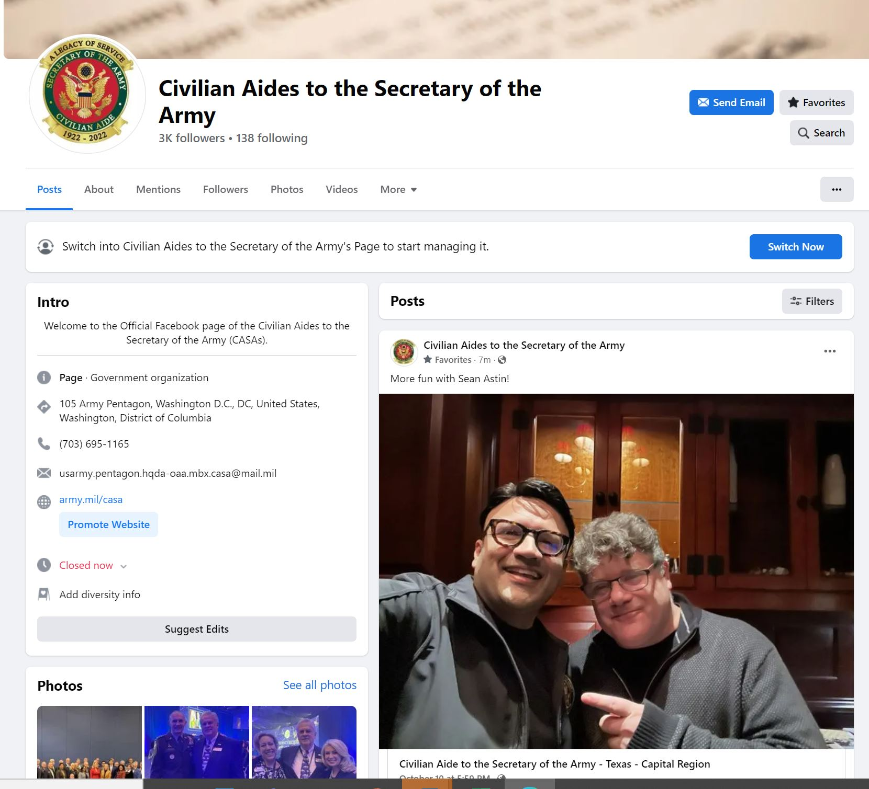
Resources
CASA Website: www.army.mil/casa
(Find a CASA)
CASA Facebook: https://www.facebook.com/CivilianAidesArmy
CASA Twitter: @CASA_Army
CASA Inbox: usarmy.pentagon.hqda-oaa.mbx.casa
Director: Angela Ritz: 703-850-3404
angela.k.ritz.civ@army.mil

Slide 7
Questions?

