Slide 1
Joint Base Lewis-McChord Uses Collaboration to Tackle Childcare
Panel Participants
Maria Tobin, Program Coordinator, South Sound Military & Communities Partnership
Colonel Phillip Lamb, Garrison Commander, JBLM, WA
Corissa Yahnke, Child & Youth Services Coordinator, JBLM, WA
Stacey K. Young, Director, Office of Military Family Readiness Policy, DoD
Kelli May Douglas, Pacific Southwest Regional Liaison, Defense State Liaison Office
Olivia Burley, Military Spouse Liaison, Washington Department of Veterans Affairs
2022

Slide 2
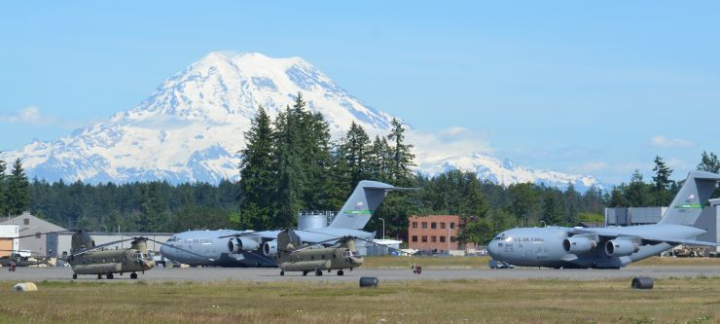
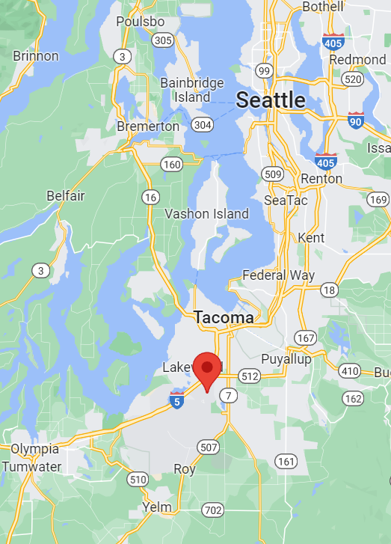
Joint Base Lewis McChord
Washington Military Installations also include:
Fairchild AFB - Spokane County
Naval Base Kitsap - Kitsap County
Naval Station Everett - Snohomish County
Naval Air Station Whidbey Island – Island County
2022

Slide 3
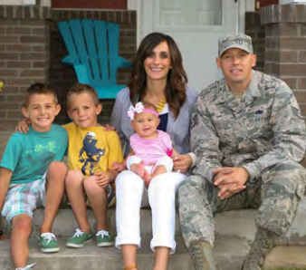
Joint Base Lewis McChord
By the Numbers
4th largest military base in the U.S.
7th most populated state in the U.S. for active duty personnel
12th highest state for cost of living
Approximately 71% of JBLM personnel reside off base
$535,000 Median housing cost in Pierce County, WA
$1,935 - 2BR median rental rate in Pierce County with a 98% occupancy
$250/month - median cost for utilities
BAH E4 and below - $2,034/month
2022

Slide 4
Joint Base Lewis-McChord Uses Collaboration to Tackle Childcare
Panel Participants
Maria Tobin, Program Coordinator, South Sound Military & Communities Partnership
Colonel Phillip Lamb, Garrison Commander, JBLM, WA
Corissa Yahnke, Child & Youth Services Coordinator, JBLM, WA
Stacey K. Young, Director, Office of Military Family Readiness Policy, DoD
Kelli May Douglas, Pacific Southwest Regional Liaison, Defense State Liaison Office
Olivia Burley, Military Spouse Liaison, Washington Department of Veterans Affairs
2022

Slide 5
A Partnership of more than 50 member cities, counties, the Nisqually Indian Tribe,
Joint Base Lewis-McChord, State, regional, corporate, and non-profit organizations
dedicated to fostering outcomes that are mutually beneficial to the South Sound region.
SSMCP focuses on the intersection of issues between local governments and the military community
2022

Slide 6
JBLM Childcare Concerns
Problem Statement
The JBLM community, both on and off base, is unable to meet Service Member and DoD workforce demand for childcare (#1 Quality of Life concern).
This leads to not only recruiting and retention challenges, but behavioral and emotional stressors, greatly impacting holistic readiness.
Waitlist (as of 14 October)
760 children on the Child Development Center (CDC) waitlist (Birth-5)
140 children on the School Age Center (SAC) waitlist (K-5th grade)
DoD Priorities for Childcare
JBLM is focused on full-day care for the highest priority patrons.
(CYS employees, single/dual Active Duty (AD), and AD with full-time working spouses)
In these top priorities, the current waitlist is:
329 CDC children; 77 SAC children
Children outside these priorities are unlikely to get a childcare offer on base.
Active Duty with part-time employed or student spouses
DoD Civilians – single/dual or with full-time/part-time/student spouses
Guard/Reserve Members not on Active Duty orders

Slide 7
Staffing Challenges
JBLM 30 SEP FY22 | CYS DIRECT CARE STAFF |  |  |  |  | CYS NON DIRECT CARE STAFF |  |  |  |  | CYS TOTAL STAFF
Center Type | Staff Authorized | Staff Onboard | Vacancies | % Filled |  | Staff Authorized | Staff Onboard | Vacancies | % Filled |  | Staff Authorized | Staff Onboard | Vacancies | % Filled
CDC | 371 | 190 | 181 | 51% |  | 61 | 48 | 13 | 79% |  | 432 | 238 | 194 | 55%
SAC | 114 | 63 | 51 | 55% |  | 25 | 20 | 5 | 80% |  | 139 | 83 | 56 | 60%
MST | 21 | 6 | 15 | 29% |  | 13 | 7 | 6 | 54% |  | 34 | 13 | 21 | 38%
TOTALS | 506 | 259 | 247 | 51% |  | 99 | 75 | 24 | 76% |  | 605 | 334 | 271 | 55%
Staffing Levels are the key driver of limited childcare spaces
JBLM is currently able to offer 60% of its space capacity due to staffing levels
Factors Impacting Staffing Levels
Funding in High Cost Areas
Workload demand – high EFMP population; behavior/resilience challenges
Recruitment and Retention Incentives
Priority waitlist placement
Childcare discount for CYS employees
Hiring bonuses
Built-in training and career advancement opportunities
Flexible, Part-time, and Full-time options available
Transferability of the career as Military Families PCS

Slide 8
Working Together to Provide Quality Child Care for Military Families
November 1, 2022

Slide 9
The Military Child Care System
The Military Child Care Act of 1989 revolutionized the military child care system into a model for the nation based on the tenets of:
Quality through National Accreditation and rigorous oversight.
Affordability with fees based on Total Family Income.
Availability for all ages with various care options.
The Department oversees the country’s largest employer-sponsored child care program: 160,000 children annually (birth through 12 years old) through:
Military child development centers serve birth to 5 year olds.
Military-certified family child care homes serve birth to 12 year olds.
Military school-age care programs serve 6 to 12 year olds.
Community–based Fee Assistance serves birth to 12 year olds.
Working Military families/Child Development Program staff are highest priority for care.

Slide 10
Challenges and Initiatives
Challenges
Installation-based capacity shortfalls in specific locations
Staffing shortfalls
Local community child care capacity shortfalls
Overall, meeting the child care need is complex with no single solution
Initiatives
Military Child Care in Your Neighborhood-PLUS Initiative.
Expands eligibility to providers who are participating in state child care quality rating and improvement system.
In-home child care fee assistance pilot.
Fee assistance for in home providers such as nannies.
Child Care Installation Innovation Pilots.
Installations submit proposals for funding to pilot creative solutions to improve staffing, utilization, and capacity.
Notes:
MCCYN is our community-based fee assistance program- buys down the cost of care for military-connect families in approved civilian child care program. Child care programs must be state licensed, inspected annually, conduct employee background checks, and Nationally accredited by a DoD approved accrediting body. Because less than 15% of cilivilan child care providers are accredited- we piloted MCCYN-PLUS which utilizes the states child care quality rating and improvement system as the quality indicator in leiu of national accreditation. This expands the pool of eligible providers to participate in fee assistance. The p8ilot was successful in MD and VA. So we’ve removed the “pilot” label and are working on partnering with other states to join this effort. This will be discussed at the next Council of Governor’s session on 28 Jan to potentially include in their official list of approved efforts. The First Lady’s Joining Forces initiative is very interested in this effort as well. This impacts the level of quality for not only our military families but families outside of the military.

Slide 11
Defense – State Liaison Office
Association of Defense Communities IIF November 2022
Kelli May Douglas

Slide 12
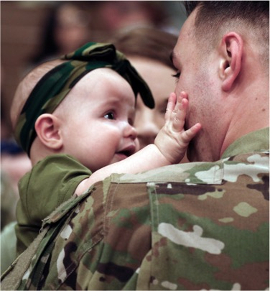
DSLO: Who We Are and What We Do
The Defense-State Liaison Office (DSLO) was established by the Under Secretary of Defense (P&R) in 2004.
DSLO Mission:
Alleviate barriers as a result of military life
Harmonize differences in state and federal laws
The DSLO works with Defense Department leaders and other stakeholders to choose key issues to focus on each year, based on a comprehensive study of potential key issues. Considerations:
Importance/relevance to DoD and the military departments
Feasibility of the majority of states to approve policy
Necessity to address through state policy
In the past decade, we've worked with state policymakers who have enacted over 1,000 policies that make life better for the military community.

Slide 13
2023 DoD Key State Policy Issues (QoL)
Enhanced Military Spouse Licensure Portability
Military Spouse Occupational Licensure Access
Licensing Compacts
Purple Star Schools Program
Licensure Exemptions for Military Family Child Care Providers
Open Enrollment Flexibility
Military and Family Life Counselor Licensure Waiver
Child Abuse Identification and Reporting
Concurrent Juvenile Jurisdiction
Defining Armed Forces in State Policy

Slide 14
Licensure Exemptions for Military Family Child Care Providers
Family Child Care (FCC) providers offer military families 24/7 personalized care in a homelike setting, on and off installations.
87% of FCC providers were military spouses (FY 2021).
Certification granted upon completion of the required home inspections.
Services need ~1400 FCC providers to meet needs. Currently have ~700
States require licensure for off-installation FCC providers — which is duplicative of the military service FCC certification process
Delays provider from providing child care, which is harmful to a military spouse and family who would have otherwise received child care.
States can enhance the quality of life and economic security of both the FCC provider and military families seeking qualified child care options by exempting FCC providers already certified through the military service process.
Notes:
Best Practices
Alaska provides for exemption from state child care requirements4 for “a facility located on a United States Department of Defense or United States Coast Guard installation that is located on federal property, or a facility certified as a family child care provider by a branch of the United States Department of Defense or by the United States Coast Guard;”
Oklahoma SB 1286, Section 403.A.17., amended the Oklahoma Child Care Facilities Licensing Act such that it does not apply to “A program on a military base or federal property, or a facility licensed as a family child care provider by a branch of the United States Department of Defense or by the United States Coast Guard.”

Slide 15
Working with state policymakers to support
military families
The Defense-State Liaison Office stands ready to assist your efforts to improve the quality of life for military Service members and their families.
For additional information, visit statepolicy.militaryonesource.mil

Slide 16
Mission: “Serving those who served” by serving military spouses
Vision: Every military spouse in the State of Washington is empowered and supported on their journey to fulfilling their needs and finding meaningful employment

Slide 17
Washington state military family child care supports
Military Spouse Listening Sessions held across the State in 2019 with WDVA and Washington State Employment Security Department.
Military Spouse Liaison is legislatively mandated to examine barriers and provide recommendations to assist spouses in accessing high quality child care and developing resources in coordination with military installations and DCYF to increase access to high quality child care for military families.
Military Spouse Liaison is appointed as a councilmember on the Washington State Early Learning Advisory Council to represent military families’ child care needs.
MCCYN-PLUS expanded to Washington in February 2022. Washington State DCYF communicated with entire network of 3,900 Early Achiever Child Care Providers (State QRIS system providers) about the launch and participates in ongoing collaborations.
Washington Military Family Child Care Resource Directory publication planned for Dec. 2022 to include programs/resources to support military child care.
The Washington State Military Family Child Care Workgroup launched in 2021 and has published a report quantifying the military child care need in our State along with a set of recommendations.

Slide 18
WASHINGTON STATE MILITARY FAMILY CHILD CARE WORKGROUP
A collaborative effort between Federal, State, Service Branch, Installation, Nonprofit, Corporate partners and others to address the military child care need in Washington.
Department of Defense
Washington State Department of Veterans Affairs
Washington State Department of Children, Youth, & Families
Installation Leadership for all Major Installations in the State
Installation Child and Youth Program Leaders for all Major Installations in the State
Service Branch Representatives
Child Care Providers
Military Families
School Districts
Nonprofit Organizations Offering Child Care
Economic Development Organizations

Slide 19
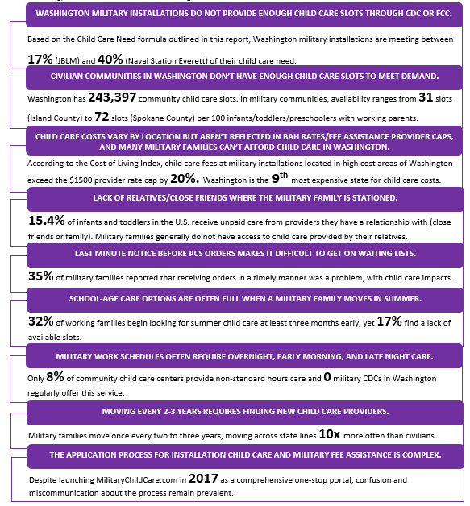
BARRIERS TO CARE

Slide 20
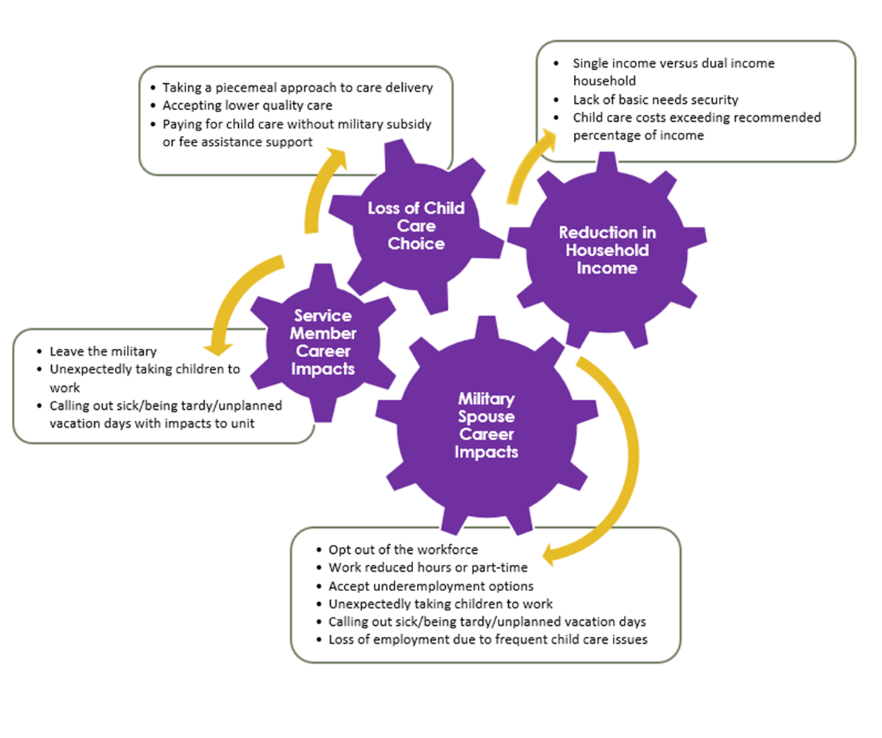
IMPACTS FROM LACK OF CHILD CARE AVAILABILITY

Slide 21
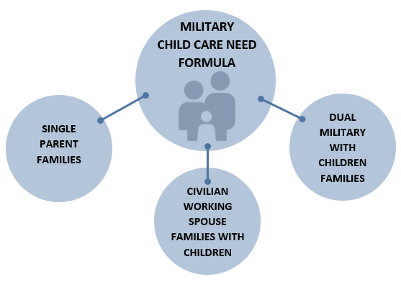
Child care need, Access & affordability

Slide 22
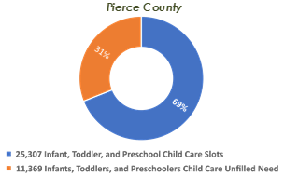
Civilian child care in WASHINGTON
At least 32% of DoD subsidized child care for military children in Washington is provided by civilian child care providers.
The Washington State Child Care Collaborative Task Force
Staffing
Facilities
Fee Assistance
Communications:
The Fair Start for Kids Act
Early Learning Advisory Council

Slide 23
Washington state military family child care workgroup recommendations
Recommendation 1 ADVOCACY AND PRIORITY
Recommendation 2 RATES/ALLOWANCES/FLEXIBLE SPENDING ACCTS
Recommendation 3 REPORTING
Recommendation 4 STAFFING
Recommendation 5 COMMUNICATION AND ADMINISTRATION
Recommendation 6 FUNDING

Slide 24
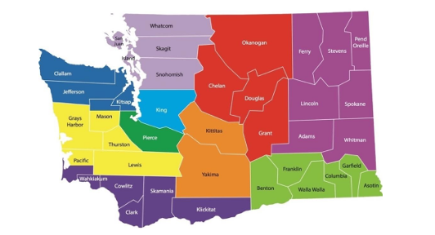
Child Care Collaboration
Leading Panel Discussion to improve awareness of the program, its incentives and to reduce any stigmas associated with misinformation
Outreach Initiative: Panel Discussion regarding Military Child Care in Your Neighborhood at County Child Child Care Networking Meeting
Meeting Discussion Points
JBLM to speak to the need for childcare and action items
CCOA and DoD to talk about the main program (MCCYN) and the pilot program (MCCYN-PLUS)
DCYF to talk about application processing and expansion of the MCCYN-PLUS into Washington
Participating partners to share personal experiences with the program

Slide 25
Joint Base Lewis McChord Uses Collaboration to Tackle Childcare
Panel Discussion
Identify strategies to increase access to affordable childcare both on and off base
Identify pain points in DoD program’s rollout and possible solutions to overcome challenges
2022

