Slide 1
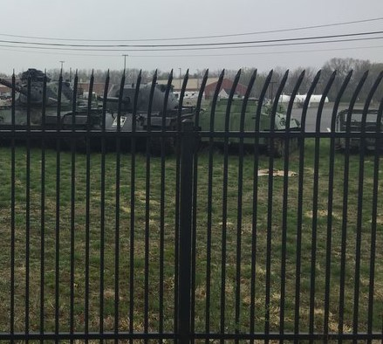
DEVENS RESERVE FORCES TRAINING AREA
KEY COMMUNITY PARTNER: Devens, MA (MassDevelopment)
SUPPORTING INDUSTRY: MIT Lincoln Labs
Devens, MA: managed by MassDevelopment, the state’s finance and development agency; Devens has been recognized as a national model for military base reuse
A winning partnership:
Preserving FT Devens history in Devens, MA
Improved Post security with perimeter fence
Intergovernmental Support Agreement (IGSA)
Improving defense access with Lovell St.
Bridge repair & renovation
$4.6M Defense Community Infrastructure Program (DCIP) award
Mediated Fitchburg Airport airspace dispute
MIT/Lincoln Labs: A winning partnership with industry; Devens RFTA provides land that enables R&D in return for reimbursables to maintain ranges
LTC Trent R. Colestock/ 978-615-6025 / trent.r.colestock.mil@army.mil 1 of 1
01NOV2022

