Slide 1
ADC Conference
Slides

Slide 2
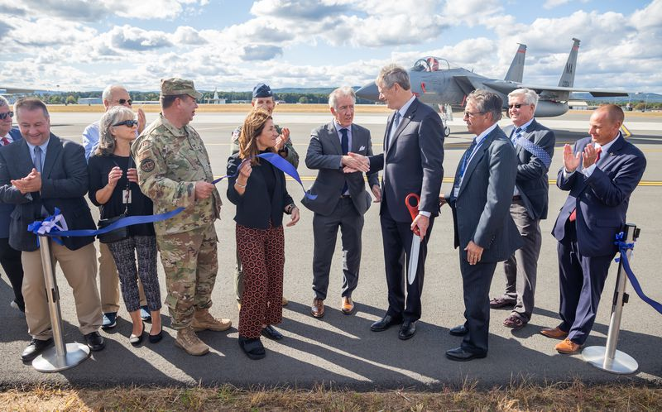
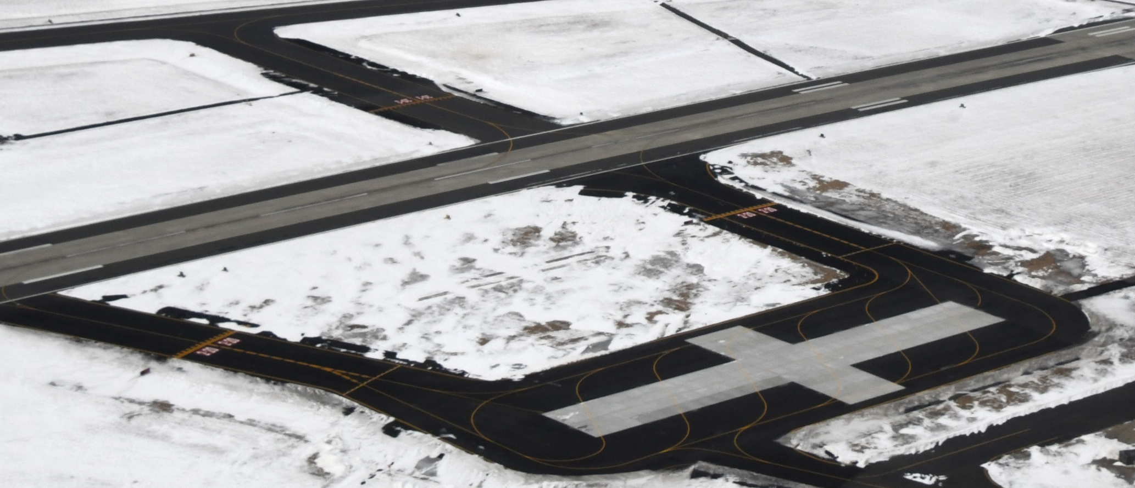
East Ramp
Sponsors
  MassDevelopment ($4.7M)
Parnters
  104th Fighter Wing
  Westfield-Barnes Regional
  Airport
Outcomes
  Eliminate Back-Taxiing
  True Runway Crossing
  Visiting Fighters x6
  Mobility Aircraft x2
  Hot Cargo Loading
  Hot Pit Refueling
Notes:
Key points:
There is a military need for parking space like this based off our parking configuration.

Slide 3
Relocate Main Gate
Sponsors:
  ANG
  MassDevelopment
  MassDOT ($3M Intersection)
Funding Structure:
  Design (100% ANG)
  Construction ($4.7M,
  100% State)
Outcomes
  Community Support
  Key Metric in Conversion
  Consideration
  AT/FP Improvement
  Stunning Entrance

