Slide 1
Massachusetts Leads the Way: Innovative Partnerships from Across the State
Massachusetts Military Asset and Security Strategy Task Force
November 1, 2022

Slide 2
Agenda
Overview of the Massachusetts Military Asset and Security Strategy Task Force (MASS-TF)
Installation overview:
Joint Base Cape Cod
Fort Devens Reserve Forces Training Area
Westover Air Reserve Base
Barnes Air National Guard Base
Questions / Discussion

Slide 3
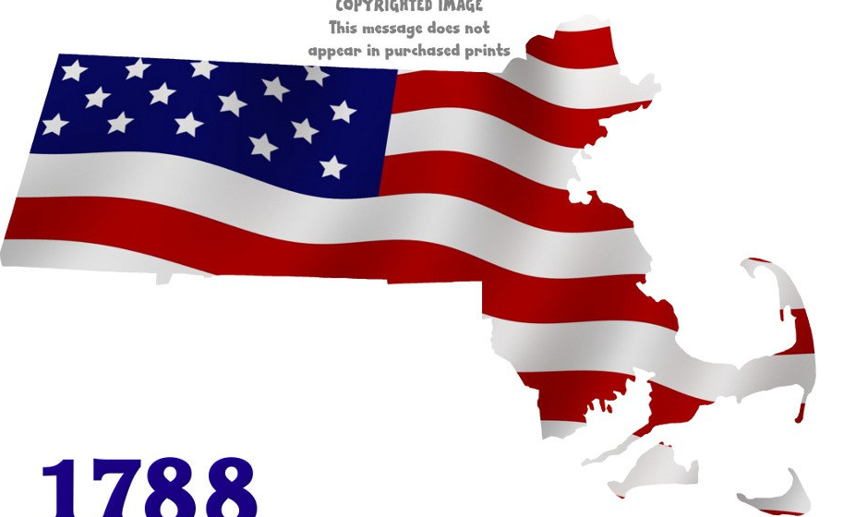
Economic Impact of Six Military Installations
$13.3 Billion & 57,618 Jobs
Fort Devens
$184 Million
3,027 Jobs
Hanscom Air Force Base
$6.1 Billion
16,229 Jobs
Joint Base Cape Cod
$331 Million
3,789 Jobs
Barnes Air
National
Guard Base
$198 Million
1,648 Jobs
Westover Air Force
Reserve Base
$324 Million
3,990 Jobs
Natick Soldier
Systems Center
$5.6 Billion
14,569 Jobs
Source: MassDevelopment/UMASSDI: An Economic Contribution Analysis and Overview of Massachusetts Military Installations, December 2015
Notes:
Here is WHY is matters…
Per our 2015 UMASS Donahue institute study…our six installation have a significant economic impact on the Commonwealth.

Slide 4
#7 in Defense Spending

Slide 5
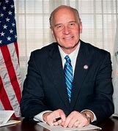
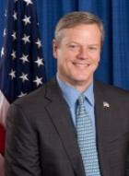
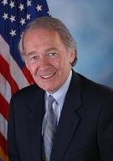
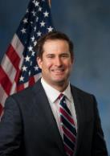
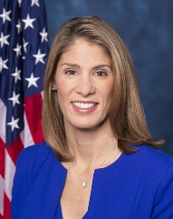
Massachusetts and the Defense Community
Created in 2012, the Massachusetts Military Asset and Security Strategy Task Force (MASS-TF) is a national model to support and strengthen Massachusetts' military installations.
Housed in the Governor’s Office, MASS-TF coordinates with the Commonwealth’s agencies and military facilities to maximize their efficiency.
The MASS-TF partners with DoD and, when appropriate, invests in the Commonwealth’s installations.
Massachusetts’ commitment to DoD installations is backed by 2014 military bond bill, which authorizes $177M in investments to support DoD installations. Examples of these investments include, but are not limited to:
$5.0M in a first-of-its-kind energy audit at every Massachusetts installation.
$5.0M to build the UMass Aviation Training Center adjacent to Westover Air Reserve Base
$2.5M improvements to Natick SSC front gate and General Greene Blvd
$9.2M to expand taxiway and construct new gate at Barnes Air National Guard Base
$900K to construct an improved “Doriot Climactic Chamber” at Natick SSC.
Rep. Keating
HASC
Senator Warren
SASC
Charlie Baker
Governor
Senator Markey
Foreign Relations
Rep. Moulton
HASC
Rep Trahan
HASC

