Slide 1
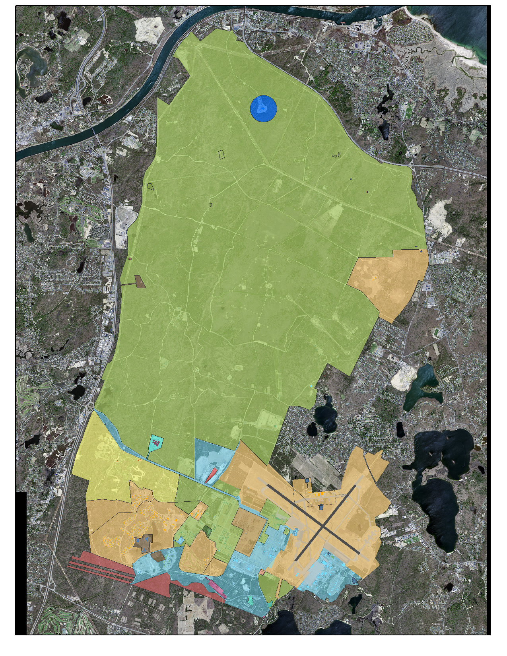
102 IW: JBCC Overview
JBCC Partners
Air Guard: 102d Intelligence Wing, Otis ANGB
Army Guard: Camp Edwards, Army Aviation, RTI
Coast Guard: Air Station Cape Cod; Base Cape Cod
Space Force: 6th Space Warning Squadron
Other Organizations
Veterans Administration National Cemetery
Barnstable County Sheriff’s Office /Prison
FAA Cape Approach
USDA, USGS, Volpe Test Center, MA Env Police, etc.
JBCC: 22,000 Acres
(1/10 of Cape Cod)
Current ANG Support Responsibilities
Water/Wastewater Systems
Electricity Distribution
Communications Infrastructure
Roads & Grounds
Joint Base Defense Ops Center (24/7 Ops)
ANG Current Land Holding: 3,700 Acres
ANG Divestment Program
Privatize Utilities
Reduce landholding acreage from 3,700 to 300
  Lease and Fee owned
Reduce building sq footage by 258K sq ft
Collaborative Effort (Fed/State/Municipal/Private)
ANG Goal: 300 Acres

Slide 2
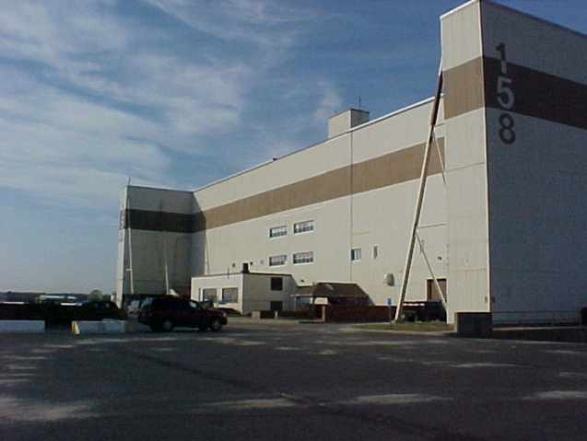
102d Divestment Efforts
Water/Wastewater Exchange for $3.2M Readiness Facility
  Regional Water/Wastewater solution for Upper Cape
  Private Entity coordinating with surrounding communities
  ANG divests water responsibilities and lowers costs (14% of usage)
Future use of Airfield and adjacent Industrial Facilities
  Currently under utilized (USCG is primary user)
  ~1.8 mile/~1.5 mile runway lengths
  160K Sq Ft of vacant hangar space (B158)
  Coordinating with State Agencies and USCG for divestment opportunities
Land Divestment Way ahead
  Federal Land: Exchange existing land/buildings current/future 102IW building needs (10 USC 18240)
  State Leased Land: Assessing current and future needs
Electric Utility Divestment
  Standard Utility Privatization Approach vs. Exchange Opportunity
Strengths:
Location/Value of Property
Leadership Support/Trust
Internal Collaboration
Relationship Development
Challenges:
Bureaucracy
Learning Curves
Inter-dependencies
Culture
Succession Planning

