Slide 1
UNCLASSIFIED
Using Partnerships to Address Water Quality Challenges: A Success Story from Fort Leavenworth KS
Version 1
25 October 2022
UNCLASSIFIED

Slide 2
Partnerships to Address Water Quality
Agenda
Panel Members
History of Fort Leavenworth
Challenge Faced
Infrastructure
Timeline
Partnership
Take Aways

Slide 3
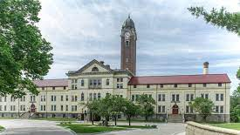
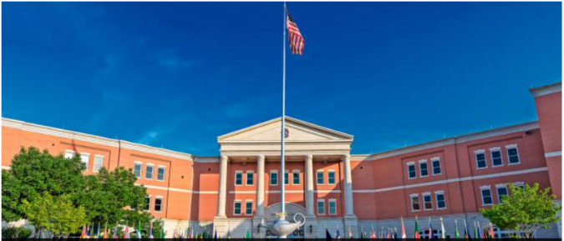
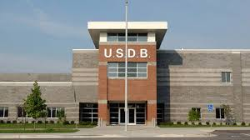
Fort Leavenworth at a Glance
Population Impact
Economic Impact
Fort Leavenworth supports a population equivalent to a small city (like Albany, NY or College Station, TX)
Fort Leavenworth’s contribution to the Kansas City Metro area: $1.9 Billion annually
Military (Includes CGSC) 3,523
Family Members (estimated) 19,500
DoD/ NAF Civilian Employees 3,556
Service Provider Civilian Employees 1,526
Inmates 652
Retirees & Family Members 47,470
Gold Star Families 447
TOTAL Supported Population 76,674
DoD Payroll (Military & Civilian) $595,935,424
Service and Supplies $41,723,506
Travel Expenditures $14,843
USD 207 School Budget (non DoD) $50,189,561
Sustain, Restore & Modernize $ 10,250,4000 Budget TOTAL $698,113,734
Economic Multiplier X2.75
Overall Economic Impact FY2021 $1,919,812,769
Combined Arms Center
“Intellectual Center of the Army”
Permanent Party Students
(SAMS/ CGSC) 1,165
Over 25 Temporary Duty Courses
Over 8,000 Students Annually
United States Disciplinary Barracks
Joint Regional Correction Facility
Operates 24/7 365, No Fail Mission
Fort Leavenworth Covers
5,634 Acres/ 8.8 Square Miles
4 On-Post Schools (3 Elementary/ 1 junior High)
2020-2021 School Year Enrollment 1,555 Student

Slide 4
Partnerships to Address Water Quality
Panel Members
Colonel John Misenheimer, Garrison Commander, Fort Leavenworth, KS
Paul Kramer, City Manager, Leavenworth, KS
Jake Kowalewski, General Manager, American Water
Bill Waugh, Director of Public Works, Fort Leavenworth, KS
Dale Cleland, Chief, Environmental Division, DPW

Slide 5
Partnerships to Address Water Quality
UNCLASSIFIED
The Challenge
Maintain the water supply to the Fort Leavenworth Community while the installation water treatment plant was offline for upgrades to remove PFOS/PFOA contamination
Bill Waugh / 913-684-5646 / Harold.W.Waugh.civ@mail.mil

Slide 6
Partnerships to Address Water Quality
UNCLASSIFIED
Background
2016 EPA set the Health Advisory for PFOS+PFOA to 70 ppt
2016 Fort Leavenworth drinking water first sampled for PFOS/PFOA
2017 Contract awarded by Omaha Corps of Engineers to OTIE to investigate drinking water options, primarily a new well location
2017 Production wells cannot stay consistently below the EPA HA
Sample protocols and requirements were still evolving
Very strict sampling protocols to prevent false positives
Sample accuracy varied widely when split samples sent to 3 different labs
Bill Waugh / 913-684-5646 / Harold.W.Waugh.civ@mail.mil

Slide 7
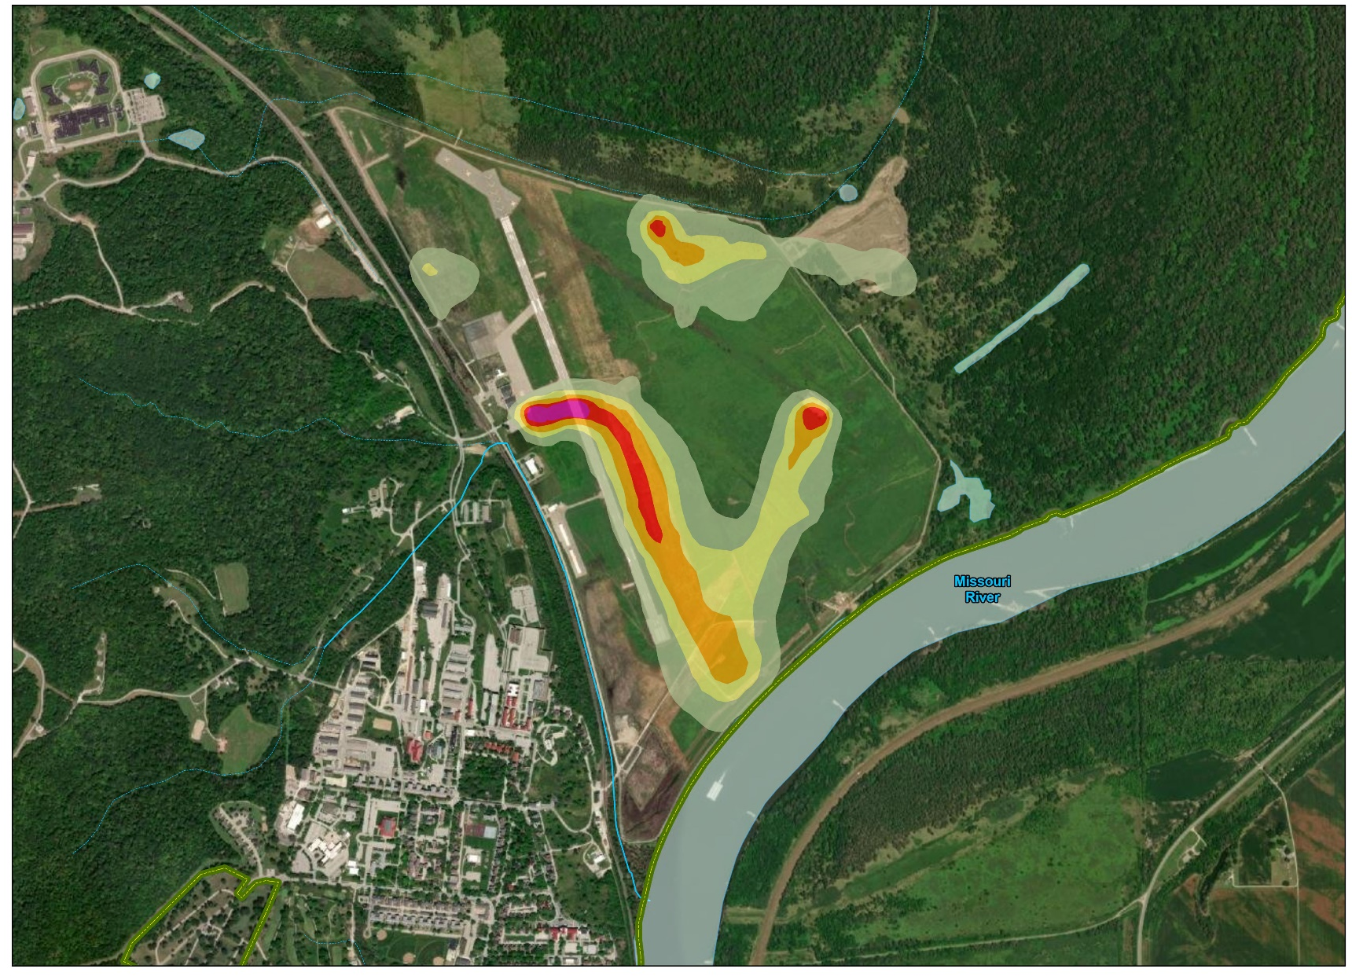
Partnerships to Address Water Quality
UNCLASSIFIED
FTL-10 AFFF Training
FTL-9 Landfill
FTL-11 AFFF Training
Old Fire Station
Drinking Water Wells
Bill Waugh / 913-684-5646 / Harold.W.Waugh.civ@mail.mil

Slide 8
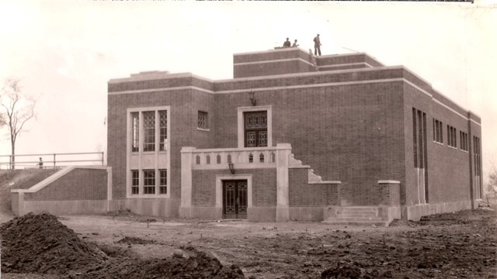
Groundwater Source & Treatment Process
Original plant constructed 1934 (shown left)
5 groundwater wells drilled between 1975 and 1987
5.3 MGD capacity
Lime softening plant
GAC for PFAS removal as of 2022 (shown below)
Monochloramines & Fluoridation
Notes:
Treatment process: Aeration, Lime softening, Coagulant aid, settling basins, CO2, pre-filter chlorination, filtration, GAC, post-GAC chlorination, ammonia for monochloramines, and fluoridation.

Slide 9
Partnerships to Address Water Quality
UNCLASSIFIED
Alternate Water Source
Fort Leavenworth had an existing non-functional 2 way connection with the Leavenworth Waterworks
Due to flooding concerns at the well field, Fort Leavenworth worked with Leavenworth Waterworks to replace the valve and water meters and install a backflow preventer (Leavenworth Waterworks no longer desired two-way flow).
A service contract for annual pipe flushing and emergency use was established
Interconnection opened upon determination that Installation water supply could not maintain appropriate PFOS/PFOA levels
Water purchased from Leavenworth Waterworks from January 2018 through May 2022.
Bill Waugh / 913-684-5646 / Harold.W.Waugh.civ@mail.mil

Slide 10
Partnerships to Address Water Quality
UNCLASSIFIED
Project Timeline
Fort Leavenworth
Resumes Water
Production
MAY 22
Apr 2022 – KDHE provides provisional
certification DWTP
Mar 2021 – Army starts remedial investigation to delineate
extent and concentration of contaminate plume
Dec 2020 – KDHE approves final design
Aug 2020 – American Water starts construction on GAC facility
Aug 2020 – City of Leavenworth concurs with plant modifications with before
and after wastewater sampling for PFOS/PFOA
Jan 2019 – American Water starts design of GAC system
Aug 2018 – IMCOM approves granular activated carbon (GAC) for FTL water treatment plan
Apr 2018 – Fort Leavenworth starts preliminary assessment/investigation for PFAS sources
Jan 2018 – Fort Leavenworth starts purchasing water from Leavenworth Waterworks
2017 OTIE contract for alternate water source; concerns with rising PFOS/PFOA levels
2017 Coordination with Leavenworth City Water Works for interconnect
Dec 2016 – Fort Leavenworth gets first official sample results showing PFOS/PFOA
Jun 2016 – EPA established new health advisories for PFOS/PFOA
Bill Waugh / 913-684-5646 / Harold.W.Waugh.civ@mail.mil

Slide 11
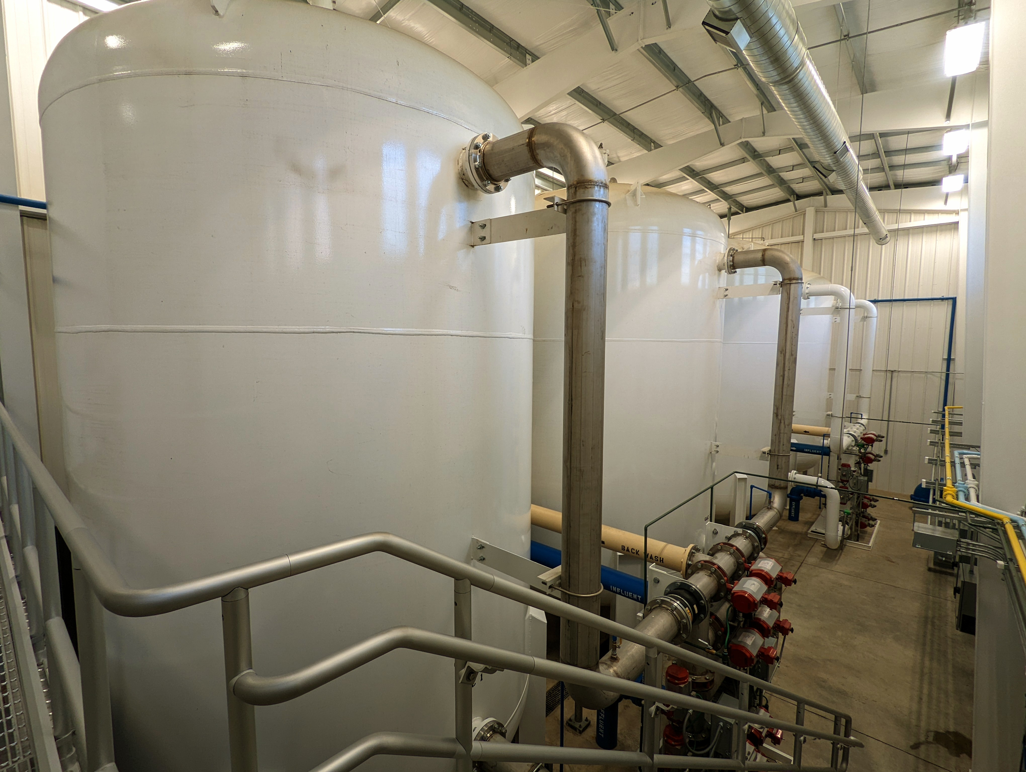
GAC Process
GAC vessels operate in pair with one acting as lead and one acting as lag.
Water flows through the top of the lead vessel, interacts with GAC, flows out the bottom of the lead, through the lag and into the clear well.
GAC interacts and removes PFAS via physical adsorption.
Media replacement scheduled to occur in two vessels annually.
Media can be regenerated or exchanged for new media
GAC increases overall water quality – Not just PFAS removal
4 OCT 2022 Raw Water – PFOA 19.0 ng/L PFOS 244.6 ng/L
4 OCT 2022 Finished Water – Non-Detect
Perform full pilot test prior to media decisions
Notes:
Regulations are coming at some point. Try to stay informed on what the regulations mean for your system. If you don’t know, reach out to KDHE, it will save you time if you communicate with them before it’s required.
Find out as early as you can what resources may be available to offset project costs. Don’t wait until mitigation is mandated to see what help may exist.
Maintain a strong relationship with the manufacturers, suppliers, and contractors associated with the project. They are our best source of information and invaluable when dealing with and unexpected issues that may arise.

Slide 12
Partnerships to Address Water Quality
UNCLASSIFIED
City Partnership
Initial considerations:
Third party review of GAC process based on level/type of PFAS contamination
City hired and the Fort funded a study by Black and Veatch
A requirement of shared data to produce the report
Other key considerations:
The future impact of this process on the City’s wastewater treatment operations
Potentially adding a PFAS generator into our wastewater when our treatment process does not touch this type of compound
Water that washes the charcoal that is used in the GAC process (backwash water from filters)
What is the expected regulatory environment in the future
The City’s discharge permit through KDHE under NPDES/EPA requirements
Final considerations and conditions for partnership:
The City has ultimate approval to accept wastewater into our waste stream
Agreement on the testing protocol and requirements to give the City the data needed to remain in compliance with permit requirements
Final approval from the City and State to move forward with proposed system
Bill Waugh / 913-684-5646 / Harold.W.Waugh.civ@mail.mil

Slide 13
Partnerships to Address Water Quality
UNCLASSIFIED
Take Aways
➢ Cooperation with City of Leavenworth and Leavenworth Waterworks for alternate drinking water allowed the Army and American Water the time to properly design a GAC filter system.
➢ GAC vs IONIC Exchange
➢ GAC filter removed all 12 PFAS tested by American Water
➢ Don’t assume off post partner has same level of knowledge on an issue
➢ Communicate early and often with all partners
➢ Look for opportunities to partner
Excess tanks from JBLM
Emergency use interconnect with Leavenworth Waterworks
Bill Waugh / 913-684-5646 / Harold.W.Waugh.civ@mail.mil

