Slide 1
Implementing the Department of the Navy’s Climate Strategy

Slide 2
Moderator: Celeste Werner, FAICP
Chief of Strategic Development Matrix Design Group
Case Study 1
Matt Ryan
County Supervisor
Coconino County, AZ
Jay Smith
Forest Restoration Director
Coconino County, AZ
Mary Beth Greiner
Deputy Regional Community Plans and Liaison Officer and Readiness and Environmental Protection Integration (REPI) Program Manager
Navy Region Southwest
Case Study 2
Scott Morgan
Chief Deputy Director
Governor’s Office of Planning and Research
State of California
Steve Chung
NW Regional Community Plans Liaison Officer
DoD Pacific Coast Energy Compatibility

Slide 3
Leveraging REPI and Sikes Act Authority in Northern Arizona
Case Study 1
Supervisor Matt Ryan Jay Smith Mary Beth Greiner Coconino Co. District 3 Forest Restoration Dir. NRSW REPI Mngr.

Slide 4
Coconino County
City of Flagstaff was the first International Dark Sky Community
Coconino County includes Naval Observatory Flagstaff Station, Navy Precision Optical Interferometer, and Camp Navajo
Joint Regional Planning Efforts
Outdoor Lighting Ordinance
JLUS Implementation
Dark Sky Education & Compliance
Conservation of wetlands and wildlife corridors

Slide 5
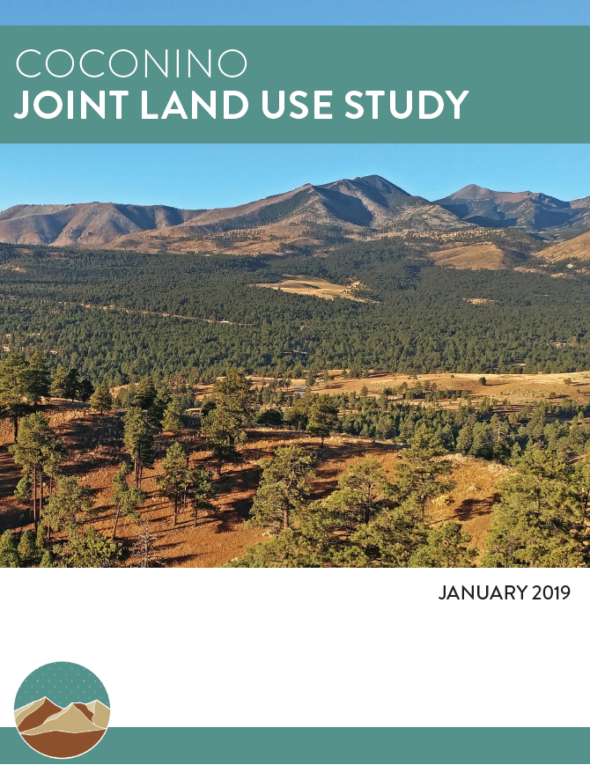
Joint Land Use Study
Primary Issues:
Land Use
Dark Skies
Transportation
Environmental Health
Forest Health
Forest Land Conversion
Migration & Wildlife

Slide 6
REPI Program Overview
What is REPI?
How to request REPI
How to implement REPI
Readiness & Environmental Protection Integration (REPI)
Supports cost-sharing partnerships between the military, private conservation groups, and state & local governments (a.k.a. eligible entities) to protect military test & training capabilities and conserve land.
Service Nomination/ Annual REPI Submission
Nomination of specific projects for funding
Partner Nomination/ REPI Challenge
In coordination with U.S. Endowment
Large, innovative projects
REPI Buffering enables military to acquire real property interests from willing sellers & may include some natural resource management work.
Implementation Agreements via Sikes Act Cooperative Agreements or Intergovernmental Service Agreements allows for management or improvement of off-base habitat preservation and resiliency initiatives without acquisition.
Notes:
Parks and Recreation Tax to support acquisition.

Slide 7
Northern Arizona Fuels & Wildfire Risk Reduction Project
The Partners
National Forest Foundation (NFF)
Coconino National Forest
Coconino County
City of Flagstaff
Naval Observatory Flagstaff Station
Objective:
The project improves the resiliency of the military assets and communities in Coconino County by thinning unhealthy forests in order to reduce hazardous fuels; protecting installations from the threat from catastrophic wildfires, post-wildfire flooding, and the smoke pollution produced by catastrophic wildfires, promoting safety for installation infrastructure, employees, and surrounding community.

Slide 8
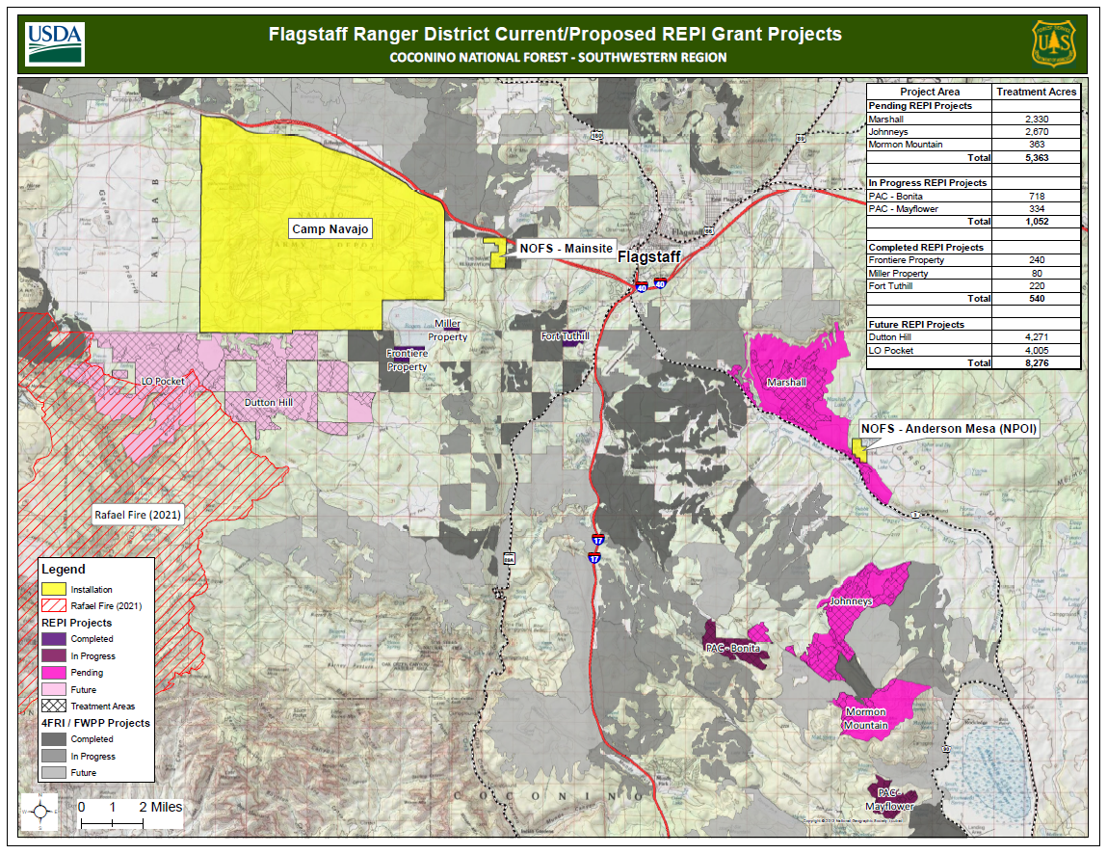

Slide 9
Northern Arizona Fuels & Wildfire Risk Reduction Project
Current Work
Future Work
Area: 6,400 acres
Funding:
REPI: ~$1.5 million
Leveraged: $9 million
Shift focus westward toward Camp Navajo and NOFS boundaries and 2021 Rafael Fire scar
Partnering with State Lands
Sentinel Landscape Designation

Slide 10
Case Study 2

Slide 19
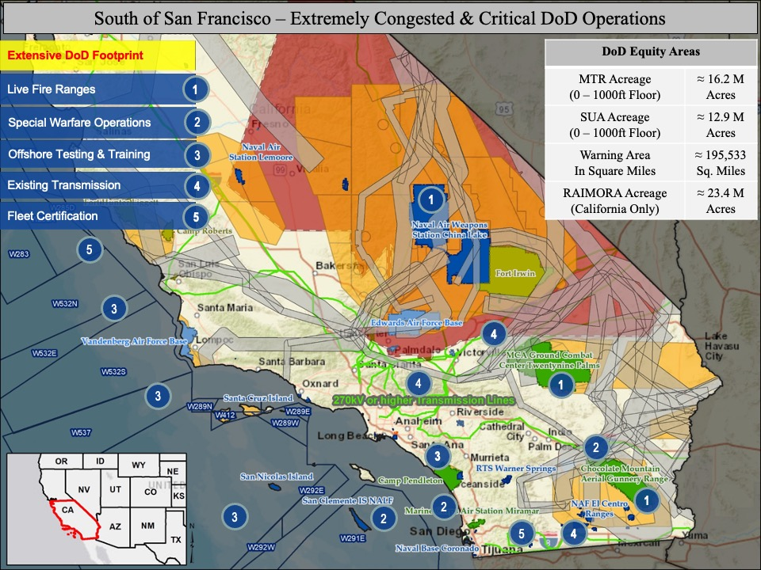

Slide 20
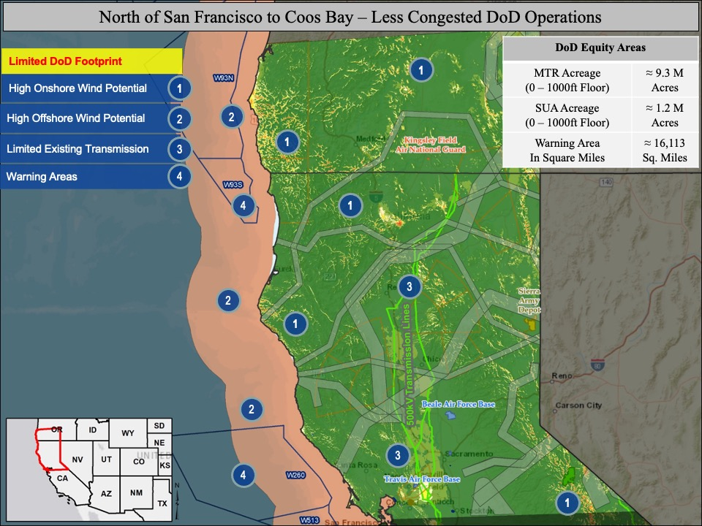

Slide 22
Implementing the Department of the Navy’s Climate Strategy
Moderator: Celeste Werner, FAICP
Chief of Strategic Development Matrix Design Group
Case Study 1
Matt Ryan
County Supervisor
Coconino County, AZ
Jay Smith
Forest Restoration Director
Coconino County, AZ
Mary Beth Greiner
Deputy Regional Community Plans and Liaison Officer and Readiness and Environmental Protection Integration (REPI) Program Manager
Navy Region Southwest
Case Study 2
Scott Morgan
Chief Deputy Director
Governor’s Office of Planning and Research
State of California
Steve Chung
NW Regional Community Plans Liaison Officer
DoD Pacific Coast Energy Compatibility

