Slide 1
Moody AFB IGSA
Installation Innovation Forum
2 Nov 2022
UNCLASSIFIED

Slide 2
Agenda
History
Community Partnership
Initial IGSA
Benefits of IGSA
IGSA Renewal
Way Ahead
Notes:
Here’s the agenda for today. I’ll provide a quick overview of the latest information and updates from the Air Force Community Partnership (AFCP) program.
We’ll review the status on Moody initiatives
Review some possibilities for new proposals
And wrap things up with plans for our next session

Slide 3
Moody IGSA
2014-2016
Moody part of initial 13 AF installations for P4 (forerunner to AFCP)
Identified Water and Wastewater Treatment Plant as possible initiative during Table Top Exercise in May 2013
BCA completed May 2014
SAF/IEI approved Oct 2014
Business clearance approved Mar 2015
  Award pushed one year to allow for delay in negotiation progress
Negotiations resumed Jun 2016 and contract awarded Aug 2016
Agreement began October 2016

Slide 4
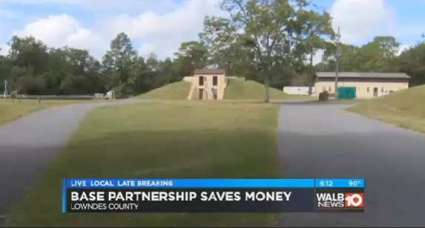
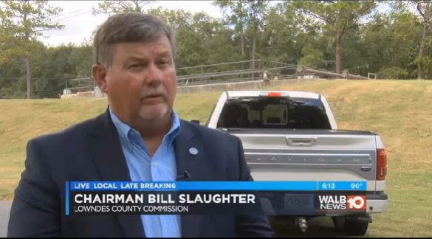
Wastewater Treatment Plant Operation
Moody AFB
Need/Requirement
  Operation of Moody’s water/wastewater treatment plants
    Previously contractor operated
What resources does each provide:
  Moody water and wastewater plants on base
  Lowndes provides manpower, expertise, and equipment/supplies to operate the plants
How does it work:
  Moody establishes a sole-source service contract for operation and maintenance of the plant infrastructure
  Lowndes takes over operations and assumes responsibility for consumables and maintenance
What value is created:
  Moody estimates a $210,000 annual savings
Notes:
Lowndes County will operate the water treatment and the wastewater treatment plant.
This partnership concept will allow Lowndes County to operate the water treatment and the wastewater treatment plant on Moody Air Force Base (AFB). Approval from SAF/IEI was obtained to enter into an Intergovernmental Support Agreement (IGSA) with Lowndes County to perform base water and wastewater treatment services.
Also looking at possibility of Moody tying into the Lowndes County water system to add resiliency to Moody’s system. Under the proposed partnership, the system would only be activated at emergency levels and Moody would pay the county for the water used, and for any construction required to connect to the county system.

Slide 5
IGSA Renewal Milestones
SEPTEMBER 2020
Initiated discussion in IGSA Renewal
JANUARY 2021
MARCH 2021
Completed BIA and initiated IGSA Determination Package for WG/CC approval/signature
IEI Approval and Requested quotes from Lowndes County
JUNE 2021
Contract Awarded!
JULY 2021
FEBRUARY 2021
WING APPROVED!
Forwarded to IEI for notification
Official signing by Lowndes County

Slide 6
2021 IGSA
Original IGSA expired Oct 2021
Initiated discussion with AF team (CE,CONS, CPTS, JA) in September 2020 for 10 year IGSA renewal
  New team members from JA, CPTS and CONS along with a few new members from CE
  Confirmed Lowndes County interest in renewal
AFCP handbook and 2019 SAF/AQC and IEI IGSA memo very helpful w/questions from new team members
Completed BIA 8 Jan 2021 and initiated IGSA Determination Package for WG/CC approval/signature
  Approved 23 Feb 21
  Forwarded for IEI notification 25 Feb 21; approved 22 Mar 21
Requested quotes from Lowndes County March 2021
Contract awarded 25 Jun 21; official signing by Lowndes County at County Commission meeting 14 July

Slide 7
Contract v. IGSA
Initial Business Case Analysis (BCA) discussions raised some of the following questions –
  Authority
    10 U.S.C 2679 v. FAR
      AFCP Handbook, SAF/IEI memo useful in clarifying process, distinction between contract and agreement as it applies to IGSA
  IGSA v. Commercial Contract
    Cost/Benefit analysis showed clear cost savings
    Substantial decrease in administrative efforts
    Added value to end user through continuation of service provider

Slide 8
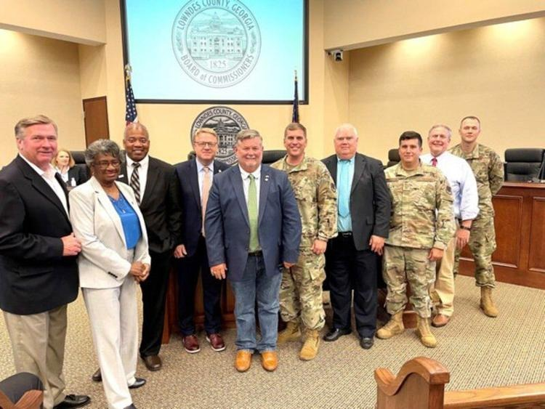
19 July 2021 Lowndes County Commission Meeting

Slide 9
Bottom Line
IGSA Renewal process is stream lined
  Very straight forward and less time consuming
AFCP assistance very beneficial and helped keep on schedule
  Quick turn on questions for guidance/assistance
Begin early
  Keep leadership informed
  Educate newcomers to process
Keep partners informed along the way
Can be used as a springboard for other ideas/partnerships
  Automatic Aid Agreement with Lowndes County Fire Dept
  Second sub-station for base

Slide 10
What’s Next for Moody and IGSA?
Moody and Lowndes County continue to explore other partnership opportunities
  Connecting Moody’s Grassy Pond Recreation Site to Lowndes County sewer plant
  Paving of Hightower Road along Moody’s north perimeter boundary fence
  Exploring possibility of connecting Lowndes County water to Moody as an emergency supply for added resiliency
  Exploring possibility of Lowndes County operating Moody’s soon to be closed golf course

Slide 11
Questions

