Slide 1
BOOM! Boosting Options for Operations and Maintenance
// UNCLASSIFIED //
Prepared for Association of Defense Communities Installation Innovation Forum
Oct 31, 2022 – Nov 2, 2022
MS. JENNIFER PETERSON
Director of Plans Analysis and Integration
USAG, Fort Stewart/HAAF

Slide 2
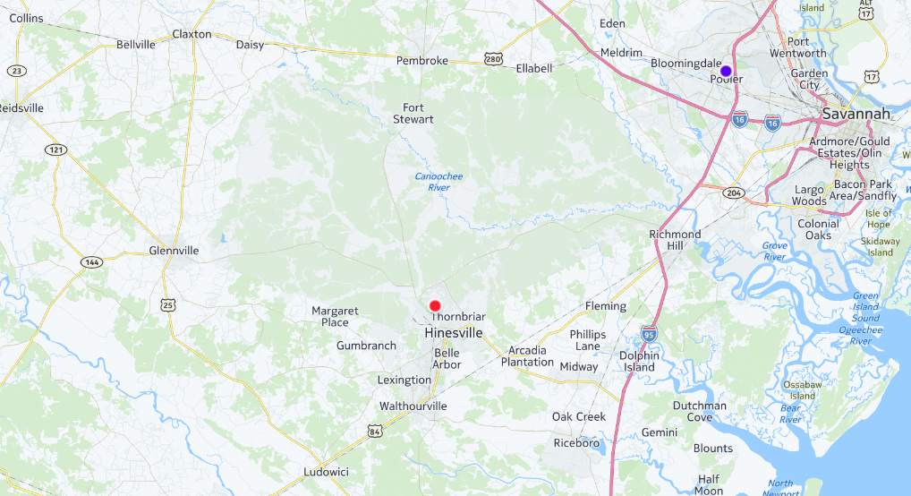
East Coast Premier Power Projection Platform
285,000 acres of training areas and operational airspace
23 miles of rail
Longest Army runway
Largest military installation East of the Mississippi River
Access to Interstates and Proximity to Ports
Service(s) Partners:
U.S. Air Force
U.S. Marines
U.S. Coast Guard
Georgia National Guard
Air Dominance Center (Savannah Air Guard)
3ID is the only ABCT within XVIII Airborne Corps
~ 20 Miles
~ 40 Miles
Community Partners
Counties: Bryan, Chatham, Effingham, Evans, Liberty, Long, Tatnall, Wayne and Beaufort (SC)
Chamber(s) of Commerce
Emergency Management Assistance Group V
Emergency Services Agencies (Fire and Police)
Georgia Southern University
Municipalities
Public School Systems
Coastal Georgia Military Affairs Coalition
Notes:
HIT THE HIGHLIGHTS ONLY
*Premier Power Projection Platform on the east coast. Six counties surround the installation.
- 285,000 acres
We provide the resources needed to enable superior training to take place for our customers. In the center of the chart you’ll find the center point of our installation – the impact area that is surrounded by training ranges for our units. The west side of the installation is primarily used for maneuvering exercises while the west side has our small arms ranges.
*Primary customer, the 3rd Infantry Division – 18,000 3rd ID Soldiers
*7,000 Soldiers and Service members assigned to Tenant units: 3d MP Group, 117 ANG, MEDDAC and DENTAC, EOD, Warrior Transition Battalion, NCOA etc.
*68% of Soldiers reside outside the gates. Key Items to Consider: Partnerships, COMREL, Education, Youth Programs, Safety & Security - $4.9 Billion economic impact.
*MFGI
*Joint training capability - Hunter AAF is home to the 3rd ID Combat Aviation Brigade along with the Ranger Battalion and Special Operations Aviation Regiment. Other branches supported: Marine Corps, USCG, and US Air Force units stationed at both Fort Stewart and Hunter. We truly are a joint base and proudly support our sister services. 3rd CAB is currently deployed to Europe.
*The Garrison Team
- Provides municipal services to those working and living on the installation. We operate roadways, traffic signals, rail lines, water and sewer systems, logistics, personnel, training, security and law enforcement.

Slide 3
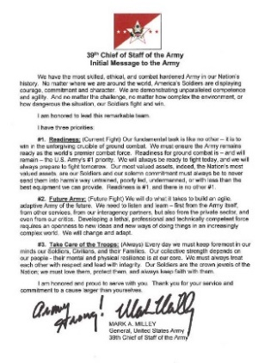
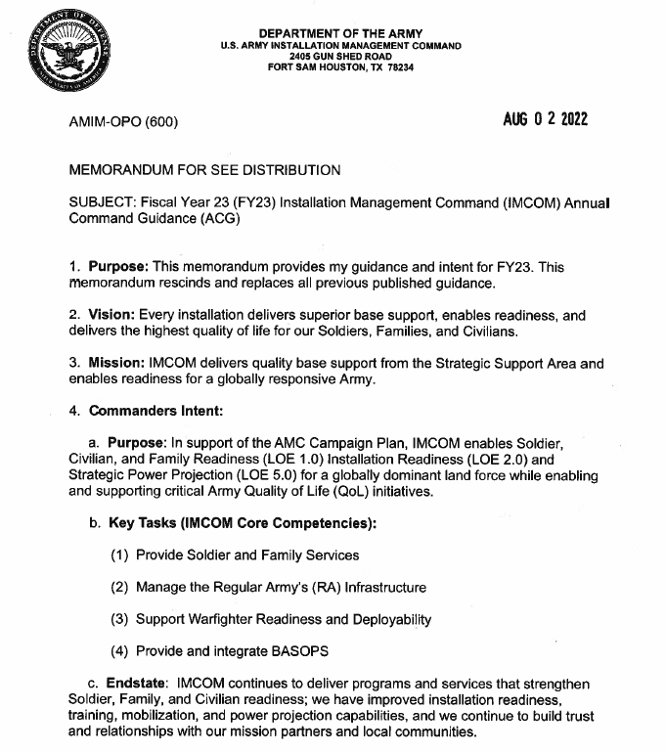
Priorities
Provide Soldier and Family Services
Manage Infrastructure
Support Warfighter Readiness and Deployability
Provide and Integrate BASOPS
We operate in a dynamic and challenging environment.
Partnerships allow us to reshape task execution and reallocate resources to accomplish our priorities.

Slide 4
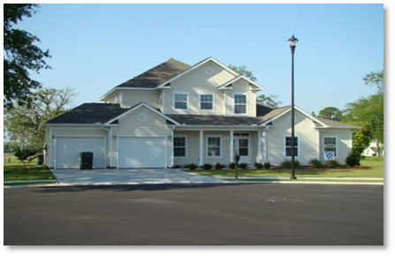
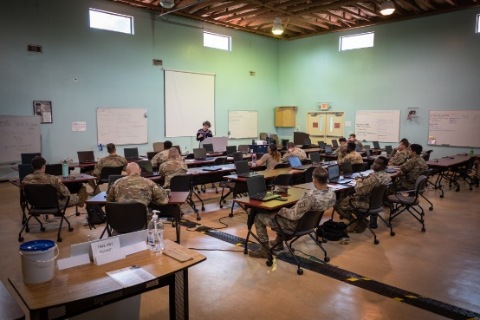
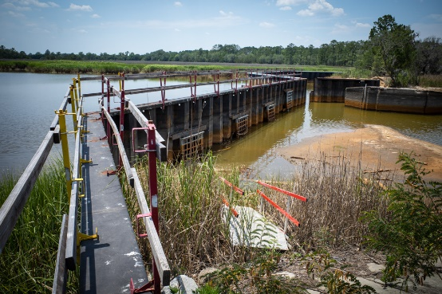
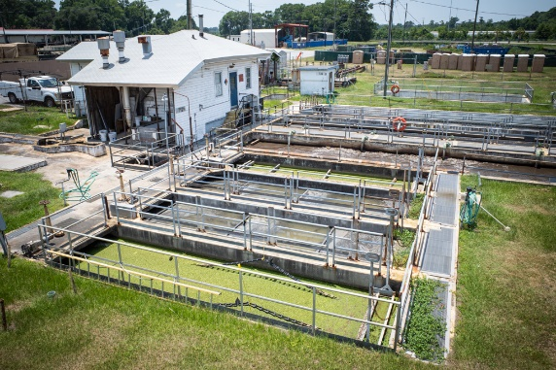
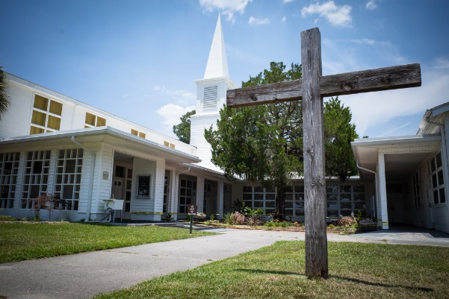
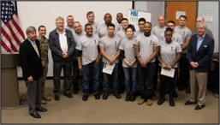
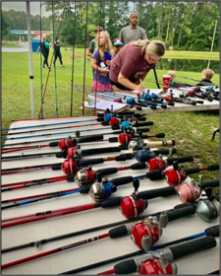
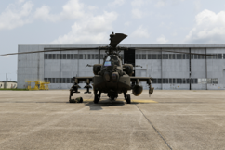
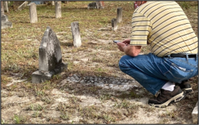
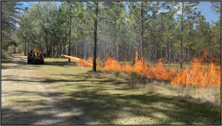
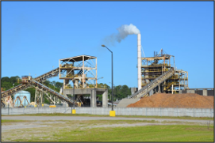
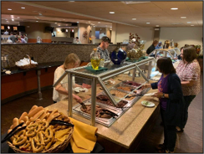
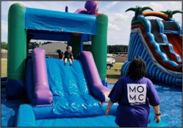
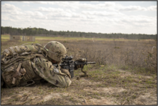
Services and Expectations
Over 180 services are delivered, 7 days/week, 52 weeks/year, to support Soldiers, Families, Civilians and Retirees.
Environmental Services
Housing
Career Transition Services
Wastewater Treatment
Special Events
Home Builder Institute
Religious Services
Prescribed Burns
Airfield Operations
Cultural Preservation
Outdoor Recreation
Soldier and Unit Training
Energy
Business Operations
Child and Youth Services
Notes:
OVERCOMMUNICATION IS THE KEY.

Slide 5
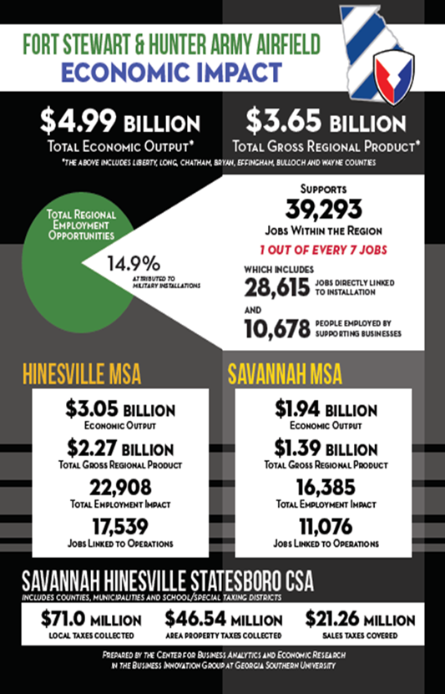
Influence in Coastal Georgia Region
Barracks
Notes:
68% of Soldiers reside outside the gates. Key Items to Consider: Partnerships, COMREL, Education, Youth Programs, Safety & Security
Census Reporting extremely critical as population figures will fund roads, schools, emergency relief, and housing
The Hinesville Metropolitan Statistical Area, which includes Fort Stewart, ranked No. 1 in the US for % of military population: 23.9% of military personnel among the total 79,977 population using 2018 population numbers.
That percentage is almost 9 percent more than the second-place area, Manhattan, KS, where the Army personnel at Fort Riley.
Datasource: Military OneSource – 24/7 Wall St
Top 5 cities are were our Soldiers reside: Others include Glennville, Rincon/Springfield, Pembroke, Pooler, etc…. 6 total counties on the primary boundary + others as Soldiers search for Education and Housing
Development
*Counties are anticipating growth with regards to housing developments slated for construction (at builder’s pace) -- These are 3 to 4 bedroom homes.
*Bryan County: 80 townhomes, 200 single family homes in <2 years
*Liberty County: 350 new apartments built in the last year with 80 more under construction presently in Hinesville (Memorial Dr); Pending another 100 apartments behind Dairy Queen
*In touch with county development authorities for needs
*FY20 Fort Stewart has 4 VOLAR barracks come offline (514, 515, 516, 517)
*FY21 Fort Stewart has 2 VOLAR barracks come offline (632, 633)
*FY22 Fort Stewart has 3 VOLAR barracks come offline (501, 518, 635)
Take Away: We have influence our community members and support RFIs and community efforts. Soldiers will continue to live off-post and QOL issues are a community concern, not just inside FS and HAAF.

Slide 6
Business Discipline
How do you turn lemons into lemonade?
Monitor Performance
“’Non est ad astra mollis e terris via.’ There is no easy way from Earth to the stars.” Seneca
Recognize Challenges
“What stands in the way becomes the way.” Marcus Aurelius
Plan Ahead
“First say to yourself what you would be; then do what you have to do.” Epictetus
Engage Partners
“Friendship produces between us a partnership in all our interests.” Seneca
Integrate Efforts
“Listen, learn, and help, then lead.” Jim Mattis
Community Relations
“Every reform movement has a lunatic fringe.” Theodore Roosevelt
Tool Kit
Defense Community Infrastructure Program
Intergovernmental Support Agreement

Slide 7
Water Tower Maintenance Case
Numerous elevated and pressure water tanks across Fort Stewart and Hunter Army Airfield required inspections, followed by immediate critical repairs and sustained annual maintenance in order to maintain safe, secure, and sanitary conditions.
Lacked internal resources to achieve success.
Researched external resource options to capitalize on expertise and economies of scale.
Not an overnight process: Teams from both sides worked together for months.
Agreement covers inspections, annual/biennial maintenance, immediate need repairs, and cathodic protection to ensure each tank meets regulatory requirements.
City of Hinesville provided an initial comprehensive Conditions Assessment Report in 2020.
Improved quantity and quality of services funded by federal tax dollars.
Discovery process generated additional opportunities, such as Wastewater Treatment Service and Wright Army Airfield Joint Management Board.
Spurred partnership interest from surrounding municipalities and counties.
Stimulates local economies and strengthens community bonds.
Key Partners: Public Works, Resource Management, and Legal Advisors

Slide 8
Forging Ahead
Partnership Opportunities:
Engineering and Architect Services
Operations & Maintenance​
Utilities Maintenance
Land Rehabilitation & Maintenance (LRAM)
Water Distribution​ Maintenance
Natural Gas Maintenance
Stormwater Services
Wastewater Services
Solid Waste Removal
Road Paving, Striping, and/or Sweeping
Dam and/or Bridge Maintenance
Demolition Services
911 CAD Services
CCTV Services
Elevator Maintenance
Overhead Door Maintenance
STARBASE (STEM)
and MORE

Slide 9
Generating Synergy and Momentum
Municipalities
County/State Agencies
Academia
Planning Workshops
Community Symposiums
Military Affairs Councils
Opportunity
Community
Civil
Military
Challenges

Slide 10
Questions
Notes:
Telework
How do I get promoted
Awards process (performance awards – QSI)
Training and deployment

