Slide 1
TEXAS A&M AGRILIFE EXTENSION SERVICE
Combating Mental Health Challenges in Military Communities
AGRILIFE.TAMU.EDU
Rachel Brauner & Lakshmi Mahadevan, Ph.D.

Slide 2
123 people die by suicide each day.
On average,
(American Foundation for Suicide Prevention)
Since 1999, more than…
930,000 people have died by drug overdose.
(Centers for Disease Control & Prevention)
580 service members died by suicide in 2020.
(Defense Suicide Prevention Office)
Nearly 1 in 5 U.S. adults' lives with a Mental Illness.

Slide 3
Mental Health First Aid in Rural Texas
Funded by the U.S. Department of Agriculture – National Institute of Food and Agriculture
The grant utilized a multi-level intervention to mental health and substance use that focused on:
Raising awareness on opioid use and misuse and related at-risk behaviors in rural Texas Counties.
Increasing mental health literacy of adults who interact with rural youth /adults through Mental Health First Aid (MHFA) training.
Providing harm reduction strategies and education in the form of opioid overdose reversal administration kits.

Slide 4
Recognize signs and symptoms of a mental health challenge and/or substance use.
What does MHFA Training Cover?
Prevent crisis by encouraging early help-seeking behavior.
Interact with a person before, during and after a crisis - patient, calm, nonjudgmental, reassuring and providing “hope with facts.”

Slide 5
Course Teaches Participants how to Apply ALGEE Action Plan.
Assess for suicide risk or harm.
Give reassurance and information.
Listen nonjudgmentally.
Encourage appropriate professional help.
Encourage self-help and other support strategies.

Slide 6
32 MHFA Trainings
(n=339)
89% of participants indicated that their knowledge of mental health challenges, signs, and symptoms has improved.
Over 72% of participants reported appreciation for the action plan and the potential for preventing, intervening and recovery for fellow citizens and battle buddies experiencing mental health challenges.

Slide 7
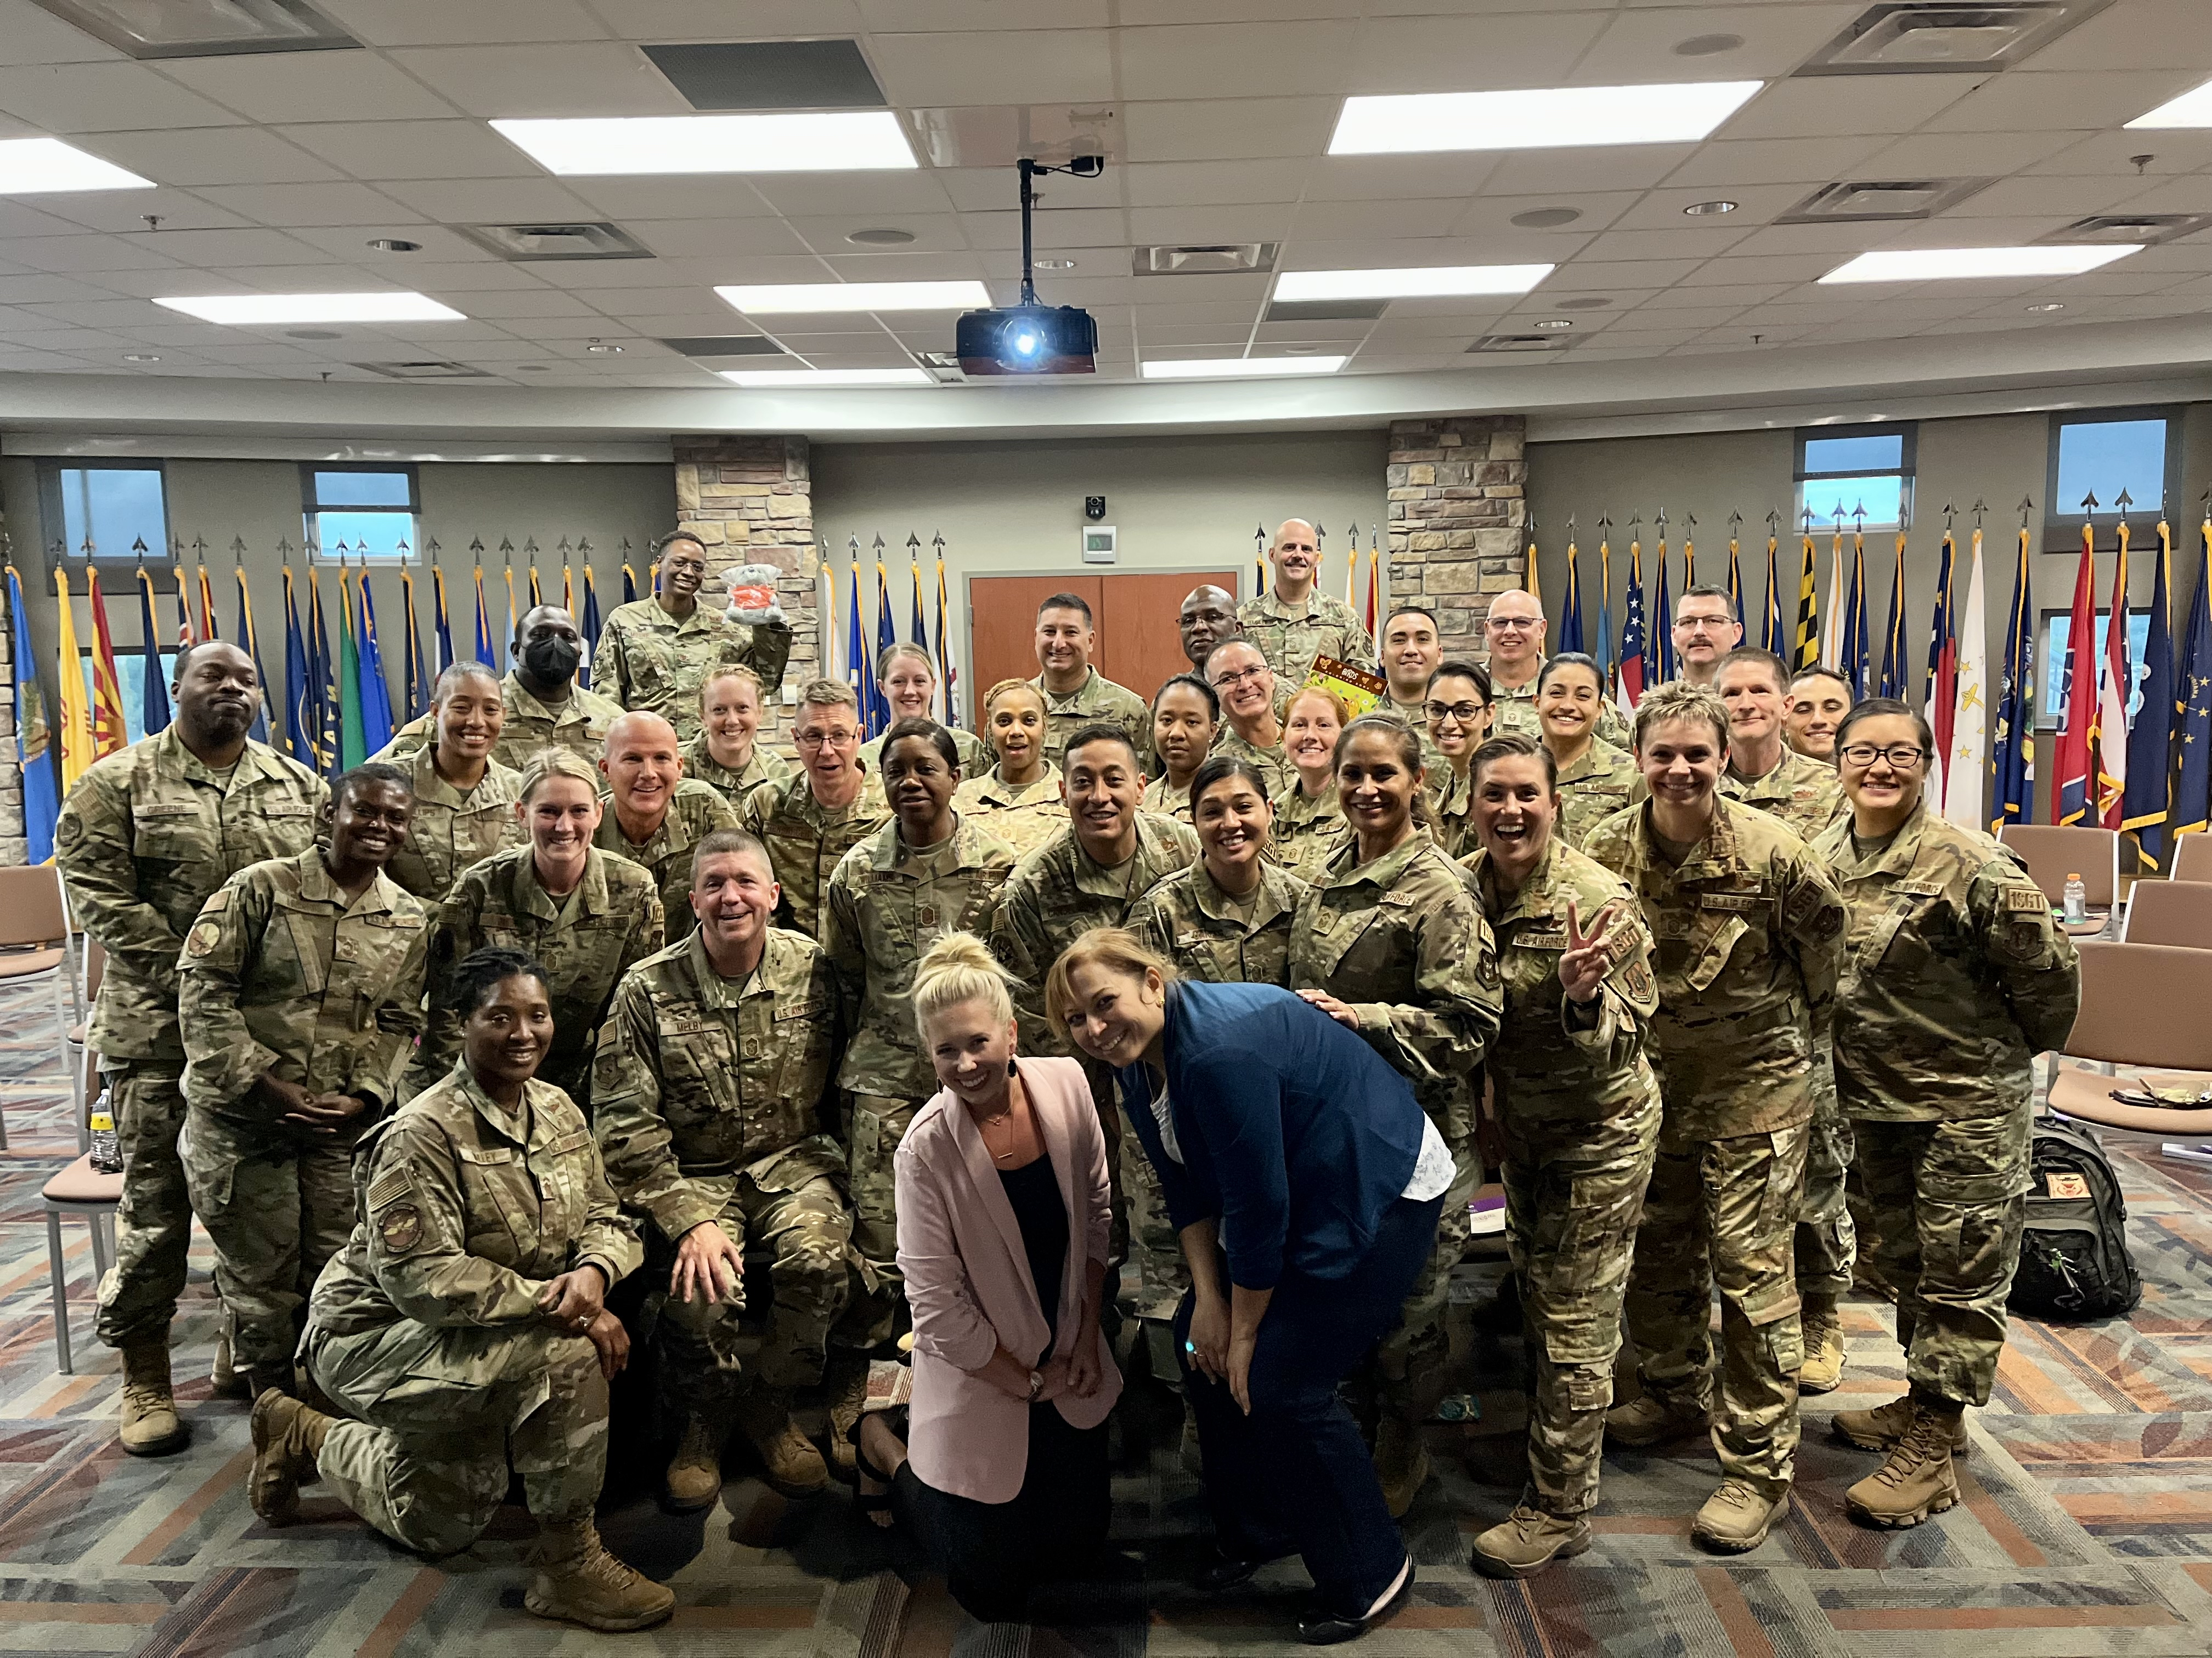
“The training was significant because it simplifies and organizes your approach to better assist someone having a potential crisis.”
“As a chaplain, this will enhance my ability to provide better help for service members who visit my office for this reason."
“Broadening my knowledge of working with people with mental health challenges both in my profession and others that I deal with in life in general.”

Slide 8
Questions for Panelists
Now that you have had some time to process your learning - what was your biggest MHFA take-away?
Has knowing MHFA impacted communication within your organizational roles and responsibilities? How?
If MHFA is implemented by you or someone else, do you feel it would be helpful in your work or in everyday life?
How would you compare MHFA to other similar trainings?

Slide 9
Now that you have had some time to process your learning - what was your biggest MHFA take-away?

Slide 10
Has knowing MHFA impacted communication within your organizational roles and responsibilities?

Slide 11
If MHFA is implemented by you or someone else, do you feel it would be helpful in your work or in everyday life?

Slide 12
How would you compare MHFA to other similar trainings?

Slide 13
Contact Us
We'd love to talk about all things
mental health and well-being.
Rachel Brauner
Extension Program Specialist – Military Program
Family & Community Health
Texas A&M AgriLife Extension Service
rbrauner@ag.tamu.edu
Lakshmi Mahadevan, Ph.D.
Associate Professor/Extension Specialist – Special Populations
Family & Community Health
Texas A&M AgriLife Extension Service
lmahadevan@ag.tamu.edu

