Slide 1
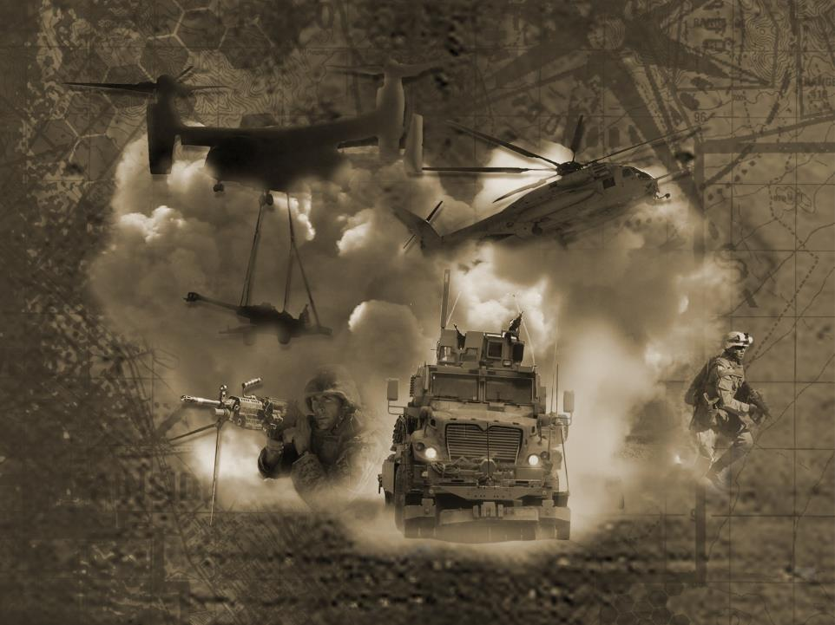

Marine Air Ground Task Force
Training Command
Proactive Encroachment Management
This Brief is Unclassified//CUI

Slide 2
MAGTF Training Command
Provides rigorous advanced individual and collective MAGTF training opportunities through Live, Virtual, and Constructive means that increase Fleet Marine Forces readiness and prepares units to think, decide, and act in the application of maneuver warfare and combined arms across multiple domains, in complex urban, mountain, desert, littoral, and information environments, to compete, fight, and win against peer adversaries and hybrid threats.

Slide 3
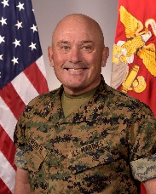

MAGTF Training Command
Marine Corps Air Ground Combat Center
MAGTFTC / MCAGCC
Marine Air Ground Training Command
Marine Corps Air Ground Combat Ctr
Chief of Staff:
Col David Suggs
Sergeant Major:
SgtMaj Jason Gillespie
MajGen Austin Renforth
Commanding General,
MAGTFTC / MCAGCC
Marine Corps Logistics Operations Group
Marine Corps Tactics and Operations Group
Dual Mission:
Marine Air Ground Task Force Training Command (MAGTFTC): Manages the Service-Level Training Exercise Program (SLTE-P), conducts Advanced Individual Training and Service-Level combined arms training to enhance the combat readiness of the Fleet Marine Force (FMF) and the Marine Corps responsibilities to national security while supporting the Marine Corps Mountain Warfare Training Center (MCMWTC) installation management functions.
Marine Corps Air Ground Combat Center (MCAGCC):
Supports the SLTE-P through logistical and service support activities and provides a standard of excellence in managing infrastructure, services, and support to the FMF and families to ensure the readiness of the tenant and resident commands aboard the Combat Center.
Marine Corps Mountain Warfare Training Center
Marine Aviation Weapons and Tactics Squadron One
Tactical Training Exercise Control Goup
Headquarters Battalion
Focus Areas:
Responsible for advanced individual and MAGTF collective training.
Provide training for the Command Element (CE), Ground Combat Element (GCE), Logistics Combat Element (LCE), and Aviation Combat Element (ACE).
Expeditionary Warfare Training Group Atlantic
Expeditionary Warfare Training Group Pacific
Reporting
MAGTF Staff Training Program
Admin Control
Coordination
Notes:
3
29 Palms training area is large enough to host a Marine Division with direct support combat logistics regiment
MAGTFTC works wot replicate pacing threat capabilities to offer the most realistic training available
Foreign forces also training at 29 Palms

Slide 4
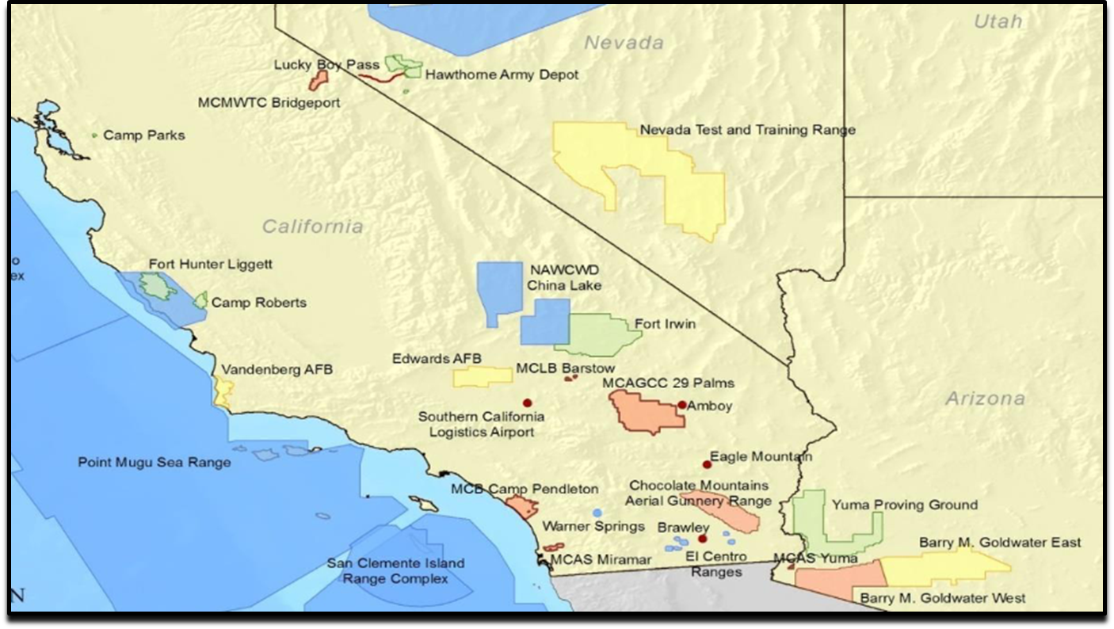


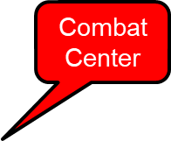


MAGTF Training Command
Mission Influence Area
Mountain Warfare Training Center
Fires
MAWTS-1

Slide 5
Service Level Training
UNCLASSIFIED
2022
2023
 | Apr | May | Jun | Jul | Aug | Sep | Oct | Nov | Dec | Jan | Feb | Mar | Apr | May | Jun | Jul | Aug | Sep
WTI
MTX
ITX
AFX
1-23
2-23
1-24
3-22
R
1-23
2-23
R
5-23
3-22
R
1-23
2-23
3-23
R
5-23
3-22
2-23
5-23
Purpose: Provide service level MAGTF training in core competency skills generating Tier 1 Readiness. Adapting SLT Events to meet Force Design requirements
360 days of live-fire combined arms training
Training 45,000 Marines, sister services and allies
Live, Virtual, and Constructed Training
Multiple domains, in complex urban, mountain, desert, littoral, and information environments
UNCLASSIFIED
5

Slide 6
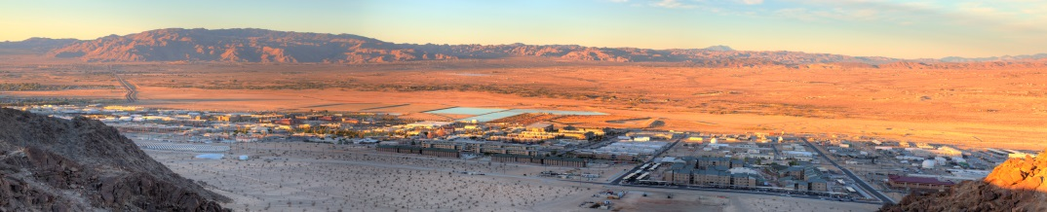
Remote & Isolated - the Benefits and Challenges
Quality of Life Challenges
  Desert Environment: Different from home for most Marines and Sailors
  Distance to services: 40 minutes to Walmart or Home Depot
  Housing: Limited in quality and quantity in local Community
  Vendor availability: Competing with Palm Springs area
  Entertainment: Most travel well over 1 hour for weekend entertainment
Operational Challenges
  Logistics: ~ 90% of “stuff” arrives via CA
  Highway 62
  Infrastructure: required to be self sufficient
  Workforce: hard to attract civilian employees with specialized skills
    - Premium paid on contracts
  Harsh Environment: Great for training
    - Tough on equipment and facilities
Notes:
6
MCAGCC is a defined by DOD as remote and isolated. It is the last thing on 29 Palms Highway before Arizona. Most resources arrive from the west via HWY 62, putting us in a position to be as self sufficient as possible. MCAGCC is home to about 10,000 active military, 1800 civilian employees, and about 6,500 family members. There are 2210 family housing units on base and the base can also accommodate up to 7,500 personnel without dependents across 29 barracks. The base produces most of its own power from solar and natural gas, has its own wells, and is self sufficient for 7 days. Family housing is about 91% occupied with most service members being assigned a home shortly after arrival.
The scale of support traveling to the base is immense. These numbers covering FY-20 are instructive: over 2.5M gallons of fuel for tactical vehicles, ~2500 personal property shipments, and 35M pounds of freight. The base also provided nearly 3M meals from 3 mess halls. The scale of maneuver training required 25,000 tons of ammunition to be handled at the Combat Center’s Magazine Area supporting 77K transactions.

Slide 7
Cultivating Defense
Community Partnerships
Foundational Programs:
AICUZ/RCUZ
Compatible Use Study (CUS)
Encroachment Partnering / REPI
Crisis and Risk Communications
Installation Resiliency Review
Engagement:
Dozens jurisdictions and municipalities
All levels of government
More than 50 organized stakeholder groups
Tens of thousands of individual stakeholders
Enhancements to Civic Engagement:
Strategic Engagement Plans (SEP)
Friends of the Combat Center
Intergovernmental Support Agreements (IGSAs)
Community Noise Mitigation Program
DOD Regional Coordination Team:
Coordination among all services
Unified voice when working with jurisdictions, project proponents, and stakeholders
  County-Wide Plan
  Renewable Energy Development
  Regional planning

Slide 8
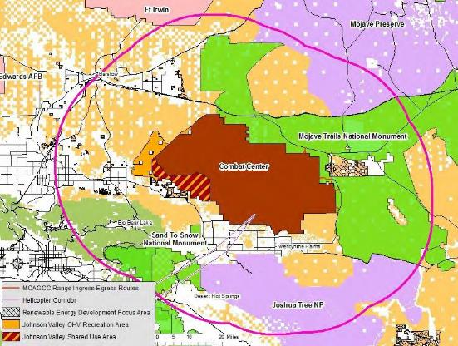
The Combat Center
Encroachment Management
Airspace
Renewable Energy development
Airspace over expansion area
Light pollution
Spectrum
Wind Turbines
All domain environment
Land Use
Light pollution
Tall towers
Public Lands
Illegal cannabis farms increase cartel presence and illegal dumping
Conservation
Increased regulatory stress/costs
Impacts to maneuverability in TAs
Renewable Energy development

Slide 9
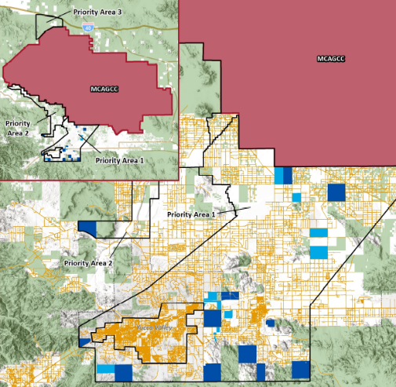
Combat Center REPI Program
Encroachment Partnering
REPI Program Objectives:
Mission buffer (airspace, TAs)
Wildlife Corridors for T&E species
Resilience (fire, aquifers, climate effects)
Overview:
11 completed projects since 2015 with 5,462 acres protected
5 NEW projects in escrow to close by FY24
Proposed Natural Resource Endowment on existing Easement
Desert Tortoise Recovery and Sustainment Program (RASP)

Slide 10
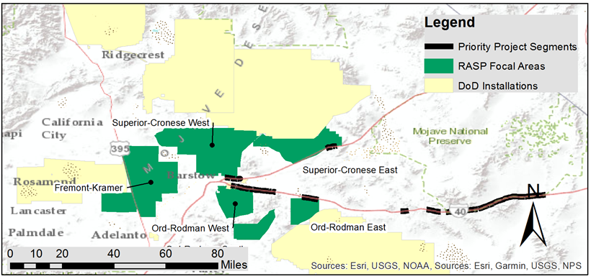
Desert Tortoise Recovery and Sustainment
Partnership (RASP) Initiative
RASP will steer partners towards species recovery, reduce risk of encroachment on installations, and garner new Biological Opinions that enable training capability, reduce regulatory burden, and execute costs on high-value cooperative conservation efforts.
Combat Center, Fort Irwin, Edwards, Barstow, China Lake
Partners: BLM, USFWS, NGOs, and others

Slide 11
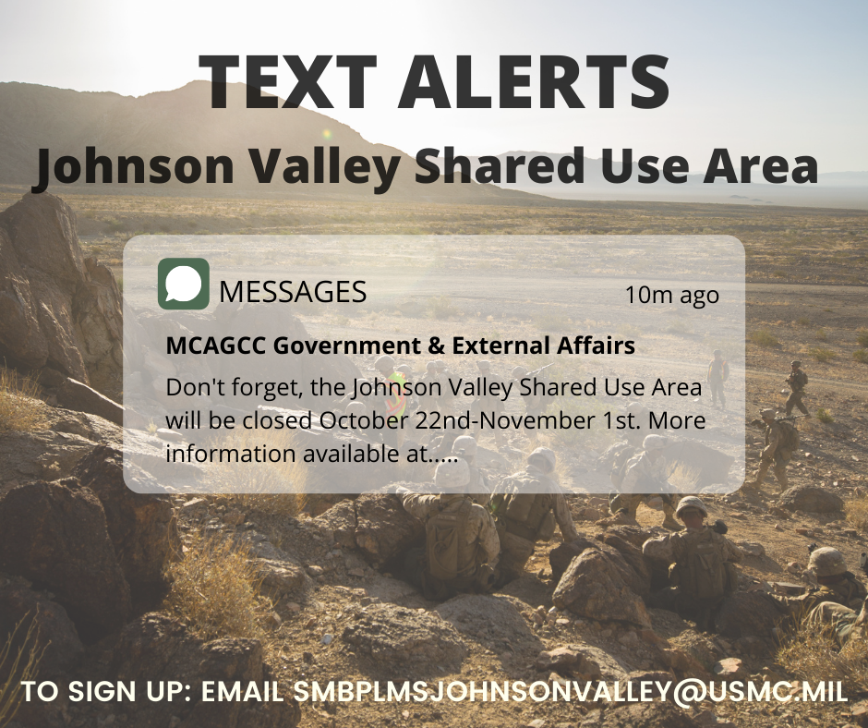
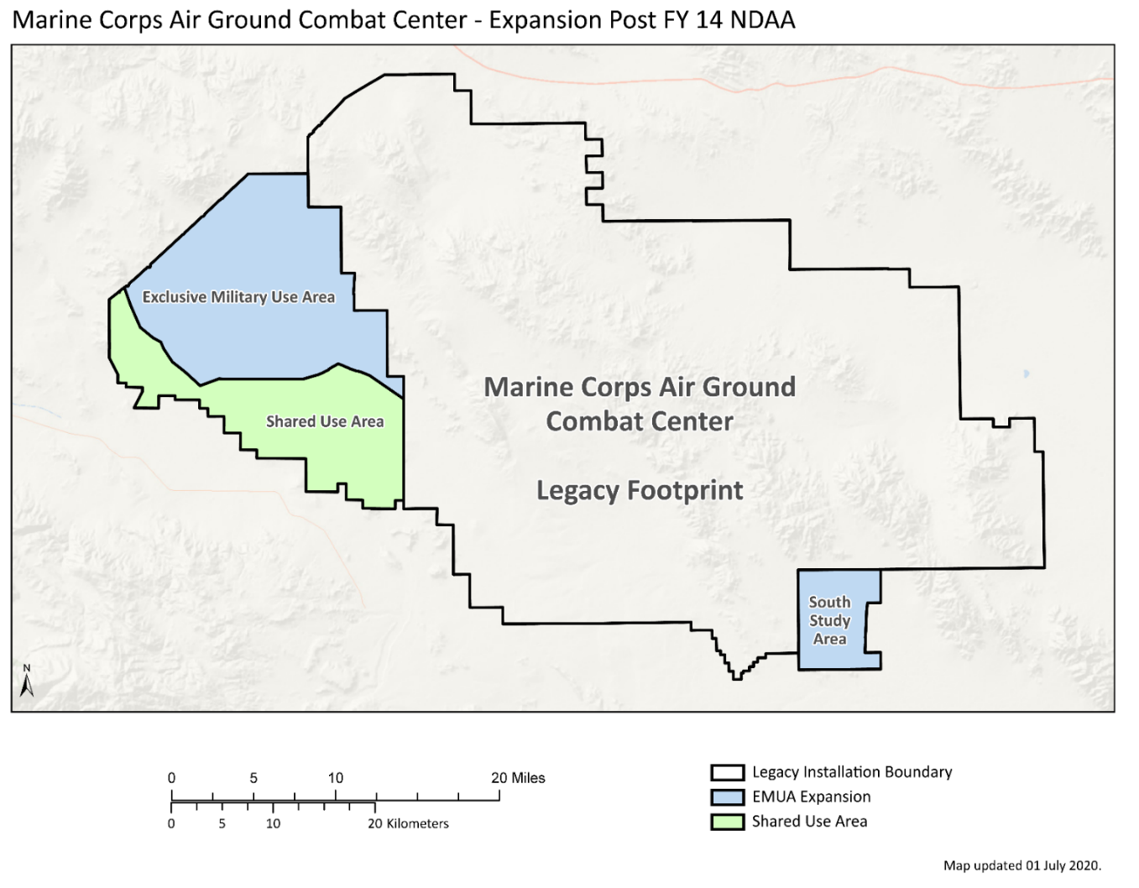
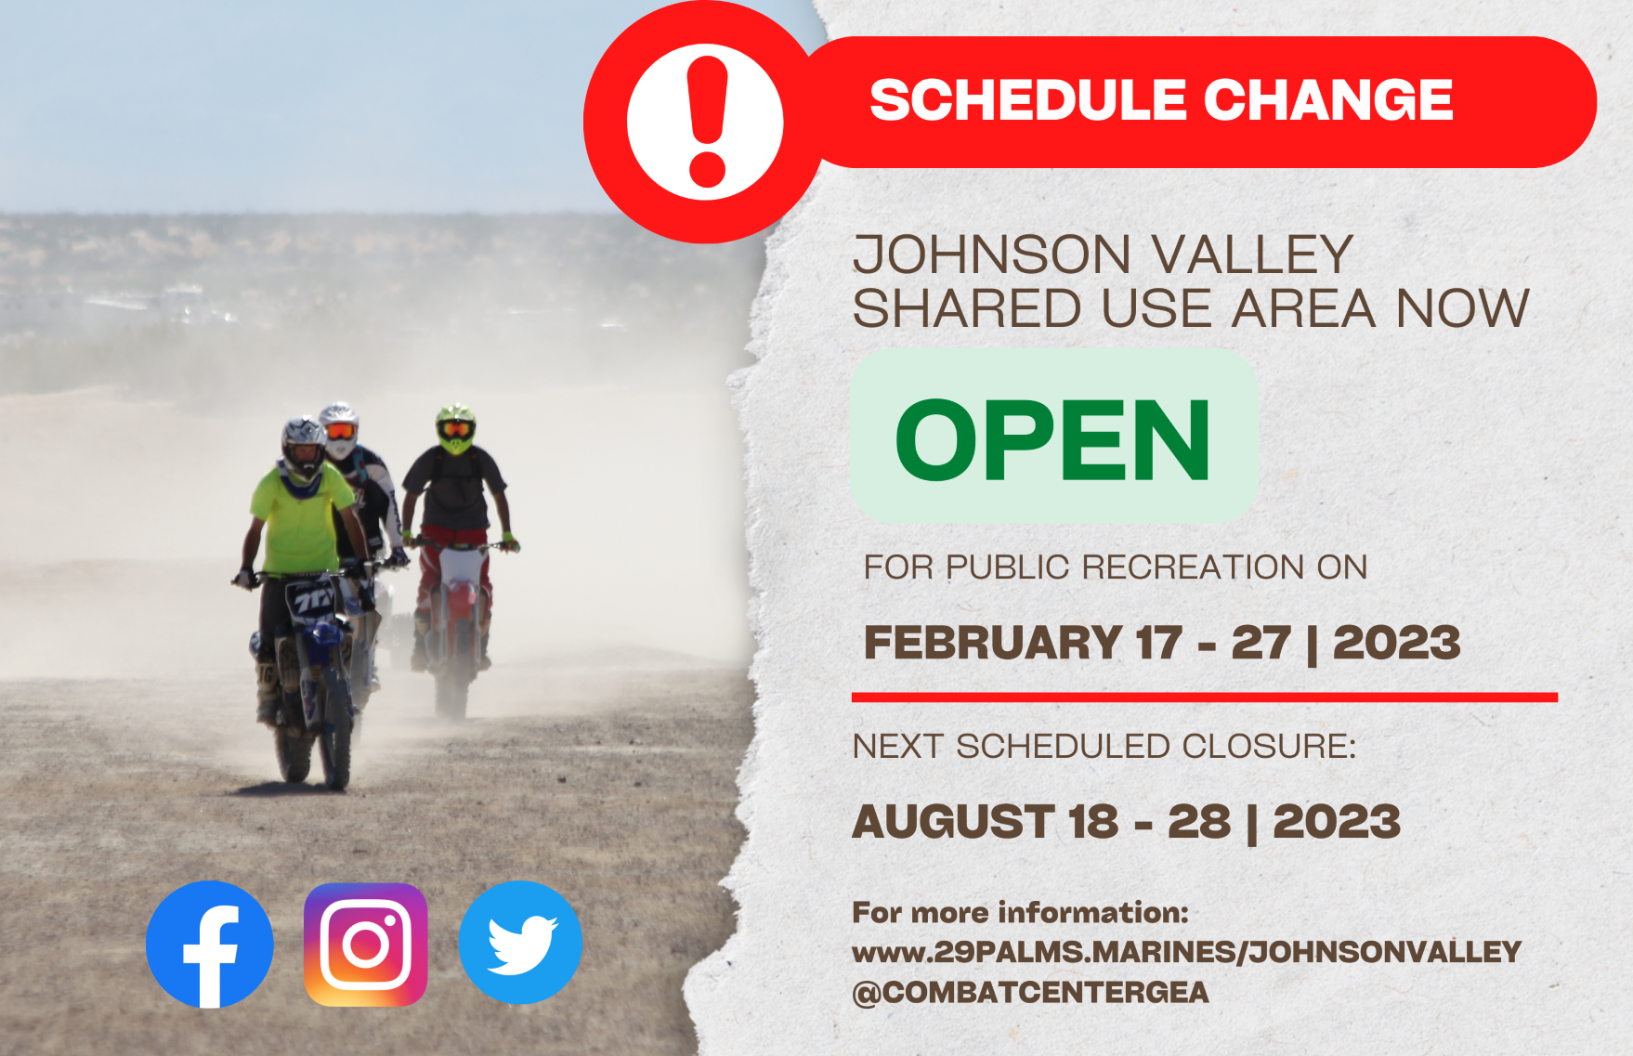
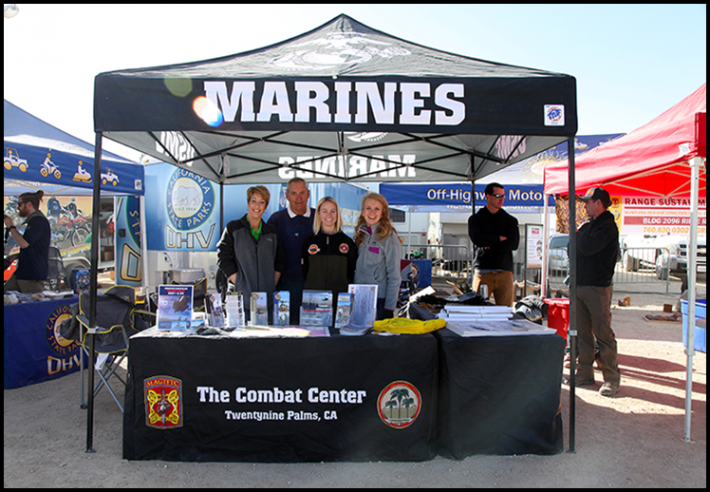
Johnson Valley Land Expansion
FY13
Expanded by 163,980 acres
Shared Use Area:
BLM manages 10 mths/yr
USMC manages 2 mths/yr
USMC priority of scheduling for two 1-month MEB Exercises
Non-dud producing LF only
Establish RMG to coordinate

Slide 12
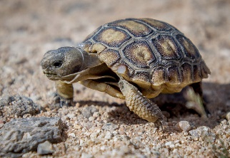
Erin Adams
Director, Government & External Affairs
MAGTFTC, MCAGCC
760-830-5473
Erin.Adams@usmc.mil

