Slide 1
MCIEAST-MCB CAMLEJ
ADC – Proactive Encroachment Management
02 November 2022

Slide 2
Agenda
History & Mission
MCIEAST Facts
Battlespace & Airspace
Cherry Point, New River & Camp Lejeune
Economic Impact
Camp Lejeune/New River
MCIEAST Operations & Training
Military Mission Footprint/ Encroachment
Encroachment Mitigation

Slide 3
History
1940: Department of the Navy purchased an initial 110,000-acre tract of land with close proximity to ports at Wilmington and Morehead City
May 1, 1941, Lieutenant Colonel William P.T. Hill was ordered by the 17th Commandant, Lieutenant General (then Major General) Thomas Holcomb, to establish and assume command of the base, then known as Marine Barracks New River, N.C.
End of 1942, the base was named Marine Barracks Camp Lejeune in honor of the 13th Commandant and Commanding General of the 2nd Army Division in World War I, Major General John A. Lejeune.
In 1944, it was renamed Marine Corps Base Camp Lejeune.
October 2005, MCIEAST established (regional command under MARFORCOM)
April 2012, MCIEAST-MCB CAMLEJ established (region/base under MCICOM)
For almost 80 years Marines from Camp Lejeune have trained to fight and win wars in the Pacific Islands, Korea,
Vietnam, Kuwait, Afghanistan and Iraq.

Slide 4
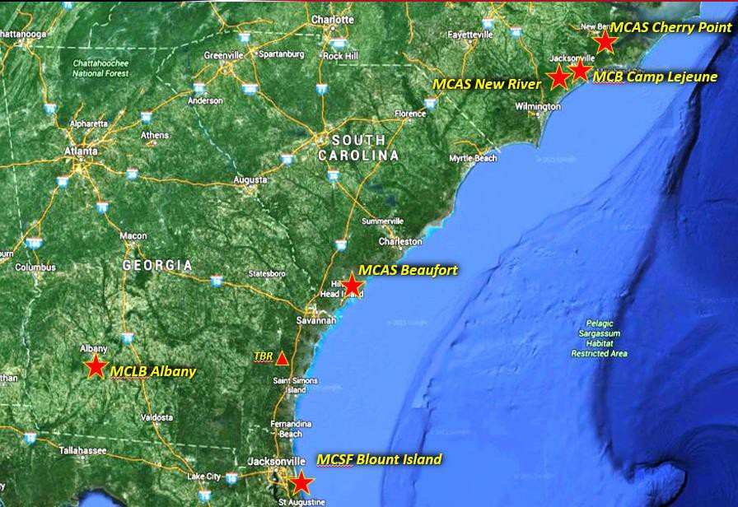
Mission
‘Places, Spaces & Services’
“MCIEAST-MCB CAMLEJ commands and controls assigned Marine Corps installations to support
the operating forces, tenant commands, military personnel and their families. MCIEAST-MCB CAMLEJ also operates a training base that promotes the combat readiness of the operating forces and the missions of other tenant commands by providing training venues, facilities, services and support in order to be responsive to the needs of Marines, sailors and their families.“

Slide 5
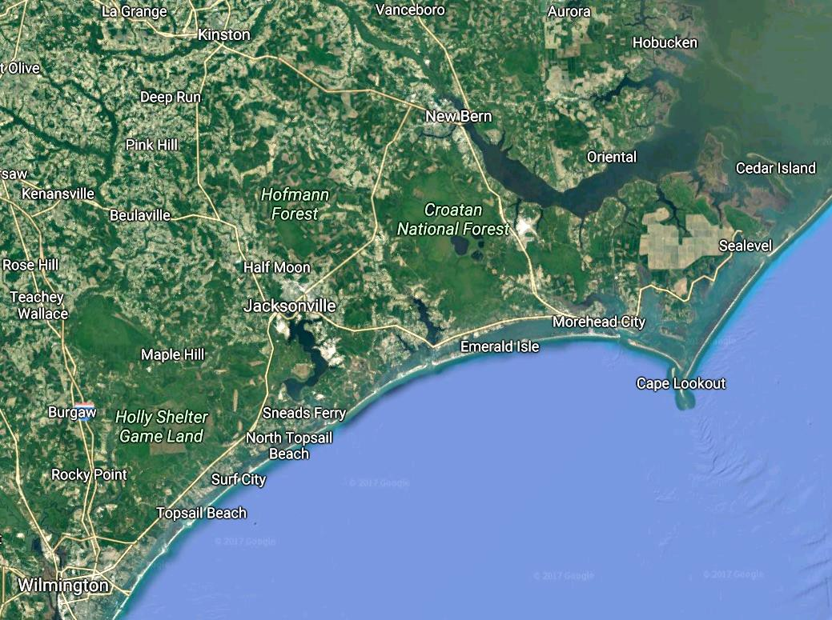
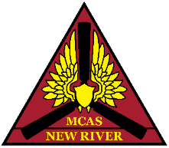
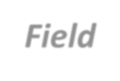
NC Battlespace
BT 9 &11
Ranges
Oak Grove
MCAS
Cherry Point
Atlantic Field
Bogue Field
CAMLEJ/New River
CONTROLLED UNCLASSIFIED INFORMATION

Slide 6
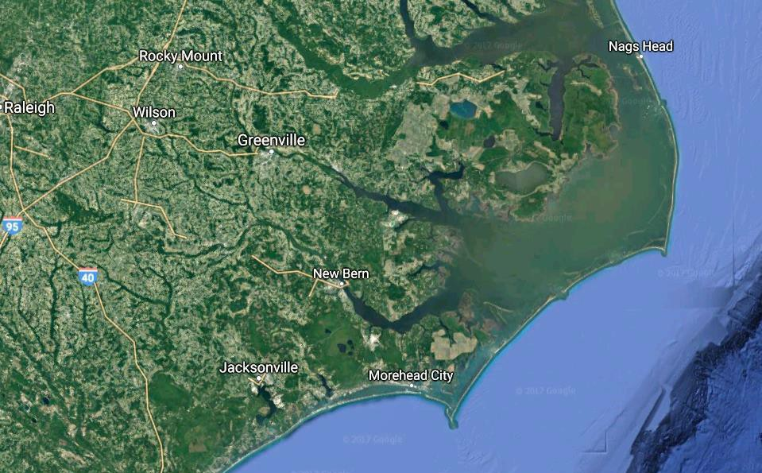
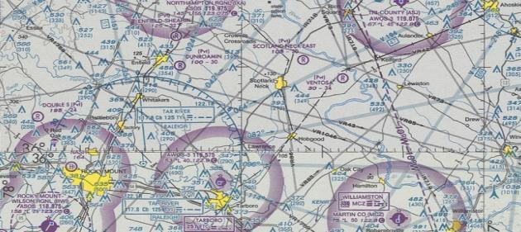
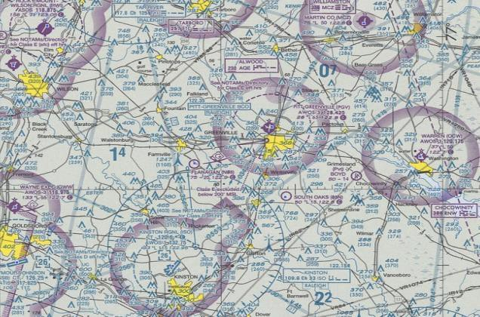
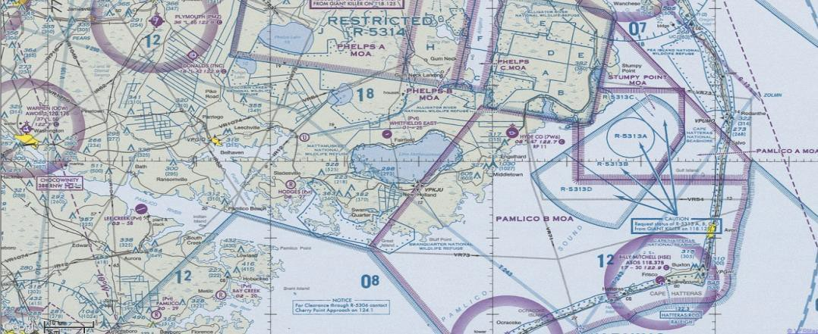
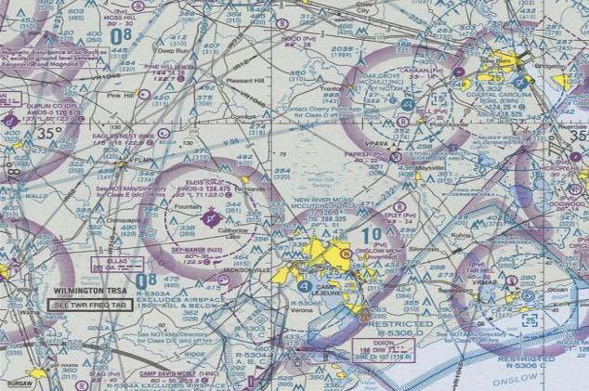
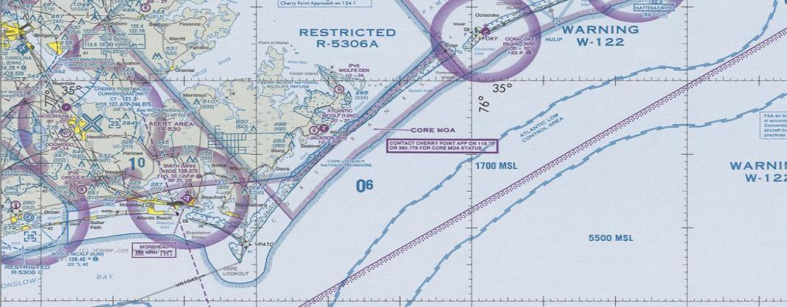
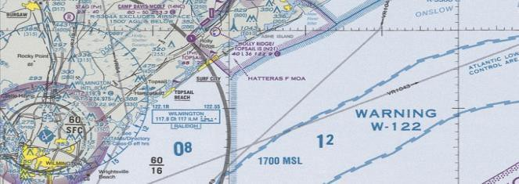
NC Airspace
NC AIRSPACE (Cherry Point RATCF)
CHERRY POINT RATCF AIRSPACE
SFC - 40
SFC - 100
Manteo
Greenville
SFC - 100
Kinston
SFC - 230
BT-9
Cape Hatteras
New Bern
BT-11
Cherry Point
New River
Morehead City
Camp Lejeune K-2 & G-10
SFC - 140
Wilmington
CONTROLLED UNCLASSIFIED INFORMATION

Slide 7
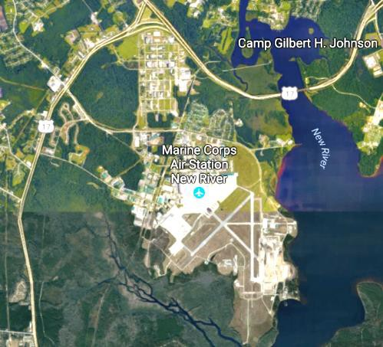
MCAS New River
Why Proactive Encroachment Management Matters to Both the Installation and Defense Communities
Total ~17,070 All Services
Based on G-1 latest Population Status Report
Tenant Commands
MAG 26 and MAG 29; all of 2d MAW Assault Support Tilt and Rotor aircraft. Includes four squadrons of CH53, seven of MV22, two of AH1/ UH1 (HMLA), two MALS, VMX-1, an MWSS
and Station HQ.
Population | 17,070
Active Duty |  | 5,987
Reserve |  | 1,619
Civilian Employees |  | 193
Military Family Members |  | 6,319
Retirees |  | 2,541
Contractors |  | 411
Salaries | $349,560,592
Military (Active Duty) |  | $230,179,238
Civilian (AF & NAF) |  | $46,986,169
Retirees (Military & Civ) |  | $72,395,185
Construction | $15,539,900
MILCON, Facilities Sustainment, & NAF Materials & Supplies $24,743,865
Purchasing, Contracting, Supplies & Materials, Equipment,
Communications, Rent, Utilities & NAF
Miscellaneous $60,343,867 Healthcare, Travel & Transport of Personnel,
Transport of Things, Contributions & Concession Revenue
Total Economic Impact: $450,188,224

Slide 8
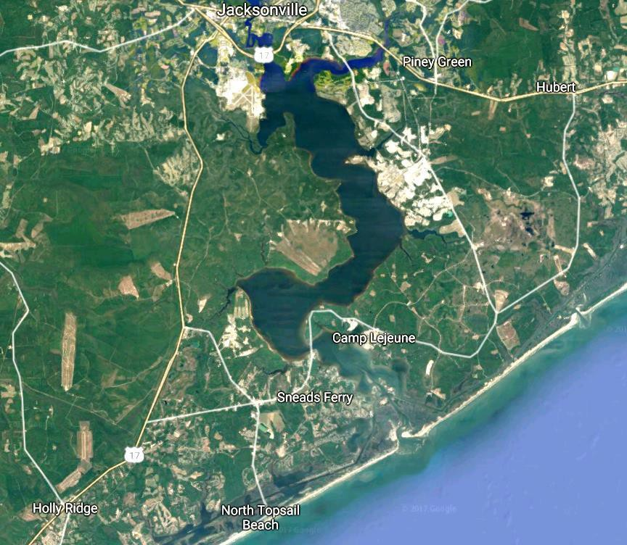
MCB Camp Lejeune
Why Proactive Encroachment Management Matters to Both the Installation and Defense Communities
Tenant Commands
II MEF(-)
MARSOC
MCIEAST-MCB CAMLEJ
TECOM Schools
Naval Medical Center Camp Lejeune
Joint Maritime Training Center
Population
Active Duty
Reserve
Civilian Employees Military Family Members Retirees
Contractors
~27,200
~2,200
~1,000
~1,200/3,200
~1,150
~280
120,968
36,948
8,965
5,496
36,215
19,344
13,927
Salaries
Military (Active Duty)
Civilian (AF & NAF) Retirees (Military & Civ)
Construction
$2,565,923,353
$1,579,417,117
$368,225,641
$618,280,595
$121,153,551
MILCON, Facilities Sustainment, NAF & Hospital
Materials & Supplies $362,537,855
New River
Cherry Point
Purchasing, Contracting, Supplies & Materials,
Equipment, Communications, Rent , Utilities & NAF
Total Economic Impact: $3,370,813,878
Miscellaneous
$321,199,119
Healthcare, Travel & Transport of Personnel, Transport of Things, Contributions & Concession Revenue
Total ~120,968 All Services
Based on G-1 latest Population Status Report

Slide 9
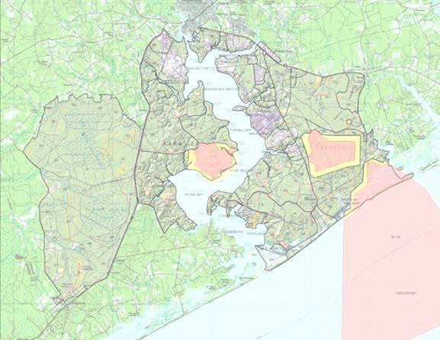
Ops and Training
Camp Lejeune Laydown
Camp Johnson
Jacksonville
Camp Geiger
Swansboro
NAVAL
MEDICAL
Urban
Complex
CENTER
MCAS
New River
Main Side
French Creek
NEW RIVER
G-10
K-2
Impact Area
Impact Area
GSR
Training Area
Maneuver
Area
Stone Bay
Court
House Bay
Sneads Ferry
HWY 17
ONSLOW BAY

Slide 10
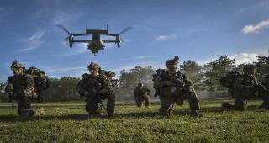
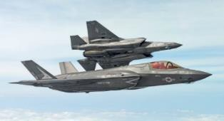
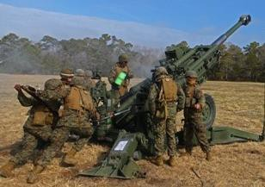
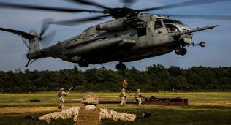
MCIEAST Operations & Training (FY-21)
updated 24 Nov 21
Marine Corps Installations (MCIs) and ranges are key national defense assets that offer a unique combination of ocean, coastal, riverine, inland, and airspace training areas.
Ranges/Training Areas
Live Fire & Maneuver (company level) | 4
Mechanized/Motorized | 6
Machineguns | 15
LAV/AAV employment | 5
Artillery/Mortar positions | 27 / 8
Rockets/Missile systems | 4
Engineering (demo/explosives) | 16
Parachute Drop Zones (PDZ) / Water Drop Zones (WDZ) | 14 / 2
Amphibious Operations | 41
MOUT/IIT complexes | 13
FOBs/Airfield Seizure facilities | 4 / 2
Assault Support (TLZ/ALZ) | 56 / 20
Offensive Air Support (CAS/Gunnery/PGMs) | 4 / 7 / 2
Anti-Air Ranges | 1
Electronic Warfare | 15
Restricted Operating Zones (UAS) | 18
Simulators (SAVT, CCS, ISMT) | 33
 | Training the Force (Pers. Trained)
 | F-Ranges |  | 10,824
 | G-Ranges |  | 85,690
 | K-Ranges |  | 197,099
 | SR Ranges |  | 51,021
 | Annual Qual Ranges |  | 95,680
 | MOUT/IIT complexes |  | 77,075
 | Amphibious/Littoral Ops |  | 11,618
 | ATC Operations |  | 249,624
 | Aviation Ranges |  | 32,773
 | Outlying Landing Fld Ops |  | 101,259
 | UAS |  | 12,986
 | Simulators |  | 71,560
Deployments (CE/BN/Sqdn)
(2) 2d MEB
(4) Marine Expeditionary Units
(6) SPMAGTF
(12) Unit Deployment Program
Major Exercises (CE/BN/Sqdn)
(8) MEFEX / MEF CE Events
(31) MEB/DIV/MAW/MLG MRX
(39) Integrated Training Exercise (ITX)
(15) Weapons Tactics Instructor Crs (WTI) & Local Fleet Support
(176) Rgt/Bn & MAG/Sqdn FIREXs & FEXs
(28) MC Combat Readiness Evaluations (MCCREs)
(12) Tactical Air Control Party (TACP) Exercises
Entry-Level Marines & Sailors Trained (TECOM)
28,498

Slide 11
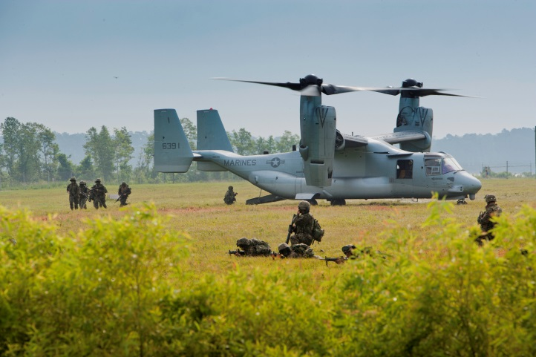
Proposed MV-22 LZs
Develop 2-3 Off-Base MV-22
Tactical Training Areas and LZs
Caledonia Prison Farm
Uwharrie National Forest
Bladen Lake’s State Forest
OPERATIONAL
FUTURE
OPERATIONAL
110 miles
150 miles
70 miles
Camp Lejeune

Slide 12
NC Military Mission Footprint
Refers to the combination of air, land, and sea space, as well as electromagnetic spectrums required to support the military training and operations of a Region or an installation. The MMF is tied directly to the Commander’s Area of Responsibility. The MMF clearly defines the mission impact boundaries wherein the military community(ies) must work together to ensure compatible air, land, sea, and electromagnetic spectrum uses for military operations and public safety. Furthermore, the MMF serves as the foundation and driver for the identification of Areas of Interest and priority areas for encroachment management.
Encroachment Categories
Air Quality
Airspace Use
Cultural Resources
Electromagnetic Spectrum
Land Use
Marine Use
Natural Factors & Climate Effects
Noise
Protected Natural Resources
Security & Safety
Unexploded Ordnance (UXO) & Munitions
Water Supply and Quality

Slide 13
Marine Corps MMF

Slide 14
Encroachment
Definition – Encroachment refers to factors that degrade or have the potential to degrade the Marine Corps’ capability to conduct current and future military testing, training, and general mission activities. Encroachment factors refer to the internal or external activities that result in present or potential constraints to Marine Corps mission capabilities. The Marine Corps classifies encroachment factors into twelve categories:
Air Quality
Airspace Use
Cultural Resources
Electromagnetic Spectrum
Land Use
Marine Use
Natural Factors & Climate Effects
Noise
Protected Natural Resources
Safety & Security
Unexploded Ordnance & Munitions
Water Supply & Quality

Slide 15
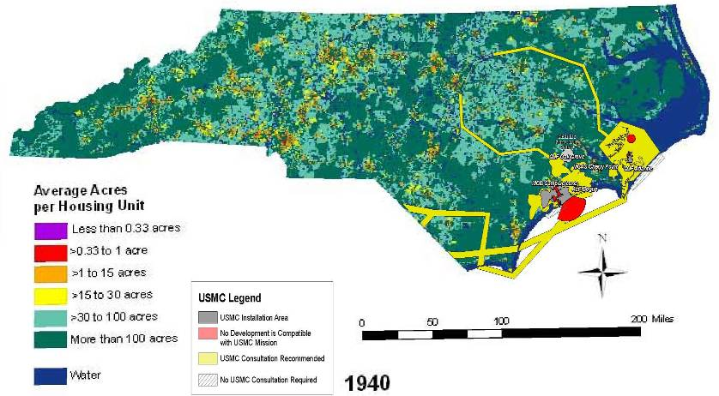
Marine Corps Mission Footprint 1940 Housing Density

Slide 16
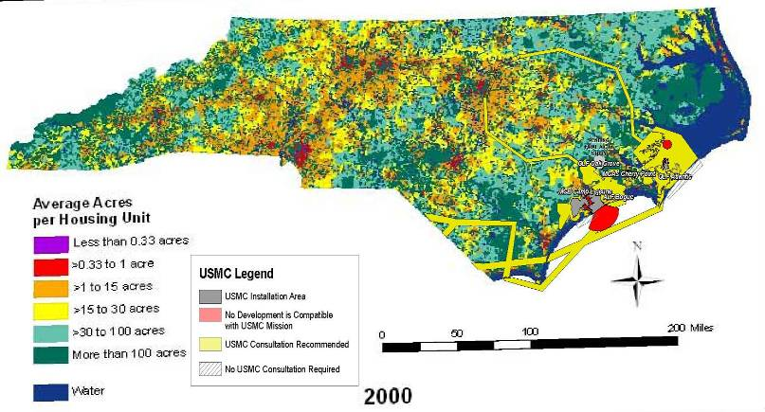
Marine Corps Mission Footprint 2000 Housing Density

Slide 17
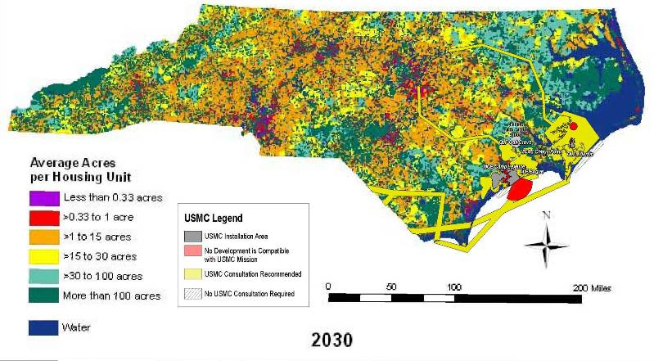
Marine Corps Mission Footprint 2030 Housing Density

Slide 18
Proactive Encroachment Mitigation Two-way Street
Moved EOD/Engineer demolition pits to the base interior.
Moved tank gunnery from SR-7 to SR-10 tank range.
Installed BLAM system to monitor range noise. If decibel level exceeded, triggers training mitigation.
Implemented quiet hours from Midnight to 6:00 a.m. M-F & Midnight to 12:00 p.m. on Sunday.
Limiting flights below 1000’.
Ceasing demolition training one hour prior to sunset unless prior approval.
Working with GA Airfield Managers to implement local course rules into Airfield Facilities Directories

Slide 19
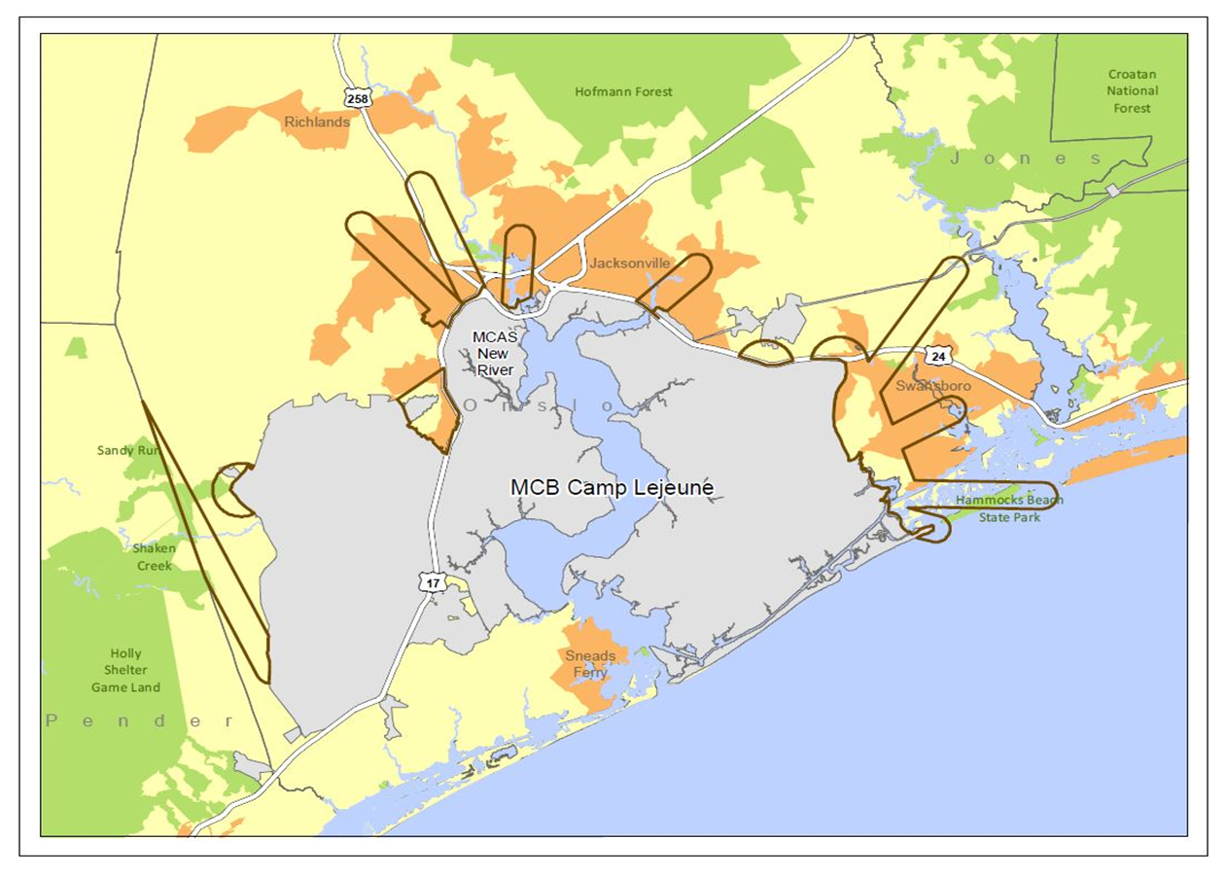
Proactive Encroachment Mitigation Two-way Street
Mil/Civ Cooperative Planning Group (CPG)
Encroachment Partnering Agreements to allow access to perpetual and term easements (REPI, ADFP)
Off-base species crediting on State lands (RASP)
Flight Path Overlay District (FPOD)
Intergovernmental Support Agreements (IGSA) – Resiliency
- Potable Water interconnect (City/ONWASA)
- Waste Water
County/Municipality Ordinances
- Solar
- Wind Farm

Slide 20
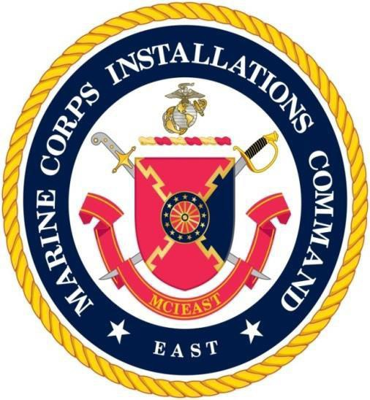
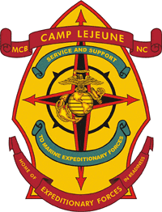
QUESTIONS

