Slide 1
Presented By: [Your Name Here]
[Presentation Date]
Visit HBAnet.org for more information.

Slide 2
Table of Contents
Overview
Membership
Programming
Signature Events
Corporate Partnership
Gender Parity Collaborative
Contact Information

Slide 3
Overview

Slide 4
Core Purpose, Vision, and Mission
Core Purpose:
To further the advancement and impact of women in the business of healthcare.
Vision:
The HBA is the global leader in gender equity, advancing women into positions of influence and decision-making to improve health equity and outcomes.
Mission:
The HBA is a global nonprofit organization comprised of individuals and organizations in healthcare committed to:
Achieving gender parity in leadership positions
Providing equitable practices that enable organizations to realize the full potential of women
Facilitating career and business connections to accelerate advancement
The HBA accomplishes its mission through strong business networks, education and leadership development, and global recognition of outstanding individuals and companies.

Slide 5
https://www.youtube.com/watch?v=conw0EtV6CY

Slide 6
Key Stakeholders
Business Professionals
The HBA serves women in the business of healthcare who strive to advance their careers. We offer career resources, volunteer opportunities, and an invaluable network that empower women of all backgrounds to grow professionally. When you are part of the HBA, you are empowered to advance your career, your company, and gender parity as a catalyst for change across the business of healthcare.
Corporate Partners
HBA’s initiatives and community of industry leaders and peers help companies advance their women further, faster. When you partner with the HBA, you strengthen your company’s commitment to advancing women, enhance your competitive edge, and become a catalyst for change.

Slide 7
A United Force for Change
When members of the HBA come together, it’s with a shared purpose: to be a United Force for Change.
We connect diverse groups of both women and men across all healthcare and life science disciplines.
By taking focused action to advance our mission, we are creating a powerful movement that directly drives professional opportunity and corporate growth.
We believe that by joining forces in the relentless pursuit of gender equity, we are doing more than uniting individuals — we are strengthening the business of healthcare.

Slide 8
Our DE&I Journey
Diversity, Equity, and Inclusion (DE&I) are the foundation of our existing organizational values, our culture, and respect for all people and their ideas and identities. Our greatest strength lies in our understanding of the diverse range of stakeholders we are honored to represent.
As 2020 presented a seismic shift in our world to more widely expose racial, gender, economic, and health inequities, our mission to advance the careers of women has accelerated the necessity to achieve more impactful change now.
Visit https://www.HBAnet.org/the-HBAs-dei-journey for the past, present, and future of our journey!
And we’re now looking ahead to our third annual…

Slide 9
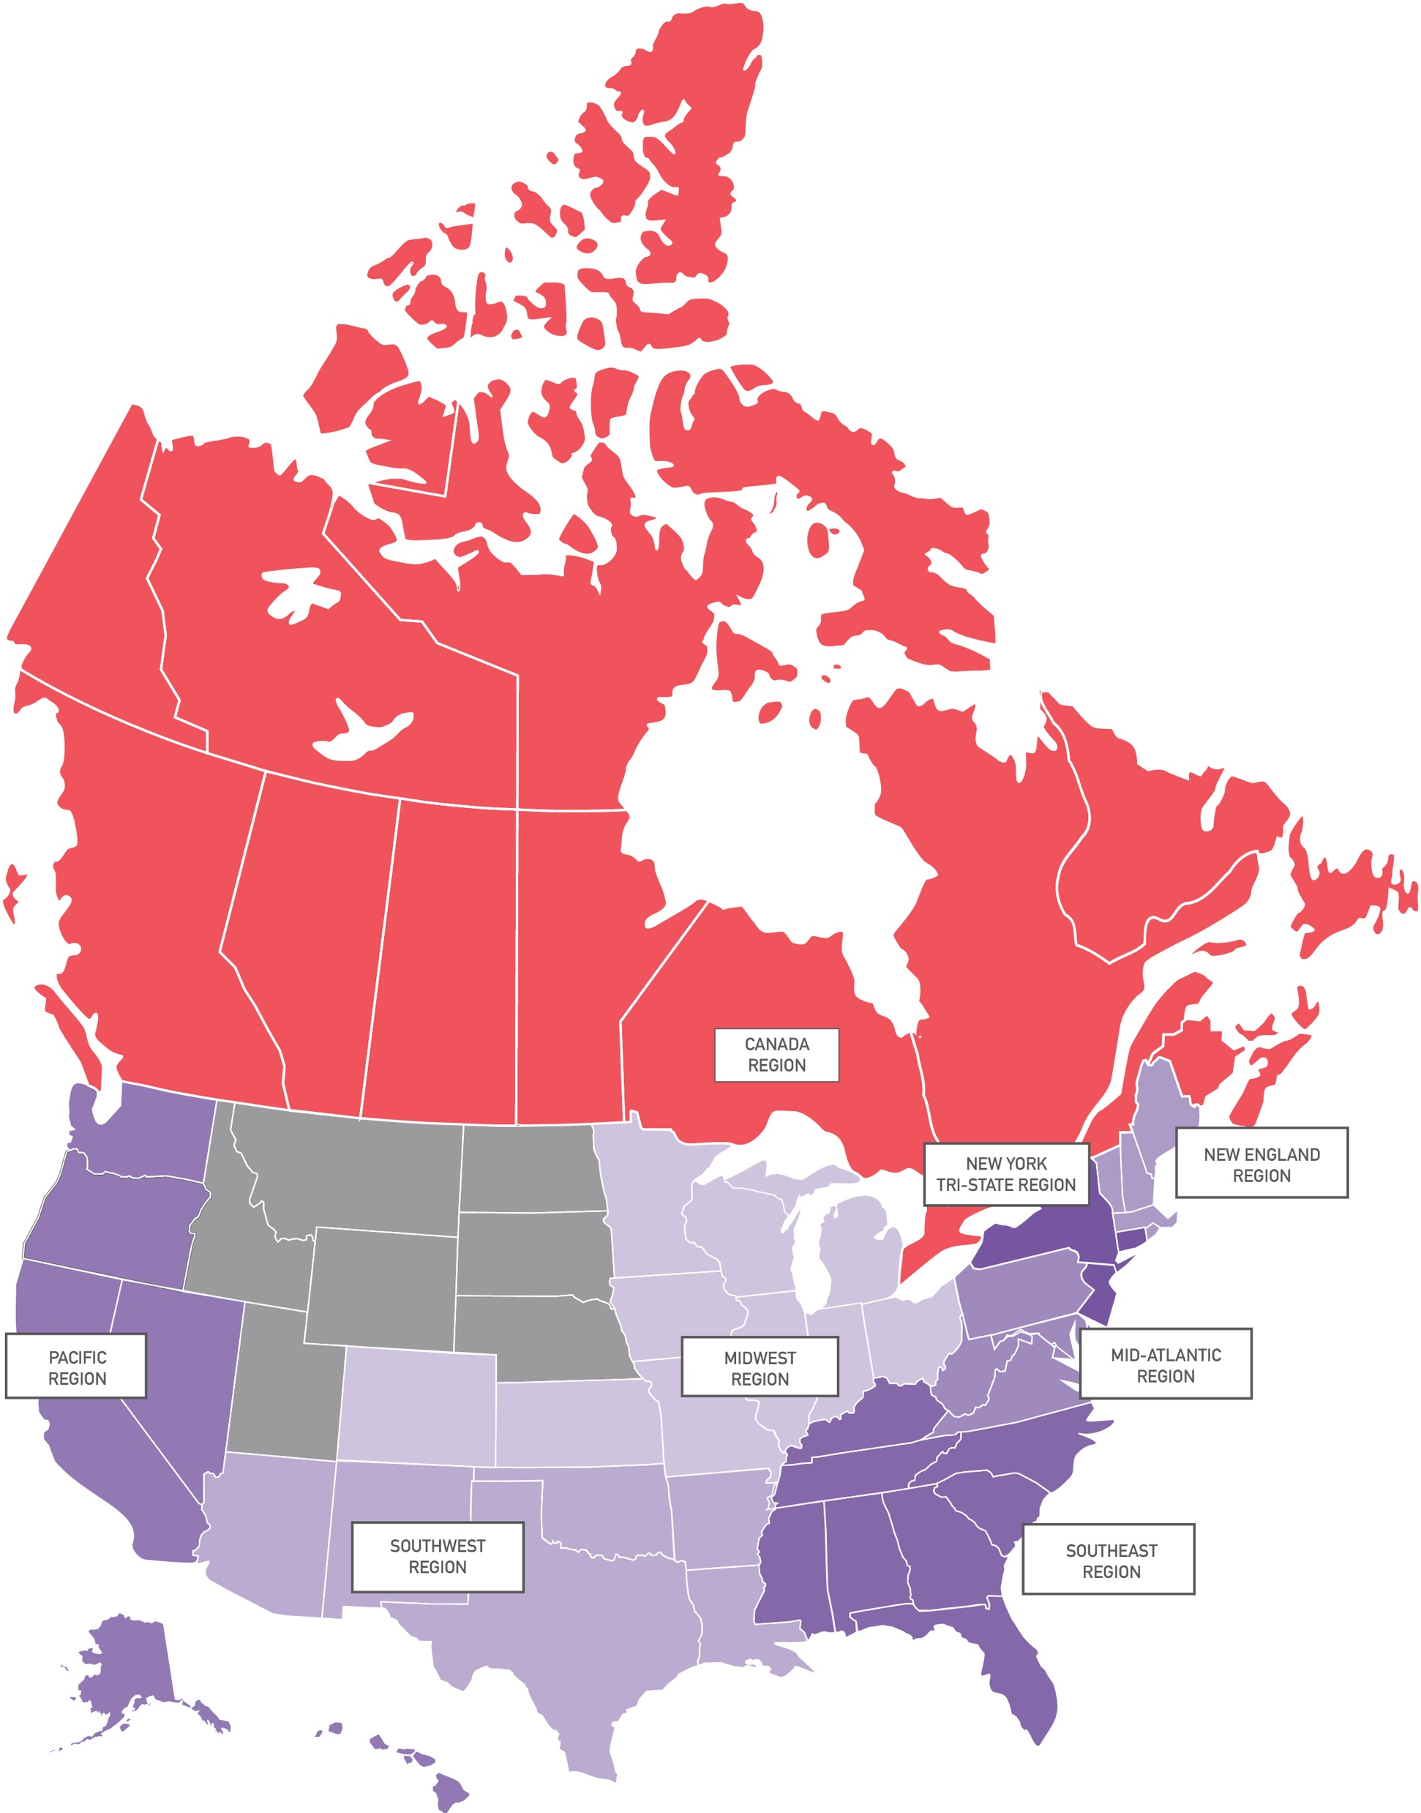
HBA Locations: North America
Canada Region
Montreal
Toronto
Mid-Atlantic Region
Greater Washington Metro
Philadelphia
Suburban Delaware Valley
Pacific Region
Los Angeles
Orange County
San Diego
San Francisco Bay Area
Seattle
New England Region
Boston-Cambridge Metro
Metro West MA
New York Tri-State Region
Central New Jersey
Fairfield County, CT
New York
Northern New Jersey
Rochester
Midwest Region
Chicago-Downtown
Chicago-Northern Suburbs
Cincinnati
Columbus
Denver
Indianapolis
Kansas City
St. Louis
Southeast Region
Atlanta
Charlotte
Miami
Palm Beach
Research Triangle Park
Tampa
Southwest Region
Albuquerque
Austin
Dallas – Fort Worth
Houston
Phoenix

Slide 10
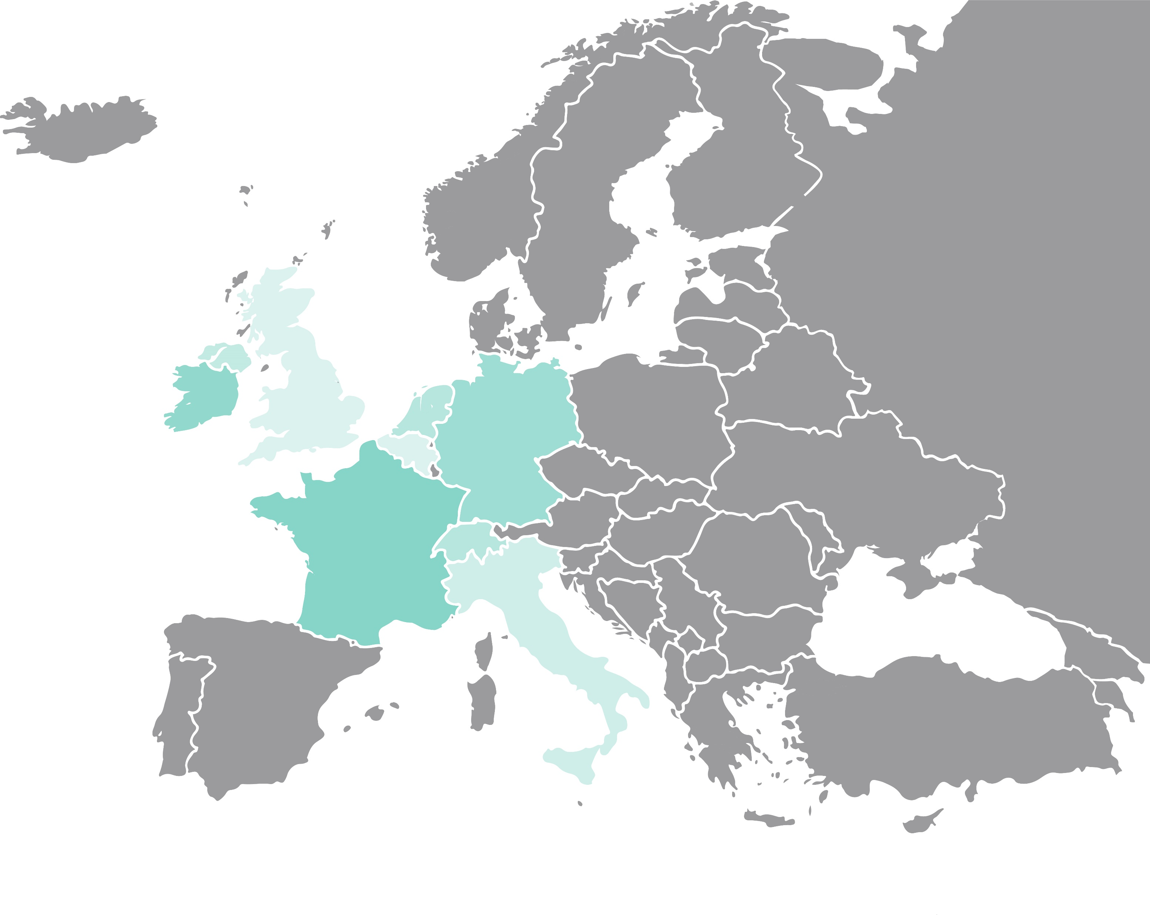
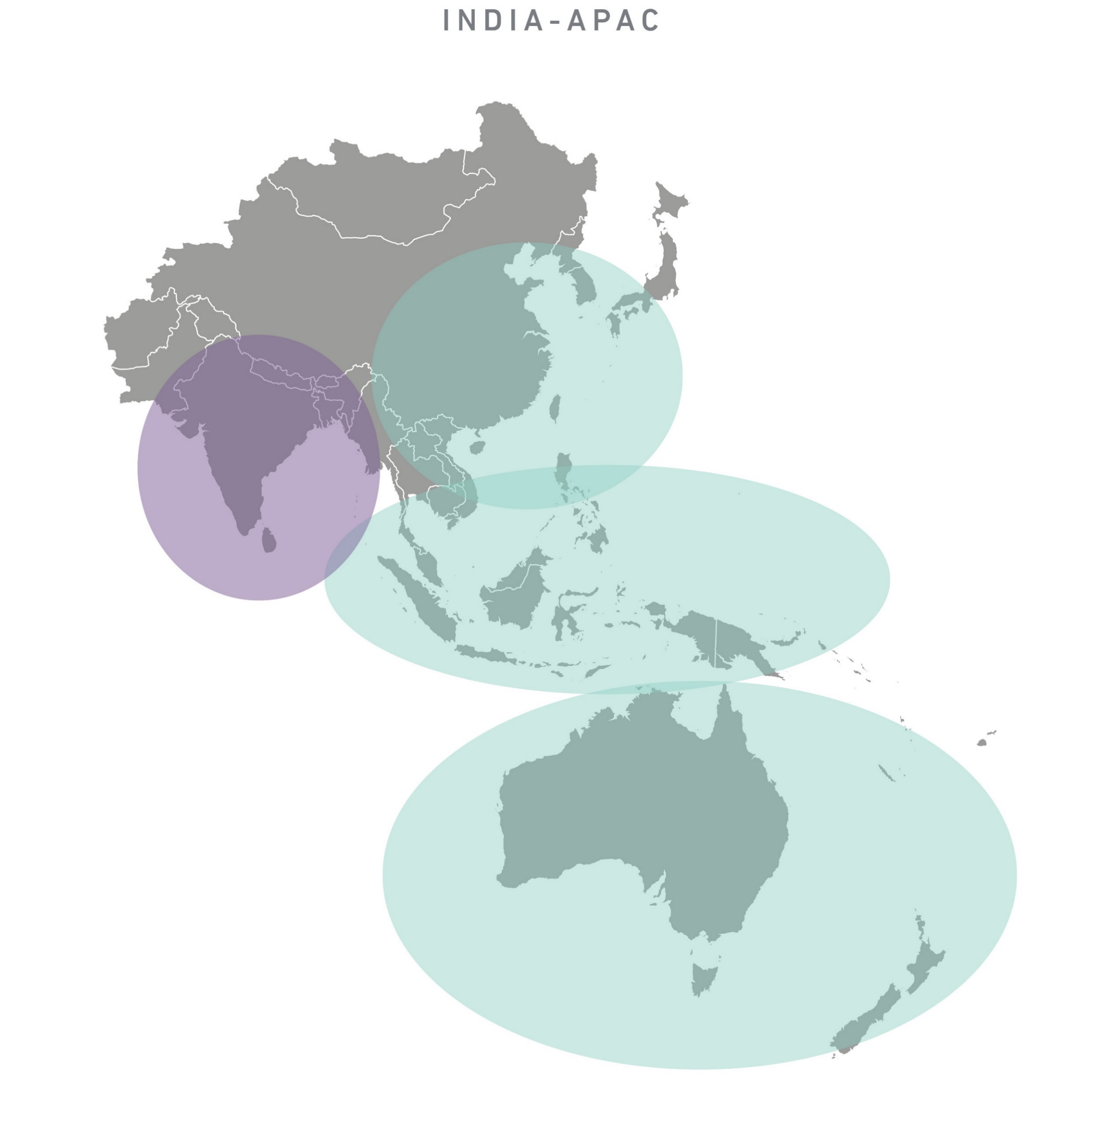
HBA Locations: Europe and Around the World
Asia Pacific Region
India Region
…and more to come!
Europe Region
Amsterdam
Basel
Bavaria
Berlin
Brussels
Dublin
Frankfurt
London
Lyon
Milan
Paris
Suisse Romande
Zurich-Zug

Slide 11
Membership

Slide 12
Connect with 14,000+ other passionate healthcare and life science professionals, representing more than 1,100 companies.
Explore new skills, share your expertise, advance your career, and be a catalyst for change.

Slide 13
The Value of HBA Membership
Show your support for our mission and be a part of our United Force for Change
Exclusive free networking events
Discounts on hundreds of educational programs
Invitation to member-only events such as the HBA Annual Conference
Access to online member directory, forums, online Career Center, and resource libraries
Opportunity to join affinity groups based on your interests
Join member-only formal mentoring programs to enhance your professional success
Leadership opportunities to broaden your professional experience and gain industry visibility
Receive recognition of leadership contributions through volunteer awards
Enjoy unique opportunities through HBA partners like Bolster who can boost your next bold move
Steer the future and governance of the association by nominating leaders and exercising voting privileges in the annual business meeting

Slide 14
Career Advancement Through Leadership
The HBA offers hundreds of engagement opportunities to make a difference!
Build your leadership experience
Increase your visibility and professional connections
Advance your career

Slide 15
Embracing Radical Hospitality
https://youtu.be/mvi8S16UfHk

Slide 16
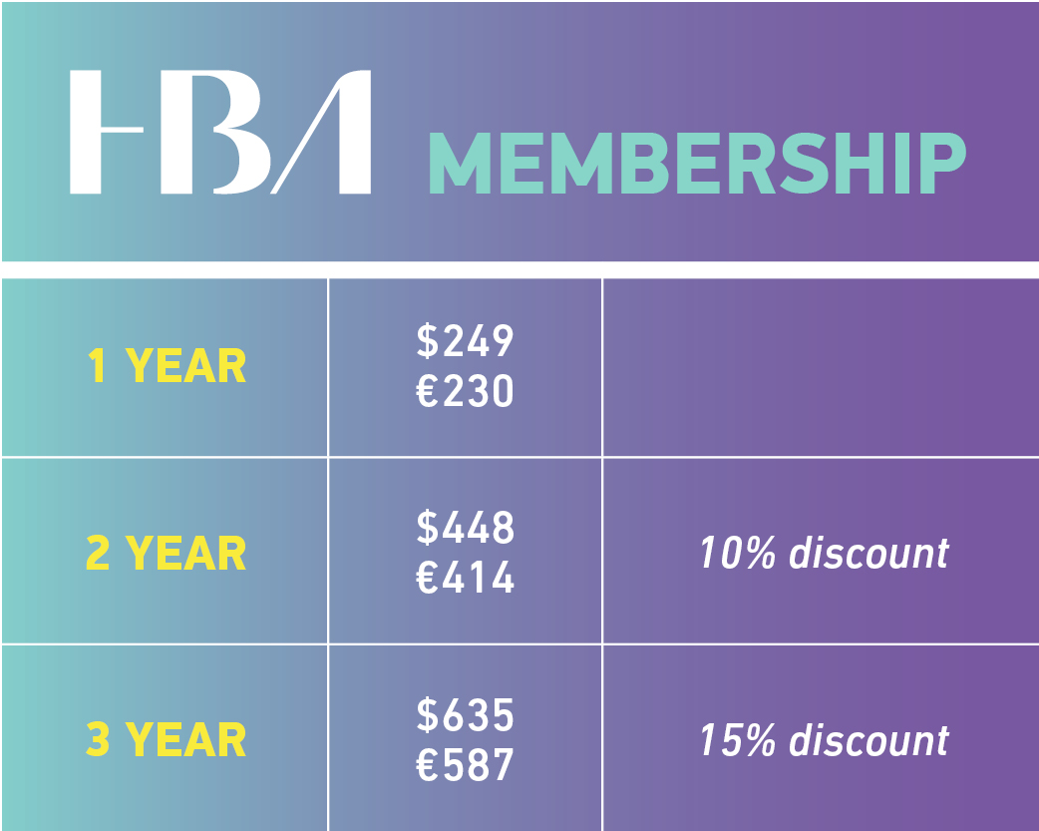
Individual Membership Fees
*The HBA is proud to offer a membership rate of $125/€110 per year for those 30 and under, which includes all benefits of full membership except voting in the annual business meeting and the ability to serve on boards. Additional discounts do not apply to this membership type. Subject to verification at the time of purchase.

Slide 17
Programming

Slide 18
Leadership Capability Framework
HBA programs are mapped to these capabilities to assist with professional development planning.
Enlighten
Demonstrates integrity
Communicates effectively
Exhibits business and industry acumen
Empower
Displays professional presence
Determined to achieve
Makes decisions and takes risks
Engage
Influences and persuades
Builds relationships and teams
Networks and ethically self-promotes
Evolve
Facilitates change
Fosters innovation
Continues to learn, grow, and transform

Slide 19
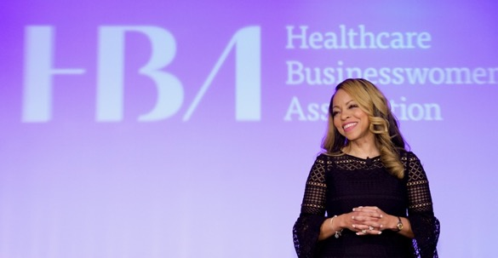
In-Person and Virtual Events
HBA members receive free or significantly discounted access to:
Hundreds of virtual and in-person local events throughout North America, Europe, and APAC
Virtual programs, such as the quarterly Career Conversations webinar series, as well as free access to select webinar offerings throughout the year
Signature events, namely Woman of the Year, the European Leadership Summit, Building Better Business Connections (3BC), and Annual Conference
In 2022, the HBA held over 400 events and members get access (and discounts) to ALL of them.

Slide 20
International Women’s Day
(Photos from the 2022 HBA International Women’s Day Selfie Station)
The HBA celebrates International Women’s Day (8 March) each year.
Get ready to #EmbraceEquity with us!

Slide 21
Career Conversations
Save the dates for the 2023 Career Conversation webinars!
Theme: Disruption on Purpose
Career Conversation 38 — 16 March
Career Conversation 39 — 15 June
Career Conversation 40 — 21 September
Career Conversation 41 — 7 December
The webinars can be purchased individually or as a series.
Visit HBAnet.org/career-conversations to learn more.

Slide 22
The HBA Mentoring Program
Enhance your professional success through the power of the HBA network!
Since 2014, the HBA Mentoring Program has impacted over 6,000 professionals and advanced women across the industry into influential leadership roles. Now is YOUR time to enhance your skills and capabilities so that you can shine and advance in your organization!
A healthy mentoring relationship provides growth opportunities for both mentor and mentee—with the added bonus of enhancing on-the-job performance.
Registration for the 2023 HBA Mentoring Program closes 31 January, 2023. Sign up today at HBAnet.org/mentoring.

Slide 23
HOPE Program
Honoring Opportunities for Partnerships & Equity (HOPE) is an accelerated one-year leadership program designed to help support and advance the careers of mid- to senior-level, high-potential talent in underrepresented and underestimated groups (i.e., LGBTQ+, women of color, women with ability diversity). The program aims to provide access and opportunity through career coaching, mentoring, networking, professional development, and volunteering.
At its core, HOPE focuses on the emotional intelligence leadership (EIL) theory, incorporating professional development programs designed to develop and enhance participant’s executive presence, mindset, and influence.
Learn more today at HBAnet.org/HOPE.

Slide 24
Affinity Groups
Get Involved
Network with like-minded members and leaders
Gain exposure with volunteer leadership opportunities
Build Community
Build a targeted professional network
Share personal and professional experiences and success stories
Stay Connected
Gain access to key individuals and content for a select slice of the industry
Stay abreast of current trends, innovations, and emerging roles and job opportunities
Find your fit today!
This is a FREE benefit of HBA membership, and you can join as many affinity groups as you’d like!

Slide 25
Global Affinity Groups

Slide 26
Signature Events

Slide 27
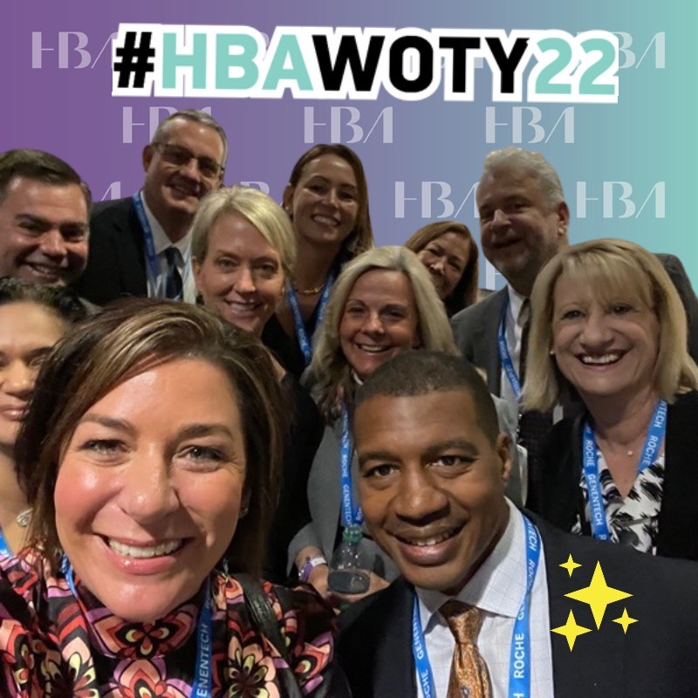
Woman of the Year
Every year in May, the HBA gathers in NYC to recognize the work of individuals who have made significant contributions to the business of healthcare and been committed advocates of gender parity in the workplace. These awards attract more than 2,000 attendees and garner significant visibility for the award recipients and their companies.
The 2023 Woman of the Year event will take place 16 May at the Sheraton New York Times Square Hotel.
Registration is now open! Secure your seat today.

Slide 28
European Leadership Summit
Held in Brussels, Belgium, the 2022 European Leadership Summit convened healthcare leaders to enjoy interactive workshops, TED-style talks, networking, and expert speakers discussing the steps they are undertaking within their organizations to achieve gender parity.
The 2023 Summit will take place from 8-9 June in Amsterdam, Netherlands at the Van der Valk Hotel Schipol. We hope to see you there!

Slide 29
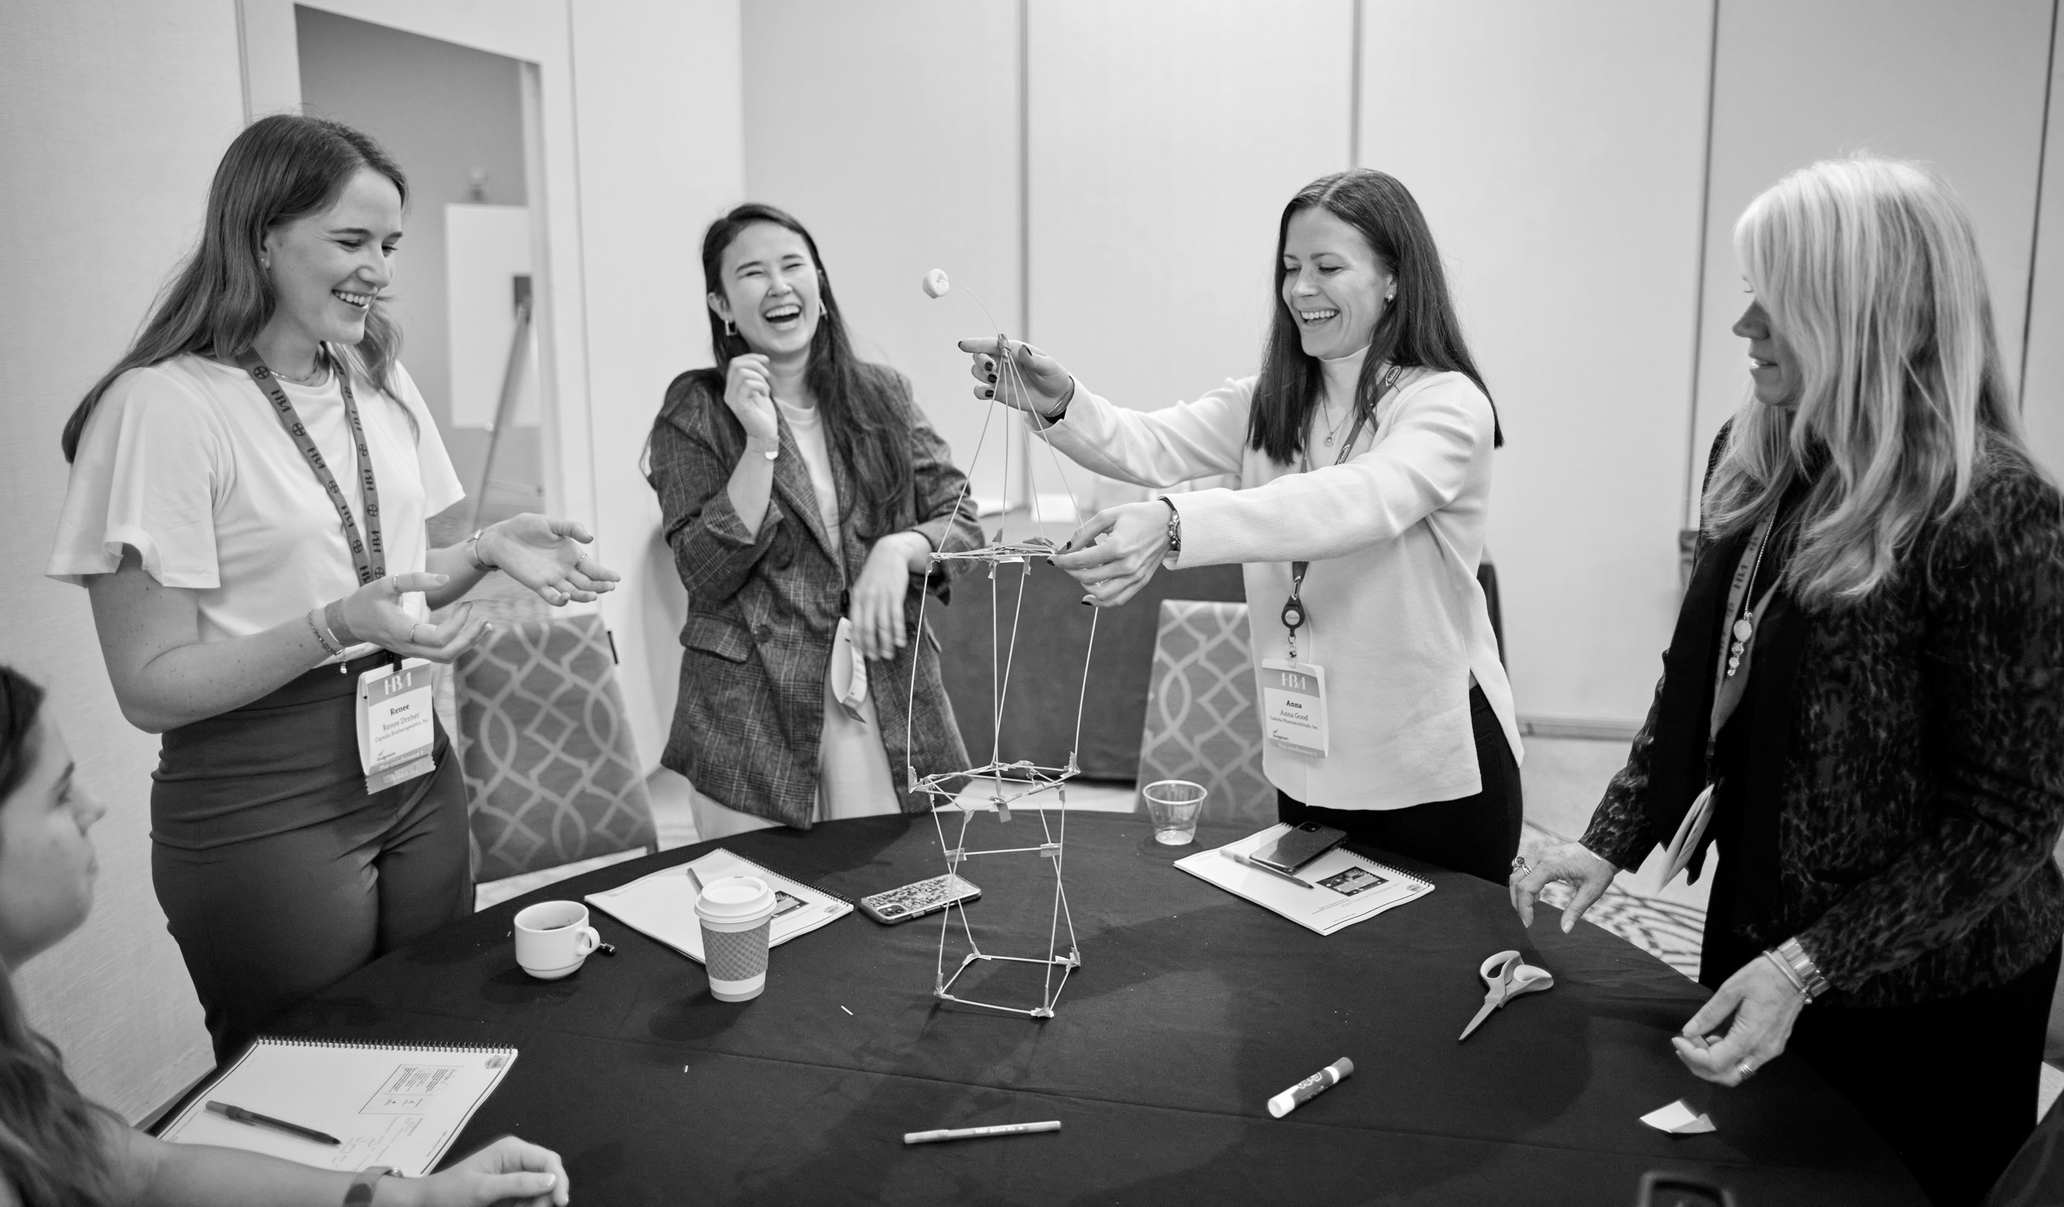
Annual Conference
The 2022 HBA Annual Conference took place in Philadelphia, PA from 1-3 November. We were so happy to have had 840+ attendees on site, representing more than 100 companies from over 12 different countries!
This conference convenes women and men at all stages of their careers to build business connections for a sustainable leadership advantage, learn from thought leaders to broaden perspective, and develop actionable insights.
The 2023 HBA Annual Conference will be held in Chicago, IL from 6-8 November. Learn more at HBAnet.org/2023AC!

Slide 30
Building Better Business Connections (3BC)
Established in 2011, 3BC is an annual event for our corporate partner community:
Chaired by an industry leader
Connecting senior executives
Collaborating to overcome organizational challenges and achieve business goals
The 2023 event will take place in New York City on 17 May. The exclusive, invite-only event provides a forum for executive leaders to engage in important conversations and leave with action items to implement as individual leaders and as a collective of leaders engaged in the business of healthcare.
For more information, visit HBAnet.org/building-better-business-connections-3bc

Slide 31
Corporate Partnership

Slide 32
Lead the Way for Change
The business of healthcare is changing rapidly and following the trends won't be enough. Lead the way by sponsoring HBA events — and gain the competitive advantage for high-profile visibility and exposure.
The Value of Partnership
Improved business results by developing talent within your organization
Increased recognition on a national platform for your brand and leadership and for celebrating accomplishments of your female talent and internal programs
Stronger relations with organizations across the healthcare industry
Empowered women within your organization — driving opportunities for leadership development and growth

Slide 33
*Partial Listing
Current Corporate Partners
*

Slide 34
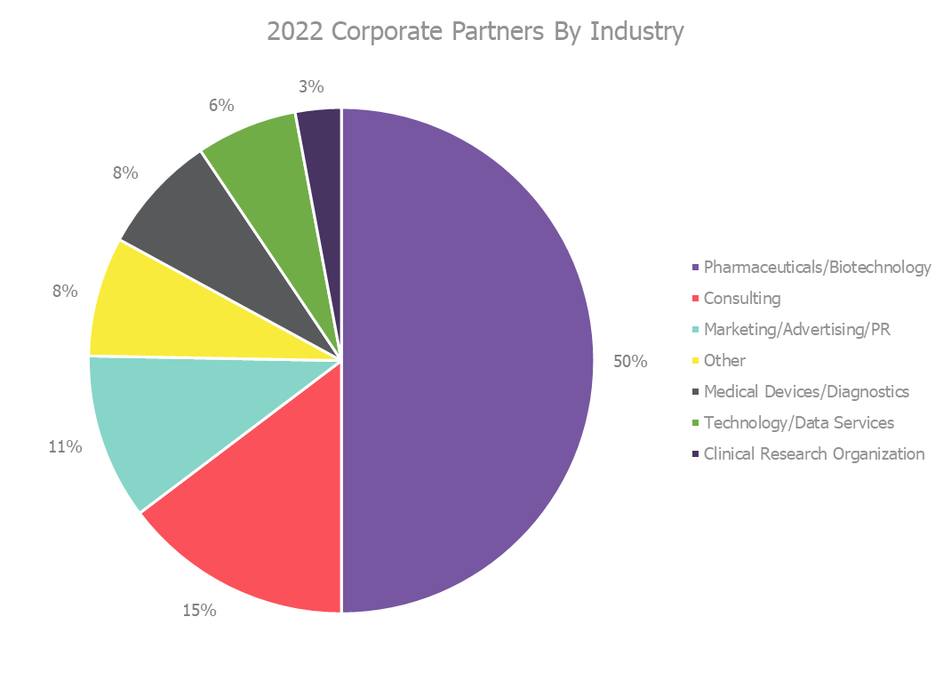

Slide 35
Corporate Partner Packages
Our corporate partner packages have been built to meet the needs and desires of all healthcare and life science organizations. Choose the path for your company by visiting HBAnet.org/corporate-partners or emailing us at CorporatePartners@HBAnet.org.

Slide 36
Rising Stars and Luminaries
Eligible corporate partner packages offer the option to designate a select number of employee members as HBA Rising Stars and/or Luminaries. Award winners benefit from significant year-long visibility.
HBA Rising Stars are professionals in the early stages of their career. They represent various sectors of the healthcare industry and are designated by HBA's corporate partner organizations. The honor recognizes individuals’ outstanding performance, commitment to excellence, and valuable contributions to their companies’ success. The Rising Stars are inspiring leaders and are celebrated for their vision, dedication, and action.
HBA Luminaries are professionals with more than 20 years of professional industry experience, serve as a role model in their company, actively mentor and sponsor others, and are shining examples of transformational leadership that the organization wants to formally recognize.
Rising Stars and Luminaries are honored at the annual HBA Woman of the Year event.

Slide 37
ACE Awards
The prestigious ACE (Advancement. Commitment. Engagement.) Awards program recognizes exemplary leadership initiatives that advance and enhance the careers of women.
Interested? Here’s what you need to know before applying:
The application process is open to public and private companies of all sizes.
Winners gain significant industry visibility!
Your application will receive feedback from independent judges on:
Business performance
Sustainability
Stewardship
Execution
Measurable results
2022 ACE Award Winners: Delix Therapeutics and Pfizer UK

Slide 38
Ambassador Program
The HBA Ambassador Program helps Corporate Partners* accelerate the development, advancement, diversification, and visibility of their emerging talent pool. It also aids talent retention through ongoing leadership training.
This 12-month leadership development opportunity brings together an internal task force of 15-30 employees focused on individual development goals and impactful group initiatives for your organization.
The program is self-directed, customizable to corporate goals, develops a motivated and engaged HBA community within your company, collaborates with and enhances existing employee resource groups, and provides access to HBA’s global community.
HBA's global Ambassador Program Committee of 100+ trained volunteers will work with your organization to develop, launch, and operate your company’s program.
Learn more today at HBAnet.org/the-hba-ambassador-program
*Available exclusively for Purple, Gold and Silver level partners

Slide 40
HBA’s Gender Parity Collaborative is an award-winning and growing consortium of healthcare and life sciences companies dedicated to accelerating gender parity by fostering and adopting systemic changes in the industry workplace.
Together, Collaborative companies commit to taking an active role in defining strategies, measuring performance, creating change, and inspiring others.

Slide 41
Impact and Key Priorities
The Collaborative brings together senior executives to discuss systemic changes and proven solutions needed to accelerate the pace of change — and transform our industry in the process.
On average, Collaborative companies have more women at every level — from entry-level all the way to the C-suite — than their pharma industry peer companies.
The Collaborative’s work is data-driven — allowing for cohort-specific benchmarking, tracking, and measurement of progress and impact.
Ongoing Key Priorities
Advancing
Women of Color and Cultural Ethnicities
Creating Inclusive Cultures and Capabilities
Driving Accountability for Inclusion Throughout Organizations
Engaging Men as Allies
Tackling the Broken Rung

Slide 42
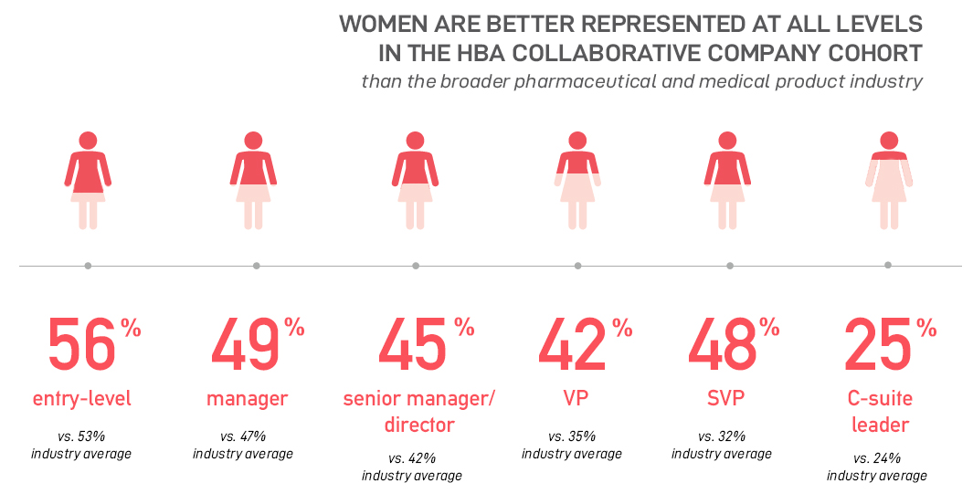
Source: Gender Parity Collaborative Insights & Impact 2021 Report

Slide 43
HBA Collaborative companies are accelerating gender equality progress in the healthcare and life sciences industry – and they’re doing it quicker than their peers.
Source: Insights & Impact 2021 Report

Slide 44
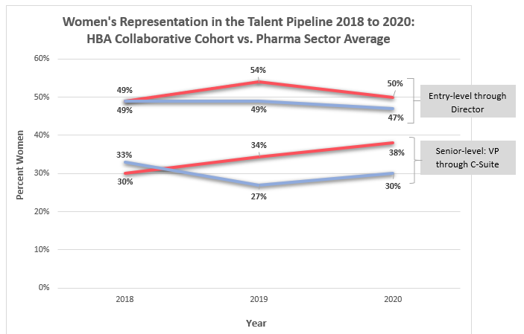
From the start of 2018 to 2020, the Collaborative doubled the percentage of women at the SVP level, nearly achieving equal gender representation and paving the way for breakthroughs into the C-suite.
The Collaborative has increased the percentage of women of color in leadership roles each year since 2018, the first year our consortium was launched. The cohort has more women of color in leadership compared to the corporate U.S. average.
For more data, insights, and impact, see the Insights & Impact 2021 Report.
Source: Insights & Impact 2021 Report

Slide 45
Evolution of the Gender Parity Collaborative
Launch an industry consortium
Establish priorities and industry benchmark
Evolve offering and continue global expansion
2018
2019 – 2022
2023 and Beyond
Create consortium of companies committed to accelerating gender equality, with a focus on engaging executives to transform organizations through systemic changes
Define the consortium’s priorities
Discover and share best practices across companies through Global Council and Solutions Summits
Establish industry benchmark; data confirms that members, on average, are outperforming broader industry in women’s representation and other markers
Increase collective influence and reinforce the Collaborative as leaders in advancing gender equality to improve health equity and health outcomes
Continue expanding global presence
Publish proprietary data and share best practices and resources externally

Slide 46
Questions? Contact [NAME].

