Slide 1

Assessing
Child Safety
Child Protective Services Policy

Slide 2

Engagement
Supervision
Quality Assessments
Provoke Awareness
Time Management

Slide 3
Provide foundational knowledge and practice opportunities with the reassessment of safety.
Strategies for better engagement with families to assist in the assessment of child safety.
Information regarding fostering connections and maintaining sibling relationships.

Slide 4
ENGAGING: Effectively joining with the family to establish common goals concerning child safety, well-being and permanency.
Engaging is the ongoing ability to establish and sustain a genuinely supportive relationship with the family while developing a partnership, establishing healthy boundaries and maintaining contact as mutually negotiated.
Notes:
Melissa
Discuss why engagement is important. Sets a foundation.

Slide 5

ASSESSING: Gathering information about reported concerns and family needs, evaluating the relevance of that information, and identifying family strengths and community resources that may be applied to address those concerns and needs.
Assessment is the process of gathering accurate, comprehensive information using relevant and credible sources of information, documenting the information using appropriate assessment tools, and objectively analyzing the information to determine the best course of action.
Notes:
So what do we mean when we say assessing?
In my min2, Assessing can essentially be broken down into 3 processes.
First is the information gathering process. This is where we rely heavily on our engagement tool to ask questions, be respectfully curious, and gather a lot of information about what is going on with the family. Important to note is that this process does not stop with the assessment/investigation phase of a case or the initial home study evaluation of a foster or adoptive family. Assessment is an ongoing process, akin to Continuous Quality Improvement, where we are consistently gathering and weighing new information.
A key to success in the information gathering process to always start with the families STRENGTHS and we will talk about this a little more as we get a little further along today.
The second process is evaluating the information we collected. Many times we will refer to this process as critical thinking. We’ll hear more about critical thinking in a little bit. This is where you look at the information you gather and figure out how it all fits together to form a wholistic picture of the family. You ask yourself questions such as: What are the family’s strengths? What are the areas of concern? What is day to day life like for this family? Who or what are supports that the family has access to?
You may also be asking yourself things like… Does all of this information line up? Have I received contradictory pieces of information that need to be reconciled? Are my sources of information credible?
The third process is analyzing the information, which also requires good critical thinking skills. This is a little different than evaluating, in that it is a more thorough process where you methodically look at the information you’ve collected – you go through it with a fine-tooth comb – so to speak; for the purposes of understanding what it all means; it’s all the process by which you apply your professional judgement and make an interpretation of what the information reveals in terms of the big picture of family functioning. Synthesizing all of the information. So for example, you’re looking at how the current family dynamic - including things such as the child’s age, vulnerabilities, and adult protective capacities- may impact the potential for future maltreatment. You’re thinking about what services and community resources may be a good support in addressing the concerns you identified and the families’ needs. The analysis process also involves clearly documenting the information you gathered, and the conclusions you’ve came to by using the appropriate assessment tools.
These different components of assessment will most likely look a little different depending on where you’re at and what your role is in our statewide child welfare system. If you are screener your assessment process is a lot more limited than if you are an intake worker, or ongoing caseworker, or a foster care licensing worker, or an adoption assessor. But regardless of what the assessment process looks like for you there are some key “ideal practices” that are applicable to all child welfare professionals regardless of your role.
3-5 minutes
(Lindsay)
15 Minutes Into Webinar

Slide 6

ASSESSING: IDEAL PRACTICE
Seeks and reassesses safety and risk information at each decision point and at prescribed intervals throughout the family’s involvement with the agency.
Notes:
Safety and risk-re-assessments should also be conducted on an ongoing basis - both at CRITICAL DECISION POINTS and also at prescribed intervals – for Ohio this is during the 90 day case reviews and Semi-Annual Administrative reviews (SARs).
What are critical decision points?
A critical decision point is anytime the case situation changes and there could be a potential impact to the safety or risk balance for the family – think back to our 3 overlapping circles – then safety should be re-assessed. Also in the case of reported rule violations for foster parents; we need to take that opportunity to do some re-assessment of the family’s abilities to meet the needs of the children placed in their home and determine if additional supports are need to help the foster parents. Or if a new youth enter the home and brings new behavioral needs….
Going back to the example we talked about a few minutes ago with the infant and mother with MH and SA issues who were living with gma and gma had the protective factors to mitigate risk. But when gma has a medical emergency that changes the situation and prompts a need for a safety (point in time) re-assessment.
In terms of re-assessing safety and risk at 90 day reviews; it is easy to look at the case review process of “another piece of paperwork” we are required to fill out and totally miss the purpose and intent behind the process. In Montgomery county our case review unit seeks to be purposeful in the case review process by going back to previous assessments of safety and tracking that families progress or lack thereof. We use the case reviews as an opportunity to look critically at the family’s current situation and make and/or adjust plans for achieving the child’s case plan goals… (Patricia – say what you want here – just my thoughts based on your FF article ;)
Patricia 3-5 minutes
45 minutes into webinar
Insert Scaling Example after this slide!

Slide 7

Applying Critical Thinking Skills
Critical thinking involves analyzing, synthesizing, evaluating, and applying information generated by one’s conversations, observations, experiences, reflections, and reasoning. When done well, it brings “clarity, accuracy, precision, consistency, relevance, sound evidence, good reasons, depth, breadth, and fairness” (Michael Scriven & Richard Paul for the National Council for Excellence in Critical Thinking Instruction).
Notes:
Sonia (1 minute)
We want to draw attention to the word “synthesizing” here which speaks to how you pull of the of the information you gathered from various sources together to get a wholistic and complete picture of the family dynamics, safety, and risk. Or, the case of a foster or adoptive family you are looking at the complete picture of their strengths and opportunities to improve their parenting skills, therapeutics skills, abilities to work with families of origin, etc.

Slide 8
SAFETY RE-ASSESMENT
FAMILY ASSESSMENT
CASE REVIEW
ONGOING CASE ASSESSMENT INVESTIGATION TOOL
REUNIFICATION ASSESSMENT

Slide 9
Safety Factors
Child Vulnerabilities
Protective Capacities
Child Safety
Notes:
Assessment of Safety
Within the CAPM Safety Assessment there are 11 listed safety factors that must be assessed. The safety factors are comprised of signs of present danger, safety threats, and serious harm. Information obtained in relation to the safety factors during the intake process will assist in completing an accurate screening decision.

Slide 10
Safety Re-assessment
1. A safety threat is not currently active.
2. If a safety threat is not currently active, but had
been active at any time since the last
assessment of safety was completed:
3. If a safety threat is active now:
Notes:
Review information from portion of case review: Is there a safety plan? Why? What are the identified concerns? Does the information provided assist you in completing decisions regarding the children’s safety?
Is there additional information you would like to have before completing decisions of safety?

Slide 11
Safety Re-assessment
A safety threat is not currently active.
a. Describe new information obtained regarding protective capacities.
b. Describe new information obtained regarding child vulnerability.
Notes:
Review information from portion of case review: Is there a safety plan? Why? What are the identified concerns? Does the information provided assist you in completing decisions regarding the children’s safety?
Is there additional information you would like to have before completing decisions of safety?

Slide 12
Safety Re-assessment
2. If a safety threat is not currently active, but had
been active at any time since the last assessment of safety was completed:
a. Describe the safety threat and then summarize the information that demonstrates safety threat resolution, sufficient safety threat reduction and/or adequate protective capacities necessary to protect the child(ren) from serious harm.
Notes:
Review information from portion of case review: Is there a safety plan? Why? What are the identified concerns? Does the information provided assist you in completing decisions regarding the children’s safety?
Is there additional information you would like to have before completing decisions of safety?

Slide 13
Safety Re-assessment
3. If a safety threat is active now:
a. Describe the active safety threat(s), identify which children are affected, and which caregivers or other adults are involved. Describe any progress toward alleviating the safety threat(s).
b. Describe the present protective capacities of each caregiver and highlight significant changes that may have occurred since the last assessment of safety was completed.
c. Describe the present vulnerability of each child and highlight significant changes that may have occurred since the last assessment of safety was completed.
Notes:
Review information from portion of case review: Is there a safety plan? Why? What are the identified concerns? Does the information provided assist you in completing decisions regarding the children’s safety?
Is there additional information you would like to have before completing decisions of safety?

Slide 14
Safety Re-assessment
1. A safety threat is not currently active.
2. If a safety threat is not currently active, but had
been active at any time since the last
assessment of safety was completed:
3. If a safety threat is active now:
Notes:
Review information from portion of case review: Is there a safety plan? Why? What are the identified concerns? Does the information provided assist you in completing decisions regarding the children’s safety?
Is there additional information you would like to have before completing decisions of safety?

Slide 15
Group 1
Case Review Type | Approval Date
Case Review/Closure | 03/15/2011
3 Month Case Review | 01/04/2011
Semiannual Administrative Review | 09/28/2010
3 Month Case Review | 09/07/2010
3 Month Case Review | 06/28/2010

Slide 16
2. If a safety threat is not currently active, but had been active at any time since the last assessment of safety was completed.
Describe the safety threat and then summarize the information that demonstrates
safety threat resolution, sufficient safety threat reduction and/or adequate protective
capacities necessary to protect the child(ren) from serious harm.
Jade and Jacoby were in need of permanency. Both children had witnessed domestic violence between their mother and step-dad leading to a protection order against step-dad. The CPO was violated and step-dad was permitted back in the home. On August 01, 2010, both children were removed from their biological mother’s home and placed together into foster care. On November 10, 2009, Jade was transported to her paternal Grandmother (PGM), who resides in a different county, as a pre-placement until a court hearing could be set. PGM successfully completed a home study in her county and is caring for Jade at this time. Jacoby has been placed with biological father until Mason County Children Services can complete the home study process. Both children are in safe nurturing environments with family who are willing to provide for their need of food, shelter, education, supervision, medical, psychological and social needs. Continued involvement is needed until the determination of a court hearing date to transfer custody of Jacoby to his father and Jade to PGM. At the court hearing on March 1, 2011, Jacoby’s father was awarded legal custody of his son, and PGM, was awarded legal custody of Jade. During the life of this case the following services were provided to the families: Case management/case services, requests for home studies to other counties, visitation, transportation, case planning, referrals to community resources as well as ensuring the safety of the children by making monthly foster home visits.
Notes:
Review information from portion of case review:
Is there an active safety plan? Yes or No?
What are the safety concerns for the children?
What are the safety concerns for the children in the removal home?
Does the information provided assist you in completing decisions regarding the children’s safety?
Does the information provided inform about the biological mother’s home?
Is there additional information you would like to have before completing decisions of safety?

Slide 17
Group 2
Case Review Type | Approval Date
Case Review/Closure | 03/15/2011
3 Month Case Review | 01/04/2011
Semiannual Administrative Review | 09/28/2010
3 Month Case Review | 09/07/2010
3 Month Case Review | 06/28/2010

Slide 18
2. If a safety threat is not currently active, but had been active at any time since the last assessment of safety was completed.
Describe the safety threat and then summarize the information that demonstrates
safety threat resolution, sufficient safety threat reduction and/or adequate protective
capacities necessary to protect the child(ren) from serious harm.
Jade and Jacoby were in need of permanency. Both children had witnessed domestic violence between their mother and step-dad leading to a protection order against step-dad. The CPO was violated and step-dad was permitted back in the home. On August 01, 2010, both children were removed from their biological mother’s home and placed together into foster care. On November 10, 2009, Jade was transported to her paternal Grandmother (PGM), who resides in a different county, as a pre-placement until a court hearing could be set. PGM successfully completed a home study in her county and is caring for Jade at this time. Jacoby has been placed with biological father until Mason County Children Services can complete the home study process. Both children are in safe nurturing environments with family who are willing to provide for their need of food, shelter, education, supervision, medical, psychological and social needs.
Notes:
Review information from portion of case review:
Is there an active safety plan? Yes or No?
What are the safety concerns for the children?
What are the safety concerns for the children in the removal home?
Does the information provided assist you in completing decisions regarding the children’s safety?
Does the information provided inform about the biological mother’s home?
Is there additional information you would like to have before completing decisions of safety?

Slide 19
Group 3
Case Review Type | Approval Date
Case Review/Closure | 03/15/2011
3 Month Case Review | 01/04/2011
Semiannual Administrative Review | 09/28/2010
3 Month Case Review | 09/07/2010
3 Month Case Review | 06/28/2010

Slide 20
2. A safety threat is active now.
a. Describe the active safety threat(s), identify which children are
affected, and which caregivers or other adults are involved.
Describe the progress toward alleviating the safety threat(s).
The natural mother had been violating the protective supervision order placed on the children. She refused several drug screens, denied Agency access to the children, Jade and Jacoby, on a monthly basis and allowed a known felon around the children. Following an Ex-Parte filed 8/31/2010 the children were placed into Foster care.
Notes:
Review information from portion of case review:
Is there an active safety plan? Yes or No?
What are the safety concerns for the children?
What are the safety concerns for the children in the removal home?
Does the information provided assist you in completing decisions regarding the children’s safety?
Does the information provided inform about the biological mother’s home?
Is there additional information you would like to have before completing decisions of safety?

Slide 21
b. Describe the present protective capacities of each caregiver and highlight significant changes that may have occurred since the last assessment of safety was completed.
Jade and Jacoby are currently in an agency approved licensed foster home where their basic needs are being met. The Agency is continuing to work with their natural mother towards reunification. An Uncle from Wetzel County has come forward and is interested in caring for both children. A referral for a home study is being requested.
c. Describe the present vulnerability of each child and highlight significant changes that may have occurred since the last assessment of safety was completed.
Jacoby and Jade are able to verbalize any neglect/abuse; however, their ages make them dependent on adults to meet their basic needs. The children were removed from the natural mother and placed into foster care where all of their daily needs are met.
Notes:
Review information from portion of case review:
Is there an active safety plan? Yes or No?
What are the safety concerns for the children?
What are the safety concerns for the children in the removal home?
Does the information provided assist you in completing decisions regarding the children’s safety?
Does the information provided inform about the biological mother’s home?
Is there additional information you would like to have before completing decisions of safety?

Slide 22
Group 4
Case Review Type | Approval Date
Case Review/Closure | 03/15/2011
3 Month Case Review | 01/04/2011
Semiannual Administrative Review | 09/28/2010
3 Month Case Review | 09/07/2010
3 Month Case Review | 06/28/2010

Slide 23
2. If a safety threat is not currently active, but had been active at any time since the last assessment of safety was completed.
Describe the safety threat and then summarize the information that demonstrates
safety threat resolution, sufficient safety threat reduction and/or adequate protective
capacities necessary to protect the child(ren) from serious harm.
The natural mother had been violating the protective supervision order placed over the children, Jade and Jacoby. She refused several drug screens, would not allow the Agency to have access to the children on a monthly basis and had a known felon residing in the home. The worker reviewed this information with the Agency's legal department and it was determined that the children needed to be removed from the home. The children were placed in the Agency's custody on 8/01/2010 following an Ex-Parte. The children are currently in an Agency approved foster home.
Notes:
Review information from portion of case review:
Is there an active safety plan? Yes or No?
What are the safety concerns for the children?
What are the safety concerns for the children in the removal home?
Does the information provided assist you in completing decisions regarding the children’s safety?
Does the information provided inform about the biological mother’s home?
Is there additional information you would like to have before completing decisions of safety?

Slide 24
Group 5
Case Review Type | Approval Date
Case Review/Closure | 03/15/2011
3 Month Case Review | 01/04/2011
Semiannual Administrative Review | 09/28/2010
3 Month Case Review | 09/07/2010
3 Month Case Review | 06/28/2010

Slide 25
1. A safety threat is not currently active.
A protective supervision order was obtained over the children on May 01, 2010. The children’s natural Mother's husband has been sentenced to 18 months in jail and is prohibited from having any contact with the children. The Natural Mother has agreed to comply with this agency and follow through with case plan goals to reduce the risk of harm to the children.
b. Describe new information obtained regarding child vulnerability. Include
information concerning any child not interviewed for the safety
assessment.
Jade and Jacoby are unable to protect themselves due to their ages. They must rely on the adults in the home to provide for their basic needs. The children have witnessed domestic violence in their home increasing their level of vulnerability.

Slide 26
Safety Factors
Child Vulnerabilities
Protective Capacities
Child Safety
Notes:
Assessment of Safety
Within the CAPM Safety Assessment there are 11 listed safety factors that must be assessed. The safety factors are comprised of signs of present danger, safety threats, and serious harm. Information obtained in relation to the safety factors during the intake process will assist in completing an accurate screening decision.

Slide 27
Safety Factors
1. The family refuses access to the child or there is reason to believe the family will flee.
2. Child has inflicted physical injuries.
2a. Caretaker has an unconvincing or insufficient explanation for the child’s serious, inflicted physical injury. Safety factor 2a. is conditional on selecting safety factor 2.
3. Any member of the family or other person having access to the child has made a credible threat, describes, or acts toward the child in extremely negative terms or has extremely unrealistic expectations of the child which would result in serious harm to a child.
4. The behavior of any member of the family or other person having access to the child is violent and/or out of control including acts of family violence that pose an immediate and serious physical and/or emotional danger to the child.
5. Drug and/or alcohol use by any member of the family or any person having access to the child places the child in immediate danger of serious harm.
Notes:
Handout 5-6

Slide 28
Safety Factors
6. Behavior(s) of any member of the family or any person having access to the child is symptomatic of mental illness or disability that places the child in immediate danger of serious harm.
7. Caretaker is unwilling or unable to meet the child’s immediate needs for sufficient supervision, food, clothing, and/or shelter to protect child from immediate danger of serious harm.
8. Household environmental hazards place the child in immediate danger of serious harm.
9. Caretaker is unwilling or unable to meet the child’s serious physical or mental health needs.
10. Child sexual abuse/sexual exploitation is suspected, and circumstances suggest that the child may be in immediate danger of serious harm.
11. Other
Notes:
Handout 5-6

Slide 29
Meet the
Parsons/Masters
Family

Slide 30
2. If a safety threat is not currently active, but had been active at any time since the last assessment of safety was completed.
Describe the safety threat and then summarize the information that demonstrates
safety threat resolution, sufficient safety threat reduction and/or adequate protective
capacities necessary to protect the child(ren) from serious harm.
There was a domestic violence incident between Sherry and her husband, John, in front of Jade and Jacoby at their home. Jade, age 7, called the police. John was arrested and charged. A court order was issued on April 20, 2010, prohibiting John from living in the home and being around the children.
Notes:
Review information from portion of case review:
Is there an active safety plan? Yes or No?
What are the safety concerns for the children?
What are the safety concerns for the children in the removal home?
Does the information provided assist you in completing decisions regarding the children’s safety?
Does the information provided inform about the biological mother’s home?
Is there additional information you would like to have before completing decisions of safety?

Slide 31
2. If a safety threat is not currently active, but had been active at any time since the last assessment of safety was completed.
Describe the safety threat and then summarize the information that demonstrates
safety threat resolution, sufficient safety threat reduction and/or adequate protective
capacities necessary to protect the child(ren) from serious harm.
John Parsons was court ordered out of the home due to domestic violence with his wife, Sherry. He was ordered to wear an ankle monitor and reside temporarily at another address. However, John continued to live in the home with his wife, Sherry, and her children. On May 1, 2010, Sherry and John were involved in another domestic violence incident outside of the home. The incident did not take place in the home or in front of the children. John was placed in jail and was taken to the hospital due to her sustained injuries. The children were placed with the maternal grandmother until the safety threats were reduced. Sherry must have supervised contact with the children at this time. John is in jail, he is being held without bond.
Notes:
Review information from portion of case review:
Is there an active safety plan? Yes or No?
What are the safety concerns for the children?
What are the safety concerns for the children in the removal home?
Does the information provided assist you in completing decisions regarding the children’s safety?
Does the information provided inform about the biological mother’s home?
Is there additional information you would like to have before completing decisions of safety?

Slide 32
Safety Factors
Child Vulnerabilities
Protective Capacities
Child Safety
Notes:
Assessment of Safety
Within the CAPM Safety Assessment there are 11 listed safety factors that must be assessed. The safety factors are comprised of signs of present danger, safety threats, and serious harm. Information obtained in relation to the safety factors during the intake process will assist in completing an accurate screening decision.

Slide 33
Protective Capacities
Cognitive: Intellect, knowledge, understanding, and perception used to assist in protecting a child.
Behavioral: Specific action and activity to assist in protecting a child.
Emotive: Specific feelings, attitudes, and motivations that are directly associated with child protection.
Notes:
Strengths or resources that reduce, control, or prevent threats of serious harm from arising or having an unsafe impact on a child. Identifying how the family utilizes protective capacities to ensure the child’s safety is important in the screening decision.
Protective capacities of the Adult
The purpose is to identify family strengths or resources that reduce, control, or prevent threats of serious harm from arising or having an unsafe impact on a child. Simply put, how can they keep the child safe?
What happens if our assessment is wrong?
We may fail to intervene and a child suffers more maltreatment.
We may intervene too quickly and cause the family and the child additional unnecessary trauma.
We may intervene too severely and cause the family and the child additional unnecessary trauma.
We may fail to intervene at an appropriate level to meet the need and the child is maltreated again.
It is critical when assessing protective capacity that we take the time necessary to fully review the family’s capacity to protect the child.

Slide 34
Protective Capacities
Cognitive: Intellect, knowledge, understanding, and perception used to assist in protecting a child.
Cognitive abilities include : Recognizing a child's needs (such as the basic needs of food, shelter, and clothing, social needs, psychological needs, and the need for protection from harm). Personal responses to various stimuli. Awareness of threatening family circumstances within their family system. Understanding the parent’s responsibility to protect. Other examples include: being reality oriented; having an accurate perception of the child and his vulnerabilities.
Notes:
Strengths or resources that reduce, control, or prevent threats of serious harm from arising or having an unsafe impact on a child. Identifying how the family utilizes protective capacities to ensure the child’s safety is important in the screening decision.
Protective capacities of the Adult
The purpose is to identify family strengths or resources that reduce, control, or prevent threats of serious harm from arising or having an unsafe impact on a child. Simply put, how can they keep the child safe?
What happens if our assessment is wrong?
We may fail to intervene and a child suffers more maltreatment.
We may intervene too quickly and cause the family and the child additional unnecessary trauma.
We may intervene too severely and cause the family and the child additional unnecessary trauma.
We may fail to intervene at an appropriate level to meet the need and the child is maltreated again.
It is critical when assessing protective capacity that we take the time necessary to fully review the family’s capacity to protect the child.

Slide 35
Protective Capacities
Behavioral: Specific action and activity to assist in protecting a child
This category refers to specific action and activity to assist in protecting a child. An individual's physical capacity to intervene to protect a child. The ability to defer one's own needs in favor of the child. The skills associated with meeting the child's safety related needs. Other examples include being adaptive, assertive and responsive, taking action, and using impulse control. The behavioral component must be present for a protective capacity to be sufficient to protect a child.

Slide 36
Protective Capacities
Emotive: Specific feelings, attitudes, and motivations that are directly associated with child protection
This category refers to specific feelings, attitudes, and motivations that are directly associated with child protection. Emotional abilities include: A willingness and desire to protect. Emotional stability. Resiliency. The form in which love is expressed and reciprocated and the nature of the parent-child attachment. Also included is how effectively the parent meets his/her own emotional needs.

Slide 37
Safety Factors
Child Vulnerabilities
Protective Capacities
Child Safety
Notes:
Assessment of Safety
Within the CAPM Safety Assessment there are 11 listed safety factors that must be assessed. The safety factors are comprised of signs of present danger, safety threats, and serious harm. Information obtained in relation to the safety factors during the intake process will assist in completing an accurate screening decision.

Slide 38
Vulnerabilities of the Child
Ability to protect self
Age
Ability to communicate
Likelihood of serious harm
Provocativeness of the child/s behavior or temperament
Special needs: behavioral, emotional, or physical
Access to individuals who can protect the child
Family composition
Role in the family
Physical appearance, size, and robustness
Resilience and problem-solving skills
Prior victimization
Ability to recognize and report abuse/neglect
Notes:
The degree to which a child can avoid or modify the impact of safety threats or risk concerns. Any information regarding the following characteristics of the child will assist in completing a screening decision.
Handout

Slide 39
Child’s Past Experiences
  History of maltreatment
  History of chronic neglect
  Repeated victimization
  Does not talk about past abuse/neglect
  Passive due to ongoing maltreatment
  Child report feeling powerless
  Child appears fearful of anyone in the family system
  Isolation

Slide 40
Physical
  Physical needs
  Appearance
  Size
  Physical development

Slide 41
Emotional (Personality)
Robustness
Passivity
Powerless
Adjustability
Sensitivity
Distractibility
Tolerance - Frustration

Slide 42
Cognitive
Emotional needs
Disability
Ability to problem solve
Developmental stage
Ability to recognize abuse/neglect

Slide 43
Behavioral
  Provocative
  Defiant
  Resists parental authority
  Seeks negative attention
  Sexually provocative behaviors
  Argumentative
  Energy level
  Behaviors

Slide 44
Group 3
Case Review Type | Approval Date
Case Review/Closure | 03/15/2011
3 Month Case Review | 01/04/2011
Semiannual Administrative Review | 09/28/2010
3 Month Case Review | 09/07/2010
3 Month Case Review | 06/28/2010

Slide 45
3. A safety threat is active now.
a. Describe the active safety threat(s), identify which children are
affected, and which caregivers or other adults are involved.
Describe the progress toward alleviating the safety threat(s).
The natural mother had been violating the protective supervision order placed on the children. She refused several drug screens, denied Agency access to the children, Jade and Jacoby, on a monthly basis and allowed a known felon around the children. Following an Ex-Parte filed 8/31/2010 the children were placed into Foster care.
Notes:
Review information from portion of case review:
Is there an active safety plan? Yes or No?
What are the safety concerns for the children?
What are the safety concerns for the children in the removal home?
Does the information provided assist you in completing decisions regarding the children’s safety?
Does the information provided inform about the biological mother’s home?
Is there additional information you would like to have before completing decisions of safety?

Slide 46
b. Describe the present protective capacities of each caregiver and highlight significant changes that may have occurred since the last assessment of safety was completed.
Jade and Jacoby are currently in an agency approved licensed foster home where their basic needs are being met. The Agency is continuing to work with their natural mother towards reunification. An Uncle from Wetzel County has come forward and is interested in caring for both children. A referral for a home study is being requested.
c. Describe the present vulnerability of each child and highlight significant changes that may have occurred since the last assessment of safety was completed.
Jacoby and Jade are able to verbalize any neglect/abuse; however, their ages make them dependent on adults to meet their basic needs. The children were removed from the natural mother and placed into foster care where all of their daily needs are met.
Notes:
Review information from portion of case review:
Is there an active safety plan? Yes or No?
What are the safety concerns for the children?
What are the safety concerns for the children in the removal home?
Does the information provided assist you in completing decisions regarding the children’s safety?
Does the information provided inform about the biological mother’s home?
Is there additional information you would like to have before completing decisions of safety?

Slide 47
Make Your Time Count!
Quality Contacts = Quality Assessments

Slide 48

ENGAGING: IDEAL PRACTICE
Actively involves children and parents or caregivers in all aspects of the case by using activities such as scaling, life circles, genograms, strengths and needs exercises and pointing out to the family what is going well. Uses these techniques with family members individually or together as appropriate to the case situation.
Notes:
Melissa
Shannon:
If the child happens to be in paid placement with a private agency don’t forget to partner with the private agency as they can also be used to engage the family. Private agencies, when appropriate and with custodial agency permission can include the family by sending the family a letter explaining the services their child is receiving while in the foster home. The private agency can also make calls to family, include them in on therapy sessions and on the child’s service plan .

Slide 49

ENGAGING: IDEAL PRACTICE
Uses protective authority only when necessary; engages law enforcement authority only when necessary to ensure child or worker safety, or as required by the county’s memorandum of understanding (MOU).
Recognizes and verbalizes to the family members their strengths and skills.
Effectively uses strategies detailed in this profile to continuously explore and address family resistance and encourage participation and collaboration.
Notes:
Melissa

Slide 50
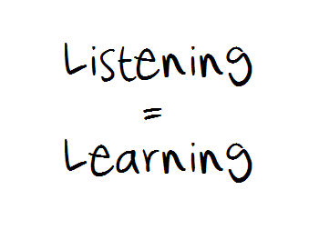
ENGAGING: IDEAL PRACTICE
Listens actively to each family member and solicits perspectives from all involved (for example, by summarizing for the family members what the worker understood them to say) and encourages the family to tell their story without interruption by allowing the family members to speak more than the worker.
Notes:
Melissa
Discuss verbal vs. non-verbal interactions.

Slide 51
ENGAGING: IDEAL PRACTICE
Actively involves children and parents or caregivers in all aspects of the case by using activities such as scaling, life circles, genograms, strengths and needs exercises and pointing out to the family what is going well. Uses these techniques with family members individually or together as appropriate to the case situation.
Notes:
Melissa
Shannon:
If the child happens to be in paid placement with a private agency don’t forget to partner with the private agency as they can also be used to engage the family. Private agencies, when appropriate and with custodial agency permission can include the family by sending the family a letter explaining the services their child is receiving while in the foster home. The private agency can also make calls to family, include them in on therapy sessions and on the child’s service plan .

Slide 52



Successful home visit
Effective Communication
Partnership Building
Ongoing assessment of:
  Safety
  Risk
  Services
  Parents’ strengths and needs
  Interaction between family members

Slide 53
PURPOSEFUL VISITS
Responsive to Needs during Crisis
Crisis should not drive majority of contacts
Regular contact = observation of normative behaviors

Slide 54
Observations during visits
Parental interaction with the children.
Interaction with the family members in their home setting to identify strengths, areas of difficulty or stress.
Parents utilizing enhanced or newly acquired skills.
The conditions in the home and a determination of how it impacts the safety of the children.
Other individuals visiting or residing in the home in relation to:
  How frequent are these individuals in the home?
  Are they living there?
  Do they change or impact the risk levels or safety threats within the family?
  Are these individuals a support or resource for the family?

Slide 55

SCHEDULING
DETERS CRISIS DRIVEN INTERVENTION
PARTNERSHIP PLANNING
  DATE AND TIME
  DURATION
  SETTING
  AGENDA
CLARIFIES THE FOCUS AND PURPOSE

Slide 56

FAMILY VALUE
Supportive resource
Assists family to identify available assets
Useful information

Slide 57
QUALITY CONTACTS
Help Parents retain a sense of control.
Help Child retain sense of comfort.
Clarify commitment and obligations to the working relationship.

Slide 58
QUALITY CONTACTS
Approach each individual involved with an open mind.
Acknowledge difficult feelings and encourage open and honest discussion of feelings.
Be consistent, persistent, and follow through.

Slide 59
QUALITY CONTACTS
Find out what is important.
Use mirroring.
Listen to the parents’ explanation without correcting or arguing.

Slide 60
QUALITY CONTACTS
Reassess Safety and Risk
Observe
Learn Family Members and Dynamics
Separate Visits with Each Parent

Slide 61

Reunification Assessment

Slide 62
Reunification Assessment
Safety
  Original (Safety Factors)
  New (Safety Factors)
  Protective Capacities
  Child Vulnerabilities
Progress
Focus
Services

Slide 63
Reunification Assessment
What were the original safety issues that resulted in the child(ren)’s placement?
Have the original safety issues been altered or reduced to a sufficient level whereby control within the family is probable?
Were there other safety issues identified after the child(ren) came into placement that necessitated or contributed to the continuation of the placement?
Have the safety issues identified in Question C been resolved or reduced sufficiently whereby control within the family is probable?

Slide 64
Reunification Assessment
Are parent/guardian/custodian(s) in compliance with court orders?
Does the child(ren) demonstrate an acceptance of the reunification plan?
Does the parent/guardian/custodian demonstrate an acceptance of the reunification plan?
Does the parent/guardian/custodian have the capacity to provide for the child(ren)’s basic needs (e.g., food, clothing, shelter, medical care)?

Slide 65
Reunification Assessment
Are the parent/guardian/custodian and/or other household members willing and able to use their protective capacities, resources and strengths to provide sufficient support to the child(ren)?
During visits, has the parent/guardian/custodian demonstrated an ability to meet the child(ren)’s need for safety in a manner that suggests safety threats are not expected to emerge by the child(ren)’s presence within the family?
Are there any issues or concerns related to other children or adults in the family that may impact the child(ren)’s return?
Describe how the family dynamics will change when the child(ren) returns.

Slide 66




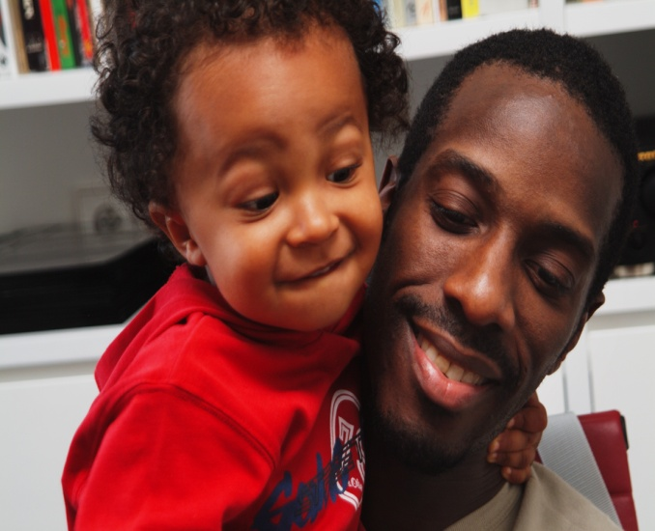
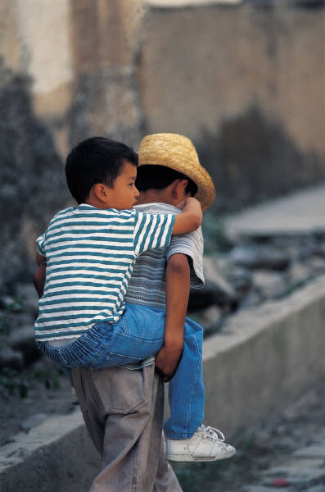




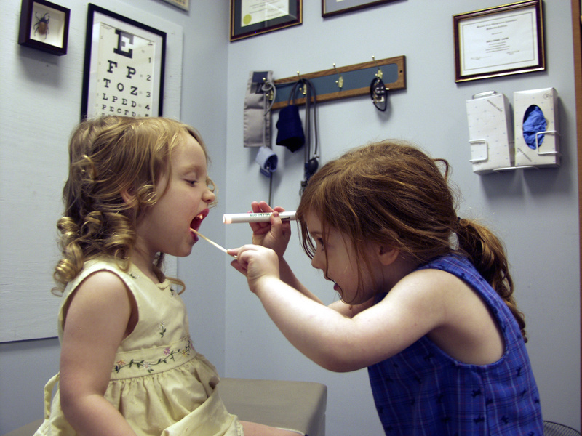
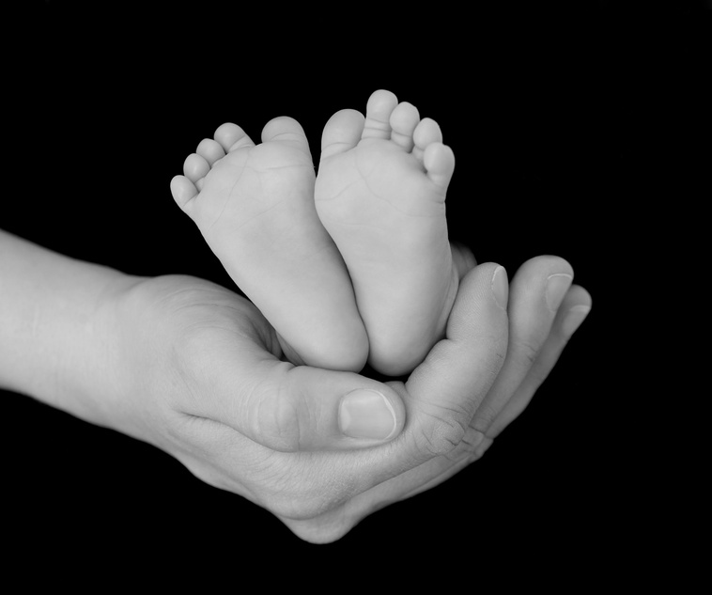


Slide 67
Reunification Assessment
What were the original safety issues that resulted in the child(ren)’s placement?
Have the original safety issues been altered or reduced to a sufficient level whereby control within the family is probable?
Were there other safety issues identified after the child(ren) came into placement that necessitated or contributed to the continuation of the placement?

Slide 68
Reunification Assessment
Have the safety issues identified in Question C been resolved or reduced sufficiently whereby control within the family is probable?
Are parent/guardian/custodian(s) in compliance with court orders?

Slide 69
Wrap Up

Slide 70
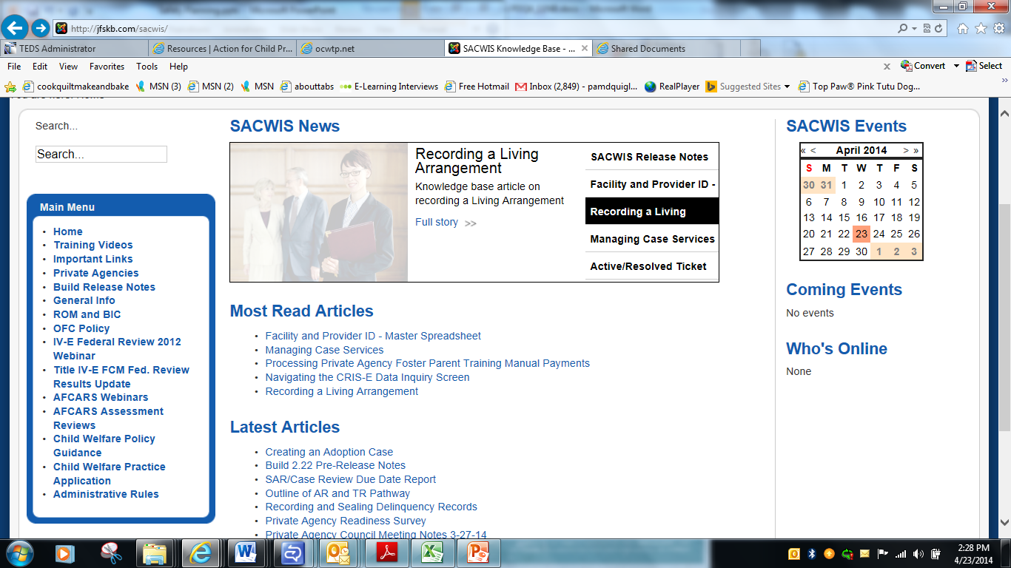
SACWIS Knowledge Base http://jfskb.com/sacwis/

Slide 71
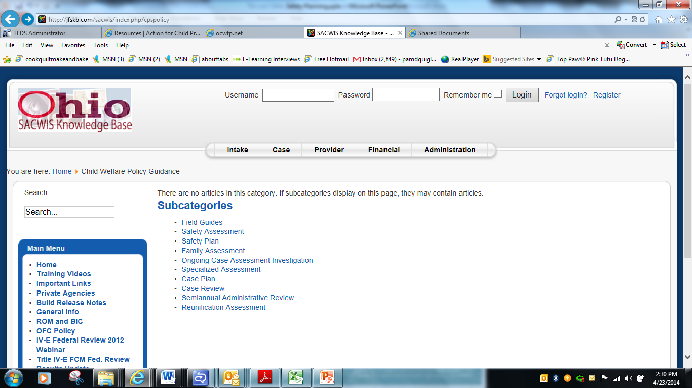

Slide 73

CPS policy capm mailbox
CAPMIS@jfs.ohio.gov

