Slide 1
Family Case Planning

Slide 2
Family Case Plans
Introductions
Develop Using Holistic & Critical Thinking
This workshop will cover:
Purpose
Process
Components
WIIFM

Slide 3
Intros & WIIFM
What is your name?
What is your role?
Burning Issue/Question?

Slide 4
Critical Thinking Process
1
2
3
4
5
6
7
Determining the purpose
Identifying relevant assessment criteria or questions
Gathering Information
Analyzing Information
Testing hypotheses
Synthesizing information to draw conclusions
Making well-informed decisions
Notes:
Determining the purpose
Requires knowing why an assessment needs to be done - what critical questions need to be answered, and what decisions will be made using the information
Identifying relevant assessment criteria or questions
Requires determining the most pertinent and relevant criteria to be assessed, that is, the type, scope, and depth of information that must be gathered to inform the decision
Gathering information
Requires implementing a variety of information-gathering strategies to access and record the needed information
Analyzing information
Requires analyzing the information (examining in detail) and formulating hypotheses about what the information reveals
Testing hypotheses
Requires testing out hypotheses to assure a high degree of accuracy and consistency in the information
Synthesizing information to draw conclusions
Requires synthesizing or integrating the information so it is congruent and allows accurate conclusions to be drawn
Making well-informed decision
Requires using the conclusions to make a well-informed decision that achieves the desired outcome

Slide 5
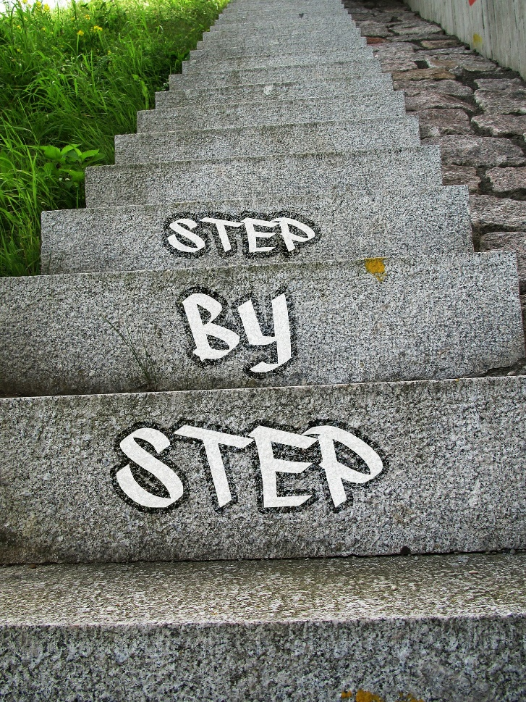
Principles of Child Protective Services Interventions
Collaborating
Implementing
Practice Profiles
Notes:
Collaborating
Establishing and maintaining mutually beneficial and well-defined relationships with families and community partners to achieve the shared goals of safety, permanence and well-being for children and families.
Collaboration should include a variety of resources, including families, coworkers, community stakeholders and service providers. A successful collaboration model is like a ship’s wheel, with the spokes of the wheel representing each resource and the center representing the goal. Everyone, including the youth and family, should work toward the common goal . Sometimes one entity drives the ship; sometimes everyone drives the ship. No matter who is driving, everyone is accountable for the shared goal
Implementing
Identifying and applying the most effective and culturally appropriate services, resources and processes to meet the goals established in the planning stage timely.
“The role of the caseworker is to collaborate with the individual or family in developing plans and selecting services that will best facilitate change…Case management emphasizes decision-making, coordination and provision of services. Caseworkers collect and analyze information, arrive at decisions at all stages of the casework process, coordinate services provided by others, and directly provide supportive services.”
“Implementation is a process, not an event. Implementation will not happen all at once or proceed smoothly, at least not at first.”

Slide 6
Purpose of Safety Planning
Substitute Protective Capacities
Control Active Safety Threats
Clarify Action Steps
Identify Responsible party
Notes:
Control active safety threats - Identify how the active safety threat will be controlled or removed.
Substitute parental protective capacities.
Identify responsible person/party.- Arranges for a responsible party to control active safety threats identified in the assessment of safety.
Establish actions required for the P/G/C and responsible party.

Slide 7
Purposes of Family Case Planning
Maximize Strengths
Behavior
Change
Measure
Progress
Coordinate
Action Steps
Notes:
You will need to look at this in the slide show presentation and click through the slides.
Behavior change –Clearly articulate the behavior needed to mitigate the concerns/needs of the family
Maximize strengths- identifying and leverage Non-Risk Contributors that can mitigate Risk Contributors
Coordinate Action steps- Identify the action steps and/or services needed to help the family and reduce risk contributors identified in the concerns.
Assign action steps to individuals- Identify the individuals who will complete these action steps to achieve the needed behavior change to reduce the risk.
Include steps the caseworker/agency will take to assist.
4) Measuring progress: how & when - Provide a detailed description of how the family's progress in achieving the action steps will be measured. Identify the activity or time period in which the worker will assess the family's progress in achieving the action steps.

Slide 8
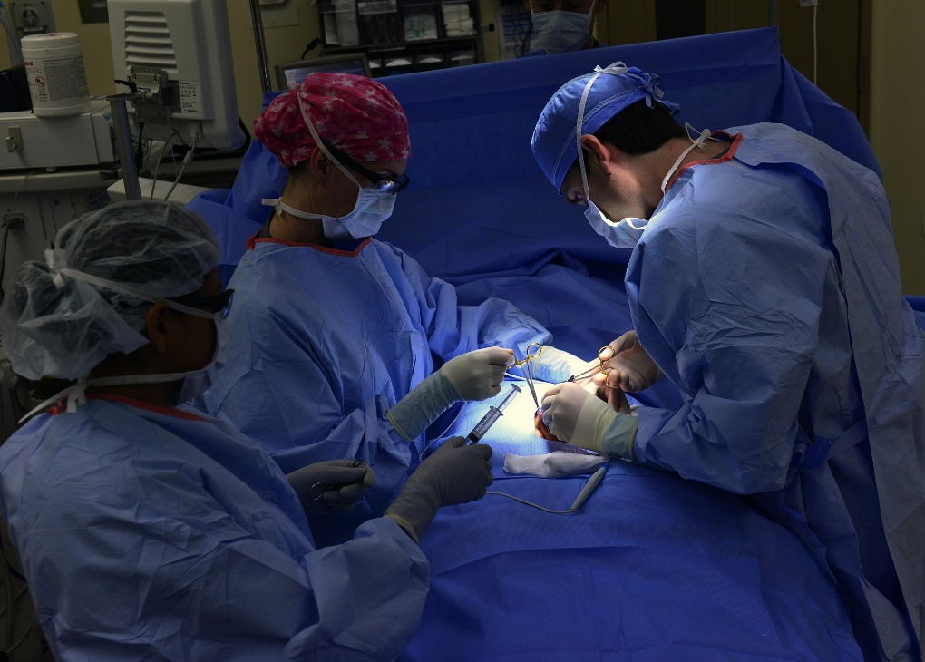
Safety Planning vs. Family Case Planning Understanding the Difference
Notes:
Example 1: Heart attack
(safety plan) = 911, hospitalization, possibly surgery
(Risk- case plan) = Dr appt- rehab, medication to prevent another heart attack

Slide 10
Concern Statement Equation
Parental Behaviors Causing
Risk
Concern Statement
Effect
on
Child

Slide 11
Safety | Risk
Immediate
Serious Harm
Significant Injury
Death
Permanent Disability
Protracted Future
Likelihood of Any Harm
Likelihood of Maltreatment
CONTROL THREAT
BEHAVIOR CHANGE
Safety Plan
Family CASE Plan
Notes:
Example 2: Diabetes
(safety plan) = Diabetic Coma
(Risk- family case plan) = Dr appt- rehab- (med management, nutrition, exercise – to prevent a future emergency
( diabetic Coma)

Slide 12
Safety Planning vs. Case Planning
Why Does It Matter

Slide 13
Families Can Have Both an Active Safety Plan
&
A Family Case Plan at the Same Time
Safety | Risk
CONTROL
Behavior Change
SAFETY PLAN
FAMILY CASE PLAN

Slide 14
Family Case Plans Are…
Assessment Driven
Family Driven
Behavior Change Focused
Strengths Mitigating Risk

Slide 15
Developing A Family Case Plan
Who’s Getting This?????
Strengths & Needs Risk Assessment Review

Slide 16
The Strengths & Needs Assessment is Completed as a part of the
Family Assessment
Within 45 Days
of a Screened-in Report
A Maximum of 15 days
If Information Needed to Complete
the "Family Assessment"
Cannot be Obtained & Reasons
are Documented in the Case Record.
BONUS 30 Points
When & For How
Long Can This
Time Frame
Be Extended????
The Strengths & Needs Assessment is part of the Family Assessment.
When must the Family Assessment be completed?
Question 1
Open Ended
(40 Points)

Slide 17
• Inform the Family Case Plan
• Identify Contributing Factors & Underlying Conditions Influencing the Maltreatment Dynamic
• Identify Risk Contributors, Non-Risk Contributors, & Strengths
• Inform Services & Action Steps to Enhance Permanency & Well-being for the Family
How Do You Use the Strengths & Needs Assessment
Information & Findings?
Question 2
Open Ended
(10 Points Each)

Slide 18
What are the Strengths & Needs Categories?
Question 3
Open Ended
(40 Points)

Slide 19
Self-Protection
Physical/Cognitive/Social Development
Emotional/Behavioral Functioning
What are the
Child Functioning
Elements?
Question 4
Open Ended
(40 Points)

Slide 20
Creates the Likelihood of Maltreatment to a Child
OR
Increases the Likelihood of Maltreatment to a Child
What is a
Risk Contributor?
Question 5
Open Ended
(20 Points)

Slide 21
What are the
Historical Functioning
Elements?
Caregiver’s Victimization of Other Children
Caregiver’s Abuse/Neglect as a Child
Impact of Past Services
Question 6
Open Ended
(40 Points)

Slide 22
Does not create the likelihood of maltreatment to a child
AND
Does not increase the likelihood of maltreatment to a child
What is a
Non-Risk Contributor?
Question 7
Open Ended
(20 Points)

Slide 23
Cognitive Abilities
Physical Health
Emotional/Mental Health Functioning
Domestic Violence
Substance Use
Response to Stressors
Parenting Practices
What are the
Adult Functioning
Elements?
Question 8
Open Ended
(40 Points)

Slide 24
A Non-Risk Contributor that Decreases or Could Potentially Reduce the Likelihood of Maltreatment Through Mitigating an Identified Risk Contributor.
Question 9
Open Ended
(40 Points)
What is a
Strength?

Slide 25
False:
The absence of risk in a particular area does not always equate to a strength.
Question 10
True of False
(20 Points)
Non-Risk Contributors are Always Strengths.

Slide 26
Strength & Needs Review
Any New Information to Warrant A Rating Change?
RC vs. NRC

Slide 27
Developing A Family Case Plan
Assessment-Based Organization

Slide 28
Grouping Risk Contributors
Group Main Underlying RC with Related RCs
List all Risk Contributors
Identify the Risk Contributors for each Family Member Related to each Major Concern/Need.
List all Major Concerns/Needs for the Family

Slide 29
Activity: Grouping Risk Contributors
Read Family Assessment
Review RCs & and NRCs
Complete Handout #6
List issues contributing to maltreatment and related RCs
Group RCs as would to develop concern statements.

Slide 30
Prioritizing Work w/ Families

Slide 31
What Strategies Might You use to Engage
the Family in Developing the Concerns/Needs to Address in the Family Case Plan?
Notes:
Involve the family- including the children at developmentally appropriate level
Listen to hear
Reflective listening
Seek win/win- find common ground
Be strength based
Be solution Focused
Include attitudes, beliefs, or knowledge deficits that contribute to maltreatment
Use Clear, Engaging Language
Relay impact of caregiver’s behavior in straight forward, non-judgmental language
Be specific to the Family

Slide 32
Family
CONCERNS
NEEDS
Notes:
What are the concerns/needs for the family?
Identify the behaviors or circumstances resulting from the risk contributor(s) identified for this concern/need. Identify how the behavior(s) or circumstance(s) impact the safety and/or risk of the children.

Slide 33
Concern Statement Equation
Parental Behaviors Causing
Risk
Concern Statement
Effect
on
Child

Slide 34
Concern Statement Example
Mike’s use of heroin and prescription pain pills prevents him from providing care and supervision to Samson and Anna. Samson and Anna, ages 2 and 3, were found by police, outside without supervision or clothing suitable for the weather.
Notes:
Critique - Language is clear and behaviorally specific. The language is free of bias, and it is based upon facts.

Slide 35
Concern Statement Activity

Slide 36
Well-Written?
Mom’s mental health issues and laziness prevent her from providing a clean home for the children. The kitchen is very messy and there is no surface clean enough for her children to eat.
Notes:
Critique
“Laziness,” “messy,” and “not clean enough” are derogatory terms and subjective. There is no specific information regarding the mother’s behavior that is causing risk or the impact on the children.
Important to not share HO7 until after the activities.

Slide 37
Well-Written?
Susan’s alcohol abuse has led to loss of employment and non-attendance at scheduled appointments to apply for food stamps, utility assistance, and rent assistance. Susan is in danger of being evicted from her apartment, having utilities shut off, and is unable to provide food and appropriate clothing for her two children, Frannie (6), and Dennis (9).
Notes:
This statement clearly describes the effect of Susan’s behavior on the children’s safety. It is non-judgmental, easy to understand, and is specific to the family.

Slide 38
Well-Written?
Sharon often sleeps 16 hours a day, and when awake lacks the energy to complete regular daily activities. As a result she is not able to provide supervision, food, or a safe environment for Shelly (4), Scott (5), and Ryan (7).
Notes:
Critique
This describes Sharon’s behavior in enough detail to understand how the behavior contributes to maltreatment. It is specific to the family and is clear, concise, and non-judgmental.

Slide 39
Well-Written?
Craig is violent with Cassie, his wife, to the point of causing visible injuries. Craig does not seem to care about his children as he becomes violent with Cassie in their presence. Cassie says she is going to leave Craig but never does and puts her needs before the needs of her children.
Notes:
Critique:
“Visible injuries” is descriptive; however, more detail regarding the types of injuries would more accurately describe Intimate Partner Violence/Domestic Violence. “Craig does not seem to care” and “Cassie…puts her needs before the needs of the children” are derogatory, subjective and indicate the caseworker does not understand the dynamics of domestic violence. The victim is never to be coerced into leaving, the violence concern is that of Craigs behavior, not Cassie’s. Information on how this is impacting the children is also needed in this concern statement.

Slide 40
Well-Written?
Dad’s low cognitive functioning makes him incapable of providing for his toddler and new infant. There was also an insufficient amount of toys and children’s items in his home to provide an enriching environment for the children.
Notes:
Critique
“Low cognitive functioning” is not of adequate detail to describe how this affects his parenting. “Makes him incapable” is derogatory. “Insufficient amount of toys” is not of sufficient detail to accurately describe the environment.
Additionally, the threshold for CPS intervention is unable to meet a child’s basic and protective needs, not merely parenting that is not “enriching”. The caseworker should describe the behaviors that are causing risk to the children and the impact it has on the children’s basic and protective needs being met.

Slide 41
Activity: Write Your Own Concern
Language Should Be:
Clear & Easily Understood
Bias Free
Fact-Based
Behaviorally Specific
Notes:
Leave PP slide on the screen during activity 2.
Describe Parental Behavior that is placing the child(ren) at risk
Describe how Parental Behaviors effect the child(ren)
Use clear and easily understood language
Be free of bias
Be fact-based
Be behaviorally specific

Slide 42
Concern Statement Feedback
Include At Least
One thing done well?
One thing that could improve?
Notes:
• Describe the risk contributor and the specific behaviors in the first sentence(s).
• Describe the effect on the children in the following sentences.
• Use language that is clear, easily understood, and free of bias and derogatory statements.
• Be based on facts and be behaviorally specific.
• Be specific to the family.

Slide 43
Well-Written Concern Statement Examples
Johnston Case

Slide 44
Concern 1
Robert has repeatedly physically assaulted and thrown household items at Alicia causing physical injuries to Alicia in the form of bruises, a black eye, and superficial cuts. The children have witnessed several altercations of violence which have resulted in the children exhibiting out-of-character behaviors, which include: overreacting to noises, nightmares, re-enacting physical violence when playing with dolls, and extensive crying.
Notes:
Trainer can cover these quickly or slowly to show other quality examples.
Have participants compare and contrast with theirs.
Risk Contributors: Domestic Relations and Family Roles, Interactions, Relationships, Emotional/Behavioral functioning of the children

Slide 45
Concern 2
Alicia uses alcohol and marijuana to relieve the stress of her relationship with Robert and being the sole income provider for their family. Alicia is not able to control her use of alcohol and drinks almost every day. Alicia has blacked out due to intoxication while caring for the children, and on one occasion drove with the children while intoxicated. Robert drinks several times a week to the point of intoxication. He is using alcohol to cope with daily stressors.
Notes:
Risk Contributors: Substance Abuse, Response to Stressors, Family Roles, Interactions and Relationships

Slide 46
Concern 3
Alicia and Robert have placed the responsibility on eight-year-old Nikki to be a primary caregiver for all of the children. Alicia and Robert have frequently left Nikki home alone to care for all the children. Ten-month-old Naya sustained a head injury when Nikki was caring for all the children overnight.
Notes:
Self-Protection Risk Contributors: Parenting practices and Self-Protection

Slide 47
BEHAVIOR

Slide 48
Engaging Families in Developing Behavior Change Statements

Slide 49
Behavior Change Equation
Behavior Change Needed
Behavior Change Statement
Change Will Result In
Notes:
What does the family and Worker want to see happen to address the identified concerns/needs? (Behavioral Change)
Describe the behaviors or circumstances that will indicate that the risk contributors identified for this concern/need have been mitigated or improved.

Slide 50
Measurable Behavior
First
Sentence
Following Sentences
The change will result in…
Bulleted List
Outcomes for Meeting Basic & Protective Needs
A general description
of the needed change.
Notes:
This format can be used to effectively outline the needed changes, whether the change is explicitly behavioral, an attitude, or cognitive.
The format identifies the change and the behaviors affecting the children associated with the needed change.
FIRST SENTENCE: A general description of the needed change
SECOND SENTENCE: The change will result in:
BULLETED LIST:
Outcomes, always including parents' behaviors, related to the concern and care of the children:
Use behaviorally observable terms.
Describe desired improvements in attitude, knowledge, mental health in terms of the resulting behavioral changes.
Use bullets rather than long sentences or paragraphs, as they are easier to read.

Slide 51
Concern Statement
Mike’s use of heroin and prescription pain pills prevents him from providing care and supervision to Samson and Anna. Samson and Anna, ages 2 and 3, were found by police, outside without supervision or clothing suitable for the weather.

Slide 52
Behavior Change Statement
Mike will not use heroin. When Mike does not use heroin he will:
Assure the children are supervised by himself or a responsible adult, within sight or sound at all times.
Take an active role in caring for and nurturing the children (for example: bathing, feeding, dressing, playing with them).
Be aware of what his children need.
Provide clothing according to weather conditions.
Attend programs to assist in learning how to appropriately meet his children’s needs.

Slide 53
Activity: Write Your Own Behavior Change
Language Should Be:
Behaviorally observable
Describe desired improvements resulting from changes.
Notes:
Leave PP slide on the screen during activity
Language should be in the future tense
Engage the Family
Use behaviorally observable terms
Utilize the following structure:
FIRST SENTENCE: A general description of the needed change
SECOND SENTENCE: The change will result in:
BULLETED LIST:
Outcomes, always including parents' behaviors, related to the concern and care of the children:
Use behaviorally observable terms.
Describe desired improvements in attitude, knowledge, mental health in terms of the resulting behavioral changes.
Use bullets rather than long sentences or paragraphs, as they are easier to read.

Slide 54
Behavior Change Feedback
Include At Least
One thing done well?
One thing that could improve?
Notes:
• Does the information provided identify what behavior must change?
• Is the language clear and written in family-friendly language?
• Is the language behaviorally specific?
• Is there a clear description of what behaviors will be observed once the behavior, attitude, or cognitive process is changed?
• Is there a clear description of how the change in behavior will protect the children?

Slide 55
Well-Written Behavior Change Statement Examples
Johnston Case
Describes change in behavior that is needed to reduce risk of maltreatment
Describes specific results that are expected when change is made
Uses behaviorally observable terms
Uses future tense

Slide 56
Concern 1
Robert has repeatedly physically assaulted and thrown household items at Alicia causing physical injuries to Alicia in the form of bruises, a black eye, and superficial cuts. The children have witnessed several altercations of violence which have resulted in the children exhibiting out-of-character behaviors, which include: overreacting to noises, nightmares, re-enacting physical violence when playing with dolls, and extensive crying.
Notes:
Risk Contributors: Domestic Relations and Family Roles, Interactions, Relationships, Emotional/Behavioral functioning of the children

Slide 57
Behavior Change Statement 1
Robert will take responsibility for his violence and how it has affected Alicia, the children, and himself. When Robert no longer assaults Alicia (hit, kick, or choke), threatens, or intimidates family members:
The children will not be exposed to ongoing physical violence in the home.
The children will not experience physical or emotional harm from violence in the home.
Alicia’s ability to care for her children will not be compromised by Robert’s violence or threats.
Children will receive therapeutic services to address the emotional trauma they have experienced due to witnessing Robert’s violence.

Slide 58
Concern 2
Alicia uses alcohol and marijuana to relieve the stress of her relationship with Robert and being the sole income provider for their family. Alicia is not able to control her use of alcohol and drinks almost every day. Alicia has blacked out due to intoxication while caring for the children, and on one occasion drove with the children while intoxicated. Robert drinks several times a week to the point of intoxication. He is using alcohol to cope with daily stressors.
Notes:
Risk Contributors: Substance Abuse, Response to Stressors, Family Roles, Interactions and Relationships

Slide 59
Behavior Change Statement 2
Alicia and Robert will learn and use coping mechanisms that do not have a negative impact on the children. This could include talking to a counselor, family member, friends, or any other coping mechanisms recommended by the counselor. When Alicia and Robert replace negative coping mechanisms with positive coping mechanisms:
Neither Robert nor Alicia will use substances, marijuana, or alcohol, as a way to deal with stress or feeling overwhelmed.
Alicia will not use marijuana or drink alcohol when she is responsible for caring for the children.
Robert will not use alcohol when he is responsible for the children.
Alicia and Robert will not become impaired through alcohol and drugs while caring for their children.

Slide 60
Concern 3
Alicia and Robert have placed the responsibility on eight-year-old Nikki to be a primary caregiver for all of the children. Alicia and Robert have frequently left Nikki home alone to care for all the children. Ten-month-old Naya sustained a head injury when Nikki was caring for all the children overnight.
Notes:
Self-Protection Risk Contributors: Parenting practices and Self-Protection

Slide 61
Behavior Change Statement 3
Alicia and Robert will take responsibility as primary caregiver for all of the children at all times. When this occurs:
Nikki will not be expected to take on the role of primary caregiver for her younger siblings, which would include baths, preparing meals, or getting her siblings ready for school and bed. When Nikki is no longer expected to take on the role of caregiver for her siblings:
The children, including Nikki, will have basic needs and supervision met by Alicia and Robert.
Robert and Alicia will utilize a developmentally appropriate caregiver/babysitter for their children in their absence.

Slide 62
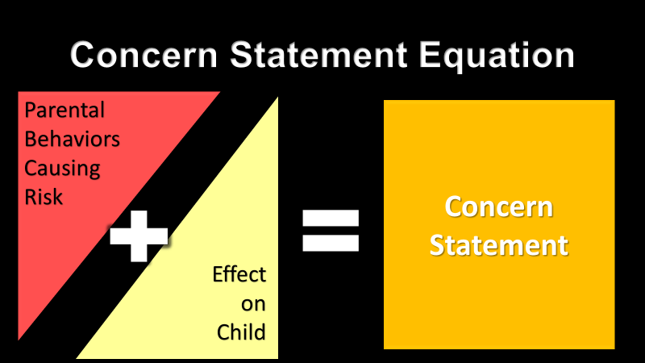
Associating Risk Contributors
Risk Contributors
for this concern
Notes:
Describe the Risk Contributors identified above as they relate to this specific concern for the family.

Slide 63
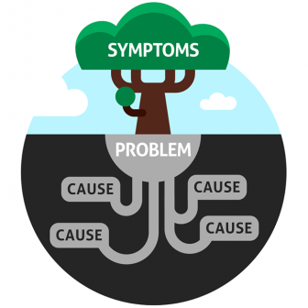
What is causing these Concerns/Needs for the family?
Are we Addressing the “Root Cause”
or
Just the Symptoms?
Notes:
Ask the family what they think is causing the concern.

Slide 64
Concern 2
Alicia uses alcohol and marijuana to relieve the stress of her relationship with Robert and being the sole income provider for their family. Alicia is not able to control her use of alcohol and drinks almost every day. Alicia has blacked out due to intoxication while caring for the children, and on one occasion drove with the children while intoxicated. Robert drinks several times a week to the point of intoxication. He is using alcohol to cope with daily stressors.
Notes:
Risk Contributors: Substance Abuse, Response to Stressors, Family Roles, Interactions and Relationships

Slide 65
Behavior Change Statement 2
Alicia and Robert will learn and use coping mechanisms that do not have a negative impact on the children. This could include talking to a counselor, family member, friends, or any other coping mechanisms recommended by the counselor. When Alicia and Robert replace negative coping mechanisms with positive coping mechanisms:
Neither Robert nor Alicia will use substances, marijuana, or alcohol, as a way to deal with stress or feeling overwhelmed.
Alicia will not use marijuana or drink alcohol when she is responsible for caring for the children.
Robert will not use alcohol when he is responsible for the children.
Alicia and Robert will not become impaired through alcohol and drugs while caring for their children.

Slide 66
What is causing these concerns/needs for the family?
Alicia and Robert identified that they drink when they are stressed. The family’s response to stress is causing the concern.
Selected Risk Contributors for this Concern

Slide 67
Adding Strengths
Risk Contributors
for this concern
Non-Risk Contributors
for this concern
Notes:
From your non-risk contributors, which can be used as strengths.

Slide 68
CONNECTING STRENGTHS
Review all RCs & NRCs
Report Out Strengths
Review: Johnston Family Assessment
Identify NRCs that mitigate RCs
Notes:
Describe the Non-Risk Contributors identified and how they mitigate the Risk Contributors for this concern.
What strengths and family/community supports does the family have?

Slide 69
What Strengths & Family/Community Supports Does the Family Have?
Selected Non-Risk Contributors for this Concern
Johnston, Robert - Physical Health
Johnston, Alicia - Extended family
Social & Community Supports
Multiple family members support and assist in providing care for the children. The family members support the children and Alicia in improving her relationship with her children. Alicia identified that she drinks when stressed; knowing her children are with family is a stress relief. Family members want to provide support to Alicia and minimize her drinking.
Robert is physically able to work and wants to work and become the primary income earner in the home. Robert identified being unemployed has created additional stress for himself and made him feel bad. Robert is an auto mechanic which is a transferable skill in the job market. Alicia maintains employment and continues to alleviate some financial stress on the family through working.
Notes:
Johnston Family Case Plan sample – concern 2

Slide 70
Developing Action Steps to Behavior Change
Notes:
Good time to cross check with your behavior change statement. These action steps are to drive the behavior change that are not the change. An example is a GPS where there is construction. The GPS will be altered as you go depending on traffic and construction but will get you the same destination. It is a dynamic process and constantly evolving. “more than one way to get there” thinking.

Slide 71
Which Individual
Activity that must be completed
Steps to Behavior Change
Why & When activity should be completed

Slide 72
Engage the Family in Developing Action Steps

Slide 73
Developing Family Activities
Family Led
Educational Resources
Step-by-Step Detail
Transparent on Non-Negotiables
Link to Behavior Change
Easy-to-Understand Language
Linking, not just referring services
Caseworker & Provider steps
Notes:
Answer the question “How will the CW/Service Team help the family make this change?”

Slide 74
Example of Family Action Steps
POORLY Written
WELL-Written
“Ms. Wilson will engage in consultation with her doctor to discuss the efficacy of her medication intervention.”
“Ms. Wilson will meet with her doctor once a month to talk about how her medication is working for her.”

Slide 75
Example of Family Action Steps
WELL-Written
POORLY Written
“Mr. Gomez will participate in monthly parenting education classes to learn how to cope with toilet training and temper tantrums with a toddler.”
“Father will participate in parenting classes and attend all sessions.”

Slide 76
Steps the Caseworker/Agency Will Take to Assist the Family Reach Their Goals

Slide 77
Case Management
Direct Services
Caseworker Activities

Slide 78
Caseworker & Service Team Activities
“The Counselor at Substance Abuse Services will contact Todd within three days of receiving the referral to schedule the appointment for the initial assessment.”
“The caseworker will conduct random, unannounced home visits to make sure that dangerous or hazardous items are not within reach of the children.”
“The caseworker will talk with the substance abuse counselor about Mr. Hernandez’s attendance and progress in treatment.”

Slide 79
Bringing Family, Provider, & Caseworker Steps Together
Notes:
Action steps are broken up by activity (not by person). Individual tasks are listed to demonstrate who will complete each task of the activity.
How will each service associated with the concern be completed? How will this action step help the family and reduce risk contributors identified?
Explicitly state activities in clear language
Activities should parallel those in the family activities
Include linking services, not just referring services
Include steps service providers are expected to complete
Answer the question “How will the CW/Service Team help the family make this change?”
Example:
Substance Abuse Treatment- intended to help Mr. Smith stop compulsive drug seeking and use.
Caseworker will make a referral for Mr. Smith to complete a drug and alcohol assessment.
ABC Treatment will contact Mr. Smith to schedule a drug and alcohol assessment.
Mr. Smith will complete the assessment to which he is referred.

Slide 80
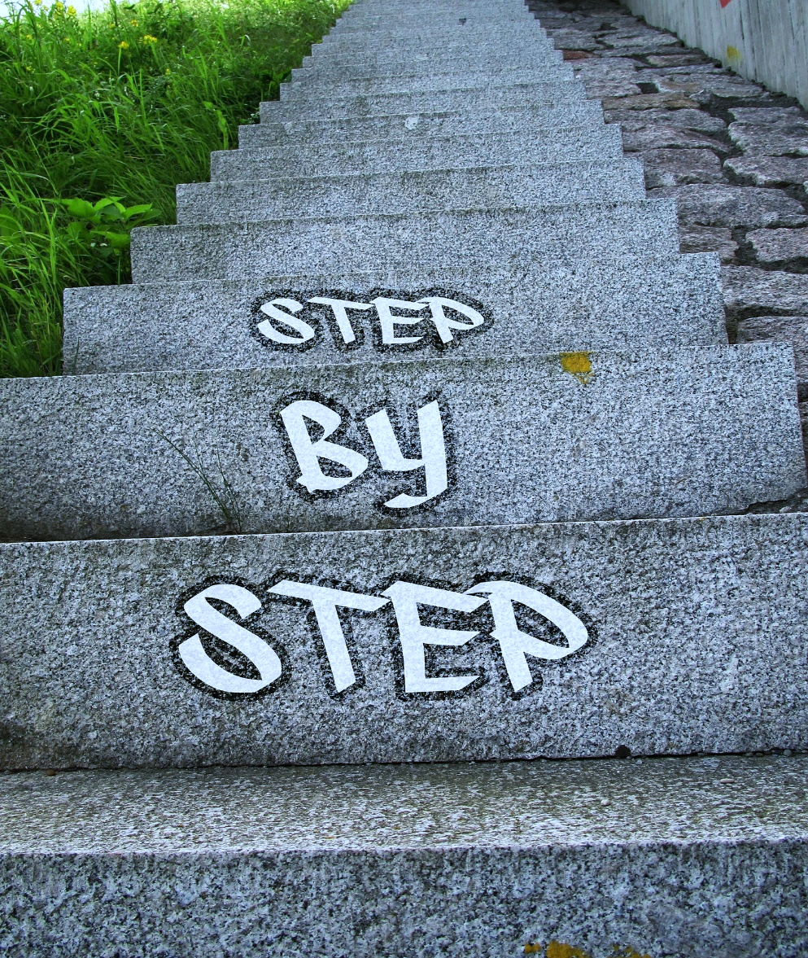
Activity Write Your Own Action Steps
Family
Caseworker
Service Provider

Slide 81
Action Steps Feedback
Include At Least
One thing done well?
One thing that could improve?
Notes:
Is it clear what action steps and services must be completed?
Is it clear who will complete the action step?
Is it clear how the action step to help achieve desired behavior change?
Is it clear when it should be completed?

Slide 82
Concern 1: What steps will the family take to achieve what the Family and Caseworker want to see happen? Identify the individuals who will complete these action steps. (Services to address the concerns/needs)
Batterer’s Intervention
Caseworker will make a referral to the batterer’s intervention program for assessment and treatment.
Robert will complete the intake/screening process for the batterer’s program to which he is referred.
Batterer’s intervention program will complete an assessment and a treatment plan for Robert. The batterer’s intervention program staff will provide resources designed to help Robert stop the pattern of violence, intimidation and control against Alicia, and damage to items in the home.
Robert will actively participate in the batterer’s intervention program.
Robert will follow his treatment plan and recommendations from the program.
Robert will sign releases of information to allow the caseworker to talk with staff from the batterer’s intervention program and receive monthly reports from them.
Caseworker and batterer’s intervention counselor will discuss Robert’s participation and progress towards behavior change as described in this case plan on a monthly basis or as needed.
Counselor will provide progress in treatment with the family’s caseworker through regular reports and conferences. The reports will include information about Robert’s attendance and progress in treatment, and progress towards behavior change as stipulated in this case plan.
Caseworker will review written reports from the batterer’s intervention program.
If Robert needs help with transportation to appointments, he will call 111-1111 48 hours prior to his appointment to schedule transportation with XYZ transportation service.
Caseworker will assist Robert in resolving any barriers to attending his treatment appointments, including transportation.
Caseworker will check for any current law enforcement reports regarding domestic violence charges against Robert.

Slide 83
Concern 1 Continued:
Trauma Services
Caseworker will conduct a trauma screening on all of the children.
Caseworker will make a referral to trauma treatment if the screening indicates this is necessary.
Robert and Alicia will ensure the children receive trauma screening.
The trauma treatment therapist will provide an assessment and treatment plan for Nikki, Jan, Allie, Mark and Sammi to assist them in coping with their fears and behaviors.
The trauma treatment therapist will provide ongoing counseling/therapy as determined by the treatment plan. The sessions will assist the children as indicated by the assessment.
Robert and Alicia will follow the treatment plan and recommendations which may include attending counseling.
The trauma treatment therapist will provide the PCSA caseworker with written reports on the children regarding their progress in coping and dealing with the trauma they have experienced as a result of Robert’s violence, threats, controlling behavior and destruction of property.
Robert will support the children in attending and participating in any recommended counseling sessions, including attending any appointments as requested by the counselor.
If Robert or Alicia need help with transportation to appointments, they will call 111-1111 48 hours prior to their appointment to schedule transportation with XYZ transportation service. The caseworker will assist in resolving any barriers to the children attending therapy sessions.
The PCSA caseworker will assist Alicia and Robert with identified barriers (such as child care or transportation) that could prevent them from attending appointments.

Slide 84
Concern 2: What steps will the family take to achieve what the Family and Caseworker want to see happen? Identify the individuals who will complete these action steps. (Services to address the concerns/needs)
Alicia Substance Abuse Recovery:
The caseworker will refer Alicia to the ABC Recovery Center.
The caseworker will provide ABC Recovery Center with information about Alicia’s substance use and stressors.
Alicia will complete the assessment process at ABC Recovery Center.
The counselors at ABC Recovery Council Center will assess Alicia’s alcohol and substance dependence as well as mental health status to determine treatment needs.
The counselors will develop an individualized treatment plan for Alicia.
The counselors will provide the PCSA caseworker with Alicia’s treatment plan.
Alicia will follow her treatment plan and recommendations from the assessment.
Alicia will sign all releases of information to allow the counselor to report attendance, participation, and treatment progress to the caseworker.
The caseworker will review the ABC Recovery Center counselors’ written reports.
The counselors will provide the PCSA caseworker with monthly written reports regarding Alicia’s progress in treatment.
The caseworker will review with Alicia how treatment is going and steps taken to maintain sobriety, coping strategies used, and family interactions.
The PCSA caseworker will assist Alicia with identified barriers (such as child care or transportation) that could prevent her from attending appointments.
The caseworker will request and arrange for Alicia to submit to random drug screens.
The counselors will conduct random drug screens.
Alicia will complete all requested drug screens within 24 hours of the request.

Slide 85
Concern 2 Continued:
Robert Substance Abuse Recovery:
The caseworker will refer Robert to the ABC Recovery Center.
The caseworker will provide ABC Recovery Center with information about Robert’s substance use and stressors.
Robert will complete the assessment process at ABC Recovery Center.
The counselors at ABC Recovery Council Center will assess Robert’s alcohol and substance dependence as well as mental health status to determine treatment needs.
The counselors will develop an individualized treatment plan for Robert.
The counselors will provide the PCSA caseworker with Robert’s treatment plan.
Robert will follow her treatment plan and recommendations from the assessment.
Robert will actively participate in counseling specializing in drug/alcohol abuse and coping with stressors and depression.
Robert will sign all releases of information to allow the counselor to report attendance, participation, and treatment progress to the caseworker.
The caseworker will review the ABC Recovery Center counselors’ written reports.
The counselors will provide the PCSA caseworker with monthly written reports regarding Robert’s progress in treatment.
The caseworker will review with Robert how treatment is going and steps taken to maintain sobriety, coping strategies used, and family interactions.
The PCSA caseworker will assist Robert with identified barriers (such as child care or transportation) that could prevent him from attending appointments.
The caseworker will request and arrange for Robert to submit to random drug screens.
The counselors will conduct random drug screens.
Robert will complete all requested drug screens within 24 hours of the request.

Slide 86
Concern 2 Continued:
Robert Employment:
Robert will seek employment opportunities and attend job interviews.
The PCSA caseworker will assist Robert in searching and applying for employment.
Robert’s counselor will provide assistance to Robert and the PCSA caseworker regarding preparing Robert to enter the workforce.

Slide 87
Concern 3: What steps will the family take to achieve what the Family and Caseworker want to see happen? Identify the individuals who will complete these action steps. (Services to address the concerns/needs)
Parent Education:
The caseworker will refer Alicia and Robert to the XYZ Family Center.
The caseworker will provide XYZ Family Center with information about Alicia’s and Robert’s needs regarding parenting education.
The counselor at XYZ Family Center will assess Alicia’s and Robert’s parenting needs.
Alicia and Robert will register for parent education services through XYZ Family Center.
XYZ Family Center will enroll Alicia and Robert in parent education service(s).
XYZ Family Center will provide Alicia and Robert with education on determining reasonable expectations of children through providing instruction in assigning chores, responsibilities, and education on supervision requirements based on the children’s age, maturity, physical development, cognitive development, and behaviors.
The XYZ Family Center will assist Alicia and Robert in providing guidance on the characteristics necessary in identifying caregivers that can effectively supervise their children.
Alicia and Robert will participate in parent education services at XYZ Family Center.
Alicia and Robert will complete all the activities and homework assignments required through the parent education service.
Alicia and Robert will sign releases of information for the parent education services.

Slide 88
Concern 3 Continued:
Parent Education:
The XYZ Family Center will provide the PCSA caseworker with ongoing reports regarding Alicia and Robert’s attendance, participation, and progress.
The caseworker will discuss, with the parent education counselor, Alicia’s and Robert’s progress towards understanding age appropriate expectations for children, and appropriate supervision for children.
The caseworker will review the XYZ’s counselor’s written reports.
Alicia and Robert will talk with the PCSA caseworker about what they have learned during parent education as it relates to their children’s age and development.
Alicia and Robert will demonstrate the information and skills learned in classes when caring for the children. Alicia and Robert (with the assistance of the caseworker) will develop a list of responsibilities, chores, and expectations for each child. The chores and responsibilities will be based on each child’s age, maturity, physical development, cognitive development, and behaviors.
The caseworker will assist Alicia and Robert in developing a list of caregivers that can assist in supervising the children.
The caseworker will consult with relative caregivers regarding interactions between the children and Alicia and Robert.
The caseworker will assist Alicia and Robert with identified barriers (such as child care or transportation) that could prevent them from attending appointments.

Slide 89
Sequencing
Johnston Case

Slide 90
Change Process
Pre-contemplation
Action
Maintenance
Contemplation
Preparation
Notes:
Fear workers so far removed from core- they may not remember this. Maybe they do it, but don’t know they are doing it. This could get off as a tangent. BC only a day- don’t have enough time- conversation could be understanding their role in the change process and that all families are different and not in the same place.
Process from cw core 6 (Hohman & Miller 1998; Rollnick 1991).
Pre-contemplation:
In this stage, families are not aware they have a problem. They might minimize or deny there is a problem, become defensive when questioned, and indicate no interest in changing. For example, a father is drinking alcohol to intoxication every day. He does not recognize this behavior is a problem and when the caseworker (or others) indicate that this behavior is problematic, he denies it is a problem or does not have any interest in changing his behavior.
Contemplation:
In this stage, families have become aware of a problem but need to think about it before they commit to making any changes. They appear ambivalent about the change and may be anxious about what change will mean. For example, a mother recognizes that her ongoing unemployment is interfering with her ability to provide a safe and stable living environment for her children. She recognizes that she needs to find a viable means for her family, but may not be ready to take any action to find a job.
Preparation:
In this stage, families have decided to make the necessary change, however they have not yet taken action to change. They may need additional support to move to action. Returning to the previous example, if the mother had identified she would like to go to a trade school to develop a skill to support her family, she may be unable to take action because she lacks knowledge of options or resources to afford education.
Action: In this stage, families take steps to change their behavior and sustain these behaviors for at least six months. (Note this does not imply all client changes must be maintained for a specified time before case closure or reunification can occur.) For example, a father is engaged in treatment for his bipolar disorder. He is taking his medication and going to counseling weekly. As a result, he has demonstrated a pattern of going to work, paying utility bills, and ensuring the children are clean, dressed and fed prior to sending them to school in the morning.
Maintenance: The client is increasingly more comfortable with the changes they made and continue to act in ways to sustain the change. For example, a mother who is in recovery from opiate addiction has a history of going to weekly NA meetings for over a year, has not had a lapse in 9 months, has dissassociated with all of her substance using friends, and has immersed herself in a healthy pro-social support system at her local community college. She provides daily supervision for her children and meets their basic needs for safety and security, food, hygiene, and education. She articulates her plan for managing challenges and communicates openly with her support system.

Slide 91
Recognizing
BEHAVIOR
CHANGE
Notes:
Describe specific indicators that are evidence of successful progress towards behavior change.
Answer the question “What will it look like when this change has occurred?”
Describe how the information will be gathered.
Use behaviorally observable terms.
How will improvements in knowledge, attitude beliefs, or mental health conditions will be evidenced by the caregiver’s behavior change?

Slide 92
Behavior Change Measures
Informs case decisions
How will progress be measured?
When will progress be reviewed?
Notes:
HOW: Provide a detailed description of how the family’s progress in achieving the action steps will be measured.
WHEN: Identify the activity or time period in which the worker will asses the family’s progress in achieving the action steps.

Slide 93
How Will the Family’s Progress be Measured?
Caseworker will observe Ms. Warner’s interactions with her children during visits. Evidence of progress in learning and using non-physical discipline would include:
Use of discipline strategies such as time-out, natural and logical consequences, restricting privileges, or other methods learned from the caregiver mentor.
No use of physical discipline such as hitting, punching, spanking, slapping, or pinching.

Slide 94
Activity Progress Measured Critique & Correction
Specific?
Clear & Easily Understandable?
Measures = Desired Behavior Change?
Outline how Observations, Interviews, & Reports will be used to Behavior Change is Occurring?

Slide 95
Concern 1 How will the Family's progress be measured?
The PCSA caseworker will review progress in the following ways to determine if Robert has been violent, made threats, or destroyed property:
Regular announced and unannounced visits to Alicia and Robert’s home.
Conversations with Alicia, Robert, and the children. These discussions will include exploring different ways Robert has handled difficult or frustrating situations without using violence.
The caseworker will observe the home and will observe Robert’s interactions with Alicia and the children. The following will be evidence of progress:
No physical violence, controlling behaviors, or destruction of property by Robert towards any of the family members or their property/belongings.
Decrease in the children’s fear reactions.
The children will have age appropriate control of their emotions.
The children will not express fear or anxiety in response to Robert’s presence.

Slide 96
When should the Family’s progress be reviewed?
Notes:
Informal and formal times throughout the life of a case. Should be measured frequently , and at logical times during working with the family, such as home visits (informal). Also during formal case review times.

Slide 97
Concern 1 When will the Family’s progress be measured? 1
Progress towards behavior change will be reviewed monthly with Robert’s counselor.
Progress in trauma therapy for the children will be reviewed monthly.
The caseworker will meet with Robert, Alicia, the children, and the children’s caregivers regularly, during home visits and visits to the relative caregivers, no less than monthly.
The case plan and services will be reviewed every 90 days.

Slide 98
Concern 2 When will the Family’s progress be measured? 1
Progress in treatment for Robert and Alicia will be reviewed monthly.
Progress in applying for employment will be reviewed monthly.
The caseworker will meet with Robert, Alicia, the children, and the children’s caregivers regularly, during home visits and visits to the relative caregivers, no less than monthly
The case plan and services will be reviewed at least every 90 days.

Slide 99
Concern 3 When will the Family’s progress be measured? 1
Progress with caregiver education will be reviewed no less than monthly.
The caseworker will meet with Alicia and Robert no less than monthly, during casework announced and unannounced visits to their home.
Observation of interactions between Alicia and Robert and the children will occur no less than monthly.

Slide 100
Share three things you will do differently when Family Case Planning with families.
Notes:
To make sure your goals are clear and reachable, each one should be:
Specific (simple, sensible, significant).
Measurable (meaningful, motivating).
Achievable (agreed, attainable).
Relevant (reasonable, realistic and resourced, results-based).
Time bound (time-based, time limited, time/cost limited, timely, time-sensitive)

Slide 101
CAPM Mailbox:
CAPM@jfs.ohio.gov

Slide 102
Reminder!
Your E-Track Certificate email will have a link to the correct survey answers so you can check your work!
This Photo by Unknown Author is licensed under CC BY

