Slide 1
30 Day Reassessments

Slide 2
Federal Register 409.44
(A) The patient’s function must be initially assessed and periodically reassessed by a qualified therapist, of the corresponding discipline for the type of therapy being provided, using a method which would include objective measurement (409.44(c)(1)(iv))
(B) At least every 30 calendar days a qualified therapist (instead of an assistant) must provide the needed therapy service and functionally reassess the patient in accordance with subsection A listed above (409.44(c)(2)(i)(A)
(C) Therapy visits for therapy discipline(s) not in compliance with these policies will not be covered until the following conditions are met:
(1) The qualified therapist has completed the reassessment and objective measurements of the effectiveness of the therapy as it relates to the therapy goals. As long as the paragraphs of this section are met, therapy coverage resumes with the completed reassessment therapy visit.
(2) The qualified therapist has determined if goals have been achieved or require updating (c)(2)(i)(C)(2)
(3) The qualified therapist has documented measurement results and corresponding therapy effectiveness in the clinical record in accordance with the federal registers requirements for reassessments of this section (c)(2)(i)(C)(3) referencing (c)(2)(i)(F).
Reference: https://www.ecfr.gov/current/title-42/chapter-IV/subchapter-B/part-409/subpart-E/section-409.44
Notes:
The Federal Register is a daily gazette that contains new and amended Federal regulations. It discusses regulations and requirements for public health and medicare programs. Subpart E, 409.44 discusses the requirements for home health skilled services

Slide 3
Medicare Chapter 7 40.2.1
Reassessment must be performed at least every 30 days (performed in conjunction with an ordered therapy service)
At least once every 30 days, for each therapy discipline for which services are provided, a qualified therapist (instead of an assistant) must provide the ordered therapy service, functionally reassess the patient, and compare the resultant measurement to prior assessment measurements. The therapist must document in the clinical record the measurement results along with the therapist’s determination of the effectiveness of therapy, or lack thereof
Reference: https://www.cms.gov/Regulations-and-Guidance/Guidance/Manuals/Downloads/bp102c07.pdf
Notes:
In Medicare Chap 7, we see similar verbiage on the requirements for reassessment visits.
Medicare Chap 7 describes covered services under the Home Health Prospective Payment System and the conditions to be met for Medicare to cover these services

Slide 4
Reminders
If the therapy reassessment is missed for any reason, reschedule the reassessment visit as soon as possible in order to ensure all visits will remain billable for therapy services
Do not perform another routine visit, prior to the reassessment being completed
If a therapy assistant is part of the patients care team, they should not treat the patient again until the 30-day reassessment has been completed by the qualified therapist
The 30-day clock begins with the first therapy service (of that discipline) and the clock resets with each therapist’s visit/assessment/measurement/documentation (of that discipline) as long as the required documentation is present
For multi-discipline therapy cases, a qualified therapist from each of the disciplines must functionally reassess the patient. The therapist must document the measurement results which correspond to the therapist’s discipline and care plan goals in the clinical record

Slide 5
Scheduling
Plot the PT/OT/ST 33 visit per your agency guidelines
Plotting a reassessment within the 30-day window is initially the evaluating therapists responsibility
Office staff should ensure a reassessment was plotted in time and correctly during processing the workflow in the back office
Visit type PT/OT/ST 33 should be used to schedule reassessments mid episode and no later than 30 days from the evaluation to satisfy this requirement while 02 or 06 recertification visit types should be performed toward the end of a 60-day episode and within the 5-day window to continue services if needed and are structured to also satisfy this requirement

Slide 6
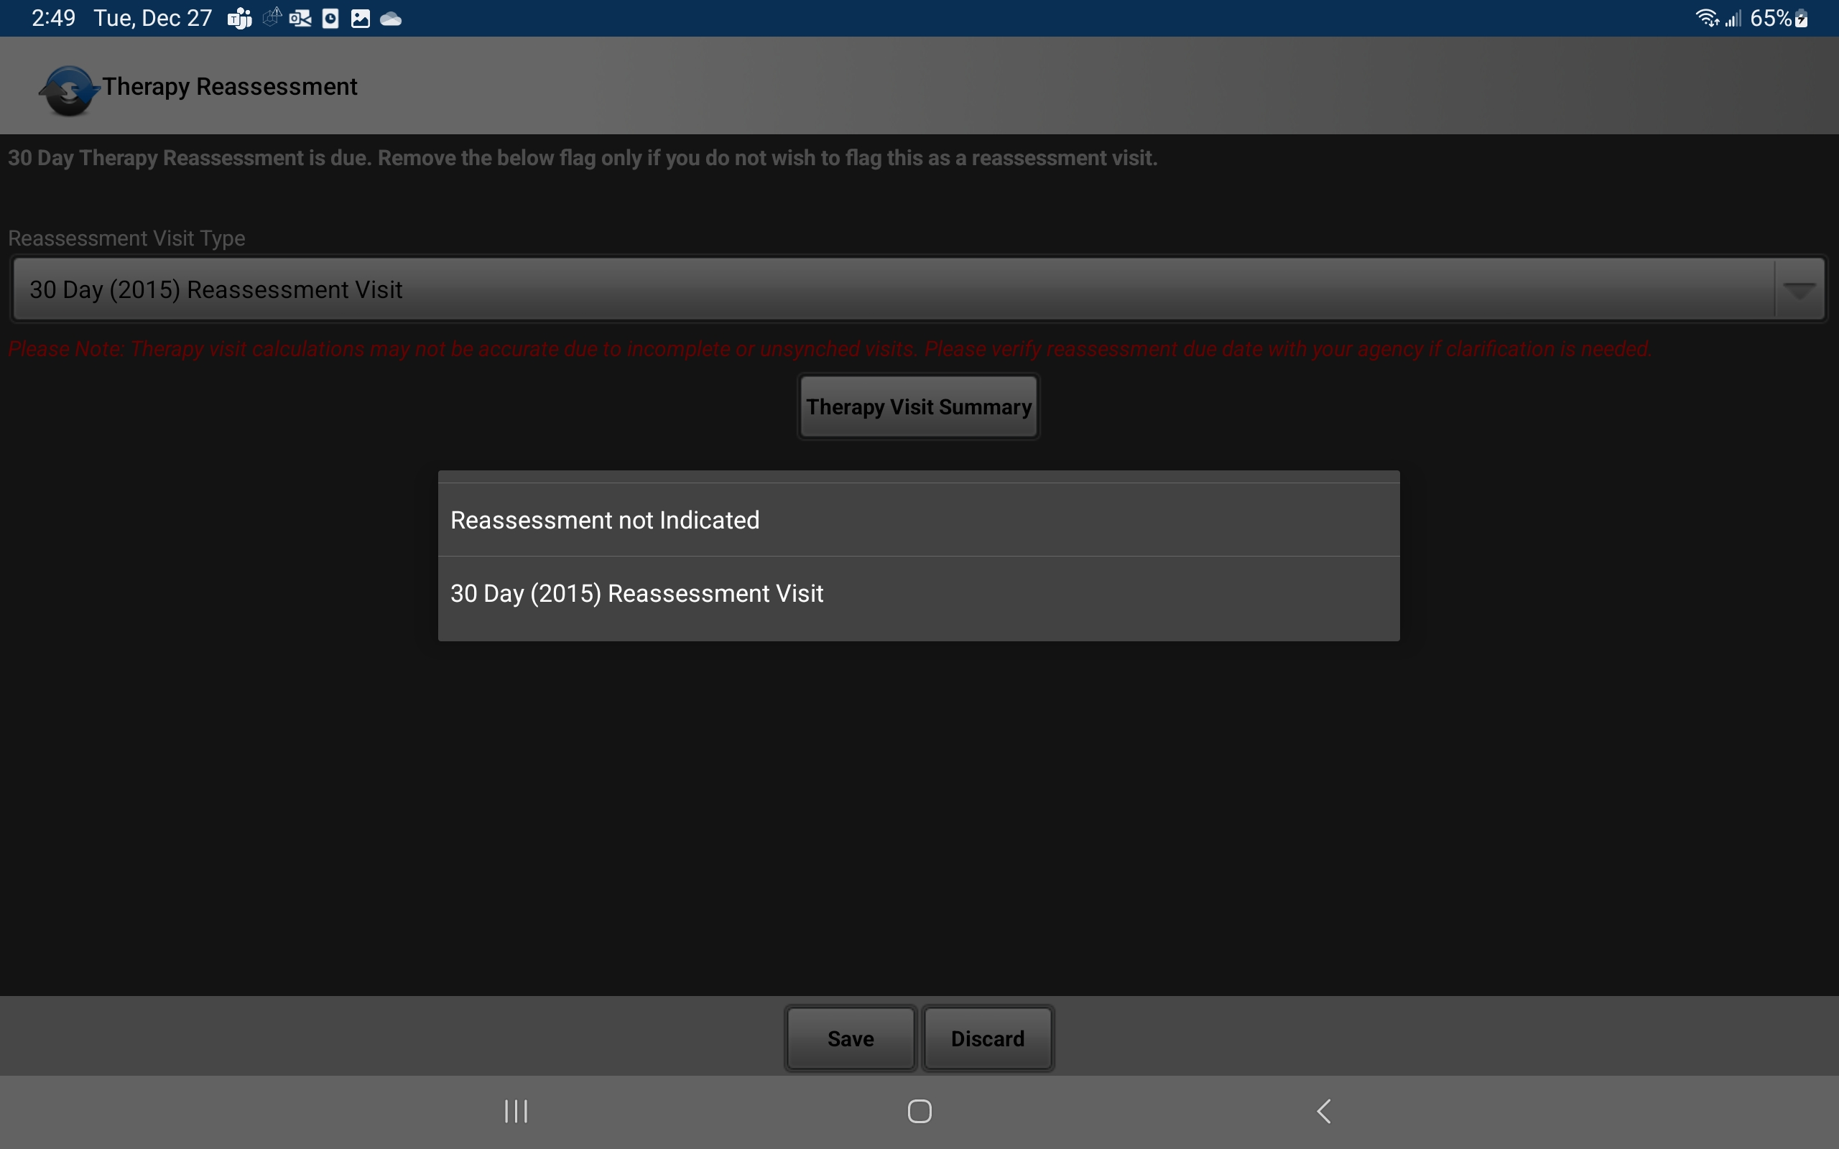
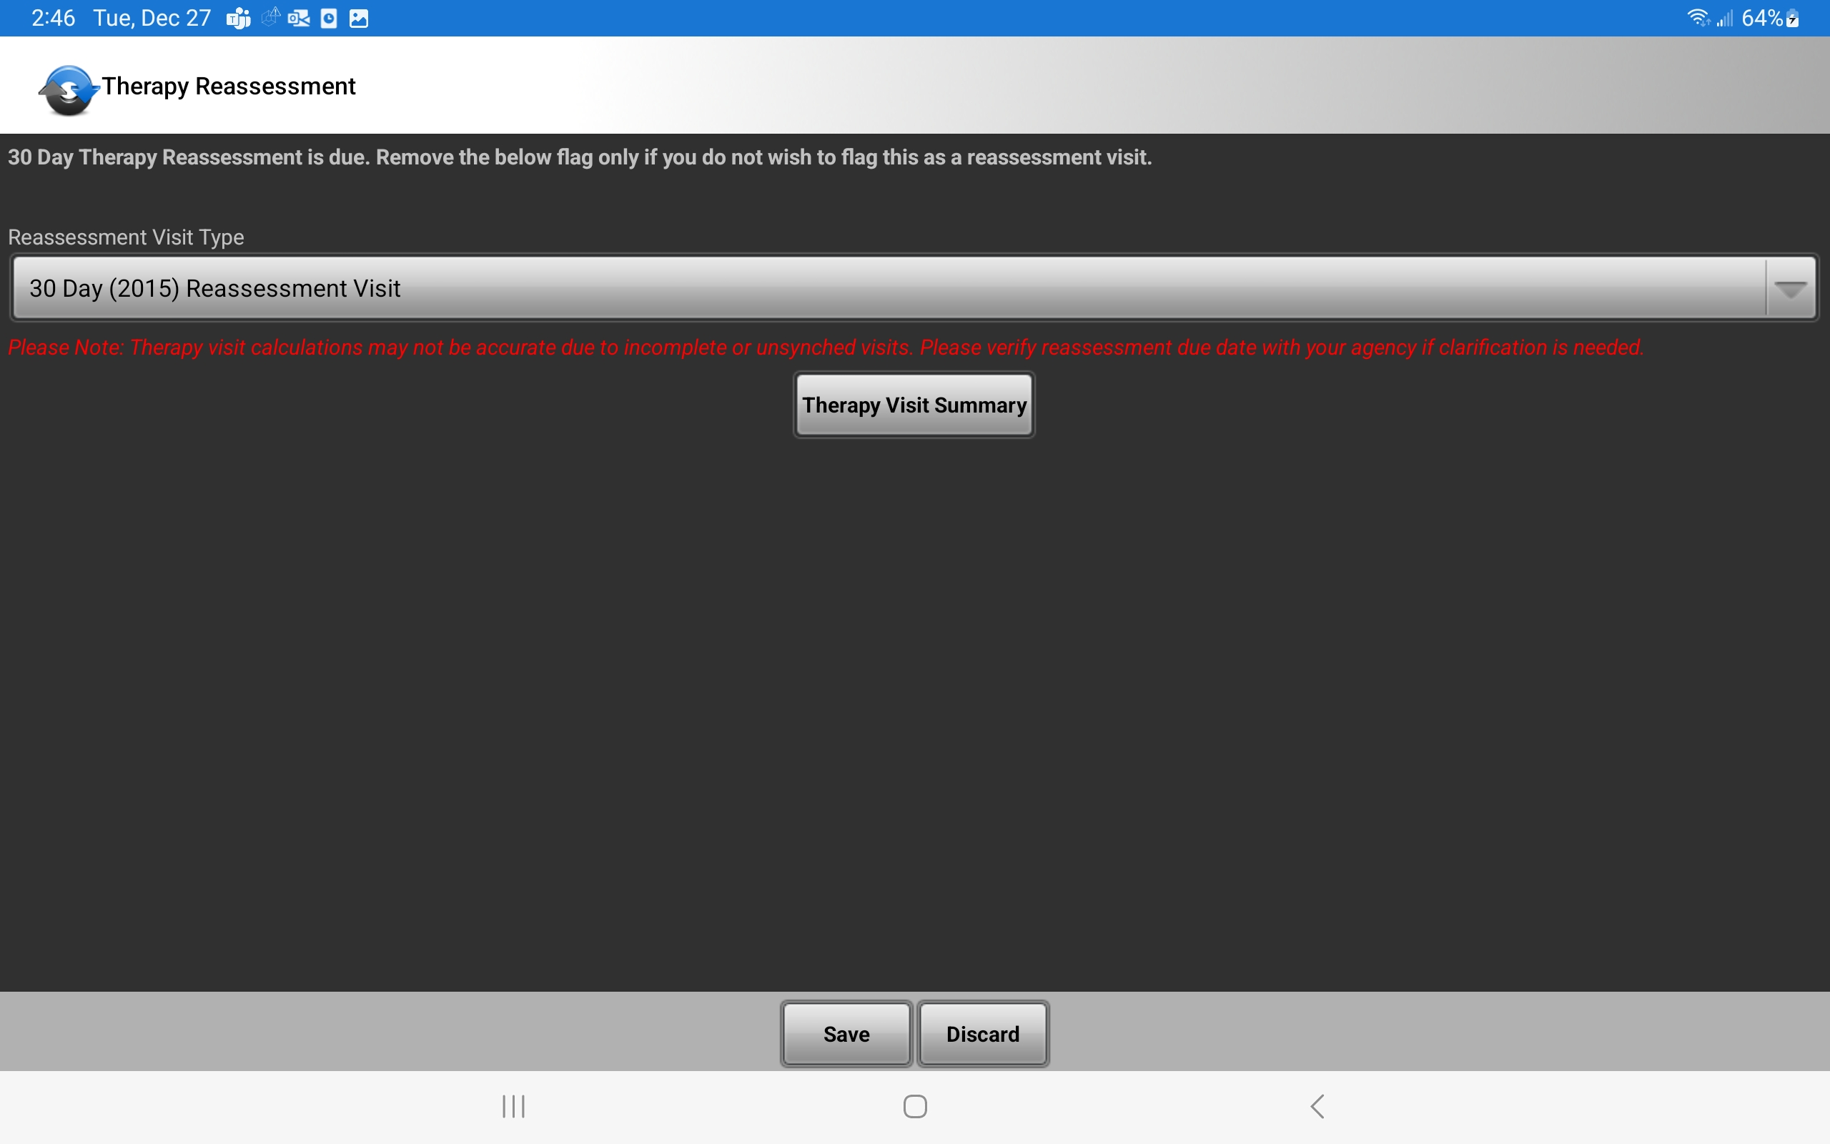
Reassessment Tracking
Select the option “30 Day (2015) Reassessment Visit” to the query at the start of the visit and choose save. When a reassessment is being completed, this will re-set the 30-day clock in HCHB.
HCHB will default an FRA reminder every 30 days if not performed correctly.
An evaluation does NOT reset the 30-day reassessment clock UNLESS an FRA is completed (comparison of objective measures, etc.) AND documentation requirements are met
If for any reason the visit is not being used to satisfy the 30-day reassessment requirements, select “Reassessment not indicated instead.

Slide 7
Reassessment Structure
The assessment section inside HCHB/Pointcare has been structured to meet the documentation requirements set forth by the Federal Register, Medicare Chap 7, LCDs, and COPs. When completing a reassessment, you will be required to document under the following question statements:
FOR ALL GOALS, SPECIFICALLY LIST AND COMPARE CURRENT RESULTS OF OBJECTIVE TESTS TO PRIOR TESTS AND INTERPRET FINDINGS.
INDICATE THE EFFECTIVENESS OF THERAPY TO DATE. HOW THE PATIENT HAS MADE PROGRESS OR LACK THEREOF TOWARDS GOALS. JUSTIFY THE REASON FOR CONTINUED THERAPY

Slide 8
Objective Measure Comparisons
Objective measures must be compared to previous measures
Document current objective measures
Compare current objective measures to previous measures
Previous measures are not automatically populated or visible on 33 visits, therefore the previous measures must also be documented
Note: There are a few ways to view previously recorded measures
Look back feature while viewing the goal in the therapy goal/status section
Medical Records → Therapy History→ Select Relevant Category (Blue Text)→Select Specific Goal (Blue Text)
Pathway goals can viewed in Order History→ Select 485 note→ Scroll down to see Pathway Goals for your discipline in paragraph form
Notes:
Relevant Category such as Strength, Specific Goal such as MMT

Slide 9
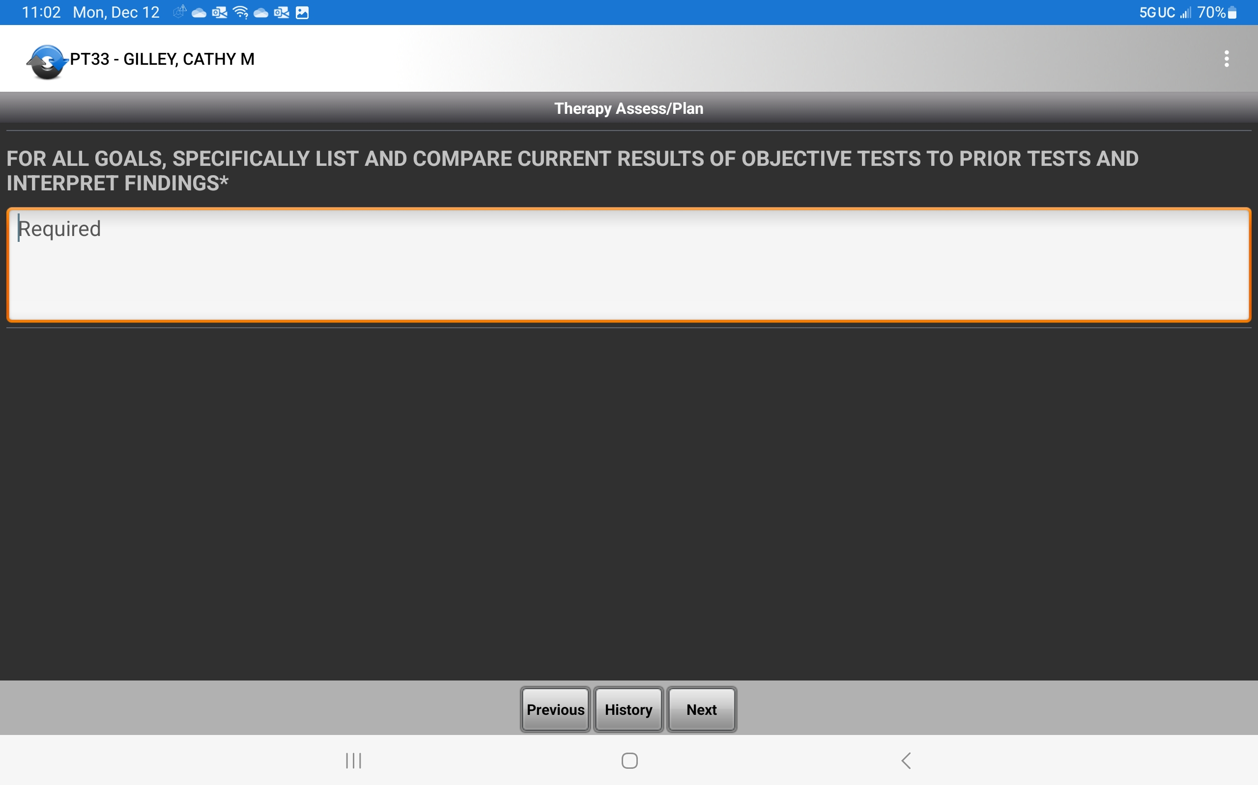
Objective Measure Comparisons
During a reassessment (33) or recert (06,02), you MUST compare the patients current functional status to the status at their previous assessment for ALL goals
Example:
“Patient has improved sit to stand transfers from MOD A to SBA, ambulation from 20 feet with MIN A and 2ww to 50 feet with SBA and 2ww and is now able to walk from the bedroom to the kitchen.”
“Patient has improved ability to perform UB dressing from MINA to SBA requiring VC’s 25% of the time for sequencing.”

Slide 10
Effectiveness of Therapy
Effectiveness of Therapy, Statement of Progress, and Patient’s Need for Continued Service
Document the effectiveness of therapy, or lack thereof
Document improvements in objective measures from baseline → reassessment : Describe how the patients improvements can be attributed to the applied interventions to demonstrate the effectiveness of treatment
Include:
Why progress is functionally important
If interventions are working, what will be next intervention and/or progression
If current interventions do not work, what interventions will be implemented (and/or POC update to change)
Example
GOOD: Skilled assessment of the patient shows progress as expected based on achievement of <goals>. Progress can be attributed to <interventions> provided.
NOT GOOD: Therapy has been very effective
Notes:
Following your goal comparisons you will be asked to indicate the effectiveness of therapy and justify reason for continuation.

Slide 11
Effectiveness of Therapy
During a reassessment (33) or recert (06,02), you MUST also document the effectiveness of the therapy
Examples:
“Patient has reached 70% of their goals up to this point and I anticipate they will be able to reach all goals by end of therapy plan of care. Current program is effective based on aforementioned progress and will update gait goal for patient to be able to walk into garage to enter vehicle for appointments. Will progress gait training to manage unlevel surfaces and increase cadence of steps.”

Slide 12
Reassessment Examples
Physical Therapy:
FOR ALL GOALS, SPECIFICALLY LIST AND COMPARE CURRENT RESULTS OF OBJECTIVE TESTS TO PRIOR TESTS AND INTERPRET FINDINGS.
“Patient has improved sit to stand transfers from MOD A to SBA, ambulation from 20 feet with MIN A and 2ww to 50 feet with SBA and 2ww and is now able to walk from the bedroom to the kitchen. Patient has improved ability to perform UB dressing from MINA to SBA requiring VC’s 25% of the time for sequencing.”
INDICATE THE EFFECTIVENESS OF THERAPY TO DATE. HOW THE PATIENT HAS MADE PROGRESS OR LACK THEREOF TOWARDS GOALS. JUSTIFY THE REASON FOR CONTINUED THERAPY.
“Patient has reached 70% of their goals up to this point and I anticipate they will be able to reach all goals by end of therapy plan of care. Current program is effective based on the aforementioned and will update gait goal for patient to be able to walk into garage to enter vehicle for appointments. Will progress gait training to manage unlevel surfaces and increase cadence of steps.”

Slide 13
Reassessment Examples
Occupational Therapy:
FOR ALL GOALS, SPECIFICALLY LIST AND COMPARE CURRENT RESULTS OF OBJECTIVE TESTS TO PRIOR TESTS AND INTERPRET FINDINGS.
“Patient has improved seated front reach progressing from 9 to 13 inches and MMT of R shoulder abduction from 4/5 to 5-/5, meeting both balance and strength goals. Client has progressed from min assist in shower transfer and bathing to independent bathing with shower bench and CGA shower transfer with use of grab bar in and out of shower.”
INDICATE THE EFFECTIVENESS OF THERAPY TO DATE. HOW THE PATIENT HAS MADE PROGRESS OR LACK THEREOF TOWARDS GOALS. JUSTIFY THE REASON FOR CONTINUED THERAPY.
“With further skilled training the client will be able to independently take correct medications and proper dosages at correct times. Pt also has nearly met dressing goal, will be ready soon to increase independence to item retrieval and donning clothing and not just setup/supervision from seated position. Will progress patient to achieve safe and independent showering and dressing as well as safe and independent medication management.”

Slide 14
Reassessment Examples
Speech Therapy:
FOR ALL GOALS, SPECIFICALLY LIST AND COMPARE CURRENT RESULTS OF OBJECTIVE TESTS TO PRIOR TESTS AND INTERPRET FINDINGS.
“Patient has improved Sustained /A/ to 7.3 seconds from 5.9 seconds at evaluation. Patient sustained /I/ for 7.9 second average, Improvement from 6.2 second average at eval. Adequate change of pitch from lower to higher pitch. Speech intelligibility at sentence level is mild deficit with intelligibility of 88% from 72% at eval. MASA improved from 140 at eval to 138.”
INDICATE THE EFFECTIVENESS OF THERAPY TO DATE. HOW THE PATIENT HAS MADE PROGRESS OR LACK THEREOF TOWARDS GOALS. JUSTIFY THE REASON FOR CONTINUED THERAPY.
“Patient has made steady improvement with established goals to date. Patient will continue to benefit from verbal and visual cues for use of THE BREATHER device to further improve inspiration and expiration for the improvement of phonation and to improve overall speech intelligibility. Patient still with mildly delayed mastication, with suspected premature spillage over tongue base with thin liquids and will continue from further training and education for improvement and achievement of goals. Patient and spouse will benefit from continued education regarding diet modifications of mechanical soft and compensatory strategies with chin tuck, slow intake rate, and throat clearing.”

Slide 15
Questions?
Notes:
If you have any questions regarding the documentation requirements for a reassessment, please reach out to your local therapy manager or therapy regional director.

