Slide 1
HHCCN = Home Health Change in Care Notice
General Information
HHA’s are required to use the HHCCN to notify the beneficiary of reductions and terminations in health care in accordance with Medicare CoP’s. “The right to be fully informed orally and in writing (in advance of coming under the care of the [home health] agency)”
HHCCN is used to notify beneficiaries of changes to their plan of care
Must be provided whenever there is a reduction or termination in home health services due to physician/provider orders or limitations in providing the specific service.
The HHCCN fulfills the requirement that HHA’s provide beneficiaries with written notification of changes in care as contained in the CoP’s for HHA’s.
Triggering events: Reduction or termination in beneficiaries care

Slide 2
HHCCN = Home Health Change in Care Notice
Triggering event
HHCCN – Reduction of Care
When Home Health Agency reduces or stops some item(s) and/or service(s) during spell of illness, while continuing others
Includes when orders for one home health discipline to discontinue, but others continue
Includes a reduction due to shortage of staff
Reduction was not planned
Example of reduction due to phys or provider change in order: The plan of care lists wound care daily, provider gets order to decrease to every other day.
Example of reduction due to home agency reason: PT services are ordered 4xw on the POC, the Home Health agency has an unexpected change is staffing and can only provide 2xw.

Slide 3
HHCCN = Home Health Change in Care Notice
Triggering event
HHCCN at End of Care
HHCCN should be used if discontinuing for “cause”- the home health agencies determination of unsafe conditions, or unable to staff.
HHCCN should be used if no face to face is obtained

Slide 4
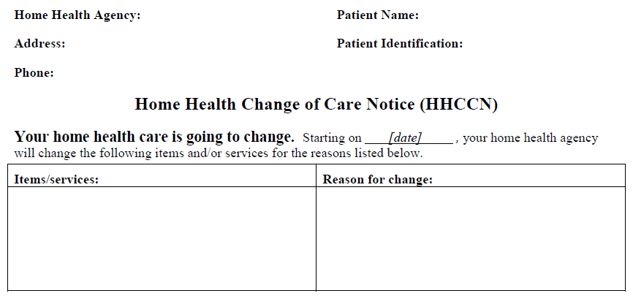
HHCCN Form

Slide 5
HHCCN Form Directions
Your home health care is going to change. Starting on (date).. This date should be a future date. You should be notifying the client before the change happens.
Items/Services:
Explain what is being decreased or terminated
State if the item/service is being decreased or terminated
Reason for change:
Insert the specific reason the change is occurring.
Example of physician order changes: The physician has changed your order for this care.
Example of agency change: Your dog has repeatedly threatened our staff and we are unable to safely enter your home.

Slide 6
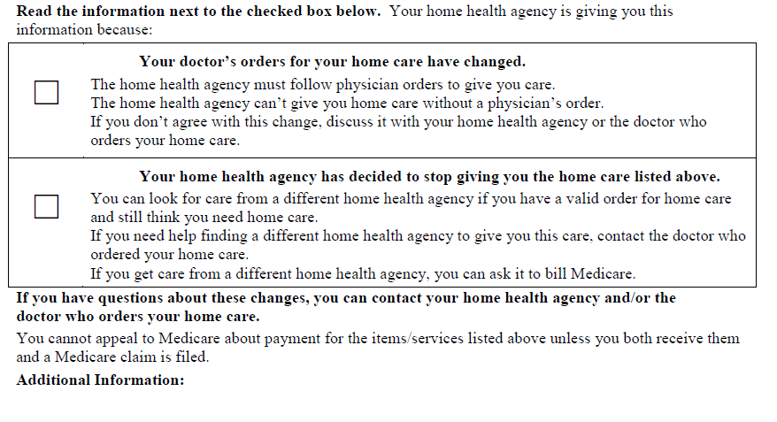
HHCCN Form

Slide 7
HHCCN Form Directions
The HHA must identify the general reason for the change or changes that are listed in the table above.
The HHA must check one of the 2 checkboxes in the section under “Read the information next to the checked box below.”
“Your doctor’s or provider’s orders for your home care have changed.” The HHA checks the first box when care will be reduced or stopped because of an order change or the lack of an order to renew care.
“Your home health agency has decided to stop giving you the home care listed.” The HHA checks the second box when the HHA decides to stop providing some or all care for its own financial and/or other reasons, regardless of Medicare policy or coverage, such as the availability of staffing, closure of the HHA, or safety concerns in a beneficiary’s home.

Slide 8
HHCCN Form Directions
When multiple care changes occur due to simultaneous order changes and agency specific reasons for change, the HHA must give the beneficiary (2) separate HHCCN’s so that s/he can identify the reason that corresponds to each change. Only one check box indicating the reason for change can be marked on each HHCCN.
Additional Information: An entry in this area is optional. HHAs should use this area to include information that may be helpful to the beneficiary’s specific case. For example, the ordering provider’s name and phone number could be inserted here if the beneficiary has questions on an order change that the HHA can’t answer.

Slide 9
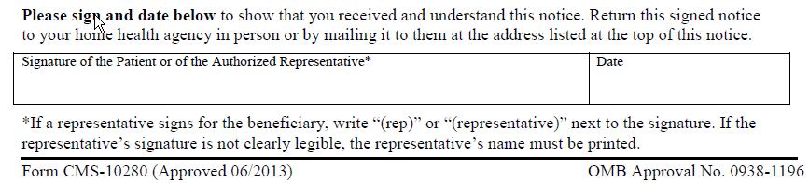
HHCCN Form

Slide 10
HHCCN Form Directions
The Signature and Date Section
This section contains 2 boxed and labeled blanks for completion. The beneficiary or representative is required to sign and date the HHCCN confirming his/her review and understanding of the notice.
• Signature: The beneficiary or representative must sign the HHCCN.
• Date: The beneficiary or representative must enter the date that the HHCCN was signed. The HHA may insert the date if the beneficiary is having difficulty and requests assistance.
Note if a representative is signing on behalf of the beneficiary or if the beneficiary refuses to sign, note this on the form..

Slide 11
HHCCN Form Directions
HHCCN Delivery
When delivering HHCCN’s, Home Health Agencies are required to explain the entire notice and its content and answer all beneficiary questions to the best of their ability. HHAs must make every effort to ensure beneficiaries understand the HHCCN prior to signing it. If common abbreviations are used, the Home Health Agency should explain their meanings to the beneficiary. While in-person delivery of the HHCCN is preferable, it is not required.

