Slide 1
CERTIFIED HOME HEALTH DOCUMENTING SKILLED NURSING
JUNE 2022

Slide 2
DEFINITION SKILLED NURSING NEED
To be considered a skilled service, the service must be so inherently complex or essential for the patient that it can only be safely and effectively performed by, or under the supervision of a professional nurse.
This is ongoing and must be determined at each visit throughout the episode of care AND EVIDENT IN THE VISIT NOTES.

Slide 3
PURPOSE of DOCUMENTATION
Framework
Shows implementation of interventions
Evaluates the patients at each visit to show how outcomes are being met
Contains observations of patient's conditions, treatments, education and patient responses.
Shows evolution of care provided to effectively communicate status of patient at each visit to support why the “payer” is paying for services.
Becomes part of the patient legal record used to support medical necessity and provide defense for agency against audits.
Documentation = Nursing Process

Slide 4
ACCURACY IN DOCUMENTATION
Documentation should be specific
Should not include what clinician “feels”, should only include medical terminology and not slang or vague.
Include Objective data
Medical necessity can be captured by painting a picture of the patient
Include the patient response to the care
What is the risk for the patient if nursing was not present?
Defensible: justifiable by argument
3 C’s- Clear, Concise, Comprehensive
Champion this to help our patients

Slide 5
What is Important to Document
Identify the skilled service and the reason this skilled service is necessary
Why does the nurse need to be at the home at that visit?
What was accomplished at that visit?
What was the response to the care provided?
What is the plan for the next visit?
Document the patient complexity, overall patient risk level to support skilled services provided.
Identify if there is a change in condition
Not adequately documenting this can harm a patient and cause possible incorrect care.
Notes:
Some offices will have medical records,

Slide 6
What is Important to Document-Continued
Identify if the patient is improving
Showing improvement is important to help determine when the patient is able to manage the specific disease process to allow for a discharge plan.
Patient-centered and meaningful for the patient.
Documenting what you do for and with your patient is very important.
Patients' response to interventions:
This will prove or become defensible to support the medical necessity
Can support additional time required or that patient is achieving outcomes sooner than anticipated.

Slide 7
Challenges in Documentation
Time- Management
Document in the home to ensure that accurate real time documenting is done. Less chance of error.
Will also reduce charting fatigue if waiting to try and do all charting at the end of the day.
Will help reduce any legal implications when being asked to recall patients from weeks, months or years ago. Documentation will support the services provided at that visit if ever questioned.
Technology
False belief that technology will do the “thinking” for the clinicians.
Each clinician is special, and only they are able to use the clinical judgement and knowledge with each patients.
Nurses have responsibilities to provide safe and competent care for your clients.
Technology will not make a clinical decision for you.

Slide 8
Objective vs Subjective
Objective:
What is assessed using the senses: Hearing, smelling, touching, visual.
Specifics that are facts obtained by professional assessment
Subjective:
Information gathered from the patient or caregiver- what they say or feel

Slide 9
Summary
Documentation is the framework of ensuring high standards of, but also accurate payment
By keeping it defensible it is the key to documenting for medical necessity at each visit.
Important component of nurses professional and legal responsibilities.
Documentation is the evidence of using the nursing process in caring for your patients

Slide 10
Examples

Slide 11
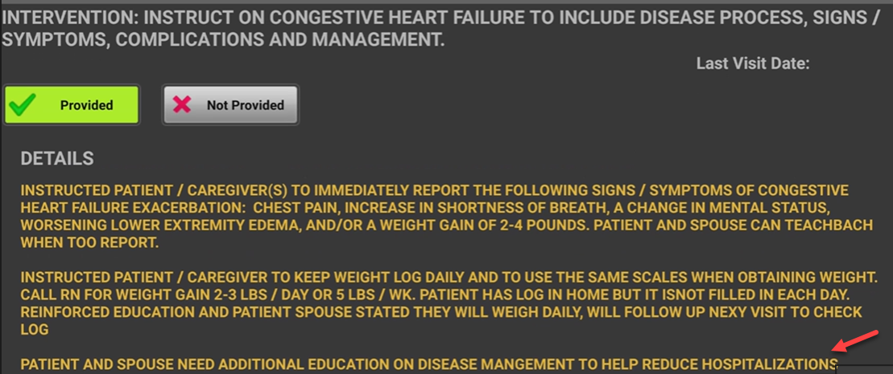
Examples

Slide 12
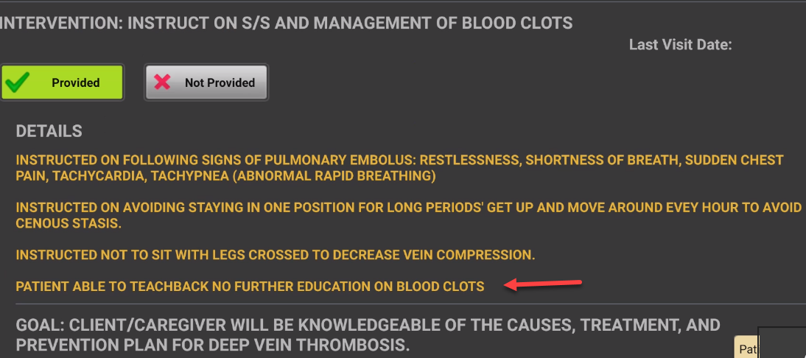
Examples

Slide 13
In the End…….
Did we make a positive Impact for the patient?

Slide 14
Resources: Chapter 7 and Chapter 10

