Slide 1
Marketing Resources
for volunteers
A “HOW TO” GUIDE FOR SUCCESS

Slide 2
Overview of Marketing Process
All volunteers must read and agree to the HBA Marketing Communications Policies.
These documents can be found within the Volunteer Resource Center in the Policy Handbook.
Key Takeaways:
  Communications
  Ensure all copy (event descriptions, social media posts, news articles, etc.) adheres to the HBA Style Guide (AP Style).
  Brand
  Ensure all the elements meet the requirements outlined in the HBA Brand Guidelines (messaging, colors, logo usage, etc.).
  Social Media
  Do not create new social media pages. Only use the accounts that have been created.
  Do not create new hashtags for chapters. Only use #HBAimpact and your local hashtag (see slide 14).
  Please refrain from posting photos with alcohol or making overtly political posts.
  Event Materials
  Only use the templates and graphics available in Marq.
  Do not create your own templates or use other images that we don’t have copyright to use.
  Community Engagement and Email Marketing
  Due to CAN-SPAM, GDPR and CASL, we are unable to share member emails outside of the HBA Central email service provider. We strongly recommend use of your regional HBA Community on the Higher Logic platform as it not only encourages direct member engagements on posts, but also triggers email communications to members of the Community.

Slide 3
Overview of Channels and Branding Material
Channels
Branding
Digital
HBA website (HBAnet.org)
HBA Community
Email (HBA Central)
Twitter (HBA regional accounts)
LinkedIn (HBA regional accounts)
Facebook (HBA regional accounts)
Instagram (HBA regional accounts)
YouTube (HBA Central account)
Digital ads (paid, earned, and house)
(as defined by HBA Central)
Print
Brochures
Flyers
Signs and banners
HBA Brand Guidelines
HBA Style Guide
Messaging and positioning
Standard templates
  PowerPoint
  Flyers
#HBAimpact
Local hashtags (ex: #HBAcanada)
Graphic designs found in the
Volunteer Resource Center and Marq

Slide 4
Event Promotion
Standard Practices

Slide 5
Event Marketing Process — Four Key Steps
Review Event Details Before Submission
Create Promotional Materials in Marq
Event Management: During and After
Event Preparation
Ensure event title is enticing in order to gain attention. All event titles should be in title case. (Example: Making the Most of Your HBA Membership)
Review the event description and adjust as needed to generate interest in the event.
Copy edit all text to meet requirements in the HBA Style Guide.
Use the branded templates available in Marq to create:
  Social media graphics
  PPT promotional slide
  8.5x11” flyer (for in-person events only)
Send materials to board, committees, partners, and sponsors, and ask for distribution support.
Work with your regional social media team to set a marketing plan.
Encourage all board and committee members to like/share/retweet social posts.
Ensure the PPT slide and flyer are at all events and in all presentations.
(For in-person events): Distribute the flyer at the event.
Encourage live social media engagement using #HBAimpact and your local hashtag.
Take pictures and send to your regional social media team for posting.
Write an event recap article to share on the website.

Slide 6
Marq
Creating Print/Digital Promotional Materials

Slide 7




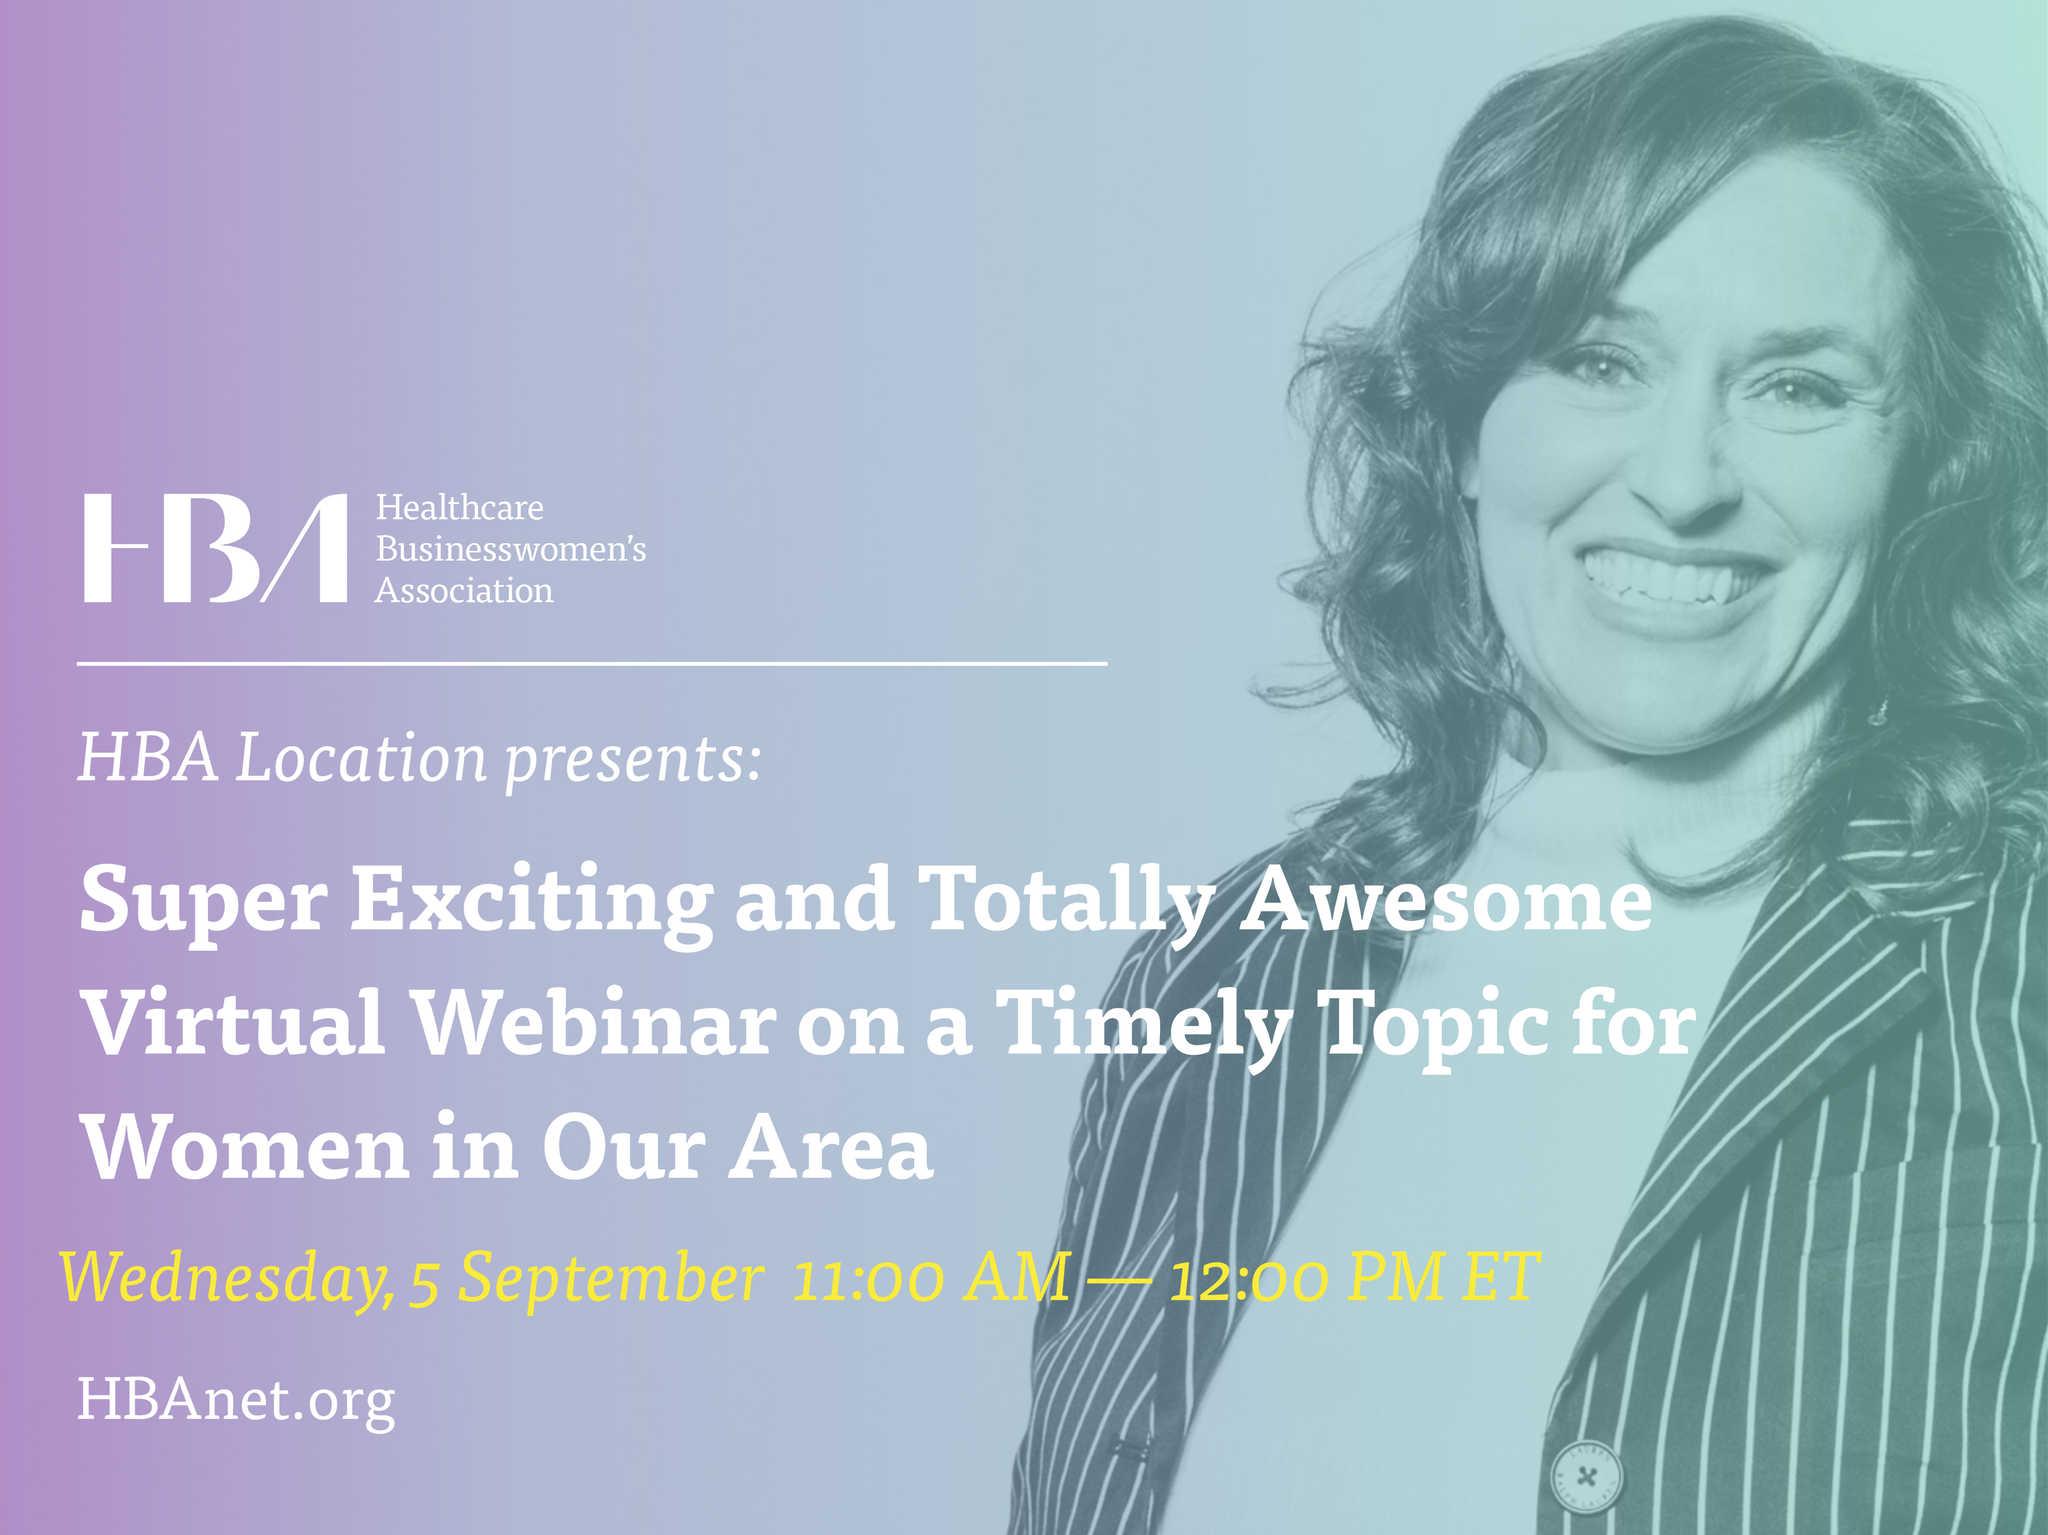
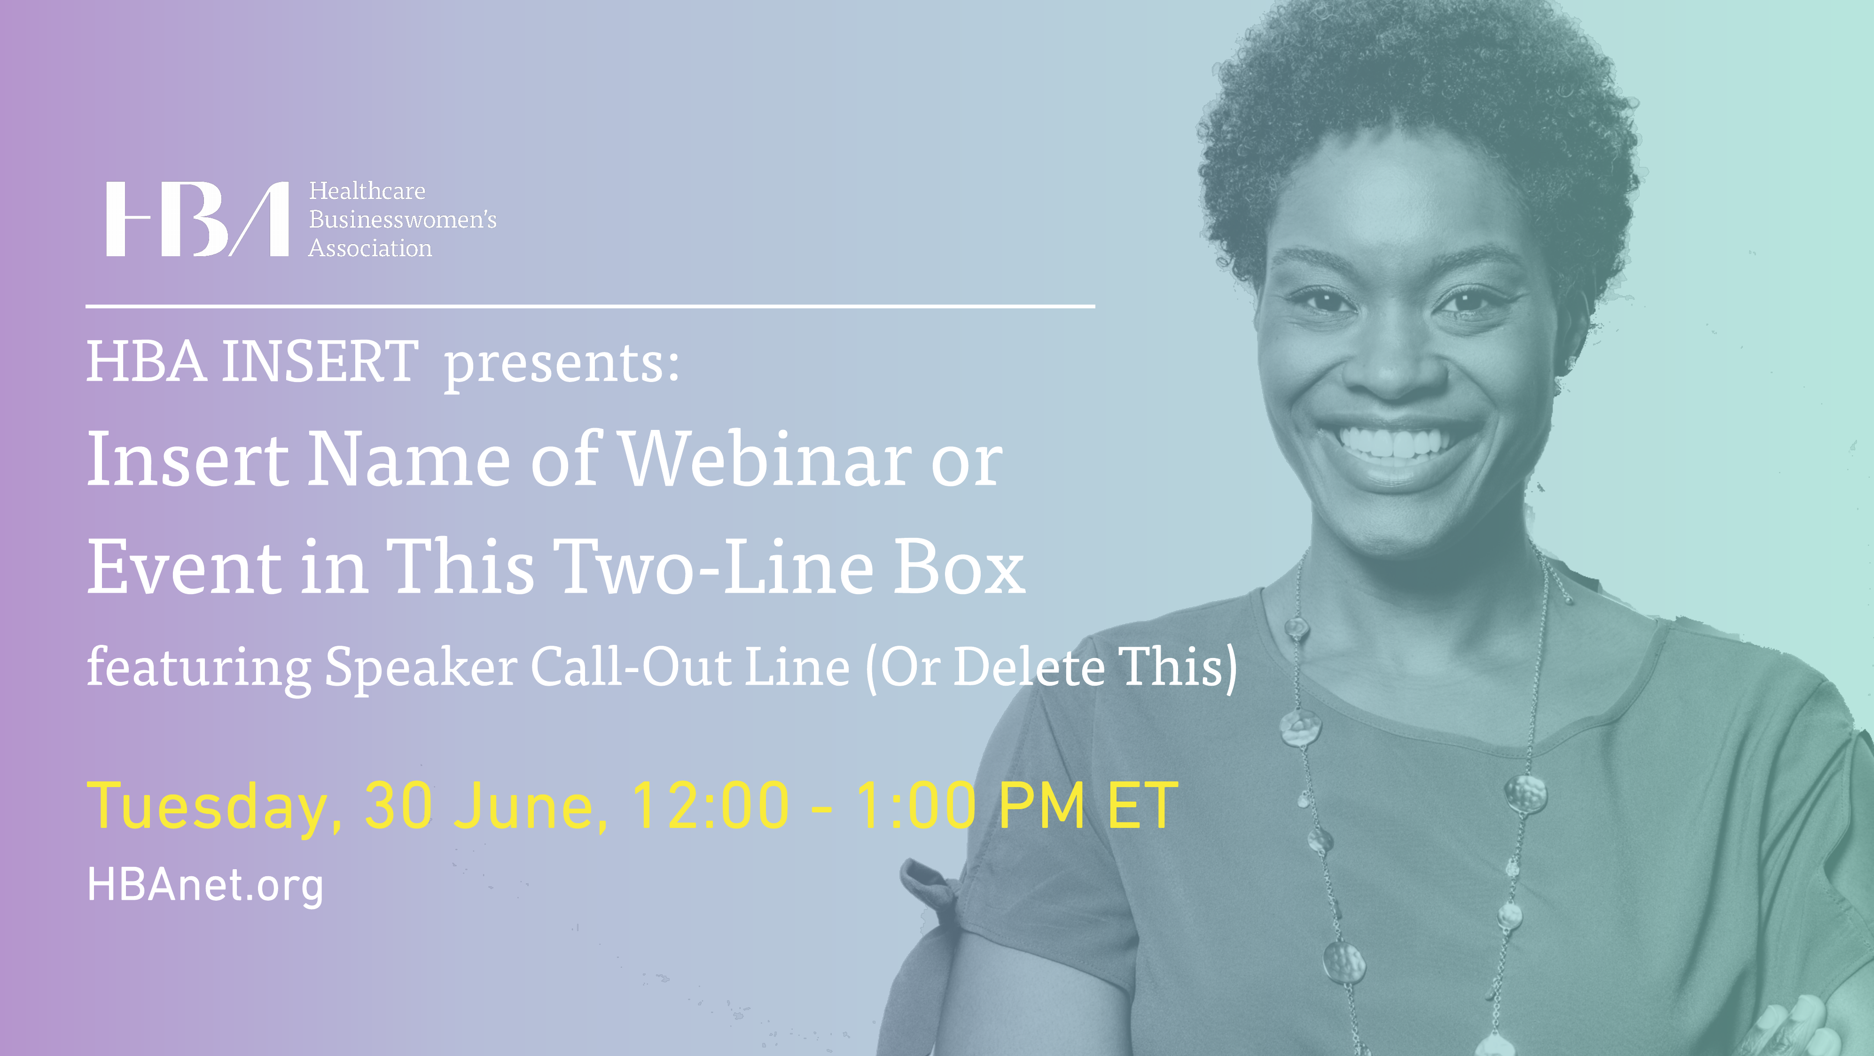
Examples of Materials Created in Marq
Membership and Events
Event Flyer
Social Media Graphics
Banner
Membership Postcard
PPT Slide

Slide 8
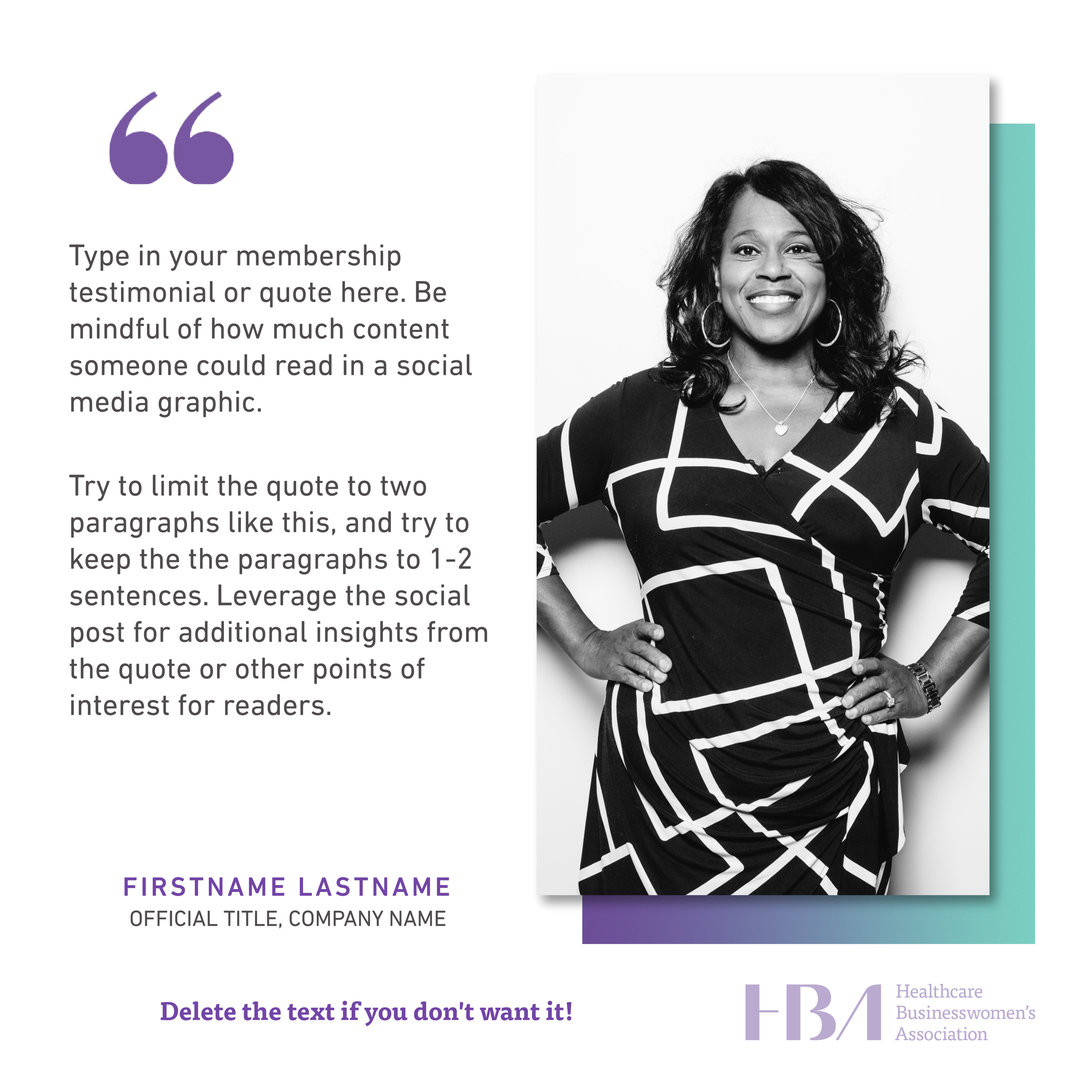
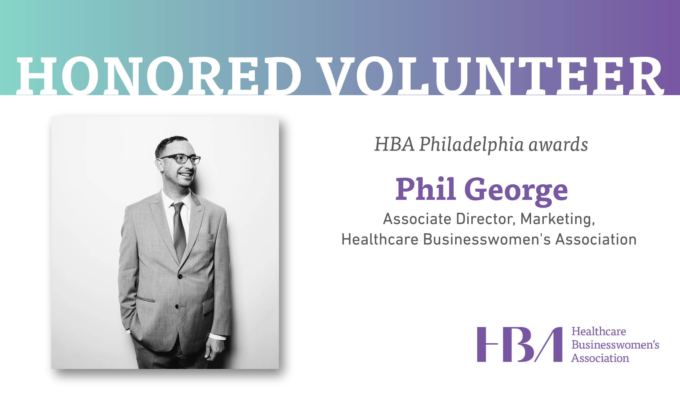
Examples of Materials Created in Marq
Volunteer and Chapter Highlights

Slide 9
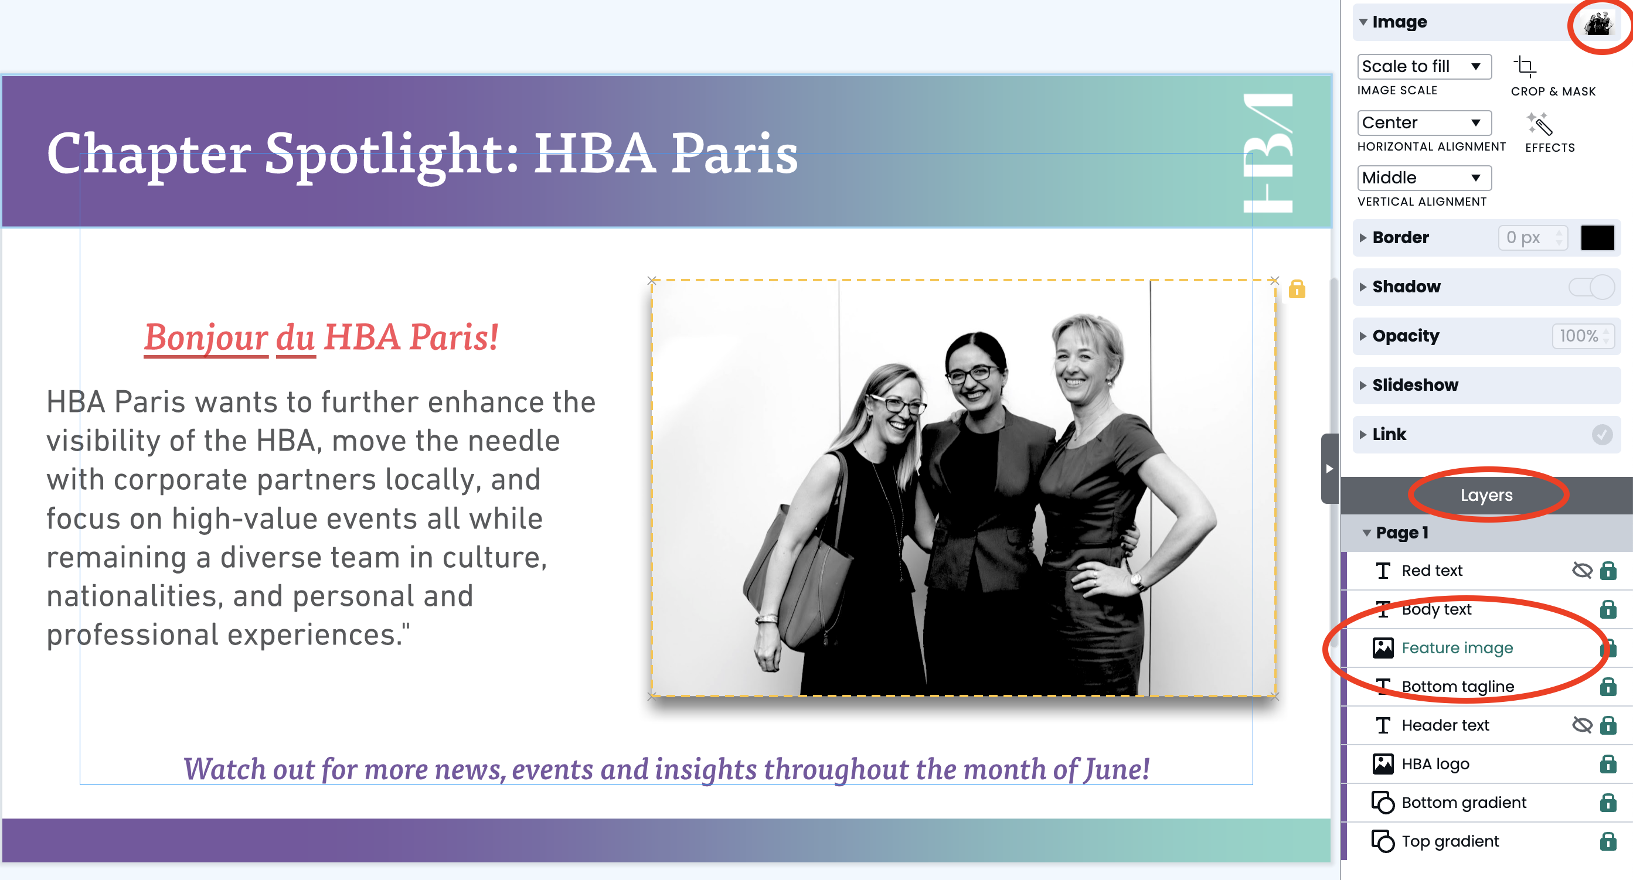
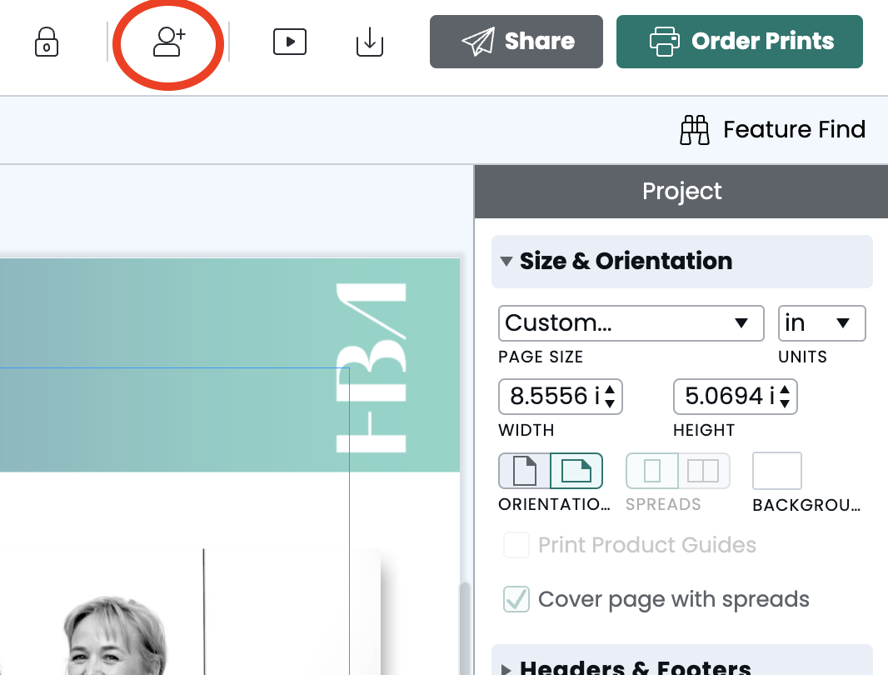
Marq: Quick Tips
Only use the HBA branded templates in Marq.
Do not create your own templates.
Do not pull images from the Internet to include
in your materials (copyright restrictions).
  There is a library of HBA branded photos available with real HBA members to include in your materials.
If including speaker headshots, only use photos provided by the speaker (do not grab from LinkedIn).
If including sponsor logos, only use logos provided by the sponsor (do not grab from the Internet).
Don’t forget! Images can be swapped out and modified by double clicking on the image or right-clicking on the image layer in the right sidebar.
If you need help with a design, click the “Collaborate” icon in the top right menu and add HBA Marketing (marketing@HBAnet.org) as a collaborator. Add a message or note to your design explaining your question. Devon will hop in and help you out at her earliest convenience!
Once a month, Devon Bortz (HBA’s Digital Marketing Manager) holds Marq open forums. Feel free to come (or send a team member) and ask questions!
You can find the forum dates and more information at https://hbavolunteer.knowledgeowl.com/help/marq-training.

Slide 10
Ordering Materials
All print products (banners, signs, flyers, postcards, etc.) can be ordered directly through Marq.
To determine your budget for materials, talk to your Regional Marketing President (contact information can be found on the last slide of this deck). Affinity Groups should contact Michelle Morse for budget information (mmorse@HBAnet.org). HBA Central will not reimburse your chapter/region for marketing materials.
When finished with your design, simply click “Order Prints” in the top-right corner. Select your product (the recommended product will be auto-selected) and proceed to Checkout. Shipping charges will be calculated after you input your shipping address.
If you need materials to be delivered to a location outside of the U.S., you will need to order prints through a local vendor. Simply download your designs as PDFs (or whatever file type you need) and share them with your vendor. If you’re in the U.S. and know a local vendor with better pricing than Marq, feel free to use them instead!
Want to order promotional materials such as pens, tablecloths, balloons, and pins? We currently work with Daniel Swider at Branded on Demand. You can browse product offerings here.
Once you’ve decided what products you’d like to order, please email marketing@HBAnet.org. Note: All items ordered from Branded on Demand require approval from HBA Central’s Marketing Team before purchase.

Slide 11
Social Media

Slide 12





Overview of Social Media
Each region has a Twitter page, a Facebook page, an Instagram profile, a LinkedIn company page, and a LinkedIn group. Chapters do not have social media pages.
HBA Central has its own channels, in addition to a YouTube page.
@HBAimpact
@HBAnet
@Healthcare Businesswomen’s Association
@HBAimpact
@HBAnet
To manage content and schedule posts, each region has access to a Hootsuite account. To get access to your region’s account, contact HBA’s Social Media Manager, Carly Markowitz, at cmarkowitz@HBAnet.org.
Once a month, Carly holds social media open forums. Feel free to come (or send a team member) and ask questions! You can find the forum dates and more information at https://hbavolunteer.knowledgeowl.com/help/2023-social-media-strategy.

Slide 13
Strategy Recommendations
Work with your Regional Director of Social Media to discuss social media strategy.
All regional strategies should support and be aligned with the HBA Central social media strategy and editorial calendar.
Draft a post calendar in advance with a plan to post at least 2-3 regular posts per week.
Try to include a mix of content including but not limited to:
  Event promotions
  Volunteer and member spotlights
  Live event coverage
  Event recaps (including video clips)
  Testimonials
  HBA Central initiatives
  Corporate Partner highlights
  Articles from your HBA region or chapter pages
  Relevant industry news
Respond to comments, engage with the community, and frequently check regional and chapter hashtags to engage with what people are saying about you.
  Share posts using your hashtag from volunteers’ personal account in your stories
Click here for more information on HBA’s social media strategy.

Slide 14
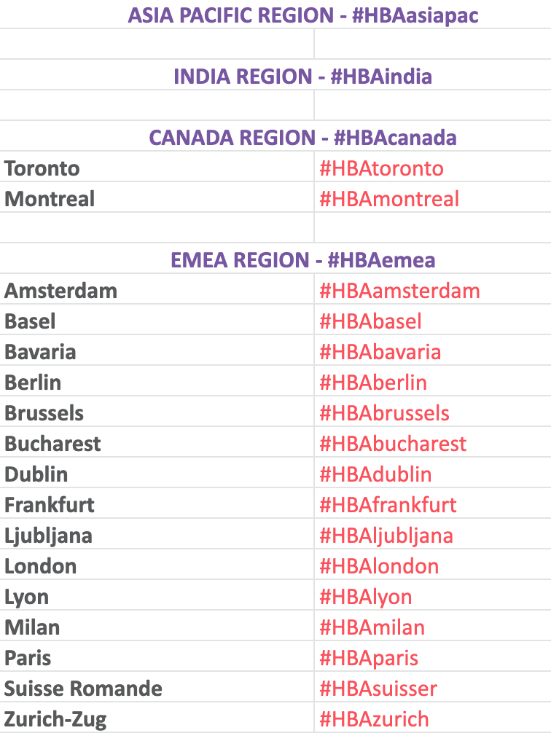
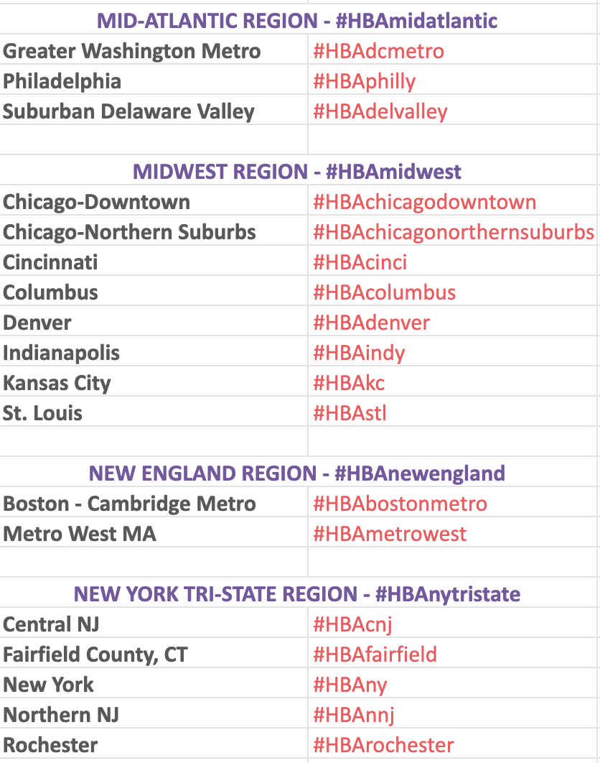
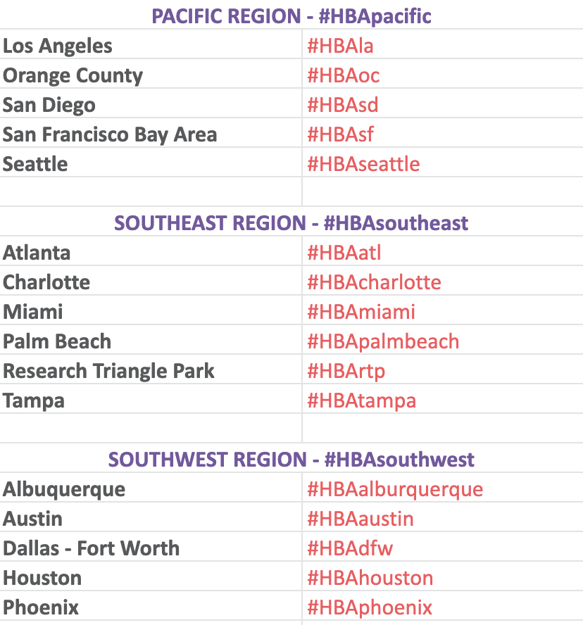
Chapter and Regional Hashtags
Use in addition to #HBAimpact.
If you do not see your chapter/region below, contact marketing@HBAnet.org.

Slide 15
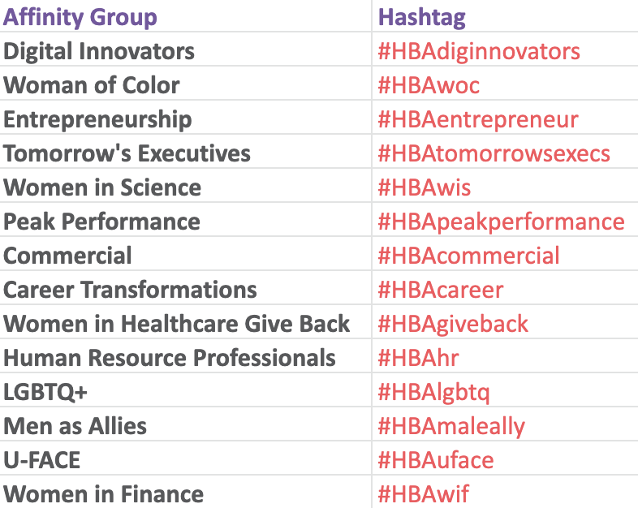
Affinity Group Hashtags

Slide 16
Email Marketing

Slide 17
Overview and Targeted Mailing Requests
First — be sure to leverage your HBA Communities! All posts notify Community members via email.
All emails to HBA members are sent from HBA Central. HBA policy prohibits chapters and regions from sending emails to members directly.
Beyond the weekly event digest, monthly regional chair messages, and HBA Central programming emails, HBA Central may – on a limited basis – send targeted emails in cases such as:
  Inviting executives to an exclusive event
  Sending important pre- or post-event communications to registrants
  Inviting volunteers to volunteer-only events
Note: All requests for targeted emails are reviewed on a case-by-case basis by HBA Central staff. Based on the volume of communications on the HBA Central calendar, requests may be declined due to resource availability and/or member profile data limitations. We can only invite individuals from our database who have opted in to receiving our emails (HBA policy).
Requests for targeted marketing must be sent to marketing@HBAnet.org A MINIMUM OF 10 BUSINESS DAYS before the requested send date. Any requests made without 10-days notice may not be accepted.
HBA member privacy policies prohibit HBA Central from providing email addresses to volunteers.

Slide 18
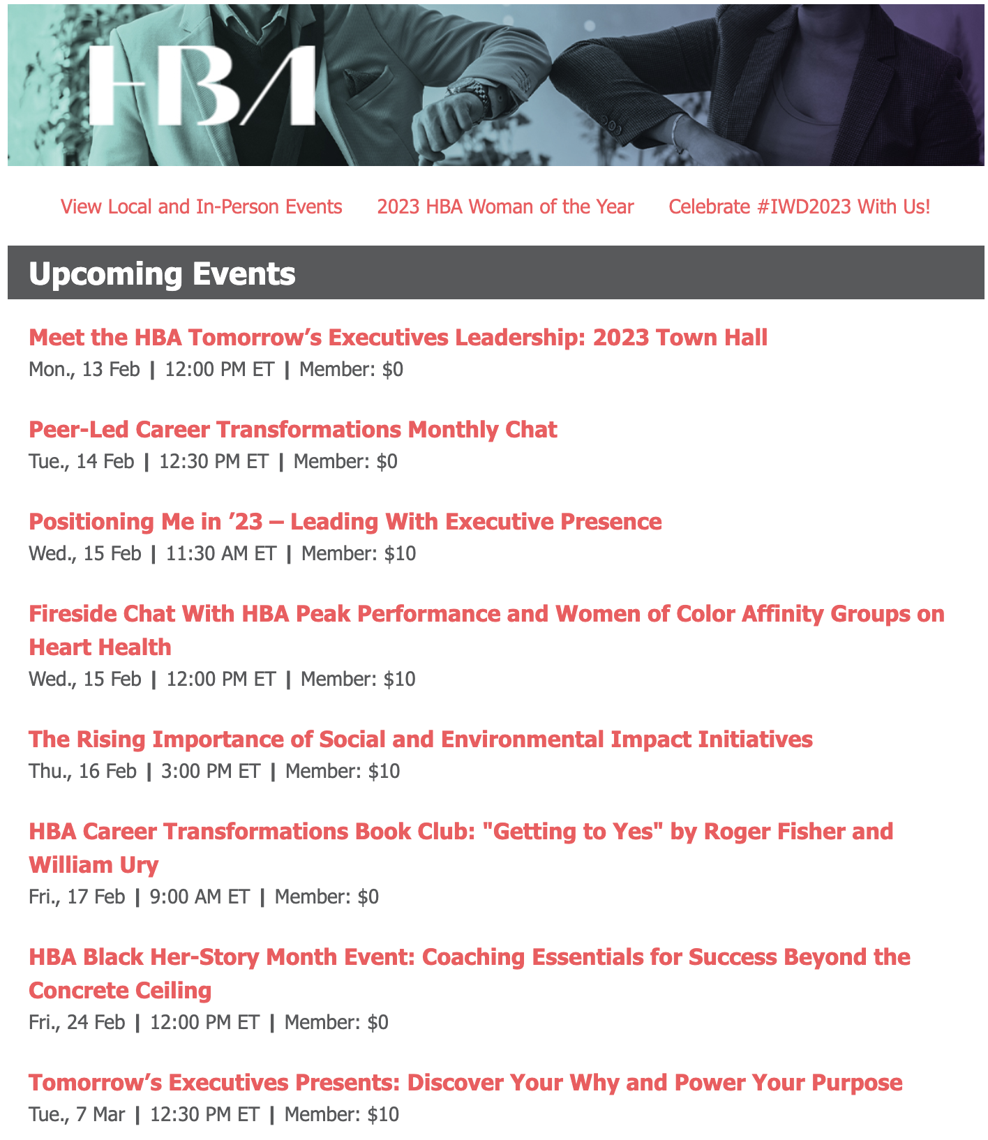
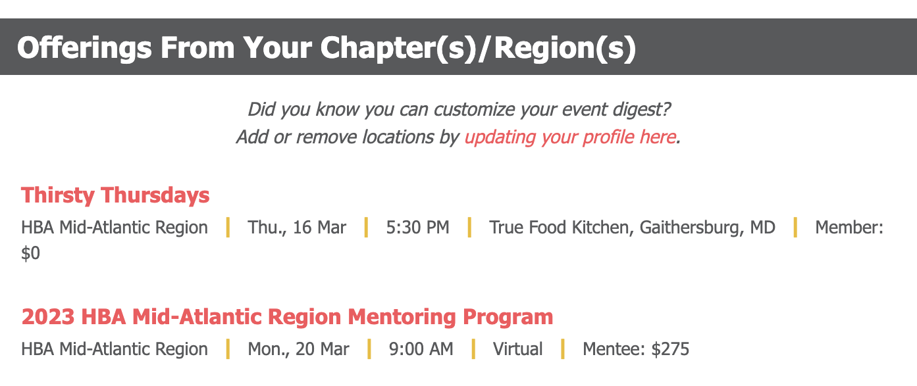
Weekly Event Digest
Sent every Monday at 11:00 AM local time.
  Conveys information about all HBA events (local, virtual, signature) in one consolidated format.
  Cross-promotes all events to maximize attendance.
  Customized for each recipient. (Members can select the chapters/regions from which they want to receive highlighted information.)
  Great click-through and open rates.
  Responsive on all devices.

Slide 19
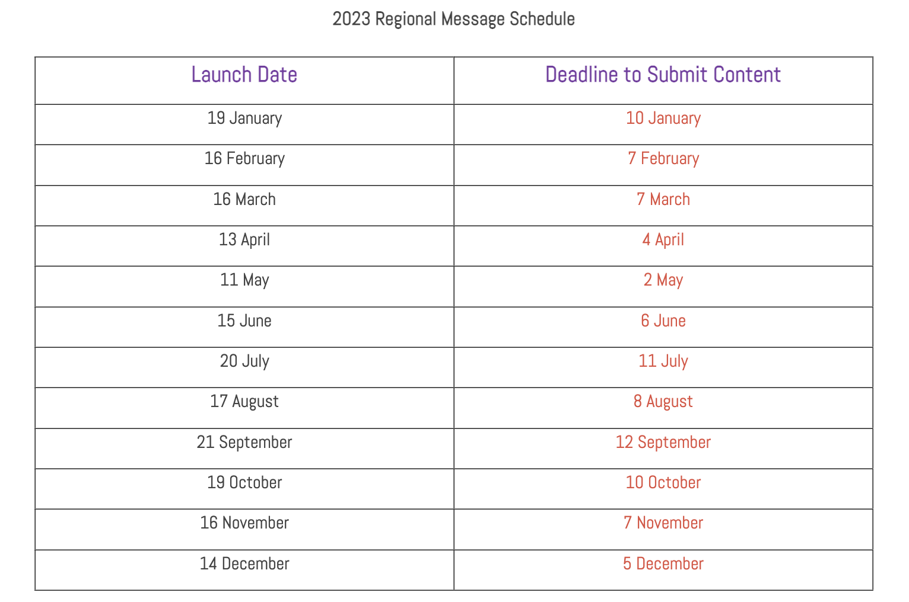
Regional Chair Messages
HBA Central publishes a monthly Message From the Regional Chair that
goes to members and prospects.
The monthly Message From the Regional Chair is a prime opportunity to directly address your region. This monthly outreach is your region's opportunity to create or close the loop among your various marketing channels and segments.
The Regional Communications Committee is responsible for working with the Regional Chair and submitting content by the posted deadlines.

Slide 20
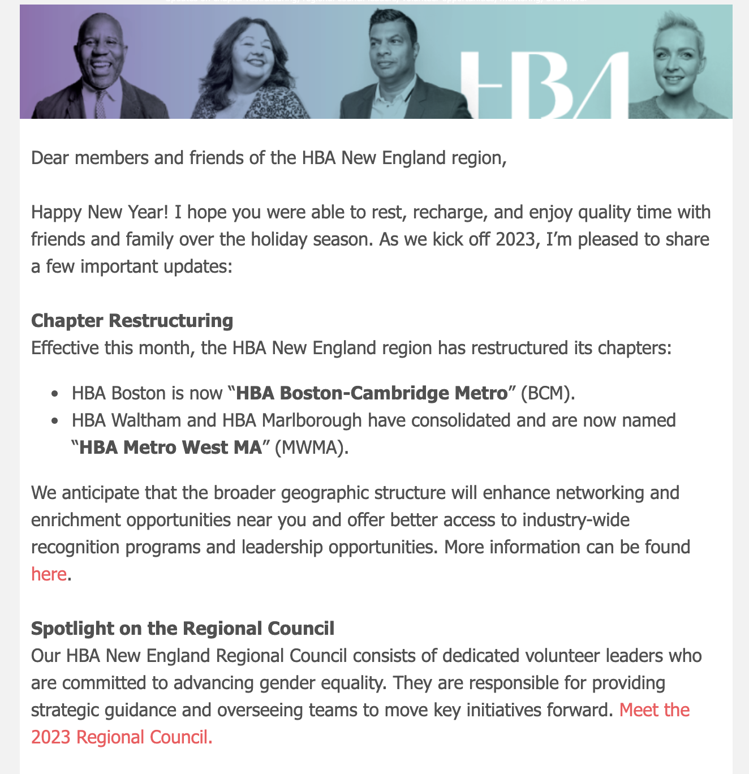
Regional Chair Messages (continued)
Best practices:
Your audience isn't limited to members OR seasoned readers. Some readers will be seeing this message for the first time, while others are familiar members. A conversation with your engagement volunteers will help determine whose engagement is critical at the time of sending. Boilerplate calls-to-action (social media, regional events, etc.) may also fill new readers' information gaps.
Timing is everything. Be mindful of the events occurring around the time of the message's launch..
Leverage other channels. Messages are limited to no more than 700 words, so make use of the different channels you have available!
  Publish longer articles on the website and reference them. To have an article added to the website, please send the article and any accompanying images to marketing@HBAnet.org.
  Shoutout your leaders and volunteers on social media — and tag them! — and encourage readers to join the celebration on social.
  Looking for local feedback or resources? Post a question to your regional Community and encourage readers to head over there to share their thoughts.

Slide 21
HBA Communities

Slide 22
Overview
The HBA Community is a private and secure, members-only online community where members can connect, participate in discussion, access useful information, contribute to the knowledge base, and post questions to peers. It can be accessed directly by clicking here and logging into your HBA profile. You can also access the HBA Community by visiting the HBA website, logging into your profile, and clicking the HBA Community link at the top of the page.
Once logged in, your HBA Community homepage will show you the most recent HBA Central offerings, member announcements, discussions, and career postings. Some highlights (which you’ll see depending on your membership and volunteer leader access) include:
The Member Forum is for discussion and networking with all HBA members.
Communities can be accessed by clicking the dropdown “My Communities” button. Here, you’ll see all the functional, geographic, and interest-specific Communities you have access to.
The Directory allows you to search our full list of HBA member contacts.
The Volunteer tab gives you access to join HBA's volunteer pool or browse open volunteer opportunities.

Slide 23
Participating in
Community Discussions
If you are posting in the “Member Forum,” click the link on the community navigation bar. If you are posting in another Community, click "Communities” and then choose "My Communities." Select the community to you are planning to post the content in. From here, you can browse discussions, shared files, and the member list.
To start a discussion thread, click the green “Post New Message” button.
  In accordance with the HBA Community etiquette policy, please keep topics relevant to the HBA mission and refrain from posting commercial messages. Job opportunities should be posted in the HBA Career Center instead of within the HBA Community.
You can read an existing discussion by clicking the topic title.
For each post, you can choose to respond publicly to the discussion or directly to the sender through a message. Simply click on “Reply to Discussion” or click the arrow icon to “Reply to Sender.”
Visit https://hbavolunteer.knowledgeowl.com/help/hbacommunity for more information.

Slide 24
Resources for Marketing Committees

Slide 25
In the Volunteer Resource Center
The following content can be found in the HBA Volunteer Resource Center.
  HBA Brand Guidelines
  HBA Style Guide
  HBA PowerPoint Template
  About the HBA Overview Deck
  Logos
  HBA Brand Photography
  Virtual/Zoom Background Graphic
  Communications Strategy
  Social Media Strategy
  Corporate Partner and Event Sponsorship Materials

Slide 26
Website
Content

Slide 27
Chapter News
Your Chapter Communications Committee is responsible for ensuring the website is updated with relevant news and information.
Submit articles regularly! Suggestions include:
A “Letter From the Chapter President” that discusses current events and news within the chapter
Volunteer recruitment
Regional and HBA Central programming highlights
Event recaps (with photos)
Board member and volunteer features and awards

Slide 28
Submitting Content for the Website
To make updates to an existing page:
Copy and paste existing content into a Word document.
Turn on “Track Changes.”
Edit.
Save and send revised document showing changes to
marketing@HBAnet.org.
To submit news:
Create content in a Word document.
Send the Word document to marketing@HBAnet.org.
HBA Central will respond to your email with a link to the article on the HBA website.
Send the URL to your chapter’s Social Media Committee and request they submit the article to your Regional Social Media Team to post on social media using your chapter hashtag and the official HBA hashtag: #HBAimpact.
NOTE: Board pages are automatically populated by information in the individual’s member profile (photo, title, company). However, if someone is missing or listed incorrectly, please contact Katie Cammer at kcammer@HBAnet.org.

Slide 29
Marketing and Communications Committee Structures

Slide 30
Chapters
Each chapter has one Marketing Director at Large who oversees the:
Chapter Marketing Team
  Works with the Chapter Programming Team to implement event marketing activities which optimize event success
  Provides sizzle and spice to event titles and descriptions
  Drives interest before, during, and after events
  Critical success factor for chapter programs
Chapter Communications Team
  Provides writing/content for chapter communications using HBA website and/or chapter Community
  Works with the Regional Marketing and Communications Committee to set schedule and cadence for chapter communications
Chapter Social Media Team
  Supports event promotion and chapter communications
  Works with the Regional Social Media Team to use various social media channels to create/increase awareness and buzz around chapter news, activities, events, recognition, awards, etc.
  Aligns and coordinates social media activity with other chapters in region, the Regional Marketing and Communications Committee, and the HBA Central Marketing Team

Slide 31
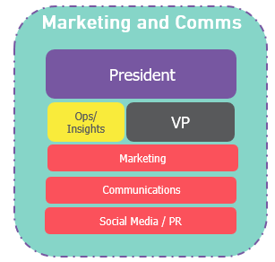
Regions
Dedicated to: Regional marketing, communications, and social media
Scope: Strategic planning around regional marketing, communications, social media, and PR; execution of regional event marketing, regional communications, and all social media needs
Teams:
  Regional Marketing Team: Regional event/program marketing and best practices
  Regional Communications Team: Region-wide communications coordination and content development
  Regional Social Media Team: Region-wide social media content development/posting and PR opportunities

Slide 32
Have Questions? Contact Us
Your Chapter Marketing Committee is supported by a Regional Marketing Committee.
(See the next slide for an overview of committee structure.)
Regional Marketing Presidents:
  All Europe Regions: Vacant
  Canada: Fanny Sie | fanny.sie@roche.com
  Mid-Atlantic: Desiree Priestley | desiree.priestley@otsuka-us.com
  Midwest: Karen Murray | karen.murray@abbvie.com
  New York Tri-State: Julia Helms | julia.helms@bms.com
  New England: Gretchen Murphy | gmurphy.hba@gmail.com
  Pacific: Shawn Takiguchi | shawn.takiguchi@otsuka-us.com
  Southeast: Glynda Pineres | pineresg@bellsouth.net
  Southwest: Courtney Nall | courtney.nall@novartis.com
HBA Central Staff:
Philip George | Associate Director, Marketing | pgeorge@HBAnet.org
Nancy White | Senior Director, Communications | nwhite@HBAnet.org
Devon Bortz | Digital Marketing Manager | dbortz@HBAnet.org
Carly Markowitz | Social Media Manager | cmarkowitz@HBAnet.org
If you aren’t sure who
from HBA Central you
should reach out to, email marketing@HBAnet.org.

Slide 33
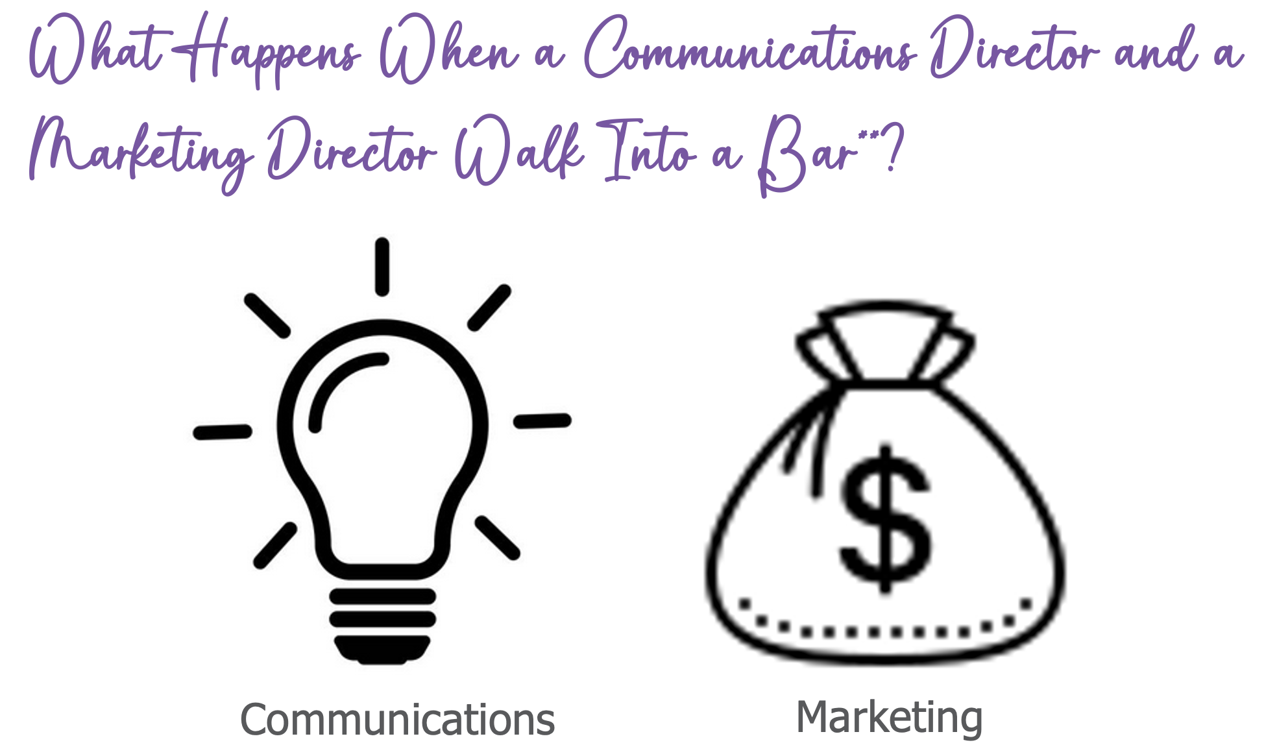
Not Sure Who to Contact?
Communications vs. Marketing
To understand the differences between marketing and communications, it helps to think about this allegory: What happens when a Communications Director and a Marketing Director walk into a bar?
The Communications Director develops a story to tell the history of the bar, the importance of the business to the community, and its impact on the economy while working to get the message out to the masses.
The Marketing Director develops strategies and executes tactics to advertise the bar and sell drinks and menu items directly to the marketplace.
Each aims to contribute to the bar’s financial success and brand, but how they do this is wholly unique.

