Slide 1
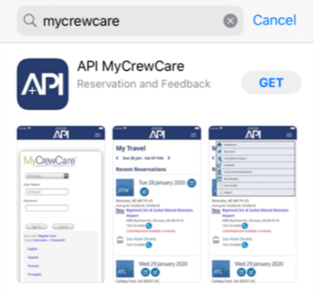
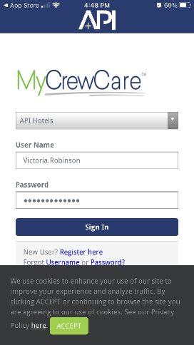
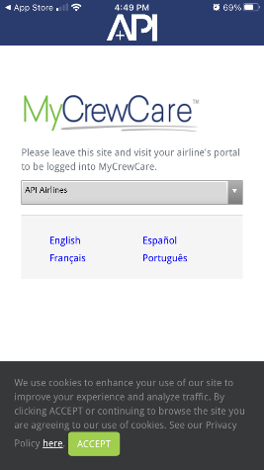
API is excited to announce the launch of our MyCrewCare App!
As valued clients of API, you have been selected to be the first users to get access to the new MCC App and provide us with valuable feedback.
The MCC App provides access to all of the great features and functionalities that you had before – but with an added benefit of viewing key information while offline! This means you can now view hotel & GT information for the current week, as well as reservation data for the previous and following week without waiting until you have internet access.
HOW TO ACCESS SINGLE SIGN ON (SSO)
Download the MyCrewCare App from the App Store for the mobile device you now use to access MyCrewCare. If you have previously downloaded the app please delete and re-install
The application can be found on the Apple App Store by clicking the below link or searching for “MyCrewCare”
https://apps.apple.com/us/app/api-MyCrewCare/id1497360147
After the application has downloaded, select Open. You will be required to select your airline from a dropdown and enter your username and password. Selecting your airline is a onetime authentication and you will not be required to entire your airline once you have logged in and stored your information.
As a Single Sign On (SSO) participant, you will be prompted to log into your airlines intranet for access.

Slide 2
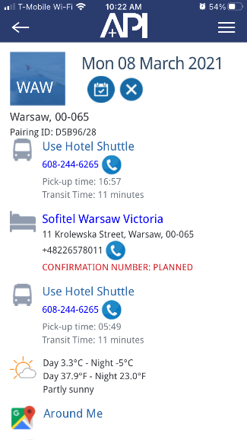
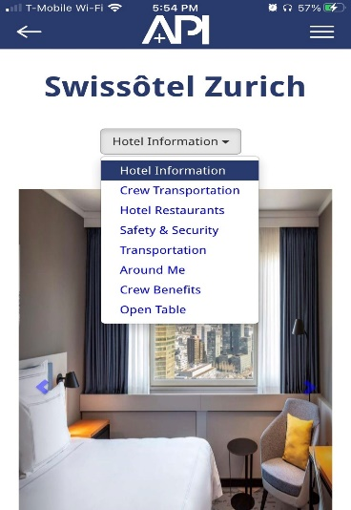
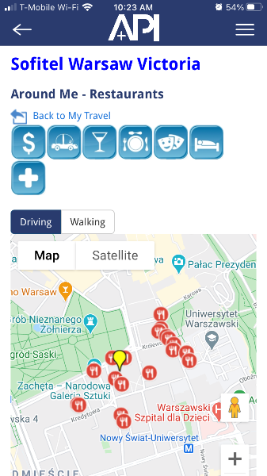
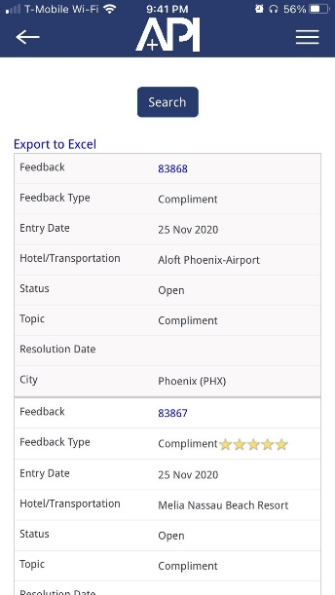
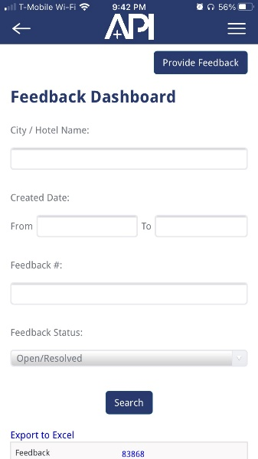
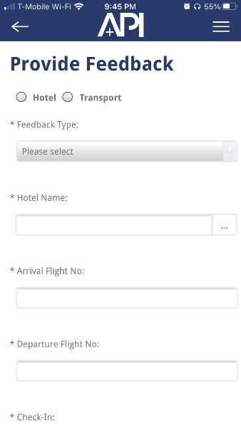
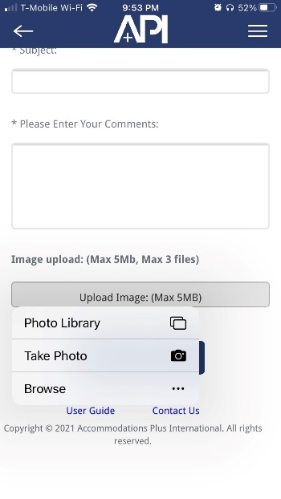
KEY FEATURES
My Travel is the home screen after logging into the MyCrewCare App. My Travel Function helps crewmembers monitor hotel and ground transportation dates. The main reservation page will arrival transportation and hotel details as well as departing transportation details. There will be links to call the hotel and transportation suppliers as well as pickup times and transit time details.
Contracted Hotel information can be accessed by selecting the hotel hyperlink in MyTravel. The Hotel Information feature will provide you with hotel amenities and area information as well as Crew Benefits that have been negotiated specifically for your airline.
Around Me opens an interactive Google-map with nearby places of interest and directions. Place of interest include:
Banks
Taxis
Restaurants
Cinema
Hotels
Pharmacies
Click the listed item or icon for direction, phone and more.
My Feedback provides a forum to provide compliments and complaints for Hotel and Ground Transportation suppliers. The MyFeedback feature also gives full visibility into your open issues and feedback resolution.
Select Hotel or Ground Transportation provider to provide complaints or compliments. Ability to upload pictures from camera library or take new pictures.
API’s account management team will work to resolve your feedback and rectify for future instances.

Slide 3
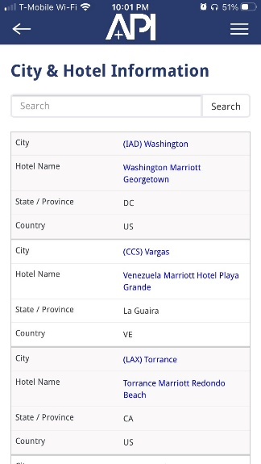
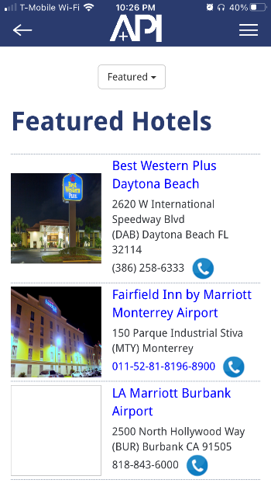
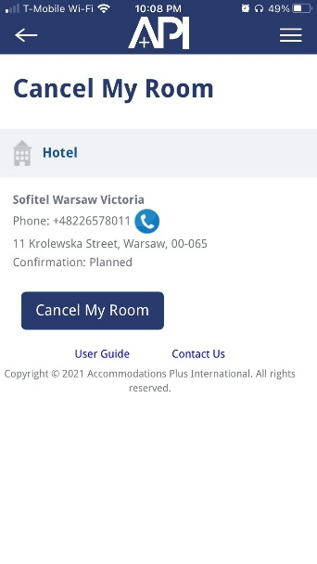
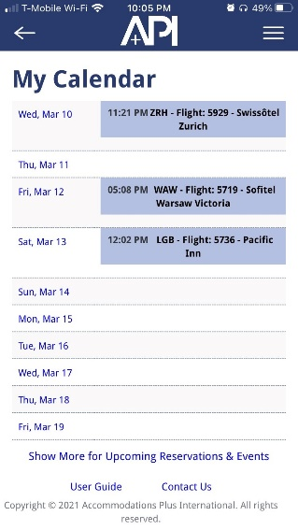
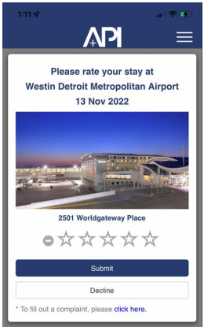
KEY FEATURES
City & Hotel Information provides the ability to see all contracted hotels within your network. Search by City and Location. The Hotel Information feature will provide you with hotel amenities and area information as well as Crew Benefits that have been negotiated specifically for your airline.
Featured Hotels highlights your new contracted destinations as well as notable properties.
Cancel My Room allows crew members to cancel their room when they are not utilizing room. Full reporting on canceled rooms available.
My Calendar is an app calendar that synchronizes your API travel information with calendar information you update within the application.
RateMyLayover is a rating function that allows crew members to rate their hotel stay after check out.

