Slide 1
Path To Agility®
An Outcome-Based Agile Transformation Approach

Slide 2
Problem

Slide 3
Current State of Agility
Superficial Agility | Improving Agility | Predictable Agility | Fast Agility
Going through the motions Work is visible Silo development Lots of carryover Not strong PO/ SM | Retrospectives have meaning Scrum Master is Coach Work is estimated and velocity being measured Swarming and cross training is starting to happen Team identity is being created | Carryover is limited Team’s have focus (Limiting WIP) Constant team Backlog Refinement Break work down and swarm Whole team ownership embracing cross functional goals | Cycle Time has been significantly reduced Able to respond to new high priority and deliver quickly Leadership focus on optimizing the whole Urgently resolve organizational impediments Test Automation, Continuous Integration, DevOps in place

Slide 4
Top 5 Reasons Transformations Fail
1
2
3
4
5
Implementing Practices Over Outcomes
Focus Only On Team Level
Training without Coaching
Not Optimizing Across Entire Value Stream
Lack of Business Engagement
Notes:
New Simplified top 5

Slide 5
6 Keys to Transformation Success
1
2
3
Business Outcomes are the Goal
Leaders Lead the Change
Value Driven Mindset (Product vs. Project)
4
5
6
Manage the Change Journey
Involve the Whole Org
Build Internal Coaching Capacity
Notes:
Business Outcomes are the goal - Outcome focused, create a sense of urgency with a compelling why
Leaders have to lead the change - More than team level. Leadership shift, have to own, optimize the whole system
Make the shift to a Product/Value driven mindset - Product vs Project
Manage the change journey - Long term, Manage the change not just training
Not Just IT you need Biz, HR and Finance Engagement
Build Internal Agile Coaching Capability for Sustainable Improvement

Slide 6
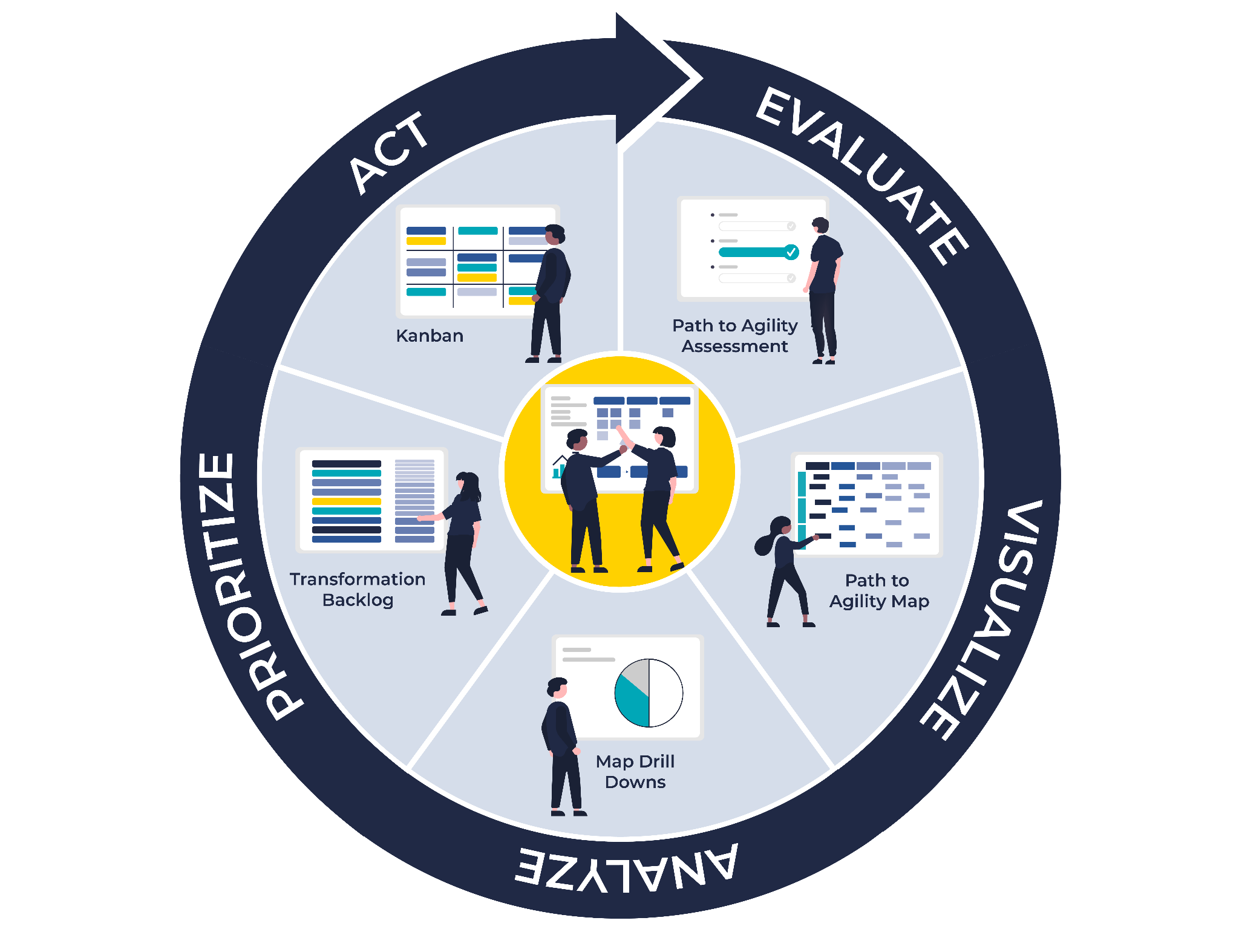
Transformation Management Process
Evaluate the status of your transformation with a consistent assessment process.
Visualize status with an interactive, data-driven map that correlates Agile practices with business outcomes.
Analyze transformation efforts with drill-downs and dashboards that deliver actionable insights.
Prioritize actions you should take to maximize impact on your business goals.
Act on tasks that are coordinated in Kanban boards and use connected dashboards to track transformation progress.

Slide 7
Overview

Slide 8
Employee Engagement
Speed
Market Responsiveness
Employees are more satisfied in their work, willing to go the extra mile, passionate about the purpose of their jobs and committed to the organization.
The time it takes to deliver an idea into the market
The ability of the organization to pivot quickly to respond to ever-changing market demands.
Copyright Path to Agility, LLC All Rights Reserved
Copyright Path to Agility, LLC All Rights Reserved
Copyright Path to Agility, LLC All Rights Reserved
Customer Satisfaction
Predictability
Productivity
Customers are satisfied with the experience, benefits and outcomes when using your product or service.
Teams maintain a predictable cadence of delivery enabling the business to make informed business decisions.
Increase the business value realized while maintaining or reducing costs.
Copyright Path to Agility, LLC All Rights Reserved
Copyright Path to Agility, LLC All Rights Reserved
Copyright Path to Agility, LLC All Rights Reserved
Quality
Innovation
Continuous Improvement
The product or service meets the expectations of the market for usability, reliability, etc.
New ideas, creative thoughts, or novel imaginations providing better solutions to meet new requirements, unarticulated needs, or known market needs.
The ability of the organization to relentlessly pursue optimizations in all aspects of business functions.
Copyright Path to Agility, LLC All Rights Reserved
Copyright Path to Agility, LLC All Rights Reserved
Copyright Path to Agility, LLC All Rights Reserved

Slide 9
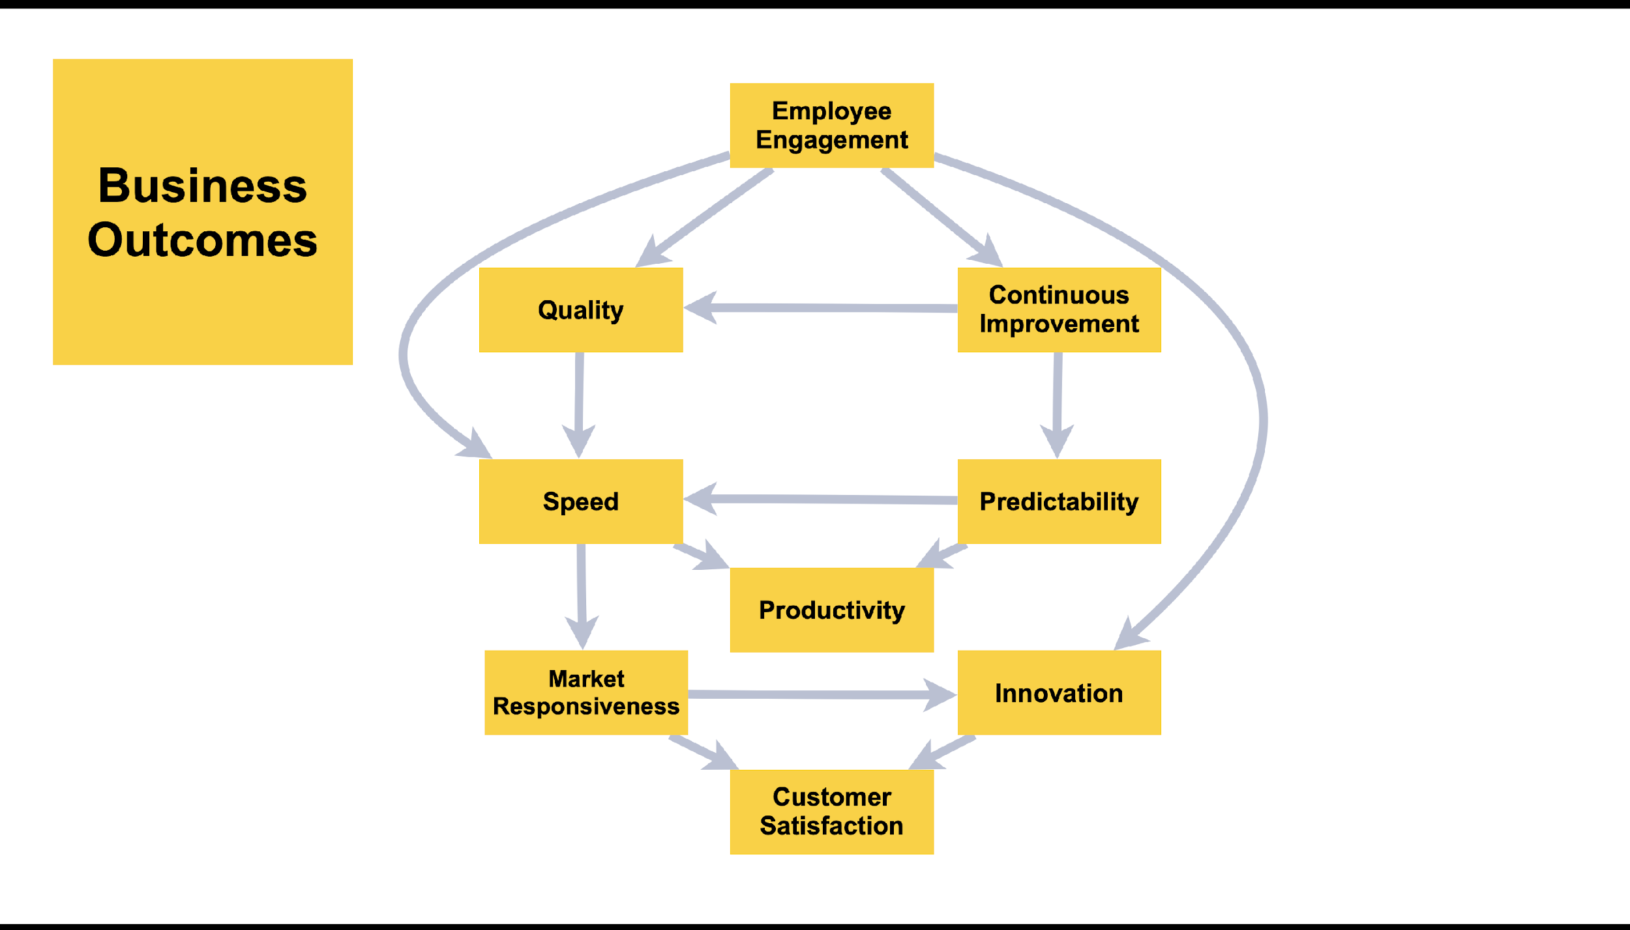

Slide 10
Business Outcomes
Path To Agility®
“Why” Dictates Priorities
Agile Outcomes
Which Are Achieved Through
Accomplish
Agile Capabilities
By Implementing
Drive
Agile Practices
Enable
Notes:
The P2A model helps to identify where to focus efforts, which capabilities are needed in order to achieve desired outcomes,
We get multiple feedback loops which allow us to inspect and adapt on the journey

Slide 11
New Status Quo
Integration & Practice
Status Quo
Chaos & Resistance
Align
Learn
Predict
Accelerate
Adapt

Slide 12
Levels

Slide 13
Levels of Path To Agility®
Leadership
Culture/Mindset Strategy
Organizational Structure
HR/Finance Practices
Org
Organization
System of Value Delivery
Flow of Work
Scaling
Cross Team Cord.
System
System 1
System 2
Team level Practices
Scrum/Kanban
Code Quality
DevOps
Team
Team 1
Team 2
Team N

Slide 14
Agile
Outcomes

Slide 15
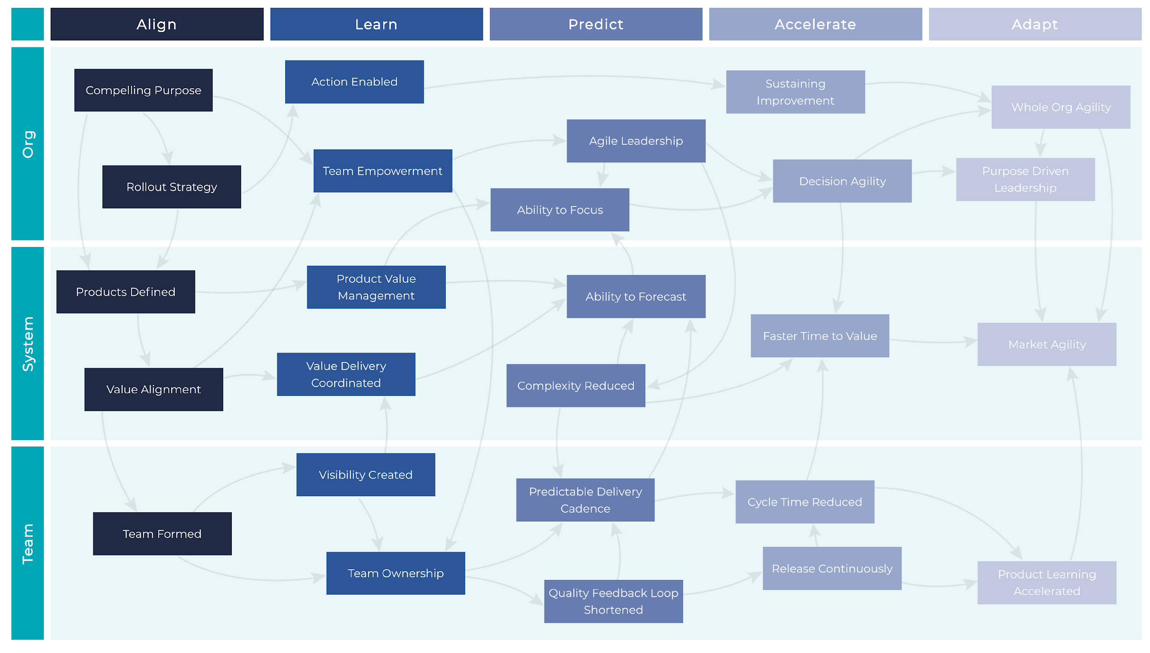
Path to AgilityⓇ 2.5 : © 2017-2023 Path to Agility, LLC. All Rights Reserved.

Slide 16
Path to AgilityⓇ 2.5 : © 2017-2023 Path to Agility, LLC. All Rights Reserved.

Slide 17
Path to AgilityⓇ 2.5 : © 2017-2023 Path to Agility, LLC. All Rights Reserved.

Slide 18
Path to AgilityⓇ 2.5 : © 2017-2023 Path to Agility, LLC. All Rights Reserved.

Slide 19
Path to AgilityⓇ 2.5 : © 2017-2023 Path to Agility, LLC. All Rights Reserved.

Slide 20
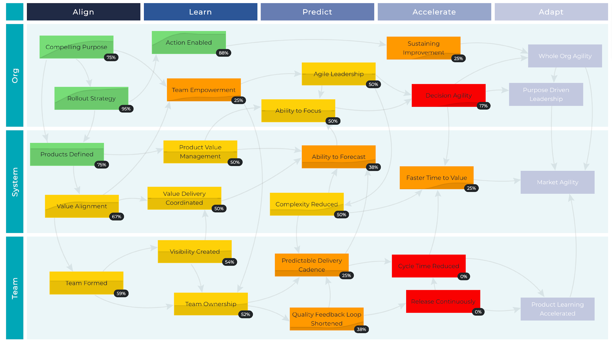
Path to AgilityⓇ 2.5 : © 2017-2023 Path to Agility, LLC. All Rights Reserved.

Slide 21
Capabilities

Slide 22
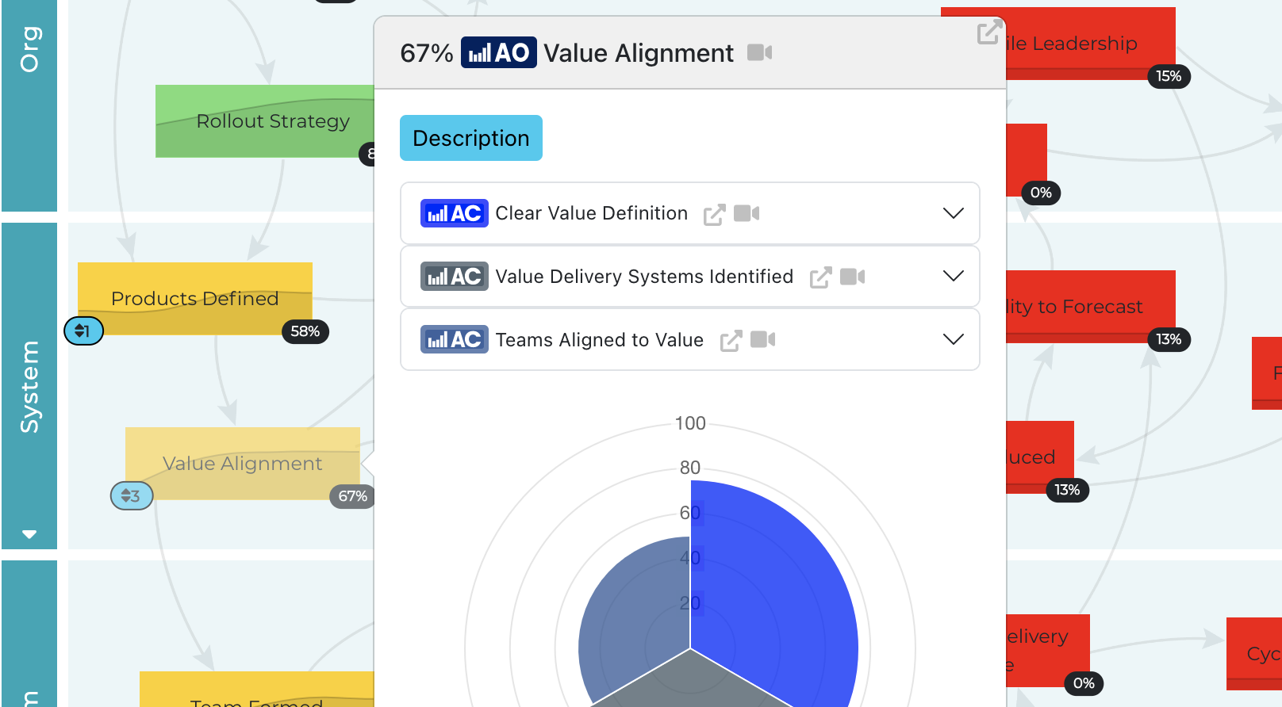

Slide 23
Path to Agility® Cards
Org Vision
Acceptance Criteria
The vision describes the organization's purpose and what it aspires to be.
The vision inspires and motivates the organization
The vision aligns the organization to a common goal
The vision is clear and everyone in the organization can speak to it
The vision informs the strategic themes of…
Org Objectives
Acceptance Criteria
Clear organizational objectives have been defined with measurable success criteria.
Organizational objectives are defined in alignment with the vision and strategy
Clear business objectives have been articulated and agreed upon by organization leadership
The business objectives and measures have been broadly shared with the organization…
FRONT
BACK
Urgency to Change
Acceptance Criteria
A compelling reason why the organization should change has been communicated across the organization, clear measures of success have been defined, and everyone is compelled into action.
It is clear to all why it is imperative that the organization must change
A guiding vision that will focus and provide clarity of mission for the transformation approach has been created
Clear business objectives have been defined with measurable success criteria
Path to AgilityⓇ 2.5 : © 2017-2023 Path to Agility, LLC. All Rights Reserved.

Slide 24
Path to Agility® Navigator

Slide 25
Business
Outcomes

Slide 26
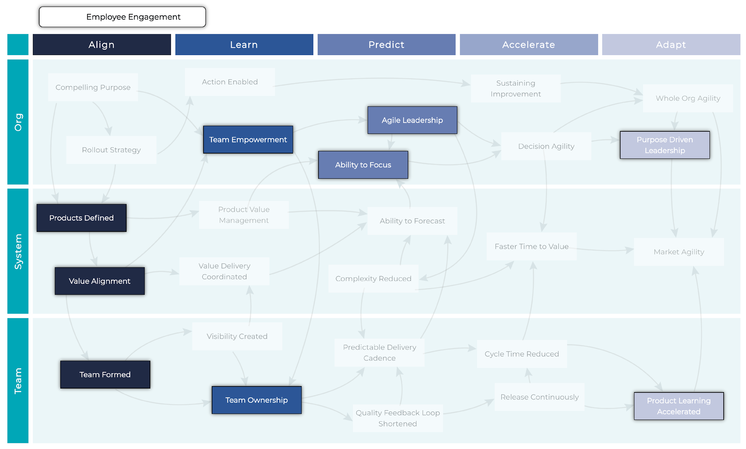
Employee Engagement
Path to AgilityⓇ 2.5 : © 2017-2023 Path to Agility, LLC. All Rights Reserved.

Slide 27
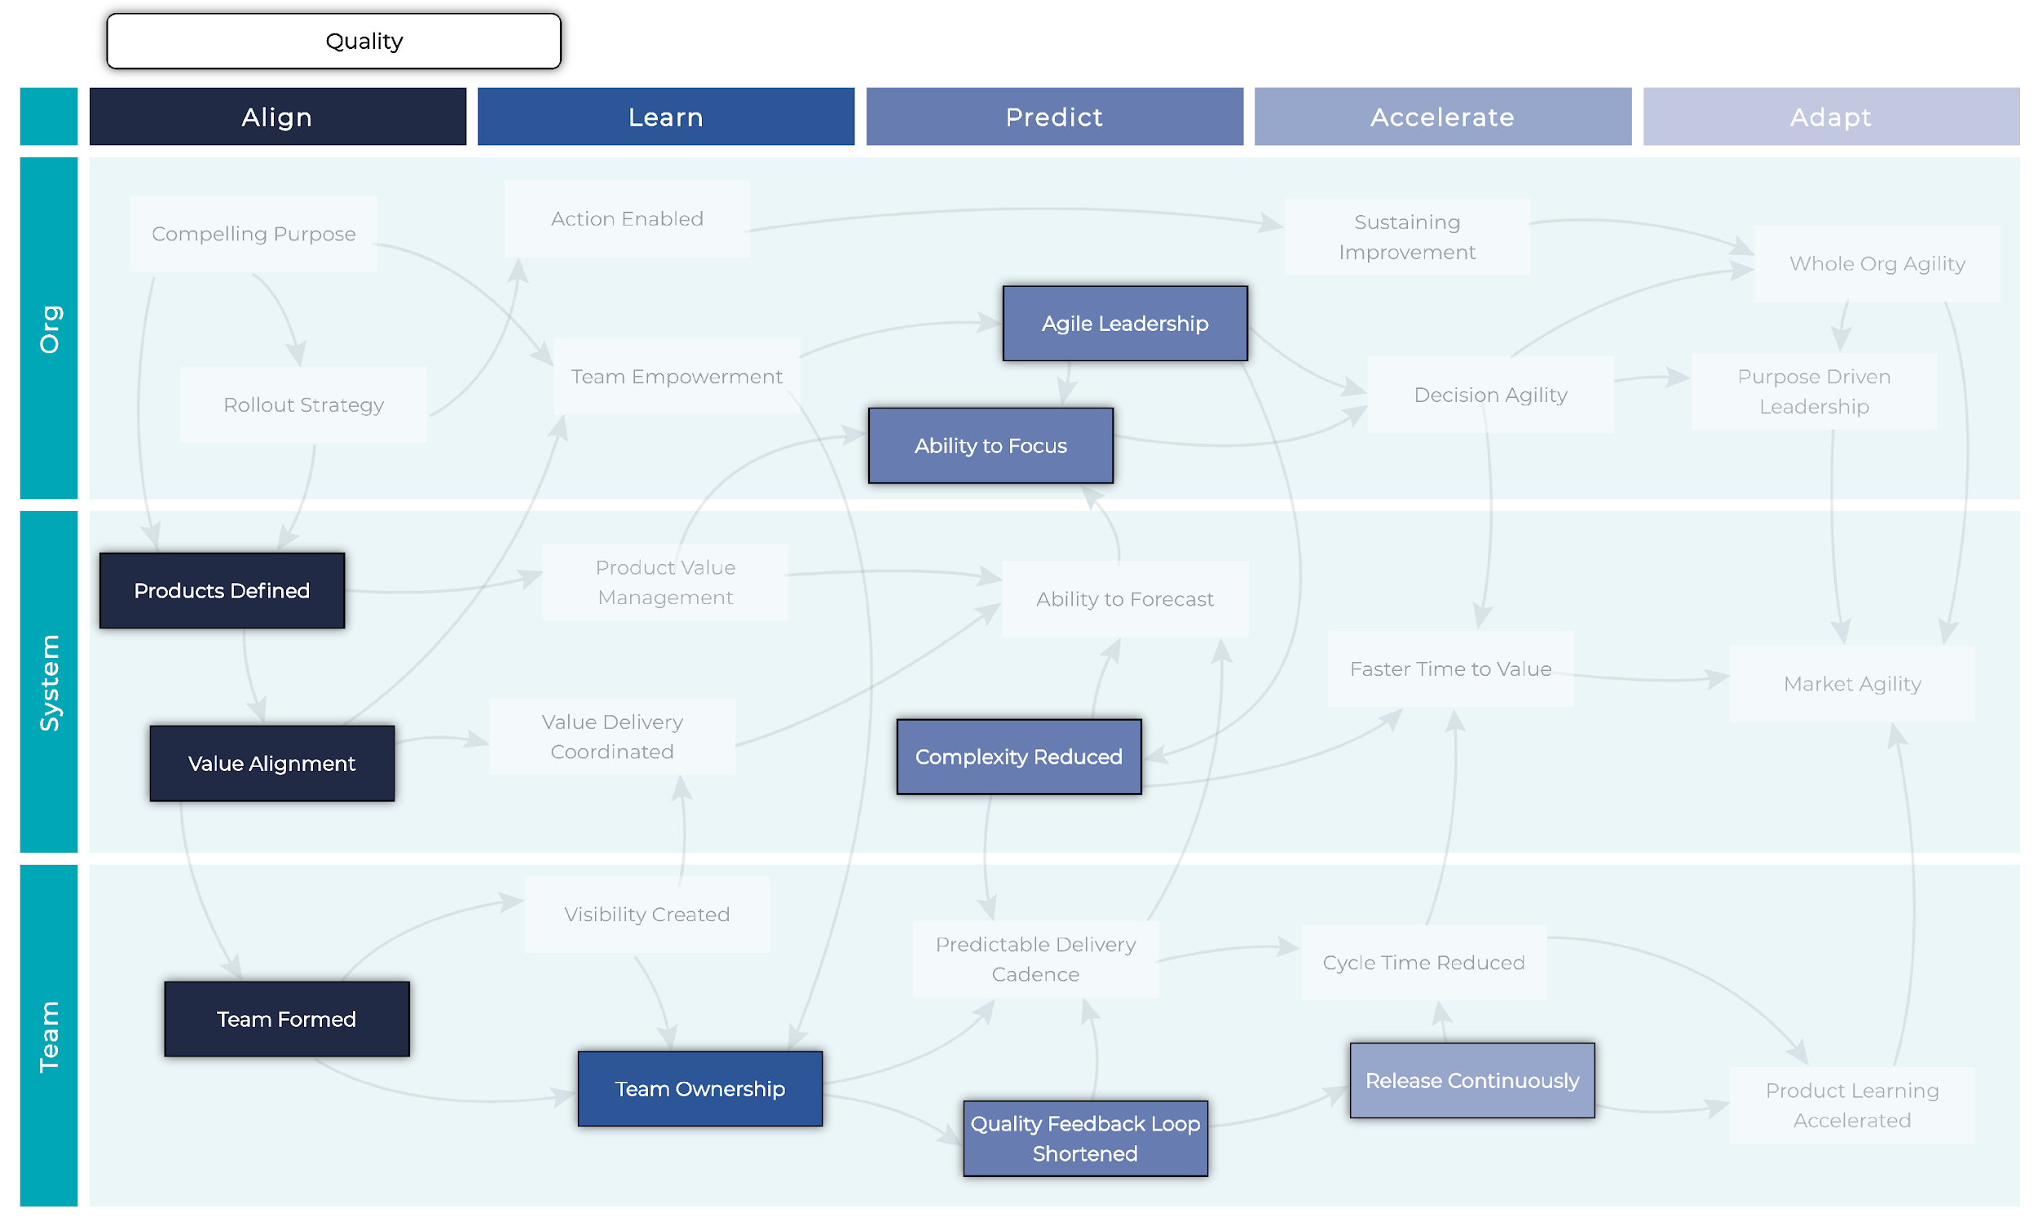
Quality
Path to AgilityⓇ 2.5 : © 2017-2023 Path to Agility, LLC. All Rights Reserved.

Slide 28
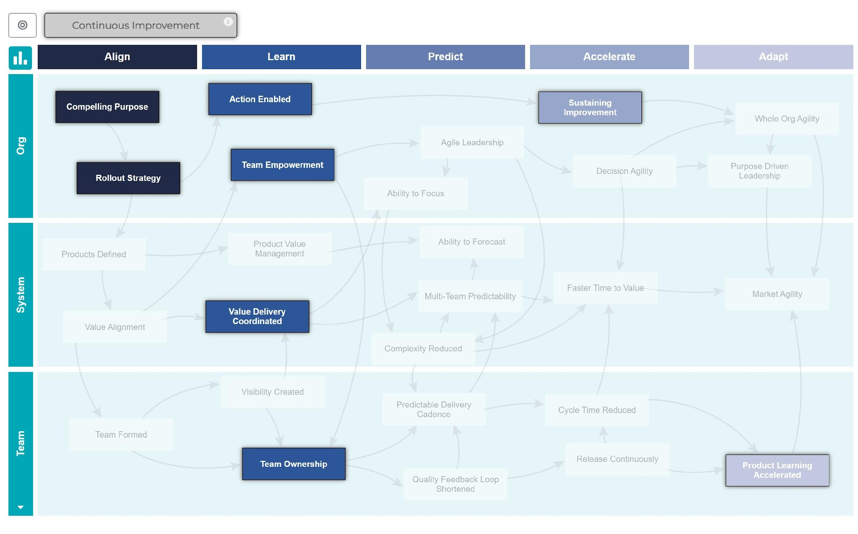
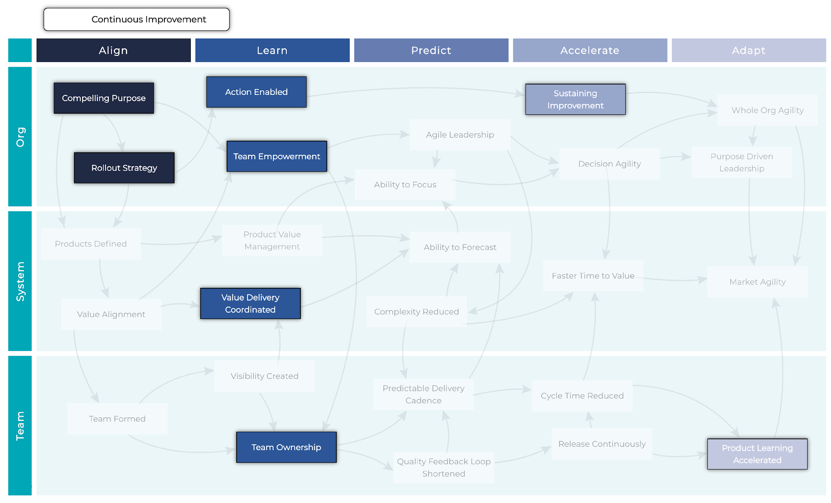
Continuous Improvement
Path to AgilityⓇ 2.5 : © 2017-2023 Path to Agility, LLC. All Rights Reserved.

Slide 29
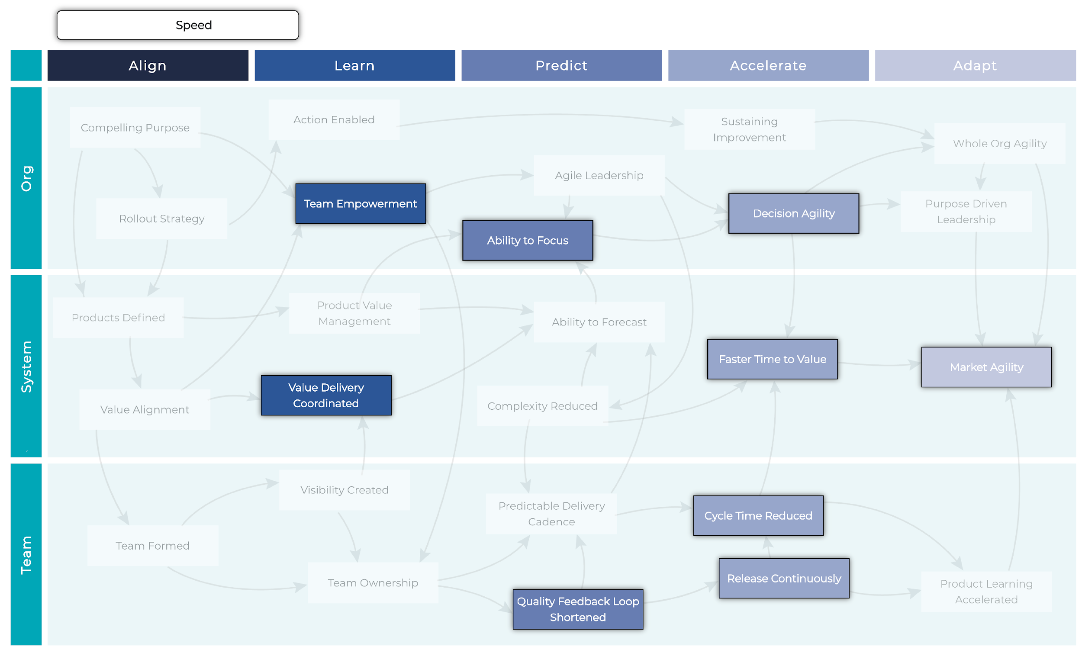
Speed
Path to AgilityⓇ 2.5 : © 2017-2023 Path to Agility, LLC. All Rights Reserved.

Slide 30
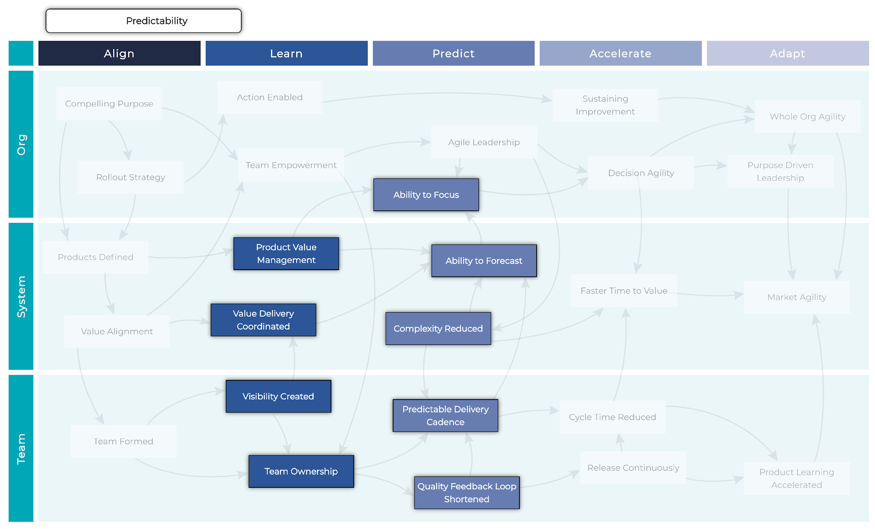
Predictability
Path to AgilityⓇ 2.5 : © 2017-2023 Path to Agility, LLC. All Rights Reserved.

Slide 31
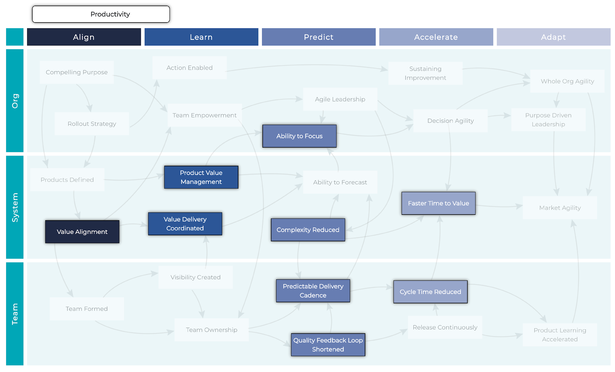
Productivity
Path to AgilityⓇ 2.5 : © 2017-2023 Path to Agility, LLC. All Rights Reserved.

Slide 32
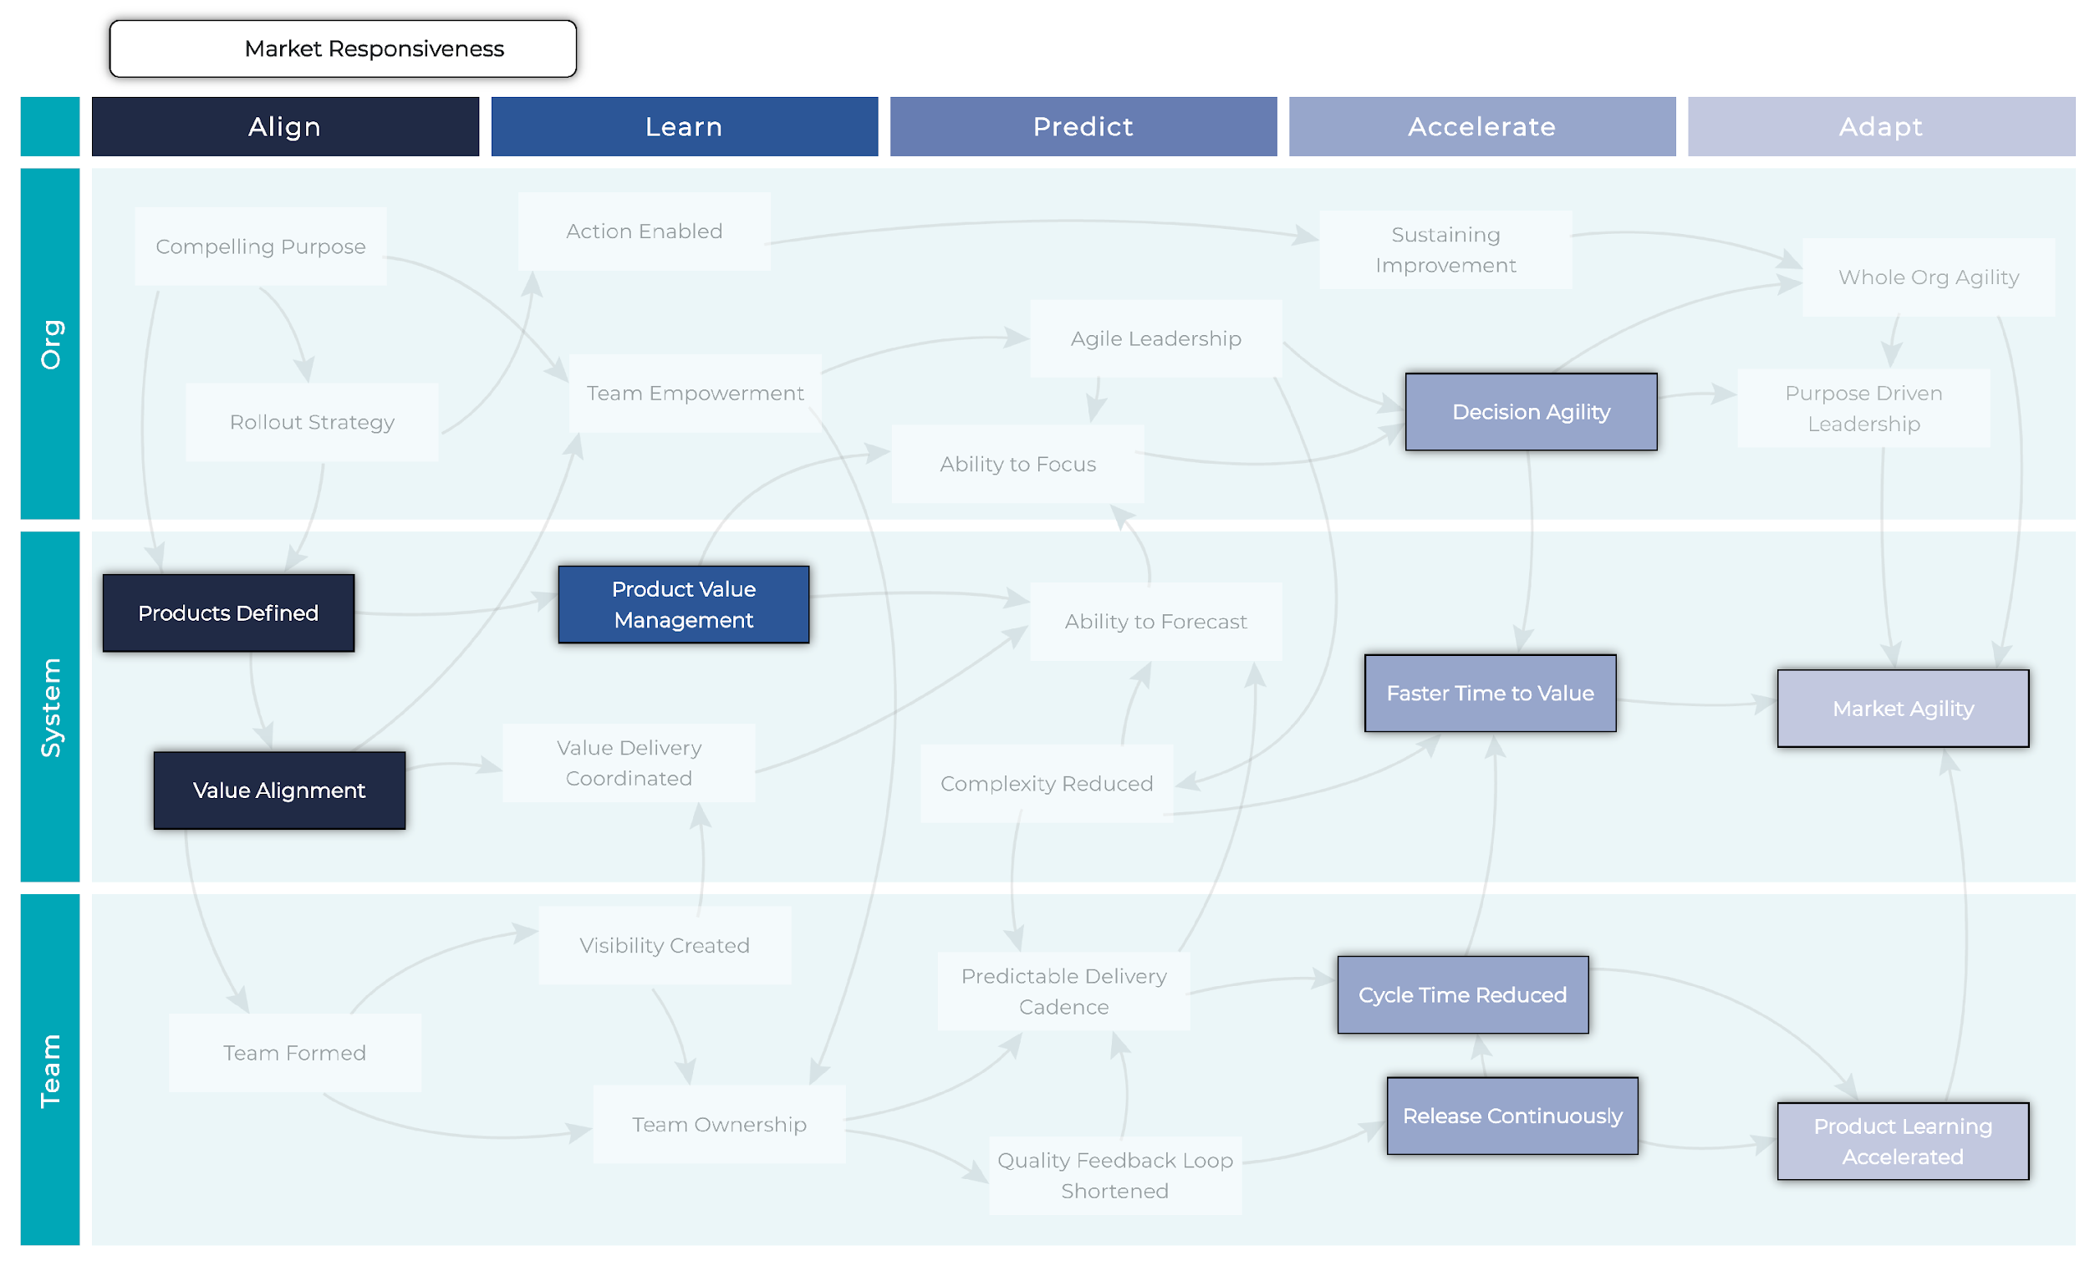
Market Responsiveness
Path to AgilityⓇ 2.5 : © 2017-2023 Path to Agility, LLC. All Rights Reserved.

Slide 33
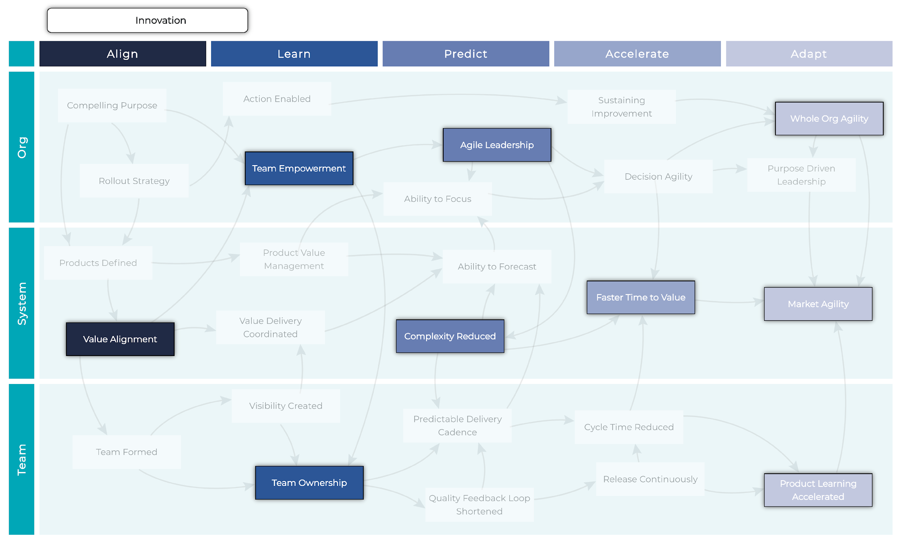
Innovation
Path to AgilityⓇ 2.5 : © 2017-2023 Path to Agility, LLC. All Rights Reserved.

Slide 34
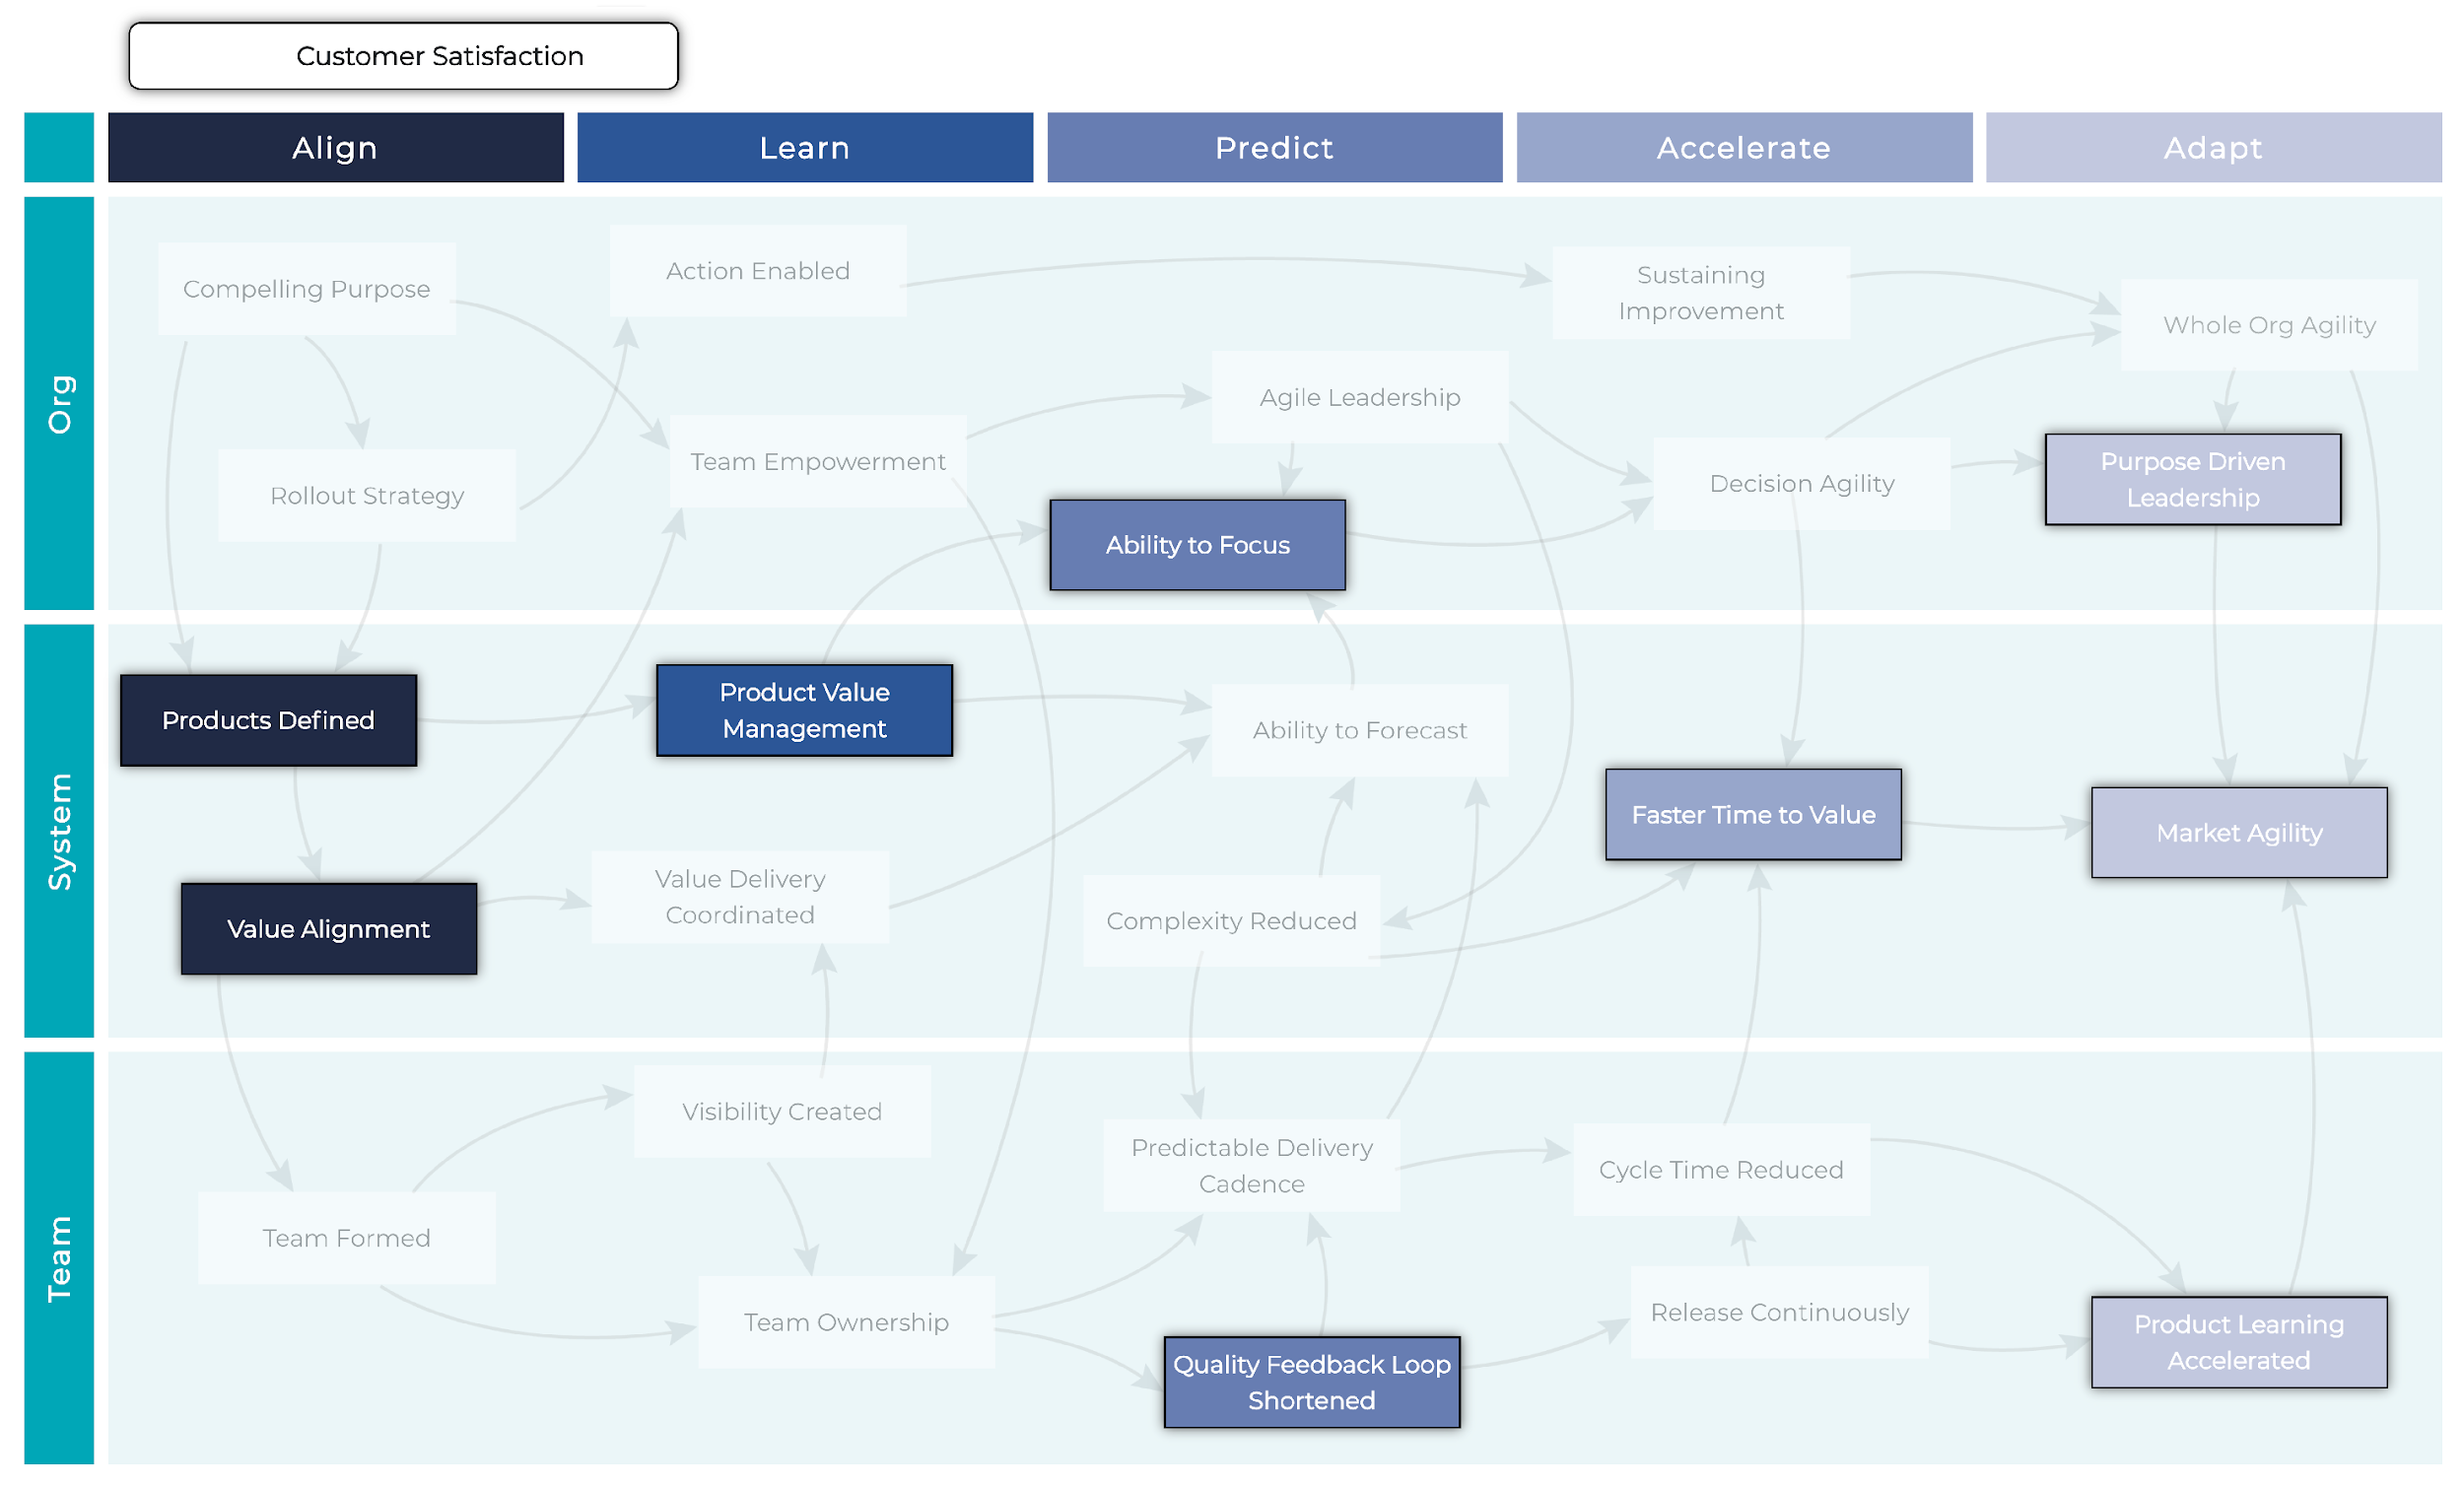
Customer Satisfaction
Path to AgilityⓇ 2.5 : © 2017-2023 Path to Agility, LLC. All Rights Reserved.

Slide 35
Progress

Slide 36
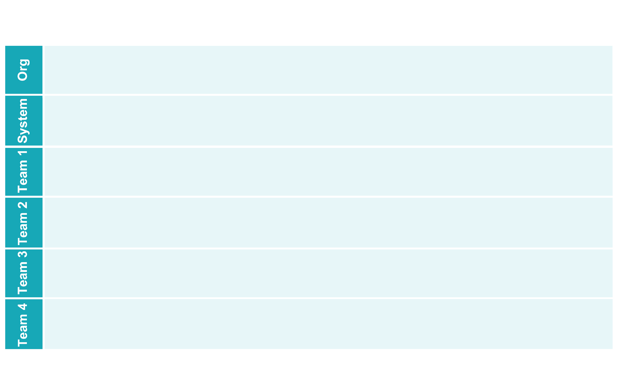
Visualization of Progress
Backlog
Planned
In Progress
Done
Decision Agility
Agile Leadership
Self-Sustaining Improvement
Ability to Focus
Action Enabled
Compelling Purpose
Team Empowerment
Rollout Strategy
Value Driven
Ability to Measure
Cross-Team Coordination
Teams Aligned to Value
Optimize the Whole
Ability to Forecast
Complexity Reduced
Reduced Cycle Time
Predictable Delivery Cadence
Foundational Team Practices
Visibility Created
Team Agreements
Release Continuously
Quality Feedback Loop Shortened
Continuous Improvement Culture
Clear Value Purpose
Reduced Cycle Time
Predictable Delivery Cadence
Quality Feedback Loop Shortened
Continuous Improvement Culture
Visibility Created
Team Agreements
Release Continuously
Foundational Team Practices
Clear Value Purpose
Reduced Cycle Time
Quality Feedback Loop Shortened
Continuous Improvement Culture
Clear Value Purpose
Visibility Created
Team Agreements
Release Continuously
Predictable Delivery Cadence
Foundational Team Practices
Reduced Cycle Time
Quality Feedback Loop Shortened
Continuous Improvement Culture
Visibility Created
Team Agreements
Release Continuously
Predictable Delivery Cadence
Foundational Team Practices
Clear Value Purpose

Slide 37
