Slide 1
Value Based Series REWIND: Introduction
Susan Jirsa, RN, BSN, COS-C, HCS-D, HCS-O
Divisional Director of Quality Assurance

Slide 2
KNOW YOUR VALUE, SHOW YOUR VALUE
What does VALUE mean to you?
Monetary
Estimation of Worth
Standards in Behavior
Efficiency
Beneficial
QUALITY

Slide 3
REWIND THE MIND
Sense of Urgency
Eliminating the Excuses
Don’t Stress the TPS
Shed the Dread

Slide 4
Sense of Urgency
(2022) Baseline Year = calendar year that provides a basis from which each respective HHA’s performance would be measured for calculating achievement and improvement points
(2023) Performance Year = calendar year during which data are collected for the purpose of calculating a competing HHA’s performance on applicable quality measures
(2025) Payment year = calendar year in which the applicable adjustment, a maximum upward or downward adjustment, applies

Slide 5
Nothing Special
Our Patients are Not Unique
Risk Adjustment Accounts for any Variances
Model adjusts for hospice transfers now!
HHAs to compete nationally with their respective small vs. large cohorts

Slide 6
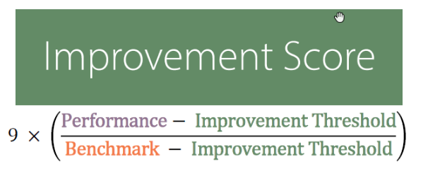
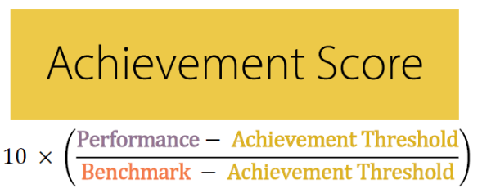
Don’t Stress the TPS (Total Performance Score)
Improvement Score → Compares an agency’s performance in the performance year (2023) to its baseline year (2022 for agencies certified prior to January 1st)
Achievement Score → Compares an agency’s performance in the performance year (2023) to it’s respective cohort in the Model baseline year (2022 for agencies certified prior to January 1st)

Slide 7
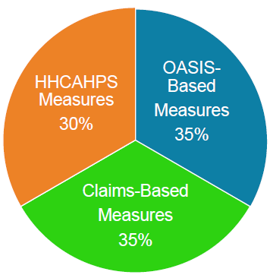
Shed the Dread
Improvement in Dyspnea
Discharges to Community
Improvement in Management of Oral Medications
Total Normalized Composite Change in Mobility (TNC Mobility)
Total Normalized Composite in Self-Care (TNC Self-Care)
Acute Care Hospitalization during the 1st 60 Days of Home Health use (Claims-Based)
Emergency Department Use without Hospitalization During 1st 60 Days of Home Health (Claims-Based)
HHCAHPS

Slide 8
REWIND THE MIND
Sense of Urgency
Eliminating the Excuses
Don’t Stress the TPS
Shed the Dread

Slide 9
Value Based Series REWIND: Dyspnea
Susan Jirsa, RN, BSN, COS-C, HCS-D, HCS-O
Divisional Director of Quality Assurance

Slide 10
OASIS WALK REWIND
Just Breathe
Zero Isn’t The SOC Hero
“Hello, I’m Dyspnea!”
Minimalism
Take Charge at Discharge

Slide 11
OASIS Walk REWIND: Just Breathe
(M1400) When is the patient dyspneic or noticeably Short of Breath?
0 - Patient is not short of breath
1 - When walking more than 20 feet, climbing stairs
2 - With moderate exertion (e.g., while dressing, using commode or bedpan, walking distances less than 20 feet)
3 - With minimal exertion (e.g., while eating, talking, or performing other ADLs) or with agitation
4 - At rest (during day or night)

Slide 12
OASIS Walk REWIND: Just Breathe
Level of Activity NOT Severity of Dyspnea
Put everything in PERSPECTIVE
Paint a CONGRUENT Picture
Consider impact of loss of lean muscle mass
(M1400) When is the patient dyspneic or noticeably Short of Breath?
0 - Patient is not short of breath
1 - When walking more than 20 feet, climbing stairs
2 - With moderate exertion (e.g., while dressing, using commode or bedpan, walking distances less than 20 feet)
3 - With minimal exertion (e.g., while eating, talking, or performing other ADLs) or with agitation
4 - At rest (during day or night)

Slide 13
OASIS Walk REWIND: Zero Isn’t the SOC Hero
Must show improvement – Patients with 0’s are excluded from calculations
Our patients should not typically reflect a 0
What areas impact shortness of breath?
Respiratory conditions (COPD, PNA)
Cardiovascular conditions (CHF, A-fib)
Anemia
PE
Anxiety, Panic
Stress
Pain
Obesity
Temperature Changes
High Altitudes

Slide 14
OASIS Walk REWIND: “Hello, I’m Dyspnea!”
(M1400) When is the patient dyspneic or noticeably Short of Breath?
What is “Noticeable”?
Subjective
Symptoms may differ
Patients deny
Subtle Cues

Slide 15
OASIS Walk REWIND: “Hello, I’m Dyspnea!”
(M1400) When is the patient dyspneic or noticeably Short of Breath?
No face to dyspnea
Avoid multitasking
Watch entire activity
Focus ONLY on breathing

Slide 16
OASIS Walk REWIND: “Hello, I’m Dyspnea!”
Studies find that despite treatment options, chronic dyspnea “remains largely invisible to both the public and clinicians who may feel that nothing further can be done. This is partly due to its slow onset in many conditions, so breathlessness is seen as “normal.” Intentional “hiding” of the symptom, a stoical response to breathlessness by patients [leads to] a lack of attention to the symptom from clinicians.”
Hutchinson, A.; Barclay-Klingle, N.; Galvin, K.; Johnson, M. (2018).
Living with breathlessness: a systematic literature review and qualitative synthesis.
European Respiratory Journal 2018 51: 1701477; DOI: 10.1183/13993003.01477-2017

Slide 17
OASIS Walk REWIND: Minimalism
(M1400) When is the patient dyspneic or noticeably Short of Breath?
0 - Patient is not short of breath
1 - When walking more than 20 feet, climbing stairs
2 - With moderate exertion (e.g., while dressing, using commode or bedpan, walking distances less than 20 feet)
3 - With minimal exertion (e.g., while eating, talking, or performing other ADLs) or with agitation
4 - At rest (during day or night)
Consistently and properly use the term
Think chronic dyspnea patients!
Not just the nature of the task
Who defines “other ADLs”?
CLINICIAN!
Who defines minimal exertion?
CLINICIAN!

Slide 18
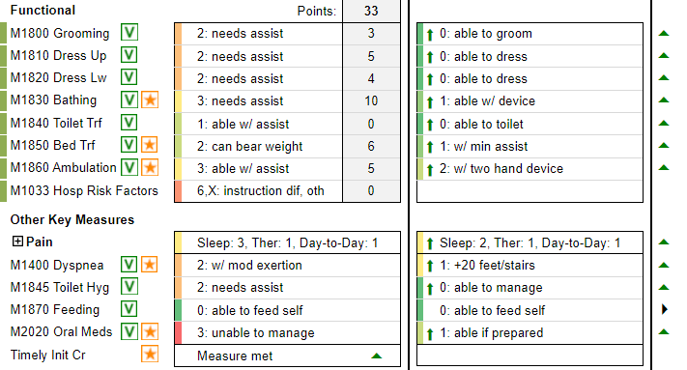
OASIS Walk REWIND: Take Charge at Discharge
Spontaneous Recover (Therapy)
Slowing down OR avoiding activities
Breathing Techniques
Pursed-lip breathing
Diaphragmatic breathing
Positioning
Tripod Position (COPD, Emphysema)
Sitting forward
Sitting forward supported by a table
Standing with supported back
Standing with supported arms
Sleeping in a relaxed position (Apnea)
Using a fan (Cancer patients)
Drinking coffee (Asthma patients)
Lifestyle changes to treat shortness of breath
Quit smoking, Avoid pollutants, etc.
Medications
Inhaled medications that help open the airways
Drugs to treat specific conditions
Oxygen
Top Agencies improve dyspnea 98.47% of the time!

Slide 19
OASIS WALK REWIND
Just Breathe
Zero Isn’t The SOC Hero
“Hello, I’m Dyspnea!”
Minimalism
Take Charge at Discharge

