Slide 1
What to do if you cannot print in EnergyTrack
This applies to the Cognitive Advantage printer.

Slide 2
Beginning Steps
Make sure that the driver has the handheld in the truck/cradle, connected to Wi-Fi, and truck turned on and running.
Ask the driver what kind of printer they have mounted in the truck.
*Make sure the two green lights next to the FEED button are lit.
* If the power light is not lit, then skip to the Lind Power Supply diagnosis section.
Connect to the driver’s handheld with Bomgar.

Slide 3
Accessing the Port and Printer Settings
Once connected to the handheld, go to Windows Printer Settings, specifically the Cognitive Advantage 4 inch and Cognitive Advantage 4 inch2.
To access the windows settings, press the windows icon in the lower left corner of the desktop screen.
Then press the settings tab.
Select the Devices tab.
Then choose the Printers & scanners tab.
Press the Cognitive Advantage 4 inch or the Cognitive Advantage 4 inch2 tab.

Slide 4
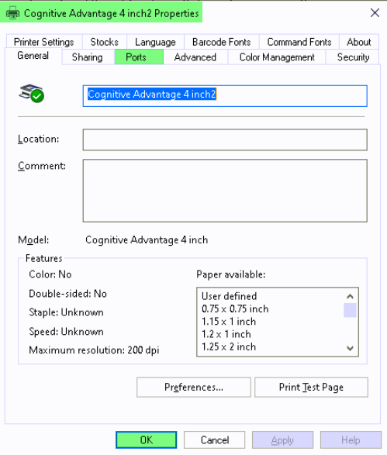
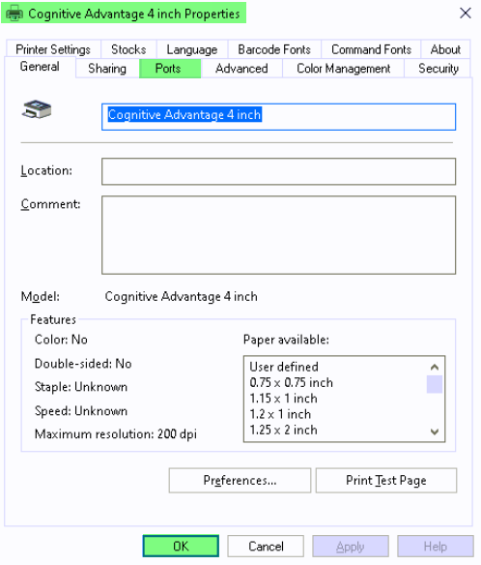
Accessing the Port and Printer Settings
Select the Manage tab.
Press the Printer properties tab.
In the next box that pops up, press Ports then press OK.

Slide 5
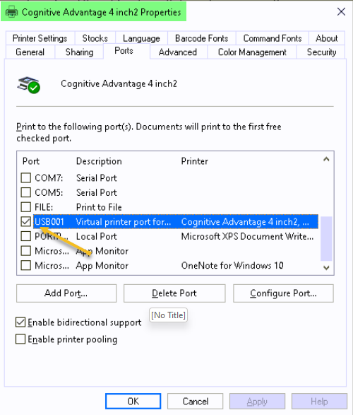
Port Settings
Make sure that the port on both drivers are set to the USB00_ option.

Slide 6
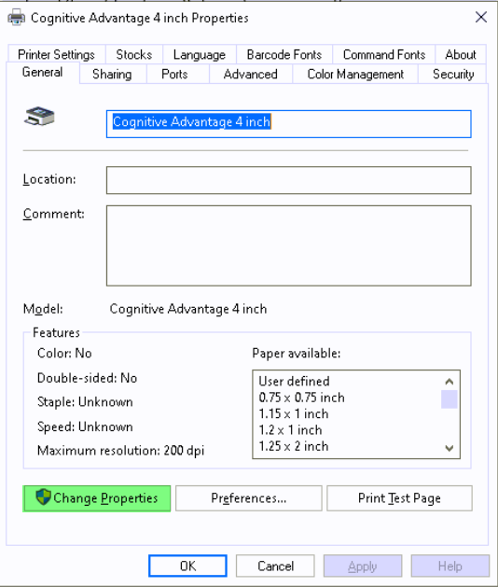
Port Settings
While in the Port settings, if the options are greyed out, there might not be admin rights to do this.
An alternative option:
Click on Change Properties to make the port change.

Slide 7
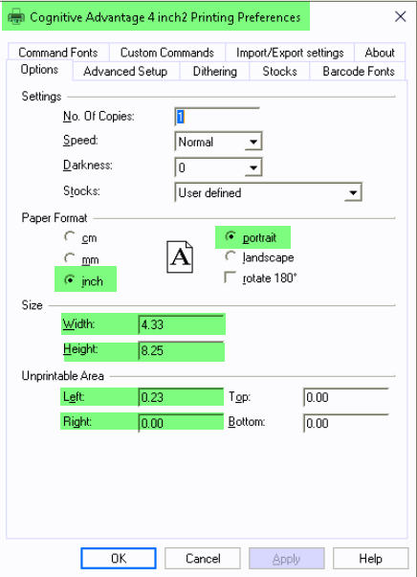
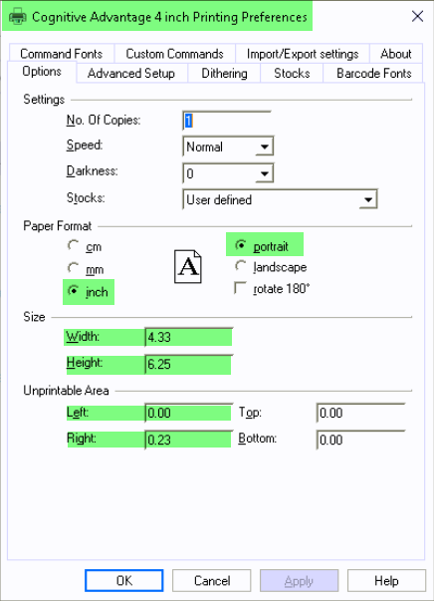
Printer Settings
Close the Properties box and then open the Printing preferences box.
In the Options tab, make sure the settings for each printer driver match the settings in the screenshots.

Slide 8
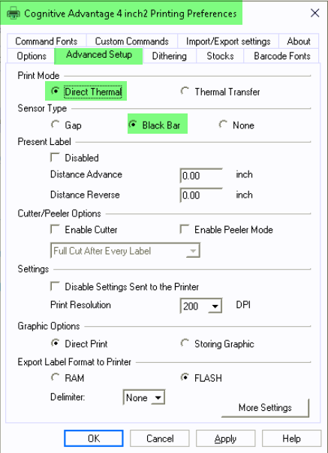
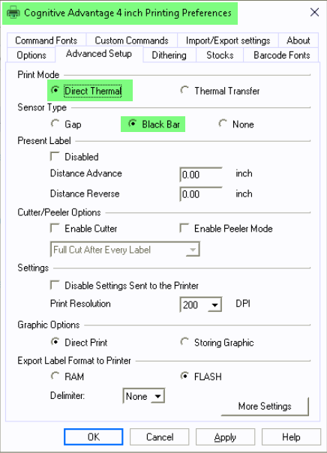
Printer Settings
Under the Advanced Setup tab for both Cognitive Advantage 4 inch2 and Cognitive Advantage 4inch, make sure that the settings match the screenshots.

Slide 9
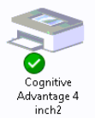
Default Printer Setting
Make sure that the Cognitive Advantage 4 inch2 printer is set as the default printer.
Verify this in either of two places, Printers & scanners in the windows settings or in the Control panel, specifically Devices and printers.
In the Windows settings, it will look like this.
In the Control panel, Devices and printers it will look like this.

Slide 10
Adobe Default Program
Next, check that Adobe is the default program.
Press the Windows tab.
Then press the Settings tab.
Then press the Apps tab.
Select the Default apps tab.
After the window opens, scroll to the bottom and select Choose default apps by file type.
When screen loads, scroll down and choose .pdf.

Slide 11
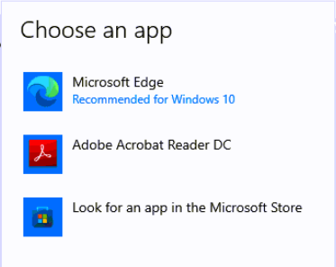
Adobe Default Program
A window opens and with three options to choose from:
Choose the Adobe Acrobat Reader DC tab.
Exit the Settings window.

Slide 12
Printer Showing Offline
Make sure the printer is not showing offline.
Select the Windows tab.
Then choose the Settings tab.
Select the Devices tab.
Then choose the Printers & scanners tab.
If the Cognitive Advantage 4 inch2 or Cognitive Advantage 4 inch is showing offline, do the following steps for a hard reset.

Slide 13
Hard reset procedure.
Turn the power to the printer off at the switch.
Unplug the wide, 20 pin, cable that has clips holding it to the back of the printer.
Shut the truck off with the ignition, and any other power switches giving power to the printer.
Remove the handheld from the cradle.
Restart the handheld.
Wait about a minute and a half.
Plug the cable in to the back of the printer and put the clips back in place.
Turn the power switch on the side of the printer back on.
Start the truck and turn any additional switch, if there is one to power the printer.
Place the handheld back into the cradle and clamp the handle down.
Check to make sure that the printer is not still showing Offline.

Slide 14
Reset Printer Cable
If the printer is still showing Offline, try the printer cable reset.
Turn the power to the printer off with the switch on the side of the printer.
Turn off the truck with the ignition.
Unplug the wide, 20 pin, cable that has clips holding it to the back of the printer.
Unplug the other end of the same cable from the back of the cradle.
Wait about a minute and a half.
Reinstall both ends of the cable to where they were removed from.
Turn the power switch on the side of the printer on.
Start the truck.
Confirm that the printer is not showing Offline still.
In the Control panel, Devices and printers, confirm that it is reading the USB2.0-Print is under the Unspecified section. Or the name of the cable could be something similar.

Slide 15
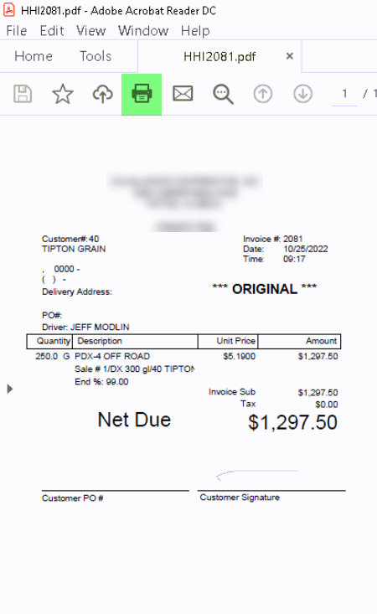
Test Reprint in Images Folder
Open Windows (C:).
Select CTLS93.
Select DD85.
Select DATA.
Select Images.
Select on any HHI____ Adobe image.
Select the Print icon at the top of the image.
Continue to the next page.

Slide 16
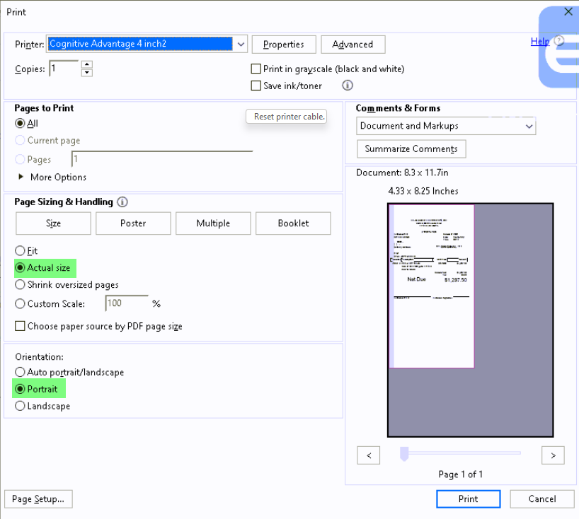
Adobe Settings for Reprint
Confirm the Adobe settings match the image.

Slide 17
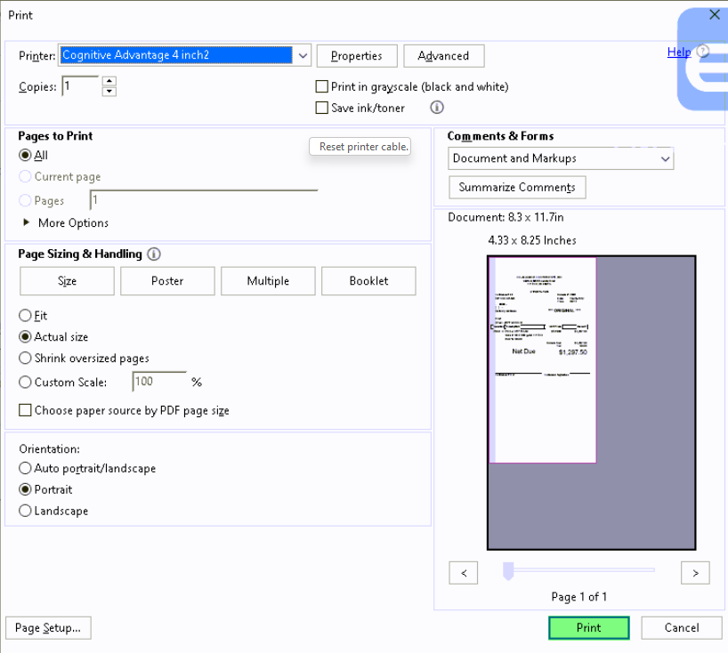
Adobe Settings for Reprint
Press Print. Then confirm with the driver that the image printed.

Slide 18
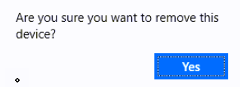
Uninstall and Reinstall Print Drivers
If the image did not print, uninstall both Cognitive Advantage 4 inch2 and Cognitive Advantage 4 inch print drivers.
Select the Windows tab, then select the Settings tab.
Select the Devices tab, then select the Printers & scanners tab.
Select Cognitive Advantage 4 inch2 or Cognitive Advantage 4inch.
Select Remove device tab.
In the pop-up window select Yes to remove the device.

Slide 19
Uninstall and Reinstall Print Drivers
Confirm that neither Cognitive Advantage 4 inch2 or Cognitive Advantage 4 inch printer are showing in the Printers & scanners page.
Open Windows (C:), then select the CognitivePrintDrivers tab.
In the next window scroll down and select PrnInst tab.
A User Account Control box will open. Select Yes.
An install wizard window will open. Select Next.
Select the printer window opens, choose Cognitive Advantage 4 inch and select Next.

Slide 20
Uninstall and Reinstall Print Drivers
Select Finish.
Once the install has finished, install the second print driver.
In the next window scroll down to and select the PrnInst tab.
A User Account Control box will open. Select Yes.
An install wizard window will open. Select Next.
Select the printer window opens, choose Cognitive Advantage 4 inch.
Select Next then select Add new printer.

Slide 21
Uninstall and Reinstall Print Drivers
In the Printer name: line, add the number 2 to the end of the word inch. Make sure that it matches the picture.
Once the second installer has finished, close the window.
Return to the Printer Settings to match the screen shots.
After the settings have been changed, try printing again.

Slide 22
Calibrate Printer Settings
Calibrate the printer if it gives extra blank sheets when it prints delivery tickets or trip reports.
Calibrate both printer settings by using the same steps.
Select the Windows tab.
Select the Settings tab.
Select the Devices tab.
Then select the Printers & scanners tab.
Choose either Cognitive Advantage 4 inch printer tab.
Select Manage tab.

Slide 23
Calibrate Printer Settings
Select Printer preferences tab.
In the new window, select Advanced Setup tab.
Select More Settings tab.
In the next window, select Calibrate tab.
The printer will then feed about an inch or an inch and a half piece of paper.
Press the FEED button on the printer to advance the paper to the next perforation.
Repeat the same calibration process for the other Cognitive Advantage print driver.

Slide 24
Lind Power Supply Diagnosis.
Make sure that the power supply is showing a green light.
If the power supply has a fuse, make sure that it is not blown.
Make sure all cables plugged into the power supply are fully seated.
When checking the power supply for the Blaster printer, it must have 24 volts coming out of it and going to the printer. Same for the TSC printer.
When checking the power supply for the Havis/Panasonic docking station, it must have 12 volts coming out of it and going to the docking station.

Slide 25
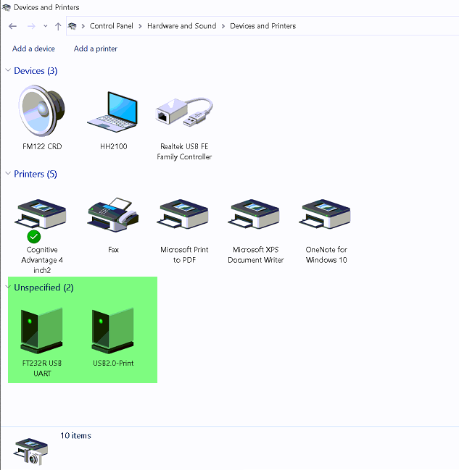
Havis Docking Station Diagnosis.
Makes sure that all cables plugged into the docking station are fully seated.
Check the Control Panel to make sure the items are going through the docking station. Specifically, the Devices and Printers.
If there is not a GPS reading or can not print, unplug the USB portion of that plug and plug directly into the ToughPad to see if it works.

Slide 26
GPS Puck
Makes sure that the truck is not parked in or next to a metal building.
From the open session of Energy Track, select Utilities tab.
Select Test Hardware tab.
Select GPS tab.
Select Get & Write GPS tab.
If Latitude and Longitude line are blank check cables and make sure that they are plugged in fully to the docking station.
If the GPS is not working, unplug from the back of the docking station and plug directly into the ToughPad and retest.

Slide 27
Confirm Printer Needs Replaced
After confirming all the above processes that apply, the driver will need to use their handheld in another truck and try to reprint a document from the Reporting tab, Re-Print Documents tab.
If able to reprint a document, this shows that the printer in the truck that was not working needs replaced.
Also try putting another printer in the truck and seeing if reprinting a document works properly.

