Slide 1
Home Health
Value Based Purchasing
REWIND: M1860
Susan Jirsa, BA, BSN, RN, COS-C, HCS-O, HCS-D
Divisional Director of Quality Assurance

Slide 2

REWIND: Composite Measures
com·pos·ite
Adjective
made up of various parts or elements.
Why discuss M1860 First?
  Because SAFE ambulation impacts almost all other functional items
  How they get to location of the dressing, bathing, etc. impacts the scoring
  If we get M1860 wrong…it’s a domino effect
TNC Change in Mobility
  M1840 Toilet Transferring
  M1850 Bed Transferring
  M1860 Ambulation/Locomotion
TNC Change in Self-Care
  M1800 Grooming
  M1810 Upper Body Dressing
  M1820 Lower Body Dressing
  M1830 Bathing
  M1845 Toileting Hygiene
  M1870 Eating

Slide 3
REWIND: W.A.L.K.
Win the “Most improved” Award
Assistance
Leverage the GG’s
Know how to assess safely

Slide 4
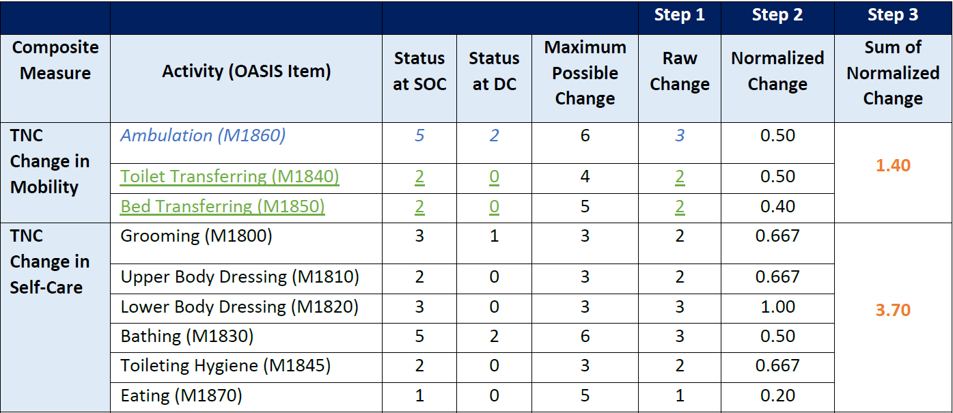
REWIND: Win the “Most improved” Award
The Home Health Value-Based Purchasing (HHVBP) composite measures, Total Normalized Composite (TNC) Change in Self-Care and TNC Change in Mobility, capture the magnitude of change (not just improvement) in multiple OASIS items.
Raw change score → Normalized Change (Divide by Possible Change) → Sum of Normalized Change
  Example: If the patient goes from a “3” on bathing at start or resumption of care to a “0” on bathing at discharge, the raw change score for the episode is “3”.
  If the patient worsens, the episode will earn a negative change score.

Slide 5
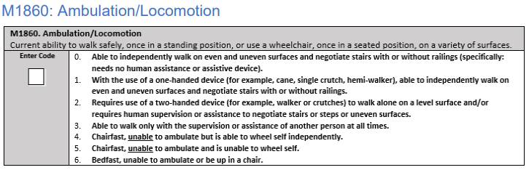
REWIND: Win the “Most improved” Award
DETAILS MATTER!
  0’s on M1860 aren’t excluded for VBP
  Penalized for negative change
  Must be safe 100% of the time → No majority convention for M1860
  Includes a variety of surfaces
  Devices MUST be present to assess level of safety (Response 1,2, & 4)
  Consider the ‘ideal’ setting vs. reality in home *SAFETY!!!*
  Code prior to interventions

Slide 6
REWIND: Win the “Most improved” Award
“During a SOC assessment, the patient ambulated from the chair to the sofa without an assistive device. Although the patient made it to the sofa without a fall, the nurse was nervous during the transfer and felt the patient was unsafe even with nurse supervision. What is the best OASIS response to M1860 in this situation?”
  Midwest Region
    5. Chairfast, unable to ambulate and is unable to wheel self
    CMS Guidance: Code 4 or 5, if a patient:
      Is unable to ambulate even with the use of assistive devices and/or continuous assistance
      Demonstrates or reports ability to take one or two steps to complete a transfer, but is otherwise unable to ambulate

Slide 7
REWIND: Assistance Level
Assistance Definition:
  Assistance refers to assistance from another person, be it hands-on assistance, verbal cueing/reminders, or simply stand-by assistance/supervision.
  Code 2 if the assistance required is intermittent. Code 3 if the assistance required is continuous.
“During a SOC assessment, the patient is able to ambulate with a device on their own sometimes and needs supervision during other parts of the day. What is the best OASIS response to M1860 in this situation?”
  Waupaca Branch Leadership

Slide 8

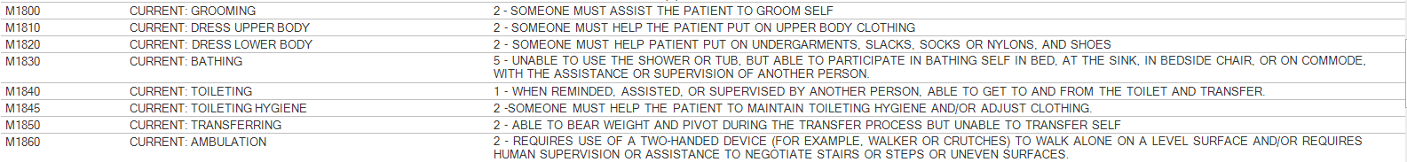
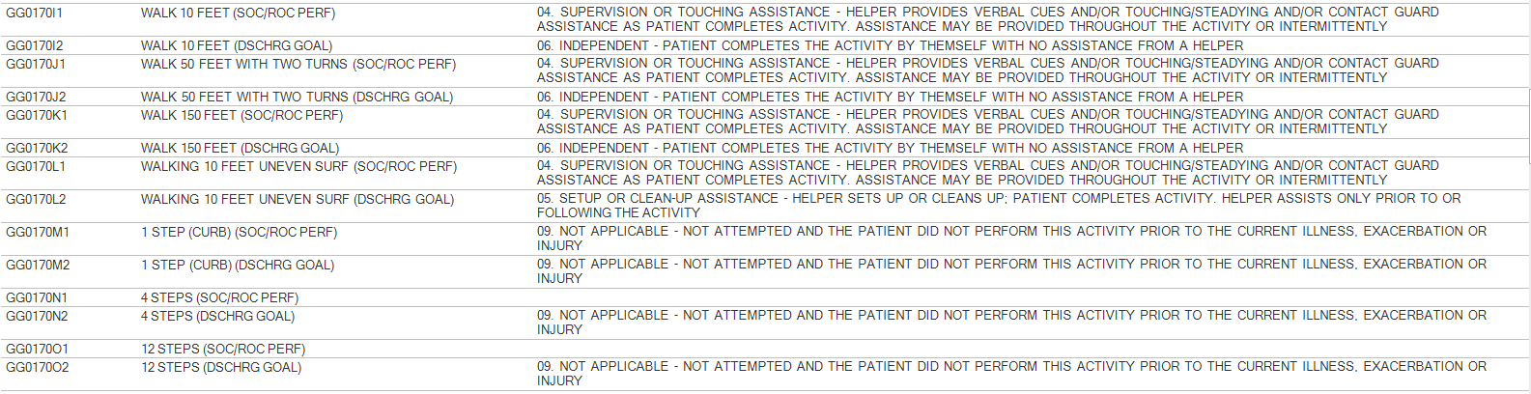
REWIND: Leverage the GG’s
M1860- Safe with 2 hand-device
GG0170I,J,K,L – Safe with supervision or touching assistance

Slide 9
REWIND: Leverage the GG’s

Slide 10
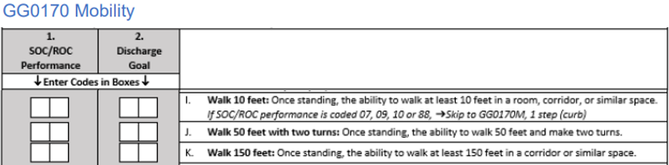
REWIND: Leverage the GG’s
“Aveanna admits a patient who lives in an ALF for nursing and therapy services following a CHF exacerbation. The patient uses a walker in their small apartment, but due to the distance uses a wheelchair to go down to the dining room. What is the best OASIS response to M1860 and GG0170I, J, and K in this situation and how can we show improvement at discharge?”
  Midwest Region
SOC/ROC
3
0 4+
0 6
0 4+
0 6
8 8
0 6
DISCHARGE
2?

Slide 11
REWIND: Know how to Assess Safely
What is safely?
  Clinician intervention protected the patient from injury
    Does the patient have to fall to be unsafe?
    Does the patient have to experience an injury to be unsafe?
    Does the patient have to outwardly complain during the activity to be unsafe?
      Pain, Dizziness, Tired, Weak etc.?
    Does the physician have to restrict the activity?
“How can I help educate our clinicians on scoring per safe ability? The individual response options provide terms and descriptions that trip up accurate scoring for M1860?”
  Sebring branch leadership

Slide 12
REWIND: Know how to Assess Safely
“I have a patient who is dependent in all aspects of care. 2 person transfers currently. However, they do get up in a wheelchair at times. The clinician marked a 5 at SOC for M1860. However, the patient does not have much core strength and fatigues quickly while sitting. Would this patient be more appropriately scored a 6 at SOC given I am questioning their safety in a seated position?”
  Baraboo Branch Leadership
  6. Bedfast, unable to ambulate or be up in a chair
    Rationale: A patient who cannot safely tolerate being upright is considered bedfast.

Slide 13
REWIND: W.A.L.K.
Win the “Most improved” Award
Assistance
Leverage the GG’s
Know how to assess safely

Slide 14

Welcome to HOME HEALTH REWIND!
M1860 LAUNCHED TODAY!
Email link to be sent out today to all Clinical Managers
KB Article link to webinars and podcasts
https://docs.aveanna.com/home/hh-value-based-purchasing-education

