Slide 1
Home Health Value Based Purchasing: M1830- Bathing
Alisa Staples, RN, BSN, HCS-D, HCS-O
Quality Assurance Specialist
Codie Wilson MOTR/L, CHC, Area Director of Operations

Slide 2
REWIND: Composite Measure
com·pos·ite
Adjective
1. made up of various parts or elements.
Why is bathing next??
M1860’s counter part under TNC Change in Self Care
Greatest potential for change compared to the other items
Magnitude of change matters not just improvement
Goal is to Climb that Ladder!

Slide 3
REWIND- Magnitude of Change Matters
The Home Health Value-Based Purchasing (HHVBP) composite measures, Total Normalized Composite (TNC) Change in Self-Care and TNC Change in Mobility, capture the magnitude of change (not just improvement) in multiple OASIS items
Raw Change (SOC-DC); Normalized Change (Divide Raw change by Maximum possible change); Sum of Normalized Change (Add up the normalized change)
Example: If the patient goes from a “3” on bathing at start or resumption of care to a “0”on bathing at discharge, the raw change score for the episode is “3”.

Slide 4
REWIND- Item Overview
Considerations
Safe ability to wash ENTIRE body.
Consider presence of devices
0-3 safe in shower/tub
4-6 safe at sink, chair , commode
Options 2 vs 3 (intermittent vs continuous)
Leverage GG item
Assistance-VC, SBA, Supervision, Hands on Assist. Scoring before interventions
DETAILS MATTER!
Like Participation and effectiveness!!

Slide 5
“When I am alive, I tell a story, most of safety one might say.
But other factors go unnoticed each and every day.
What part has been forgotten,
What option is the best score.
Help me find what’s missing, a true mystery to be solved for. “
~M1830
M1830

Slide 6
MURDER MYSTERY M1830
A crime has been committed and M1830 has been down coded!!
Objective : Mrs. Bubbles OASIS was inaccurately coded at SOC. Solve the following riddles related to missing oasis guidance to unlock video clues needed to accurately code M1830.

Slide 7
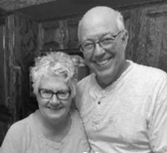
M1830 Murder Mystery-Scenario
Mrs. Bubbles is a 65-year-old female who is post op from a right knee replacement and has just returned home. She lives with her husband, who is her caretaker. She lives in a two-story home with a tub bath and shower. Since her surgery she uses a walker for ambulation and has a shower chair for bathing. She has no other secondary diagnosis or past surgical history. Mrs. Bubbles has periodic pain and muscle cramps to her right leg. She has been elevating, icing and taking pain medications every 4 hours.
How would you score M1830- bathing??

Slide 8
M1830 Murder Mystery- Guidance Riddle #1
Tyler and Susan spoke to me well.
My impact is great now can’t you tell?
I play a huge role in many items;
Without me you might even get frightened.
For independence on our Oasis could be the result,
Please don’t make me the reason you’d be at fault.
What M1830 Guidance am I??
WALKING / SAFE ACCESS

Slide 9
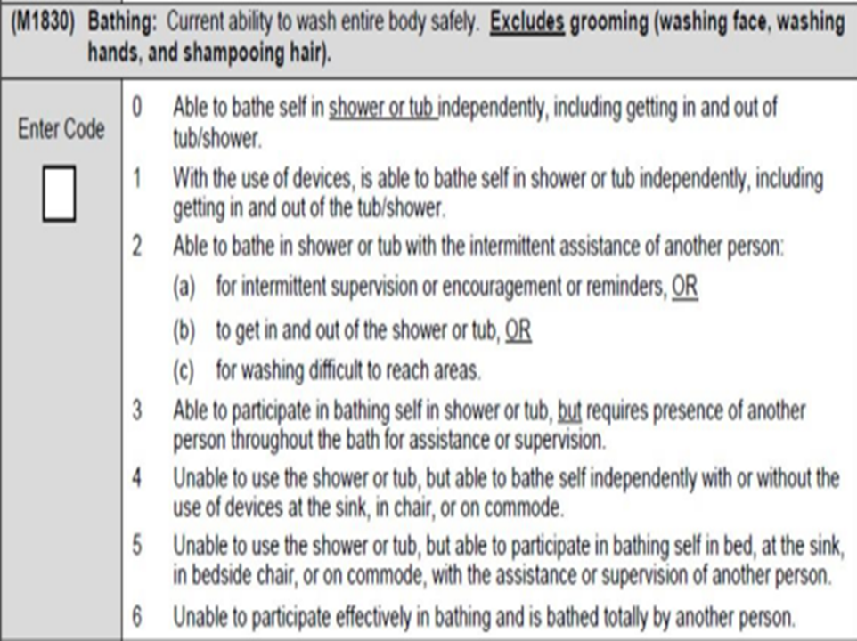
Clue #1- Safe Access
Why does safe access matter?
Difference between coding a 0-3 or 4-6
First Step: Determine the safest place to bathe
Safe access to the shower/tub is included
If needing assistance getting to the tub/shower, minimum score of a 2
LOOK AT M1860!!
If unsafe even with assistance 4-6
Code prior to intervention- environmental modification
Consider medical restrictions
Preference doesn’t count
Consider dementia patients variability with safe access **
Ability 50% of the time
Use Collaboration and interview

Slide 10
Safe Access Q&A
Question: If a patient routinely uses a bath upstairs and has a goal to return to using the tub upstairs, but due to recent decline, now is only safe to use a shower on the main level. How do you score M1830?
Answer: M1830 addresses the patient’s ability to bathe in the shower or tub, not preference, regardless of where or how the patient currently bathes. Willingness and adherence are not the focus of the item.

Slide 11
Mrs. Bubbles- Access to Bathroom

Slide 12
Investigative Report … Safe Access
What did you see in the video of Mrs. Bubbles that impacts how you would score M1830?

Slide 13
M1830 Murder Mystery – Guidance Riddle #2
“To bed, to bath, to chair
This can happen anywhere.
I might include one step or two,
My balance might be unsteady.
So please do not forget me
or for my bath, I may not be ready.”
What M1830 guidance am I??
Transferring

Slide 14
CLUE #2: Transferring
Why does transferring in/out of the shower/tub matter?
If its not safe even with assistance, we are coding at least a 4
What should we consider when assessing safe transfers? **
It has to be SAFE
Physical/mental components
Equipment
Code prior to Intervention. If they don’t have the equipment, you can’t say they are safe.
Caution- Slippery when wet!
Includes transferring in AND out (code at least a 2 if assistance is needed)
Impact of Caregivers- do they need training?

Slide 15
Mrs. Bubbles: Transferring IN

Slide 16
Mrs. Bubbles Transferring OUT

Slide 17
Investigative Report… Transferring
What did you see in the video of Mrs. Bubbles that impacts how you would score M1830?

Slide 18
M1830 Murder Mystery- Guidance Riddle #3
Think of me and you will not get hurt,
the OASIS will tell a true story.
Not one about blunders or what you’ve been told,
Instead, one that captures the true hand that you hold.
Consider the risks and red flags you see
And please answer based on this part of my true ability.
What M1830 guidance am I?
SAFETY

Slide 19
Clue #3- Safe Ability
Why does safe ability matter?
If patient is not safe to participate effectively in bathing, despite the location, code 6
Patients with dementia
What does safe ability look like in shower/tub?**
Consider physical and cognitive ability to wash ENTIRE BODY, SAFELY, EFFECTIVELY
How you see a patient performing may not equal their ability. Consider SAFETY.
Dementia patients- Can they effectively participate? If so, what are our goals for improvement?
Fear can impact ability
Assessing an actual bath- Collaborate! Water adds an additional concern
Preference/Willingness is EXCLUDED. If I chose not to bathe, I still have ability!
Presence/absence of a caregiver does not equal ability.
What considerations should we make when assessing safety at the sink?**
Is the environment safe or did we need to intervene?
Is the patient sitting or standing? Is it safe?
Patient must safely and effectively participate to code a 5. Use your GG items, even supervision means a 5.
We are still considering safety to bath ENTIRE BODY effectively. This isn’t just washing face and hands!
Q&A: How do I score a patient who pays for bathing in an ALF building?

Slide 20
REWIND: Safe Ability Q&A
1. How do we score a patient who doesn’t have the equipment they need to be safe, for example Shower bench? At minimum code 2.
2. How do we show improvement and accurately code intermittent vs continuous assistance (2 vs 3)??
Intermittent I’m 100% confident I’m safe to leave
Intermittent supervision/assistance OR assistance getting in/out OR washing difficult to reach areas
Continuous= I need to be present at all times for safety
Consider assistance to washing the entire body
Physical and mental limitations
3. How do you answer when a patient lives in ALF and pays for someone to bathe them?
Still determine the person’s safe ability
Is the caregiver safe or do we need to intervene with education? Code SOC prior to the education.
What really are our goals?

Slide 21
Mrs. Bubbles- Safe Ability
Notes:
.

Slide 22
Investigative Report…Safe ability
What did you notice in the video of Mrs. Bubbles that will impact scoring in M1830?

Slide 23
Can you SOLVE the Murder Mystery??
Mrs. Bubbles is a 65-year-old who is post op day 2 from a right knee replacement and has just returned home. She lives with her husband, Mr. Scrubby, who is her caretaker. She lives in a two-story home with a tub bath and shower located upstairs. She currently uses a walker for ambulation and has a tub bench for bathing. She has no other secondary diagnosis or past surgical history. Mrs. Bubbles has periodic pain and muscle cramps to her right leg. She has been elevating, icing and taking pain medications every 4 hours.
How would you score M1830- bathing??

Slide 24
Murder Mystery REWIND
SAFE ACCESS
Transfering IN AND OUT shower/tub
Safe Bathing

Slide 25
Questions?

