Slide 1
Incorporating Model-based Geostatistics into the Tropical Data service
Notes:
Hello everyone, I’m Anna Harte, I work at THE LONDON SCHOOL OF HYGIENE AND TROPICAL MEDICINE and I’m the project manager for Tropical Data Geostatistics. Today I am going to be hosting the webinar on incorporating model-based geostatistics into the tropical data service.

Slide 2
Webinar outline
Webinar administration details
Model-Based Geostatistics (MBG) overview
Use case examples
MBG and Tropical Data surveys
Current research and next steps
Q&A
Notes:
So this is the structure of the webinar. First I’ll go through some webinar admin details, such as how to ask questions and choose the language of your choice. We’ll then go straight into an overview of model-based geostatistics presented by Lancaster University. Next, we’ll review some use case examples of how MBG has been used in trachoma surveys already, and then on to how MBG will be incorporated in to the Tropical Data service. Finally, we’ll look at the research that is currently being done and the next steps. We’ll finish with a Q&A session with our panelists from the WHO, Lancaster University, Tropical Data, RTI and Tanzania and Nigeria health ministries.

Slide 3
Webinar administration details
Please choose the correct channel to hear the audio in your desired language (français, español or português)
The webinar is being recorded and will be available on the Tropical Data Youtube channel
You do not have access to your cameras or microphones
Please ask all questions in the Q&A box- we will prioritize questions with the most votes so please upvote the questions that interest you!
If you have a question for a specific panelist, please indicate this by stating the name of the panelist in the question
Questions will be answered at the end in the Q&A session
Questions and answers will be collated and sent around to all attendees post-webinar
Notes:
So first off some webinar admin details. We have simultaneous interpreters available for French, Portuguese and Spanish, if you click on the interpretation symbol shown in the image in the top right you can choose the language of your choice. This webinar is also being recorded, and will be available on the tropical Data youtube channel. You do not have access to your cameras and microphones, as there are a lot of people on this webinar, so if you have any questions please ask them in the Q&A box- you can also vote on questions that interest you and these will be prioritized in the Q&A session at the end. f you have a question for a specific panelist, please indicate this by stating the name of the panelist in the question. As I said questions will be answered at the end in the Q&A session with our panelists at the end. Questions and answers will be collated and sent around to all attendees post-webinar. This webinar is set for one hour, so if there are a lot of questions we may not get round to answering all of them, but we will respond to all questions posted in the Q&A in the post-webinar report.

Slide 4
Model-Based Geostatistics (MBG) overview
Misaki Sasanami, CHICAS, Lancaster University
Notes:
So lets get started with the webinar. We will first hear from Misaki Sasanami from Lancaster university who will give an overview on Model-based Geostatistics.

Slide 5
Introduction
Current Tropical Data methods use field surveys
Analysis at EU level
Challenges:
Estimating low levels of prevalence
Impossible to estimate the prevalence in EUs where surveys cannot be conducted
95% confidence intervals
Ignore spatial correlation → statistically less reliable
Interpretation: How narrow should it be?
We are researching the use of model-based geostatistics (MBG) to enhance current survey methods
Practical standard survey methods unchanged
Notes:
Slide 1
Hi my name is Misaki Sasanami, I am a research associate at Lancaster University.
From this slide I would like to give you an overview of geostatistics
To assess the elimination status of trachoma, Tropical Data supports the field surveys and analyses these data to estimate the TF and TT prevalence for each evaluation unit or EU
However, as we progress towards the elimination, it becomes more difficult to estimate the low levels of prevalence
And it is impossible to estimate the prevalence in EUs where surveys cannot be conducted
Another issue is that the 95% confidence intervals ignore spatial correlation, which is statistically less reliable
Also the interpretation is difficult – for example there is no consensus regarding how narrow it should be, and we are not sure how confident we can be about the elimination status from the confidence intervals alone
To address these challenges, we are researching the use of model-based geostatistics or MBG
We would like to stress that the current standard methods will not be changed or replaced, but MBG is an enhancement of the current methods

Slide 6
Introduction to MBG
Geostatistics is a branch of spatial statistics
The aim: study geographical variation throughout a region of interest
When: the available data are limited to sampling locations
Difference from non-spatial statistical methods: the ability to quantify and account for spatial correlation
Trachoma prevalence tends to cluster spatially
Diggle, P. J., & Giorgi, E. (2019). Model-based geostatistics for global public health : Methods and applications. CRC Press LLC..
Notes:
So what is MBG
Geostatistics is a branch of statistical methods relevant to the analysis of geolocated data with the aim being to study geographical variation throughout a region of interest when the available data are limited to surveyed locations
What differs from non-spatial statistical methods is the ability to quantify and account for spatial correlation, the phenomenon that things are more similar when the geographical locations are closer
It is known that trachoma prevalence tends to cluster spatially, so in such a case, we can leverage the spatial correlation so that information from sampled locations can help understand neighbouring unsampled locations

Slide 7
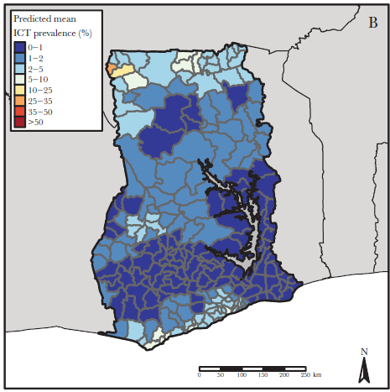
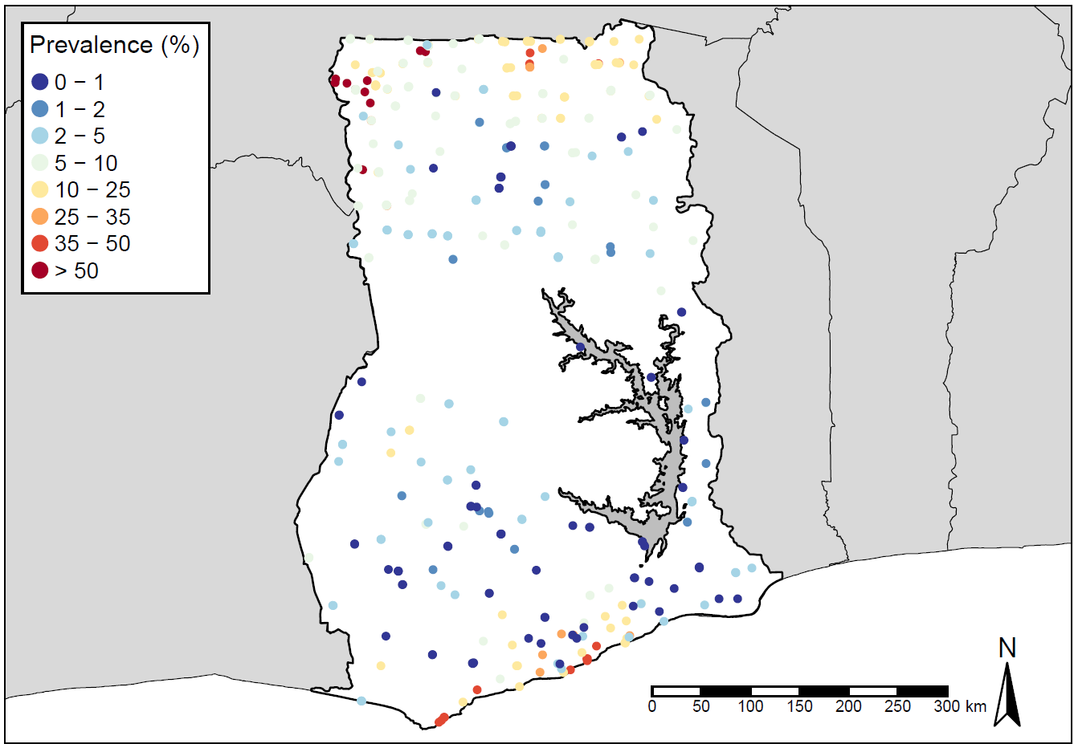
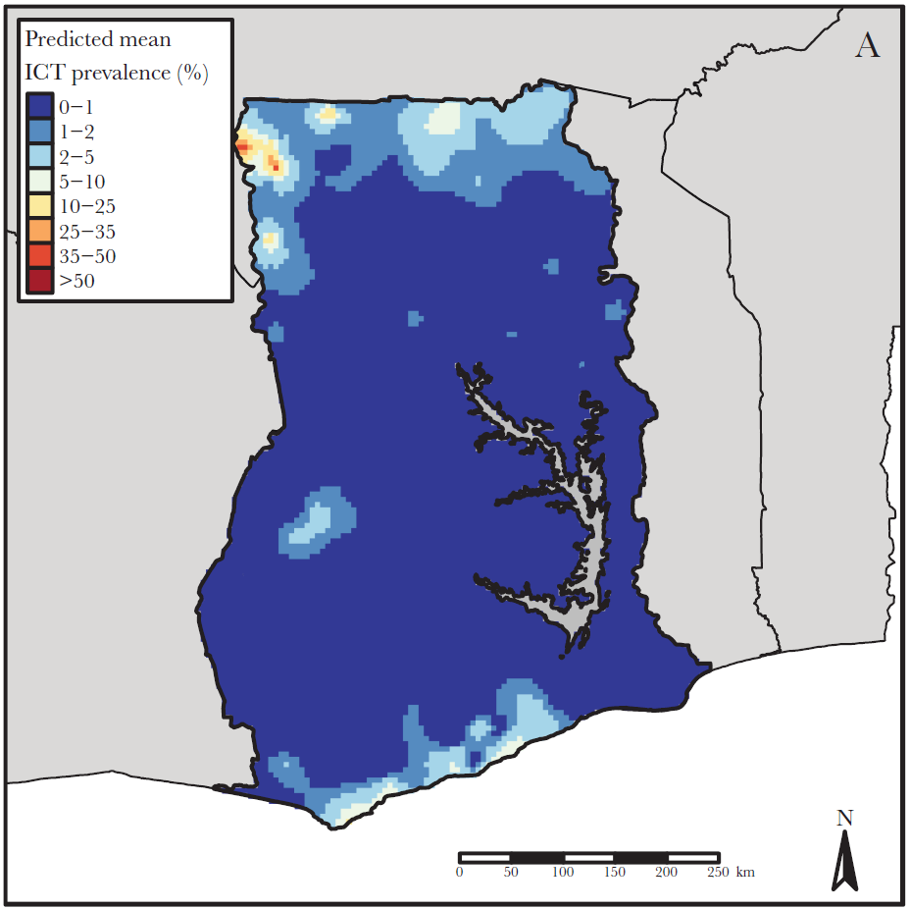
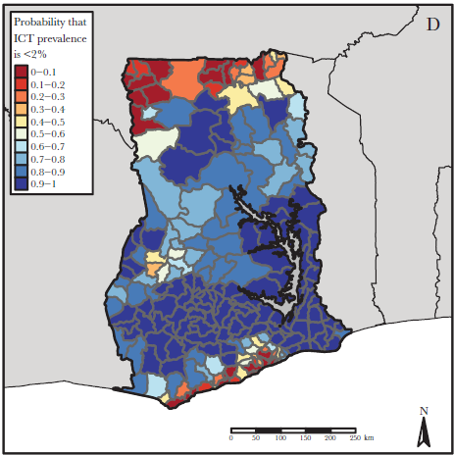
How does MBG work?
Output 1. EU-wide prevalence
Survey at limited locations
Continuous risk surface
Aggregate at a desired spatial scale
Output 2. Predictive probability
= likelihood of elimination
Rationale: the risk factors tend to be spatially correlated = vary smoothly over space
Fronterre et al., J. Infect. Dis. 2020.
Notes:
Then how does it work practically?
As shown in the map on the left, we have the data only from samples, because it is infeasible to examine everyone in the area of interest.
If we simply calculate the prevalence, we implicitly assume that the prevalence or the risk of the disease is uniform over space within the same EU.
In contrast, MBG allows us to treat the risk surface as continuous over space, as shown in the middle map. Risk factors for infectious diseases, such as temperature, precipitation, and population density tend to be correlated and smoothly vary over space, and so does the disease that depends on them. This is one of the reasons why we often see the spatial correlation in infectious diseases.
As the next step, we can aggregate the continuous surface at any desired spatial scale. For trachoma, it can at the EU level.
Furthermore, we can provide the predictive probability of elimination, which can be interpreted as the probability of having achieved the elimination target. As the values get closer to 100 or 0%, we can be very confident that the elimination has been or has not been achieved.
If the value is close to 50%, there is a lot of uncertainty and we are not sure about the elimination status.
As opposed to the conventional 95% confidence intervals, the predictive probability provides more tangible quantification of uncertainty.
These two main outputs are statistically reliable and advantageous from mainly two aspects.

Slide 8
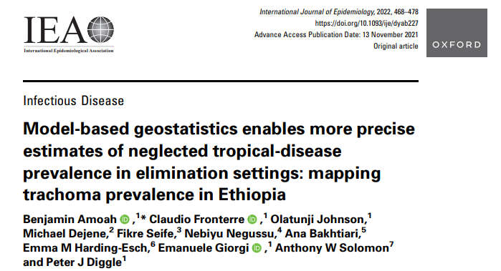
Benefit 1: Improved precision
MBG can improve the precision of prevalence estimates by exploiting spatial correlation
The data at sampled locations can inform the prevalence at unsampled locations
Model-fitting process allows data to choose optimal strength of information we can borrow from nearby locations
MBG have yielded 10 times more precise TT prevalence estimates
Notes:
First is the improved precision in the prevalence estimates.
Because MBG can use the data from sample locations to inform neighbouring unsampled locations, we can make the most possible use of limited data
Model-fitting process allows the data to choose optimal strength of information we can borrow from nearby locations
The previous study analysed the TT data from Ethiopia and showed that MBG has yielded 10 times more precise TT prevalence estimates than the current standard methodology.

Slide 9
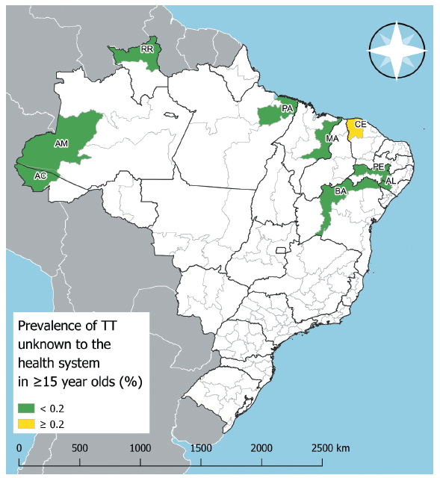
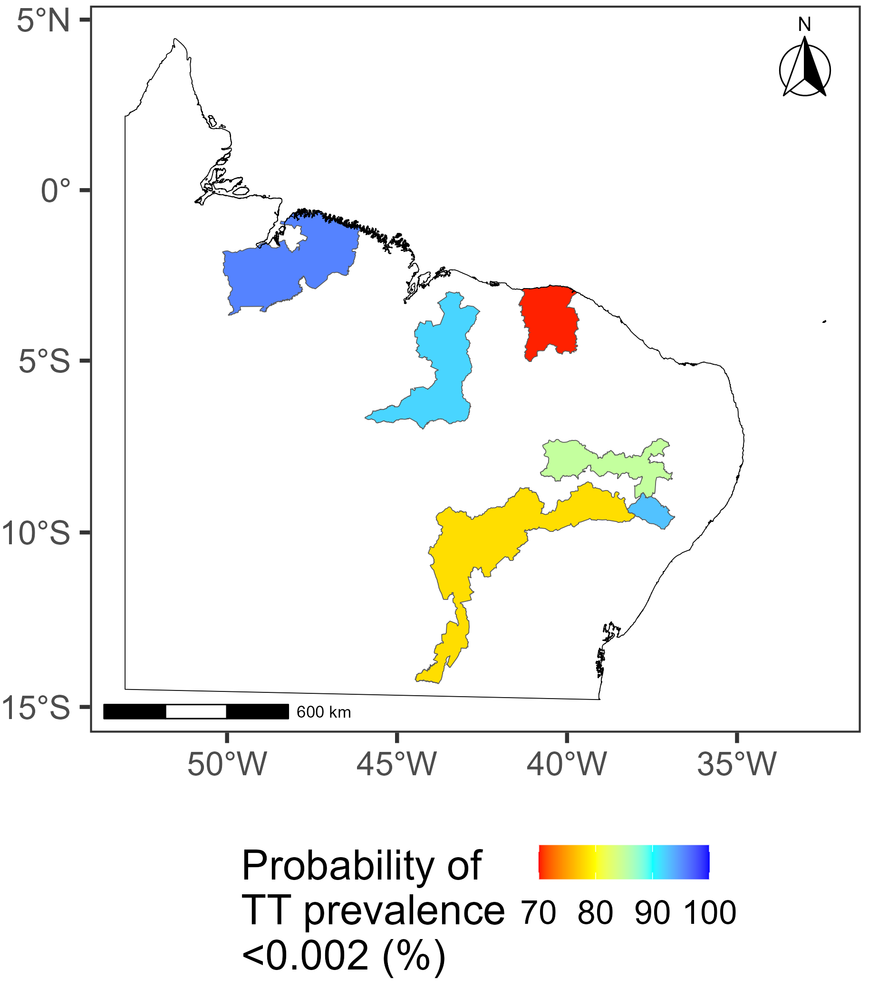
Benefit 2: Use of predictive probability of elimination (PPE)
Current method: whether or not the prevalence is below the elimination threshold
MBG method: Probability of the prevalence being below the elimination threshold
→ How much uncertainty are policymakers willing to tolerate?
Szwarcwald et al., Ophthalmic Epidemiol. 2021.
Sasanami et al., PLoS Negl Trop Dis. 2023.
Notes:
The second benefit is the usefulness of predictive probability of elimination. I would like to use an example from Brazil here.
Traditionally, based on the estimated prevalence, we classify the EUs into two categories: having achieved elimination OR having not achieved elimination
In the left map, we would conclude the green areas have achieved the elimination target, whereas the yellow area has not.
However, this does not tell you anything about uncertainty about such classification
So instead, If we look at the probability of elimination produced by MBG on the right map, in the area with the red colour the probability of elimination is around 70%. This can facilitate the discussion of if that is a tolerable uncertainty level for the policymakers.

Slide 10
MBG and NTDs
Soil-transmitted helminths
Schistosomiasis
Onchocerciasis
Mycetoma
Lymphatic filariasis
Snakebite envenoming
Notes:
Because of its usefulness, MBG has been increasingly used for a wide range of infectious diseases. This is the list of NTDs that has used MBG to guide the elimination effort.

Slide 11
Comparison: standard survey and MBG methods
Analysis | Standard survey | MBG
Number of EUs | Single EU only | All EUs available
Input | Prevalence data Population census data | Same as left Additionally (research ongoing): Climate Environment Demographic
Method | % prevalence standardised by age (TF) or age and gender (TT) | Same as left Additionally account for: Spatial and non-spatial variation Population density Climate, environmental and demographic risk factors (research ongoing)
Output | % prevalence and 95% CI | % prevalence and 95% predictive intervals Predictive probability of elimination
Notes:
As a summary, I would like to highlight the difference between the standard survey approach and MBG methods.
The current approach calculates the TF and TT prevalence EU by EU as the surveys are completed.
The age or age and gender specific prevalence of TF or TT is calculated and they are standardised using the census data.
This produces the standardised TF and TT prevalence in each EU
In contrast, using MBG, we are combining the data within the same country
And we follow the same steps as the standard methods in that we calculate the age or age and gender specific prevalence and then standardise them. The main difference is that we also account for spatial correlation between sampled clusters and individual level variations within the clusters if the data support their evidence
Furthermore, we started investigating if accounting for other factors improves the accuracy and precision
The final outputs are prevalence and the predictive probability of elimination

Slide 12
Use case examples
Tanzania Health Ministry- Dr George Kabona
Nigeria Health Ministry- Nicholas Olobio
Notes:
So now we have a background on what MBG is and how it works, We will go on to some examples of how model based geostatistics has been used already. Our first speaker is Dr George Kabona from the Tanzanian Health Ministry, followed by Nicholas Olobio from the Nigerian Health Ministry.

Slide 13
Ministry of Health
Neglected Tropical Diseases Control Program
Tanzania Geostatistics case study
Date: 29th -30th August 2023

Slide 14
Ministry of Health
Neglected Tropical Diseases Control Program
Tanzania Geostatistics case study
Date: 29th -30th August 2023

Slide 15
Background
Tanzania has implemented the SAFE strategy since 1999
MDA was expanded to cover a total of 69 districts (77 evaluation units) and 89 districts were eligible for TT surgery program.
The prevalence of TF and TT have usually been measured at the same time.
If TF prevalence survey is not indicated, the TT-only survey may be an option for TT prevalence estimates

Slide 16
Rationale
11 districts met the criteria for TT-only surveys
Despite completing the TT surgery program, through observation by frontline health workers it was suspected that the TT prevalence was above 0.2% in these areas
Combining geographically contiguous and homogenous districts into single super-evaluation units provides reliable estimates of TT prevalence
This approach is cost effective due to the reduction in the number of clusters in a super EU

Slide 17
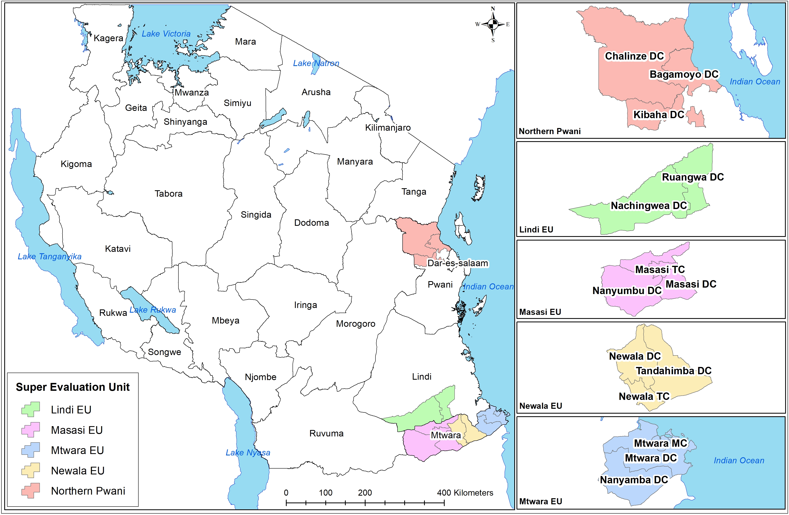
Formed Super EUs

Slide 18
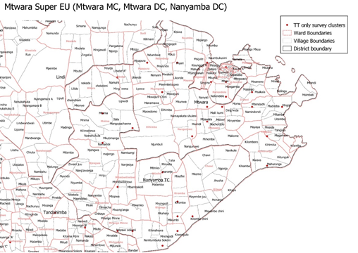
Methods
We used the trachoma surveys data of 2014,2017 and 2018 to randomly select 30 villages per super-EU using a geostatistical design
Mtwara MC
Mtwara DC
Nanyamba TC

Slide 19
Results
A Binomial geostatistical model was fitted to the data and was then used to generate the probability that the super EU-level standardized TT prevalence falls below 0.2%.
Super EU | Predicted TT prevalence (%) | Lower limit (%) | Upper limit (%) | Probability elimination (%)
Northern Pwani | 0.369 | 0.144 | 0.795 | 12
Mtwara | 1.215 | 0.735 | 1.893 | 0
Newala | 1.34 | 0.843 | 2.067 | 0
Masasi | 1.069 | 0.579 | 1.895 | 0
Lindi | 1.629 | 0.913 | 2.768 | 0

Slide 20
Thank you!

Slide 21
Nigeria Case study
Notes:
Next up is the case study from Nigeria, kindly provided by the Nigerian Health Ministry.

Slide 22
Numan, LGA, Adamawa State, Nigeria
Baseline mapping in 2017 demonstrated TF< 5%, trichiasis prevalence just above threshold at 0.21%
Neighbouring EUs all had trichiasis prevalence below 0.2%
Is the difference in observed prevalence between surveys biologically meaningful or an artifact of sampling error?
MBG model combined data from all surrounding EUs to try and generate a new estimate
New estimate had a PPE of 0.447 (~50% confidence elimination threshold had been reached)- too low to rely on!
Therefore a different approach was used: Can MBG be used to refine the geographical area for trichiasis case-finding activities?
Notes:
This was a study on a single EU called Numan LGA in Adamawa state, Nigeria. It has a similar background to the Tanzania case study, where Baseline mapping in 2017 demonstrated TF< 5%, and a trichiasis prevalence just above threshold at 0.21%. Neighbouring EUs all had trichiasis prevalence below 0.2%
The original objective here was to determine whether the difference in observed prevalence between surveys biologically meaningful or an artifact of sampling error?
So an MBG model was used to combine data from all surrounding EUs to try and generate a new estimate
The New estimate had a PPE of 0.447 (~50% confidence elimination threshold had been reached) which is too low to rely on!
There fore a new approach was used to see whether MBG can be used to refine the geographical area for trichiasis case-finding activities?

Slide 23
In many districts the trichiasis prevalence is not homogenous across clusters, but rather exhibits signs of focality, indicating that the program challenge is confined to a specific geographic area.
MBG allows model predictions to be aggregated at any spatial scale (e.g., sub-district, village, etc.).
It can identify geographical areas with a high probability that the prevalence of trachoma is high and could allow for better targeting of program resources
It may also show where it is appropriate to split the district, stopping treatment in areas where there is a high probability that the threshold has been achieved or reframing EUs altogether, if this would be politically acceptable and allow for practical implementation of future interventions.
Using MBG, a map of the predicted standardized TT prevalence over a grid over the whole EU was generated.
Notes:
And we were interested in this because In many districts the trichiasis prevalence is not homogenous across clusters, but rather exhibits signs of focality, indicating that the program challenge is confined to a specific geographic area.
MBG allows model predictions to be aggregated at any spatial scale (e.g., sub-district, village, etc.).
It can identify geographical areas with a high probability that the prevalence of trachoma is high and could allow for better targeting of program resources
It may also show where it is appropriate to split the district, stopping treatment in areas where there is a high probability that the threshold has been achieved or reframing EUs altogether, if this would be politically acceptable and allow for practical implementation of future interventions.
Using MBG, a map of the predicted standardized TT prevalence over a grid over the whole EU was generated.

Slide 24
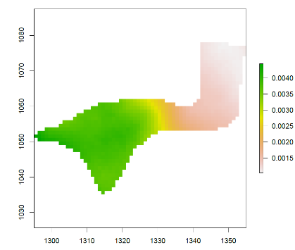
Results
Green = high TT prevalence
MBG predicted that the majority of TT cases would be located in the west of the LGA Numan EU
However, case-finding showed that most TT cases were actually found in the east.
The predictive probability of elimination (PPE) of the entire EU was ~50%, indicating there was a lot of uncertainty in the model
This uncertainty was likely due to a lack of data- there was a high proportion of zeros in the dataset (many clusters with no TT cases at all)
Due to the uncertainty implied by the 50% PPE, next steps for this EU would be to undertake house to house case searches, or implementing a treatment programme and resurveying after an interval.
Notes:
The MBG model predicted that the majority of TT cases would be located in the west of the LGA Numan EU, as shown in the graphic on the right here, where green predicts high TT prevalence.
However case-finding showed that most TT cases were actually found in the east.
As previously stated, the predictive probability of elimination (PPE) of the entire EU was ~50%, indicating there was a lot of uncertainty in the model
This uncertainty was likely due to a lack of data- there was a high proportion of zeros in the dataset (many clusters with no TT cases at all).
Due to the uncertainty implied by the 50% PPE, next steps for this EU would be to follow standard Tropical Data guidelines; house to house case searches, or implementing a treatment programme and resurveying after an interval.

Slide 25
Potential future applications
Inaccessible EUs
Spatial temporal models e.g. using all previously collected data to identify areas of high disease risk for Post-Validation surveillance
?
Notes:
So those were some examples of how geostats models have been used so far, but there are other ways that geostats may be able to help. For example, As of March 2022, 17 countries covering 240 districts are reported by WHO as being hard-to-reach, meaning surveys cannot be conducted and countries are not able to know their trachoma status. MBG can be used to pull data from surrounding EUs to estimate the prevalence of TF and TT.
MBG may also be used as a form of post-validation surveillance, where we can combine data from baseline, impact and surveillance surveys to estimate trachoma prevalence and try and predict whether or not any recrudescence may occur.

Slide 26
MBG and Tropical Data
Notes:
So in the next section I’ll give a brief overview of the background of when Tropical Data decided to start investigating the use of MBG, as well as how we are working on incorporating MBG, as there are a number of criteria that need to be met.

Slide 27
Implementing MBG
First discussed and agreed at the 2018 4th Global Scientific Meeting on Trachoma
End Game Challenges, December 2021
GET2020 Istanbul, April 2023
Notes:
So the idea to use MBGs in trachoma control has also been in the works for some time. It was first formally discussed in 2018 at the 4th Global scientific meeting, with the outcome being that MBG analysis was deemed an acceptable way to demonstrate TT elimination had been achieved.
It was also discussed at the end game challenges in December 2021, and at GET2020 in Istanbul in April.
So we know that MBG has WHO approval, but that doesn’t mean that it will used for all future trachoma surveys, as there are a number of criteria that must be met before we can use MBG.

Slide 28
Ministries of health must give permission for the use of all data
Are there shapefiles available for the EUs in question?
NO
NO
Is there household or cluster level GPS?
Can’t progress with MBG
NO
Does the data show spatial correlation?
YES
Is there evidence of large population movement?
Use standard data analysis methods
Do we have access to the necessary covariate data?
NO
PPE too low to be confident in prediction
Use MBG
PPE &
% prevalence
Notes:
So this is a decision tree that provides a very simple overview of what we need in order to run an MBG model. One of the first things is whether we have up to date shapefiles for the EUs in question, and this is something I’ll explain further in the next slide. The data also needs to show spatial correlation, the analysis of which will be supported by the Centre for health informatics, computing and statistics at Lancaster University. Household or cluster level GPS, no evidence of large population movement and access to the necessary covariate data are also all required in order to use MBG. If we don’t have any of these things, then we can progress with MBG, and we default to the standard data analysis methods. And as demonstrated in the previous Nigeria case study, even if we do have enough information to run the MBG, if the PPE is too low, we would default to standard data analysis methods as well.

Slide 29
Shapefiles and MBG
A shapefile is how data describing the location, size, shape and boundaries of a defined area is stored and displayed
Administrative changes occur often and map/shapefile creation often lags far behind these changes.
If surveys are planned in newly formed districts for which a shapefile and/or map does not yet exist, we are missing a crucial piece of the information needed to do a cluster selection using geostatistical methods.
Standard survey methods can be used however as long as we know which district each cluster belongs to.
District 1 North
District 1 South
Notes:
So I mentioned in the previous slide that I would explain why Shapefiles are important. So firstly, A shapefile is how data describing the location, size, shape and boundaries of a defined area is stored and displayed. And these are being constantly changed and updated because local administrative changes, where perhaps a district is split into two separate districts as shown in this graphic, occur fairly often. Shapefile creation often lags far behind these changes, and If surveys are planned in newly formed districts for which a shapefile and/or map does not yet exist, we are missing a crucial piece of the information needed to do a cluster selection using geostatistical methods. Standard survey methods can be used however as long as we know which district each cluster belongs to.

Slide 30
MBG research and next steps
Notes:
So now we’ll go on to review the current research that the tropical data team are involved with, and the next steps for this project.

Slide 31
Recent research
Higher TF prevalence:
Lower mean annual precipitation
Lower mean annual temperatures
Lower altitudes
Rural
Less accessible
Fewer medical services
Fewer schools
Lower access to water and sanitation.
Higher TT prevalence:
Higher aridity index
Distance to stable nightlights
Notes:
So we’ve mentioned in previous slides covariates such as rainfall and altitude, which are two variables that may affect trachoma prevalence. Recent research by Clara Burgert found a number of ecological factors that are linked to high trachoma prevalence, including: precipitation, temperature, altitude, ruralness, and access to medical services, schools and water and sanitation. Aridity and distance to stable nighlights were indicated for TT prevalence.

Slide 32
Current research
Which covariates should be included in the model and how beneficial are they?
Should the models be standardized or should they be customized by country?
Where should the data be sourced?
What if the covariates change over time?
Notes:
However just knowing what the risk factors are isn’t the end of the research, we still need to decide: Which covariates should be included in the model and how beneficial are they? And linked to this, Should the models be standardized or should they be customized by country? Misaki and Clara are both looking at how variables influence trachoma in different countries, and it is possible that we may need to customize models for each country on a case by case basis. For example, in country A rainfall, altitude and aridity influence trachoma prevalence the most, whereas in country B access to water and sanitation and medical services is more influential, so we wouldn’t be able to run identical models for both countries. Another part of the research is deciding where the variable data should be sourced as consistency is very important, and also what do we do if the risk factors change over time. These are all questions that need to be answered before we implement MBG within the Tropical Data service.

Slide 33
Next steps
Explore level of MBG analysis automation – decide on which covariates to use and how
Develop code and incorporate into Tropical Data’s existing processes
Development of user-friendly interface that is integrated with the Tropical Data platform
Development of guidance materials on result interpretation for countries
Tropical Data MBG methods paper
Notes:
So our next steps are to: Explore level of MBG analysis automation – decide on which covariates to use and how
Develop code and incorporate into Tropical Data’s existing processes
Development of user-friendly interface that is integrated with the Tropical Data platform
Development of guidance materials on result interpretation for countries
Tropical Data MBG methods paper

Slide 34
Summary
MBG model:
is an enhancement to improve survey precision
can account for other covariates such as rainfall, altitude, temperature, demographics etc.
Multiple criteria need to be met to use MBG
Final output is % prevalence and PPE
Standard field-based survey methods unchanged
Still lots of work to be done before widespread implementation!
Notes:
To summarise: MBG model:
is an enhancement to improve survey precision
can account for other risk factors such as rainfall, altitude, temperature, demographics etc.
Multiple criteria need to be met to use MBG
Final output is % prevalence and PPE
Standard field-based survey methods unchanged
Still lots of work to be done before widespread implementation!

Slide 35
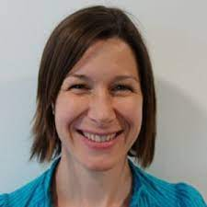
People
Anthony Solomon
Misaki Sasanami
Emanuele Giorgi
Emma Harding-Esch
Clara Burgert-Brucker
Ana Bakhtiari
Jeremiah Ngondi
Stephanie Sommerville
Anna Harte
Notes:
Just to wrap up, I would like to highlight the important people involved in this project, many of which are available today to answer your questions in the Q&A session.

Slide 36
Dedicated to Aryc Mosher
Notes:
One final slide- so the reason this a webinar is because at GET2020 in Istanbul in April 2023, we presented some research on MBG and to our surprise, there was a lot of confusion and some worry about how MBG will change tropical data methods- Eric from USAID was there and he was super keen, but very accurately noted that there was a fair amount of confusion in the room, and so he suggested we do a webinar to explain it in more detail. So this webinar is dedicated to Eric Mosher.

Slide 37
Acknowledgements
Health ministries that shared data & experiences
Nigeria
Tanzania
Notes:
Thank you to all the health ministries that have allowed their data to be used to test out the MBG method, and thank you to all the partners involved.
Thanks to Sightsavers, ITI and USAID for funding this webinar.

Slide 38
Q&A session
Panelists
-Ana Bakhtiari
-Anthony Solomon
-Clara Burgert-Brucker
-Emanuele Giorgi
-Emma Harding-Esch
-George Kabona
-Misaki Sasanami
-Stephanie Sommerville
Notes:
So we will now start the Q&A session where we will answer the questions you have submitted during the presentation.

