Slide 1
Home Health Value Based Purchasing: M1850 Transferring
Ciji Garcia RN, HCS-D, HCS-O
Quality Assurance Specialist
Alisa Staples, RN, BSN, HCS-D, HCS-O
Quality Assurance Specialist

Slide 2
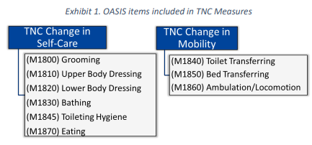
REWIND: HHVBP
M1850
Part of TNC Change in Mobility
Capturing Magnitude of change
not enough to just improve
Goal is to climb the ladder!!
Notes:
Next greater opportunity to improve more

Slide 3
REWIND- Item Overview
Identifies the patient’s ability to safely transfer from bed to chair (and chair to bed), or position self in bed if bedfast
Consider where nearest sitting surface is and device use
Report patient’s safe ability more than 50% of the time
Leverage GG0170 A-E
Get the Patient Moving! Observation is Preferred Method!

Slide 4
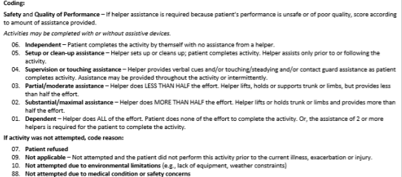
GG0170 A-E
GG0170 A-E are included
tasks in M1850!
GG0170 Mobility
Scoring Scale

Slide 5
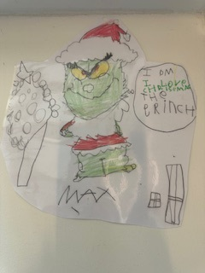
How the Grinch Scored Transferring
Every Clinical Manger in Aveannaville liked the OASIS A LOT
But the Grinch who lived north of Aveannaville….. OH he Did NOT
The Grinch hated the OASIS and the whole scoring system
Now please don’t ask why, no one had such wisdom
It could be that his he didn’t know the guidance quite right
It could be that CMS always changes…. never an ending as in sight
But I think that the most likely reason of all
May have been that scoring M1850 always made him stall
The Grinch could not understand … what is this item asking ??!
To get to the bottom of this it would take some unmasking
By: Max
Age:6

Slide 6
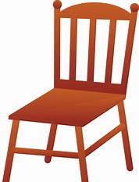
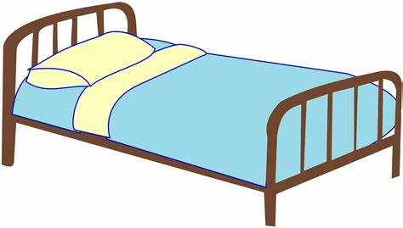
Unmask Transferring Task
WHAT IS INCLUDED IN M1850 TRANSFER TASK???
For most patients, the transfer between bed and chair will include transferring from a supine position in bed to a sitting position at the bedside, then some type of standing, stand-pivot, or sliding board transfer to a chair, and back into bed from the chair or sitting surface.
Starting at bed so getting to the bed is EXCLUDED but getting to the sitting surfaces is INCLUDED!

Slide 7
How the Grinch Scored Transferring
The Grinch didn’t know what is meant by safe ability ?
He wondered and thought is this their capability ?

Slide 8
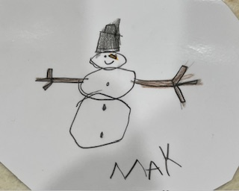
Safe Ability
Always consider TRUE SAFE ability. Is pt’s current performance safe?
While assessing transferring did we need or feel like we needed to intervene in anyway ?
Did we need to give reminders to follow any precautions ? (if breaking precautions NOT safe ! )
While assessing transferring did we need to modify patient's environment or notice any unsafe device use?
Safety in ambulation is considered here!
SCORE PRIOR TO OUR INTERVENTIONS !!!

Slide 9
How the Grinch Scored transferring
Now that The Grinch knew what was meant by safety
He wanted to move on… but then got too hasty
The Grinch stood there with his back in a hunch
Now his stockings were really in a bunch
When he thought ….what is human assist?
He felt like a seasick Crocodile …. he couldn’t resist

Slide 10
M1850 Minimal Assistance
WHAT IS MINIMAL ASSISTANCE??
Person assisting provides 25% or less of effort to complete task
Assistance can be Verbal Cues, SBA, Contact guard, environmental set up or hands on assistance
GG0170 A-E Score of 6-4 minimal assistance or even 3 Partial assistance if <25% effort from CG

Slide 11
M1850 Option Response 1
• Code 1: if the patient: Transfers either with minimal human assistance (but not a device), OR with the use of a device (but no human assistance)
Pt is able to provide >75% of the total effort to complete the task
Is the Patient SAFE ?? If only using a device is it being used Safely/Correctly ? If not would a score 2 be a better option ?

Slide 12
M1850 Option Response 2
Code 2: if the patient: Requires BOTH minimal human assistance AND an assistive device to transfer safely
Requires 25% or less than of the total effort to come from whoever is assisting AND also a device
There is no definitive list of assistive devices
Code 2: Can both bear weight and pivot, but requires more than minimal human assistance
Cg provider more than 25% of effort
Pt has to be able to bear weight AND pivot !

Slide 13
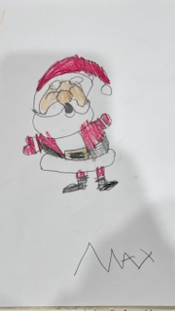
How the Grinch Scored Transferring
The grinch looked at the Christmas tree and the weight in its limbs
The ornaments hung low, and the stocking filled to their brims
With his teeth all yellow and his skin all green
He started to wonder what does weight bearing really mean ?

Slide 14
M1850 Bearing Weight
What does able to bear weight really mean?
Merriam Webster:
weight-bearing(noun): the act or state of supporting or withstanding the weight of something(such as a building or the body)
CMS Guidance Manual:
Can support majority of their body weight safely through ANY combination of weight bearing extremities

Slide 15
M1850 Option Response 3
Code 3, if the patient is unable transfer self and is unable to bear weight or pivot and is not bedfast.
Unable to safely bear majority weight OR pivot(unable to do one or the other and is not bedfast)
Look at GG0170 E Chair/Bed to Chair (Wheelchair) a scored of 2 or 1 may point to an option response 3
Consider Provider ordered weight-bearing restrictions!

Slide 16
How the Grinch Scored Transferring
With everyone all tucked into bed
Waiting for Santa to arrive in his sled
The Grinch wondered who would be able to see
All of the presents Santa placed under the tree
Who could get to nearest chair to watch presents being opened
Or who was bedfast and would need these memories spoken

Slide 17
M1850 Option Response 4 or 5
Response 4
Bedfast, unable to transfer but is able to turn and position self in bed
Response 5
Bedfast, unable to transfer and is unable to turn and position self
CMS Guidance: Bedfast refers to being confined to the bed, either per physician restriction or due to a patient’s inability to tolerate being out of the bed.

Slide 18
What is Bedfast?
• Bedfast refers to being confined to the bed, either per physician restriction or due to a patient’s inability to tolerate being out of the bed.
If cannot tolerate being out of bed for any amount of time then considered bedfast
Use clinical judgement
Ensure documentation will support this if Bedfast option selected

Slide 19
The END
The Grinch now knows the magnitude of change is what matters
And the importance of accurate scoring to help climb that ladder !
Now in Aveannaville they say …The Grinches heart grew three sizes
today !
When he learned just how to score transferring the right way !

Slide 20
Common Questions
Q1: “My patient doesn’t have a walker and can stand by himself but he is a 3 for ambulation “ How would I score M1850?
A1: If pt doesn’t have a device but needs one are they really safe with just minimal assistance ? It is likely person assisting will be providing more than 25% of the effort so would be 2 in this situation.
REMEMBER device needs to be present in the home to assess safe ability with that device we cannot assume pt would be safe with device they don’t have.

Slide 21
Questions
Q2: A quadriplegic is totally dependent, cannot even turn self in bed, however, he does get up to a gerichair by Hoyer lift. For M1850 – Transferring, is the patient considered bedfast? [Category 4b, Q151.3; Q&A EDITED 05/22; ADDED 08/07; M item updated 09/09; Previously CMS OCCB 05/07 Q&A #29]
A2: Response 3 is the response that most closely resembles this pt’s ability as pt is able to tolerate being up in a chair 4 or 5 wouldn’t apply

Slide 22
Questions
Q3: Is M1850 – Transferring assessed for the patient who has slept for years in a recliner? [Category 4b, Q151.7,1; Q&A EDITED 05/22; EDITED 12/12; ADDED 01/11; Previously CMS OCCB Q&A 01/10 Q13]
A3: Assess all patients for M1850 regardless of whether they sleep in a bed or elsewhere. If, for example, the patient sleeps on a couch or recliner, assess their ability to move from the supine position on that sleeping surface to a sitting position and then as they transfer to another sitting surface.

Slide 23
Questions
Q4: Patient has severe dementia, doesn’t use a device to transfer however needs verbal cues/reminders 100% of the time. How would I score M1850?
A4: Based on the scenario score of 2 due to more than 25% assistance. Here is the reason. • For Response 1, “minimal human assistance” could include any combination of verbal cueing, environmental set-up, and/or actual hands-on assistance. • In order for the assistance to be considered minimal, it would mean the individual assisting the patient is contributing less than 25% of the total effort required to perform the transfer. If it is 100 % verbal cues it seems to me my assistance, even though verbal is a lot more then 25% of the time. Also if there was a device - walker or is grabbing furniture to rise etc. with cues and device would be a 2. This would allow us to show improvement even on a potential dementia because the use of repetitive training strategies.

Slide 24
Questions?

