Slide 1
The HERM Business Capability Model A Framework for Digital Transformation
Edge Board of Trustees
June 2023
(selected images updated March 2024)

Slide 2
Mastering Capabilities Catalyzes Change
Student
Business Model
Value Proposition
Financial Model
Capabilities
Linchpin
Operating Model
Value Streams
Governance
Resources
HE Reference Models Global Initiative Launch 2021, J.M. Lowendahl, Gartner (adapted). To access the HERM library, including the Business Capability Model: https://library.educause.edu/resources/2021/9/the-higher-education-reference-models

Slide 3
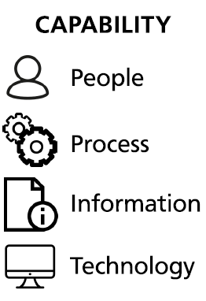
What is a Business Capability?
A Business Capability is a particular logical combination of People, Process, Information, and Technology necessary to deliver a discrete required outcome to achieve a specific business objective.
Outcome
Capabilities
HE Reference Models Global Initiative Launch 2021, J.M. Lowendahl, Gartner (adapted). To access the HERM library, including the Business Capability Model: https://library.educause.edu/resources/2021/9/the-higher-education-reference-models

Slide 4
Some Examples of Higher Ed Business Capabilities
Curriculum Management
Curriculum Planning
Curriculum Design
Curriculum Production
Curriculum Accreditation
Offering Management
Curriculum Improvement
Curriculum Disestablishment
Marketing Management
Advertising Management
Campaign Management
Market Research
Marketing Planning
Merchandising
Communications Management
Outcome
Capabilities
HE Reference Models Global Initiative Launch 2021, J.M. Lowendahl, Gartner (adapted). To access the HERM library, including the Business Capability Model: https://library.educause.edu/resources/2021/9/the-higher-education-reference-models

Slide 5
BC001 Curriculum Management
BC002 Curriculum Planning
BC003 Curriculum Design
BC004 Curriculum Production
BC007 Curriculum Accreditation
BC235 Offering Management
BC038 Curriculum Improvement
BC041 Curriculum Disestablishment
BC008 Student Recruitment
BC012 Domestic Student Recruitment
BC013 International Student Recruitment
BC014 Student Admission
BC015 Study Application Management
BC018 Learning Recognition Management
BC019 Student Enrollment
BC020 Matriculation
BC021 Enrollment
BC022 Student Allocation
BC027 Timetable Management
BC023 Curriculum Delivery
BC024 Learning & Teaching Resource Preparation
BC025 Learning & Teaching Resource Management
BC026 Learning & Teaching Delivery
BC059 Student Supervision
BC028 Student Assessment
BC029 Learning Assessment
BC031 Student Research Assessment
BC032 Completion Management
BC035 Completion Award
BC044 Student Management
BC010 Scholarship Management
BC246 Student Liability Management
BC046 Student Academic Progress Management
BC225 Cross-Institutional Study
BC030 Placement Management
BC223 Examination Management
BC224 Special Consideration Management
BC047 Research Candidature Management
BC049 Student Misconduct Management
BC052 Student Support
BC055 Careers Advice
BC053 Academic Advice
BC054 Core Skills Development
BC056 Financial Advice
BC226 Student Grievance Management
BC065 Research Opportunities & Planning
BC066 Research Opportunity Management
BC067 Collaborative Opportunity Management
BC070 Research Project Design
BC071 Research Funding
BC072 Research Fund Sourcing
BC215 Research Grant Management
BC245 Research Assurance
BC094 Research Ethics Management
BC212 Research Integrity Management
BC090 Research Performance Management
BC091 Research Quality Management
BC093 Research Management
BC073 Research Funds Management
BC069 Research Program Management
BC074 Research Delivery
BC077 Research Data Management
BC075 Research Creation
BC097 Research Infrastructure Management
BC236 Research Resource Management
BC086 Research Dissemination
BC083 Research Output Management
BC237 Research Outcome Management
BC228 Research Impact Management
BC088 Research Commercialization Management
BC147 Strategy Management
BC148 Vision & Strategy Development
BC149 Strategic Plan Management
BC206 Business Capability Management
BC230 Business Planning
BC209 Enterprise Architecture
BC217 Customer Experience Management
BC216 Business Process Management
BC218 Service Management
BC207 Change Management
BC210 Portfolio & Program Management
BC243 Project Management
BC244 Product Management
BC208 Benefits Management
BC133 Library Administration
BC213 Library Collection Management
BC134 Collection Access Management
BC160 Governance, Risk, & Compliance
BC164 Policy Management
BC165 Quality Management
BC168 Risk Management
BC170 Compliance Management
BC161 Business Continuity Management
BC234 Incident Management
BC167 Investigation Management
BC163 Internal Audit
BC166 Complaint & Compliment Management
BC232 Advancement Management
BC037 Alumni Management
BC222 Development & Fundraising
BC233 Donor, Sponsor, & Philanthropist Management
BC107 Marketing Management
BC108 Advertising Management
BC109 Campaign Management
BC111 Market Research
BC112 Marketing Planning
BC113 Merchandising
BC220 Communications Management
BC238 Engagement & Relationship Management
BC239 Relationship Management
BC240 Outreach Management
BC241 Engagement Management
BC242 Extension Management
BC155 Legal Services
BC159 Legal Advisory
BC156 Contract Management
BC157 Dispute Resolution & Litigation
BC201 Information & Communication Technology Management
BC202 Alignment, Planning, & Organization
BC203 Build, Acquisition, & Implementation
BC204 Delivery, Service, & Support
BC205 Monitoring, Assessment, & Evaluation
BC171 Human Resource Management
BC172 Organizational Design
BC174 Workforce Planning
BC175 Talent Acquisition
BC182 Workforce Training & Development
BC176 Remuneration & Benefits Management
BC178 Workforce Resource Management
BC181 Workforce Performance Management
BC173 Workforce Relations Management
BC183 Human Resource Support
BC184 Financial Management
BC190 Financial Planning & Analysis
BC187 Accounts Payable
BC188 Accounts Receivable
BC189 Price Modelling
BC191 Tax Management
BC214 Payroll Management
BC192 Bank Management
BC193 Procurement Management
BC194 Project Accounting
BC197 Asset Management
BC199 Investment Management
BC219 Treasury Management
BC135 Information Management
BC144 Advanced Analytics
BC140 Artifact & Collection Management
BC141 Copyright Management
BC143 Data Management
BC136 Information Governance
BC137 Information Search & Discovery
BC138 Information Security Management
BC139 Identity & Access Management
BC145 Records Management
BC146 Enterprise Content Management
BC211 Business Intelligence & Reporting
BC231 Digital Preservation
BC125 Facilities & Estate Management
BC126 Building & Facilities Management
BC127 Property Management
BC128 Campus Transportation Management
BC129 Campus Security Management
BC130 Commercial Tenancy Management
BC131 Cleaning & Waste Management
BC132 Groundskeeping Management
BC221 Environmental Sustainability Management
BC227 Space Utilization Management
BC114 Supporting Services
BC115 Housing & Accommodation Management
BC116 Gallery & Museum Management
BC117 Childcare Management
BC118 Healthcare Management
BC180 Health, Safety, & Wellbeing Management
BC124 Membership Management
BC120 Printing Management
BC121 Sport & Recreation Management
BC229 Intercollegiate Athletics Management
BC123 Retail Management
BC195 Travel Management
BC110 Event Management
BC122 Venue Management
BC119 Mail Management
What if you could organize, catalog, and manage your business capabilities like you do your curriculum?

Slide 6
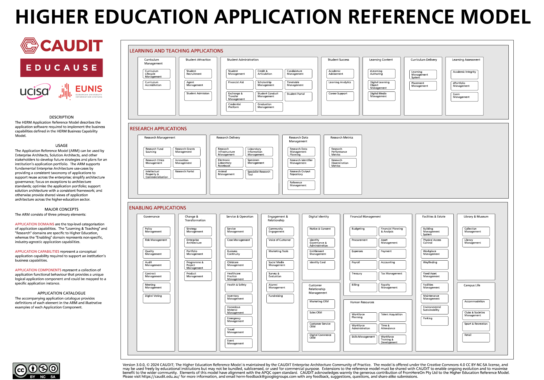
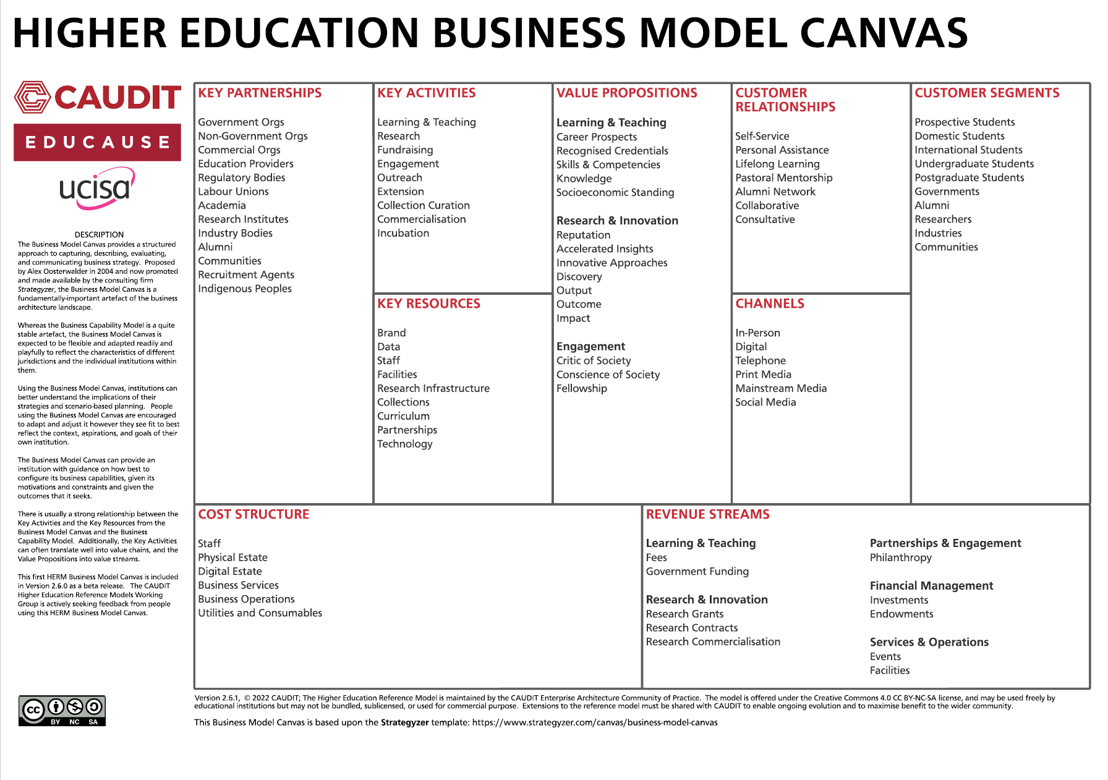
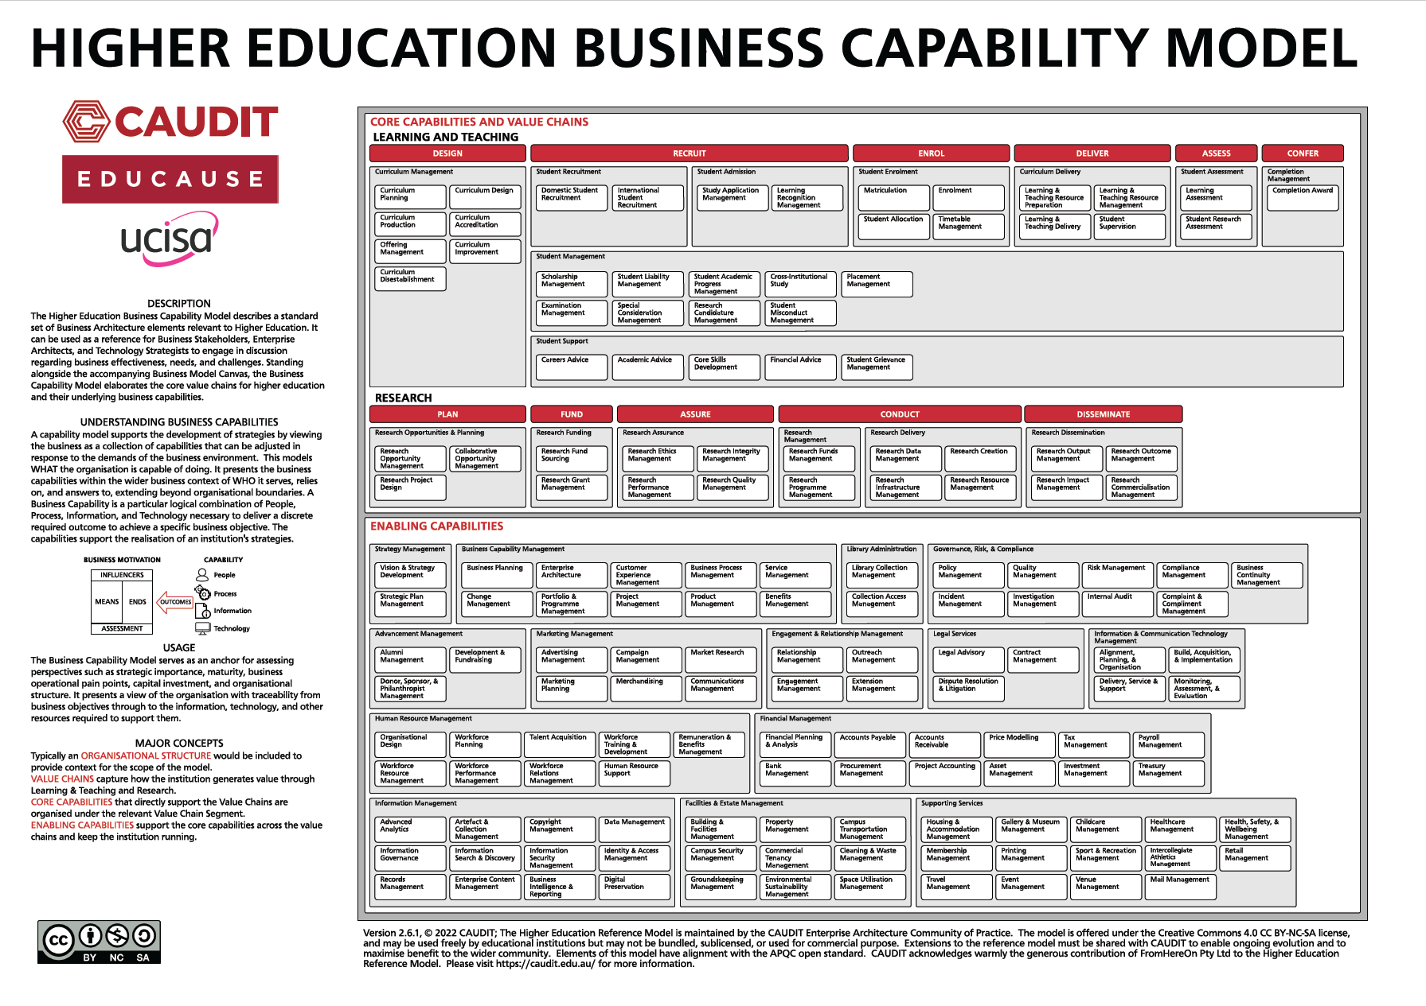
Business Capability Model
Business Model Canvas
Data Reference Model
Application Reference Model
The HERM is a global standard adopted and endorsed in 2021 by:
EDUCAUSE
CAUDIT
UCISA
EUNIS
to facilitate strategic and operational planning and investment.
HE Reference Models Global Initiative Launch 2021 (adapted). To access the HERM library, including the Business Capability Model:
https://library.educause.edu/resources/2021/9/the-higher-education-reference-models

Slide 7
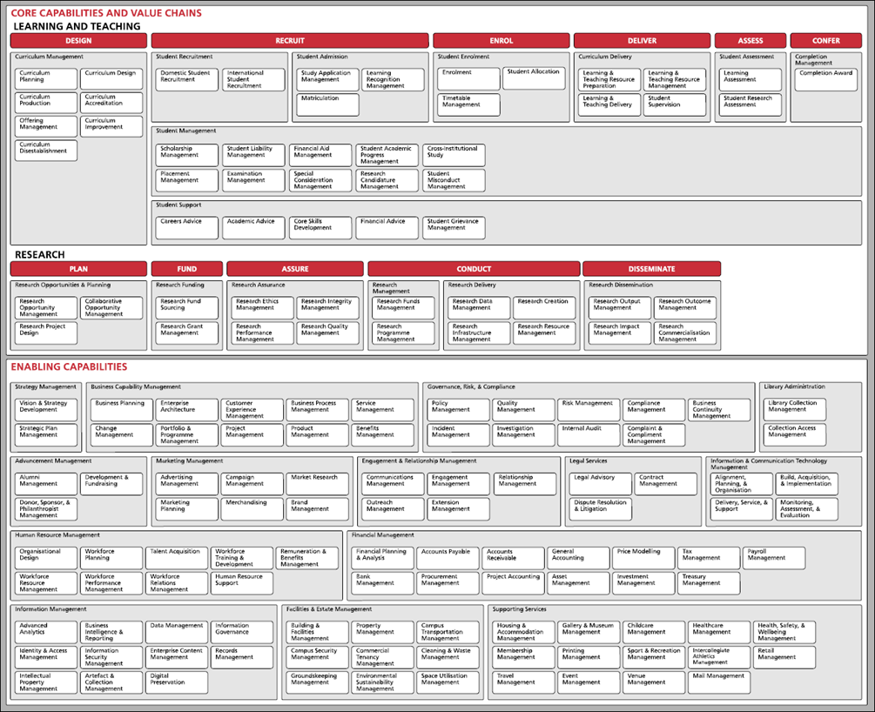
Higher Education
Business Capability Model
(HERM BCM v300)
A comprehensive framework for planning and managing adaptive business capabilities
in a highly dynamic world.
HE Reference Models Global Initiative Launch 2021 (adapted). To access the HERM library, including the Business Capability Model: https://library.educause.edu/resources/2021/9/the-higher-education-reference-models

Slide 8
Higher Education
Business Capability Model
(HERM BCM v300)
It can be used as a reference for Business Stakeholders, Enterprise Architects, and Technology Strategists to engage in discussion regarding business effectiveness, needs, and challenges.
HE Reference Models Global Initiative Launch 2021 (adapted). To access the HERM library, including the Business Capability Model: https://library.educause.edu/resources/2021/9/the-higher-education-reference-models

Slide 9
Higher Education
Business Capability Model
(HERM BCM v300)
The Business Capability Model serves as an anchor for assessing perspectives such as strategic importance, maturity, business operational pain points, capital investment, and organizational structure.
HE Reference Models Global Initiative Launch 2021 (adapted). To access the HERM library, including the Business Capability Model: https://library.educause.edu/resources/2021/9/the-higher-education-reference-models

Slide 10
Higher Education
Business Capability Model
(HERM BCM v300)
CORE CAPABILITIES AND VALUE CHAINS
ENABLING CAPABILITIES
Divided into two major groups:
Core Capabilities and Value Chains
Enabling Capabilities
HE Reference Models Global Initiative Launch 2021 (adapted). To access the HERM library, including the Business Capability Model: https://library.educause.edu/resources/2021/9/the-higher-education-reference-models

Slide 11
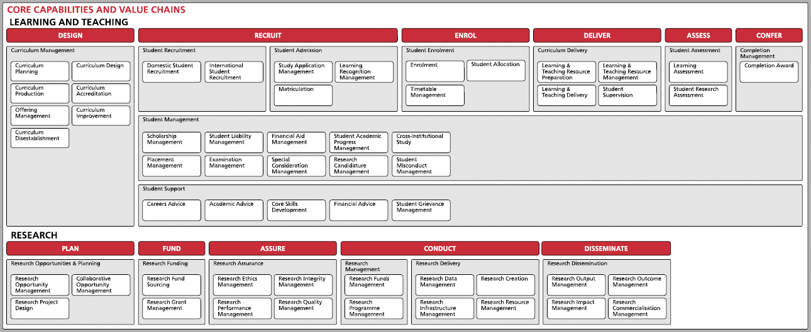
Core Capabilities
and
Value Chains
Learning and Teaching | Design || Recruit || Enroll || Deliver || Assess|| Confer Student Recruitment (2), Admission (3), Enrollment (3), Student Management (8), Student Support (5) Curriculum Management (7), Delivery (4), Assessment (2), Completion Management (1)
Research | Plan || Fund || Assure || Conduct || Desseminate Research Planning (3), Funding (2), Assurance (4), Management (2), Delivery (4), Dissemination (4)
Value Chains
VALUE CHAINS capture how the institution generates value through Learning & Teaching and Research.
HE Reference Models Global Initiative Launch 2021 (adapted). To access the HERM library, including the Business Capability Model: https://library.educause.edu/resources/2021/9/the-higher-education-reference-models

Slide 12
Core Capabilities
and
Value Chains
Learning and Teaching | Design || Recruit || Enroll || Deliver || Assess|| Confer Student Recruitment (2), Admission (3), Enrollment (3), Student Management (8), Student Support (5) Curriculum Management (7), Delivery (4), Assessment (2), Completion Management (1)
Research | Plan || Fund || Assure || Conduct || Desseminate Research Planning (3), Funding (2), Assurance (4), Management (2), Delivery (4), Dissemination (4)
Value Chain Segments
HE Reference Models Global Initiative Launch 2021 (adapted). To access the HERM library, including the Business Capability Model: https://library.educause.edu/resources/2021/9/the-higher-education-reference-models

Slide 13
Core Capabilities
and
Value Chains
Learning and Teaching | Design || Recruit || Enroll || Deliver || Assess|| Confer Student Recruitment (2), Admission (3), Enrollment (3), Student Management (8), Student Support (5) Curriculum Management (7), Delivery (4), Assessment (2), Completion Management (1)
Research | Plan || Fund || Assure || Conduct || Desseminate Research Planning (3), Funding (2), Assurance (4), Management (2), Delivery (4), Dissemination (4)
Parent Capabilities
HE Reference Models Global Initiative Launch 2021 (adapted). To access the HERM library, including the Business Capability Model: https://library.educause.edu/resources/2021/9/the-higher-education-reference-models

Slide 14
Core Capabilities
and
Value Chains
Learning and Teaching | Design || Recruit || Enroll || Deliver || Assess|| Confer Student Recruitment (2), Admission (3), Enrollment (3), Student Management (8), Student Support (5) Curriculum Management (7), Delivery (4), Assessment (2), Completion Management (1)
Research | Plan || Fund || Assure || Conduct || Desseminate Research Planning (3), Funding (2), Assurance (4), Management (2), Delivery (4), Dissemination (4)
Core Capabilities
CORE CAPABILITIES that directly support the Value Chains are organized under the relevant Value Chain Segment.
HE Reference Models Global Initiative Launch 2021 (adapted). To access the HERM library, including the Business Capability Model: https://library.educause.edu/resources/2021/9/the-higher-education-reference-models

Slide 15
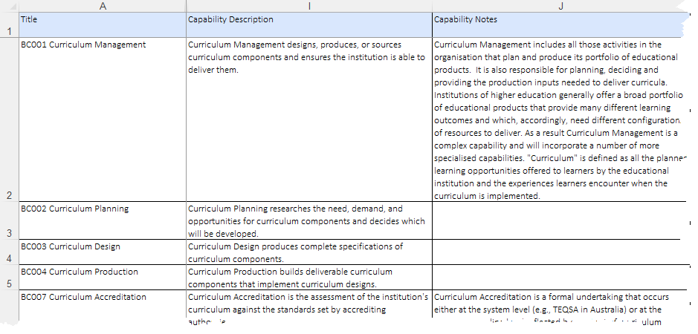
Core Capabilities
and
Value Chains
Learning and Teaching | Design || Recruit || Enroll || Deliver || Assess|| Confer Student Recruitment (2), Admission (3), Enrollment (3), Student Management (8), Student Support (5) Curriculum Management (7), Delivery (4), Assessment (2), Completion Management (1)
Research | Plan || Fund || Assure || Conduct || Desseminate Research Planning (3), Funding (2), Assurance (4), Management (2), Delivery (4), Dissemination (4)
Core Capabilities
Each Has Supporting Detail
HE Reference Models Global Initiative Launch 2021 (adapted). To access the HERM library, including the Business Capability Model: https://library.educause.edu/resources/2021/9/the-higher-education-reference-models

Slide 16
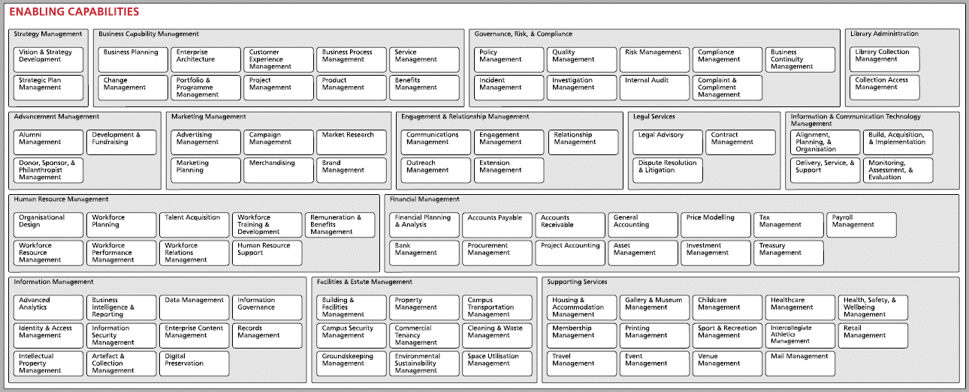
Enabling Capabilities
Strategy Management || Business Capability Management || Library || Governance, Risk, & Compliance || Advancement Marketing || Engagement & Relationship Mgmt || Legal || Information & Communication Technology Mgmt Human Resource Mgmt || Financial Mgmt || Information Management || Facilities & Estate Mgmt || Supporting Services
ENABLING CAPABILITIES support the core capabilities across the value chains and keep the institution running.
HE Reference Models Global Initiative Launch 2021 (adapted). To access the HERM library, including the Business Capability Model: https://library.educause.edu/resources/2021/9/the-higher-education-reference-models

Slide 17
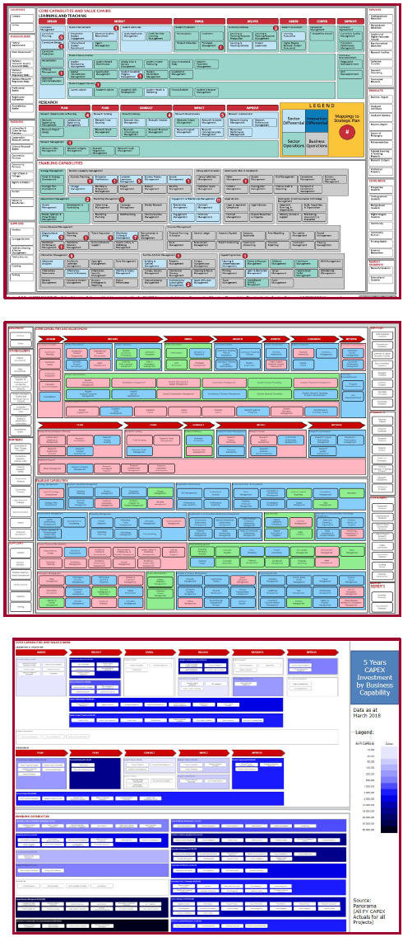
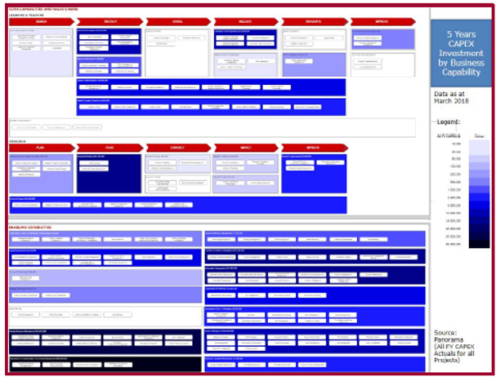
The Higher Education Reference models help institutions to:
Foster ‘whole of institution’ understanding and thinking
The ‘map of our world’
Use enterprise storytelling to engage effectively with stakeholders
Guide operational and strategic planning
Facilitate the exchange of architectural knowledge and best practice throughout the community
Invest in the capabilities that deliver the most important business outcomes
Examples from University of Auckland
HE Reference Models Global Initiative Launch 2021 (adapted). To access the HERM library, including the Business Capability Model: https://library.educause.edu/resources/2021/9/the-higher-education-reference-models

Slide 18
Sample Use Cases for the Business Capability Model
Use Cases:
Degree of Change
Pace of Change
Strategic Priorities
IT Support Levels
Key Applications
HE Reference Models Global Initiative Launch 2021, J.M. Lowendahl, Gartner (adapted). To access the HERM library, including the Business Capability Model: https://library.educause.edu/resources/2021/9/the-higher-education-reference-models

Slide 19
Sample Heat Map Indicating Degree of Change
Use Cases:
Degree of Change
Pace of Change
Strategic Priorities
IT Support Levels
Key Applications
HE Reference Models Global Initiative Launch 2021, J.M. Lowendahl, Gartner (adapted). To access the HERM library, including the Business Capability Model: https://library.educause.edu/resources/2021/9/the-higher-education-reference-models

Slide 20
Pace Layering for Managing Pace of Change
Use Cases:
Degree of Change
Pace of Change
Strategic Priorities
IT Support Levels
Key Applications
HE Reference Models Global Initiative Launch 2021, J.M. Lowendahl, Gartner (adapted). To access the HERM library, including the Business Capability Model: https://library.educause.edu/resources/2021/9/the-higher-education-reference-models

Slide 21
Strategic Choices and Priorities
Use Cases:
Degree of Change
Pace of Change
Strategic Priorities
IT Support Levels
Key Applications
HE Reference Models Global Initiative Launch 2021, J.M. Lowendahl, Gartner (adapted). To access the HERM library, including the Business Capability Model: https://library.educause.edu/resources/2021/9/the-higher-education-reference-models

Slide 22
IT Support Levels
Use Cases:
Degree of Change
Pace of Change
Strategic Priorities
IT Support Levels
Key Applications
HE Reference Models Global Initiative Launch 2021, J.M. Lowendahl, Gartner (adapted). To access the HERM library, including the Business Capability Model: https://library.educause.edu/resources/2021/9/the-higher-education-reference-models

Slide 23
Key Application Landscape
Use Cases:
Degree of Change
Pace of Change
Strategic Priorities
IT Support Levels
Key Applications
HE Reference Models Global Initiative Launch 2021, J.M. Lowendahl, Gartner (adapted). To access the HERM library, including the Business Capability Model: https://library.educause.edu/resources/2021/9/the-higher-education-reference-models

Slide 24
The HERM and its Business Capability Model (BCM)
Edge’s Role
Foster awareness, education, and adoption of the BCM
Plan procurements, and categorize and evaluate solutions and vendors in EdgeMarket (e.g. ERP re-bid)
How About You?
Are you currently using or considering the HERM or its BCM?
Do you know someone who is using the HERM or its BCM?
Are you interested in learning more?
What more should Edge do in this area?
Let us know: dan.miller@njedge.net
To access the HERM library, including the Business Capability Model:
https://library.educause.edu/resources/2021/9/the-higher-education-reference-models

