Slide 2
Table of Contents
Overview
Membership
Programs & Events
Signature Events
Corporate Partnership
Gender Equity Think Tank
Contact Information

Slide 3
Overview

Slide 4
About the HBA
Core Purpose
To further the advancement and impact of women in the business of healthcare.
Mission
The HBA is a global organization comprised of individuals and organizations in healthcare committed to:
Achieving gender parity in leadership positions
Providing equitable practices that enable organizations to realize the full potential of women
Facilitating career and business connections to accelerate advancement

Slide 5
HBA’s Vision for the Future
The Healthcare Businesswomen’s Association is the global leader in gender equity, advancing women into positions of influence and decision-making to improve health equity and outcomes.

Slide 7
Key Stakeholders
Business Professionals
The HBA serves women in the business of healthcare who strive to advance their careers. We offer career resources, volunteer opportunities, and an invaluable network that empower women of all backgrounds to grow professionally. When you are part of the HBA, you are empowered to advance your career, your company, and gender parity as a catalyst for change across the business of healthcare.
Corporate Partners
HBA’s initiatives and community of industry leaders and peers help companies advance their women further, faster. When you partner with the HBA, you strengthen your company’s commitment to advancing women, enhance your competitive edge, and become a catalyst for change.

Slide 8
The HBA’s Growth…
New HBA Locations | Future HBA Locations
Barcelona, Spain | Athens, Greece
Detroit, Michigan | Bangalore, India
India | Buenos Aires, Argentina
Ljubljana, Slovenia | Denmark, Copenhagen
Montreal, Canada | Kuala Lumpur, Malaysia
Singapore | Lagos, Nigeria
Tokyo, Japan | Madrid, Spain
United Arab Emirites (UAE) | Melbourne, Australia
 | Mumbai, India
 | Nairobi, Kenya
 | Pittsburgh, Pennsylvania
 | Portland, Oregon
 | Rome, Italy
 | Sao Paulo, Brazil
 | Sydney, Australia
 | Vancouver, Canada
 | Vienna, Austria

Slide 9
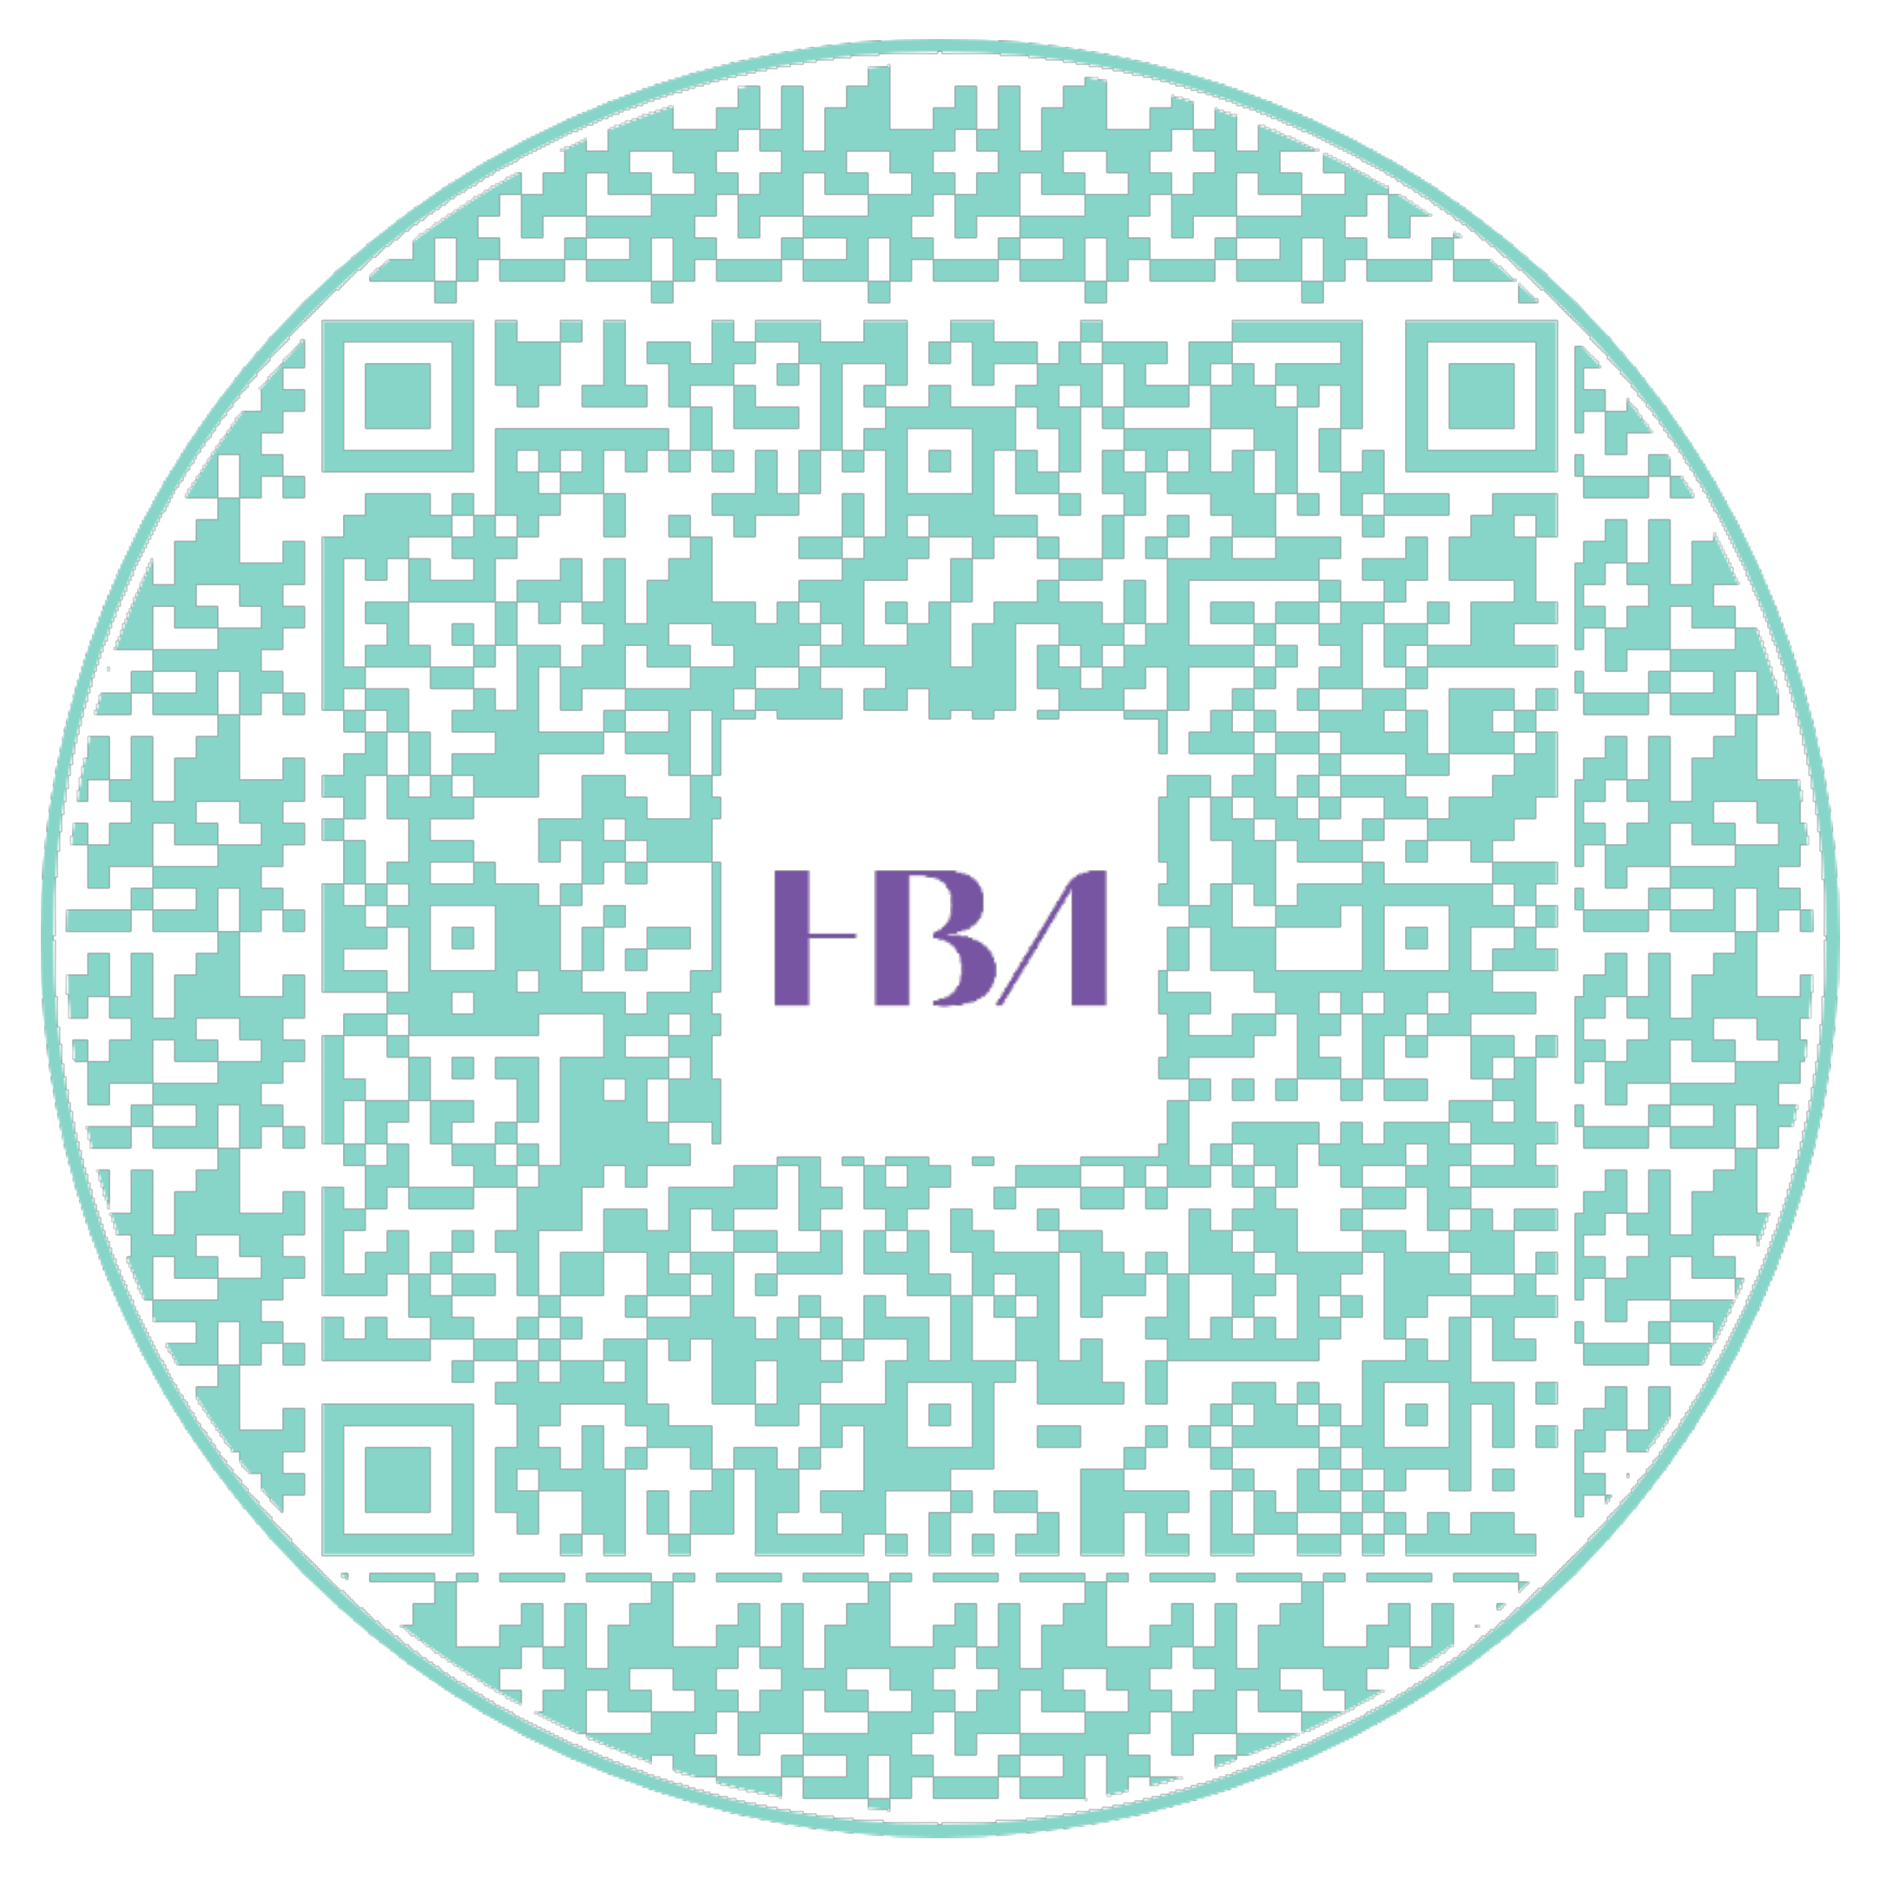
Our Reach
Our Reach
The HBA has expanded its reach to over 80 locations*.
For more information on all locations, click here
or scan this QR Code.
*as of May 2024

Slide 10
Membership

Slide 11
About HBA Members
High level of industry experience
28 percent>20 years
53 percent=5 to 20 years
19 percent<5 years
Career Levels
Individual Contributor
Manager (all levels)
Director (all levels)
VP (all levels)
Executives (Principal/Partner, C-Suite,
Owner/Founder)
Many functional areas
Top 3: Marketing, Operations, Sales/Support
Variety of industry sectors
Top 3: Pharmaceuticals, Biotechnology, Medical Device/Diagnostics
Primarily business professionals
BA/BS, MA/MS, MBA, PhD
Although many have RN, RPh, MD

Slide 12
The Value of Membership
The HBA is your gateway to professional growth and success.
Empower your career and join our movement to further the advancement and impact of women in the business of healthcare.
Connect with more than 20,000 passionate healthcare and life science professionals committed to driving lasting, positive change.

Slide 13
Member Benefits

Slide 14
https://www.youtube.com/watch?v=conw0EtV6CY

Slide 15
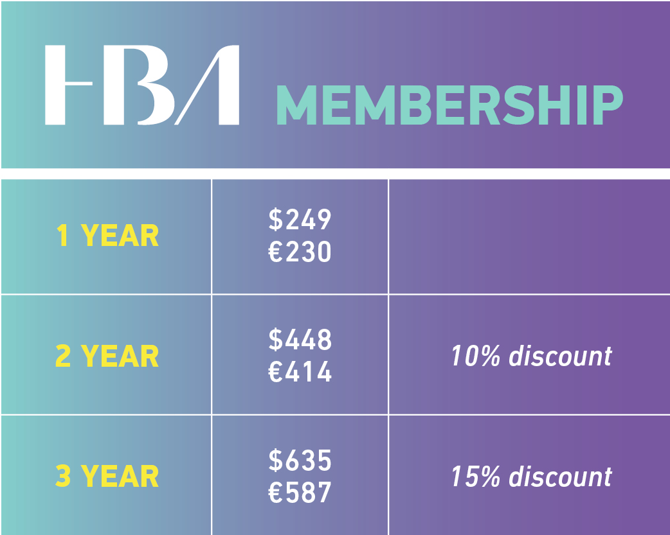
Individual Membership Fees
*The HBA is proud to offer a membership rate of $125/€110 per year for those 30 and under, which includes all benefits of full membership except voting in the annual business meeting and the ability to serve on boards. Additional discounts do not apply to this membership type. Subject to verification at the time of purchase.

Slide 16
Events & Programs

Slide 17
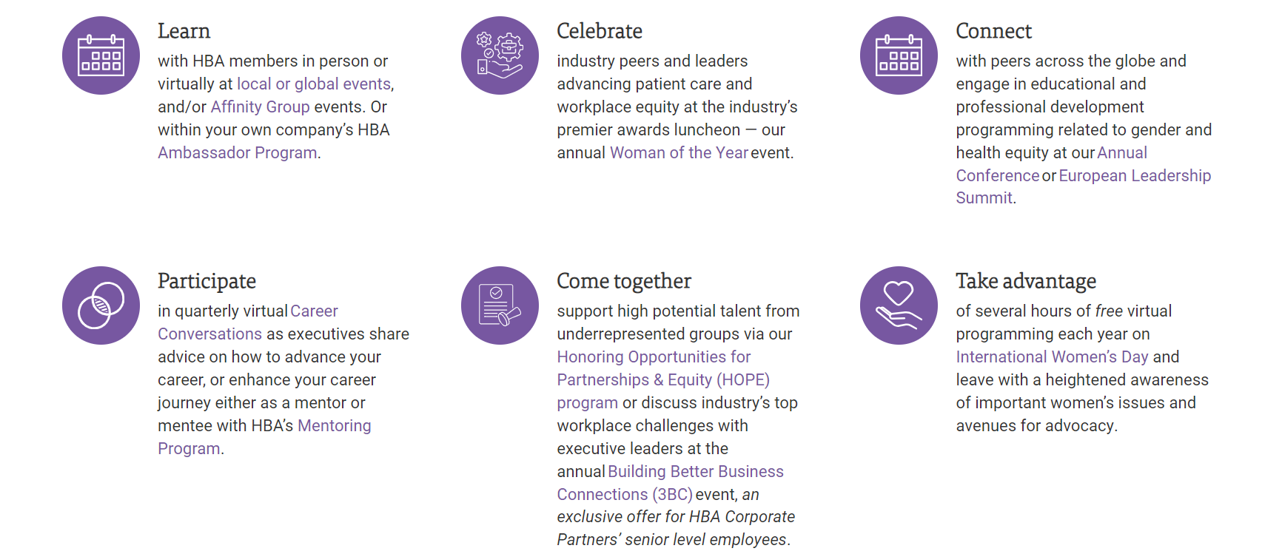
HBA Events & Programs

Slide 18
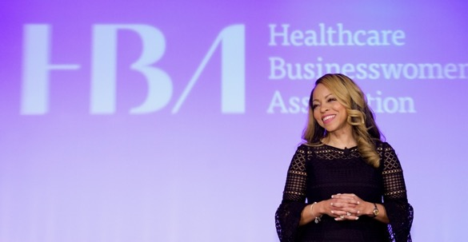
In-Person and Virtual Events
Gain access to 600+ events and programs each year that offer opportunities to accelerate your career development, celebrate your success and foster networking opportunities with industry peers and influencers.
Hundreds of virtual and in-person local events throughout North America, Europe, and APAC
Virtual programs, such as the quarterly Career Conversations webinar series, as well as free access to select webinar offerings throughout the year
Signature annual events including our Woman of the Year Gala, the European Leadership Summit, Building Better Business Connections (3BC), and Annual Conference

Slide 19
Engage in Celebratory & Milestone Events
Each year, the HBA delivers opportunities for members to engage in annual awareness and recognition days. From Black History Month and International Women’s Day to National Volunteer Week to Equal Pay Days, the HBA offers unique experiences for members including social media “take-over” days, networking educational programs.

Slide 20
HBA’s Mentoring Program
Grow your professional success through the power of the HBA network!
Join a network that has positively impacted over 7,000 healthcare professionals since 2014 and continues to help women advance into influential leadership roles.
Enhance your skills, boost visibility, and unlock your leadership potential. Experience the mutual benefits of mentorship, fostering growth for both mentors and mentees, while elevating your on-the-job performance.

Slide 21
Career Conversations
Join us for quarterly virtual conversations that transcend conventional boundaries by exploring the pivotal discussions that propel leaders forward!
The 2024 HBA Career Conversations webinar series delves into workplace conversations that leaders often find challenging.
Join us to experience stimulating dialogue, gain insights, and connect with peers in quarterly virtual sessions crafted to stimulate growth and transform apprehension into empowerment.
Visit HBAnet.org/career-conversations to learn more.

Slide 22
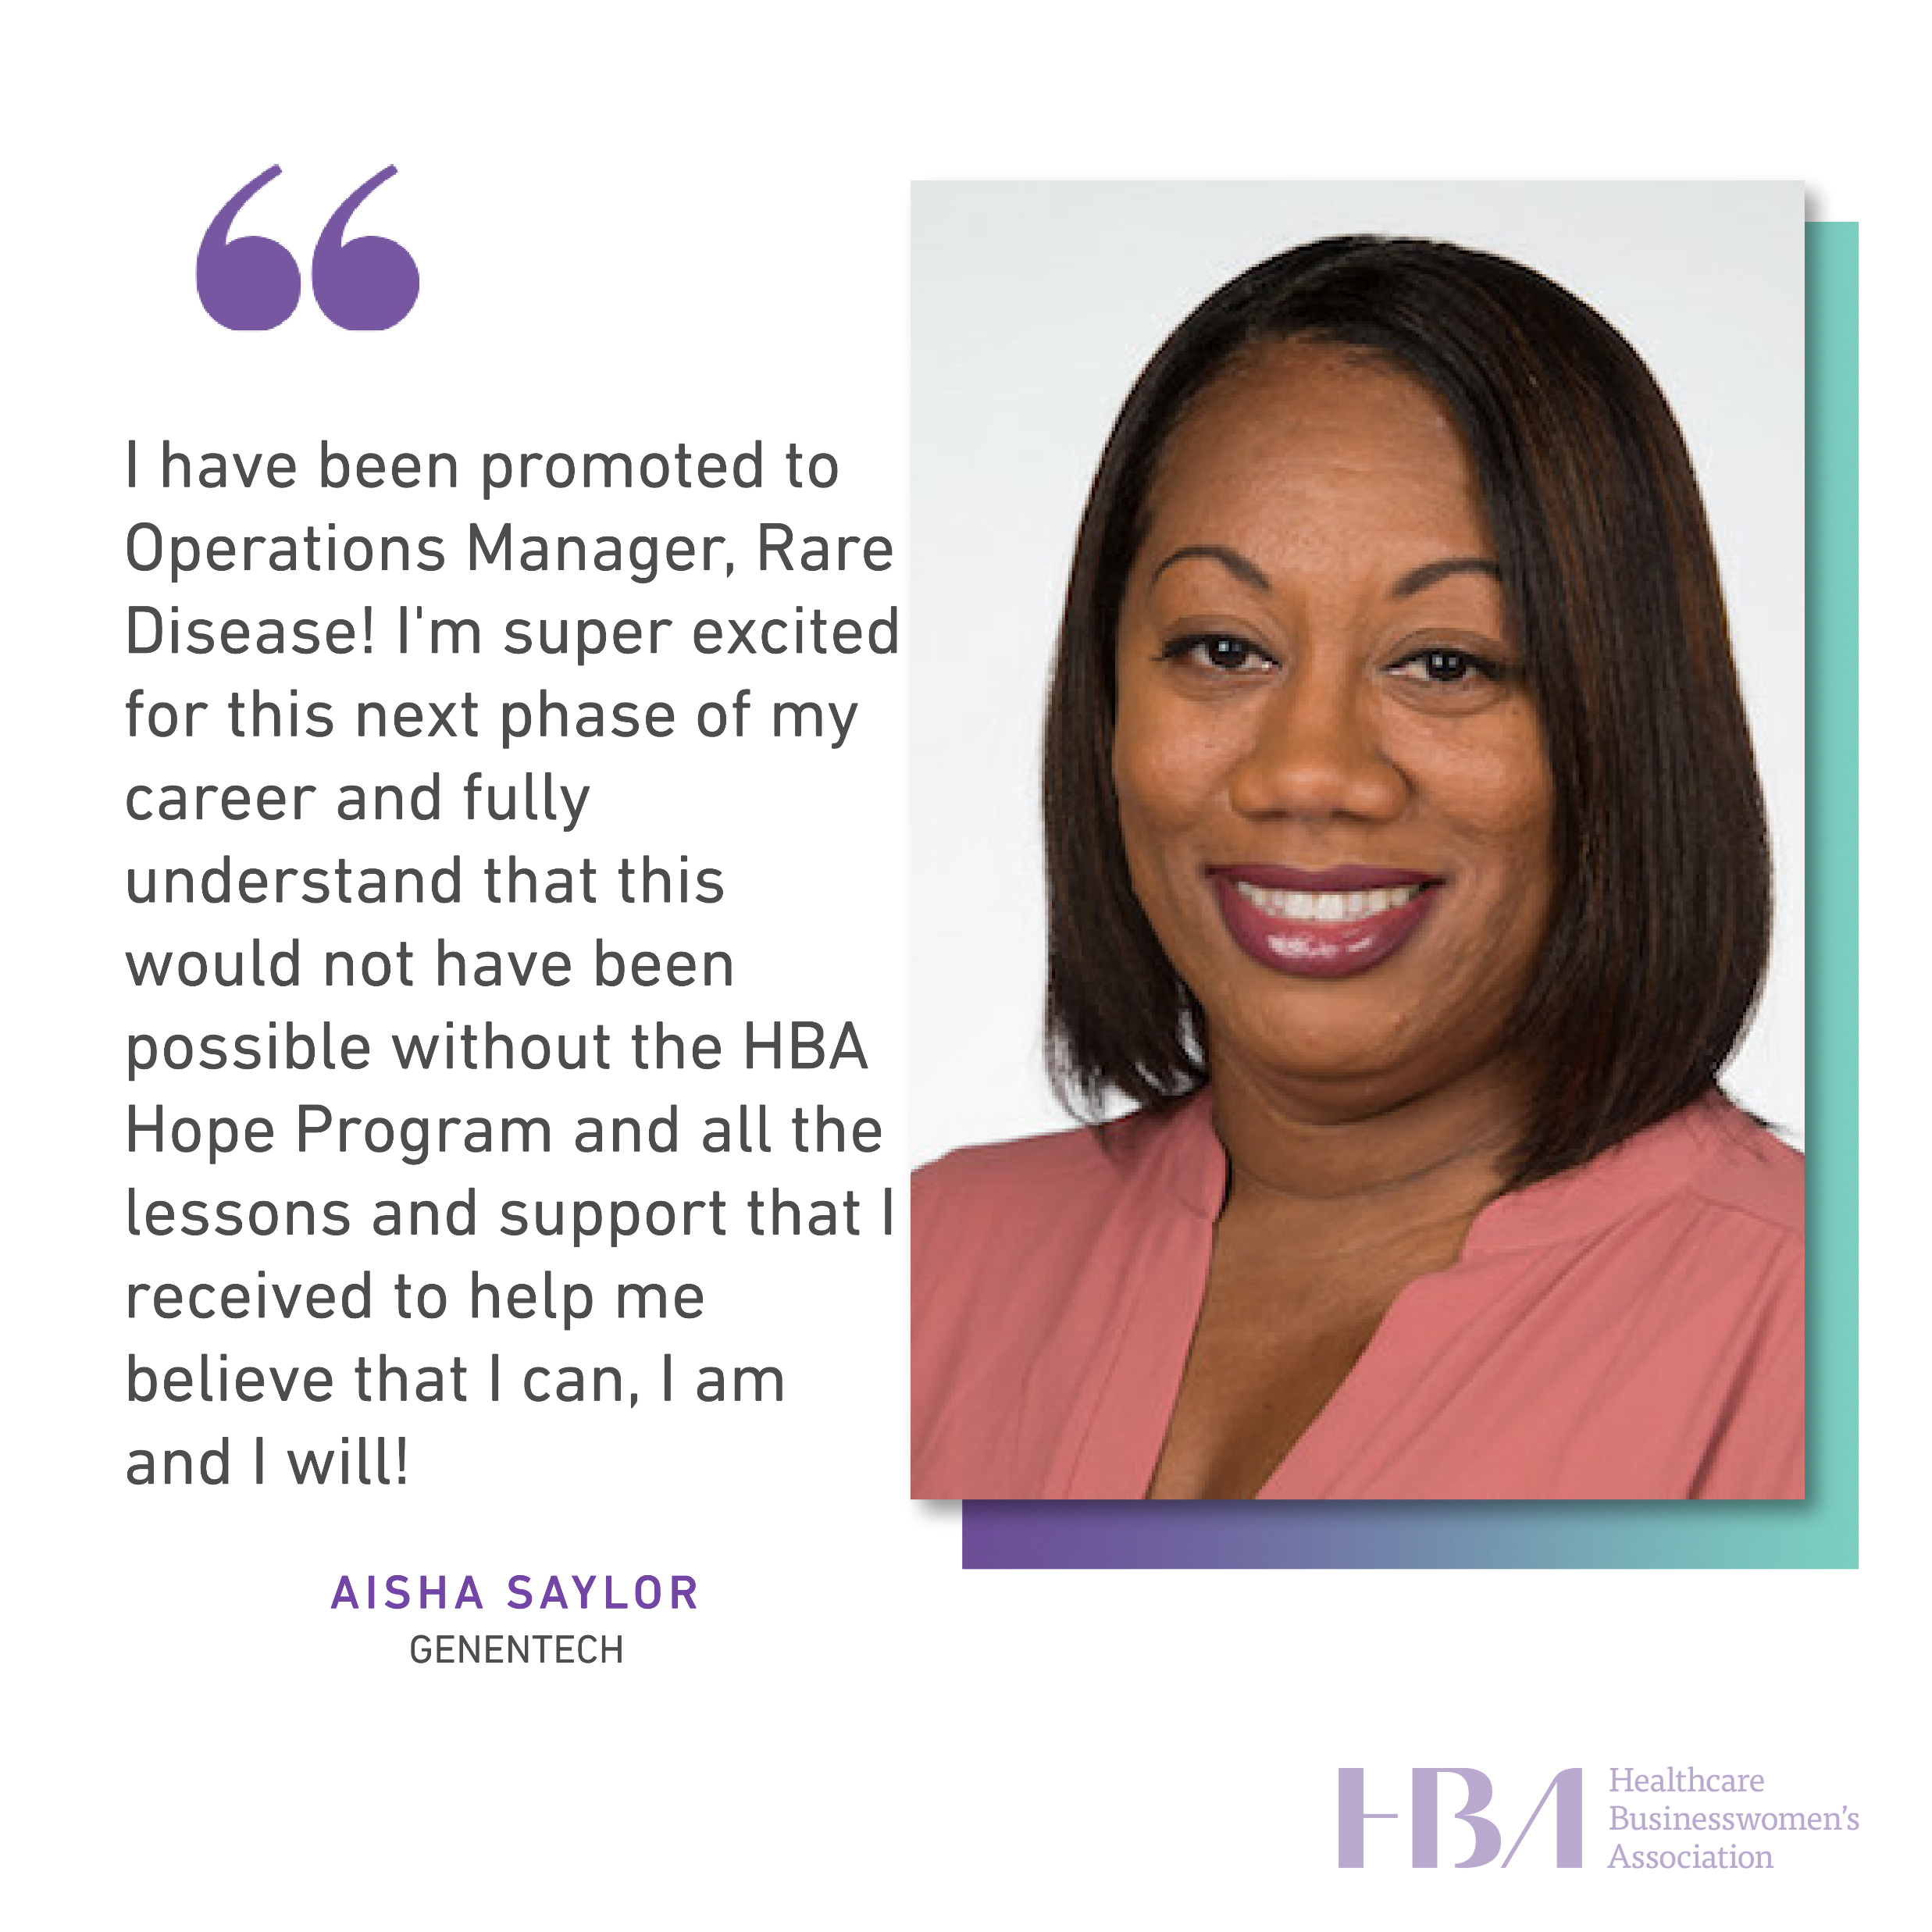
HOPE Program: Harnessing Opportunities for Partnership & Equity
HOPE is an intensive one-year leadership initiative targeting mid- to senior-level talent from underrepresented groups, including LGBTQ+, women of color, and women with ability diversity. In collaboration with HBA Corporate Partners and their high-potential employees, this program is designed to achieve the following for participants:
Cultivate Career Advancement: Empower participants to explore pathways to advance their careers within their companies.
Navigating Workplace Culture: Provide strategies and tools to navigate complex workplace cultures effectively.
Leveraging Unique Strengths: Enable individuals to harness their unique strengths, thereby increasing their visibility and value within their organizations.

Slide 23
Global Affinity Groups
HBA Affinity Groups are self-forming member communities centered around a shared purpose, interest, identity, and/or professional aspiration.
Engage in this free member benefit to expand your professional network, participate in exclusive virtual or in-person programs, and grow alongside a community of people who see, hear, and support you.

Slide 24
Signature Events

Slide 25
Woman of the Year Gala
Each May, the HBA convenes nearly 2,000 industry influencers in New York City to recognize exceptional individuals who have made significant contributions to the business of healthcare and been committed advocates of gender equity.
In addition to celebrating the Woman of the Year, the Honorable Mentor, and STAR, our community also salutes the 150+ Rising Stars and Luminaries nominated by their companies, HBA’s Corporate Partners.

Slide 26
European Leadership Summit (ELS)
For over a decade, the European Leadership Summit (ELS) has been the premier event for the HBA in Europe, the Middle East, and Africa, delving into healthcare industry issues and opportunities. It brings together professionals from various disciplines to advance gender equity in healthcare workplaces through knowledge sharing and collaboration.
With expert presentations, data insights, and networking opportunities, the ELS has become a vital forum for sparking ideas and fostering collaboration.
Its importance was underscored in 2023 when it drew attendees from over 100 companies across 23 countries.

Slide 27
Annual Conference
As a member-driven organization, the HBA delivers what members seek: leadership development, global networking, recognition, and a link to its nearly 50-year legacy.
Each fall, the Annual Conference embodies these fundamental elements and is a premier destination for nearly 1,000 industry professionals seeking connection, radical hospitality, and empowerment.
Attendees gain insights from keynotes, engage in transformative workshops, and network with influential leaders. Tailored programming offers numerous opportunities to network with industry leaders, and gain actionable insights for career advancement.

Slide 28
Building Better Business Connections (3BC)
HBA's 3BC half-day program nurtures a dynamic community of executive influencers committed to enhancing the impact of women leaders in healthcare and life sciences.
Exclusive to HBA Corporate Partners, 3BC consistently earns top ratings, making it one of our most coveted offerings.
Focused on transformation opportunities, 3BC empowers companies to harness the full potential of the female talent pipeline and elevate its impact and influence industry-wide.

Slide 29
Corporate Partnership

Slide 30
Lead the Way for Change
Join forces with HBA to accelerate the advancement of women in our ecosystem, becoming a beacon for top talent and achieving enduring business success.
Partnering with our United Force for Change delivers:
Enhanced business outcomes through internal talent development.
National recognition for your brand and leadership, spotlighting female achievements and internal programs.
Strengthened relationships with healthcare industry organizations.
Empowered women in your company, driving leadership development and growth opportunities.

Slide 31
Corporate Partner Benefits

Slide 32
Current Corporate Partners
*
*Partial Listing

Slide 33
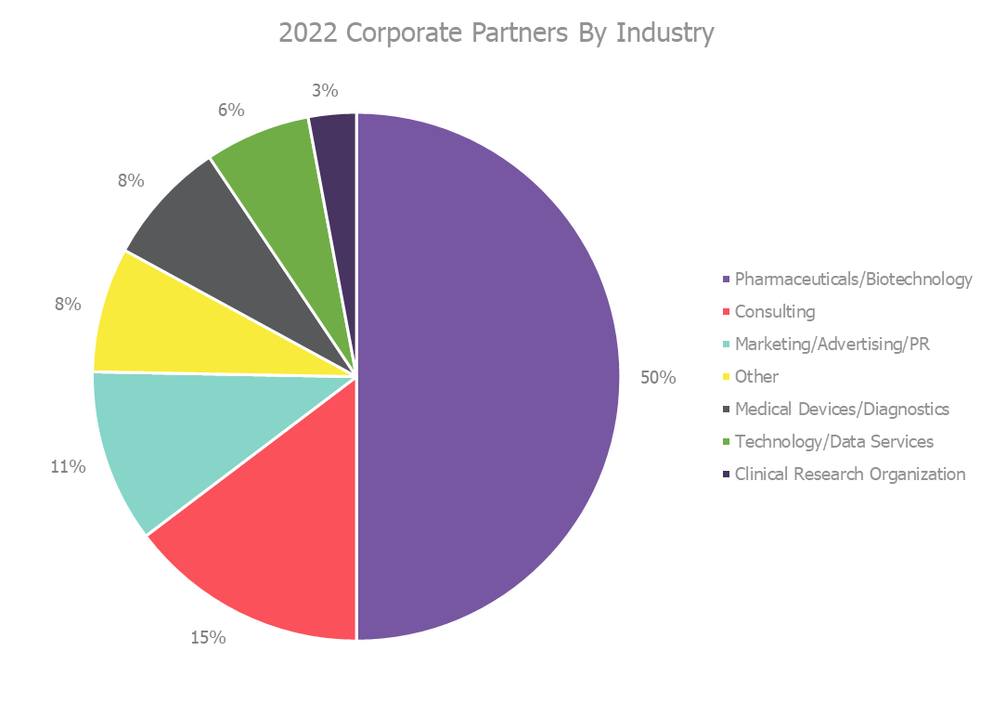
Corporate Partners by Industry

Slide 34
Corporate Partner Packages
Our corporate partner packages have been built to meet the needs and desires of all healthcare and life science organizations.
Choose the path for your company by visiting HBAnet.org/corporate-partners or emailing us at CorporatePartners@HBAnet.org

Slide 35
Rising Stars & Luminaries
Eligible corporate partner packages offer options to designate employee members as HBA Rising Stars and/or Luminaries. Award winners are honored at the annual May HBA Woman of the Year Gala and benefit from year-long visibility.
HBA Rising Stars are in the early stages of their career. The honor recognizes individuals’ outstanding performance, commitment to excellence, and valuable contributions to their companies’ success. The Rising Stars are inspiring leaders and are celebrated for their vision, dedication, and action.
HBA Luminaries are industry influencers with more than 20 years of professional experience, serve as a role model in their company, actively mentor and sponsor others, and are shining examples of transformational leadership that the organization wants to formally recognize.

Slide 36
ACE Awards
This annual accolade salutes company initiatives dedicated to championing equitable practices and empowering women in leadership roles. As our United Force for Change continues to disrupt traditional obstacles, we want to recognize programs aimed at propelling female talent forward and breaking the status quo.
Past honorees include programs championed by large companies and start-ups alike and range from broad initiatives like internal women's networks to targeted strategies addressing the gender pay gap.
All industries and company sizes are eligible to showcase their stellar leadership initiatives.

Slide 37
Global Ambassador Program
As a signature offering for HBA’s Corporate Partners, the Global Ambassador Program (GAP) provides leadership immersion to ‘fill GAPs’ in existing professional development opportunities internally and transcends existing ERGs to elevate women to positions of influence and decision-making.
The program also ‘bridges the GAP’ across Corporate Partners to:
Collect and share best practices on equity and inclusion
Foster community and connections among participating business professionals, resulting in robust HBA networks both internally and externally
Activate executives as allies and sponsors, enhancing their commitment as champions of DE&I and gender equity
Accelerate HBA’s growth in new markets

Slide 38
Gender Equity Think Tank (GETT)

Slide 39
TITLE
Tier 1
Tier 2
Tier 3

Slide 40
GENDER EQUITY THINK TANK
The Gender Equity Think Tank is an award-winning and growing consortium of healthcare and life sciences companies dedicated to accelerating gender parity by fostering and adopting systemic changes in the industry workplace.
Together, companies participating in the Think Tank commit to taking an active role in defining strategies, measuring performance, creating change, and inspiring others.

Slide 41
GENDER EQUITY THINK TANK
The Think Tank will drive and amplify conversations, and set goals to advance impactful progress on the following issues:
Holistic approach of addressing of equity for women in healthcare
Innovation in health equity by women
Social determinants of health
Women’s wellness globally
Global workforce of the future—engaging women earlier in the pipeline
Financial wellness for women

Slide 42
Questions? Contact [NAME].

