Slide 1
Frontier Airlines Crew Planning
Flight Attendant Initial Training
Notes:
We have 9 Crew planners for over 5700 crewmembers. Please refer to other FA’s, your contract and AFA. We are happy to help however we are outnumbered if everyone has questions.

Slide 2
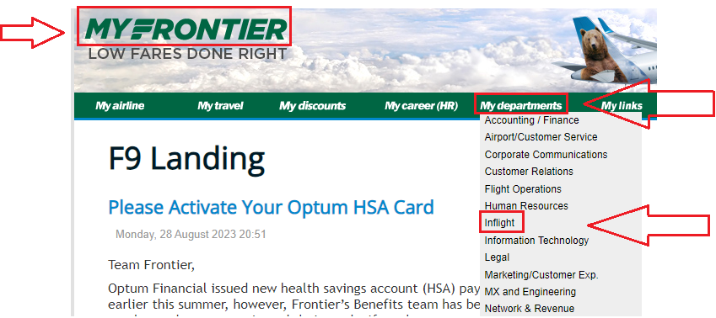
Accessing this presentation
Log into myfrontier.org
Select ‘Inflight’ located under ‘My departments’

Slide 3
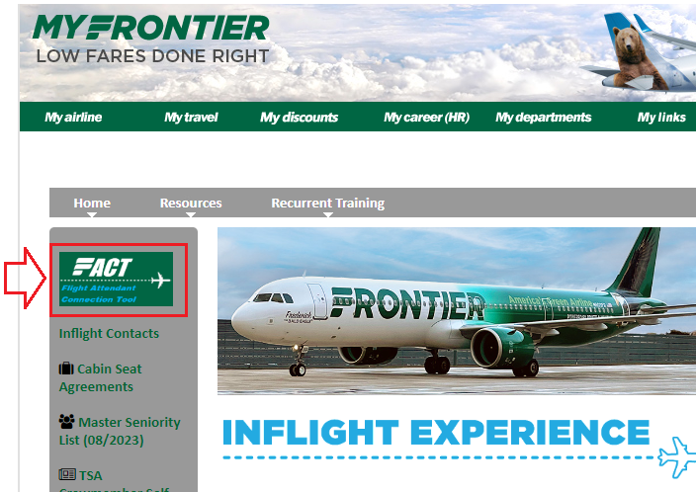
Accessing this presentation
Click on the ‘FACT’ page located on the left when on the inflight page

Slide 4
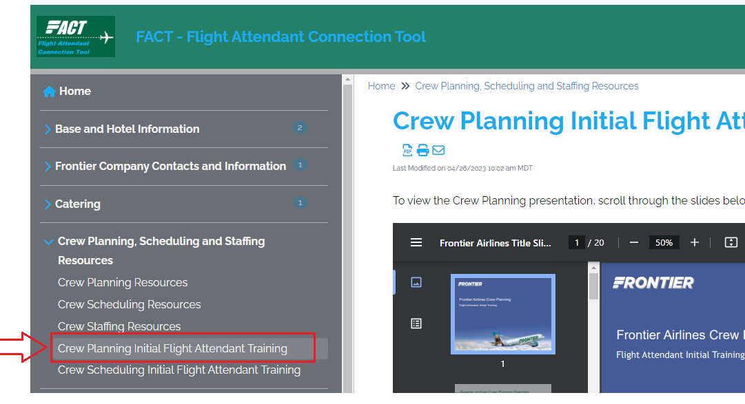
Accessing this presentation
Finally, under ‘Crew Planning, Scheduling and Staffing Resources, select ‘Crew Planning Initial Flight Attendant Training’.

Slide 5
Frontier Airlines Crew Planning Overview
Crew Resources Department
Crew Staffing (future) –Staffing analysis, future hiring decisions, system vacancy bid, and annual vacation bids.
Crew Planning (future) – Administer all the functions surrounding the building of monthly schedules (i.e. bidding for your schedule, vacation slides and recurrent ground school award, pre-award assignments).
Crew Scheduling (current) – Administer all the functions surrounding your schedule after it is awarded. (i.e. changes to your schedule, assigning trips, operational issues, etc).
Notes:
3 Departments under the Crew Resources Umbrella.

Slide 6
Frontier Airlines Crew Planning Overview
Crew Planning Tasks
Build Pairings (Trips)
Create the Bid Packet (list of trips and other important information)
Administer Preferential Bidding – Lineholder Bidding
Administer Reserve Preferential Bidding – Reserve Bidding
Vacation Slides
Recurrent Ground School Awards
Also process similar functions for Frontier Pilots
Contact us at: FAcrewplanning@flyfrontier.com

Slide 7
Frontier Airlines Crew Planning Overview
Crew Planning builds pairings (trips) that you fly based on schedule files that we receive from Network Planning. We run several different solutions in our pairing optimization program to ensure trips are built legally and where our staffing permits.
Each pairing number starts with a letter followed by a number.
D4001 (Denver trip)
M4523 (Orlando trip)
L4300 (Las Vegas trip)
B4135 (Tampa trip)
A4440 (Atlanta trip)
X4125 (Phoenix trip)
W4134 (Dallas-Ft. Worth trip)
O4015 (Cleveland Trip)
K4005 (Cincinnati Trip)
S4025 (San Juan Trip)
C4501 (Chicago trip) MDW/ORD Co-Base
T4111 (Trenton trip) TTN/PHL Co-Base
F4021 (Miami trip) MIA/FLL Co-Base
Notes:
Run several different solutions in the pairing optimizer and ensure trips are legally built and each base has correct hours based on staffing
Currently have 13 domiciles; three of which are co-domiciles. Can fly out of either airport for these pairings- make sure to know which airport.

Slide 8
Frontier Airlines Crew Planning Overview
Sample 1- 1 duty pairing, 4 position
Sample 2- 1 duty pairing co-domicile, 1 position, and Min Duty Credit (3.A.11) Note: TTN/PHL (T) trip operates out of PHL airport
Notes:
Report/Release Article 4.D
1 hour brief in domicile 50 minute brief times in outstations. 30 minute Debriefs everywhere.
More on pairing pay types--- Article 3.A.11-13

Slide 9
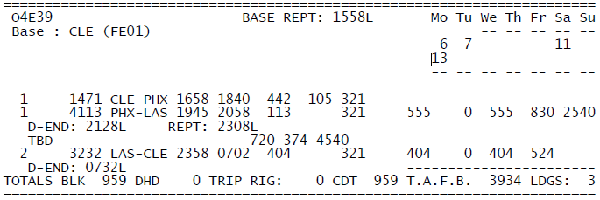
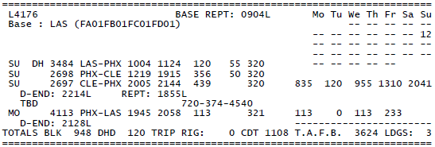
Frontier Airlines Crew Planning Overview
Sample 3: Multi-duty pairing (hotel), recurring
Sample 4: Multi-duty pairing (hotel) with deadhead
Notes:
O4E39 is a recurring pairing throughout the month (No days of week, instead uses day 1, 2, etc)
L4176 contains a DH on 1st segment of the pairing, then work PHX-CLE and CLE-PHX.

Slide 10
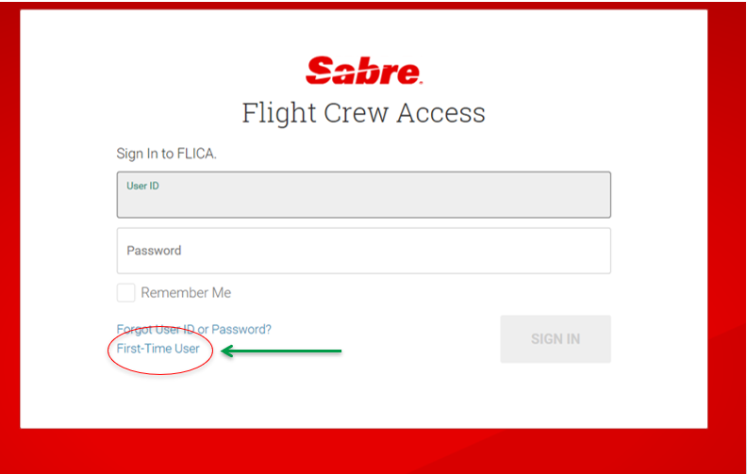
FLICA First Time User
Go to www.flica.net
User ID: fft(employee number) ie. fft123456
Initial password is your birthdate MMDDYY (ie. 021891)
Click on First-Time User at the bottom left of the window.

Slide 11
Setting up Access Anywhere
Default access to Flica may be set to ‘At Work’. This setting allows access to Flica ONLY from a company terminal (not from home or other locations).
Each user is encouraged to ensure the setting is set to ‘Access Anywhere’ so you can access Flica anywhere you have Internet access.
Notes:
Recommend just double checking ‘Access anywhere’ is defaulted

Slide 12
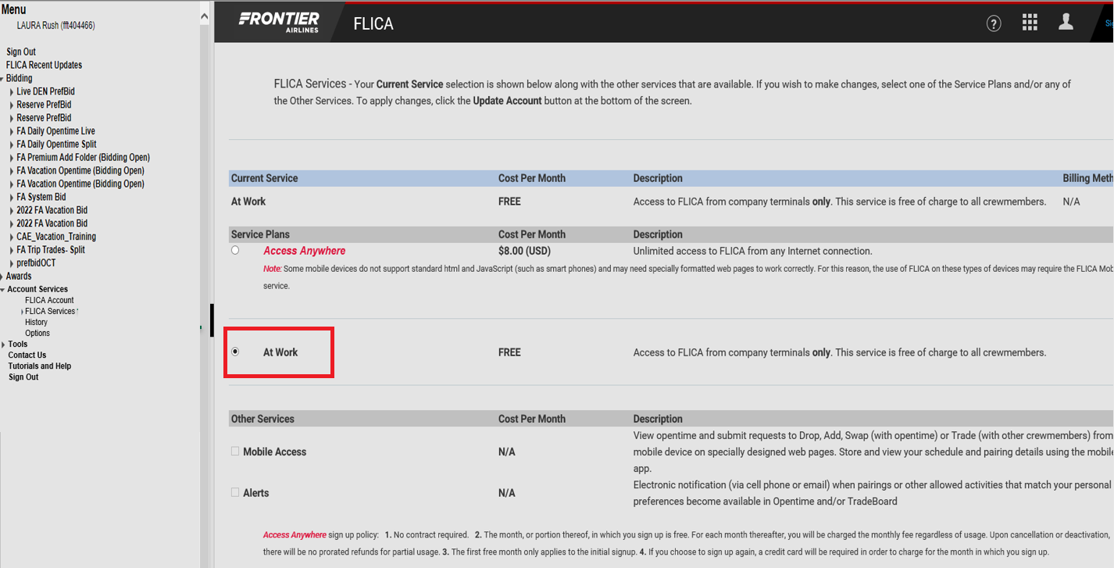
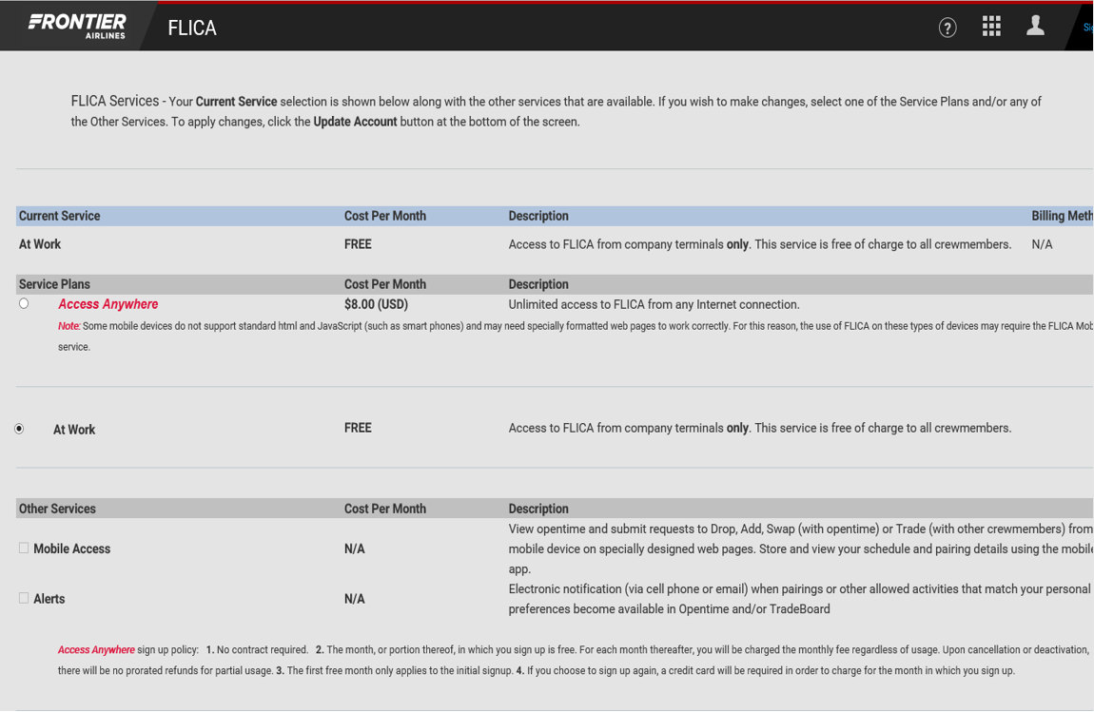
Setting up Access Anywhere
Select ‘Flica Services’ located under ‘Account Services’

Slide 13
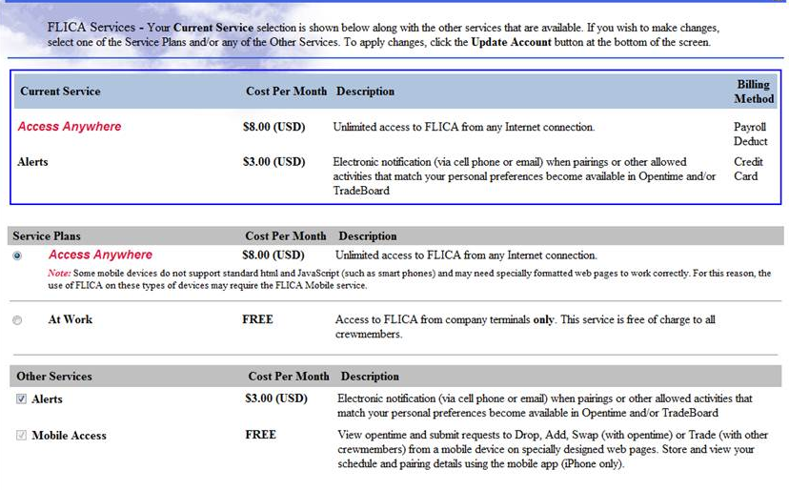
Setting up Access Anywhere
Make sure ‘Access Anywhere’ is selected. There is no cost for ‘Access Anywhere’.
Notes:
Note: Access Anywhere does not have a cost per month. ‘Alerts’ do have a cost if you want to use that feature.

Slide 14
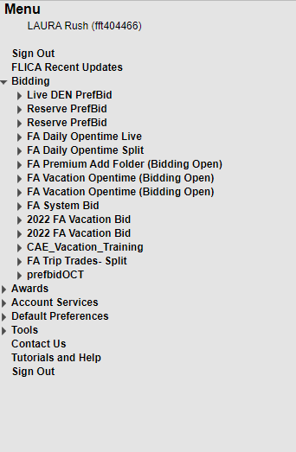
Frontier Airlines Crew Planning Overview
FLICA Crew Planning Folders
Notes:
Reiterated on next slide as well.
Initial Pref Bid opens 6th of Month at 1200Mountain Time, Closes on 12th at 1200. posted 16th at 1200
Reserve Pref Bid opens 6th of Month at 1200Mountain Time, Closes on 17th at 1200. posted 18th at 1200

Slide 15
Frontier Airlines Crew Planning Overview
Preferential Bidding and Reserve Preferential Bidding
Live Prefbid – Lineholder Bidding
- Bidding opens at 1200 Mountain Time on the 6th
- Bidding closes at 1200 Mountain Time on the 12th
- Bids awarded by 1200 Mountain Time on the 15th
Reserve Prefbid – Reserve Bidding
- Bidding opens at 1200 Mountain Time on the 6th
- Bidding closes at 1200 Mountain Time on the 16th
- Bids awarded by 1200 Mountain Time on the 18th
Notes:
If you want reserve, must bid voluntary reserve in live prefbid.

Slide 16
Frontier Airlines Crew Planning Overview
Preferential Bidding for Lineholders
Reserve Preferential Bidding

Slide 17
Frontier Airlines Crew Planning Overview
Important Monthly Bidding Information
Bid Packet is online in FLICA and emailed from Inflight
Update Page is in FLICA (valuable information)
Pre-award questions (RGS, VAC, COM, etc.)
If you're not active in FLICA folders for Initial Bids, Vacation, System Bid
Contact Crew Planning at FAcrewplanning@flyfrontier.com
Initial bid and award questions
Contact your AFA Scheduling Committee members at:
ORD/MDW
schedulingchi@afafrontier.org
MCO
schedulingmco@afafrontier.org
MIA/FLL
schedulingmia@afafrontier.org
DEN
schedulingden@afafrontier.org
LAS
schedulinglas@afafrontier.org
PHL/TTN/SJU
schedulingttn@afafrontier.org
ATL/CVG
schedulingatl@afafrontier.org
PHX
schedulingphx@afafrontier.org
DFW
schedulingdfw@afafrontier.org
TPA
schedulingtpa@afafrontier.org
CLE
schedulingcle@afafrontier.org

Slide 18
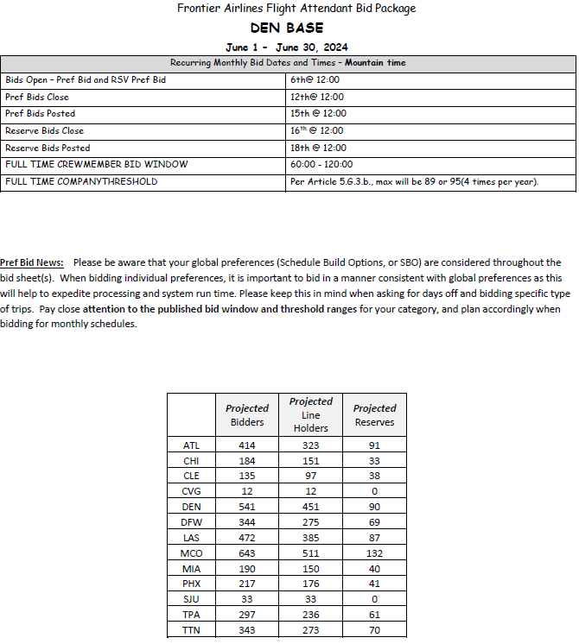
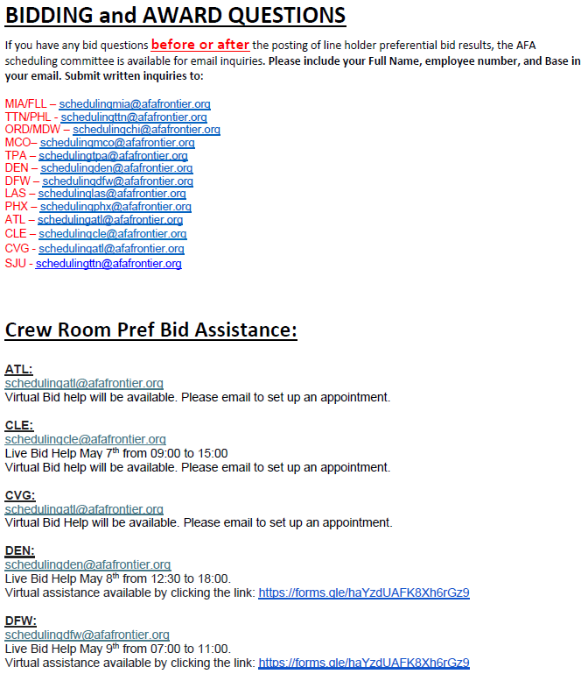
Frontier Airlines Crew Planning Overview
SAMPLE: Bid Package Update Page
Notes:
Key information: Bid dates, Open, Close, projected numbers, questions before or after bid and awards should be directed to AFA. They will then forward on any issues they see to crew planning. Another resource is the Crew rooms, times afa is available in person

Slide 19
Frontier Airlines Crew Planning Overview
Reserve Bidding “Tips”
Remember to keep your bid very “general” at this point due to your seniority.
You mainly want to bid for days off.
As your seniority goes up, you can add more specifics.
Your previous month will be considered in your bid.
For help with bidding, please contact your AFA representatives at their respective email addresses.

Slide 20
Frontier Airlines Crew Planning Overview
Bidding Reserve PrefBid
Article 6.A Reserve Flight Attendants – General Guidelines
Reserve lines will have a minimum of 11 days free from duty. 12 days off will be awarded four times during the year. Notice will be provided in the Bid Packet for the months when 12 days off are awarded.
Reserve lines will be constructed with a minimum of three consecutive “R” days.
Reserve lines will be constructed with two or more consecutive days off.
**Option to allow single days off**
**During the transition to the next month, the system may award a single day off or award less than three “R” days.
Must have one calendar day off every 7 days (max 6 days on in a row)
Notes:
Always awarded at least 3 days in a row.

Slide 21
Frontier Airlines Crew Planning Overview
Bidding Advice
Keep your bid simple, especially until you gain seniority.
Your previous month will be considered during your award.
Build your schedule on the calendar to see if your bid is even possible.
“A” Reserve Shift (0001-1300), “B” Reserve Shift (1100-2400)
Reserve PrefBid Award Sample
Note: Blank days are ‘off’ days, days with x are required ‘off’ days, green A or B indicate reserve days
Notes:
Always awarded at least 3 days in a row. Keep in mind months before and months after the bid. Not all bid months will be a calendar day.

Slide 22
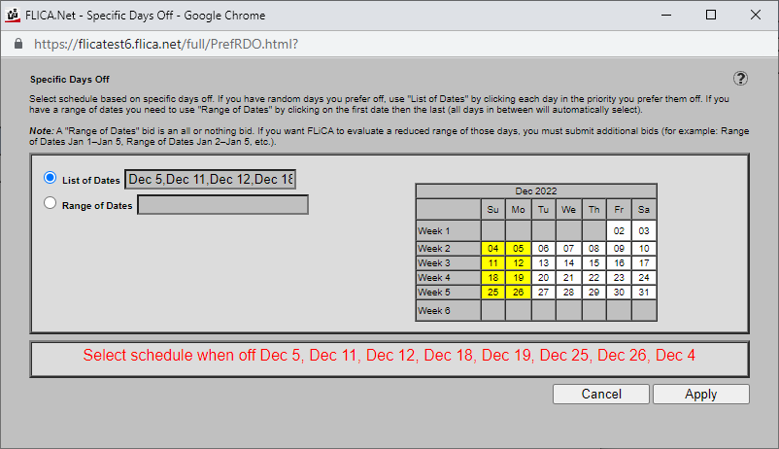
Frontier Airlines Crew Planning Overview
Example of a Flica reserve day off bid
This FA is asking for 8 days off in this bid
Notes:
Example of a reserve day off in an actual bid.

Slide 23
Frontier Airlines Crew Planning Overview
Your contract and Crew Planning
Article 5 Crew Planning and Crew Scheduling
5.H Initial Bid
5.I Pre-Award period
Vacation, vacation slides, RGS
Article 6 Reserve Flight Attendants
6.A General Guidelines
Provides guidance on how your reserve line will be constructed.
Article 9 Vacation
Article 13 Vacancies
13.A Standing Bids
If you’re happy in your base, PLEASE don’t submit a bid.

Slide 24
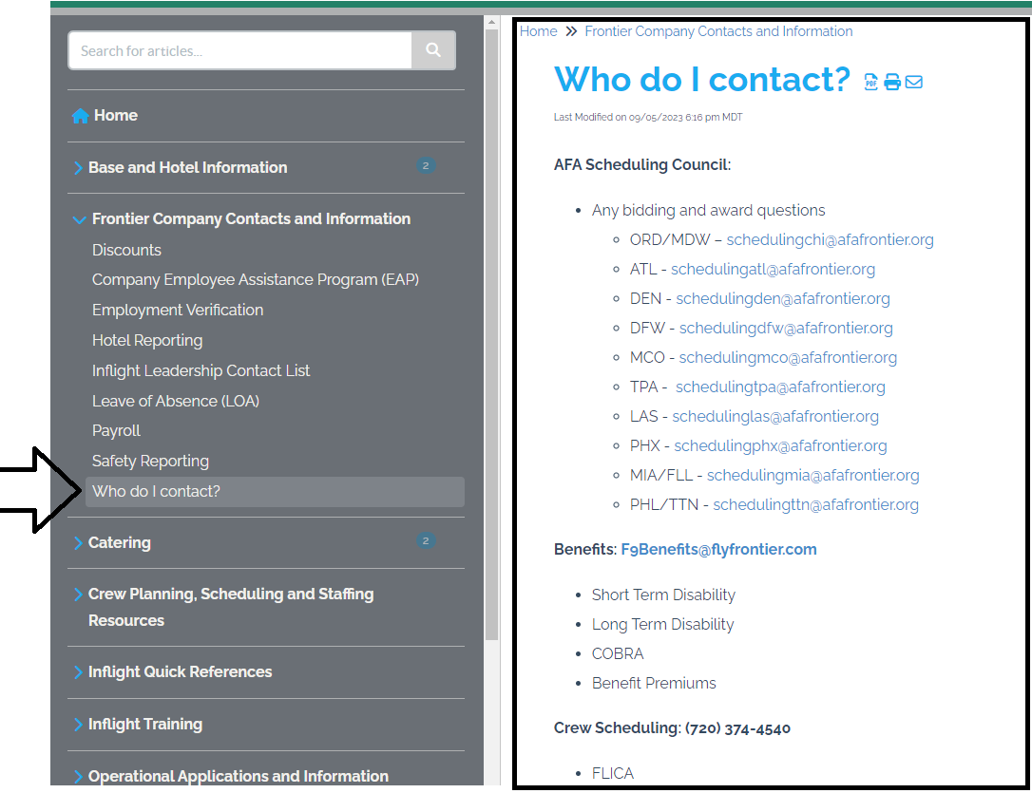
Who do I contact?
To help differentiate which department handles which tasks, we have added a ‘Who Do I Contact’ tab on the FACT page. Please reference this if you are trying to determine which department you should contact for specific items.
On the FACT page, locate ‘Frontier Company Contacts and Information’ on the left and select ‘Who do I contact?’
Notes:
To more quickly assist you we have made a document in the FACT page

Slide 25
Frequently asked questions and answers
FA Question: I did not get some days off that I asked for, can you please adjust my schedule for me?
Crew Planning Answer: Crew planning CANNOT alter your awarded schedule. We recommend using Flica to attempt to trade your schedule. If you need a leave of absence, please contact the proper department (See Who do I contact on FACT page). (Article 5.H.3.)
FA Question: If I am awarded a vacancy award, what happens to my future vacation that I have already been awarded in my current base? I want to keep that week.
Crew Planning Answer: As per the communications attached to the vacancy bids/awards and your CBA, any future vacations WILL BE dropped and you will need to rebid your vacation in your new base. (Article 9.A.5)
FA Question: I want to trade my reserve days/trips, can you help me with this?
Crew Planning Answer: Crew scheduling manages Flica folders after your schedules have been awarded. Crew planning is unable to assist with folders related to daily open time, trip trades, or aggressive reserve as examples.

Slide 26
Frontier Airlines Crew Planning Overview
Important Contacts -
FAcrewplanning@flyfrontier.com
ATL/CVG
schedulingatl@afafrontier.org
CLE
schedulingcle@afafrontier.org
LAS
schedulinglas@afafrontier.org
MIA/FLL
schedulingmia@afafrontier.org
PHL/TTN/SJU
schedulingttn@afafrontier.org
TPA
schedulingtpa@afafrontier.org
DEN
schedulingden@afafrontier.org
DFW
schedulingdfw@afafrontier.org
MCO
schedulingmco@afafrontier.org
ORD/MDW
schedulingchi@afafrontier.org
PHX
schedulingphx@afafrontier.org

