Slide 1
HBA Global Ambassador Program
I am bolder and have found my place at the table.
- Nyawira Njeru
Former BD Program Champion and
2023-2024 HBA Board Member
Overview for Corporate Partners

Slide 2
Agenda
HBA Global Ambassador Program Overview
Getting Started
The Ambassador Journey
Notes:
We’ll pause for questions between each section!

Slide 3
HBA Global Ambassador Program
The Global Ambassador Program (GAP) is the HBA’s premier corporate program for leadership development. Serving as a global resource for HBA Corporate Partners*, it offers leadership immersion to address gaps in current professional development opportunities. The program transcends existing ERGs, aiming to elevate women to influential decision-making roles.
The program also ‘bridges the GAP’ across Corporate Partners to:
Collect and share best practices on equity and inclusion
Foster community and connections among participating business professionals, resulting in robust HBA networks both internally and externally
Activate executives as allies and sponsors, enhancing their commitment as champions of DE&I and gender equity
Accelerate HBA’s growth in new markets
*Currently exclusively available for Purple, Gold, and Silver level Corporate Partners
Notes:
The program is the HBA’s premier corporate program for leadership development. It is a cost-effective tool to help companies develop a diverse bench of future leaders and aid talent retention through ongoing leadership training. The goal is to accelerate the leadership development, advancement, diversification, and visibility of an organization's emerging talent pool, providing cross-functional exposure and opportunities to grow.
It also bridges the gap…

Slide 4
How does it work?
THE RESULTS
For the Ambassadors:
Significant cross-functional exposure
Visibility
Confidence-boosting autonomy
Customized leadership development
Accelerated advancement
The HBA Global Ambassador Program is a 12-month self-directed leadership development program for 15-30 mid-level, emerging leaders (HBA members*), embedded in the workday, office-based or virtually. Designed to accelerate their advancement, the HBA and HBA-trained volunteer Advisors will empower and guide the ‘Ambassadors’ through the development and execution of:
Individual goals and leadership capabilities development to ready themselves for the next step on their career ladder
Group initiatives for the company, which empower the Ambassadors to explore their leadership potential in new ways and result in positive impacts and benefits across the organization
For the Company:
An engaged HBA Community internally
Customized task force for strategic priorities
Showcases inclusion initiatives
Positive impacts from group initiatives
Develops, diversifies, retains talent
*Many companies provide designee memberships to their Ambassadors, but the HBA can facilitate a bulk membership purchase if needed. Please contact us.

Slide 5
What’s included?
5
Live and virtual peer-support ‘communities of practice’ for:
Champions
Executive Sponsors
Executive Committees
Ambassadors
And Alumni
6
6+ hours of HBA-led live sessions to get set up for success
1
Live Launch event during a designated launch window
2
HBA-trained volunteer Advisors
1
HBA-trained volunteer Program Excellence Manager
30
Digital Badges to showcase Ambassador credentials
And exclusive access to:
The HBA GAP Resource Center
Ambassador Program events, content, and offerings
Notes:
Significant improvements in the program inclusions, and additional clarity to set expectations

Slide 6
The GAP Experience
Purple
Community of Practice
Advisor Office Hours and Meetings
Teal
Virtual/self-paced onboarding
Set/assess progress towards goals
Orientation
Leadership and Motivating the Cohort
Ambassador Selection and Launch Planning
Champion
Orientation
Opportunities and Best Practices*
Inspiration and Mentoring*
Executive Sponsor
LAUNCH
Alumni Communities
GRADUATION
Program Orientation and Goal Selection
Making Progress
Ambassadors
Leadership Orientation
Leading the Cohort*
HBA Advisor support with Program Excellence Managers (PEM) Check-Ins
Executive Committee
*future state
Notes:
Improved experience including training, communities, metrics, support along the way, and alumni communities

Slide 7
Why the Global Ambassador Program?
Empowers women and men to amplify their voices and become thought leaders for diversity, shifting the mindset towards proactive leadership through self-direction
Offers exposure and ongoing support on-the-job from internal and external industry leaders (HBA Advisors, peers, and senior advocates)
Operates independently with guidance from the HBA, leveraging key leadership, innovation and communication skills when interfacing with managers and other departments like HR to minimize operational burden; cost-effective compared to standard leadership training
Can collaborate with employee resource groups to enhance efforts and be an amazing platform to showcase DE&I initiatives to build company brand
Exclusive access to HBA Ambassador Offerings, such as the Ambassador Learning Center, Awards, Networking events and much more…
The HBA has over 100 individuals supporting nearly 50 programs, representing nearly 30 companies, resulting in a vast global network of support and connections.

Slide 8
GAP Impact
I discovered new leadership skills within myself, which gave me confidence and inner strength.
- Géraldine Wagner
Novartis Ambassador
Since inception in 2012…
Over 200 cohorts launched
Serving over 4,000 Ambassadors
Across over 50 companies
In 2023 alone…
45 cohorts launched
Serving nearly 1000 Ambassadors
Representing 19 companies
Across over 20 countries
And supported by 80 HBA Advisors
Resulting in a vast global network of support and connections
In one recent program…
13
One Third
(9 out of 27) received promotions during the course of the program.
Self-esteem is such an important value gleaned from the Ambassador Program. For many of our cohort members, it is a game-changer.
- Sharon Weinstein
HBA Ambassador Learning Center co-lead

Slide 9
Eligibility and Costs
Purple, Gold, and Silver HBA Corporate Partners are exclusively eligible for the Ambassador Program:
Partnership Level | Standard* Partnership Package Includes:
Purple | Three (3) active Ambassador Programs
Gold | Two (2) active Ambassador Programs
Silver | One (1) active Ambassador Program
A-la-carte programs for eligible Corporate Partners: $15,000​
*Number of programs in partnership package can be customized.
Additional fees may apply (All Ambassadors must be HBA members. If the program launch is held in person, your company will be responsible for the HBA Launch Leader travel/rooming costs). ​
Notes:
Ambassadors must be HBA Members.
HBA Partnerships include a specific number of memberships.
If additional memberships are required, high-level Corporate Partners are eligible for discounted memberships.
Corporate Partners must have active HBA partnerships during the 12- month course of the program.
If a partnership expires during the 12 months, the Ambassador program may also discontinue at the time of expiration.
Each Ambassador program will have 2 HBA Advisors assigned to the group for one year.
There are no costs for assigned HBA Advisors.
The Ambassador program can often provide speakers for fireside chats and panelists often at no cost.

Slide 10
Exclusive Offerings for Ambassador Companies
The HBA has a number of exclusive offerings for HBA Ambassador Companies and participants to take advantage of during the program:
Master classes and coaching through our Ambassador Learning Center
Annual award events
Networking events in conjunction with HBA Woman of the Year, the HBA European Leadership Summit, and the HBA Annual Conference
Also, as HBA members, Ambassadors have access to a wealth of HBA membership benefits, including:
In-person and virtual networking and educational events
Leadership opportunities within HBA chapters, regions, and other sanctioned groups
More at www.hbanet.org/membership

Slide 11
You’re Interested…Now What?
Please see the
GAP Activation Toolkit
to submit your intent to launch.
Step 1: build your team and collaborate with the HBA
Step 2: develop your program details
Step 3: submit your Activation Form confirming your intent to launch*
Step 4: Launch, Engage, Assess, and Graduate Your Emerging Leaders!
*The HBA sets multiple designated launch windows each year. Dates and deadlines can be found on the HBA Website.
Notes:
Upcoming launch windows
Sept/Oct 2024
For September launches, Activation forms are due by 30 June (hard/fast deadline: 15 Jul) – COP kicks off end of June/early July
For October launches, Activation forms are due by 31 July (hard/fast deadline: 15 Aug – COP kicks off early-mid August
Jan 2025
Forms due by 31 Oct (hard/fast deadline)
CoPs kickoff Oct/Nov
It is critical that Activation Forms are submitted by these deadlines to ensure your team is set up for a stress-free setup experience.

Slide 12
I stand here today with a sense of self-assurance that radiates in my day-to-day activities.
- Kristin DeWitt
Daiichi Sankyo Ambassador
Questions?
Next up… guidance for getting started
This program has been a game-changer, providing me with a unique opportunity to break down barriers [silos] and collaborate with key stakeholders across my organization. This exposure has been incredibly valuable, prompting a significant shift in my mentality and allowing me to incorporate fresh approaches in my current role.
- Megan Hernandez
athenahealth Ambassador

Slide 13
Getting Started…
Why launch windows?
Leans into peer-support
Builds cross-company connections
Increases transparency and collaboration
Allows for clear, manageable timelines
The HBA GAP launches new programs multiple times each year during designated Launch Windows.
These launch windows form an HBA Community of Practice, led by the HBA GAP, and bringing together company leaders involved in the setup of each program for peer-support, guidance, and sharing of best practices.
January
February
March
April
May
June
July
August
September
October
November
December
Launch Window 1
Setup
Program Running
Launch Window 2
Setup
Program Running
Launch Window 3
Setup
Program Running
Launch Window 4
Setup
Example of launch windows
Notes:
Community and networking is what HBA is the best at, and the GAP will build your community for you
Also, clear timeline and expectations, walk step by step through the process w peers

Slide 14
The GAP Setup Process
Step 1: Submit Activation Form
Step 2: Select Ambassadors
Step 3: Plan Launch event
Step 4: Determine cohort focus(es)
Step 5: LAUNCH!
Automated form makes it easier for companies to provide HBA all we need to know to start the setup process on their own time/at their own pace (some pre-work required)
[Champion] Enhanced by peer Communities of Practice, and armed with numerous tools, resources, and best practices to help make it easy
[Executive Sponsor] Provides the framework to ensure group initiatives achieve game-changing results for the organization, supported by HBA
A robust 3- to 4- hour live event experience to ensure the program is kicked off with gusto
Notes:
The HBA has simplified our program setup process, and we will support you each step of the way. Lets review some of the top-level details to ensure you’re set up for success

Slide 15
Setting up for success
Please refer to our Executive Sponsor and Champion One-Pagers for additional information.
It is critical to pre-determine the key individuals supporting the Ambassador Program internally at your company so the HBA can best orient and support them through the process.
Executive Sponsors
The senior executive supporters of the program who:
Champions
The key internal success drivers of the Ambassador Program who:
Provide strategic guidance and framework for group initiative ideation
Assist the program in identifying key stakeholders and open doors for budgetary needs, HR or legal approvals, etc.
Inspire and mentor the cohort to excel, providing helpful feedback during meetings and progress presentations
Identify 1-2 Executive Sponsors per cohort
Strategically and tactically plan the program’s setup and launch**
Oversee cohort progress via collaboration with HBA Advisors and by leveraging situational leadership to motivate the group
Serve as a conduit of communication to the Executive Sponsors
Identify 1-2 Champions per cohort
*HBA membership is also strongly recommended for these key roles. HBA profiles are required.
**The HBA also recommends identifying 2-3 lower/mid-level employees (a ‘Program Launch Team’) support the Champion(s) in the logistics of the launch planning in return for participation in the program’s professional development opportunities.
Notes:
To get set up for success internally however, some pre-work is needed. Firstly…
The HBA will work especially closely with your program Champions through invitation to our Community of Practice sessions, which will walk them step by step through the program setup process and where to find tools and resources to make it easy.

Slide 16
What is a Community of Practice?
A forum to enhance the diversity, scope, and richness of the HBA Ambassador experience through shared knowledge and best practices for all participants, both external and internal.
The HBA will deliver our Communities of Practice via a combination of live meetings and virtual Community forums.
*Note: the Champion Community of Practice for program setup is 6 sessions across 8-12 weeks. Attendance is critical for setup success
Notes:
Our launch windows effectively create cohorts of cohorts, all setting up to launch TOGETHER – a COP which can work together, learn from each other and benefit from HBA’s setup guidance as a group. The HBA will walk your Champions step by step through the setup process on a series of 6 sessions across 8-12 weeks. On these sessions prior to launch, we’ll go through the program setup milestones, discuss best practices, share guidance, answer questions (ex: ‘what does mid-level translate to at my company’), and provide helpful resources for every task at each step of the process. Post launch, these communities of practice will continue and provide a forum for the Ambassadors as well, for professional development, connections and guidance during the program.

Slide 17
How to recruit
Executive Sponsors
Tap senior HBA partnership advocates
Previous HBA Luminaries
Former IWN or ERG leadership
Champions
Previous HBA Rising Stars
Previous Ambassadors (if the program has been run before)
IWN or ERG emerging leaders: Are there individuals looking to step up, step out, or do something that is outside the ERG but still a massive benefit to it?
Put out a call on internal comms channels
Please refer to our
Executive Sponsor and Champion One-Pagers for additional information.
Notes:
Please refer to our ES and Champion one-pagers, which describe whats in it for the individual, additional qualifications, role responsibilities and other guidelines you can utilize in the selection of these roles

Slide 18
Setting up for success
Please refer to HBA’s Activation Toolkit for additional information and guidance.
Once your Executive Sponsors and Champions have been determined, it’s time put some thought into your program details, specifically:
Preliminary Launch Details
Program Composition
Which upcoming launch window?
Target launch date?
Launch format (virtual/in-person)
Preliminary program focuses
Program composition (geography, business unit, etc)
Preliminary Ambassador Criteria
Cohort size and needs
Notes:
We highly recommend utilizing the HBA’s Activation Toolkit when determining these details. The toolkit includes helpful details about the program that will help you make the best decisions for your company and your Ambassadors. HBA has also provided a number of best practices that have been built over the years such as the recommendation that Ambassadors not span more than 6-8 time zones, or our recommendation that Ambassadors have at least conversational English to reap the maximum benefits from the program as our COPs are conducted currently in the language.

Slide 19
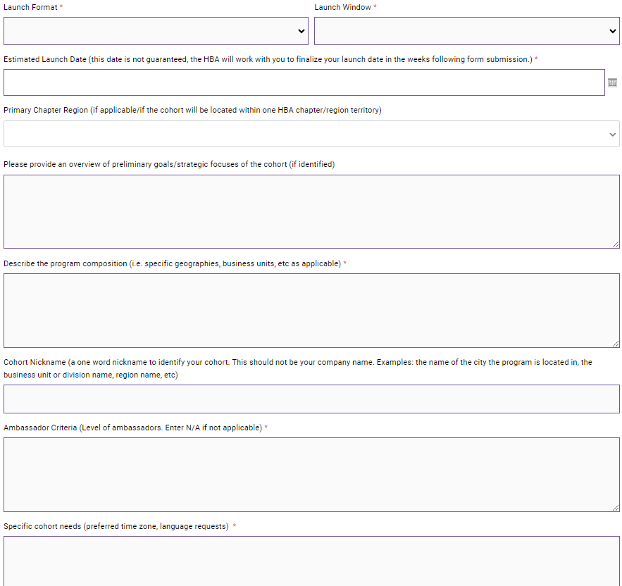
The GAP Activation Form Submitting your intent to launch
Once you have determined these items, it is time to indicate your intent to launch by submitting a completed GAP Activation Form.
The HBA GAP Activation Form is an easy way to provide the HBA all the information needed to begin the setup of your program. Multiple programs may be launched simultaneously, however a separate form must be submitted for each program.
Please utilize our Activation Toolkit, which provides significant additional detail about this process and helpful guidance.
Notes:
The form itself is simple, and will ask you to provide these details and indicate the Executive Sponsors and Champions associated with your cohort

Slide 20
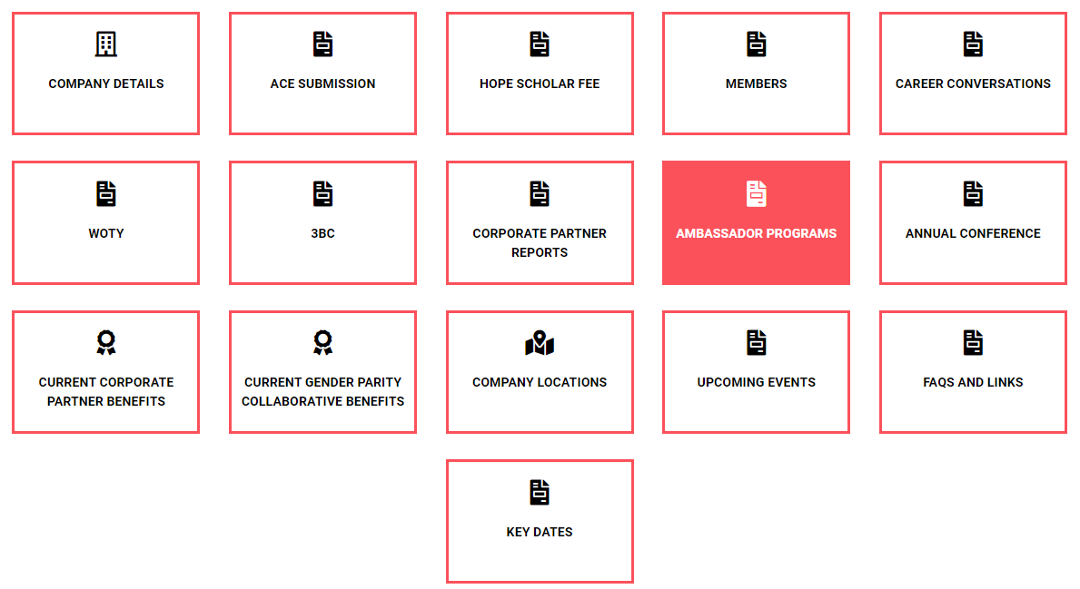
GAP Activation Form
Activating a program in an HBA Corporate Partnership
Only designated partnership contacts have access to activate the programs.
To activate, please visit the HBA Corporate Partner Portal in your HBA profile and select ‘Ambassador Programs’
Please note: if you are not a partnership contact, please connect with them to determine if any programs remain. Your company’s primary contact name can be found in your HBA Profile under My Company > Company Details.

Slide 21
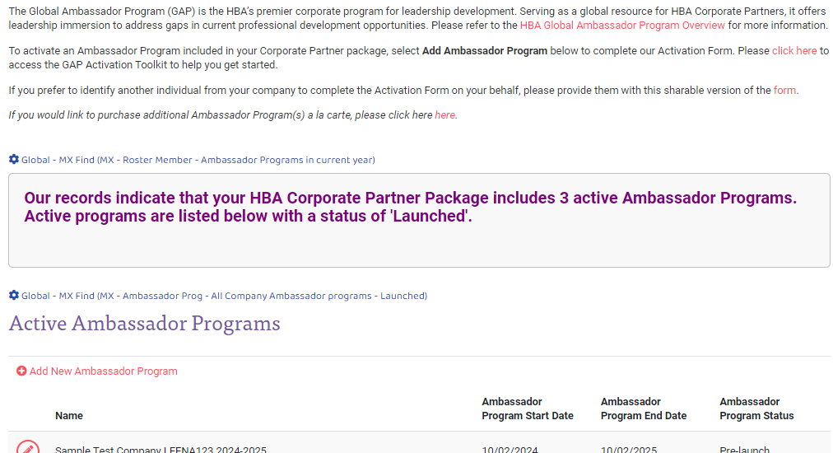
GAP Activation Form
Activating a program in an HBA Corporate Partnership
Within the Ambassador Program section of the CP Portal, designated contacts may:
Click the “Add New Program” button to complete the Activation Form themselves
OR copy the Shareable Link and provide it to a trusted contact to complete the form.
Shareable Link
Add New Program
If you would like to purchase an additional program a la carte, please click here. Once processed, the form will be sent to you via email with your purchase confirmation.

Slide 22
What happens after submission?
Soon after submission, Champions and Executive Sponsors will receive communications with:
Their tools/resources to get started
Access to the HBA GAP Resource Center
Community of Practice schedule of live meetings to get set up for launch
The HBA will:
Assign Advisors, Program Excellence Manager, and Launch Leader, making introductions once assignments are made
Host Community of Practice Sessions to support you through the setup and launch of your programs

Slide 23
[The team] has been ignited with a wave of enthusiasm, active participation, and also enabled collaboration among employees across our organization.
- Gabriella Caravello
speaking on the Syneos Health Argentina Cohort
Questions?
Next up… the Ambassador Journey
I have discovered a stronger core skill in strategy, and leading teams to navigate through ambiguity.
- Nana-Ama Amaning
J&J Ambassador and 2024 HBA Rising Star

Slide 24
The Ambassador Experience
Set Career Goals
Develop Group Initiatives
Build Leadership Capabilities
HBA Ambassador Community of Practice
Orientation
HBA Advisor support
Goal selection and self-assessment
Ramp Up
MVP Presentations (as needed)
Making Progress
LAUNCH
Ramp Down
HBA Alumni Communities
GRADUATION
Mid-program progress presentations
Final presentations
Mid-program self-assessment
Leadership Orientation
Final self-assessment
Executive Committee
Internal leadership team
Champions
Oversight and motivation of the cohort
Executive Sponsors
Inspiration and mentoring of the cohort
Notes:
The overall program experience will primarily focus on setting individual career goals, brainstorming and bringing to life big ideas via the group initiatives, and building the leadership capabilities along the way that you need to reach your goals
After orientation, the program officially kicks off a the launch, where the cohort will bond, ideate and begin to self-organize to ready themselves as a group for the journey. After launch, the first ~45 days are the ramp up period, where additional research, cross-collaboration, and ideas refinement takes place to finish honing the group initiative ideas and often culminating in an MVP (or minimum viable product) presentation to the executive sponsors. At the same time, the groups self-selected Executive Committee begins to lead the group, and your Champions are there for oversight and motivation, and executive sponsors provide inspiration and mentoring. This time also begins the HBA Ambassador Communities of Practice, where the HBA will help you navigate the HBA to make the most of your experience, provide opportunities for learning, and provide opportunities for networking and best practice sharing. Your HBA-trained volunteer advisors also begin their roles, working closely with the executive committee to provide guidance and help maintain momentum.
Progress continues on group imitative work and capabilities development for the majority of the program, punctuated by a mid-program self-assessment and mid-program presentations of progress. The final ~45 days is the ramp down period, where work is being finalized, executive summaries are developed, Ambassadors complete their final self-assessment, and, if needed, sustainability or hand-off plans to continue progress post-program. The program culminates with a Graduation, where the Ambassadors can gather to share their progress, report on final results, and celebrate. Post-Program, HBA’s Ambassador alumni communities will provide a way to stay connected and engaged with the HBA and your fellow Ambassadors

Slide 25
Goals and Self-Assessments
Ask yourself – where do you want to be by the end of this journey? How will you get there?
Select 1-3 Career Goals
Increased scope: additional job responsibilities within current position
Achieve new role: promotion or up-level opportunity gained
Cross-functional collaboration: successful completion of project in or with another cross-functional area
Personal brand: substantial expansion of sphere of influence internally and externally
Executive demeanor & delivery: increased confidence and authentic, professional self-presentation necessary to support consideration for the next level of management
Executive support: develop senior advocates and mentors internally/ externally
Subject matter expertise: substantially advance knowledge and/or recognition in preferred subject-matter area
Increased Global Exposure: across the organization via a new role or project
and
Self-Assess Across HBA’s Leadership Capabilities
Notes:
As mentioned, much of the professional development you’ll receive during this program will be experiential via leadership immersion, however the HBA does put an emphasis on building leadership capabilities to help you get where you want to go. So the program will ask you to start with the end in mind – where you want to go? Where do you want to be at the end of this journey? choose 1-3 career goals that you hope to reach. AND then you’ll complete a self-assessment of yourself across HBA’s Leadership Capabilities framework. Once you’ve completed your assessment, you’ll want to select a few growth areas to focus on during the course of the program through your day-to-day program work, as well as through the HBA organization, as all our events and offerings are mapped to this framework. By focusing on developing your capabilities in your growth areas throughout the program, you’ll set yourself up to reach each of your career goals

Slide 26
Leadership Opportunities
During the launch, time will be dedicated to group discussion of the cohort’s organizational needs. There will be opportunities to enhance your program participation by self-selecting into a leadership role:
Executive Committee members: the leaders of the cohort overall, collaborating to oversee cohort and initiative advancement, manage Ambassadors, and report out progress towards goals
Team Leads: lead each of the cohort Group Initiatives, developing plans, overseeing team members in the execution, tracking and reporting on progress
Notes:
The Ambassador Program encourages people to step up and self-select into leadership roles, as this amplifies the opportunities for development, and there is ample opportunity to do so. There are opportunities to participate as a member of the executive committee… and as a team lead…

Slide 27
Group Initiatives
During the program, you will be asked to brainstorm and collaborate to bring big ideas to life to solve real challenges. These big ideas are the Group Initiatives. Here are a few examples of an identified problem, and the proposed initiative developed to solve it.
Problem/Issue | Proposed Initiative*
Outdated company policy on flex-time, impacting recruitment and retention of employees with children. Need external models from other companies that adhere to government and company requirements | Create a task force and bring in experts to review and model their country specific program that worked. Seek to make a formal proposal to policy holder group for company or department.
No one to go to in the company to get advice from and get ready for interviewing and gaining advocate support for internal positions that are posted. | Create a small group of internal interview coaches that are available to all company employees at the site. The Ambassadors provided training for these coaches from the Ambassador committee and HBA resources and design in sustainable process for on-going use.
Newer employees do not have access to a network of decision makers and thought leaders | Determine how onboarding of new hires are built and the Ambassadors propose an additional 30 minute segment that cohort designs to introduce key leaders in their department / company to showcase what their roles are from a strategic standpoint.
Feeling unknown in the company, because long term employees have their own network and most functional areas in the company stick to themselves | Create a cadence of on site or virtual events with Ambassadors as moderators, panelists, organizers. Invite long term employees to participate and be presenters. Ambassadors to influence actions to cross-fertilize functional silos with vigor and purpose.
Notes:
The HBA Global Ambassador Program Group Initiatives represent a visionary approach to strategic problem-solving. These initiatives foster co-creation and collaboration, harnessing real-time innovation to address gaps, create multiple options for challenges, and cultivate solutions that nurture the next generation of leaders.
During the program, your cohort will work on 2-3 group initiatives for the company, in most cases from initial ideation to completion. Group Initiative focuses vary widely and can address any element of DE&I, career or professional development, work/life, company culture, leadership delivery, etc. Employee-focused initiatives benefit the individual, which results in organizational success.
Throughout this process, you’ll cultivate a diverse skill set, which includes:
Visualization: The ability to conceive and communicate abstract concepts.
Adaptation and Pivoting: The skill of modifying approaches based on real-time feedback and changing circumstances.
Experimentation, Testing, and Refinement: A culture of constant improvement through iterative testing and analysis.
Prototyping: Transforming concepts into tangible prototypes to evaluate their viability.
Overcoming Challenges: The aptitude to confront obstacles and setbacks with optimism, approaching them as opportunities for growth and innovation.
You will be provided a framework within which you can ideate – you may be presented a challenge the company is facing, a focus area to ideate within, or a partially developed initiative to carry forward. No two initiatives are exactly the same, and it will be up to you and your cohort to brainstorm, develop plans and move forward in the execution of each of your program’s initiatives.

Slide 28
Shifting the Mindset
In the weeks following Launch, you cohort will likely be:
Selecting team leads
Refining group initiatives and charters
Conducting necessary research to inform planning and direction
Cross-functionally collaborating, and requesting necessary approvals
And often conducting MVP presentations: are the ideas really viable?
The HBA Advisors and Community of Practice will be there to support you during this critical period, along with internal support from your Champions and Executive Sponsors.
Notes:
… are the ideas really viable? These first few weeks after launch are the most exciting and critical to setting the cohort up to make progress. But they are also designed to be a challenge and stretch your leadership capabilities. This program may be your first time ever feeling empowered to be a leader, and this will be your first foray into self-direction and developing your unique leadership style.
It may feel uncomfortable if you’ve never been in a position like this before. The HBA, via our volunteer Advisors and Communities of Practice, with collaboration and support from your program champions and executive sponsors will support you through this process and help you navigate through challenges. The goal is to make you feel empowered to make decisions such as selecting leaders, refining ideas, and developing plans independently. This challenging experience is actually what instills THE AMBASSADOR MINDSET, which we’ll review in more detail in the next orientation module.

Slide 29
Support on the Journey…
Communities of Practice
Volunteer Advisors
GAP Resource Center
ALC
Notes:
You will not be going through this alone! Your company and the HBA is here to support you on the journey. Lean on your teammates, and take advantage of what the HBA has to offer
Participate in the HBA Communities of Practice (live sessions and online Community forum)
Lean on your HBA-trained volunteer Advisors
Leverage the GAP Resource Center
Explore the Ambassador Learning Center (or ALC) which includes Master Classes and Coaching
Get to know the HBA overall, and how our robust network and offerings can support you along the way

Slide 30
What is expected of you?
Be engaged – you get out what you put in
Prioritize program meetings including cohort meetings, group initiative meetings, HBA Communities of Practice and exclusive HBA offerings
Don’t forget to focus on your own capabilities development
Keep your manager informed of progress so they can support you on your journey
You can expect to dedicate ~2 hours per week to program-related activities
Notes:
Now you’ve heard what to expect of the program, but what is expected of you as an Ambassador? Like all good things in life, you will get out of this program what you put in, so be engaged and raise your hand to try new things.
Set aside time to ensure you’re making progress in your growth areas
Work it into your IDP

Slide 31
I found that the time spent within this program really provided me with a safe space to explore my potential in new ways… [the program] also taught me the essential skills and techniques I need to look at challenges from different perspectives.
- Manesha Shedh
Johnson & Johnson Ambassador
Thank You

Slide 32
Table of Contents
Who does what?
Role definitions
Program process and phases
Tools and Resources
Launch

Slide 33
What Does Each Party Do?
Identifies Advisors and PEM; and completes internal program administration; preps Ambassadors for the experience
Kicks off Communities of Practice for Setup; orients company roles and participants; provides access to GAP Resource Center
Assigns Launch Leader for launch; works with Champions to finalize Launch agenda
Launch Leaders leads launch, other HBA reps participate; set expectations and guide decisions
Advisors meet regularly with executive committee to help guide and advise
Program Excellence Manager checks in with Advisors and executive committee at regular intervals to ensure progress and satisfaction
Launches program mid- and year-end surveys; analyzes results and provides back to cohort for inclusion
Advisors guide graduation needs; the HBA Program Excellence Manager works with champions (and HBA staff) on re-launch
Identifies internal core team, program needs and Ambassadors; Completes Activation form indicating intent to launch
Works with Launch Leader to determine launch date and communicate internally; plans launch event
Recruits and selects Ambassadors; provides framework for group initiative ideation
Executive Sponsors, Champions and Ambassadors participate in launch; Ambassadors determine governance and initiatives
Cohort executive committee meets regularly with HBA Advisors to determine cohort needs / keep group on track
Cohort meets monthly/quarterly for progress updates, bonding and professional development
Cohort works throughout the program on individual goals and selected group initiatives; complete mid-and year-end assessments; exec committee presents results to Executive Sponsors
Exec committee plans/executes graduation needs; Champions work with the HBA to determine re-launch details
Your Company
The HBA

Slide 34
Role Definitions Company roles
Executive Sponsor (1-2 needed) : senior executive (usually VP or higher) supporters of the program, providing budgetary support and strategic guidance when needed. Provides guidance and framework for group initiative ideation, and inspires and motivates the cohort to excel. Provides feedback and mentorship during progress presentations.
Champion (1-2 needed): the key drivers of the Ambassador Program internally, working to strategically and tactically plan the program’s setup, launch, and monitor progress. Typically director / senior director level, with some visibility and pull within the organization. They are usually driven deeply involved in diversity, equity, and inclusion (DE&I) initiatives, viewing them as advantageous for personal, company, and broader community benefits, and may have even tried other leadership development programs to fill training gaps. Candidates with HBA experience or lower-level candidates with exceptional motivation and diverse professional backgrounds, such as cross-functional or global experience, may also be considered. Lead a team to execute the launch.
Ambassadors: the participants of the company’s current program cohort
Executive Committee: five to six Ambassadors who self-select into the leadership team of the program; works closely with HBA advisors to ensure group is making progress towards goals
Team lead(s): individuals who self-select into leading one of the identified group initiatives or functional committees.
Cohort: refers to a group of Ambassadors participating in a company’s current, particular Ambassador Program

Slide 35
Role Definitions HBA roles
*Program Excellence Manager – the key program contact from the HBA
HBA-trained volunteers are assigned to serve to one or more HBA Corporate Partner companies and are responsible for overseeing the Ambassador Program(s) within those companies. The Program Excellence Manager (PEM) manages the relationship with the company’s internal Ambassador Program contacts; starts up new programs, facilitates program renewals, and ensures overall program quality; and acts as the primary connection point for the programs, staff, participants, advisors and HBA regions/chapters. Program Excellence Managers are not the advisors who guide the cohort participants through the program.
Every Ambassador Program company is assigned one HBA Program Excellence Manager
*Advisor – guides the cohort
HBA-trained volunteer leaders assigned to each Ambassador cohort, working closely with the executive committee, driving the group and ensuring the cohort is making progress towards goals. Advisors are assigned and introduced to the cohort pre-launch, are often involved in pre-launch conversations, and take part in the launch when able. Each Ambassador cohort has two HBA Advisors.
Every Ambassador Program is assigned two HBA Advisors
HBA Regional or Chapter leadership – your local partners in collaboration
When programs are running in an existing HBA chapter or region, the Program Excellence Manager will make the connection to the local leadership team to ensure the cohort has access to all the benefits of the location and to collaborate. The local region/chapter can also provide HBA overviews (called Lunch and Learns) to employees within or outside of the Ambassador cohort to help individuals get the most out of the organization.
Launch Leader – leads/executes the launch
An HBA leader with significant experience in leading Ambassador Program launch events. The Launch Leader will lead the full launch event from start to finish, ensuring the program is set up for success

Slide 36
Corporate Partner
HBA
Global HBA Partnership
Key Contact
Account Manager
HBA Central
Ambassador Relationship
Executive Sponsors
Internal Program Management Team
HBA Program Excellence Manager
Global Ambassador Committee
Champion(s)
Executive Committee
Program Advisors
Ambassador Program
Ambassador Program
Local Regions/ Chapters
Collaboration
Benefits to other employees
Notes:
How all parties work together and interface

Slide 37
Setting up for Launch
(~2 months prior)
Launch (Program kickoff)
Program Ramp-UP (Months 0-3)
Maintenance (Months 3-12)
Re-launch (Months 9-12)
Setting up your internal team
Preliminary launch details
Launch preparation
Program setup and governance
Group initiatives determination
Executive committee and cohort meetings
Group initiative team leads established
Participant engagement
Mid-year assessment and presentation to executive sponsors
Tracking towards goals
3 months prior to program end
Establish next cohort needs/basics
AM participation for partnership renewal
Graduation (Program end)
Ambassador selection, onboarding and individual goals determination
Determining program strategy, composition and specifics
Activation
(2+ months prior)
Kick off HBA Ambassador Communities of Practice
Kick off HBA Communities of Practice
Program Process and Phases
Repeat for next cohort
Year-end assessment and presentation to executive sponsors
Ambassador graduation
HBA next steps

Slide 38
Additional Tools and Resources
The current Playbook is being significantly streamlined, removing all substantial detail and best practices to helpful program kits based on role/task.
Where are all the resources from the Playbook going?
They will be housed in a brand new HBA Global Ambassador Program Resource Center, a knowledge base* organized to make it easier for participants to find what they need as they walk through the process.
*Knowledge Base will be password protected for enhanced intellectual property security.
Notes:
Another improvement will be additional tools and resources. The Playbook, while so helpful to get us through this last year, will be significantly streamlined.
The new version of the playbook will simply contain:
A program overview with timelines and expectations
High-level role information (who does what)
High-level phases and tasks
But where is all that great guidance going? To the NEW Global Ambassador Program Resource Center, of course!

Slide 39
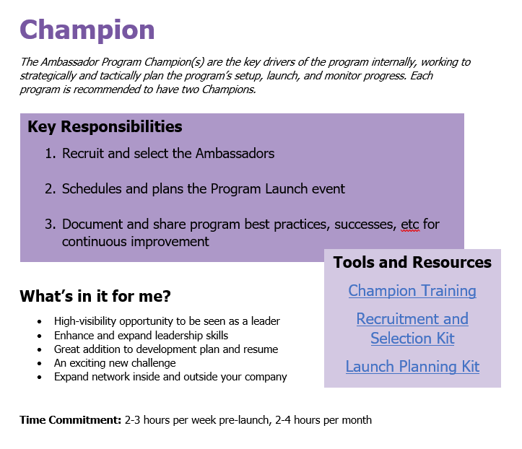
Resource Center and Tools
Will include 80+ new and revised tools, resources, and articles!
Role sheets will provide each individual clarity in their role, responsibilities, and the tools to do it quickly and easily
Resources readily available to complete responsibilities
Simplified responsibilities
Resource Kits include best practices, documents, tools and resources organized by task to make things easy
A clearly defined WIIFM
Notes:
The resource center will house numerous new and existing tools and resources, organized to maximize ease.
And that 80+ number is likely a gross underestimation given all the articles that will be created to house current playbook content!

Slide 40
Launch
The program Launch makes a big impact in one 3-4 hour session.
Agenda
Introduction from the Champions: Setting the stage for the Launch and HBA intros (10 mins)
Breakout session: Networking/individual goals discussion (20-30 mins)
Introduction from the Executive Sponsors: Delivering the problem statement and inspiring the cohort (~20 minutes)
Breakout session: Group initiatives ideation (~40 mins)
Group initiatives discussion: Narrowing in on top ideas (45 mins)
Interactive group session: Self-organization of the group and what to expect the first 45 days (40 mins)
Launch next steps and close from Champions

