Slide 1
Champion Community of Practice
Presentation 5.0
08/2/2024
Champion Community of Practice
This presentation can be found in the
Ambassador Program Resource Center

Slide 2
Agenda 5.0
Champion Key Milestones
Leadership Skills
Review: what to send in advance
Individual Objectives IO’s!
Core Capabilities
Champion Gravitas
Resources
Q & A

Slide 3
Ambassador Acceptance Letter
Click HERE
Dear [Applicant's Name],
Congratulations! We are thrilled to inform you that you have been accepted into [Company Name}’s upcoming HBA Ambassador Program. Your dedication and enthusiasm have truly stood out, and we are excited to have you on board.
As we embark on this journey together, please be sure to:
Mark your Calendar: The official launch of the program will take place on [Launch Date] at [Launch Time] in [Launch Location]. Include additional information on any other required pre-launch activities.
Inform your manager: Please take a moment to notify your manager of your acceptance into the program and reaffirm your commitment. This step ensures their support and understanding of your participation and incorporation into your individual development plan. Here is a template you are welcome to use.
URGENT ACTION NEEDED: to kick off your participation, it is critical that you:
Verify your HBA membership status or join/renew your membership. [If applicable: include HBA Corporate Partner designee or bulk membership purchase code so Ambassadors can easily join/renew their membership.
Register for our Ambassador Program cohort via HBA. Please click here to access our program’s registration page [link to unique cohort registration link, which can be found in your Activation confirmation email]
Please click here for helpful instructions to guide you through these steps.

Slide 4
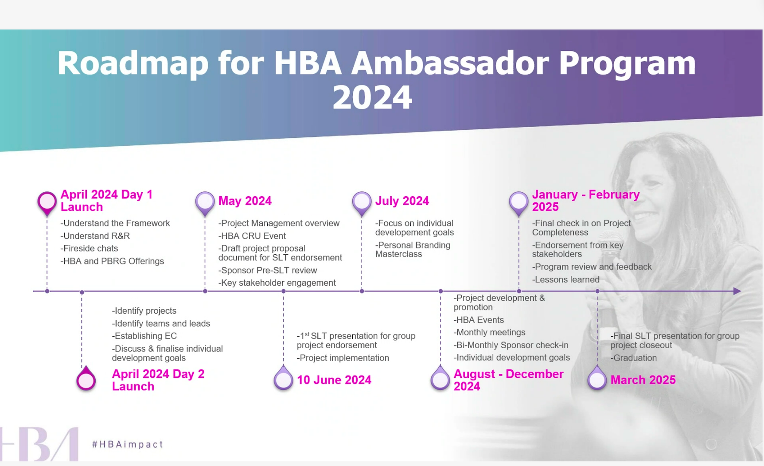

Slide 5
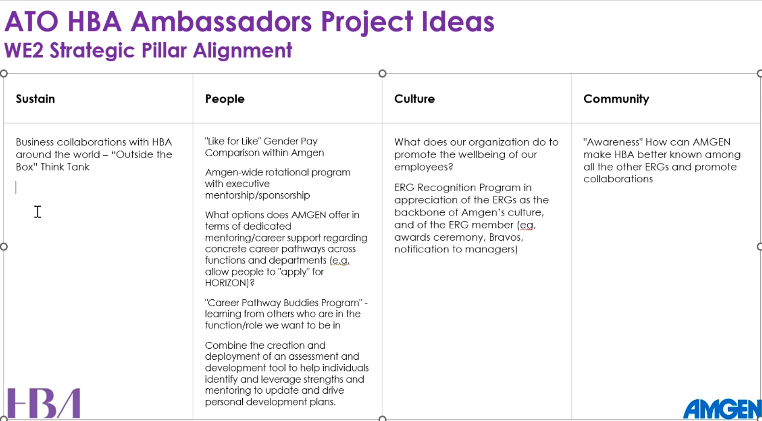
Send in Advance: Group Projects Ideas

Slide 6
What are your career goals?
At the end of your Ambassador journey, there will also be an opportunity to assess your overall career progression in the following areas.
  Additional job responsibilities within current position OR promotion to a new role
  Successful completion of project in another cross-functional area
  Personal Brand - substantial expansion of sphere of influence internally and externally
  Executive presence - additional experience internally/externally
  Develop senior advocates and mentors internally/externally
  Subject matter expert - substantially advance knowledge/ recognition in selected area
  Increase Global Exposure across organization via new role or project

Slide 7
Joining the HBA
Registration link: here is the URL for your Ambassadors to register for this cohort once selected. Here is a helpful article with guidance for the Ambassadors to verify membership and register for the cohort.
Over the next few weeks, the HBA will be in touch with next steps and additional information to get started. If questions or needs arise, please contact us.
We look forward to supporting you in the launch of your upcoming program!
Best Regards,

Slide 8
Where is my Registration Link?
HERE is the Registration Link

Slide 9
Launch Agenda and Slide Template
HERE is the launch agenda and slide template in the Resource Center

Slide 10
Launch Agenda and Slide Template
HERE is the launch agenda and slide template in the Resource Center

Slide 11
Masterclass Resource Link
HERE

Slide 12
Self Assessment and Goal Selection
HERE

Slide 13
Send in Advance…Individual Objectives
Individual Objectives List
Each ambassador is encouraged to collaborate with their manager to choose realistic, measurable, and attainable goals.
Goal Choices (Choose 1-3):
Additional job responsibilities within my current position.
Successful completion of project in another cross-functional area.
Personal Brand - substantial expansion of sphere of influence internally and externally.
Executive Presence - additional experience internally/externally.
Develop senior advocates and mentors internally/externally.
Subject matter expert - substantially advance knowledge/recognition in selected areas.
Global Exposure - increase across the organizations via new role or project.

Slide 14
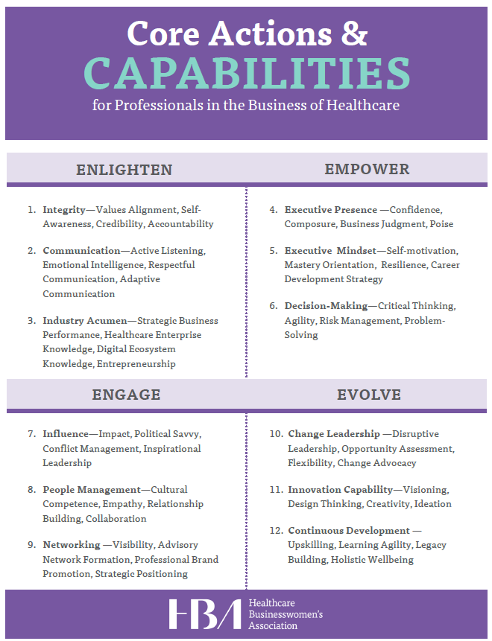
Individual Objectives Resource

Slide 15
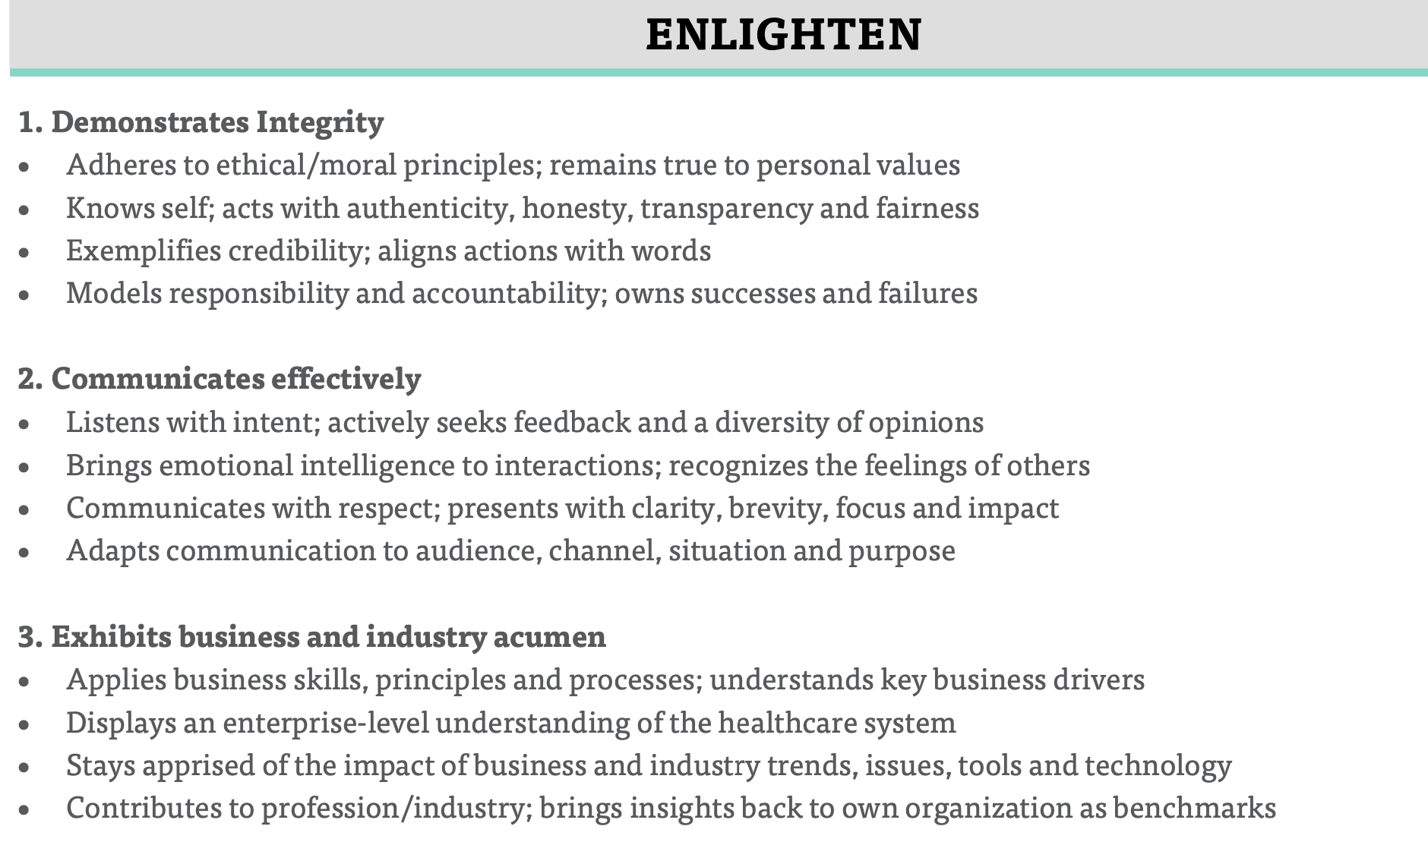
Enlighten

Slide 16
Enlighten

Slide 17
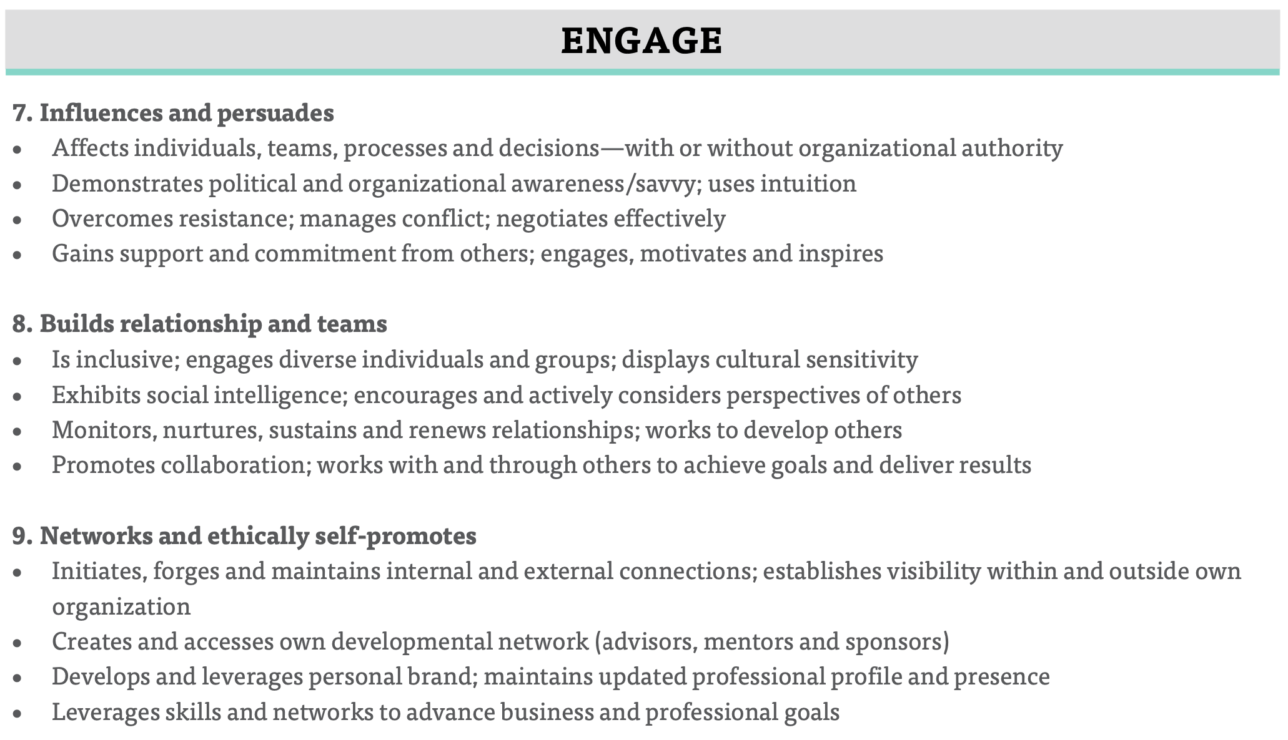
Engage

Slide 18
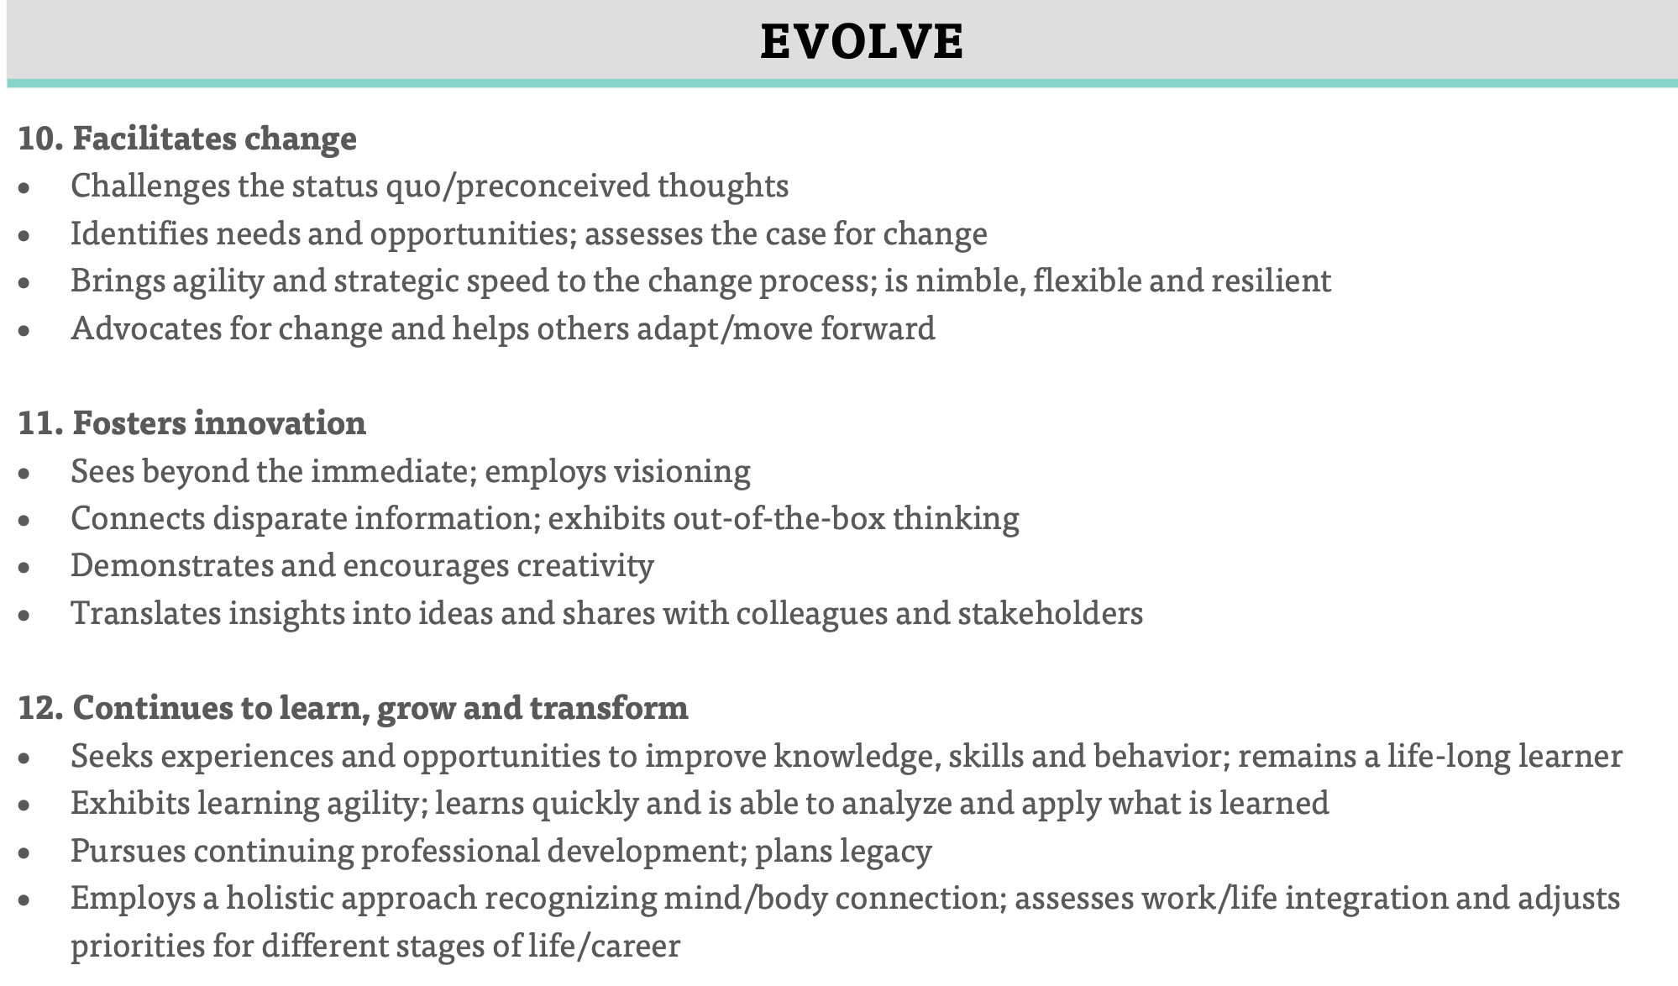
Evolve

Slide 19
Leadership Checklist
An abiding willingness to embrace uncertainty.
An urgency to capitalize on business opportunities.
Confidence and optimism, with a focus on action.
Patient, persistent, and passionate about company purpose and mission.
Build diverse teams as a priority.
Study others’ leadership moments.
Solicit coaching and mentoring.
Accept stretch experiences.
The Leaders Checklist. Dr. Michael Useem

Slide 20
Definition of Leadership Presence
Leadership presence is the ability to consistently and clearly articulate your value proposition while influencing and connecting with others.
All technical capabilities being equal, presence is what sets true leaders apart.
It enables them to adapt to any situation and connect in a significant way with their key stakeholders, all the while keeping sight of who they are as individuals.
Su, Amy Jen; Maignan Wilkins, Muriel. Own the Room

Slide 21
What Signals Leadership Presence
Status and reputation
Physical appearance
Projected confidence
Communication ability
Engagement skills
Integrity
Values
Intellect
Ability to deliver outcomes
Leverage coercive power when needed
Over Time-->
American Psychological Journal. Dagley and Gaskin.

Slide 22
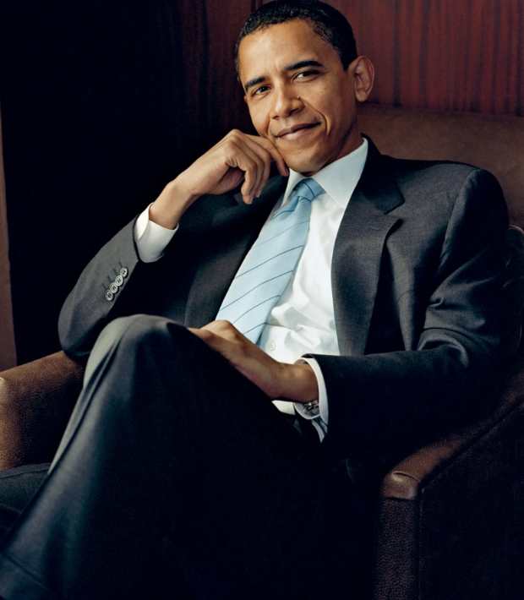
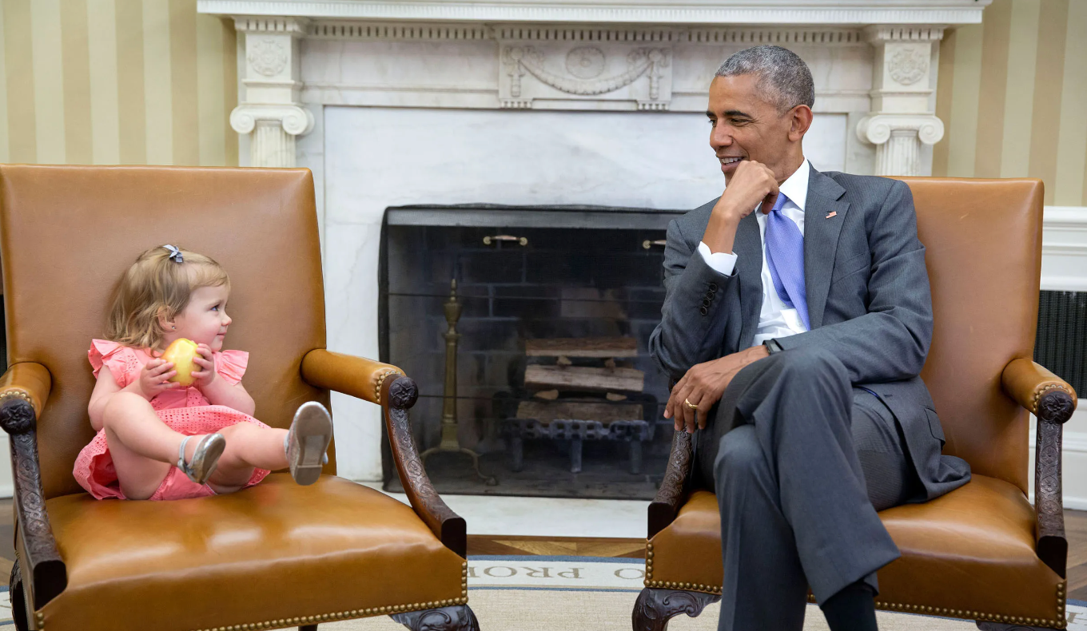
Gravitas!

Slide 23
S T Y L E
Stars. Strong sense of direction. Strategic.
Trailblazers. Trusted. Transformational. Think like a CEO.
Yearning – to succeed and focused on YOU.
Listens and draws out ideas. Learner.
Embrace and lead change. Empower and are force multipliers.

Slide 24
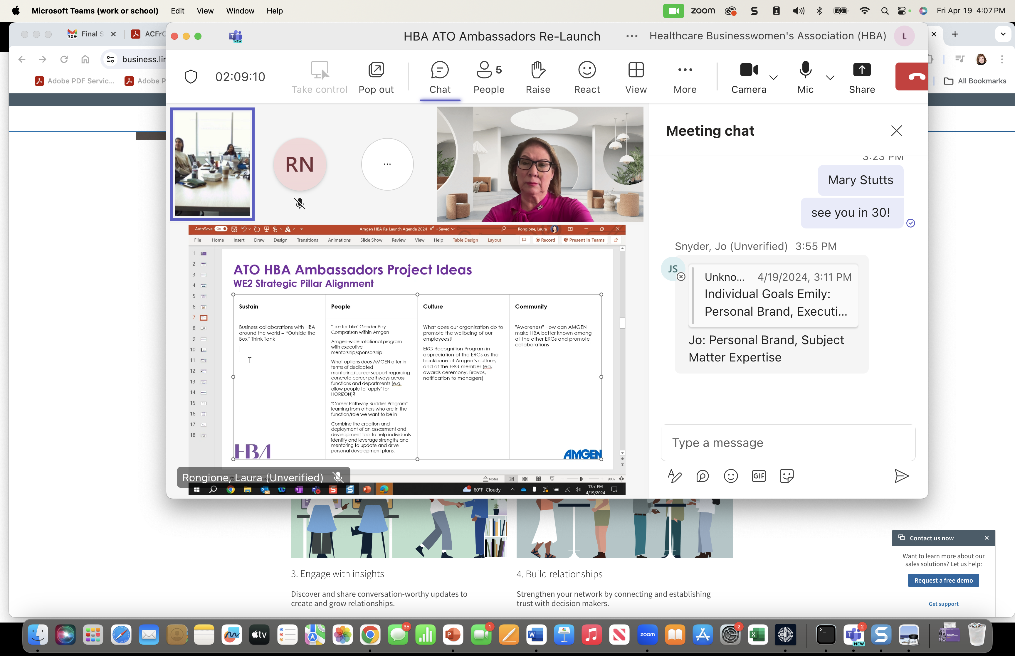

Slide 25
Key Role: HBA Advisor
HBA Advisors are experienced professional coaches and industry leaders in their careers, and HBA-trained volunteers, who are assigned to guide and support Ambassador Programs. Each program is assigned two HBA Advisors, who meet regularly with each program’s executive committee after the program launch.
The HBA Advisors:
Are involved in pre-Launch conversations and participate in the program Launch as able
Commit 1-2 hours per month to support and guide the executive committee* (max 4 hours per month) post-Launch and collaborate with the program champions
Encourage the participants in the Ambassador mindset of self-direction, taking on an informal mentorship role providing their external guidance, ideas, and experience
Assist by coaching and guiding the program executive committee through all stages of the running program, including:
  Determining priorities, organization, and how to best work together
  Determining final group objectives (if needed), team and goal progress tracking
  Stakeholder engagement
  Progress evaluations and executive-level presentations (mid and year-end)
  Awareness of HBA events, offerings, tools and resources
  Advise on cohort calendar, professional development options and HBA engagement/collaboration opportunities
  Graduation planning
  Enhancing the cohort’s brand
*Note: it is critical that the executive committee invite the HBA Advisors to their regularly scheduled meetings.

Slide 26
The Role of the Advisor
Coaching, advising, mentoring the cohort
Showing up and speaking up
Knowing when to support and when to sit back
Providing tools, resources, experiential guidance
Inspire and motivate
IS
This program is ‘self-directed’ by the participants, but HBA’s Advisors are there to ensure they are supported and guided in that self-direction.
IS NOT
Letting them ‘figure it out’ on their own
Doing the work for them

Slide 27
Executive Committee Meetings
The executive committee is the cohort’s leadership team and meets monthly (or more frequently if deemed necessary) with the HBA Advisors to drive the cohort’s progress forward.
The group works together collaboratively to accomplish their areas of oversight, determining how each responsibility gets done throughout the course of the program, and leading without authority in their governance of the cohort overall. Like the rest of the cohort, they are self-driven, making their own decisions and doing the work necessary to achieve their goals.
The first executive committee meeting should happen within 2-4 weeks of the Launch. During this meeting, some of the first priorities of the group are:
    Setting up the Executive Committee meeting series moving forward, ensuring HBA Advisors are invited to all
    Ensuring the cohort’s Group Initiatives are finalized and the team leads identified within 30 days of launch
    Scheduling first cohort meeting (usually within 45 days of launch, if deemed necessary)
    Identifying 1-2 members to be the direct points of contact with the HBA Program Excellence Manager, to check in at regular intervals during the program usually via quick survey. The program Champions should facilitate the connection to the PEM should they need to request a live meeting.
It is absolutely critical that the executive committee invite both of the HBA Advisors to their meetings to ensure the cohort receives the guidance and support promised by the HBA. This team is ultimately in charge, but the HBA Advisors are there to help them start up the program and guide them throughout.
Executive Committee Areas of Oversight
Overall cohort governance including budget and resourcing
Ambassador individual goal progress. ﻿This may include plans for workshops, panels, fireside chats, HBA events, etc on common goal topics
Group initiative goal progress.This will include having group initiative chairs periodically join monthly calls or send in updates regarding their progress and needs.
Determining (with cohort input) what programs/events to create outside of their group initiatives and create a calendar of events.
Addressing requests, issues and inquiries from individual Ambassadors. Assessing engagement of cohort participants and addressing any identified issues/troubles.
Planning the mid year and end of year progress presentation to executive sponsors
Oversee the cultivation of more senior leaders to support the journey of the Ambassadors.
Collaborate with the HBA local chapter or regional council if they exist, to increase the value to Ambassadors and help them create external networks.
Planning cohort meetings as appropriate/necessary including scheduling, invitations, agenda creation, etc
Plan and execute the program graduation and accompanying festivities

Slide 28
Examples of how to apply situational leadership and emphasizing concepts of self-directed learning
Challenge | Potential solution
Someone is dominating a work group meeting and others are not speaking | Advisor says: You have great insights, but I’d love to hear others viewpoints as well… XXX, what do you think about this?
Challenges with encouraging group collaboration/discussion | Ask at the close of the meeting: does everyone feel like they were heard?
Team doesn’t even know where to start | Take a little ownership of the first meeting(s), and direct them to top first tasks and the resources to complete
Cohort member is unable to speak up or step up to make a decision. | Acknowledge: this is the first time you’ve done this, and it’s ok to feel uncomfortable. Lets brain storm solutions to make you feel more confident in XYZ decision or direction
Group Initiative is falling behind on progress | Affirm: This is a very common challenge, lets dissect the workgroup problem. Maybe we need to simplify the problem statement or initiative to bring it to completion. Or lets review the project plan to see where we can streamline/re-distribute efforts or adjust the timelines.

Slide 29
The First 45 Days
The most important of the program...
This period is the most challenging for our Ambassadors, and where they need support from the HBA most!
During this time the Ambassadors are usually:
    Selecting team leads
    Refining group initiatives, charters
    Conducing necessary research
    Cross-functional collaboration
    And often conducting an MVP presentation: are the ideas really viable?

Slide 30
What happens at the start?
The first 45 days, the Ambassadors are experiencing leadership immersion for the first time. It is a grey area for them – many have never been in a position like this before. They may feel like they are moving blindly, so it is up to the HBA to help them navigate cross-functional collaboration, feel empowered to make decisions like selecting leaders independently, and refine the ideas they will develop.
This period is critical to:
Avoid disheartening: they need to feel supported and gently guided through.
Instill the Ambassador mindset: embrace leadership immersion, explore innovative ideas, embrace self-discovery and growth. This challenging period is when most Ambassadors TRULY begin to feel like leaders and lean into their potential
And maintain launch momentum.
The HBA Global Ambassador Program heavily relies on our Advisors during this period – you play a pivotal role in facilitating, fostering rapport, and empowering Ambassadors on the journey.
Notes:
During the first weeks of the program, Ambassadors and the cohort executive committee face multifaceted challenges, including refining group initiatives, navigating cross-functional collaboration, and selecting team leaders—all while operating independently for the first time. It is important that the Ambassadors are mentally prepared for this experience, as it can be uncomfortable and challenging,
Given this steep learning curve, proactive guidance from HBA Advisors is paramount. Advisors play a pivotal role especially during this period: in facilitating Executive Committee meetings, fostering rapport, and offering balanced coaching to empower Ambassadors without overshadowing their autonomy. By providing direction, fostering camaraderie among Ambassadors, and facilitating group dynamics, Advisors ensure a supportive environment where Ambassadors can embrace leadership immersion, explore innovative ideas, and cultivate valuable skills through their journey of self-discovery and growth.

Slide 31
What can Advisors do?
As an Advisor, you should attend all Executive Committee meetings. Some Advisors find it productive to also attend the overall Cohort meetings to better understand the group, dynamics, goals, and really get to know the individuals.
Here are just a few things that Advisors can do to support Ambassadors during that time:
Introduce yourself and your qualifications: make sure they understand who you are, your role in the program, and qualifications. Consider a Fireside Chat with your fellow advisor to help the cohort get to know you!
Proactive Guidance: Offer proactive support to Ambassadors during their first 45 days.
Facilitate Executive Committee Meetings: Lead and facilitate crucial initial meetings in collaboration with the Champions to set the tone and expectations.
Foster Rapport: Establish rapport through initial fireside chats to build trust and understanding.
Balanced Coaching: Provide balanced coaching to empower Ambassadors while respecting their autonomy.
Group Dynamics: Identify and foster engagement among Ambassadors to ensure a supportive group dynamic.
Navigate Challenges: Help Ambassadors navigate challenges in refining initiatives, gaining approvals, and more.
Notes:
At the first EC meeting, it is often helpful to ensure a robust introduction of yourself and your qualification as an Advisor so the EC understands you, your background and your role with the program. For the first few meetings, depending on the personality of the group, it may also be necessary that you facilitate the first few meetings, in collaboration with the champions, and allow the exec committee members to take on more of the leadership over the first few meetings as they grow in confidence and into their leadership capabilities. Providing a little extra direction at the start may be necessary, but always be aware of when to begin stepping back to let them begin stepping up into their leadership potential

Slide 32
Cohort Meetings
While the cohort group initiative teams meet independently and regularly to make progress towards their goals, most programs also opt to schedule a few cohort meetings for all Ambassadors. These meetings are planned and led by the executive committee and are an opportunity to connect with fellow Ambassadors, share high-level progress and updates, and often include team building exercises or professional development.
The first cohort meeting should be held within the first 45 days after launch to ensure all Ambassadors are up to speed on final group initiatives, standing committees and, and team leads. Future cohort meeting frequency should be determined by the full cohort, but they should be cognizant to avoid meetings for the sake of meetings.
Some items you may find on a Cohort Meeting agenda are:
Updates on Group Initiative progress
Event updates: what’s coming up that they can participate in or info on events in the works
Discussions on new ideas and how to get them done
Feedback sessions on events/professional development opportunities the Ambassadors would like
Many cohort meetings are also paired with an event or professional development opportunity such as:
HBA Master Classes
Fireside chats with executive leaders within the company
Internal or HBA educational events

Slide 33

What is a Community of Practice (COP)?
A forum to enhance the diversity, scope, and richness of the HBA Ambassador experience through shared knowledge and best practices for all participants, both external and internal.
The HBA will deliver our Communities of Practice via a combination of live meetings and virtual Community forums.
HBA has launched Communities of Practice for external participants (Champions and Ambassadors) and our internal HBA volunteers!
Notes:
As shared last month, our launch windows effectively create cohorts of cohorts, all setting up to launch TOGETHER – a COP which can work together, learn from each other and benefit from HBA’s setup guidance as a group. We've also begun implementing this shared learning model for our volunteers at the global and geographic levels, AND will soon be launching an Ambassador Community of Practice for spring cohorts, to provide additional support, community and provide dedicated development opportunities.

Slide 34
COP Meeting Format
Welcome
HBA and GAP Announcements/Updates (5 mins)
Continued Development Topic w/ Q&A (15 mins)
Community Sharing/Discussion (30 mins)
  Ask anything – topics driven by the attendees!
  Best practice sharing, peer-sourcing help for challenges or needs, sharing wins and opportunities
  Networking and building connections
  Where to find the tools/resources to help along the way
Close and quick peek at next time (5 mins)
Notes:
Our COP meetings will all follow a similar format and provide opportunity for...
CALL OUT DEVELOPMENT/continued learning to ensure our advisors are ahead of the curve

Slide 35
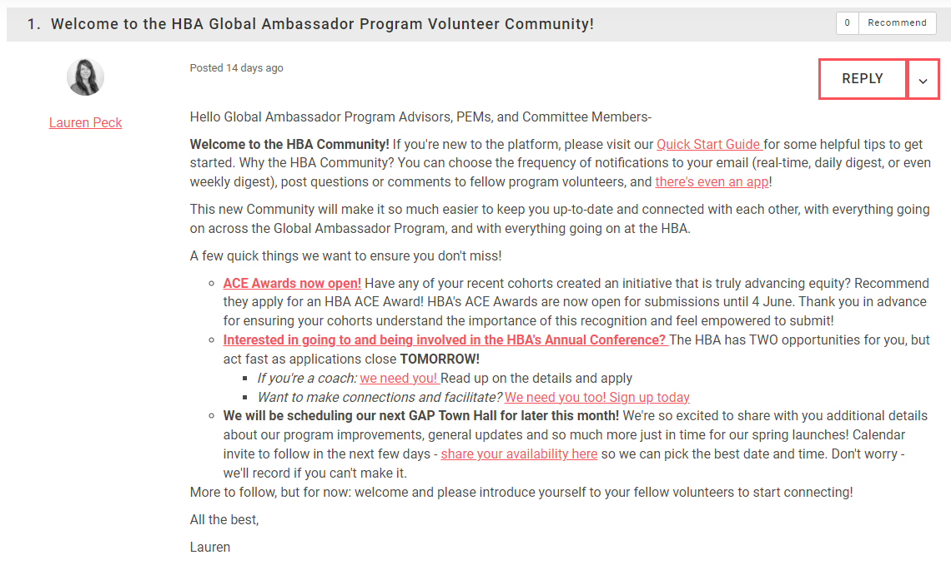
NEW! Virtual Communities
Check it out!!
Live Community of Practice sessions will be bolstered by a virtual HBA Community forum, providing a space for online discussion, sharing and ideas in between sessions.
The virtual Community will also be the HBA’s primary communication vehicle to all GAP volunteers for news, updates, and upcoming events, sessions, etc.
Two virtual Communities for GAP volunteers!
GAP Volunteers community – inclusive of all program volunteer roles
GAP Advisors community – specific to Advisors
Please visit our HBA Community Quick Start Guide to get started and set your notification preferences. Be sure to bookmark the Community pages relevant to you!
Be sure to set your notification settings so you don’t miss a thing!

Slide 36
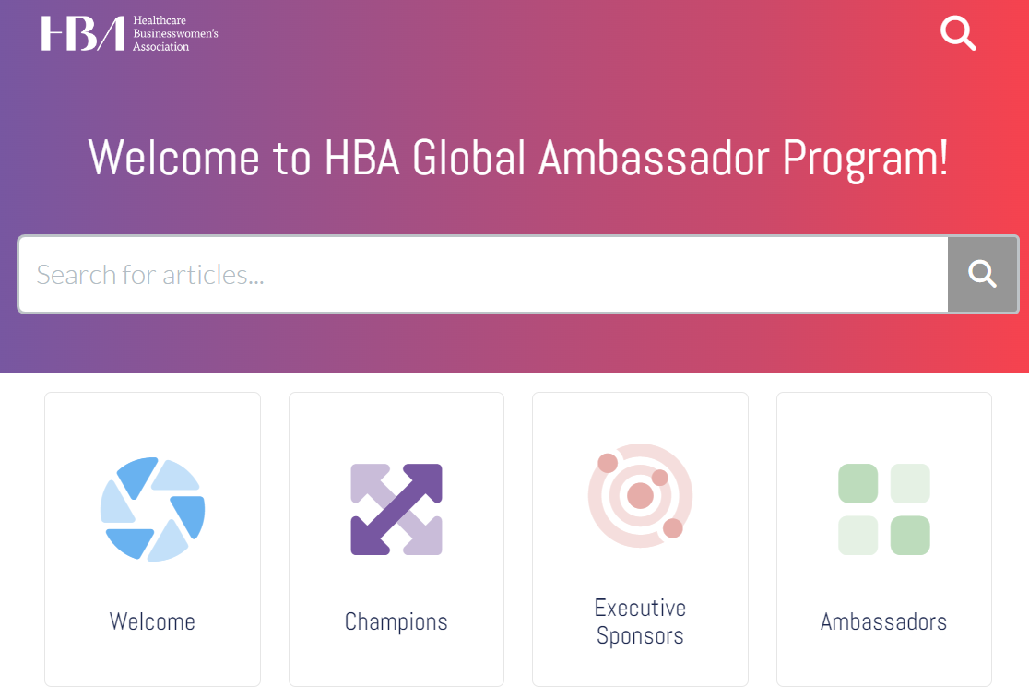

Additional Tools and Resources
The HBA Global Ambassador Program Resource Center has launched!
This knowledge base is being organized by role and phase in the program process to make it easy for Champions, Executive Sponsors and Ambassadors to find what they need at any stage.
Also, the HBA Volunteer Resource Center now has a section for GAP Volunteers that is being populated! Bookmark it and we’ll continue moving all our resources here slowly but surely.
Notes:
The new GAP resource center already houses an array of new tools, resources and templates to help each role get oriented and tackle each step of the journey.

Slide 37
Where to turn with challenges?
Proactive escalation of any challenges is crucial to the success of any cohort. Where do you turn if you’re having a problem?
Executive Committee challenges -> Program Champions
Program Champion challenges -> Program Excellence Manager
Issues that may risk the cohort overall and/or HBA’s relationship with the company -> HBA Central: globalambassadorprogram@hbanet.org
Situations you’re unsure how to best advise on and/or other perspectives -> your peers in the HBA Community of Practice

Slide 38
Executive Committee Meetings
The executive committee is the cohort’s leadership team and meets monthly (or more frequently if deemed necessary) with the HBA Advisors to drive the cohort’s progress forward.
The group works together collaboratively to accomplish their areas of oversight, determining how each responsibility gets done throughout the course of the program, and leading without authority in their governance of the cohort overall. Like the rest of the cohort, they are self-driven, making their own decisions and doing the work necessary to achieve their goals.
The first executive committee meeting should happen within 2-4 weeks of the Launch. During this meeting, some of the first priorities of the group are:
    Setting up the Executive Committee meeting series moving forward, ensuring HBA Advisors are invited to all
    Ensuring the cohort’s Group Initiatives are finalized and the team leads identified within 30 days of launch
    Scheduling first cohort meeting (usually within 45 days of launch, if deemed necessary)
    Identifying 1-2 members to be the direct points of contact with the HBA Program Excellence Manager, to check in at regular intervals during the program usually via quick survey. The program Champions should facilitate the connection to the PEM should they need to request a live meeting.
It is absolutely critical that the executive committee invite both of the HBA Advisors to their meetings to ensure the cohort receives the guidance and support promised by the HBA. This team is ultimately in charge, but the HBA Advisors are there to help them start up the program and guide them throughout.
Executive Committee Areas of Oversight
Overall cohort governance including budget and resourcing
Ambassador individual goal progress. ﻿This may include plans for workshops, panels, fireside chats, HBA events, etc on common goal topics
Group initiative goal progress.This will include having group initiative chairs periodically join monthly calls or send in updates regarding their progress and needs.
Determining (with cohort input) what programs/events to create outside of their group initiatives and create a calendar of events.
Addressing requests, issues and inquiries from individual Ambassadors. Assessing engagement of cohort participants and addressing any identified issues/troubles.
Planning the mid year and end of year progress presentation to executive sponsors
Oversee the cultivation of more senior leaders to support the journey of the Ambassadors.
Collaborate with the HBA local chapter or regional council if they exist, to increase the value to Ambassadors and help them create external networks.
Planning cohort meetings as appropriate/necessary including scheduling, invitations, agenda creation, etc
Plan and execute the program graduation and accompanying festivities

Slide 39
Cohort Meetings
While the cohort groups meet independently and regularly to make progress towards their goals, most programs also opt to schedule a few cohort meetings for all Ambassadors. These meetings are planned and led by the executive committee and are an opportunity to connect with fellow Ambassadors, share high-level progress and updates, and often include team building exercises or professional development.
The first cohort meeting should be held within the first 45 days after launch to ensure all Ambassadors are up to speed on final group initiatives, standing committees and, and team leads. Future cohort meeting frequency should be determined by the full cohort, but they should be cognizant to avoid meetings for the sake of meetings.
Some items you may find on a Cohort Meeting agenda are:
Updates on Group Initiative progress
Event updates: what’s coming up that they can participate in or info on events in the works
Discussions on new ideas and how to get them done
Feedback sessions on events/professional development opportunities the Ambassadors would like
Many cohort meetings are also paired with an event or professional development opportunity such as:
HBA Master Classes
Fireside chats with executive leaders within the company
Internal or HBA educational events

Slide 40
Team Leads
Formed as soon as the final group initiatives and functional committees are determined, each team/committee is led by 1-2 individuals who drive the team and the planning process, liaising as needed with the executive committee to provide updates on progress.
The Team Leads:
Meets monthly (or more frequently) with their team
Helps determine the project scope, including developing project plans, timelines and deliverables
Drives the project planning process, ensuring progress towards goals and tracking as the initiative goes
Delegates as needed
Escalates issues and/or road blocks to the executive committee as needed
Delivers regular project updates to the executive committee, cohort and (if needed) executive sponsors
Compiles final outputs for sharing to executive sponsors and necessary communications to share more widely within the company
Team Leads commit an additional 1-2 hours per month.

Slide 41
Send in Advance: Group Projects Ideas

