Slide 1
Champion Community of Practice Presentation 4.0
07/26/2024
Champion Community of Practice
This presentation can be found in the
Ambassador Program Resource Center

Slide 2
Agenda 4.0 Champion Key Milestones
Resources
Templates
What to send in advance
Group project formulation of ideas review
Individual Objectives IO’s!
Core Capabilities
Q & A

Slide 3
Ambassador Acceptance Letter
Click HERE
Dear [Applicant's Name],
Congratulations! We are thrilled to inform you that you have been accepted into [Company Name}’s upcoming HBA Ambassador Program. Your dedication and enthusiasm have truly stood out, and we are excited to have you on board.
As we embark on this journey together, please be sure to:
Mark your Calendar: The official launch of the program will take place on [Launch Date] at [Launch Time] in [Launch Location]. Include additional information on any other required pre-launch activities.
Inform your manager: Please take a moment to notify your manager of your acceptance into the program and reaffirm your commitment. This step ensures their support and understanding of your participation and incorporation into your individual development plan. Here is a template you are welcome to use.
URGENT ACTION NEEDED: to kick off your participation, it is critical that you:
Verify your HBA membership status or join/renew your membership. [If applicable: include HBA Corporate Partner designee or bulk membership purchase code so Ambassadors can easily join/renew their membership.
Register for our Ambassador Program cohort via HBA. Please click here to access our program’s registration page [link to unique cohort registration link, which can be found in your Activation confirmation email]
Please click here for helpful instructions to guide you through these steps.

Slide 5
Send in Advance: Group Projects Ideas

Slide 6
What are your career goals?
At the end of your Ambassador journey, there will also be an opportunity to assess your overall career progression in the following areas.
Additional job responsibilities within current position OR promotion to a new role
Successful completion of project in another cross-functional area
Personal Brand - substantial expansion of sphere of influence internally and externally
Executive presence - additional experience internally/externally
Develop senior advocates and mentors internally/externally
Subject matter expert - substantially advance knowledge/ recognition in selected area
Increase Global Exposure across organization via new role or project

Slide 7
Joining the HBA
Registration link: here is the URL for your Ambassadors to register for this cohort once selected. Here is a helpful article with guidance for the Ambassadors to verify membership and register for the cohort.
Over the next few weeks, the HBA will be in touch with next steps and additional information to get started. If questions or needs arise, please contact us.
We look forward to supporting you in the launch of your upcoming program!
Best Regards,

Slide 8
Where is my Registration Link?
HERE is the Registration Link

Slide 9
Launch Agenda and Slide Template
HERE is the launch agenda and slide template in the Resource Center

Slide 10
Launch Agenda and Slide Template
HERE is the launch agenda and slide template in the Resource Center

Slide 11
Masterclass Resource Link
HERE

Slide 12
Self Assessment and Goal Selection
HERE

Slide 13
Send in Advance…Individual Objectives
Individual Objectives List
Each ambassador is encouraged to collaborate with their manager to choose realistic, measurable, and attainable goals.
Goal Choices (Choose 1-3):
Additional job responsibilities within my current position.
Successful completion of project in another cross-functional area.
Personal Brand - substantial expansion of sphere of influence internally and externally.
Executive Presence - additional experience internally/externally.
Develop senior advocates and mentors internally/externally.
Subject matter expert - substantially advance knowledge/recognition in selected areas.
Global Exposure - increase across the organizations via new role or project.

Slide 14
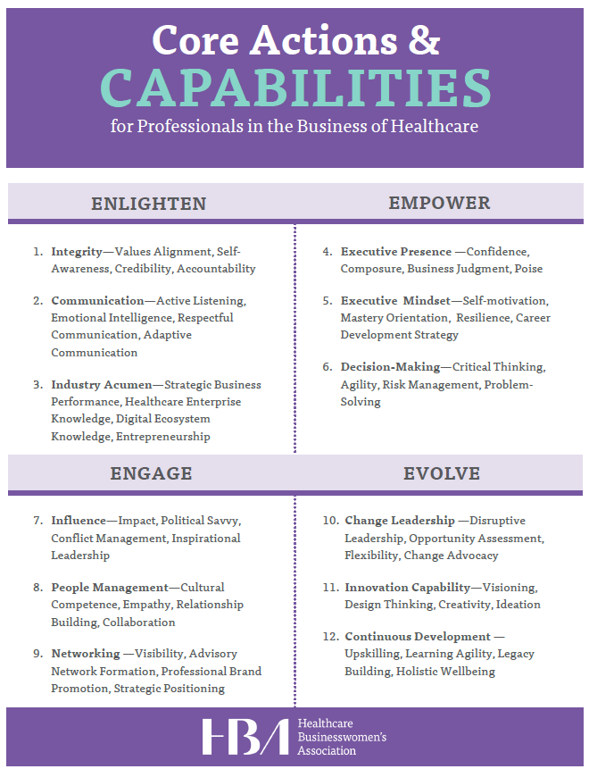
Individual Objectives Resource

Slide 15
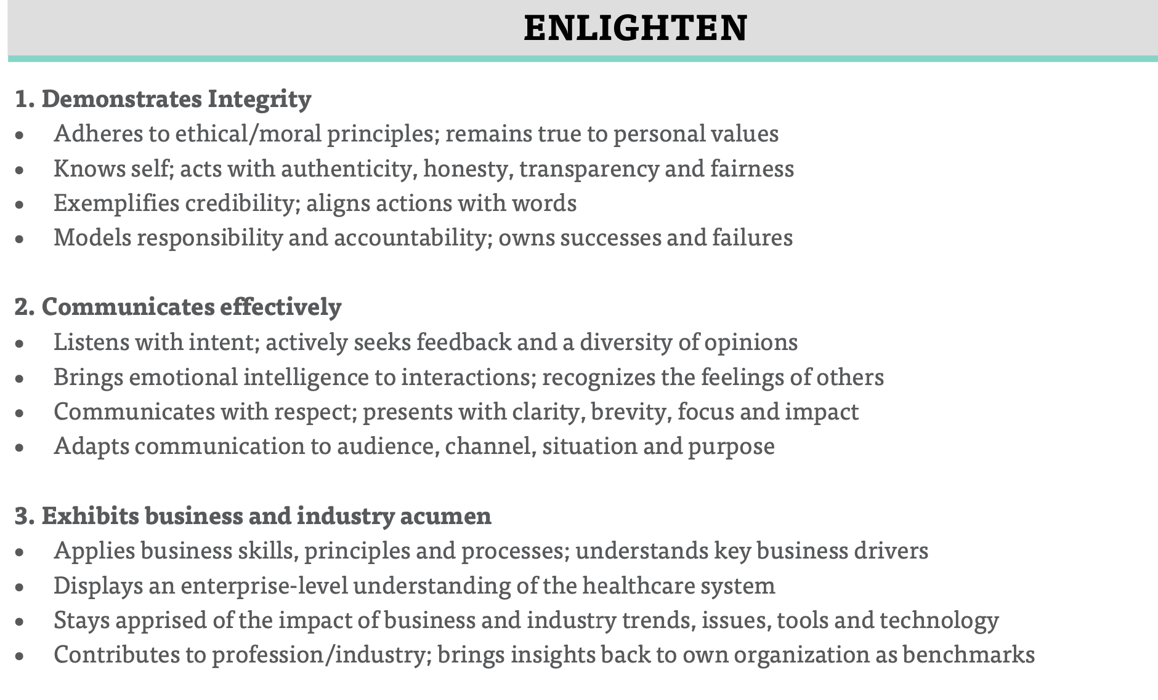
Enlighten

Slide 16
Enlighten

Slide 17
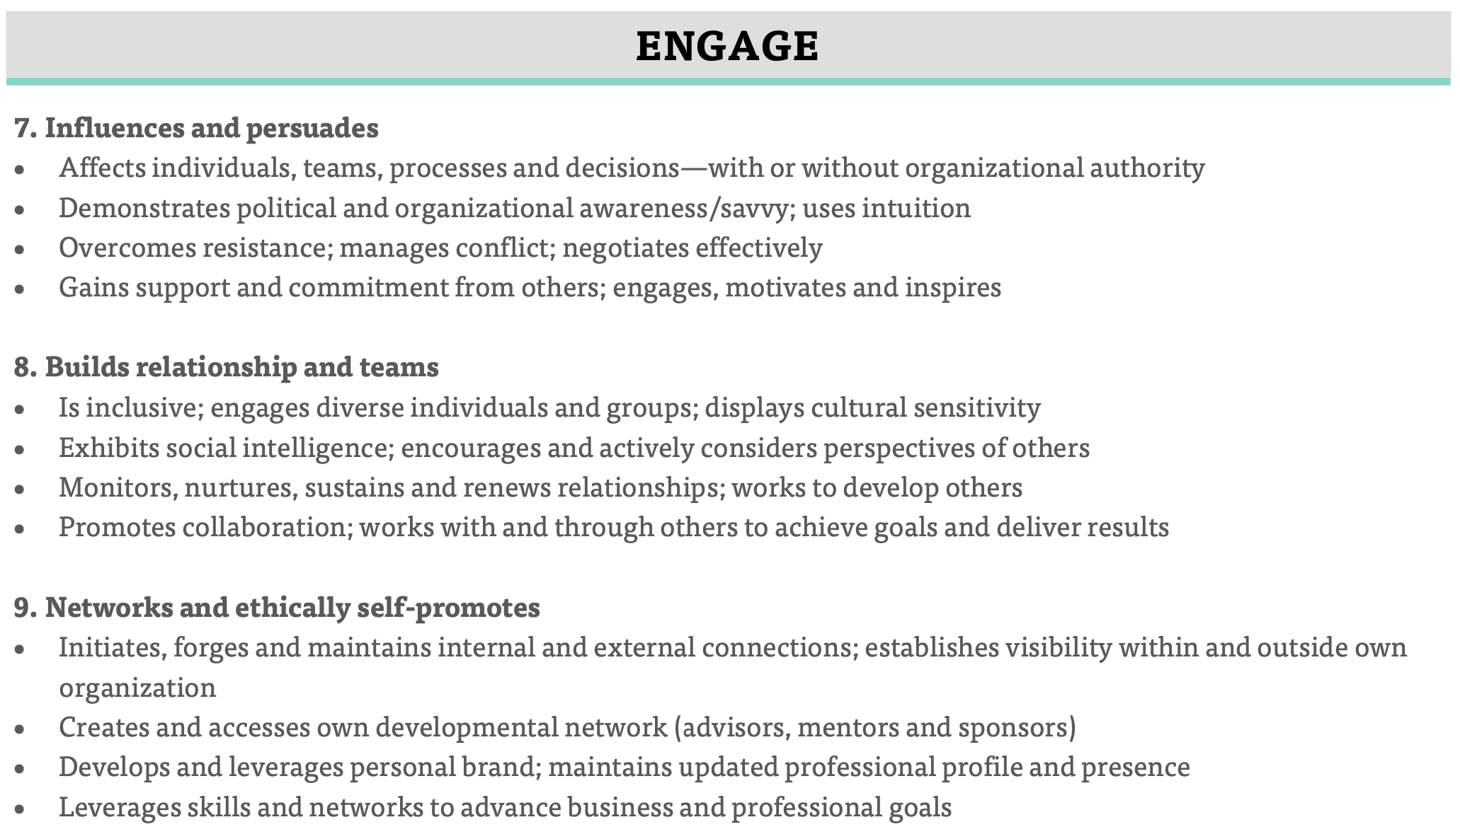
Engage

Slide 18
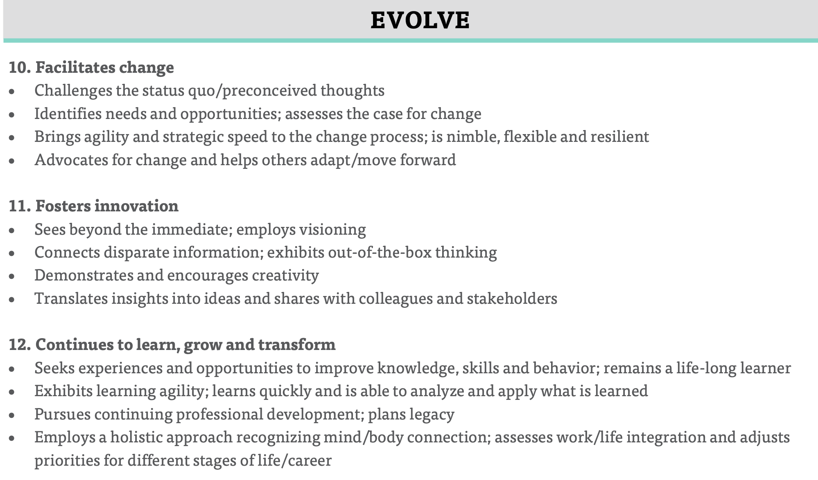
Evolve

Slide 19
Leadership Checklist
An abiding willingness to embrace uncertainty.
An urgency to capitalize on business opportunities.
Confidence and optimism, with a focus on action.
Patient, persistent, and passionate about company purpose and mission.
Build diverse teams as a priority.
Study others’ leadership moments.
Solicit coaching and mentoring.
Accept stretch experiences.
The Leaders Checklist. Dr. Michael Useem

Slide 21
Executive Committee Meetings
The executive committee is the cohort’s leadership team and meets monthly (or more frequently if deemed necessary) with the HBA Advisors to drive the cohort’s progress forward.
The group works together collaboratively to accomplish their areas of oversight, determining how each responsibility gets done throughout the course of the program, and leading without authority in their governance of the cohort overall. Like the rest of the cohort, they are self-driven, making their own decisions and doing the work necessary to achieve their goals.
The first executive committee meeting should happen within 2-4 weeks of the Launch. During this meeting, some of the first priorities of the group are:
Setting up the Executive Committee meeting series moving forward, ensuring HBA Advisors are invited to all
Ensuring the cohort’s Group Initiatives are finalized and the team leads identified within 30 days of launch
Scheduling first cohort meeting (usually within 45 days of launch, if deemed necessary)
Identifying 1-2 members to be the direct points of contact with the HBA Program Excellence Manager, to check in at regular intervals during the program usually via quick survey. The program Champions should facilitate the connection to the PEM should they need to request a live meeting.
It is absolutely critical that the executive committee invite both of the HBA Advisors to their meetings to ensure the cohort receives the guidance and support promised by the HBA. This team is ultimately in charge, but the HBA Advisors are there to help them start up the program and guide them throughout.
Executive Committee Areas of Oversight
Overall cohort governance including budget and resourcing
Ambassador individual goal progress. ﻿This may include plans for workshops, panels, fireside chats, HBA events, etc on common goal topics
Group initiative goal progress.This will include having group initiative chairs periodically join monthly calls or send in updates regarding their progress and needs.
Determining (with cohort input) what programs/events to create outside of their group initiatives and create a calendar of events.
Addressing requests, issues and inquiries from individual Ambassadors. Assessing engagement of cohort participants and addressing any identified issues/troubles.
Planning the mid year and end of year progress presentation to executive sponsors
Oversee the cultivation of more senior leaders to support the journey of the Ambassadors.
Collaborate with the HBA local chapter or regional council if they exist, to increase the value to Ambassadors and help them create external networks.
Planning cohort meetings as appropriate/necessary including scheduling, invitations, agenda creation, etc
Plan and execute the program graduation and accompanying festivities

Slide 22
Cohort Meetings
While the cohort groups meet independently and regularly to make progress towards their goals, most programs also opt to schedule a few cohort meetings for all Ambassadors. These meetings are planned and led by the executive committee and are an opportunity to connect with fellow Ambassadors, share high-level progress and updates, and often include team building exercises or professional development.
The first cohort meeting should be held within the first 45 days after launch to ensure all Ambassadors are up to speed on final group initiatives, standing committees and, and team leads. Future cohort meeting frequency should be determined by the full cohort, but they should be cognizant to avoid meetings for the sake of meetings.
Some items you may find on a Cohort Meeting agenda are:
Updates on Group Initiative progress
Event updates: what’s coming up that they can participate in or info on events in the works
Discussions on new ideas and how to get them done
Feedback sessions on events/professional development opportunities the Ambassadors would like
Many cohort meetings are also paired with an event or professional development opportunity such as:
HBA Master Classes
Fireside chats with executive leaders within the company
Internal or HBA educational events

Slide 23
Team Leads
Formed as soon as the final group initiatives and functional committees are determined, each team/committee is led by 1-2 individuals who drive the team and the planning process, liaising as needed with the executive committee to provide updates on progress.
The Team Leads:
Meets monthly (or more frequently) with their team
Helps determine the project scope, including developing project plans, timelines and deliverables
Drives the project planning process, ensuring progress towards goals and tracking as the initiative goes
Delegates as needed
Escalates issues and/or road blocks to the executive committee as needed
Delivers regular project updates to the executive committee, cohort and (if needed) executive sponsors
Compiles final outputs for sharing to executive sponsors and necessary communications to share more widely within the company
Team Leads commit an additional 1-2 hours per month.

Slide 24
Send in Advance: Group Projects Ideas

