Slide 1
Champion Communities of Practice
3.0
07/19/2024

Slide 2
Agenda 3.0 Champion Key Milestones
Pre-launch example
Purpose of group projects
Examples of pre-planning models

Slide 3
Program Setup Milestones
Ambassador Recruitment
Initiating recruitment: application criteria
Communicating out the opportunity
Set up screening committee
Vetting applicants
Final selections
Communications to participants
Ambassador administration
Announcing participants
Launch Planning
Schedule launch date (with HBA Launch Leader)
Logistics planning
Understanding the Launch Agenda
Finalize agenda (with HBA Launch Leader)
Prepare to facilitate breakouts
Draft your Launch agenda
OPTIONAL: plan your Fireside Chat
Lead your Launch with HBA
The HBA will walk program Champions step-by-step through the program setup process

Slide 5
Purpose of Group Initiatives
Collaborate, co-create, and envision multiple options for creating new opportunities, filling gaps, or improving current ERG projects to advance gender equity.
Expanding and exploring the boundaries of creativity and teamwork to further the mission and vision of your company.
To develop and exercise leadership muscles in a safe environment.

Slide 6
Approach to Group Projects

Slide 7
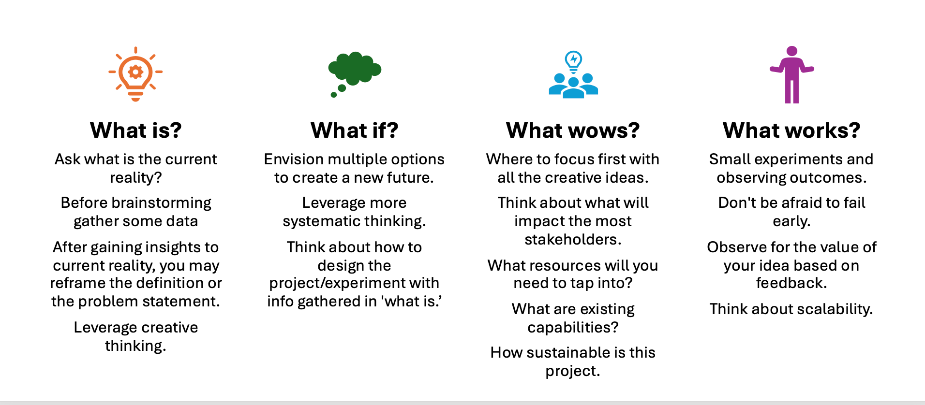
Four Step Process – Work Group Initiatives

Slide 8
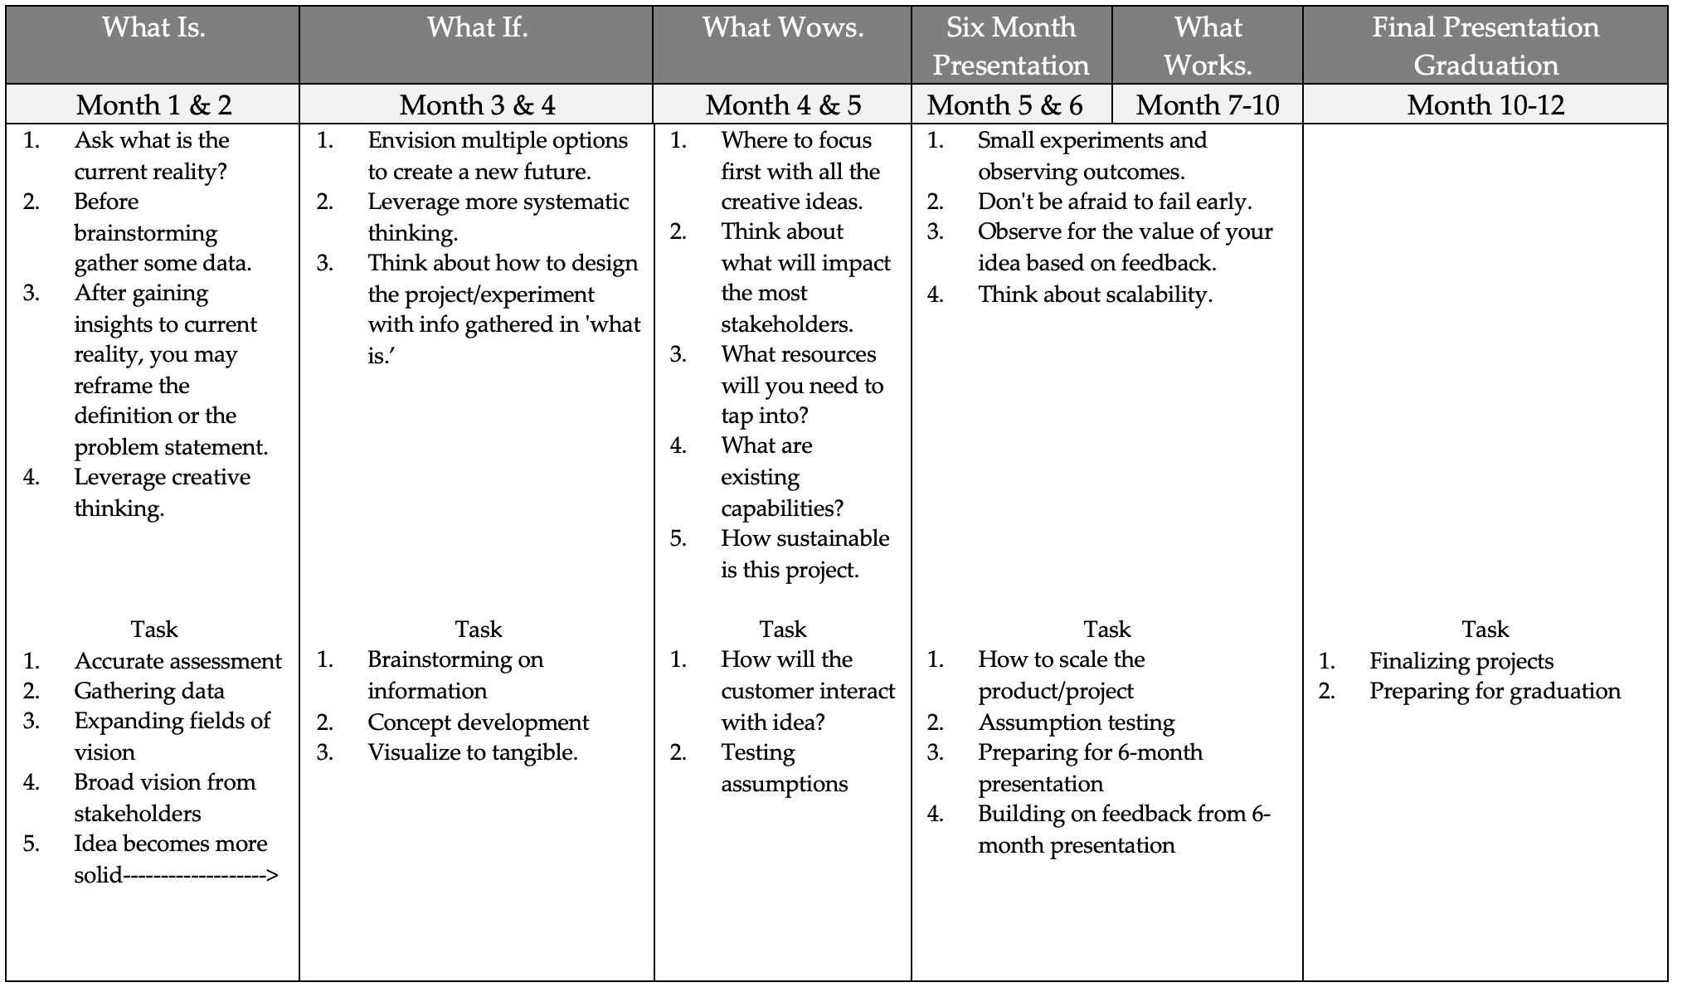

Slide 9
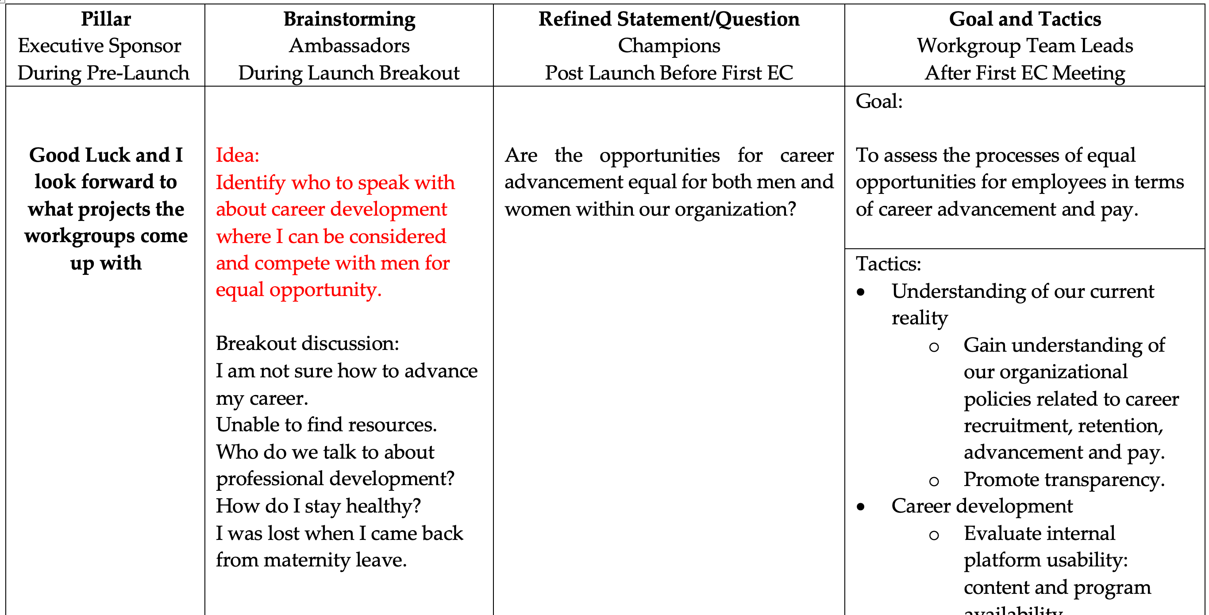

Slide 11
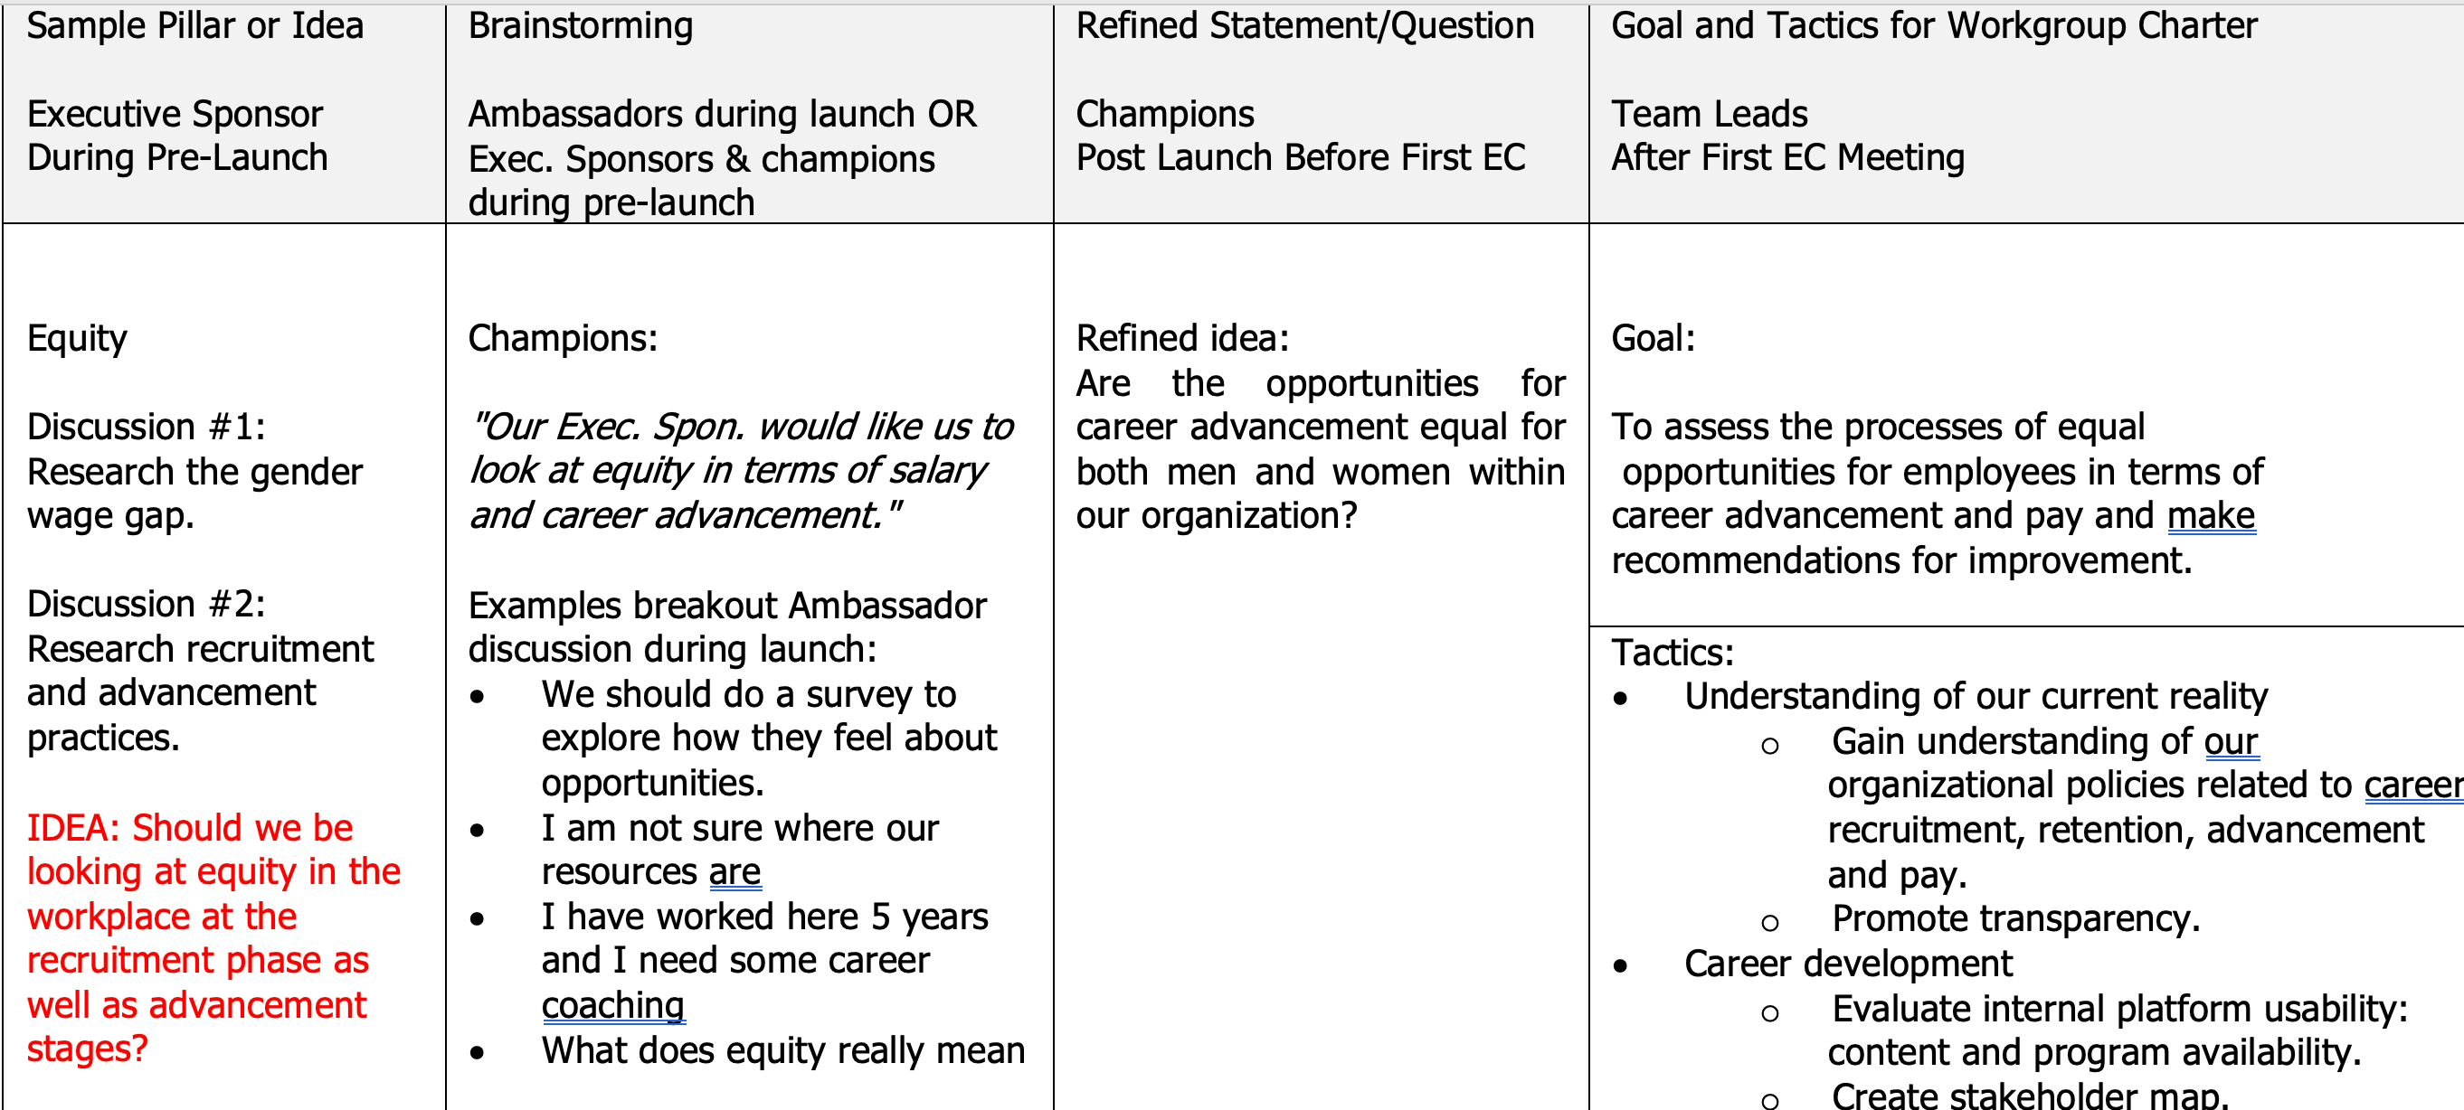

Slide 12
Getting Input Before the Launch
“We have met with our Executive Sponsors, and the overarching topics that they would like us to explore are well-being, culture, male allyship, and employee experience…”
Please review these four pillars and insert:
opportunities for improvement
potential gaps
questions
comments

Slide 13
Well-being | Male Allyship | Culture & Community | Employee Experience
How do I maintain my productivity when there is no time to workout? Where can I find out more about my flex time? Can we create a tool kit or an app on how to maintain balance? | I would like more opportunities to network with our senior leaders. My manager is very suppurative - we should do a fireside chat with him. Can we interview the senior managers about male advocacy? Is there an opportunity to see what other companies are doing to encourage male allyship? | I would love more opportunities to meet others at our company. What are the ERG opportunities? What are our values as a company? I don't feel very connected to my team. How do we increase our involvement with HBA? | I am very interested in learning more about transformational leadership. I want to understand how my company supports me after maternity leave. Should we develop a satisfaction survey?

Slide 14
Pre send Example 1 Group Projects

Slide 15
