Slide 1
Champion Community of Practice Presentation 2.2
07/12/2024
Champion Community of Practice
This presentation and recording can be found in the
Global Ambassador Program Resource Center

Slide 2
Agenda 2.2 Champion Key Milestones
Pre-Launch
Launch Template
Launch Agenda
Core Competencies

Slide 3
Program Setup Milestones
Ambassador Recruitment
Initiating recruitment: application criteria
Communicating out the opportunity
Set up screening committee
Vetting applicants
Final selections
Communications to participants
Ambassador administration
Announcing participants
Launch Planning
Schedule launch date (with HBA Launch Leader)
Logistics planning
Understanding the Launch Agenda
Finalize agenda (with HBA Launch Leader)
Prepare to facilitate breakouts
Draft your Launch agenda
OPTIONAL: plan your Fireside Chat
Lead your Launch with HBA
The HBA will walk program Champions step-by-step through the program setup process

Slide 4
GOAL: timeline, topics covered on each of the live Champion CoP meetings for both pre-launch AND post-launch
Pre-launch Key Priorities
Recruiting, selecting, and announcing Ambassador recruitment/selection Communicate the opportunity to begin recruitment (to managers AND potential participants) Vetting and selection of Ambassadors Announcing Ambassadors Communicate to the individuals, internal announcements, Internal meet/greet with fellow Ambassadors Ambassador Administration Ensure sign up Selected goals Completed orientation Schedule launch meetings | Launch planning Schedule launch date Logistics planning Agenda preparation Facilitation of breakouts Setting up meeting with Executive Sponsor Optional: Fireside chat guidance
Recruiting and leading the program launch team
Ambassador recruitment/selection
Communicate the opportunity to begin recruitment (to managers AND potential participants)
Vetting and selection of Ambassadors
Announcing Ambassadors
Communicate to the individuals, internal announcements,
Internal meet/greet with fellow Ambassadors
Ambassador Administration
Ensure sign up
Selected goals
Completed orientation

Slide 5
Post-Launch Key Discussion Topics/Milestones
Motivating the EC/cohort
Setting the calendar (EC, cohort, workgroups)
Finalizing initiatives/charters
Keeping up momentum
Mid-year presentation prep/Leadership Changeover
Setting up for graduation
Year-end presentation prep
Re-launch
Graduation

Slide 6
Exploratory Phase (2-4 months prior)
Launch Prep Phase (1-2 months prior)
Launch (Program kickoff)
Post-Launch Monitoring (Months 0-3)
Maintenance (Months 3-12)
Re-launch (Months 9-12)
Setting up your team
Set launch date
Launch preparation
Program setup and governance
Group initiatives determination
Executive committee and cohort meetings
Group initiative team leads established
Participant engagement
Mid-year assessment and presentation to executive sponsors
Tracking towards goals
3 months prior to program end
Establish next cohort needs/basics
AM participation for partnership renewal
Graduation (Program end)
Ambassador selection, onboarding and individual goals determination
Determining program strategy and specifics
Program Process and Phases
Repeat for next cohort
Year-end assessment and presentation to executive sponsors
Ambassador graduation
HBA next steps

Slide 7
Champion Key Responsibilities
Prior to launch: set up the program for success
Recruit and select the Ambassadors
Schedules and plans the Program Launch event*
Optional but recommended: plan and moderate a Fireside Chat with Executive Sponsor(s), usually in conjunction with or prior to the launch.
Set up time to discuss work group projects with the Executive Sponsor(s) (ask if there are current projects to build upon, generate ideas, problem definition
Post-launch: lead and motivate the cohort
Attend Executive Committee meetings to provide guidance, ensure progress is made, and ensure readiness for meetings with Sponsors
Create visibility and enhance program value to participants
Document and share program best practices, successes, etc. for continuous improvement
*The HBA recommends the Champion to lead a Launch Team (2-3 individuals), typically lower/mid-level, to help manage the logistics associated with launch setup internally. In return, Launch Team members may be offered to participate in any professional development opportunities the Ambassadors receive.

Slide 8
Step 1: Call for Nominations
Ambassador Selection and Orientation
Once the Ambassador profile has been created, it’s time to notify the appropriate individuals internally within your organization. Using your preferred internal communications channels, send out the call for nominations:
What to send: include high-level detail about the program/outcomes and accepted nomination formats
Who to send to: be sure the communications reach your target audience and are curated with the appropriate call to action (for example, if you’re looking for self-nominations be sure to send through any/all communication channels that will reach individuals fitting your target criteria with encouragement to self-nominate)
How to expand the reach: don’t hesitate to contact your Internal Women’s Network, relevant diversity Employee Resource Groups or even Human Resources to help find candidates. Participation in the program can be a great reward to those who have volunteered extensive time to your employee resource groups!
Include a deadline for nominations about 1 month prior to Launch. This allows time to:
Vet and select the final candidates
Invite Ambassadors to the Launch
Ensure Ambassadors have time to join the HBA/their cohort, orient themselves to the program and select their individual goals.

Slide 9
Step 2: Ambassador Selection
Ambassador Selection and Orientation
Once your nomination deadline has passed, it’s time to select your Ambassadors. This step is typically handled by the program Champions, consulting the program Advocates as needed.
Review each nominee’s information and evaluate it against your pre-determined Ambassador Profile and criteria. The HBA recommends:
When possible, assign each submission a number rather than by the candidate’s name ensure fair and unbiased assessments
Create a ‘scorecard’ with your evaluation criteria to make the process simple and collaborative
Build your list of Ambassadors with the top candidates until you achieve your pre-determined critical mass number
Often there are more deserving candidates than available slots in the cohort. The HBA recommends beginning a ‘wait list’ of these individuals. They can be first in line for consideration for a separate/concurrent cohort (if your organization plans to have multiple) or for the following year’s cohort.
Notify the Ambassadors of their acceptance along with:
The Ambassador Program welcome kit (see next slide)
Join Link (provided by your HBA Program Excellence Manager, see step 3)
Invitation to the Launch
Note: participants should be able to opt out at this time if their circumstances have changed
Send the final list of Ambassadors (Name, Email, Title, Site) with your HBA Program Excellence Manager

Slide 10
Step 3: Ambassador Join Process
Ambassador Selection and Orientation
Selected Ambassadors must join their cohort in the HBA’s systems to ensure they can capitalize on all the benefits that come along with the program. In order to join their cohort, they must be current HBA members. It’s recommended to communicate all the necessary Join info upon acceptance into the program:
The Global Ambassador Committee admin will compare their final list of Ambassadors against those who have officially joined the cohort and send reminders as necessary in the weeks leading up to launch to ensure all Ambassadors have joined prior to the program commencement.
1. Verify HBA membership
Hopefully your organization has designee memberships available or has arranged for pre-paid memberships for all Ambassadors by this time* and you can share the prepaid membership code to the selected individuals upon acceptance.
Visit the HBA website and login or create a new account
Verify their membership status in their HBA profile.
If they are not a current member they can join, re-join or renew from their profile and enter the provided promo code
2. Join the Ambassador Cohort
Share the cohort-specific Join Link provided by your HBA Program Excellence Manager, which will bring participants to your Ambassador Program homepage.
Note: this page will only work if the individual is an HBA member and logged into their account.
Please feel free to utilize the HBA’s Joining Cohort Instructions document
Once on the page, click the red “Join” button to join the cohort
Click ‘Save’ on the entry form and done!
*please connect with your HBA Program Excellence Manager to assess available designee memberships or arrange for a bulk membership purchase

Slide 11
Launch
An Ambassador Program Launch makes a big impact in one 3-4 hour session.
Agenda
Introduction from the Champions: Setting the stage for the Launch and HBA intros (10 mins)
Breakout session: Networking/individual goals discussion (20-30 mins)
Introduction from the Executive Sponsors: The opportunity for creative problem solving, share inspiring vision of work group projects, team collaboration. If workgroup projects are predetermined, share details (~20 minutes)
Breakout session: Group initiatives ideation (~40 mins)
Group initiatives discussion: Narrowing in on top ideas (45 mins)
Interactive group session: Self-organization of the group and what to expect the first 45 days (40 mins)
Launch next steps and close from Champions

Slide 12
Launch template
This template deck has been developed to make your organization’s launch planning as easy as possible.
Step 1: draft your Launch Agenda
Step 2: draft your Launch Deck, inputting:
Company logo
Executive Sponsor, Champion and HBA photos, names, and titles
Your review with your Launch Leader to align on agenda, flow, and necessary information to include.
Worksheets are included to develop your Program’s Launch Agenda. Please adjust the flow, timing and agenda topics as needed to meet your program’s needs, plugging in your company’s speakers where indicated.
Save your presentation as a company-specific template for future program launches within your organization!

Slide 13
AGENDA SAMPLE [DATE – START/END TIME]
Here is the agenda for a typical program launch with suggested agenda items and timing for reference. Please note timing is for a 3 hour agenda and can be extended slightly to up to 4 hours total as needed.
Agenda Item | Purpose | Speaker | Timing
Introduction | Setting the stage for the Launch and introducing the HBA Launch Leader and Advisors | Champion(s) make introductions, then HBA Launch Leader takes over | 10 minutes
Breakout Session | Discussion of individual goals for the program | Breakout Sessions, facilitated by HBA Launch Leader and Champion(s) | 20 minutes
Executive Sponsor Introduction | The opportunity for creative problem solving, share inspiring vision of work group projects, team collaboration. If workgroup projects are predetermined share details . | Executive Sponsor(s) | 20 minutes
Breakout Session | Group Initiative ideation and/or early plan development | Breakout Sessions, facilitated by HBA Launch Leader and Champion(s) | 40 minutes
Break |  |  | 10 minutes
Group Initiatives Discussion | Narrow in on top ideas and/or next steps for initiative development | Group Discussion, facilitated by HBA Launch Leader | 45 minutes
Getting Organized | Self-organization of the group and what to expect in the first 45 days | Group Discussion, facilitated by HBA Launch Leader | 40 minutes
Close | Next steps after Launch and closing | Champion(s) | 5 minutes

Slide 14
Introduction (10 mins) – Champions
Champions welcome the participants and introduce: Executive Sponsors, HBA Advisors and Launch Leader
Set the stage for the launch: through storytelling, relate the journey of the cohort and underscore the honor of being selected
Launch
Detailed Agenda
Part B: Group Initiative Read-Out and Discussion (45 minutes)
Groups read out brainstormed ideas and discuss suggested initiatives to solve problems.
If a final list of initiatives is agreed upon, the group can vote in-session to move forward and self-select onto teams
If more data/research is needed to determine final group initiatives, Champions will work with the cohort Executive Committee post-Launch, and group will be tapped to help and polled as needed for final decisions
Group initiatives to be finalized within the first 45 days post-Launch, in advance of the first Cohort meeting.
Individual Goals (breakout sessions, 20 minutes)
HBA Launch Leader and Champions facilitate breakouts, 7-10 Ambassadors per group. Select a scribe to record overall impressions and impacts of the group conversation.
Introductions and discuss HBA Leadership Competencies selected by each participant, solicit feedback to ensure they will have the desired impact on the individual’s career and trajectory.
Executive Sponsor Introduction* (20 minutes)
Executive Sponsor(s) introduce themselves, shares insights, anecdotes, and that this is an opportunity for creative problem solving, share inspiring vision of work group projects, team collaboration, present details about the group initiatives: the problem statements, goals and/or initiatives themselves (if pre-determined) and their importance.
This section will set the stage for the group brainstorming, and can also include topics such as:
Why do they and the company support the HBA and the Ambassador program?
Why is it important to start the program now?
What will success look like for this program?
Getting Organized (40 minutes)
Review the Executive Committee (EC) responsibilities
Cohort members self-nominate onto EC and/or team leads
What to expect in the first 45 days
Set first cohort meeting date
Summary of next steps and action items
Q&A
Group Initiatives Brainstorming (breakout sessions, 40 mins)
HBA Facilitators lead each group, 7-10 Ambassadors per group. Select a scribe to record overall impressions and impacts of the group conversation.
The goal: develop 2-3 BIG IDEAS to be read out during the plenary session to follow, or early initiative plans.
Closing (5 minutes) –Champions
Checking in: how is everyone feeling
Champions close out
All agenda items led by HBA Launch Leader/Facilitators unless otherwise indicated
*Note: if the program has done a Fireside Chat, this section may be shortened.
Notes:
themselves, shares insights, anecdotes, and present details about the group initiatives: the problem statements, goals and/or initiatives themselves (if pre-determined) and their importance.

Slide 15
What are your career goals?
At the end of your Ambassador journey, there will also be an opportunity to assess your overall career progression in the following areas.
Additional job responsibilities within current position OR promotion to a new role
Successful completion of project in another cross-functional area
Personal Brand - substantial expansion of sphere of influence internally and externally
Executive presence - additional experience internally/externally
Develop senior advocates and mentors internally/externally
Subject matter expert - substantially advance knowledge/ recognition in selected area
Increase Global Exposure across organization via new role or project

Slide 16
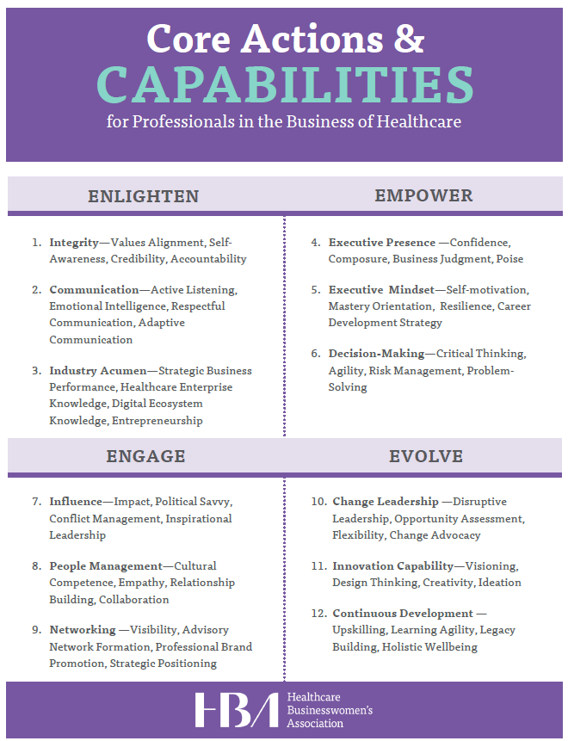
Focusing on capabilities…
Part of your Ambassador journey will focus on developing capabilities to enhance your leadership potential. Based on HBA’s Leadership Capabilities Framework.
Our next breakout will focus on where you want to go and which capabilities you’ll focus on developing during the program to get there.
What is your end goal and what capabilities do you need to develop to get there?

Slide 17
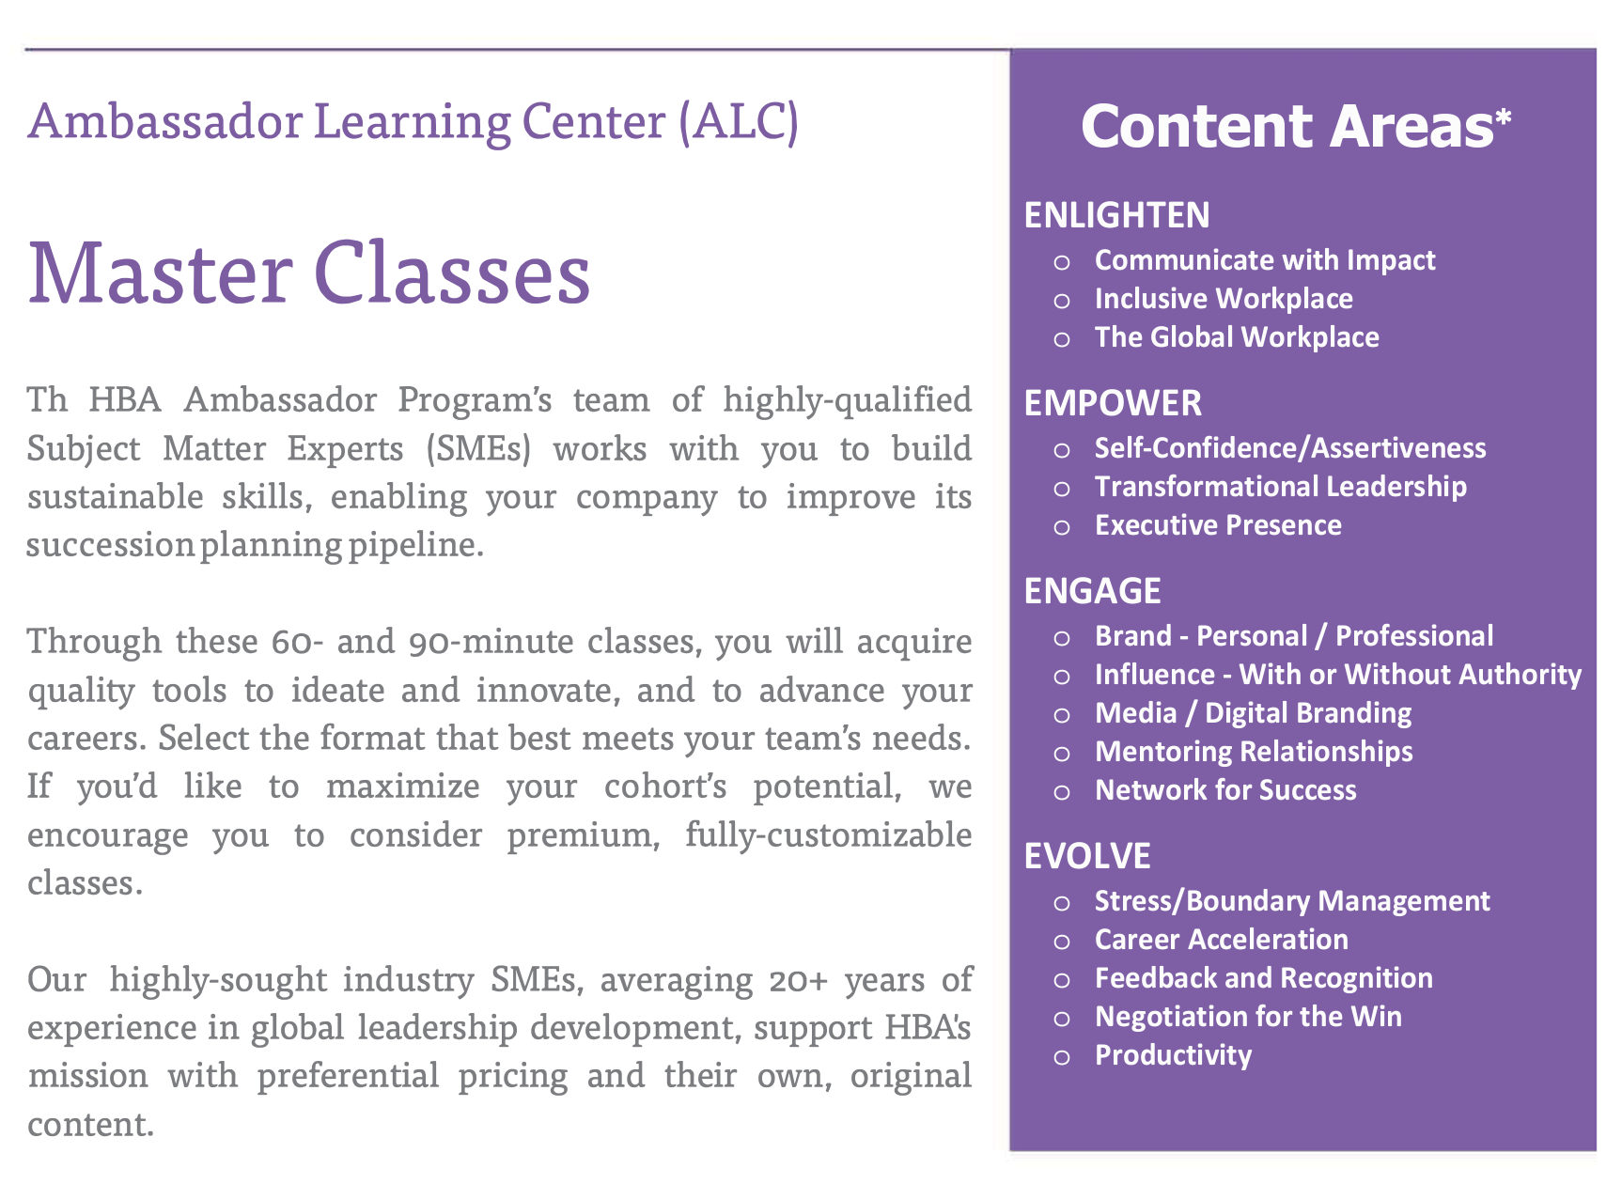
Masterclasses and the core capabilities

Slide 18
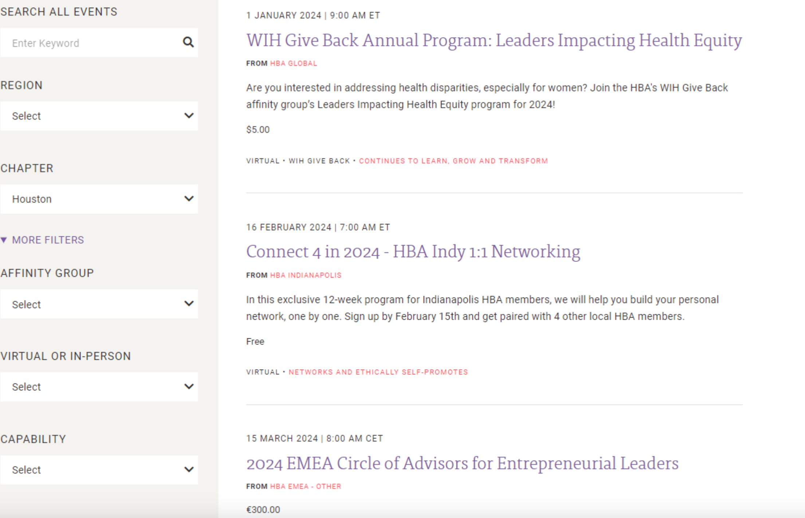
HBA Programs and the core capabilities

Slide 19
Program Setup Milestones
Ambassador Recruitment
Initiating recruitment: application criteria
Communicating out the opportunity
Set up screening committee
Vetting applicants
Final selections
Communications to participants
Ambassador administration
Announcing participants
Launch Planning
Schedule launch date (with HBA Launch Leader)
Logistics planning
Understanding the Launch Agenda
Finalize agenda (with HBA Launch Leader)
Prepare to facilitate breakouts
Draft your Launch agenda
OPTIONAL: plan your Fireside Chat
Lead your Launch with HBA
The HBA will walk program Champions step-by-step through the program setup process

